Slide 1
CSE 505
Lecture #7
September 24, 2012

Slide 2
Lambda Calculus
A higher-order functional language, where functions
are used as input amd output, and also to encode
data.
Expr ::= Var |
λ Var. Expr |
(Expr Expr)
abstraction
variable
application
Lecture 7: 9/24/ 2012
CSE 505 / Jayaraman

Slide 3
Examples of lambda terms
λ x. x
λ x. λ y. x
λ f. λ x. (f (f x))
λ f. λ g. λ x. (f (g x))
…
Sometimes called “anonymous functions”
Lecture 7: 9/24/ 2012
CSE 505 / Jayaraman

Slide 4
Informal Meaning
λx. x
➔ identity function
λx. λy. x
    ➔ a function of two parameters
    that returns the first parameter
λf. λg. λx. (f (g x))
    ➔ the composition of two
    functions, f ◦ g
Lecture 7: 9/24/ 2012
CSE 505 / Jayaraman

Slide 5
Bound and Free Occurrences
λx.(x y)
λf. λx. (f (f x))
λx. (λy. (λx.(z y) x) x)
Lecture 7: 9/24/ 2012
CSE 505 / Jayaraman

Slide 6
Free Occurrence of Variable
V occurs_free_in W iff V = W
V occurs_free_in λW.T iff V ǂ W and
V occurs_free_in T
V occurs_free_in (T₁ T₂) iff V occurs_free_in T₁
or
V occurs_free_in T₂
Lecture 7: 9/24/ 2012
CSE 505 / Jayaraman

Slide 7
Substitution
(will be used for parameter passing)
Substitution of all free occurrences of a variable
V by term T1 in term T2:
T2 [ V ← T1 ]
e.g. λx. (f (f x)) [ f ← λy.y ]
= λx. (λy.y (λy.y x))
Note: λx. (f (f x)) [ x ← y ]
ǂ λx. (f (f y)) -- since x is bound
Lecture 7: 9/24/ 2012
CSE 505 / Jayaraman

Slide 8
Substitution (cont’d)
λx. (f (f x)) [ f ← λy.(y x) ]
ǂ λx. (λy.(y x) (λy.(y x) x))
This is called the “variable capture” problem.
Correct way to do the substitution:
λx’. (λy.(y x) (λy.(y x) x’))
Lecture 7: 9/24/ 2012
CSE 505 / Jayaraman

Slide 9
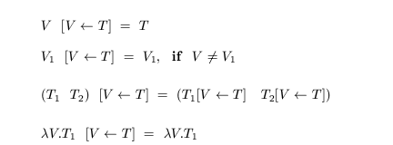
Substitution Rule
(definition)
Lecture 7: 9/24/ 2012
CSE 505 / Jayaraman

Slide 10
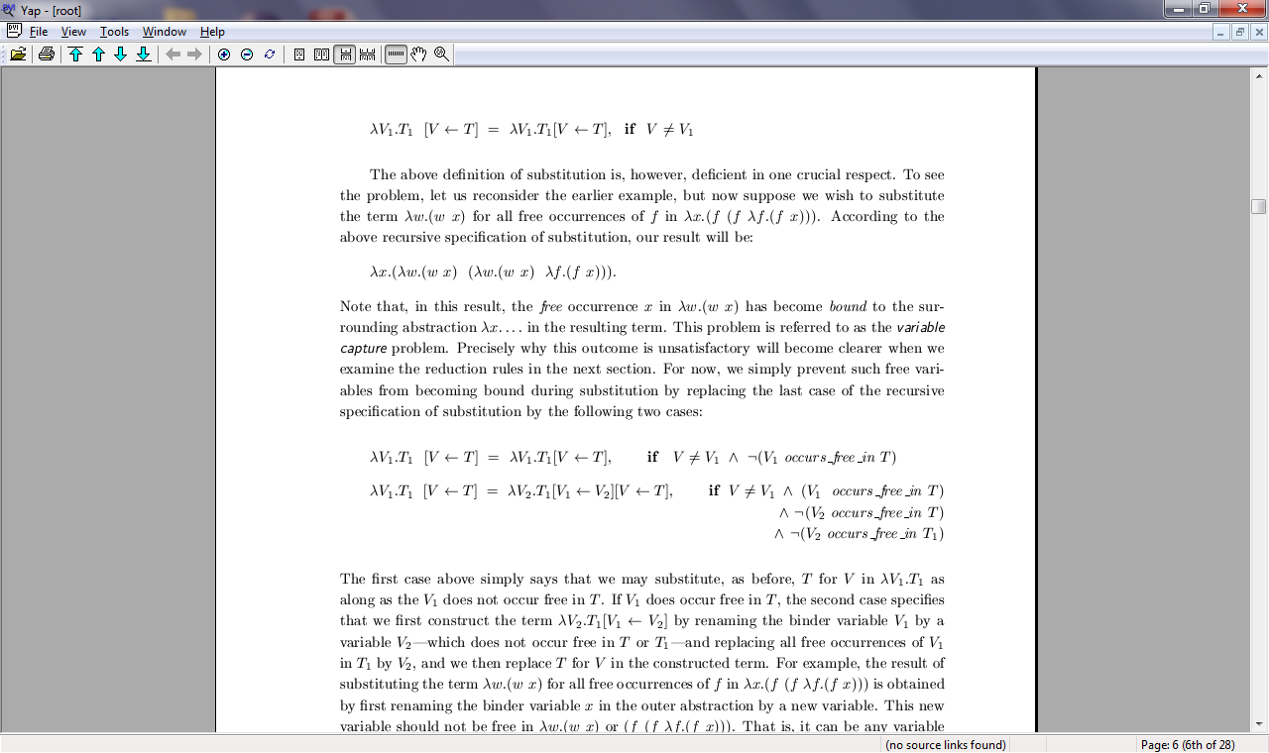
Substitution Rule
(definition continued)
Lecture 7: 9/24/ 2012
CSE 505 / Jayaraman

Slide 11
Renaming Bound Variables
Renaming the binder variables is always
permissible – similar to renaming the formal
parameters of a function. Thus:
λx. x = λy. y
λx. (f (f x)) = λx’. (f (f x’))
λf. λx. (f x) = λg. λy. (g y)
Lecture 7: 9/24/ 2012
CSE 505 / Jayaraman

Slide 12
Reduction Rules
Three famous reduction rules: α, β, η
α-reduction is renaming of binder variables – it
doesn’t really “reduce” the term.
β-reduction resembles call-by-name, and
is based on the substitution rule:
(λV.T1 T2) →_{β}
T1 [ V ← T2 ]
η-reduction is not so common:
λV.(T V) →_{η} T if V ϵ free(T)
Lecture 7: 9/24/ 2012
CSE 505 / Jayaraman

Slide 13
Computation = β-Reduction
( (λf. λx. (f (f x)) λx. x) a)
(λx. (λx.x (λx. x x) ) a)
(λx.x (λx.x a) )
(λx.x a)
a
Lecture 7: 9/24/ 2012
CSE 505 / Jayaraman

Slide 14
Another β-Reduction
( (λf. λx. (f (f x)) λx.x) a)
(λx. (λx.x (λx.x x) ) a)
(λx. (λ x . x x) a)
(λx. x a)
a
Lecture 7: 9/24/ 2012
CSE 505 / Jayaraman

Slide 15
Yet Another β-Reduction
( (λf. λx. (f (f x)) λx. x) a)
(λx. (λx. x (λx. x x) ) a)
(λx. (λx. x x) a)
(λx. x a)
a
Lecture 7: 9/24/ 2012
CSE 505 / Jayaraman

Slide 16
Confluence Property
“If a lambda term T reduces to two terms T1 and T2, then T1 and T2 can be reduced to a common term U.”
T
*
*
T₁
T₂
*
*
U
Lecture 7: 9/24/ 2012
CSE 505 / Jayaraman

Slide 17
Unique Normal Form
If a term T reduces to a term U, and
U cannot be reduced any further (by
η- or β-reductions), then U is said to
be in normal form.
Normal Form: The normal form of a term
is unique if it exists. (Uniqueness is up to
renaming of bound variables.)
Lecture 7: 9/24/ 2012
26
CSE 505 / Jayaraman

Slide 18
Proof by Contradiction
Suppose T has two normal forms N₁ and N2:
T ➔* N₁ and T ➔* N₂
By Confluence Property,
N₁ ➔* U and N₂ ➔* U
But N1 and N2 are irreducible, hence must be
the same except for alpha-reductions, i.e.,
variable renaming.
Lecture 7: 9/24/ 2012
CSE 505 / Jayaraman

Slide 19
Nontermination is Posssible!
( λ x . (x x) λ x . (x x) )
( λ x . (x x) λ x . (x x) )
( λ x . (x x) λ x . (x x) )
…
Lecture 7: 9/24/ 2012
CSE 505 / Jayaraman

Slide 20
Leftmost Reductions
How should we reduce a term in order that the normal form can be derived, if it exists?
Answer: Choose the leftmost “redex” at every step.
Let ῼ = ( λx . (x x) λx. (x x) )
Then, (λx.a ῼ) ➔ a, by leftmost reduction
A nonterminating reduction sequence is:
(λx.a ῼ) ➔ (λx.a ῼ) ➔ …
Lecture 7: 9/24/ 2012
CSE 505 / Jayaraman

Slide 21
Different Reduction Orders
Leftmost Innermost
Parallel Innermost
Rightmost Innermost
Parallel Outermost
Leftmost Outermost = Leftmost
Lecture 7: 9/24/ 2012
CSE 505 / Jayaraman

Slide 22
Church-Rosser Property
Defn: T1 <==> T2 if T1 ==> T2 or T2 ==> T1,
where ==> uses one of the three reduction rules.
Defn: T1 <==>* T2 uses <==> 0 or more times.
Church-Rosser Property: If T1 <==>* T2 then there is a term U s.t. T1 ==>* U and T2 ==>* U.
Diagram:
T1 <==> U₁ <==> ….<==> U_{n}<==>T2
*
*
U
Lecture 7: 9/24/ 2012
CSE 505 / Jayaraman

Slide 23
Relation between <==>* and ==>*
Note: T1 <==>* T2 does NOT imply
T1 ==>* T2 or T2 ==>* T1.
In reality, given
T1 <==>* T2, the situation is:
T1 <==>* P₁ <==>* … P_{n} <==>* T2
P₂
*
*
*
*
*
*
V₁
V₂
V_{n}
Lecture 7: 9/24/ 2012
CSE 505 / Jayaraman

Slide 24
Confluence implies Church-Rosser
Proof (informal):
T1 <==>* P₁ <==>* … P_{n} <==>* T2
P₂
*
*
*
*
*
*
V₁
V₂
V_{n}
…
…
U
Lecture 7: 9/24/ 2012
CSE 505 / Jayaraman

Slide 25
Church-Rosser implies Confluence
Proof (easy): Given:
T
*
*
T₁
T₂
Therefore:
T₁ <==>* T₂
*
*
Therefore:
by Church-Rosser
U
Lecture 7: 9/24/ 2012
CSE 505 / Jayaraman

Slide 26
Data Representation
The boolean type can be represented as follows:
λx. λy. x ➔ can represent “true”
λx. λy. y ➔ can represent “false”
Representation of “not” operator:
λb.((b false) true)
Lecture 7: 9/24/ 2012
CSE 505 / Jayaraman

Slide 27
Justification of “not” operator
We must show:
a. (not true) ➔* false
b. (not false) ➔* true
For example, (not true), i.e.,
(λb.((b false) true) true)
Lecture 7: 9/24/ 2012
CSE 505 / Jayaraman

Slide 28
if = λb. λt. λe.((b t) e)
We can justify if-then-else by showing:
a. (((if true) T1) T2) ➔* T1
b. (((if false) T1) T2) ➔* T2
Example:
((( λb. λt. λe.((b t) e) true) T1) T2)
Lecture 7: 9/24/ 2012
CSE 505 / Jayaraman

Slide 29
Note on Syntax
Lisp syntax:
(and T1 T2)
(if B T1 T2)
…
Lambda calculus:
((and T1) T2)
(((if B) T1) T2)
…
Lecture 7: 9/24/ 2012
CSE 505 / Jayaraman

Slide 30
What datatype can this represent?
λ f . λ x . x
λ f . λ x . (f x)
λ f . λ x . (f (f x))
λ f . λ x . (f (f (f x)))
….
These are called Church Numerals.
Lecture 7: 9/24/ 2012
CSE 505 / Jayaraman

Slide 31
Idea behind Church Numerals
Constructors: zero, succ(zero), succ(succ(zero)), …
Alternatively: z, s(z), s(s(z)), ...
Lisp Syntax: z, (s z), (s (s z)), ...
Abstract Names: λs.λz.z,
λs.λz.(s z),
λs.λz.(s (s z)), ...
Lecture 7: 9/24/ 2012
CSE 505 / Jayaraman

Slide 32
Operations on numbers
Let succ = λn. λf. λx. ((n f) (f x))
Let add = λn1. λn2. λf. λx.
((n1 f) ((n2 f) x) )
Let mult = λn1. λn2. λf. λx.
((n1 (n2 f)) x)
Let mystery = λn1. λn2. (n2 n1)
Lecture 7: 9/24/ 2012
CSE 505 / Jayaraman

Slide 33
(succ λs.λz.z)
Lecture 7: 9/24/ 2012
CSE 505 / Jayaraman

Slide 34
Data Structures
Recall Lisp lists:
‘(1)
(cons 1 nil)
‘(1 2 3)
(cons 1 (cons 2 (cons 3 nil)))
The names of the constructors nil and cons are
not important, so we “abstract them away” in
lambda calculus, as shown on next slide.
Lecture 7: 9/24/ 2012
CSE 505 / Jayaraman

Slide 35
Encoding Lists
λ c . λ n . n
λ c . λ n . ((c tom) n)
λ c. λ n . ((c tom) ((c dick) n))
λ c. λ n . ((c tom) ((c dick) ((c harry) n)))
….
Function to get first element: λl.((l λx.λy.x) a)
(λl.((l λx.λy.x) a) λc.λn.((c tom) ((c dick) n)))
➔* tom
Lecture 7: 9/24/ 2012
CSE 505 / Jayaraman

Slide 36
(λl.((l λx.λy.x) a) λc.λn.((c tom) ((c dick) n)))
((λc.λn.((c tom) ((c dick) n))) λx.λy.x) a)
(λn.((λx.λy.x tom) ((λx.λy.x dick) n))) a)
(λn.(λy.tom ((λx.λy.x dick) n))) a)
(λy.tom ((λx.λy.x dick) a)))
tom
Lecture 7: 9/24/ 2012
CSE 505 / Jayaraman

Slide 37
LAMBDA CALCULUS
TOOL DEMO
Lecture 7: 9/24/ 2012
CSE 505 / Jayaraman

Slide 38
Computability
The language of lambda expressions is powerful enough to encode all computable functions!
Notice that there is no recursive function definition – but this can be simulated, as will be next shown.
Lecture 7: 9/24/ 2012
CSE 505 / Jayaraman

Slide 39
Recursive Definition
Consider recursive definition:
f(n) = if is0(n) then 1 else n * f(n-1)
Lisp syntax:
(defun f (n) (if (is0 n) 1 (* n (f (- n 1)))))
Lambda calculus (not quite):
letrec f = λn.(((if (is0 n)) 1)
((mult n) (f (pred n))))
Lecture 7: 9/24/ 2012
CSE 505 / Jayaraman

Slide 40
Representing Recursion
letrec fact = λf. λn.(((if (is0 n)) 1)
((mult n) (fact (pred n))))
Fixed-Point Operator, Y:
let Y = λf. (λx.(f (x x)) (λx.(f (x x))
Note: Fixed point of f is an x such that f(x) = x
Non-recursive equivalent of original function:
(Y t)
Lecture 7: 9/24/ 2012
CSE 505 / Jayaraman

Slide 41
Y = λf. (λx.(f (x x)) λx.(f (x x)))
Y is fixed-point operator, because (for any t):
(Y t) <==>* (t (Y t))
Derivation:
(Y t) = (λf. (λx.(f (x x)) λx.(f (x x))) t)
==> (λx.(t (x x)) λx.(t (x x)))
==> (t (λx.(t (x x)) λx.(t (x x)))))
<==> (t (Y t))
Lecture 7: 9/24/ 2012
CSE 505 / Jayaraman

Slide 42
Recursion and Fixed-points
fact = λn.(((if (is0 n)) 1) ((mult n) (fact (pred n)))
t = λf. λn.(((if (is0 n)) 1) ((mult n) (f (pred n))))
Why does the fixed-point of t capture f?
Fixed point g has the property: g = (t g)
g = λn.(((if (is0 n)) 1) ((mult n) (g (pred n)))
Lecture 7: 9/24/ 2012
CSE 505 / Jayaraman

Slide 43
Least Fixed Point
Consider: letrec f(n) = if n=0 then 0 else f(n);
0, if n=0
1, if n ≥ 0
Fixed-point f1(n) =
0, if n=0
2, if n ≥ 0
Fixed-point f2(n) =
0, if n=0
?, if n ≥ 0
Least fixed-point g(n) =
Lecture 7: 9/24/ 2012
CSE 505 / Jayaraman

Slide 44
Typed Lambda Calculi
Thus far, we have studied the untyped lambda
calculus, i.e., no types associated with vars.
There are two well-known calculi:
- the simply-type lambda calculus
- the second-order (polymorphic) lambda calculus
Interesting, adding types causes all lambda
expressions to terminate! Cannot have (x x).
Lecture 7: 9/24/ 2012
CSE 505 / Jayaraman

