Slide 1

CSE565: Computer Security
Shambhu Upadhyaya
Computer Science & Eng.
University at Buffalo
Buffalo, New York, 14260
UB Fall 2010
8/27/12
UB Fall 2012
CSE565: S. Upadhyaya
Lec 1.<number>
CSE565: S. Upadhyaya
Lec 1.<number>
CSE565: S. Upadhyaya
Lec 1.<number>

Slide 2
Overview – Lecture 1
August 27, 2012
Introduction and Motivation (15 minutes)
Course Content, Organization (10 minutes)
Course Style, Philosophy and Discussion (5 min)
Security - What, How and Who? (10 min)
lecture slides: http://www.cse.buffalo.edu/faculty/shambhu/cse56512/
Copyright: UB Fall 2012
8/27/12
UB Fall 2012
CSE565: S. Upadhyaya
Lec 1.<number>
CSE565: S. Upadhyaya
Lec 1.<number>
CSE565: S. Upadhyaya
Lec 1.<number>

Slide 3
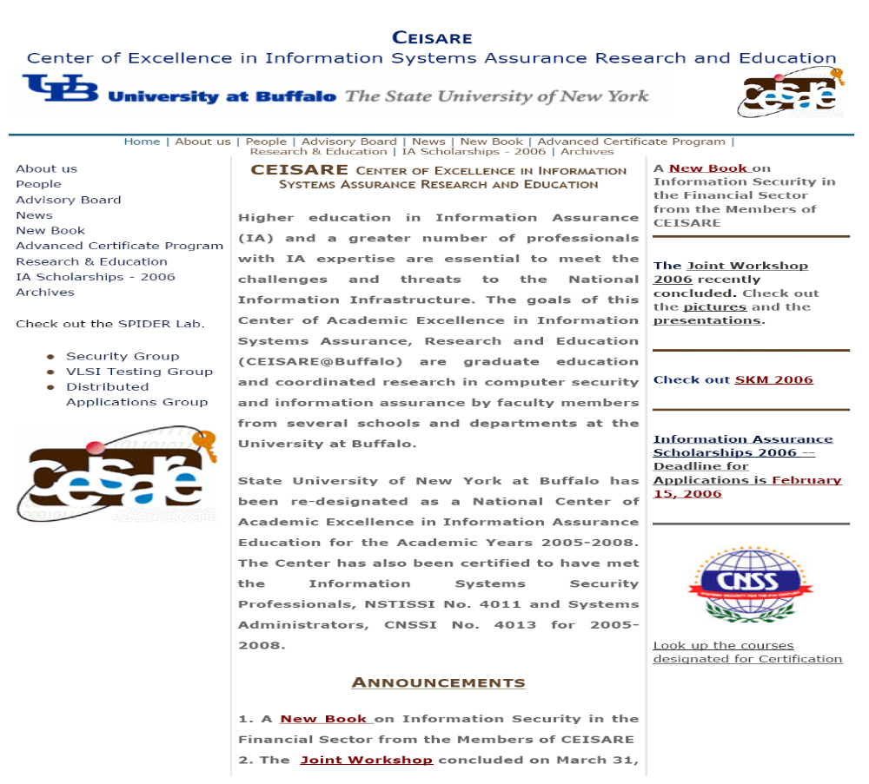
NSA Center of Excellence
8/27/12
UB Fall 2012
CSE565: S. Upadhyaya
Lec 1.<number>
CSE565: S. Upadhyaya
Lec 1.<number>
CSE565: S. Upadhyaya
Lec 1.<number>
Notes:
Mention about the availability of scholarships for U.S. Citizens
Tell the class that the professor will talk about it later.

Slide 4
Motivation
This is the age of universal electronic connectivity
Explosive growth in computer systems and their interconnections via networks
Dependency on computers by organizations and individuals
This heightened awareness of the need to protect data
Most impact on DoD systems
Viruses, hackers, electronic eavesdropping, electronic fraud, etc.
8/27/12
UB Fall 2012
CSE565: S. Upadhyaya
Lec 1.<number>
CSE565: S. Upadhyaya
Lec 1.<number>
CSE565: S. Upadhyaya
Lec 1.<number>
Notes:
In 2012
there are 1.1 billion computers in the world – 2012 – It is expected to be 2 billion by 2016
More than 300M are obsolete in the U.S.
1 trillion video playbacks on YouTube as of 2011
48 hours of video is being uploaded every minute
As of 2011, 294 billion messages per day means more than 2.8 million emails are sent every second. Around 80% of these millions of message are but spam and viruses.

Slide 5
Key Documents
The National Strategy to Secure Cyber Space, Februray 2003 (76 pages)
  Cyberspace touches practically everything and everyone
  Leadership from the top
Cyber Space Policy Review
  President Obama presented the Cyberspace Policy Review on May 29, 2009
  Beginning of the way forward towards a reliable, resilient, trustworthy digital infrastructure for the future
8/27/12
UB Fall 2012
CSE565: S. Upadhyaya
Lec 1.<number>
CSE565: S. Upadhyaya
Lec 1.<number>
Notes:
Also read Cyber security Act 2009 (S.773) and its amendments
Cyber security and Internet Freedom Act 2011

Slide 6

Recent High
Profile Attacks – 1
Hactivism (August 2011)
  Hacking and activism
  Sympathizers of freedom of information
  Protest by hacking into webpages
  When Julian Assange of WikiLeaks was arrested (December 2010), Visa, Mastercard, PayPal, CIA were attacked
  When some arrests were made by FBI, law enforcement agency websites attacked
  Hactivist examples – Anonymous, LulZec, AntiSec
  Check: http://ubfacultyexperts.buffalo.edu/tip/132
8/27/12
UB Fall 2012
CSE565: S. Upadhyaya
Lec 1.<number>

Slide 7
Recent High
Profile Attacks – 2
Stuxnet Worm
  First appeared in July 2010
  Targeted industrial-plant operations
  An example of attack on cyber-physical systems (SCADA – supervisory control and data acquisition systems)
  Most significant one – attack on Iranian nuclear facility
  Malware aimed to reprogram control systems by modifying code on PLCs (programmable logic controllers)
8/27/12
UB Fall 2012
CSE565: S. Upadhyaya
Lec 1.<number>

Slide 8
Recent High
Profile Attacks – 3
Google Hack attack (Operation Aurora)
  Happened in January 2010
  Unprecedented tactics that combined encryption, stealth programming and an unknown hole in Internet Explorer
  Malicious programs opened a remote backdoor to the computer, establishing an encrypted covert channel that masqueraded as an SSL connection to avoid detection
  Attacked some 34 companies
  Hackers had stolen IP and sought access to the Gmail accounts of human rights activists
  Attack was traced to China
  Previous attacks were on critical infrastructures but recent focus is on corporate networks
8/27/12
UB Fall 2012
CSE565: S. Upadhyaya
Lec 1.<number>
Notes:
Aurora was ultra sophisticated

Slide 9
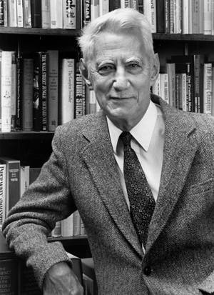
The Good Guys
Claude Shannon (Information Theorist)
Shannon's 1949 paper entitled Communication Theory of Secrecy Systems
Credited with transforming cryptography from an art to a science
Courtesy: Bell Labs
8/27/12
UB Fall 2012
CSE565: S. Upadhyaya
Lec 1.<number>
CSE565: S. Upadhyaya
Lec 1.<number>
CSE565: S. Upadhyaya
Lec 1.<number>

Slide 10
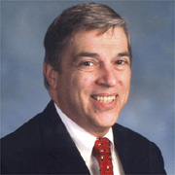
The Bad Guys - 1
Robert Hanssen (Notorious Insider)
Caught selling American secrets to Moscow for $1.4 million in cash and diamonds over a 15-year period
Sentenced for life in prison without the ability for parole in 2002
Photo Courtesy: USA Today
Have you watched the movie – Breach?
Try this link: http://www.imdb.com/title/tt0401997/
8/27/12
UB Fall 2012
CSE565: S. Upadhyaya
Lec 1.<number>
CSE565: S. Upadhyaya
Lec 1.<number>
CSE565: S. Upadhyaya
Lec 1.<number>
Notes:
Other good cyber security movies –
TakeDown (Kevin Mitnick movie)
Hackers
Firewall (Harrison Ford movie)

Slide 11
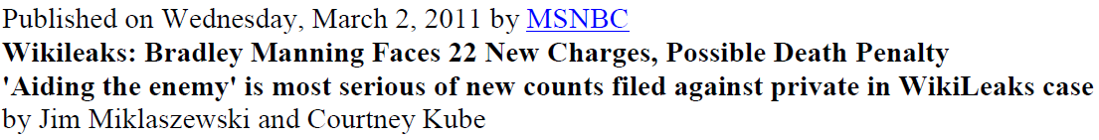
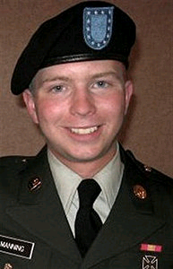
The Bad Guys - 2
This incident exemplifies the severity of insider attacks
  In 2009, Manning, then an intelligence analyst for the U.S. Army based in Iraq
  Leaked a myriad of classified documents containing national defense information to WikiLeaks
  Had the privileges to access these documents and abused them
8/27/12
UB Fall 2012
CSE565: S. Upadhyaya
Lec 1.<number>

Slide 12
CSI/FBI Survey 2006
2006 survey
  Responses of 616 computer security practitioners in U.S. corporations, government agencies, financial institutions, medical institutions and universities
The long term trends considered include:
  Unauthorized use of computer systems
  The number of incidents from outside as well as inside an organization
  Types of attacks or misuse detected, and
  Actions taken in response to computer intrusions
8/27/12
UB Fall 2012
CSE565: S. Upadhyaya
Lec 1.<number>
CSE565: S. Upadhyaya
Lec 1.<number>
CSE565: S. Upadhyaya
Lec 1.<number>
Notes:
Computer security institute/fbi survey

Slide 13
Major Findings
Virus attacks continue to be the source of the greatest financial losses
Unauthorized use of computer systems slightly decreased this year
Use of cyber insurance remains low, but may be on the rise
The percentage of organizations reporting computer intrusions to law enforcement has reversed its multi-year decline
Over 80 percent of the organizations conduct security audits
8/27/12
UB Fall 2012
CSE565: S. Upadhyaya
Lec 1.<number>
CSE565: S. Upadhyaya
Lec 1.<number>
CSE565: S. Upadhyaya
Lec 1.<number>

Slide 14
CSI/FBI Survey 2007
2007 survey
  Average cyber-losses jumping after 5-year decline
  Average annual loss $168,000 to $350,424 in this year's survey
  Financial fraud overtook virus attacks as the source of the greatest financial loss
Additional key findings:
  1/5th of respondents said they suffered a targeted attack
  Insider abuse of network access or e-mail edged out virus incidents as the most prevalent security problem
8/27/12
UB Fall 2012
CSE565: S. Upadhyaya
Lec 1.<number>
CSE565: S. Upadhyaya
Lec 1.<number>
CSE565: S. Upadhyaya
Lec 1.<number>
Notes:
Computer security institute/fbi survey

Slide 15
CSI/FBI Survey 2008
The most expensive computer security incidents were those involving financial fraud…
Virus incidents occurred most frequently…
Almost one in ten organizations reported they’d had a Domain Name System incident…
Twenty-seven percent of those responding to a question regarding “targeted attacks”…
The vast majority of respondents said their organizations either had (68 percent) or were developing (18 percent) a formal information security policy
8/27/12
UB Fall 2012
CSE565: S. Upadhyaya
Lec 1.<number>
CSE565: S. Upadhyaya
Lec 1.<number>

Slide 16
Most Critical Issues
Identified in 2008
Data protection (e.g., data classification, identification and encryption) and application software (e.g., Web application, VoIP) vulnerability, security
Policy and regulatory compliance (Sarbanes–Oxley, HIPAA)
Identity theft and leakage of private information (e.g., proprietary information, intellectual property and business secrets)
Viruses and worms
Management involvement, risk management, or supportive resources (human resources, capital budgeting and expenditures)
Access control (e.g., passwords)
User education, training and awareness
Wireless infrastructure security
Internal network security (e.g., insider threat)
Spyware
Social engineering (e.g., phishing, pharming) – steal identify
8/27/12
UB Fall 2012
CSE565: S. Upadhyaya
Lec 1.<number>
CSE565: S. Upadhyaya
Lec 1.<number>
CSE565: S. Upadhyaya
Lec 1.<number>

Slide 17
CSI/FBI Survey 2009
Respondents reported big jumps in incidence of password sniffing, financial fraud, and malware infection
One-third of respondents' organizations were fraudulently represented as the sender of a phishing message
Average losses due to security incidents are down again this year (from $289,000 per respondent to $234,244 per respondent), though they are still above 2006 figures
Twenty-five percent of respondents felt that over 40 percent of their financial losses were due to malicious actions by insiders
2010/2011 Survey results at:
  https://cours.etsmtl.ca/log619/documents/divers/CSIsurvey2010.pdf
8/27/12
UB Fall 2012
CSE565: S. Upadhyaya
Lec 1.<number>

Slide 18
Types of Attacks
Cognitive Hacking
Manipulating user’s perception
  “Killing” of Britney Spears (Oct. 2001)
Worm/Virus Attacks
  Sasser Worm (May 2004)
Virus Attacks
  SoBig.F (Aug. 2003), > $50M damage
  NIMDA virus in Sept. 2001
DoS Attacks
  Yahoo, Amazon, eBay, CNN (Feb. 2000)
SQL Injection Attacks
  UN Website defacing (8/12/07)
  http://news.com.com/8301-10784_3-9758843-7.html
8/27/12
UB Fall 2012
CSE565: S. Upadhyaya
Lec 1.<number>
CSE565: S. Upadhyaya
Lec 1.<number>
CSE565: S. Upadhyaya
Lec 1.<number>
Notes:
Sasser exploits Buffer Overflow Vulnerability and spreads by scanning a range of IP addresses and through the TCP port. Can block services
SoBig.F This worm sends massive amounts of mail with forged sender information.
NIMDA is also a mass mailing worm. Gives admin. power to guest user.
SQL injection attack -- The vulnerability is present when user input is either incorrectly filtered for string literal escape characters embedded in SQL statements or user input is not strongly typed and thereby unexpectedly executed. It is in fact an instance of a more general class of vulnerabilities that can occur whenever one programming or scripting language is embedded inside another -- wikipedia

Slide 19
Symantec’s
List of Latest Virus
  Name Type Protected
  Packed.Generic.381 Trojan, Worm 08/10/2012
  W32.Gauss Worm 08/09/2012
  Trojan.Exprez!gen2 Trojan, Virus 08/09/2012
  Android.Zeusmitmo Trojan 08/08/2012
  Trojan.Zeroaccess!inf4 Trojan 08/07/2012
These are mostly low level risks
Courtesy: Symantec’s website (Aug. 25, 2011)
http://us.norton.com/security_response/threatexplorer/threats.jsp
8/27/12
UB Fall 2012
CSE565: S. Upadhyaya
Lec 1.<number>
CSE565: S. Upadhyaya
Lec 1.<number>
CSE565: S. Upadhyaya
Lec 1.<number>

Slide 20
How Do We
Approach the Problem
Topics
  Encryption/decryption, network security, system security
Mechanisms
  Intrusion avoidance, intrusion tolerance
Issues
  Security breach by hacker challenge, malicious break-ins and insider threats
  Viruses and security breaks uncommon in 80’s
  Today computers are used everywhere - banking, commerce, contract commitments, etc.
  Usage reaches all, hence system is vulnerable to attack
  Need to know what is a security risk and how to deal with it
8/27/12
UB Fall 2012
CSE565: S. Upadhyaya
Lec 1.<number>
CSE565: S. Upadhyaya
Lec 1.<number>
CSE565: S. Upadhyaya
Lec 1.<number>

Slide 21
Detailed Course
Description
Basic encryption/decryption
  Rivest-Shamir-Adelman Algorithm
  El Gamal and Digital Signature Algorithms
  Hash Algorithms
Authentication
  Kerberos
Program Security
  Virus, Trojan horse, Malicious code, Covert channels
Network Security
  Firewall, Tripwires
  Electronic mail security, IP security, Web security
Intrusion Detection
  Audit trail-based, Concurrent intrusion detection
8/27/12
UB Fall 2012
CSE565: S. Upadhyaya
Lec 1.<number>
CSE565: S. Upadhyaya
Lec 1.<number>
CSE565: S. Upadhyaya
Lec 1.<number>

Slide 22
Course Organization and Grading
Background
  Computer networks, Probability theory, Basic math, Programming
Student Work
  Homeworks
  Projects – Vulnerability detection, Attack injections, Encryption/decryption and cryptographic key exchange, Human factor in security
Grading
  Homeworks, Project, Midterms, Quizzes
  Class attendance required
8/27/12
UB Fall 2012
CSE565: S. Upadhyaya
Lec 1.<number>
CSE565: S. Upadhyaya
Lec 1.<number>
CSE565: S. Upadhyaya
Lec 1.<number>

Slide 23
Course Goals
Examine the risks of security in computing
Consider available countermeasures
Some hands-on projects
Ideas about uncovered vulnerabilities
Where is further research needed?
8/27/12
UB Fall 2012
CSE565: S. Upadhyaya
Lec 1.<number>
CSE565: S. Upadhyaya
Lec 1.<number>
CSE565: S. Upadhyaya
Lec 1.<number>

Slide 24
Security Breaches
Exposure
  Unauthorized disclosure of data, modification of data, denial of access
Vulnerability
  Weakness in security system
Threat
  Potential to cause harm
Security Threats
  Interruption (erasure of a program or data)
  Interception (illicit copying of data, wiretapping)
  Modification (change values in database)
  Fabrication (inserting spurious transactions)
Control
  Protective measure - an action, a device, procedure or technique
8/27/12
UB Fall 2012
CSE565: S. Upadhyaya
Lec 1.<number>
CSE565: S. Upadhyaya
Lec 1.<number>
CSE565: S. Upadhyaya
Lec 1.<number>

Slide 25
Course Philosophy
Set our own pace
  Course is mathematical to some extent
  Chalkboard style instruction will be used
  Student interaction encouraged
Midterms are closed book (Oct. 8, Nov. 12, Dec. 5)
Homeworks are individual efforts
Projects are in groups
Class is 50 minutes long – come on-time
Intermix lectures with video presentations
Discussions on Friday classes
8/27/12
UB Fall 2012
CSE565: S. Upadhyaya
Lec 1.<number>
CSE565: S. Upadhyaya
Lec 1.<number>
CSE565: S. Upadhyaya
Lec 1.<number>

Slide 26
Threats to Software
Software deletion
Software modification
  Trojan horse - program that overtly does one thing while covertly doing another
  Virus - a kind of a Trojan horse, spreads infection
  Trapdoor - secret entry point to programs
  Information leaks - information accessible to unintended people or programs
8/27/12
UB Fall 2012
CSE565: S. Upadhyaya
Lec 1.<number>
CSE565: S. Upadhyaya
Lec 1.<number>
CSE565: S. Upadhyaya
Lec 1.<number>

Slide 27
Security Goals
Confidentiality
  Assets are accessible only to authorized parties (privacy)
Integrity
  Modification only by authorized parties so that accuracy can be maintained
Availability
  Assets accessible to authorized parties always
  No denial of service
  Timely response
  Fair allocation
  Fault tolerance
8/27/12
UB Fall 2012
CSE565: S. Upadhyaya
Lec 1.<number>
CSE565: S. Upadhyaya
Lec 1.<number>
CSE565: S. Upadhyaya
Lec 1.<number>

Slide 28
People Involved –
The Bad Guys
Ordinary people, teenagers or college students, mentally deranged people
Amateurs
  Most of the crime committed by amateurs
  They observe a flaw in security and take advantage of
Crackers
  University or high school students
  Done for no good reason, maybe some kind of self-satisfaction
  This continues to be an appealing crime, especially to juveniles
Career Criminals
  Do for personal gain, spying
8/27/12
UB Fall 2012
CSE565: S. Upadhyaya
Lec 1.<number>
CSE565: S. Upadhyaya
Lec 1.<number>
CSE565: S. Upadhyaya
Lec 1.<number>

Slide 29
Methods of Defense
Encryption
  Coding
  No encryption is perfect -- weak encryption can actually be worse!
Software Controls
  Internal, OS level or Developmental level
Filters
  Firewalls
8/27/12
UB Fall 2012
CSE565: S. Upadhyaya
Lec 1.<number>
CSE565: S. Upadhyaya
Lec 1.<number>
CSE565: S. Upadhyaya
Lec 1.<number>

Slide 30
Hot Topics in Security
Writing Secure Code
Phishing Prevention
Sensor Networks Security
Cloud Security
Trust, Privacy, Healthcare
Useful sites
  SANS Institute
  SecurityFocus
  DHS – US-CERT (US Computer Emergency Readiness Team)
8/27/12
UB Fall 2012
CSE565: S. Upadhyaya
Lec 1.<number>
CSE565: S. Upadhyaya
Lec 1.<number>
CSE565: S. Upadhyaya
Lec 1.<number>

Slide 31
Security Conferences
Oakland Security Conference
  http://www.ieee-security.org/TC/SP-Index.html
ACM CCS
  http://www.acm.org/sigs/sigsac/ccs/
ESORICS
  http://www.laas.fr/~esorics/
IEEE DSN
  http://www.dsn.org/
RAID
  http://www.raid-symposium.org/
8/27/12
UB Fall 2012
CSE565: S. Upadhyaya
Lec 1.<number>
CSE565: S. Upadhyaya
Lec 1.<number>
CSE565: S. Upadhyaya
Lec 1.<number>

