Slide 1

CSE565: Computer Security
Lectures 5, 6 & 7
Block Ciphers and Data Encryption Standard
Shambhu Upadhyaya
Computer Science & Eng.
University at Buffalo
Buffalo, New York 14260
9/05/12
UB Fall 2012
CSE565: S. Upadhyaya
Lec 5.<number>

Slide 2
Overview
  Block Ciphers – 10 minutes
  Description of DES – 55 minutes
    Encryption Algorithm (Initial Permutation, Key Transformation, Expansion Permutation, S-Box, P-Box, Final Permutation)
    Decryption Algorithm
    Security of DES – 10 minutes
  Cryptanalysis – Linear, Differential & Related key– 10 minutes
  DES Variants – 5 minutes
  (some slides adapted from Lawrie Brown)
9/05/12
UB Fall 2012
CSE565: S. Upadhyaya
Lec 5.<number>

Slide 3
Modern Block Ciphers
Study of modern block ciphers
One of the most widely used types of cryptographic algorithms
In particular will introduce DES (Data Encryption Standard)
We will study AES later
9/05/12
UB Fall 2012
CSE565: S. Upadhyaya
Lec 5.<number>
Notes:
Modern block ciphers are widely used to provide encryption of quantities of information, and/or a cryptographic checksum to ensure the contents have not been altered. We continue to use block ciphers because they are comparatively fast, and because we know a fair amount about how to design them.

Slide 4
S-Permutation Ciphers
Shannon observed that two weak but complementary ciphers can be made more secure by applying them together
  Product cipher (Apply E1 and then E2)
In 1949 Shannon introduced idea of substitution-permutation (S-P) networks
  modern substitution-transposition product cipher
This forms the basis of modern block ciphers
S-P networks are based on the two primitive cryptographic operations we have seen before:
  substitution (S-box)
  permutation (P-box)
Provide confusion and diffusion of message
9/05/12
UB Fall 2012
CSE565: S. Upadhyaya
Lec 5.<number>
Notes:
Claude Shannon’s 1949 paper has the key ideas that led to the development of modern block ciphers. Critically, it was the technique of layering groups of S-boxes separated by a larger P-box to form the S-P network, a complex form of a product cipher. He also introduced the ideas of confusion and diffusion, notionally provided by S-boxes and P-boxes (in conjunction with S-boxes).

Slide 5
Confusion and
Diffusion
Cipher needs to completely obscure statistical properties of original message
A one-time pad does this
More practically Shannon suggested combining elements to obtain:
Diffusion – dissipates statistical structure of plaintext over bulk of ciphertext
Confusion – makes relationship between ciphertext and key as complex as possible
9/05/12
UB Fall 2012
CSE565: S. Upadhyaya
Lec 5.<number>
Notes:
Every block cipher involves a transformation of a block of plaintext into a block of ciphertext, where the transformation depends on the key. The mechanism of diffusion seeks to make the statistical relationship between the plaintext and ciphertext as complex as possible in order to thwart attempts to deduce the key. confusion seeks to make the relationship between the statistics of the ciphertext and the value of the encryption key as complex as possible, again to thwart attempts to discover the key.
So successful are diffusion and confusion in capturing the essence of the desired attributes of a block cipher that they have become the cornerstone of modern block cipher design.

Slide 6
Feistel Cipher
Structure
Horst Feistel devised the Feistel cipher
  based on concept of invertible product cipher
Partitions input block into two halves
  process through multiple rounds
  perform a substitution on left data half
  this is based on applying a round function to the right half & subkey and take the Ex-OR
  then have permutation swapping halves
Implements Shannon’s substitution-permutation network concept
9/05/12
UB Fall 2012
CSE565: S. Upadhyaya
Lec 5.<number>
Notes:
Horst Feistel, working at IBM Thomas J Watson Research Labs devised a suitable invertible cipher structure in early 70's.
One of Feistel's main contributions was the invention of a suitable structure which adapted Shannon's S-P network in an easily inverted structure. Essentially the same h/w or s/w is used for both encryption and decryption, with just a slight change in how the keys are used. One layer of S-boxes and the following P-box are used to form the round function.

Slide 7
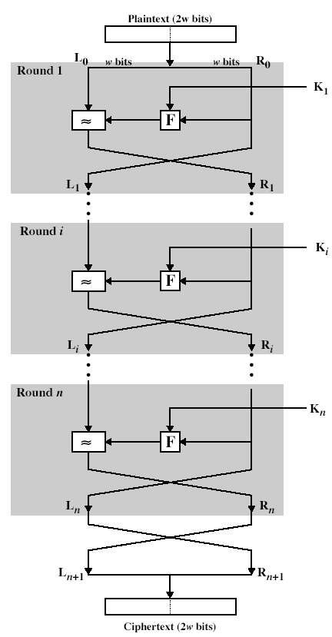
Feistel Cipher
Structure
9/05/12
UB Fall 2012
CSE565: S. Upadhyaya
Lec 5.<number>

Slide 8
Feistel Cipher
Design Principles
Block size
  increasing size improves security, but slows cipher
Key size
  increasing size improves security, makes exhaustive key searching harder, but may slow cipher
Number of rounds
  increasing number improves security, but slows cipher
Subkey generation
  greater complexity can make analysis harder, but slows cipher
Round function
  greater complexity can make analysis harder, but slows cipher
Fast software en/decryption & ease of analysis
  are more recent concerns for practical use and testing
9/05/12
UB Fall 2012
CSE565: S. Upadhyaya
Lec 5.<number>

Slide 9
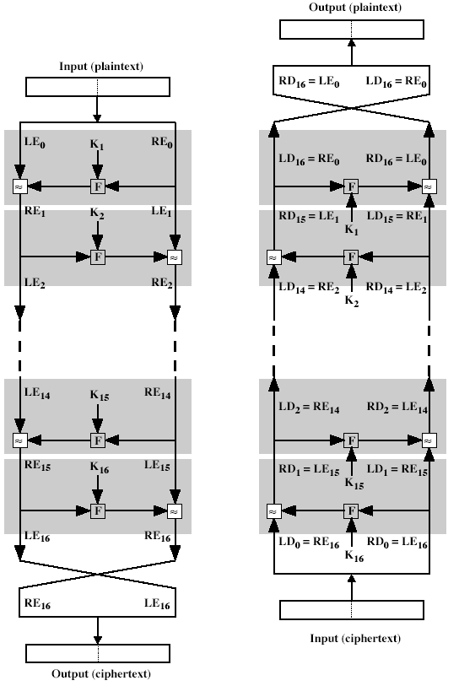
Feistel Cipher Decryption
9/05/12
UB Fall 2012
CSE565: S. Upadhyaya
Lec 5.<number>
Notes:
The process of decryption with a Feistel cipher is essentially the same as the encryption process. The rule is as follows: Use the ciphertext as input to the algorithm, but use the subkeys Ki in reverse order. That is, use Kn in the first round, Kn–1 in the second round, and so on until K1 is used in the last round. This is a nice feature because it means we need not implement two different algorithms, one for encryption and one for decryption.

Slide 10
Data Encryption
Standard (DES)
Most widely used block cipher in the world
Adopted in 1977 by NBS (now NIST)
  FIPS PUB 46
Encrypts 64-bit data using 56-bit key
Had widespread use until early 2000
Has been subject to considerable controversy over its security
9/05/12
UB Fall 2012
CSE565: S. Upadhyaya
Lec 5.<number>

Slide 11
DES History
IBM developed Lucifer cipher
  by team led by Feistel
  used 64-bit data blocks with 128-bit key
Then redeveloped as a commercial cipher with input from NSA and others
In 1973 NBS issued request for proposals for a national cipher standard
IBM submitted their revised Lucifer which was eventually accepted as the DES
9/05/12
UB Fall 2012
CSE565: S. Upadhyaya
Lec 5.<number>

Slide 12
DES Design
Controversy
DES standard is public
Considerable controversy over design
  choice of 56-bit key (vs Lucifer 128-bit)
  because design criteria were classified
Subsequent events and public analysis show in fact design was appropriate
DES has become widely used, especially in the government and financial applications
In 2002, DES has been replaced by AES and NIST has withdrawn the FIPS 46 standard in 2004
9/05/12
UB Fall 2012
CSE565: S. Upadhyaya
Lec 5.<number>
Notes:
Recent analysis has shown despite this controversy, that DES is well designed. DES is theoretically broken using Differential or Linear Cryptanalysis
but in practice is unlikely to be a problem yet. Also rapid advances in computing speed though have rendered the 56 bit key susceptible to exhaustive key search, as predicted by Diffie & Hellman. Have demonstrated breaks:
- 1997 on a large network of computers in a few months
- 1998 on dedicated h/w (EFF) in a few days
- 1999 above combined in 22hrs!

Slide 13
DES Algorithm
Confusion and Diffusion
Plaintext is encrypted in blocks of 64 bits
Substitution and Permutation (Transposition)
56 bit key + 8 bit parity = 64 bit key
64 bit block cipher
Repetitive nature – shift and xor
Outline
  Split data in half
  Scramble each half independently
  Combine key with one half
  Swap the two halves
  Repeat the process 16 times
9/05/12
UB Fall 2012
CSE565: S. Upadhyaya
Lec 5.<number>

Slide 14
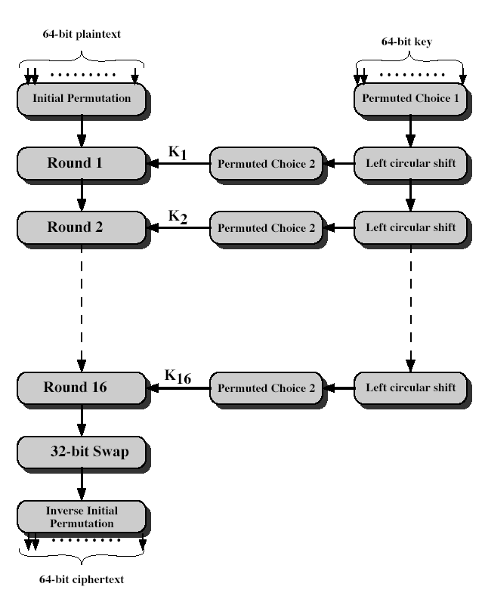
DES Encryption
9/05/12
UB Fall 2012
CSE565: S. Upadhyaya
Lec 5.<number>
Notes:
The basic process in enciphering a 64-bit data block using the DES, shown on the left side, consists of:
- an initial permutation (IP)
- 16 rounds of a complex key dependent round function involving substitution and permutation functions
- a final permutation, being the inverse of IP
The right side shows the handling of the 56-bit key and consists of:
- an initial permutation of the key (PC1) which selects 56-bits in two 28-bit halves
- 16 stages to generate the subkeys using a left circular shift and a permutation

Slide 15
Initial Permutation
IP
First step of the data computation
IP reorders the input data bits
Even bits to LH half, odd bits to RH half
Quite regular in structure (easy in h/w)
See Text Table 3.2
Example:
IP(675a6967 5e5a6b5a) = (ffb2194d 004df6fb)
9/05/12
UB Fall 2012
CSE565: S. Upadhyaya
Lec 5.<number>
Notes:
The initial permutation and its inverse are defined by tables, as shown in Tables 3.2a and 3.2b, respectively. The tables are to be interpreted as follows. The input to a table consists of 64 bits numbered from 1 to 64. The 64 entries in the permutation table contain a permutation of the numbers from 1 to 64. Each entry in the permutation table indicates the position of a numbered input bit in the output, which also consists of 64 bits.
Note that the bit numbering for DES reflects IBM mainframe practice, and is the opposite of what we now mostly use - so be careful! Numbers from Bit 1 (leftmost, most significant) to bit 32/48/64 etc (rightmost, least significant).
Note that examples are specified using hexadecimal.

Slide 16
DES Round
Structure
uses two 32-bit L & R halves
As for any Feistel cipher can describe as:
  L_{i} = R_{i–1}
  R_{i} = L_{i–1} xor F(R_{i–1}, K_{i})
Takes 32-bit R half and 48-bit subkey and:
  expands R to 48-bits using perm E
  adds to subkey
  passes through 8 S-boxes to get 32-bit result
  finally permutes this using 32-bit perm P
9/05/12
UB Fall 2012
CSE565: S. Upadhyaya
Lec 5.<number>
Notes:
Note that the s-boxes provide the “confusion” of data and key values, whilst the permutation P then spreads this as widely as possible, so each S-box output affects as many S-box inputs in the next round as possible, giving “diffusion”.

Slide 17
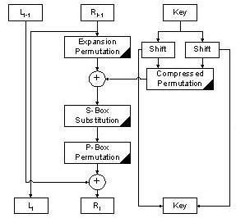
One Round of DES
L_{i} = R _{i-1}
R_{i} = L_{i-1} xor F(R_{i-1}, K_{i} )
9/05/12
UB Fall 2012
CSE565: S. Upadhyaya
Lec 5.<number>

Slide 18
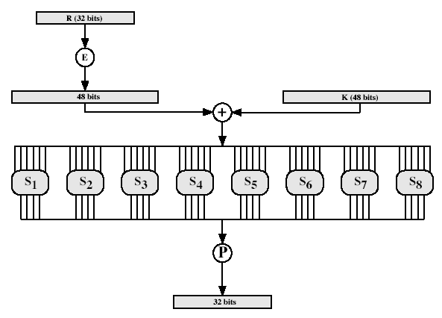
DES Round
Structure
9/05/12
UB Fall 2012
CSE565: S. Upadhyaya
Lec 5.<number>
Notes:
Stallings Fig 3.9

Slide 19
Substitution
Boxes S
Have eight S-boxes which map 6 to 4 bits
Each S-box is actually 4 little 4 bit boxes
  outer bits 1 & 6 (row bits) select one rows
  inner bits 2-5 (col bits) are substituted
  result is 8 lots of 4 bits, or 32 bits
Row selection depends on both data & key
  feature known as autoclaving (autokeying)
Example:
S(18 09 12 3d 11 17 38 39) = 5fd25e03
9/05/12
UB Fall 2012
CSE565: S. Upadhyaya
Lec 5.<number>
Notes:
The substitution consists of a set of eight S-boxes, each of which accepts 6 bits as input and produces 4 bits as output. These transformations are defined in Table 3.3, which is interpreted as follows: The first and last bits of the input to box Si form a 2-bit binary number to select one of four substitutions defined by the four rows in the table for Si. The middle four bits select one of the sixteen columns. The decimal value in the cell selected by the row and column is then converted to its 4-bit representation to produce the output. For example, in S1, for input 011001, the row is 01 (row 1) and the column is 1100 (column 12). The value in row 1, column 12 is 9, so the output is 1001.
Each row of the S-Box defines a reversible substitution. Hence, the entire DES operation is an invertible operation.

Slide 20
DES Key Schedule
Forms subkeys used in each round
Consists of:
  initial permutation of the key (PC1) which selects 56-bits in two 28-bit halves
  16 stages consisting of:
    selecting 24-bits from each half
    permuting them by PC2 for use in function f,
    rotating each half separately either 1 or 2 places depending on the key rotation schedule K
9/05/12
UB Fall 2012
CSE565: S. Upadhyaya
Lec 5.<number>
Notes:
The 56 bit key size comes from security considerations as we know now. It was big enough so that an exhaustive key search was about as hard as the best direct attack (a form of differential cryptanalysis called a T-attack, known by the IBM & NSA researchers), but no bigger. The extra 8 bits were then used as parity (error detecting) bits, which makes sense given the original design use for hardware communications links. However we hit an incompatibility with simple s/w implementations since the top bit in each byte is 0 (since ASCII only uses 7 bits), but the DES key schedule throws away the bottom bit! A good implementation needs to be cleverer!
Details of these permutations and the key rotation schedule are given in text Table 3.4.

Slide 21
DES Decryption
Decrypt must unwind steps of data computation
With Feistel design, do encryption steps again using subkeys in reverse order (SK16 … SK1)
note that IP undoes final step of encryption
1st round with SK16 undoes 16th encrypt round
….
16th round with SK1 undoes 1st encrypt round
Then final step undoes initial encryption IP
Thus recovering original data value
9/05/12
UB Fall 2012
CSE565: S. Upadhyaya
Lec 5.<number>

Slide 22
Avalanche Effect
Key desirable property of encryption alg
A change of one input or key bit results in changing approx half output bits
Makes attempts to “home-in” by guessing keys impossible
DES exhibits strong avalanche
9/05/12
UB Fall 2012
CSE565: S. Upadhyaya
Lec 5.<number>

Slide 23
How Secure is DES?
Fixed S-Box, Trap door?
Why 16 iteration? Is 16 enough?
Is 56 bit Key length secure?
What are the weaknesses of DES?
  Complements E_{k}(P)=C → E_{k’}(P’)=C’
  Weak keys
9/05/12
UB Fall 2012
CSE565: S. Upadhyaya
Lec 5.<number>

Slide 24
Cryptanalysis
Differential Cryptanalysis – Invented by Eli Biham and Adi Shamir in 1990
Linear Cryptanalysis – Invented by Mitsuru Matsui
  A XOR K = C → A XOR C = K
Related Key Cryptanalysis
9/05/12
UB Fall 2012
CSE565: S. Upadhyaya
Lec 5.<number>
Notes:
Related key cryptanalysis –
Use keys that have some dependencies. For example, the last 50 bits are the same in consecutive keys.

Slide 25
Strength of DES
– Key Size
56-bit keys have 2⁵⁶ = 7.2 x 10¹⁶ values
Brute force search looks hard
Recent advances have shown is possible
  in 1997 on Internet in a few months
  in 1998 on dedicated h/w (EFF) in a few days
  in 1999 above combined in 22hrs!
Still must be able to recognize plaintext
Now considering alternatives to DES
9/05/12
UB Fall 2012
CSE565: S. Upadhyaya
Lec 5.<number>
Notes:
DES finally and definitively proved insecure in July 1998, when the Electronic Frontier Foundation (EFF) announced that it had broken a DES encryption using a special-purpose "DES cracker" machine that was built for less than $250,000. The attack took less than three days. The
EFF has published a detailed description of the machine, enabling others to build their own cracker [EFF98].

Slide 26
Strength of DES
– Timing Attacks
Attacks actual implementation of cipher
Use knowledge of consequences of implementation to derive knowledge of some/all subkey bits
Specifically use fact that calculations can take varying times depending on the value of the inputs to it
9/05/12
UB Fall 2012
CSE565: S. Upadhyaya
Lec 5.<number>
Notes:
AES analysis process has highlighted this attack approach, and is a concern.
Timing analysis is more of a concern of public key cryptosystems.
DES is immune to it.

Slide 27
Strength of DES
– Analytic Attacks
Now have several analytic attacks on DES
These utilize some deep structure of the cipher
  by gathering information about encryptions
  can eventually recover some/all of the sub-key bits
  if necessary then exhaustively search for the rest
Generally these are statistical attacks
Include
  differential cryptanalysis (invented by Eli Biham and Adi Shamir in 1990)
  linear cryptanalysis (invented by Mitsuru Matsui)
  related key attacks
9/05/12
UB Fall 2012
CSE565: S. Upadhyaya
Lec 5.<number>

Slide 28
Differential Cryptanalysis
One of the most significant recent (public) advances in cryptanalysis
Murphy, Biham & Shamir published 1990
Powerful method to analyze block ciphers
Used to analyze most current block ciphers with varying degrees of success
DES reasonably resistant to it
9/05/12
UB Fall 2012
CSE565: S. Upadhyaya
Lec 5.<number>
Notes:
In [BIHA93] show Differential Cryptanalysis can successfully cryptanalyse DES with an effort on the order of 2⁴⁷, requiring 2⁴⁷ chosen plaintexts.
Differential cryptanalysis was known to the IBM DES design team as early as 1974, and influenced the design of the S-boxes and the permutation P. Compare with cryptanalysis of an eight-round LUCIFER algorithm requires only 256 chosen plaintexts, whereas an attack on an eight-round version of DES requires 2¹⁴ chosen plaintexts.

Slide 29
Differential Cryptanalysis
A statistical attack against Feistel ciphers
Uses cipher structure not previously used
Design of S-P networks has output of function f influenced by both input & key
Hence cannot trace values back through cipher without knowing values of the key
Differential Cryptanalysis compares two related pairs of encryptions
9/05/12
UB Fall 2012
CSE565: S. Upadhyaya
Lec 5.<number>

Slide 30
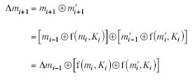
Compares Pairs of Encryptions
With a known difference in the input
Searching for a known difference in output when same subkeys are used
9/05/12
UB Fall 2012
CSE565: S. Upadhyaya
Lec 5.<number>
Notes:
Called Differential Cryptanalysis because the analysis compares differences between two related, encryptions - and looking for known difference in leading to a known difference out.

Slide 31
Differential Cryptanalysis
Have some input difference giving some output difference with probability p
If find instances of some higher probability input / output difference pairs occurring
Can infer subkey that was used in a round
Then must iterate process over many rounds (with decreasing probabilities)
9/05/12
UB Fall 2012
CSE565: S. Upadhyaya
Lec 5.<number>

Slide 32
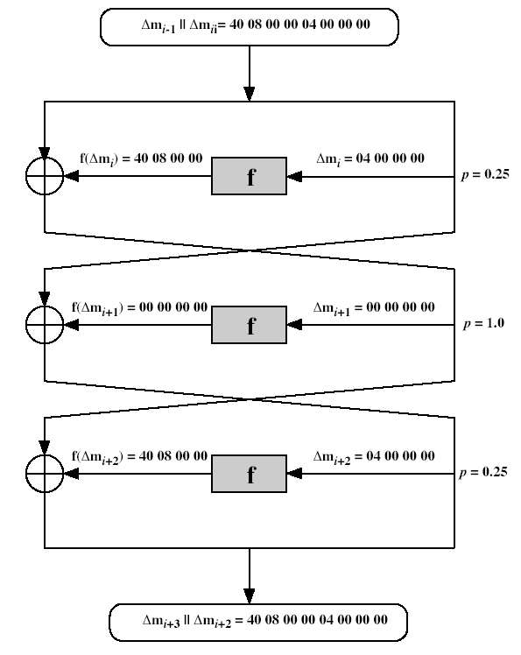
Differential Cryptanalysis
9/05/12
UB Fall 2012
CSE565: S. Upadhyaya
Lec 5.<number>
Notes:
Example of differential cryptanalysis on 3 rounds of DES (cf full 16 rounds). Overall, after three rounds the probability that the output difference is as shown is equal to 0.25 x 1 x 0.25 = 0.0625.

Slide 33
Differential Cryptanalysis
Perform attack by repeatedly encrypting plaintext pairs with known input XOR until obtain desired output XOR
When found
  if intermediate rounds match required XOR have a right pair
  if not then have a wrong pair, relative ratio is S/N for attack
Can then deduce keys values for the rounds
  right pairs suggest same key bits
  wrong pairs give random values
For large numbers of rounds, probability is so low that more pairs are required than exist with 64-bit inputs
Biham and Shamir have shown how a 13-round iterated characteristic can break the full 16-round DES
9/05/12
UB Fall 2012
CSE565: S. Upadhyaya
Lec 5.<number>
Notes:
See [BIHA93] for detailed descriptions. Attack on full DES requires an effort on the order of 2⁴⁷, requiring 2⁴⁷ chosen plaintexts to be encrypted, with a considerable amount of analysis – in practise exhaustive search is still easier, even though up to 2⁵⁵ encryptions are required.

Slide 34
Linear Cryptanalysis
Another recent development
Also a statistical method
Must be iterated over rounds, with decreasing probabilities
Developed by Matsui et al in early 90's
Based on finding linear approximations
Can attack DES with 2⁴³ known plaintexts, still in practice infeasible
9/05/12
UB Fall 2012
CSE565: S. Upadhyaya
Lec 5.<number>
Notes:
Again, this attack uses structure not seen before. This time, it works on single encryptions, collecting stats over many encryptions.

Slide 35
Linear Cryptanalysis
Find linear approximations with prob p != ½
  P[i1,i2,...,ia](+)C[j1,j2,...,jb] = K[k1,k2,...,kc]
  where ia,jb,kc are bit locations in P,C,K
Gives linear equation for key bits
Get one key bit using max likelihood alg
Using a large number of trial encryptions
Effectiveness given by: |p–½|
9/05/12
UB Fall 2012
CSE565: S. Upadhyaya
Lec 5.<number>
Notes:
See [MATS93] for details. Not widely researched by other groups.

Slide 36
DES Variants
Multiple DES (Triple-DES)
The PCI Cryptographic Coprocessor http://www.ibm.com/security/cryptocards/
DES with independent sub-keys
DESX CRYPT3 – UNIX
Generalized DES
DES with alternative S-Boxes
DES with key dependent S-Boxes
9/05/12
UB Fall 2012
CSE565: S. Upadhyaya
Lec 5.<number>
Notes:
Generalized DES – uses larger block sizes in the Feistel cipher.

Slide 37
Summary
Have considered:
DES
  details
  strength
Differential & Linear Cryptanalysis
DES variants
9/05/12
UB Fall 2012
CSE565: S. Upadhyaya
Lec 5.<number>

