Slide 1
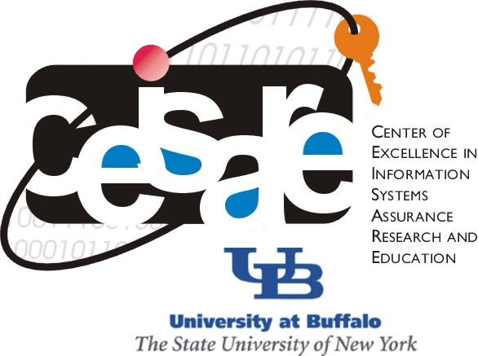
CSE565: Computer Security
Lecture 20
Digital Signatures
Shambhu Upadhyaya
Computer Science & Eng.
University at Buffalo
Buffalo, New York 14260
10/10/12
UB Fall 2012
CSE565: S. Upadhyaya
Lec 20.<number>

Slide 2
Acknowledgments
Material for some slides is drawn from Lawrie Brown’s slides
10/10/12
UB Fall 2012
CSE565: S. Upadhyaya
Lec 20.<number>

Slide 3
Digital Signatures
Message authentication (covered in previous classes) protects two parties from any third party
  does not address issues of lack of trust
Digital signatures provide the ability to:
  verify author, date & time of signature
  authenticate message contents
  be verified by third parties to resolve disputes
Hence include authentication function with additional capabilities
10/10/12
UB Fall 2012
CSE565: S. Upadhyaya
Lec 20.<number>

Slide 4
Digital Signature Properties
Must depend on the message signed
Must use information unique to sender
  to prevent both forgery and denial
Must be relatively easy to produce
Must be relatively easy to recognize & verify
Be computationally infeasible to forge
  with new message for existing digital signature
  with fraudulent digital signature for given message
Be practical to save digital signature in storage
10/10/12
UB Fall 2012
CSE565: S. Upadhyaya
Lec 20.<number>

Slide 5
Direct Digital
Signatures
Involve only sender & receiver
Assumes receiver has sender’s public-key
Digital signature made by sender signing entire message or hash with private-key
Can encrypt using receivers public-key
Important that sign first then encrypt message & signature
Security depends on sender’s private-key
10/10/12
UB Fall 2012
CSE565: S. Upadhyaya
Lec 20.<number>
Notes:
Direct Digital Signatures involve the direct application of public-key algs. But are dependent on security of the sender’s private-key. Have problems if lost/stolen and signatures forged. Need time-stamps and timely key revocation.

Slide 6
Arbitrated Digital Signatures
Involves use of arbiter A
  validates any signed message
  then dated and sent to recipient
Requires suitable level of trust in arbiter
Can be implemented with either private or public-key algorithms
Arbiter may or may not see message
10/10/12
UB Fall 2012
CSE565: S. Upadhyaya
Lec 20.<number>
Notes:
There are several options – conventional encryption, arbiter sees, arbiter doesn’t see and pke where arbiter doesn’t see.

Slide 7
Digital Signature
Standard (DSS)
US Govt approved signature scheme FIPS 186
Uses the SHA hash algorithm
Designed by NIST & NSA in early 90's
DSS is the standard, DSA is the algorithm
A variant on ElGamal and Schnorr schemes
Creates a 320 bit signature, but with 512-1024 bit security
Security depends on difficulty of computing discrete logarithms
10/10/12
UB Fall 2012
CSE565: S. Upadhyaya
Lec 20.<number>
Notes:
DSA is the US Govt approved signature scheme - designed to provide strong signatures without allowing easy use for encryption. The signature scheme has advantages, being both smaller (320 vs 1024bit) and faster (much of the computation is done modulo a 160 bit number) than RSA.

Slide 8
Summary
Have considered:
  digital signatures
  digital signature standard
Digital Signature Algorithms will be discussed next (Chalkboard discussion)
10/10/12
UB Fall 2012
CSE565: S. Upadhyaya
Lec 20.<number>

