Slide 1

CSE565: Computer Security
Lectures 24 and 25
Key Management
Shambhu Upadhyaya
Computer Science & Eng.
University at Buffalo
Buffalo, New York 14260
10/19/12
UB Fall 2012
CSE565: S. Upadhyaya
Lec 24.<number>

Slide 2
Acknowledgments
Material for some slides is drawn from Lawrie Brown’s slides
10/19/12
UB Fall 2012
CSE565: S. Upadhyaya
Lec 24.<number>

Slide 3
Key Management
Public-key encryption helps address key distribution problems
Have two aspects of this:
  distribution of public keys
  use of public-key encryption to distribute secret keys
10/19/12
UB Fall 2012
CSE565: S. Upadhyaya
Lec 24.<number>

Slide 4
Distribution of
Public Keys
Can be considered as using one of:
  Public announcement
  Publicly available directory
  Public-key authority
  Public-key certificates
10/19/12
UB Fall 2012
CSE565: S. Upadhyaya
Lec 24.<number>

Slide 5
Public
Announcement
Users distribute public keys to recipients or broadcast to community at large
  e.g., append PGP keys to email messages or post to news groups or email list
Major weakness is forgery
  anyone can create a key claiming to be someone else and broadcast it until forgery is discovered
  can masquerade as claimed user
10/19/12
UB Fall 2012
CSE565: S. Upadhyaya
Lec 24.<number>

Slide 6
Publicly Available Directory
Can obtain greater security by registering keys with a public directory
Directory must be trusted with properties:
  contains {name, public-key} entries
  participants register securely with directory
  participants can replace key at any time
  directory is periodically published
  directory can be accessed electronically
Still vulnerable to tampering or forgery
10/19/12
UB Fall 2012
CSE565: S. Upadhyaya
Lec 24.<number>

Slide 7
Public-Key Authority
Improve security by tightening control over distribution of keys from directory
Has properties of directory
Requires users to know public key for the directory
Users interact with directory to obtain any desired public key securely
  does require real-time access to directory when keys are needed
10/19/12
UB Fall 2012
CSE565: S. Upadhyaya
Lec 24.<number>

Slide 8
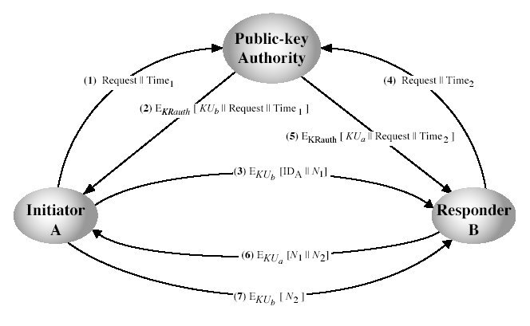
Public-Key Authority
10/19/12
UB Fall 2012
CSE565: S. Upadhyaya
Lec 24.<number>
Notes:
Stallings Fig 14.11. See text for details of steps in protocol.

Slide 9
Public-Key
Certificates
Certificates allow key exchange without real-time access to public-key authority
A certificate binds identity to public key
  usually with other info such as period of validity, rights of use, etc.
With all contents signed by a trusted Public-Key or Certificate Authority (CA)
Can be verified by anyone who knows the public-key authorities public-key
10/19/12
UB Fall 2012
CSE565: S. Upadhyaya
Lec 24.<number>
Notes:
Examples of Cas – VeriSign, GoDaddy, USPS, etc.

Slide 10
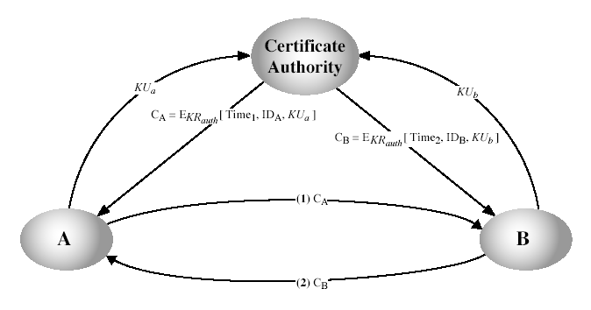
Public-Key
Certificates
10/19/12
UB Fall 2012
CSE565: S. Upadhyaya
Lec 24.<number>
Notes:
Stallings Fig 14.12. See text for details of steps in protocol.

Slide 11
Public-Key Distribution of Secret Keys
Use previous methods to obtain public-key
Can use for secrecy or authentication
But public-key algorithms are slow
So usually want to use private-key encryption to protect message contents
Hence need a session key
Have several alternatives for negotiating a suitable session
10/19/12
UB Fall 2012
CSE565: S. Upadhyaya
Lec 24.<number>

Slide 12
Simple Secret
Key Distribution
Proposed by Merkle in 1979
  A generates a new temporary public key pair
  A sends B the public key and their identity
  B generates a session key K sends it to A encrypted using the supplied public key
  A decrypts the session key and both use
Problem is that an opponent can intercept and impersonate both halves of protocol
10/19/12
UB Fall 2012
CSE565: S. Upadhyaya
Lec 24.<number>

Slide 13
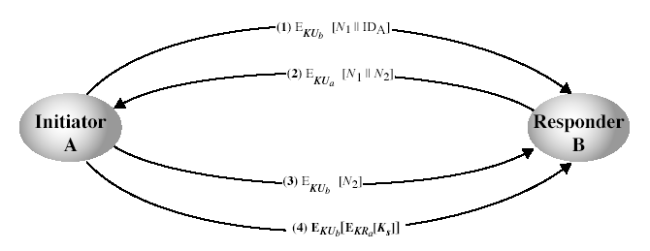
Public-Key Distribution of Secret Keys
10/19/12
UB Fall 2012
CSE565: S. Upadhyaya
Lec 24.<number>
Notes:
Stallings Fig 14.8. See text for details of steps in protocol. Note that these steps correspond to final 3 of Fig 14.11, hence can get both secret key exchange and authentication in a single protocol.

Slide 14
Summary
Have considered:
  distribution of public keys
  public-key distribution of secret keys
10/19/12
UB Fall 2012
CSE565: S. Upadhyaya
Lec 24.<number>

