Slide 1
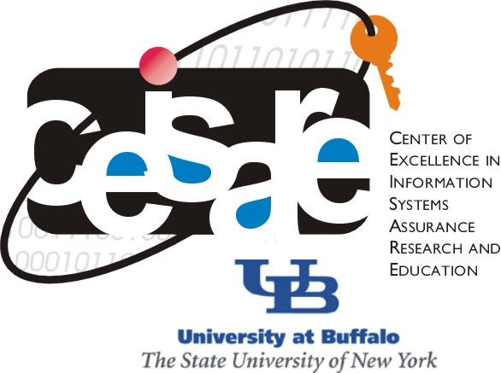
CSE565: Computer Security
Lecture 26 &27, 28 Authentication & Applications
Shambhu Upadhyaya
Computer Science & Eng.
University at Buffalo
Buffalo, New York 14260
10/24/12
UB Fall 2012
CSE565: S. Upadhyaya
Lec 26.<number>

Slide 2
Acknowledgments
Material for some slides is drawn from Lawrie Brown’s slides
10/24/12
UB Fall 2012
CSE565: S. Upadhyaya
Lec 26.<number>

Slide 3
Authentication Protocols
Used to convince parties of each other’s identity and to exchange session keys
May be one-way or mutual
Key issues are
  confidentiality – to protect session keys
  timeliness – to prevent replay attacks
10/24/12
UB Fall 2012
CSE565: S. Upadhyaya
Lec 26.<number>
Notes:
Note that user authentication is different from message authentication.

Slide 4
Replay Attacks
Where a valid signed message is copied and later resent
  simple replay
  repetition that can be logged
  repetition that cannot be detected
  backward replay without modification
Countermeasures include
  use of sequence numbers (generally impractical)
  timestamps (needs synchronized clocks)
  challenge/response (using unique nonce)
10/24/12
UB Fall 2012
CSE565: S. Upadhyaya
Lec 26.<number>
Notes:
Repetition that can be logged – replay it within the valid time window
Backward replay – sender will not be able to say that it is not a different message

Slide 5
Using Symmetric Encryption
Can use a two-level hierarchy of keys
Usually with a trusted Key Distribution Center (KDC)
  each party shares own master key with KDC
  KDC generates session keys used for connections between parties
  master keys used to distribute these to them
10/24/12
UB Fall 2012
CSE565: S. Upadhyaya
Lec 26.<number>

Slide 6
Using Public-Key Encryption
Have a range of approaches based on the use of public-key encryption
Need to ensure that you have correct public keys for other parties
Using a central Authentication Server (AS)
Various protocols exist using timestamps or nonces
10/24/12
UB Fall 2012
CSE565: S. Upadhyaya
Lec 26.<number>

Slide 7
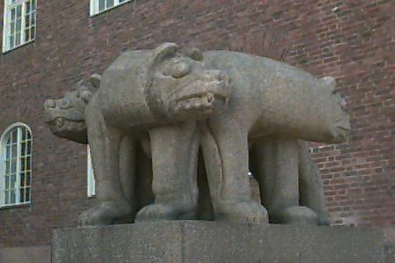
Remote Authentication
Authentication functions developed to support application-level authentication & digital signatures
Kerberos – a private-key remote authentication service
X.509 directory authentication service
10/24/12
UB Fall 2012
CSE565: S. Upadhyaya
Lec 26.<number>

Slide 8
Kerberos
Trusted key server system from MIT
Provides centralized private-key third-party authentication in a distributed network
  allows users access to services distributed through network
  without needing to trust all workstations
  rather all trust a central authentication server
Two versions in use: 4 & 5
10/24/12
UB Fall 2012
CSE565: S. Upadhyaya
Lec 26.<number>
Notes:
One of the best known and most widely implemented trusted third party key distribution systems. It was developed as part of Project Athena at MIT.

Slide 9
Kerberos
Requirements
First published report identified its requirements as:
  security
  reliability
  transparency
  scalability
Implemented using an authentication protocol based on Needham-Schroeder
10/24/12
UB Fall 2012
CSE565: S. Upadhyaya
Lec 26.<number>
Notes:
Security – no impersonation
Reliability – availability all the time
Transparency – user should be isolated from the details – only password submission is what is needed
Scalable – support large no. of clients

Slide 10
Needham-Schroeder Protocol
Original third-party key distribution protocol
For session between A, B mediated by KDC
Protocol overview is:
  1. A→KDC: ID_{A} || ID_{B} || N₁
  2. KDC→A: E_{Ka}[Ks || ID_{B} || N₁ || E_{Kb}[Ks||ID_{A}] ]
  3. A→B: E_{Kb}[Ks||ID_{A}]
  4. B→A: E_{Ks}[N₂]
  5. A→B: E_{Ks}[f(N₂)]
10/24/12
UB Fall 2012
CSE565: S. Upadhyaya
Lec 26.<number>
Notes:
This is the original, basic key exchange protocol. Used by 2 parties who both trusted a common key server, it gives one party the info needed to establish a session key with the other. Note that since the key server chooses the session key, it is capable of reading/forging any messages between A&B, which is why they need to trust it absolutely!
Note that all communications is between A&KDC and A&B, B&KDC don't talk directly (though indirectly a message passes from KDC via A to B, encrypted in B's key so that A is unable to read or alter it). Other variations of key distribution protocols can involve direct communications between B&KDC.

Slide 11
Problems with NS-Protocol & Solutions
Used to securely distribute a new session key for communications between A & B
But is vulnerable to a replay attack if an old session key has been compromised
  then message 3 can be resent convincing B that it is communicating with A, but actually it is a masquerader
Modifications to address this require:
  timestamps (Denning 81)
  using an extra nonce (Neuman 93)
10/24/12
UB Fall 2012
CSE565: S. Upadhyaya
Lec 26.<number>
Notes:
There is a critical flaw in the protocol, as shown. This emphasises the need to be extremely careful in codifying assumptions, and tracking the timeliness of the flow of info in protocols. Designing secure protocols is not easy, and should not be done lightly. Great care and analysis is needed.

Slide 12
Kerberos 4 Overview
A basic third-party authentication scheme
Have an Authentication Server (AS)
  users initially negotiate with AS to identify self
  AS provides a non-corruptible authentication credential (ticket granting ticket TGT)
Have a Ticket Granting server (TGS)
  users subsequently request access to other services from TGS on basis of users TGT
10/24/12
UB Fall 2012
CSE565: S. Upadhyaya
Lec 26.<number>
Notes:
The core of Kerberos is the Authentication and Ticket Granting Servers – these are trusted by all users and servers and must be securely administered.

Slide 13
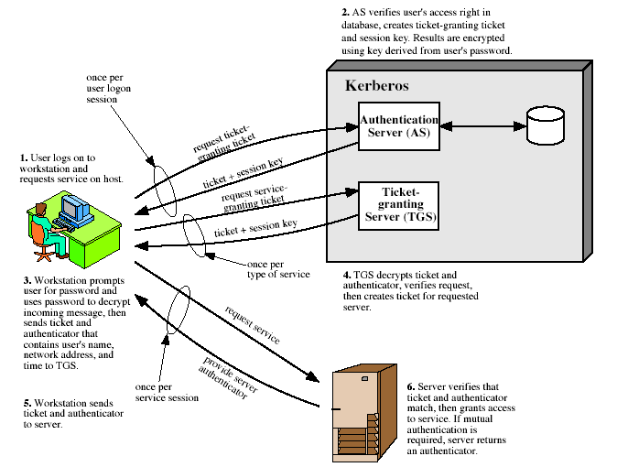
Kerberos 4 Overview
10/24/12
UB Fall 2012
CSE565: S. Upadhyaya
Lec 26.<number>
Notes:
Stallings Fig 14.1. Discuss in relation to Table 14.1 which details message exchanges.

Slide 14
Kerberos Realms
A Kerberos environment consists of:
  a Kerberos server
  a number of clients, all registered with server
  application servers, sharing keys with server
This is termed a realm
  typically a single administrative domain
If have multiple realms, their Kerberos servers must share keys and trust
10/24/12
UB Fall 2012
CSE565: S. Upadhyaya
Lec 26.<number>
Notes:
There are similarities between Facebook’s Oauth 2.0 and Kerberos 5 – TGT and Refresh Tokens, Access Tokens and SGTs. There are efforts to provide the Oauth support for Kerberos (bring these two together).
OAuth 2.0 is being integrated into Google and Microsoft APIs. Facebook uses OAuth 2.0
More than 60% of enterprises use Kerberos – some examples are Wireless authentication (others are RADIUS, LDAP), Mac systems, Solaris, Ubuntu, Google Search Appliance
OAuth uses either x.509 certificate or 256-bit symmetric key for signing the tokens.
Other authentication protocols are – Shibboleth, Active Directory, etc.
Shibboleth is a Single Sign-On federated identify management middleware used to authenticate users to networks, but typically used to authenticate users to web services. It typically uses userid and password based authentication using the Kerberos authentication server.
Active Directory is used to authenticate users in the Windows environment. It uses LDAP, Kerberos and DNS.

Slide 15
Kerberos Version 5
Developed in mid 1990’s
Provides improvements over v4
  addresses environmental shortcomings
    encryption alg, network protocol, byte order, ticket lifetime, authentication forwarding, interrealm auth
  and technical deficiencies
    double encryption, non-std mode of use, session keys, password attacks
Specified as Internet standard RFC 1510
10/24/12
UB Fall 2012
CSE565: S. Upadhyaya
Lec 26.<number>
Notes:
In version 5,
Any encryption technique can be used
Any network protocol other than IP address can also be used (such as ISO network address)
Byte order of message is standardized
Ticket lifetime is not restricted
Authentication forwarding makes things easier
Interrealm authentication requires fewer than N^2 relationships

Slide 16
X.509 Authentication Service
Part of CCITT X.500 directory service standards
  distributed servers maintaining some info database
Defines framework for authentication services
  directory may store public-key certificates
  with public key of user
  signed by certification authority
Also defines authentication protocols
Uses public-key crypto & digital signatures
  algorithms not standardised, but RSA recommended
10/24/12
UB Fall 2012
CSE565: S. Upadhyaya
Lec 26.<number>
Notes:
X.509 is the Internationally accepted standard for how to construct a public key certificate, and is becoming widely used. It has gone through several versions. It is used by S/MIME secure email, SSL/TLS secure Internet links (eg for secure web).

Slide 17
X.509 Certificates
Issued by a Certification Authority (CA), containing:
  version (1, 2, or 3)
  serial number (unique within CA) identifying certificate
  signature algorithm identifier
  issuer X.500 name (CA)
  period of validity (from - to dates)
  subject X.500 name (name of owner)
  subject public-key info (algorithm, parameters, key)
  issuer unique identifier (v2+)
  subject unique identifier (v2+)
  extension fields (v3)
  signature (of hash of all fields in certificate)
Notation CA<<A>> denotes certificate for A signed by CA
10/24/12
UB Fall 2012
CSE565: S. Upadhyaya
Lec 26.<number>
Notes:
The X.509 certificate is the heart of the standard. There are 3 versions, with successively more info in the certificate - must be v2 if either unique identifier field exists, must be v3 if any extensions are used.

Slide 18
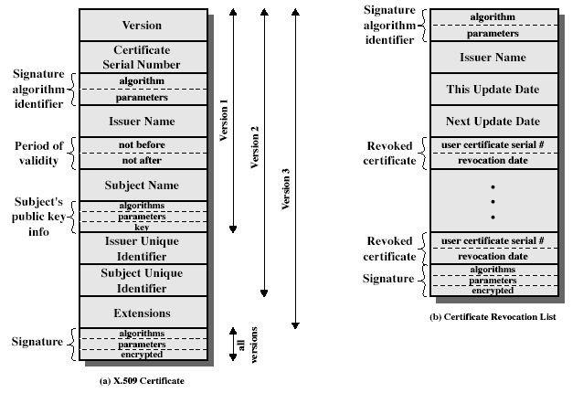
X.509 Certificates
10/24/12
UB Fall 2012
CSE565: S. Upadhyaya
Lec 26.<number>
Notes:
Stallings Fig 14.3

Slide 19
Obtaining a
Certificate
Any user with access to CA can get any certificate from it
Only the CA can modify a certificate
Because it cannot be forged, certificates can be placed in a public directory
10/24/12
UB Fall 2012
CSE565: S. Upadhyaya
Lec 26.<number>

Slide 20
CA Hierarchy
If both users share a common CA then they are assumed to know its public key
Otherwise CA's must form a hierarchy
Use certificates linking members of hierarchy to validate other CA's
  each CA has certificates for clients (forward) and parent (backward)
Each client trusts parents certificates
Enable verification of any certificate from one CA by users of all other CAs in hierarchy
10/24/12
UB Fall 2012
CSE565: S. Upadhyaya
Lec 26.<number>
Notes:
All very easy is both parties use the same CA. If not, then there has to be some means to form a chain of certifications between the CA's used by the two parties. And that raises issues about whether the CA's are equivalent, whether they used the same policies to generate their certificates, and how much you're going to trust a CA at some remove from your own. These are all open issues.

Slide 21
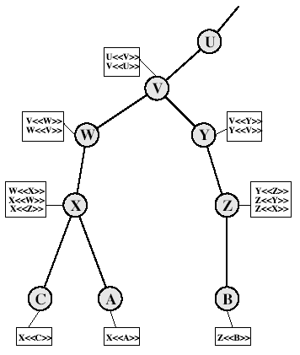
CA Hierarchy Use
10/24/12
UB Fall 2012
CSE565: S. Upadhyaya
Lec 26.<number>
Notes:
Stallings Fig 14.4.
Track chains of certificates:
A acquires B certificate using chain: X<<W>>W<<V>>V<<Y>>Y<<Z>>Z<<B>>
B acquires A certificate using chain: Z<<Y>>Y<<V>>V<<W>>W<<X>>X<<A>>

Slide 22
Certificate
Revocation
Certificates have a period of validity
May need to revoke before expiry, eg.,:
  user's private key is compromised
  user is no longer certified by this CA
  CA's certificate is compromised
CA’s maintain list of revoked certificates
  the Certificate Revocation List (CRL)
Users should check certs with CA’s CRL
10/24/12
UB Fall 2012
CSE565: S. Upadhyaya
Lec 26.<number>

Slide 23
Authentication Procedures
X.509 includes three alternative authentication procedures:
One-Way Authentication
Two-Way Authentication
Three-Way Authentication
All use public-key signatures
10/24/12
UB Fall 2012
CSE565: S. Upadhyaya
Lec 26.<number>
Notes:
The X.509 standard specifies the authentication protocols that can be used when obtaining and using certificates. 1-way for unidirectional messages (like email), 2-way for interactive sessions when timestamps are used, 3-way for interactive sessions with no need for timestamps (and hence synchronised clocks).

Slide 24
One-Way
Authentication
1 message ( A->B) used to establish
  the identity of A and that message is from A
  message was intended for B
  integrity & originality of message
Message must include timestamp, nonce, B's identity and is signed by A
10/24/12
UB Fall 2012
CSE565: S. Upadhyaya
Lec 26.<number>

Slide 25
Two-Way
Authentication
2 messages (A->B, B->A) which also establishes in addition:
  the identity of B and that reply is from B
  that reply is intended for A
  integrity & originality of reply
Reply includes original nonce from A, also timestamp and nonce from B
10/24/12
UB Fall 2012
CSE565: S. Upadhyaya
Lec 26.<number>

Slide 26
Three-Way Authentication
3 messages (A->B, B->A, A->B) which enables above authentication without synchronized clocks
Has reply from A back to B containing signed copy of nonce from B
Means that timestamps need not be checked or relied upon
10/24/12
UB Fall 2012
CSE565: S. Upadhyaya
Lec 26.<number>

Slide 27
X.509 Version 3
Has been recognized that additional information is needed in a certificate
  email/URL, policy details, usage constraints
Rather than explicitly naming new fields defined a general extension method
Extensions consist of:
  extension identifier
  criticality indicator
  extension value
10/24/12
UB Fall 2012
CSE565: S. Upadhyaya
Lec 26.<number>

Slide 28
Certificate
Extensions
Key and policy information
  convey info about subject & issuer keys, plus indicators of certificate policy
Certificate subject and issuer attributes
  support alternative names, in alternative formats for certificate subject and/or issuer
Certificate path constraints
  allow constraints on use of certificates by other CA’s
10/24/12
UB Fall 2012
CSE565: S. Upadhyaya
Lec 26.<number>

Slide 29
Summary
We have considered:
  Kerberos trusted key server system
  X.509 authentication and certificates
10/24/12
UB Fall 2012
CSE565: S. Upadhyaya
Lec 26.<number>

