Slide 1

CSE565: Computer Security
Lectures 32, 35, 36
IP Basics and IP Security
Shambhu Upadhyaya
Computer Science & Eng.
University at Buffalo
Buffalo, New York 14260
11/07/12
UB Fall 2012
CSE565: S. Upadhyaya
Lec 32.<number>

Slide 2
Outline
IP (November 07, 2012)
IP Security architecture (November 14, 2012)
Authentication Header
Key Management (November 16, 2012)
11/07/12
UB Fall 2012
CSE565: S. Upadhyaya
Lec 32.<number>
Notes:
IPv6 adoption is slower than expected. One estimate states that fewer than 10% of IP addresses are remaining. So, migration to IPv6 is inevitable. Today (2011), Verizon, HSBC, Amazon, Akamai, etc. are taking the lead.

Slide 3
The Role of IP
IP provides functionality to interconnected devices across multiple networks
IP is implemented in each end system and routers
The routers along the way must cope up with:
  Addressing schemes (IEEE 802 vs. X.25)
  Maximum packet sizes (fragmentation)
  Interfaces (hardware/software)
  Reliability (should be independent of it)
11/07/12
UB Fall 2012
CSE565: S. Upadhyaya
Lec 32.<number>

Slide 4
Some Issues of IP
Data at higher level are encapsulated in a PDU (protocol data unit)
PDU is passed through one or more networks and connected routers and to the end system
IP header must contain all the necessary addresses
No reliability assurance
  Intermediate subnets need not be concerned about reliability requirements
TCP takes care of reliability
11/07/12
UB Fall 2012
CSE565: S. Upadhyaya
Lec 32.<number>

Slide 5
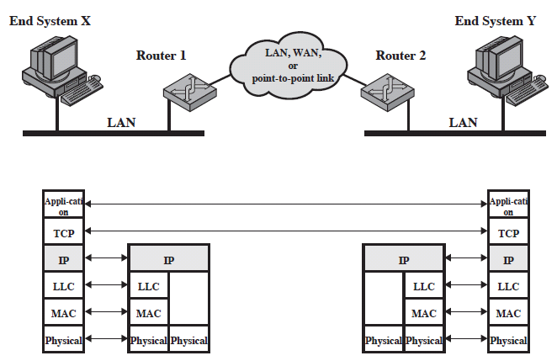
Configuration of TCP/IP
Figure: Configuration for TCP/IP Example
11/07/12
UB Fall 2012
CSE565: S. Upadhyaya
Lec 32.<number>
Notes:
Stallings Fig 19-1.

Slide 6
Operation of Routers
IP is implemented in all end systems and routers
End systems must have compatible protocols above IP
Routers need only have up through IP
11/07/12
UB Fall 2012
CSE565: S. Upadhyaya
Lec 32.<number>

Slide 7
Operation, Contd.
Block of data from X to Y
  PDU is created and IP layer attaches a header (global Internet address of Y)
  Since Y is on another network, the packet needs to be sent to router 1 in the form of an LLC PDU
  Upon receiving, MAC layer constructs a MAC packet and sticks in the address of router 1
  After examination, router 1 routes packets to router 2 (wrapping in another format if necessary)
  Router 2 strips off header to determine that the IP packet is destined to Y
  Router 2 creates a packet with destination address of Y and sends it onto the LAN
  Y removes all headers and forwards data to upper
11/07/12
UB Fall 2012
CSE565: S. Upadhyaya
Lec 32.<number>

Slide 8
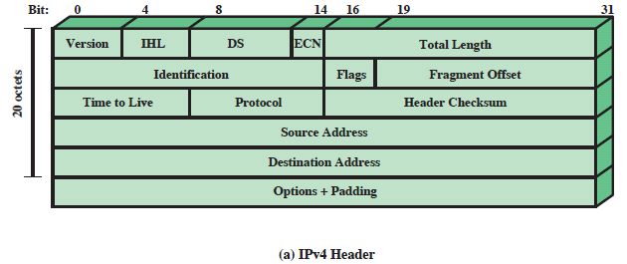
IPv4
20 bytes or 160 bits (minimum)
32 bit address (4.3 billion IP addresses)
Study shows that available address space would last until 2023 (maybe sooner?)
Maybe by Dec. 2013 due to rapid adoption of smart phones that connect to the Internet
11/07/12
UB Fall 2012
CSE565: S. Upadhyaya
Lec 32.<number>

Slide 9
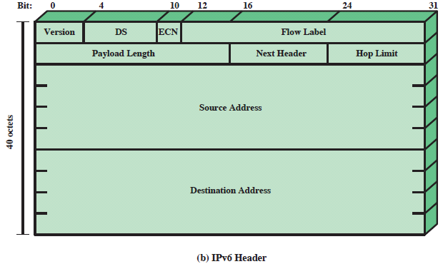
IPv6
Fixed length of 40 octets
128 bit addresses ( 5x10²⁸ addresses for each of the 7 billion people)
U.S. government specified network backbones at federal agencies must deploy IPv6 by 2008 – the adoption is slow due to lack of client base
Major backbone networks – Amazon, Comcast, HSBC, Akamai, Verizon, etc. have deployed IPv6
11/07/12
UB Fall 2012
CSE565: S. Upadhyaya
Lec 32.<number>
Notes:
Microsoft Vista, Windows 7, etc. have support for IPv6 and are enabled by default

Slide 10
Summary
IPv4 will soon run out of address space
IPv6 initiative started in 1995 but adoption is slow, will become main stream soon
Products such as Microsoft OS have support for IPv6 and are enabled by default
IPv6 has no backward compatibility since headers are significantly different
You need to run dual stacks to serve both types of networks
Situation is similar to WEP and RSN in the wireless security domain
11/07/12
UB Fall 2012
CSE565: S. Upadhyaya
Lec 32.<number>

