Slide 1

CSE565: Computer Security
Lectures 35, 36
IP Security
Shambhu Upadhyaya
Computer Science & Eng.
University at Buffalo
Buffalo, New York 14260
11/14/12
UB Fall 2012
CSE565: S. Upadhyaya
Lec 35.<number>

Slide 2
Acknowledgments
Material for some slides is drawn from Lawrie Brown’s slides
11/14/12
UB Fall 2012
CSE565: S. Upadhyaya
Lec 35.<number>

Slide 3
Outline
IP Security architecture (November 14, 2012)
Authentication Header
Key Management (November 16, 2012)
11/14/12
UB Fall 2012
CSE565: S. Upadhyaya
Lec 35.<number>
Notes:
IPv6 adoption is slower than expected. One estimate states that fewer than 10% of IP addresses are remaining. So, migration to IPv6 is inevitable. Today (2011), Verizon, HSBC, Amazon, Akamai, etc. are taking the lead.

Slide 4
IP Security
Motivation
Have considered some application-specific security mechanisms
  E.g., S/MIME, PGP, Kerberos
However there are security concerns that cut across protocol layers
Would like security implemented by the network for all applications
11/14/12
UB Fall 2012
CSE565: S. Upadhyaya
Lec 35.<number>

Slide 5
IPSec
General IP Security mechanisms
Provides
  authentication
  confidentiality
  key management
Applicable to use over LANs, across public & private WANs, & for the Internet
11/14/12
UB Fall 2012
CSE565: S. Upadhyaya
Lec 35.<number>

Slide 6
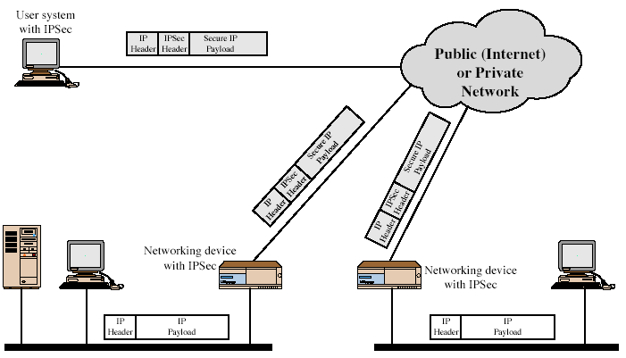
IPSec Uses
11/14/12
UB Fall 2012
CSE565: S. Upadhyaya
Lec 35.<number>
Notes:
Stallings Fig 19-1.

Slide 7
Benefits of IPSec
A firewall/router provides strong security to all traffic crossing the perimeter
Is resistant to bypass
Is below transport layer, hence transparent to applications
Can be transparent to end users
Can provide security for individual users if desired
11/14/12
UB Fall 2012
CSE565: S. Upadhyaya
Lec 35.<number>

Slide 8
IP Security
Architecture
Specification is quite complex
Defined in numerous RFC’s
  incl. RFC 2401/2402/2406/2408
  many others, grouped by category
Mandatory in IPv6, optional in IPv4
11/14/12
UB Fall 2012
CSE565: S. Upadhyaya
Lec 35.<number>

Slide 9
IPSec Services
Access control
Connectionless integrity
Data origin authentication
Rejection of replayed packets
  a form of partial sequence integrity
Confidentiality (encryption)
Limited traffic flow confidentiality
11/14/12
UB Fall 2012
CSE565: S. Upadhyaya
Lec 35.<number>

Slide 10
Security
Associations
A one-way relationship between sender & receiver that affords security for traffic flow
Defined by 3 parameters:
  Security Parameters Index (SPI)
  IP Destination Address
  Security Protocol Identifier
Has a number of other parameters
  seq no., AH & ESP info, lifetime, etc.
Have a database of Security Associations
11/14/12
UB Fall 2012
CSE565: S. Upadhyaya
Lec 35.<number>

Slide 11
Authentication
Header (AH)
Provides support for data integrity & authentication of IP packets
  end system/router can authenticate user/app
  prevents address spoofing attacks and replay attacks by tracking sequence numbers
Based on use of a MAC
  HMAC-MD5-96 or HMAC-SHA-1-96
Parties must share a secret key
11/14/12
UB Fall 2012
CSE565: S. Upadhyaya
Lec 35.<number>

Slide 12
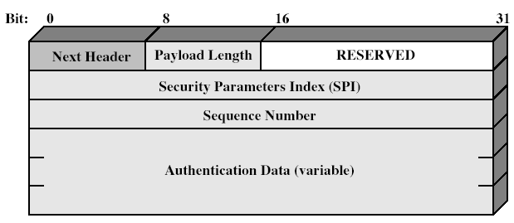
Authentication
Header
11/14/12
UB Fall 2012
CSE565: S. Upadhyaya
Lec 35.<number>

Slide 13
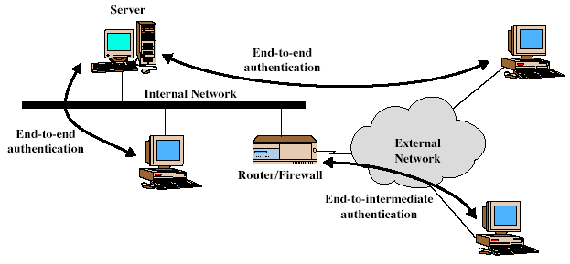
Transport &
Tunnel Modes
11/14/12
UB Fall 2012
CSE565: S. Upadhyaya
Lec 35.<number>

Slide 14
Encapsulating
Security Payload (ESP)
Provides message content confidentiality & limited traffic flow confidentiality
Can optionally provide the same authentication services as AH
Supports range of ciphers, modes, padding
  incl. DES, Triple-DES, RC5, IDEA, CAST, etc.
  CBC most common
  pad to meet blocksize, for traffic flow
11/14/12
UB Fall 2012
CSE565: S. Upadhyaya
Lec 35.<number>

Slide 15
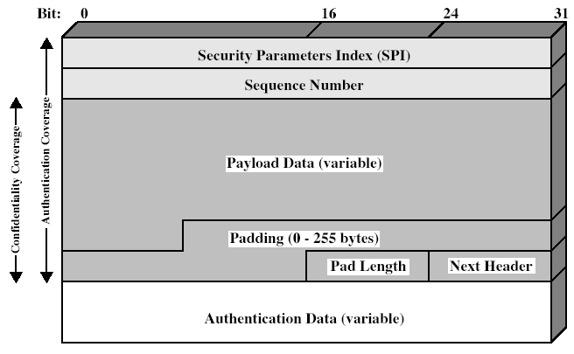
Encapsulating
Security Payload
11/14/12
UB Fall 2012
CSE565: S. Upadhyaya
Lec 35.<number>
Notes:
Stallings Fig 19-5.

Slide 16
Transport vs Tunnel Mode ESP
Transport mode is used to encrypt & optionally authenticate IP data
  data protected but header left in clear
  can do traffic analysis but is efficient
  good for ESP host to host traffic
Tunnel mode encrypts entire IP packet
  add new header for next hop
  good for VPNs, gateway to gateway security
11/14/12
UB Fall 2012
CSE565: S. Upadhyaya
Lec 35.<number>

Slide 17
Combining Security Associations
SA’s can implement either AH or ESP
To implement both need to combine SA’s
  form a security bundle
Have 4 cases (see next)
11/14/12
UB Fall 2012
CSE565: S. Upadhyaya
Lec 35.<number>

Slide 18
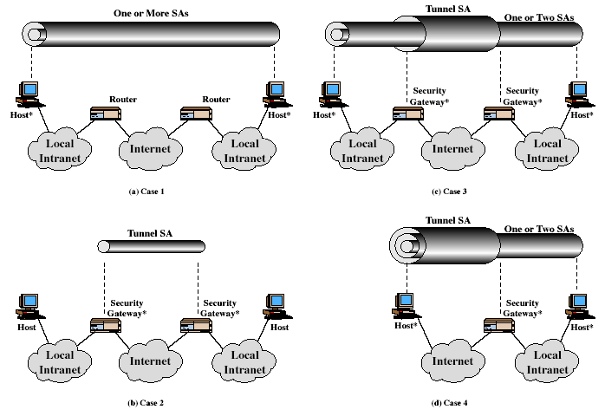
Combining Security Associations
11/14/12
UB Fall 2012
CSE565: S. Upadhyaya
Lec 35.<number>
Notes:
Stallings Fig 19-10.

Slide 19
Key Management
Handles key generation & distribution
Typically need 2 pairs of keys
  2 per direction for AH & ESP
Manual key management
  sysadmin manually configures every system
Automated key management
  automated system for on demand creation of keys for SA’s in large systems
  has Oakley & ISAKMP elements
11/14/12
UB Fall 2012
CSE565: S. Upadhyaya
Lec 35.<number>

Slide 20
Oakley
A key exchange protocol
Based on Diffie-Hellman key exchange
Adds features to address weaknesses
  cookies, groups (global params), nonces, DH key exchange with authentication
Can use arithmetic in prime fields or elliptic curve fields
11/14/12
UB Fall 2012
CSE565: S. Upadhyaya
Lec 35.<number>

Slide 21
ISAKMP
Internet Security Association and Key Management Protocol
Provides framework for key management
Defines procedures and packet formats to establish, negotiate, modify, & delete SAs
Independent of key exchange protocol, encryption alg, & authentication method
11/14/12
UB Fall 2012
CSE565: S. Upadhyaya
Lec 35.<number>

Slide 22
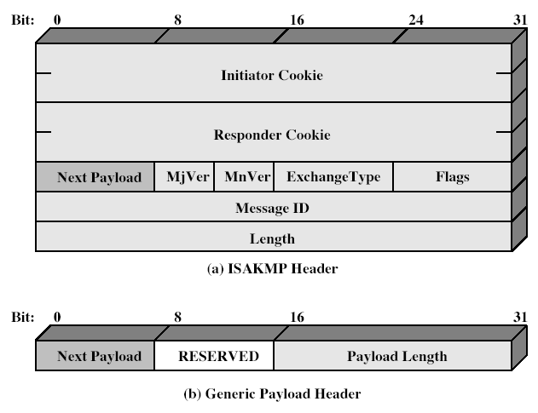
ISAKMP
11/14/12
UB Fall 2012
CSE565: S. Upadhyaya
Lec 35.<number>
Notes:
Stallings Fig 19-12.

Slide 23
Summary
Have considered:
  IPSec security framework
  AH
  ESP
  Key management & Oakley/ISAKMP
11/14/12
UB Fall 2012
CSE565: S. Upadhyaya
Lec 35.<number>

