Slide 1
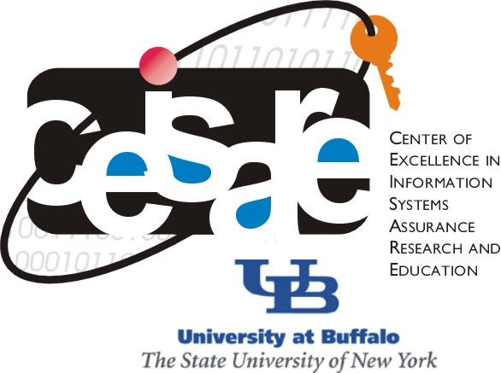
CSE565: Computer Security
Lectures 37-40
OS Security
Shambhu Upadhyaya
Computer Science & Eng.
University at Buffalo
Buffalo, New York 14260
11/19/12
UB Fall 2012
CSE565: S. Upadhyaya
Lec 37.<number>

Slide 2
Overview
Protection for general purpose operating systems (will not be covered in class)
  Control of access to general objects of operating system
  Memory protection
  File protection mechanisms
  User authentication
Introduction to trusted operating system
  What makes a design trusted?
  Trusted vs. secure
  Security policies
  Models of security
Trusted operating system design
  Security features of ordinary operating systems
  Security features of trusted operating systems
  Security kernel design
  Trusted computing base: Functions, design, implementation
  Assurance in trusted OS
11/19/12
UB Fall 2012
Lec 37.<number>

Slide 3
Secure Methods to Protect OS
The basis of protection is Separation: Keeping one user’s objects separate from the other users
Rushby and Randell state that separation in an operating system can occur in several ways
  Physical separation
  Temporal separation
  Logical separation
  Cryptographic separation
  (Combination of two or more of these forms of separation is also possible)
11/19/12
UB Fall 2012
Lec 37.<number>
Notes:
Implementation Complexity is in increasing order
First two approaches are stringent and can lead to poor resource utilization
Physical Separation: Different processes uses different physical objects
Temporal Separation: processes having different security requirements are executed at different times
Logical Separation: In which users operate under the illusion that no other processes exist, as when an OS constraints a program’s accesses so that the program cannot access objects outside its permitted domain.
Cryptographic Separation: In which processes conceal their data and computations in such a way that they are unintelligible to outside processes

Slide 4
Focus of the Lectures
The uncovered part deals with security mechanisms which would make the operations/activities on the OS to be carried out safely from a user's perspective
We need to look at OS from the designer’s point of view
  Security policies
  Security models
  Trust
11/19/12
UB Fall 2012
Lec 37.<number>

Slide 5
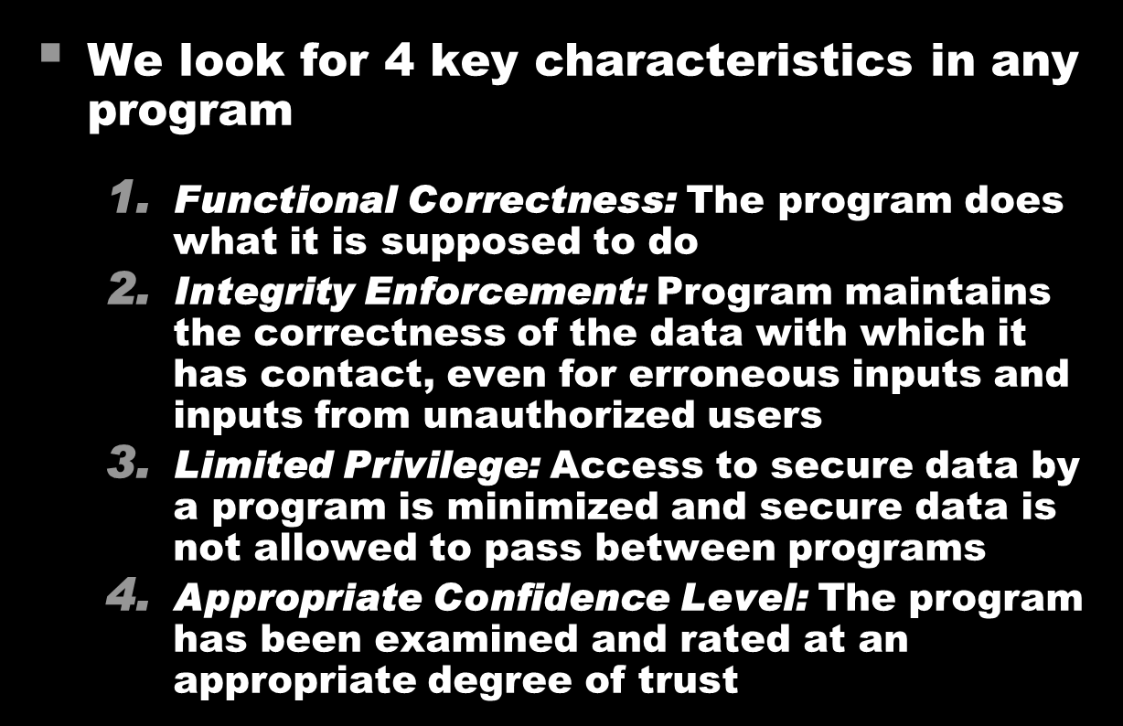
What Makes a Design
Trusted?
11/19/12
UB Fall 2012
Lec 37.<number>

Slide 6
Trusted vs. Secure
Secure | Trusted
Either-or: Something either is or not secure | Graded: There are degrees of “trustworthiness”
Property of the presenter | Property of the receiver
Asserted based on the product characteristics | Judged based on evidence and analysis
Absolute: not qualified as to how used, where, when or by whom | Relative: viewed in context of use
A goal | A characteristic
11/19/12
UB Fall 2012
Lec 37.<number>

Slide 7
Security Policy
A statement of the security that we expect the system to enforce
An Operating System can be trusted only in relation to its security policy
Addresses constraints on
  functions and flow
  access by external systems and adversaries
  access to data by people
11/19/12
UB Fall 2012
Lec 37.<number>
Notes:
http://en.wikipedia.org/wiki/Security_policy

Slide 8

Categorization of Security Policies
11/19/12
UB Fall 2012
Lec 37.<number>

Slide 9

Military Security Policy
11/19/12
UB Fall 2012
Lec 37.<number>

Slide 10
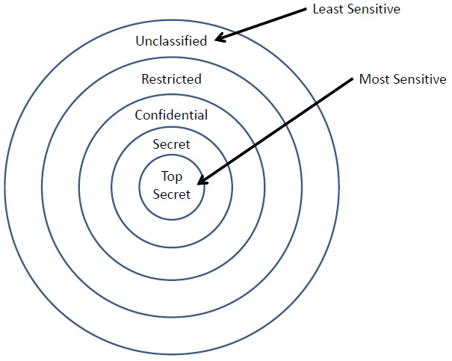
Hierarchy of Sensitivities
Military Security Policy: Hierarchy of Sensitivities
11/19/12
UB Fall 2012
Lec 37.<number>

Slide 11
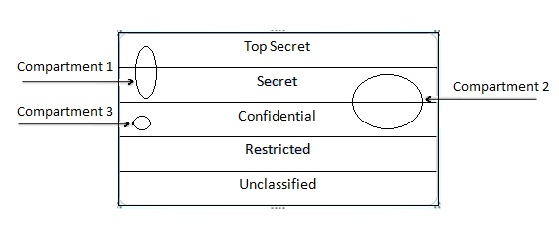
Compartments and Sensitivity Levels
Each piece of classified information may be associated with one or more projects or compartments
11/19/12
UB Fall 2012
Lec 37.<number>

Slide 12

Military Policy Terms
11/19/12
UB Fall 2012
Lec 37.<number>

Slide 13

Commercial Security Policies
11/19/12
UB Fall 2012
Lec 37.<number>

Slide 14

Chinese Wall Security
Policy (CWSP)
11/19/12
UB Fall 2012
Lec 37.<number>

Slide 15

Properties of CWSP
11/19/12
UB Fall 2012
Lec 37.<number>
Notes:
CWSP is a commercially inspired confidentiality policy

Slide 16

Models of Security
11/19/12
UB Fall 2012
Lec 37.<number>

Slide 17

Multiple Independent
Levels of Security (MILS)
11/19/12
UB Fall 2012
Lec 37.<number>
Notes:
http://en.wikipedia.org/wiki/Multiple_Independent_Levels_of_Security

Slide 18
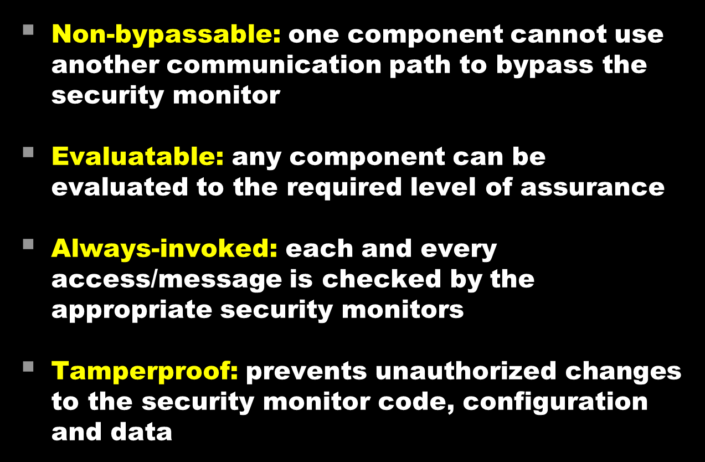
Properties of MILS
11/19/12
UB Fall 2012
Lec 37.<number>

Slide 19

Multilevel Security (MLS)
11/19/12
UB Fall 2012
Lec 37.<number>
Notes:
http://en.wikipedia.org/wiki/Multilevel_security
MILS (multiple independent levels of security) is an architecture that addresses the domain separation component of MLS

Slide 20

Lattice Model
11/19/12
UB Fall 2012
Lec 37.<number>

Slide 21

Bell–La Padula Model
11/19/12
UB Fall 2012
Lec 37.<number>

Slide 22
Bell–La Padula Properties
Consider a system where
  S = set of all the subjects
  O = set of all the objects
Each subject s in S and each object o in O has a fixed security class C(s) and C(o)
Simple Security Property (no read-up): Subject s may have read access to object o only if C(o) ≤ C(s)
*- Property (no write-down): A subject s who has read access to an object o may have write access to an object p only if C(o) ≤ C(p)
11/19/12
UB Fall 2012
Lec 37.<number>

Slide 23
Biba Integrity Model
Concentrates on the integrity of the data
Subjects and objects are ordered by an integrity classification scheme, I(s) and I(o)
Simple Integrity Property: Subject s may have write access to object o only if I(s) ≥ I(o)
Integrity *- Property: If subject s has read access to object o with integrity level I(o), s can have write access to an object p only if I(o) ≥ I(p)
11/19/12
UB Fall 2012
Lec 37.<number>

Slide 24
Overview
Protection for general purpose operating systems (will not be covered in class)
  Control of access to general objects of operating system
  Memory protection
  File protection mechanisms
  User authentication
Introduction to trusted operating system
  What makes a design trusted?
  Trusted vs. secure
  Security policies
  Models of security
Trusted operating system design
  Security features of ordinary operating systems
  Security features of trusted operating systems
  Security kernel design
  Trusted computing base: Functions, design, implementation
  Assurance in trusted OS
11/19/12
UB Fall 2012
Lec 37.<number>

Slide 25
Security Features of
Ordinary OS
Authentication of users
Protection of memory
File and I/O device access control
Allocation and access control to general objects
Enforcement of sharing
Guarantee of fair service
Inter process communication and synchronization
Protection of operating system data
11/19/12
UB Fall 2012
Lec 37.<number>

Slide 26
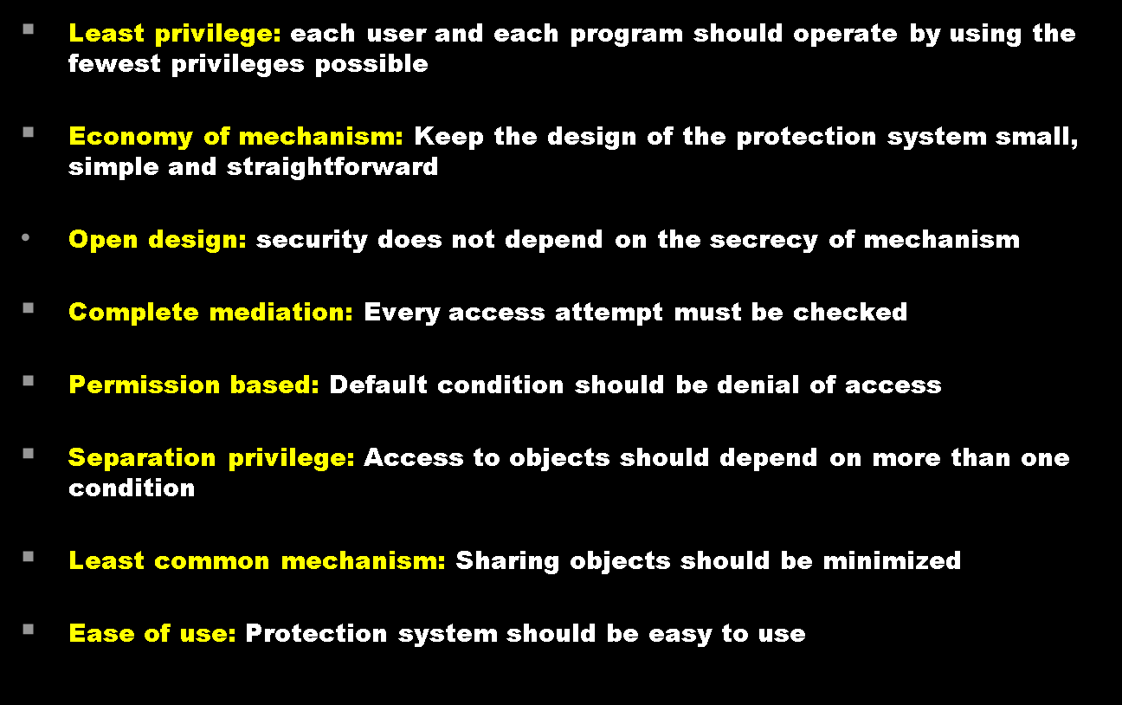
Design Elements of Trusted OS
11/19/12
UB Fall 2012
Lec 37.<number>

Slide 27

Security Features of
Trusted OS - 1
11/19/12
UB Fall 2012
Lec 37.<number>

Slide 28

Security Features of Trusted OS - 2
11/19/12
UB Fall 2012
Lec 37.<number>

Slide 29

Security Features of
Trusted OS - 3
11/19/12
UB Fall 2012
Lec 37.<number>

Slide 30

Security Features of
Trusted OS - 4
11/19/12
UB Fall 2012
Lec 37.<number>

Slide 31

Security Kernel Design
11/19/12
UB Fall 2012
Lec 37.<number>

Slide 32
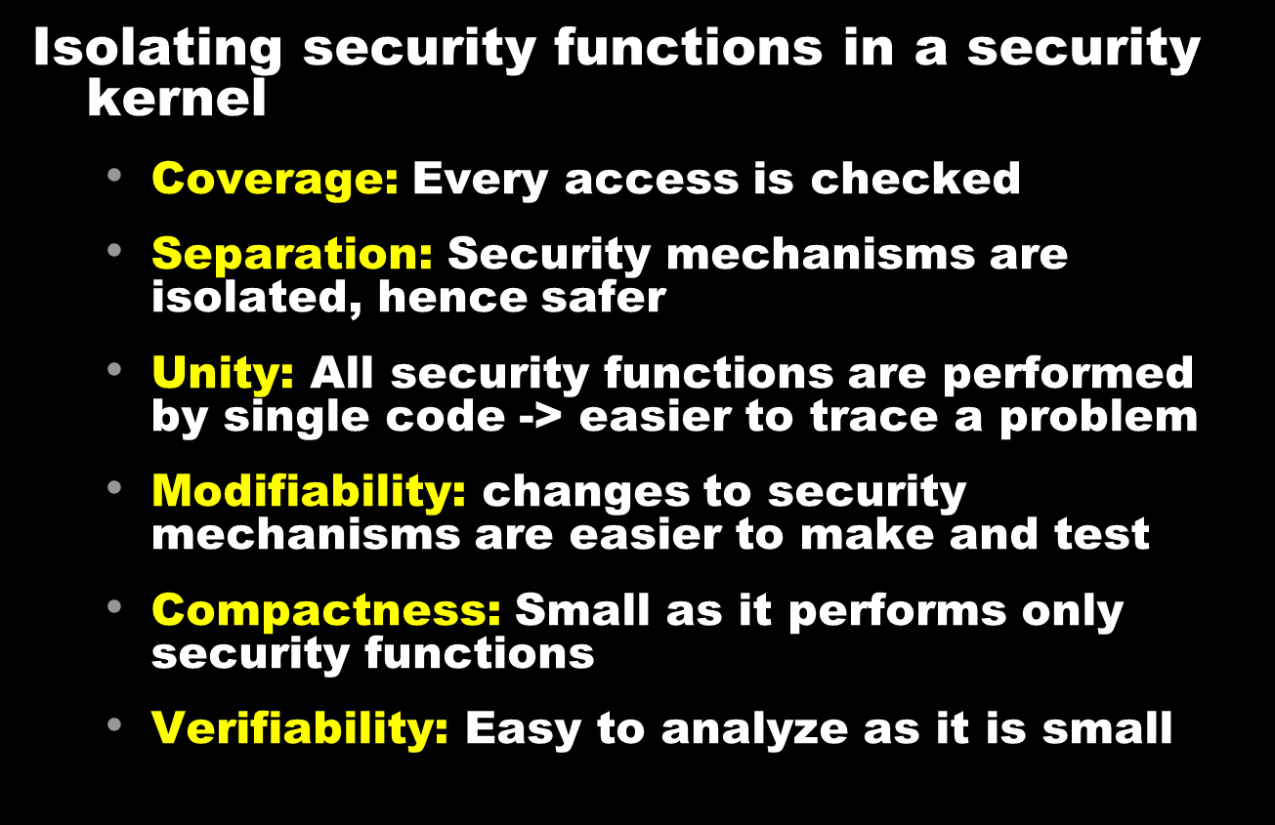
Security Functions in
Security Kernel
11/19/12
UB Fall 2012
Lec 37.<number>

Slide 33

Security Kernel:
Benefits and Limitations
11/19/12
UB Fall 2012
Lec 37.<number>

Slide 34

Reference Monitor
11/19/12
UB Fall 2012
Lec 37.<number>

Slide 35

Trusted Computing Base (TCB)
11/19/12
UB Fall 2012
Lec 37.<number>

Slide 36
TCB and Non – TCB Code
User Applications
Utilities
User request interpreter
User process coordination, synchronization
User environment: objects, names (e.g., files)
User I/O
Procedures, user processes
Creation and deletion of user objects
Directories
Extended types
Non - TCB
Segmentation, paging, memory management
Primitive I/O
Basic operations
Clocks, timing
Interrupt handling
Hardware: registers, memory
Capabilities
TCB
11/19/12
UB Fall 2012
Lec 37.<number>
Notes:
Implementation of memory management in TCB may eliminate the benefits of a microkernel approach, and end up in a more monolithic-like OS kernel. On the other hand, the TCB must prevent itself from being over written or modified. This requires that the memory management unit be treated as a part of the TCB. Also the TCB must monitor memory references to ensure secrecy and integrity for each domain containing code and data.
Segmentation, paging, memory management may belong to either TCB or non-TCB.

Slide 37
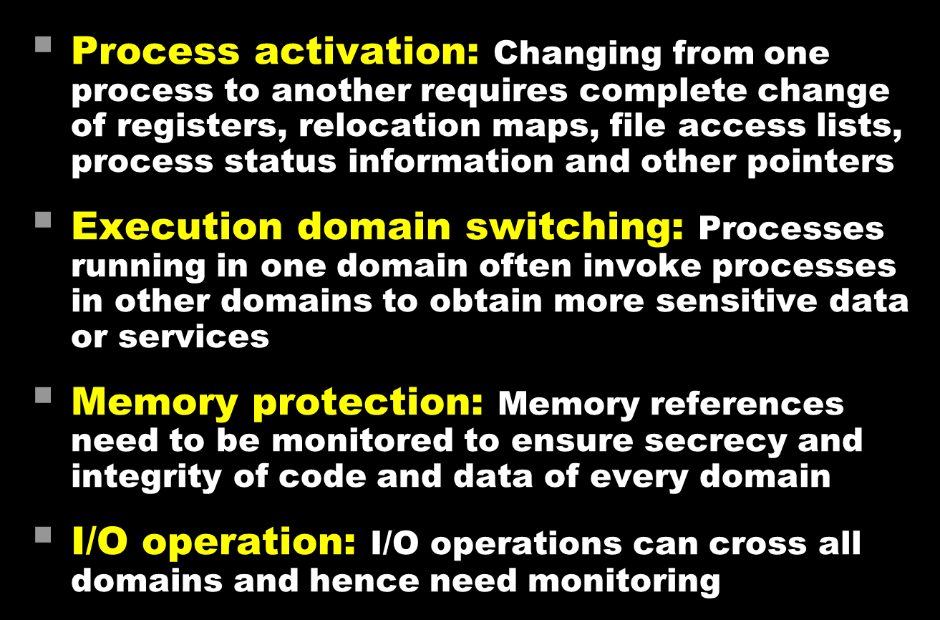
TCB Functions
11/19/12
UB Fall 2012
Lec 37.<number>

Slide 38

TCB Design
11/19/12
UB Fall 2012
Lec 37.<number>

Slide 39

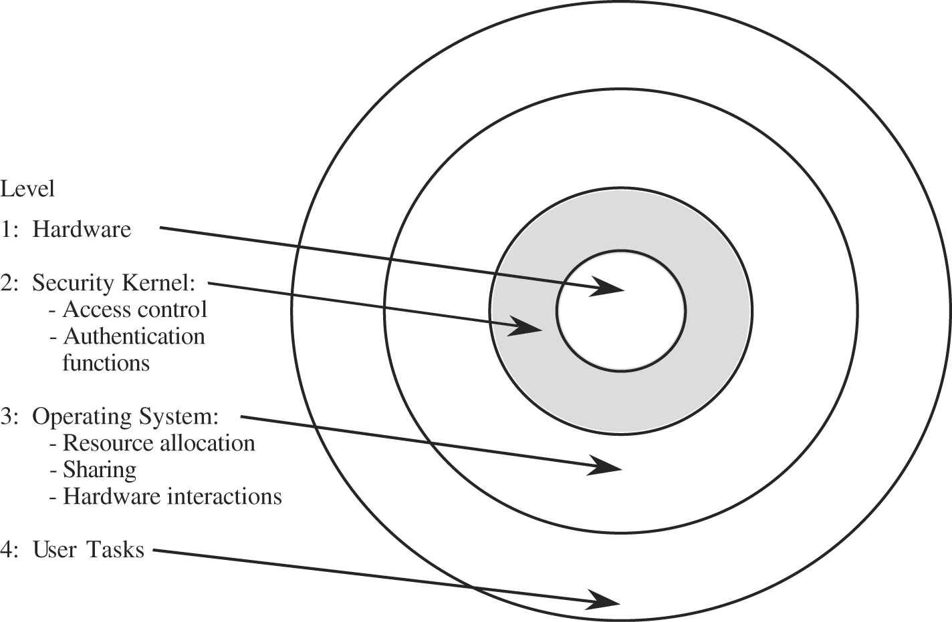
TCB Implementation
11/19/12
UB Fall 2012
Lec 37.<number>
Notes:
Scomp: a secure operating system built by Honeywell

Slide 40
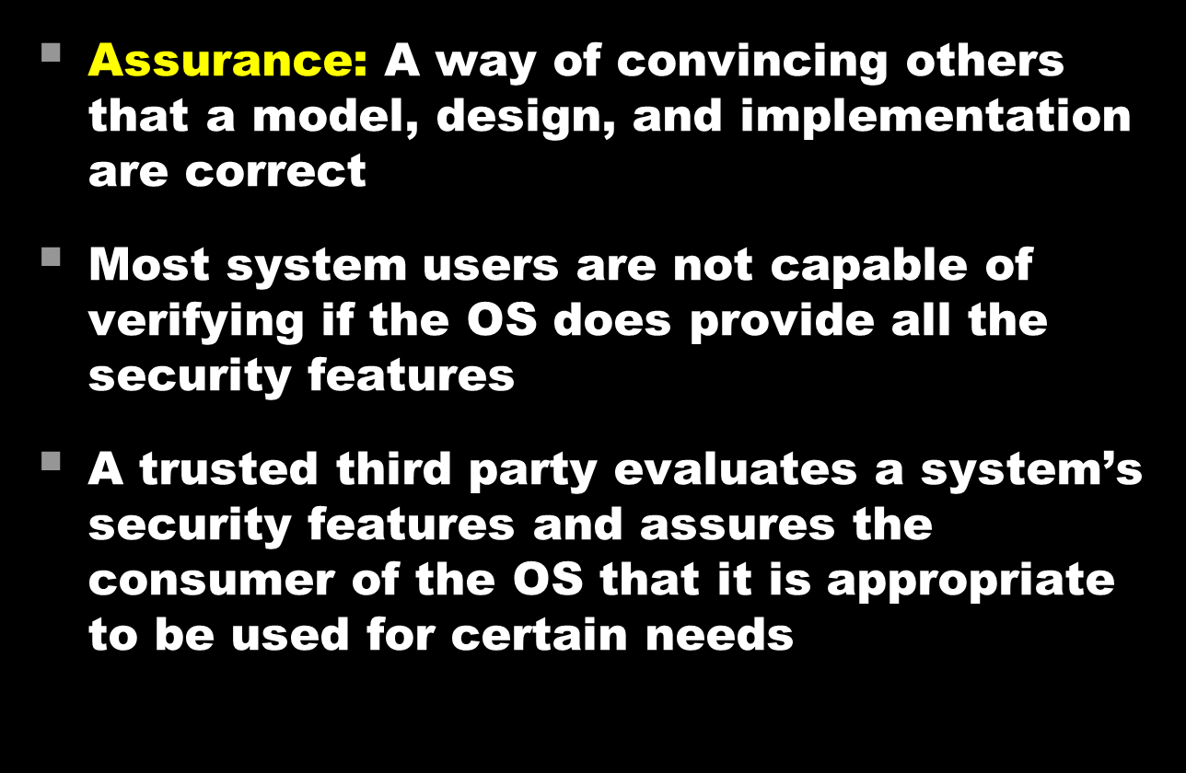
Assurance in Trusted OS
11/19/12
UB Fall 2012
Lec 37.<number>
Notes:
Section 5.5, Security in Computing, Pfleeger and Pfleeger, 4th edition

Slide 41
Typical OS
Vulnerabilities (1)
User interaction
  Largest single source of OS vulnerability
  Code to interact with users is complex and hardware dependent (harder to review the code)
  System designers may have tried shortcuts
Ambiguity in access policy
  Isolation of users and sharing of resources is not always clear at the policy level, so the distinction cannot be sharply drawn at implementation
11/19/12
UB Fall 2012
Lec 37.<number>
Notes:
These flaws to understand the careful analysis necessary in designing and testing operating systems

Slide 42
Typical OS
Vulnerabilities (2)
Incomplete mediation
  It is recommended that every request should be checked for proper authorization
  However, some systems check access only once per user interface operation, process execution or machine interval due to resource constraints
Generality
  In commercial OS, designers try to provide a means for users to customize and to allow install other company software
  Some packages execute at same access privileges as the OS
  The “hooks” by which these packages are installed are also trapdoors for any user to penetrate the OS
11/19/12
UB Fall 2012
Lec 37.<number>

Slide 43

Assurance by Evaluation
11/19/12
UB Fall 2012
Lec 37.<number>

Slide 44
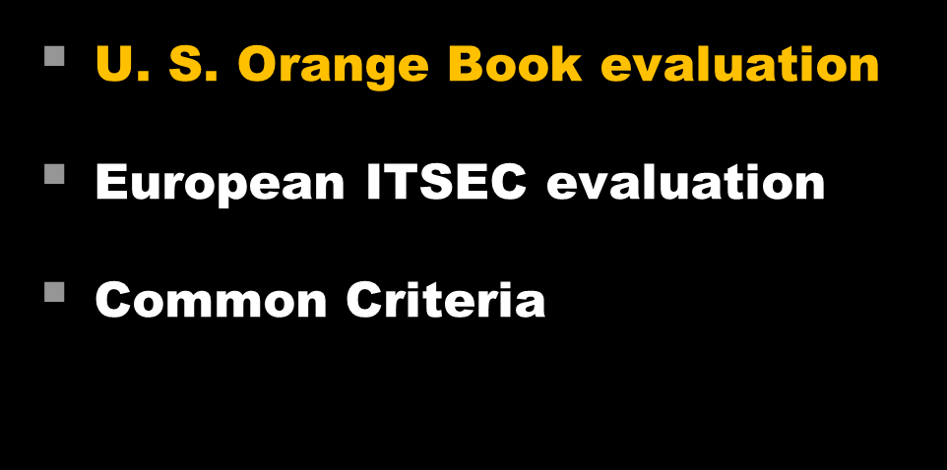
Evaluation Approaches
11/19/12
UB Fall 2012
Lec 37.<number>

Slide 45
U. S. “Orange Book” Evaluation
Defined by U. S. Department of Defense (DoD)
A set of distinct hierarchical levels of trust in operating systems
“Orange Book”, the Trusted Computer System Evaluation Criteria (TCSEC) provides criteria for an independent evaluation
4 levels: A, B, C, D
Within a division additional distinctions are made
11/19/12
UB Fall 2012
Lec 37.<number>

Slide 46
U. S. Orange Book:
Clusters of Ratings
Class | Requirement
D | Minimal Protection
C1 | Discretionary Security Protection
C2 | Controlled Access Protection
B1 | Labeled Security Protection
B2 | Structured Protection
B3 | Security Domains
A1 | Verified Design
11/19/12
UB Fall 2012
Lec 37.<number>

Slide 47
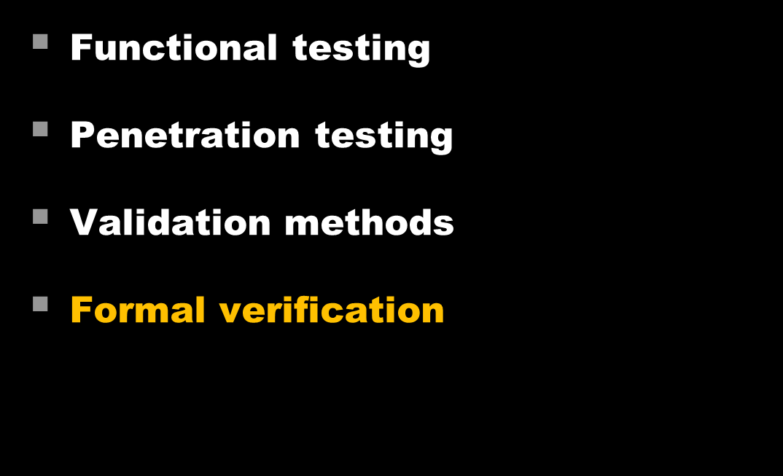
Assurance Methods
11/19/12
UB Fall 2012
Lec 37.<number>

Slide 48

Assurance Method:
Formal Verification
11/19/12
UB Fall 2012
Lec 37.<number>

Slide 49
Software Model Checking
The algorithmic analysis of programs to prove properties of their executions
Provides the conceptual framework and algorithmic procedures to formalize fundamental questions and to analyze logical questions
Based on logic proving and theorem proving approaches
Examples of execution-based tools
  Verisoft, JavaPathFinder, MaceMC, Cmc, Chess
Examples of abstraction-refinement-based tools
  Slam, Blast, Magic, F-soft
11/19/12
UB Fall 2012
Lec 37.<number>
Notes:
Reference: R. Jhala and R. Majumdar “Software Model Checking”, ACM Computing Surveys, Vol. 41, No. 4, Article 21 (October 2009)
Since we do not use Model checking for formal verification of separation kernel, we do not elaborate the model checking approach

Slide 50

Automated Theorem
Proving (ATP)
11/19/12
UB Fall 2012
Lec 37.<number>
Notes:
Material drawn from University of Miami
“An Overview of Automated Theorem Proving”
Courtesy: Dr. G. Sutcliffe,

Slide 51
Model Checking vs.
Theorem Proving
Model Checking Approach | Theorem Proving Approach
Represents knowledge as a local state in some structure | Represents knowledge by a collection of formulas in some language
Is more appropriate when we know what models should look like and can describe them precisely | Is more appropriate when we do not know what the models look like and the best way to describe them is by means of axioms
We may need more powerful languages for describing a situation than those needed for describing the properties | Assumes that the language for describing the situation is the same as the language for describing the properties of the system
Is more flexible in the sense: it lets us model the assumptions in some way | Less flexible
11/19/12
UB Fall 2012
Lec 37.<number>
Notes:
Reference: Joseph Halpern and Moshe Vardi “Model checking vs. Theorem proving: a manifesto”, IBM Almaden Research Center, 1991
In simple terms, model checking uses finite automata model and performs exhaustive search, and Theorem proving is basically a logic proof approach from axioms of the system.

Slide 52
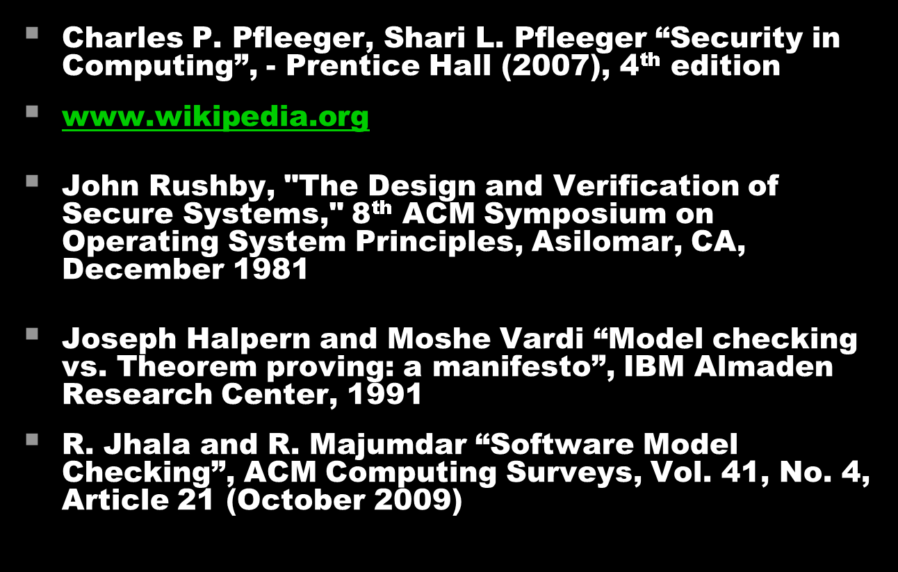
References
11/19/12
UB Fall 2012
Lec 37.<number>

