Slide 1

CSE565: Computer Security
Lecture 42
Program Security
Shambhu Upadhyaya
Computer Science & Eng.
University at Buffalo
Buffalo, New York 14260
11/30/12
UB Fall 2012
CSE565: S. Upadhyaya
Lec 42.<number>

Slide 2
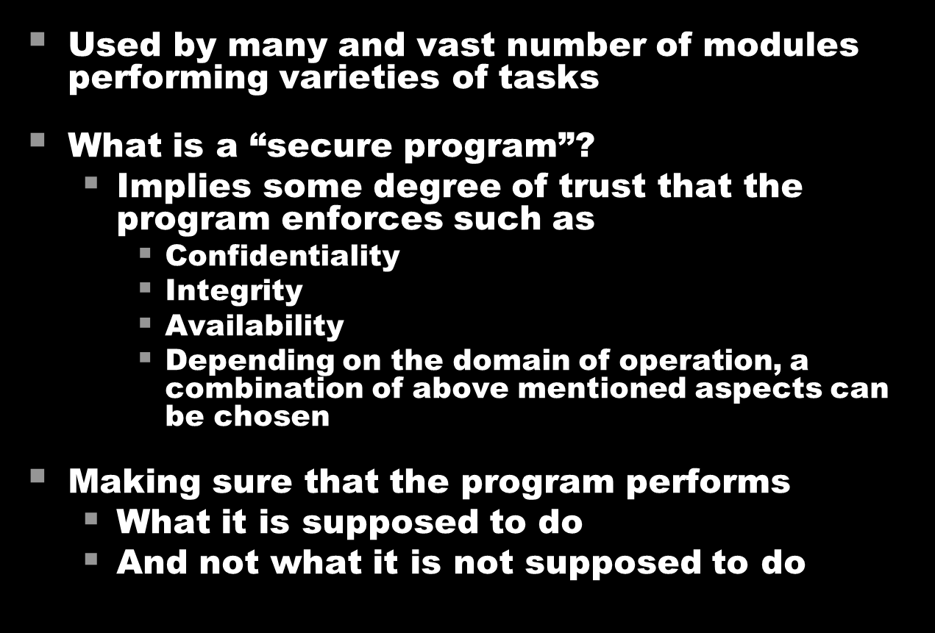
Need for Securing Programs/Code
11/30/12
UB Fall 2012
Lec 42.<number>

Slide 3
Types of Flaws
Landwehr et al. presentation on “Taxonomy of Programming Flaws”
  Intentional
    Denial of service (DoS) attacks
    Malicious
      Trojan Horse
      Trap door
      Logic/Time bomb
    Non-Malicious
      Covert channel
  Inadvertent
    Validation error: Permission checks
    Domain error: Control access to data
    Serialization and aliasing: Program flow order
    Inadequate identification & authentication: authorization
    Boundary condition violation
    Exploitable logic errors
11/30/12
UB Fall 2012
Lec 42.<number>
Notes:
A Taxonomy of Computer Program Security Flaws
CARL E. LANDWEHR, ALAN R. BULL, JOHN P. MCDERMOTT, AND WILLIAM S. CHOI
Information Technology Division, Naval Research Laboratory, Washington, D. C. 20375-5337

Slide 4
Non-Malicious Errors:
Buffer Overflow
Buffer overflow, or buffer overrun, is an anomaly where a program, while writing data to a buffer, overruns the buffer's boundary and overwrites adjacent memory
Programming languages like C and C++ provide no built-in protection against accessing or overwriting data in any part of memory and do not check whether data written to an array is within the boundaries of that array
Boundary checking can prevent buffer overflows
11/30/12
UB Fall 2012
Lec 42.<number>

Slide 5
Buffer Overflow Example
Consider the code below and the stack structure with 3-cases of input arguments:
#include <string.h>
void foo (char *bar) {
char c[12];
strcpy(c, bar); // no bounds checking...
}
int main (int argc, char **argv) {
foo(argv[1]);
}
11/30/12
UB Fall 2012
Lec 42.<number>
Notes:
Source: wikipedia, http://en.wikipedia.org/wiki/Stack_overflow

Slide 6
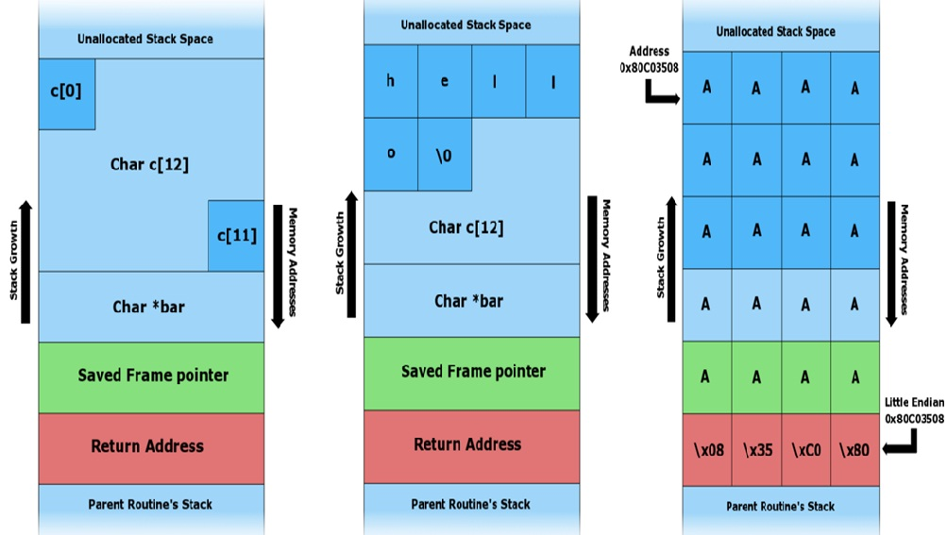
Buffer Overflow
A. - Before data is copied
B. - "hello" is the first command line argument
C."A​A​A​A​A​A​A​A​A​A​A​A​A​A​A​A​A​A​A​A​\x08​\x35​\xC0​\x80" is the first CL argument
11/30/12
UB Fall 2012
Lec 42.<number>

Slide 7
Malicious Code
Virus
Worm
Rabbit ( a program that creates multiple copies of itself)
Trojan horse
Trap door
Logic bomb
  Time bomb
11/30/12
UB Fall 2012
Lec 42.<number>
Notes:
Rabbit is a kind of DOS attack

Slide 8
Virus
A program that can pass on malicious code to other non-malicious programs by modifying them – biological metaphor
Attaches itself to the program and either destroys it or co-exists with it
Types
  Transient Virus: Has life that depends on the life of the attached program
  Resident Virus: Resides in memory
11/30/12
UB Fall 2012
Lec 42.<number>

Slide 9
Virus Attach: Appended
Virus
₌
Original Program
₊
Virus Code
Virus Code
Original Program
11/30/12
UB Fall 2012
Lec 42.<number>

Slide 10
Virus Attach: Surround a Program
Virus Code
Part a
Original Program
Original Program
Virus Code
=>
Virus Code
Part b
11/30/12
UB Fall 2012
Lec 42.<number>

Slide 11
Virus Attach: Integrated Virus
₊
₌
Original Program
Original Program
Virus Code
Virus Code
Virus Code
Virus Code
Virus Code
11/30/12
UB Fall 2012
Lec 42.<number>

Slide 12
Detecting Virus
Based on the signature
  Polymorphic virus makes the process harder
Tracking storage patterns
Execution patterns
Transmission patterns
  Boot process
  Disk access
  Network connections
Examples of virus
  Brain virus (1986), Melissa (1999)
11/30/12
UB Fall 2012
Lec 42.<number>
Notes:
Brain virus infects boot sector of the device
Melissa is mass-mailing mail virus – Outlook Express

Slide 13
Other Malicious
Programs/Code - 1
Worm
  Program that spreads copies of itself through a network
  Also copies itself as the standalone program
  Worms spread through network while viruses spread through any medium (usually thru copied programs or data files)
  Examples of Worm
    Morris worm (1990), Code Red (2001), Blaster (2003), Stuxnet (2010)
Trap door
  The undocumented entry to the system inserted during the code development
11/30/12
UB Fall 2012
Lec 42.<number>

Slide 14
Other Malicious
Programs/Code - 2
Trojan horse
  Malicious code that offers the required functionality at the same time performing some hidden work as well
Logic bomb
  Malicious code that detonates or goes off when specific condition occurs
11/30/12
UB Fall 2012
Lec 42.<number>

Slide 15
Control Against
Program Threats
Developmental controls
  Nature of software development (Software Engineering)
  Modularity, encapsulation and information hiding
  Hazard analysis
  Proper testing
  Configuration management
  Lesson from mistakes
11/30/12
UB Fall 2012
Lec 42.<number>

Slide 16
Covert Channels
It is any communication channel that can be exploited by a process to transfer info in a manner that violates system’s security policy
A built-in Trojan horse is used to get data by a programmer who is deceptive
Why would one set up a covert channel?
  Gain some benefit, illegally
Legitimate User
Service Program
Spy
Protected Data
11/30/12
UB Fall 2012
CSE565: S. Upadhyaya
Lec 42.<number>

Slide 17
How to Create Covert Channels?
In many not-so-obvious ways
  Short message is binary 0, long message is 1
  Total vs. totals in a table
  No. of spaces after :
  Last digit in field that would not be checked
  No space after last line of a subtotal
  Last digit in insignificant field
  No. of lines per page
  Use of . Instead of :
11/30/12
UB Fall 2012
CSE565: S. Upadhyaya
Lec 42.<number>

Slide 18
Storage and Timing Covert Channels
Storage Channels
  Pass info by presence or absence of objects in storage
  An example is the file lock channel
  When you write, your file is locked so that nobody else can write at the same time
  This file lock, unlock can be used to signal 1 bit of data
Timing Channels
  Pass info by the speed at which things happen
  A service program uses a timing channel to communicate by using or not using an assigned amount of time
  Multiuser system with two users – alternate allocation of time quanta
Identifying covert channels is generally hard
11/30/12
UB Fall 2012
CSE565: S. Upadhyaya
Lec 42.<number>

Slide 19
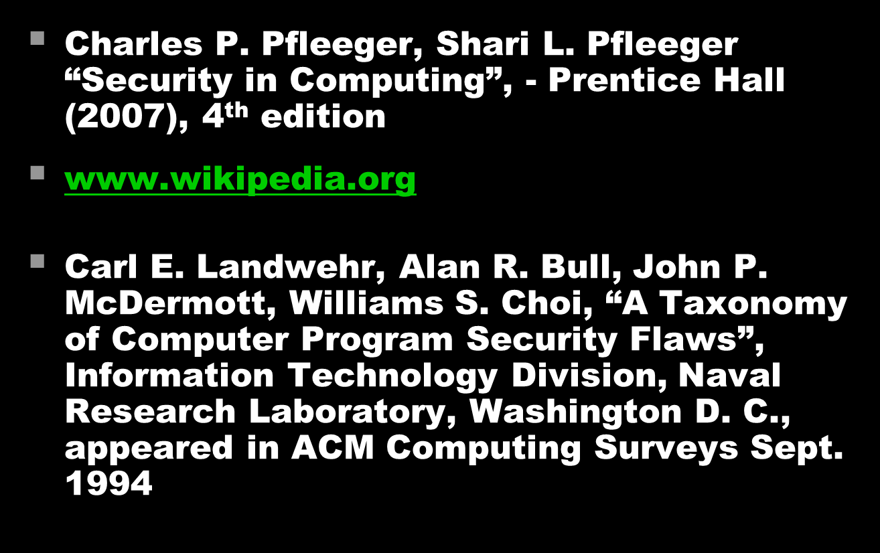
References
11/30/12
UB Fall 2012
Lec 42.<number>

