Slide 1
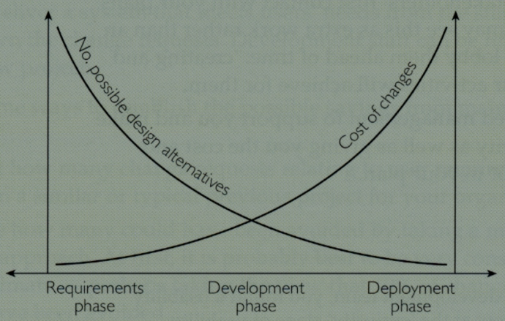
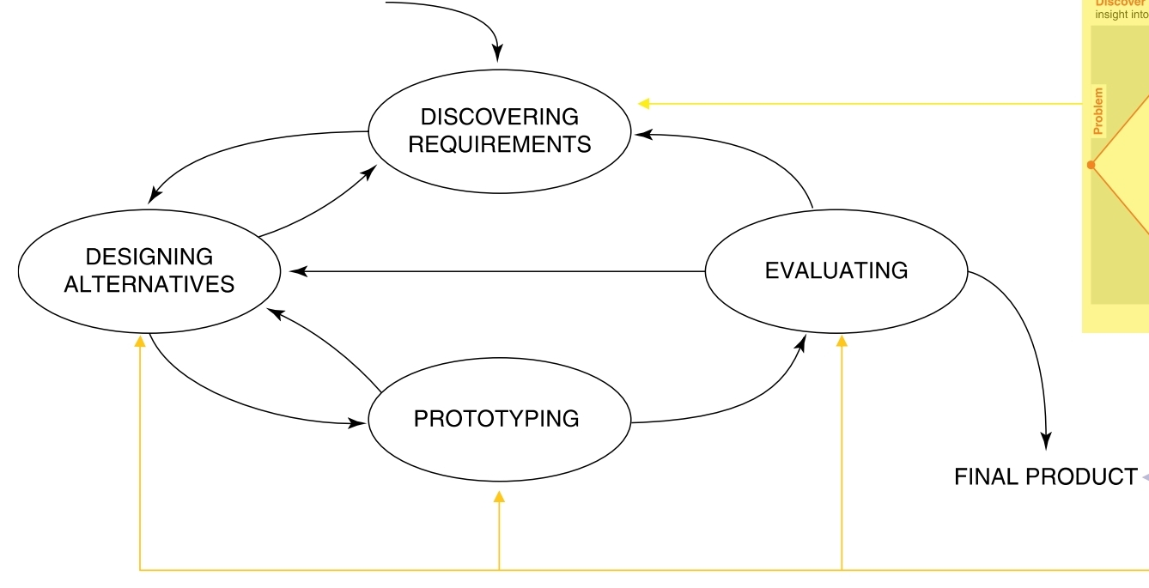
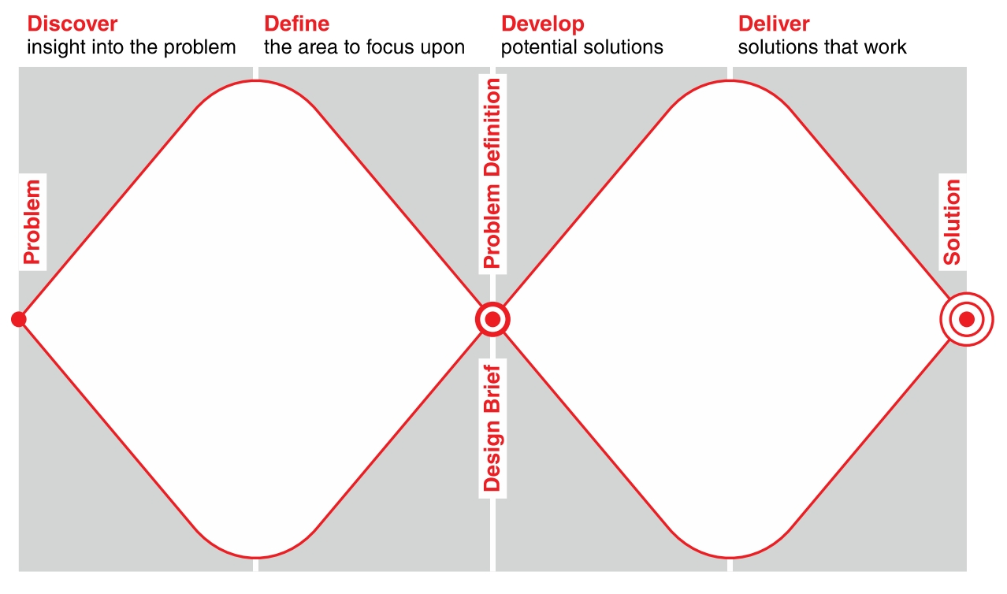
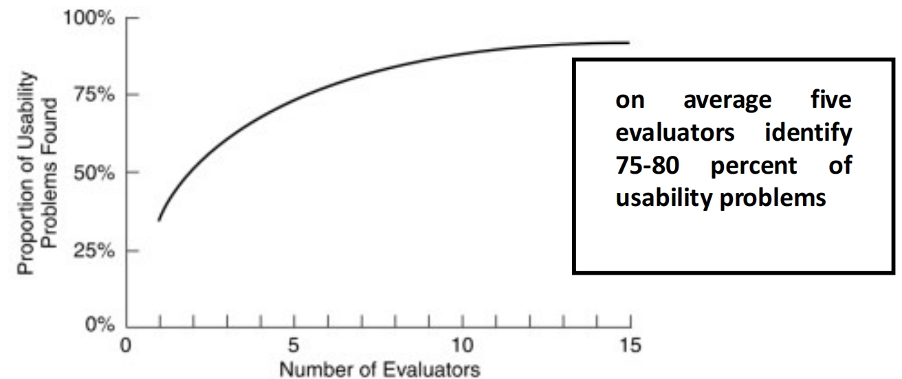
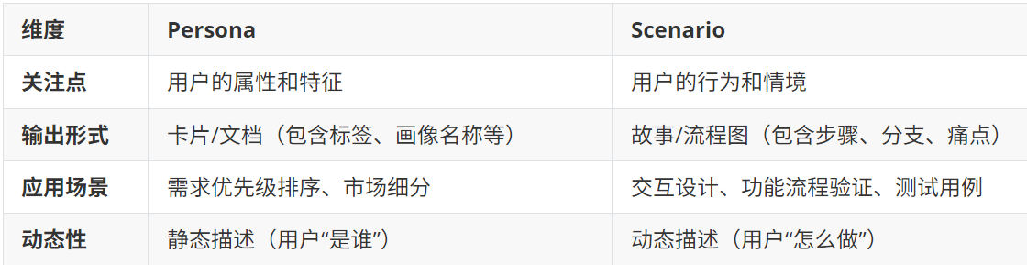
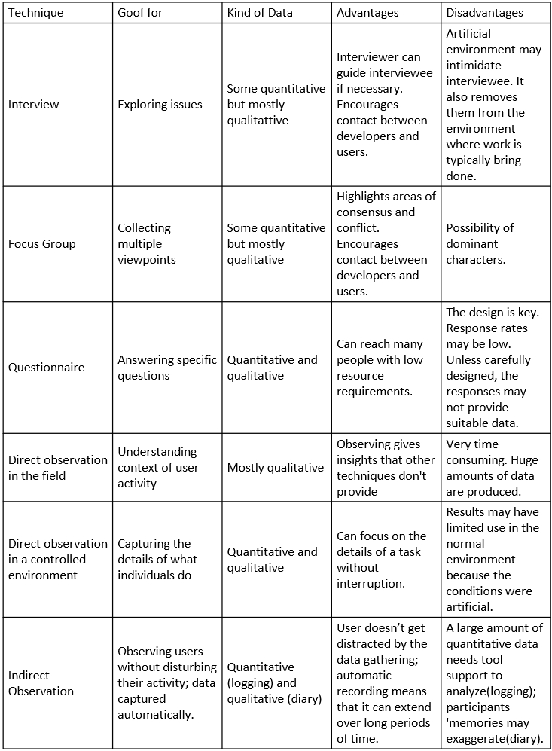
1.Introduction of Interactions:
Definition: Designing interactive products to support the way people communicate and interact in their everyday and working lives. The design of spaces for human communication and interaction.
Terminologies (Interaction design): User interface design (UI), software design, user centered design, product design, web design, user experience design (UX), interactive system design.
THREE Core Characteristics: 1). Users should be involved throughout the development of the project; 2). Specific usability and user experience goals need to be identified, clearly documented, and agreed to at the beginning of the project; 3). Iteration through the core activities
Importance of involving users: 1). Understanding of users’ goals leading to better products; 2). Expectation management; 3). determine ownership
Degree of User Involve: 1). Full-time; 2). Part-time; 3). Participatory design[involve all stakeholders in the early stages of design]; 4).face-to-face interviewee; 5). Online contributors; 5). User after release.
Usability Goal: 1). Effective to use (effectiveness) – how good it is; 2). Efficient to use (efficiency) – how
easy / fast it is; 3). Safe to use (safety); 4). Have good utility (utility); 5). Easy to learn (learnability)→ is more
objective: how useful or productive a system is from its own perspective.
User experience Goal: safisfying / enjoyable / helpful / boring / unpleasant → is more subjective: how users
experience an interactive product from their own perspective.
The process of interaction design:
FOUR Basic Activities of Interaction Design*: 1).Discovering requirements for the interactive product. 2).Designing alternatives that meet those requirements. 3).Prototyping the alternative designs so that they can be communicated and assessed. 4).Evaluating the product and the user experience it offers throughout the process.
[It is a user-centered design approach]
Double Diamond Design: Are there problems with an existing product or user experience? If so, what
are they? discover2. Why do you think there are problems? define 3. How do you think your proposed
design ideas might overcome these? develop 4. If you are designing for a new user experience, how do
you think your proposed design ideas support, change, or extend current ways of doing things? deliver
Practical Issues in Interaction Design
THREE User-centered Approaches Principals: 1).early focus on users(user/stakeholders) and tasks: directly studying cognitive, behavioral, anthropomorphic, and attitudinal characteristics[Users’ tasks and goals,
Users’ characteristics, who are targeted users?/what are their need? Users are consulted throughout development from earliest phases to the latest]; 2).Empirical measurement实证测量[users’ reactions and performance to scenarios, manuals, simulations, and prototypes are observed, recorded, and analyzed]. 3.Iterative design: when problems are found in user testing, fix them and carry out more test.
Users&Stackholders: Users are not always obvious[Many products are intended for use by large sections of the population, so user is “everybody”] Stackholders[The individuals or groups that can influence or be influenced by the success or failure of a project/Larger than the group of direct users]
Issues about Users’ Need: Users rarely know what is possible → instead, Explore the problem space/Investigate who are the users/Investigate user activities to see what can be improved/Try out ideas with potential users ➔ Focus on peoples’ goals, usability, and user experience goals, rather than expect stakeholders to clearly express requirements; Dis: managing deep and continuous user involvement can sometimes be time-consuming or require careful facilitation引导 to extract actionable insights
2. Dicovering Requirements
What, How&Why: 1). What: Explore the problem space to gain insights, Establish a description of what will be developed; 2). How: capture requirements from: prototypes, operational products, structured notations. Key requirements maintain explicit.
Requirements: A statement about an intended product that specifies what it is expected to do or how it will perform.
Different Forms and Level: Atomic requirement shell/user stories
Different Kinds of Requirements: Functional[what system should do, e.g. the system support both PC and mobile]/Non-functional[characteristics (constrain) of product, e.g. as a video game, it can run on several platforms]
SIX Common Types of Requirements: Functional / Data: What kind of and How will they be stored / Environment / Users characteristics [educational background, nationality, attitude, System use(novice, expert), profile]/ Usability goals / User experience goals
SEVEN Product Dimensions: User / Interface / Action / Data / Control / Environment / Qualitive Attribute
Requirement Gathering Techniques: the key to successful data gathering is to design right questions in questionnaire and listen carefully of interviewee’s feedback; Observation [direct and Indirect]; Interviews [individual and group. Overview → transition → main interview → wrap up → immediate analyzation]; Diaries; Surveys; Questionnaire; Think-aloud evaluation思维发声[用户边用边表达想法]; Working prototype evaluation; Studying documentation; Evaluating other systems; Research similar products; Ethnographic study; Usability tests; Context Inquiry process [part of context design. four main principles: context, partnership, interpretation, focus]
Brainstorm for Innovation: participants from wide range of disciplines; don’t stop silly; Keep record ideas
Bring requirements to life: Personas: capture characteristics of typical users that are relevant to the
product(name, characteristics, goals, personal background)under development, Synthesised from real people based on user research, develop a small set of personas with one primary
[用一个主要角色开发一组近似的人物角色]帮设计师做决策，指明目标用户群。
Scenarios: define when, where and how the story of the persona takes place [指明使用场景]. The scenario is the narrative(情节)that describes how the persona behaves as a sequence of events 比如：异地好友难过时，tony 点击对方头像，播放音乐来安抚好友
Use Case: Use cases are step-by-step descriptions of interactions, user stories focuses on outcomes and user goals. Two styles: essential use cases: no detail / use case with normal and alternative courses [提供替代方案, 如不同的错误处理方式]: more detail;
3.Conceptual Prototyping and Practical Guide
THREE Characteristics (Commonalities共性)*: cheaper & faster / Easier to communicate / direct feel.
What is Prototype: Nothing is ever completely finished, each thing that you make or activity you do can be improved. Instead of an object, prototype is more a way of thinking and receiving feedback for practical improve.
Why Prototype(Functionalities): 1).Evaluation and feedback are central to interaction design / 2).Stakeholders can see, hold, interact with a prototype more easily than a document / 3).Prototypes answer questions, and support designers in choosing between alternatives / Team members can communicate effectively / Test out ideas/Reflection
Reason1.Prototype Help User Understanding: 1). understand design alternatives: No one sure whether their current choice is the right or wrong one. So, make many and try many; 2).understand strategy: make your design from intangible to tangible to know the pros and cons[can analyse based on other designs]. 3). understand user-centred processes [Prototype could build empathy 共鸣 between designers and users with concrete ideas，user-centered design tools includes empathy map and user journey map]
Reason2.Prototype Help Communicate: In same language(视觉化的沟通方式，使得不同背景的人用相同的方式理解和讨论，能够保证在设计整个周期内都保持相同的要求 ) /to different stakeholders [Investor(highlights, potentials), factory(materials, scales), user(elderly(caring?), child(warmth?), male or female(cost?)] / No “maybe” [could save efforts in determining style, size, colour, and interactions through observable objects and peer discussion 避免模棱两可的语言，能够明确表达设计意图和功能，使得讨论和决策基于具体、可见的内容]
Reason3.Prototype Helps Test and Reflection: Examine and improve the current design; 1). Hypotheses and assumptions: when we begin the design, we have to make assumptions no matter how hard we try to understand users. The only way to find the answer is to let them play with a mock system, like you need to practice before the presentation. 因为在项目最开始我们往往需要做出假设: User can find the way to specific function / The information displayed straightforward / User could understand the UI and texts / User needs could be fully satisfied within this page; 2). other’s comments: The prototype is an opportunity for you to present and promote the idea to peers, and reflect on the availability and values from different perspectives within design group, not just limit to collect from users.
Empathy Map:帮助设计师深入理解用户的行为、态度和情感, 它包含了四个象限: Say: 用户表达的句子，反应用户的需求和期望, Thinking: 用户内心的想法和感受，Does: 用户的行为和行动，Feels: 用户的情感状态；
Example: 确定目标用户的期望结果→手机定型数据（interview，survey）→分析数据→总结；优势: 提高团队对用户需求的理解，促进决策，帮助设计是发现用户痛点和需求。
User Journey Map: 线性工具，免回用户在使用产品或服务构成中的行为，挑战和期望。记录用户在不同阶段的行为和情感变化，了解用户的旅程。Example: 用户在不同阶段的目标和期望→用户遇到的挑战和障碍→用户遇到的挑战和障碍→用户情感变化和行为模式 ；优势：提供用户与产品互动的和实话，帮帮主设计师优化功能和用户体验，验证设计概念，确保产品满足用户需求。
Fidelity: Definition: refers to how it conveys the look-and-feel of the final product (basically, its level of detail and realism). Select the right level of fidelity in prototyping is the key to the success of design process.
Low-fidelity Prototype(Minimal Viable Prototyping MVP); Tools of Prototype: Uses a medium which is unlike the final medium [paper/cardboard], 优点:Is quick, cheap and easily changed like sketches of screens[草图,use pencil and pen] / Index cards [用于 website development/app] / storyboards [used with series of scenarios, used in early design, showing how a user might progress through a task using the device] / Wizard-of-Oz [developer is responding to output rather
than the system. User is interacting with developer.]
High-Fidelity Prototype : Uses materials that you would expect to be in the final product. Disadvantages: For software-based prototyping maybe there is a slow response/sketchy icons/limited functionality. Compromises 妥协 in prototyping :all prototypes involve compromises(must not be ignored): horizontal(Breath): provide a wide range of functions, but with little detail /vertical(Depth): provide a lot of detail for only a few functions (There are costs and trade-offs with raising or lowering fidelity in any dimension) Lower fidelity may be useless(more detail?), higher fidelity may be time- and money-consuming → fidelity is a spectrum(频谱), no clear separations.
随着项目进程推进，每次更改的花费会显著增加，因此潜在的替代设计会逐步减少。
Design Principles: Based on theory-based knowledge, experience, common-sense. Visibility: 系统状态可见性，操作功能可见性，反馈可见性，约束条件可见性；Feedback: Sending information back to the user about what has been done,
Like sound, highlighting, animation; Constrains: Restrict possible wrong actions that can be performed[鼠标和键盘对应的接口处添加不同icon];
Consistency: 1). Internal: refers to designing operations to behave the same within an application, 2). External: refers to designing operations, interfaces, and so on to be the same across applications and devices, 3). Aesthetic: style and appearance is repeated enhance recognition, communicates membership and sets emotional tone[梅奔=尊贵], 4). Functional: meaning and action are consistent to improve learnability and understanding; Affordance: an attribute of an object that allows people to know how to use it. [scrollbars to enable moving up and down]
Continuum连续体: is a continuous sequence or whole in which noticeably from its neighboring section.
Spectrum: is a range that is a continuous infinite, one-dimensional set.
4. Design Principles and Design Alternatives
Accessibility: the extent to which an interactive product is accessible by as many people as possible. [更侧重于技术和设计上的实现，确保残障用户可以使用]
Inclusiveness: making products and services that accommodate the widest possible number of people. [更宏观，让设计惠及每一个人，消除排斥因素]
{以上两者不光帮助了解 user need, 也有助 user want}
Disability People: 1). Sensory impairment[deaf, lose vision]; 2). Physical[stroke, spine cord injuries];Cognitive[lose memory in old age, weak learning ability]; 以上的种类可以细分: Permanent永久, Temporary间歇, Situational诱发
CONTINUE to steps:
7). 2nd Walkthrough: Evaluators scrutinize individual elements according to the heuristics. They also examine how these fit into the overall design, clearly recording all issues encountered; 8). Debrief evaluators: in a session so they can collate results for analysis and suggest fixes.
Cognitive Walkthroughs(without user):适用于早期设计阶段，可
以在没有真实用户参与, Simulating how users go about problem-solving at
each step in a human-computer interaction. Focus on ease of learning.
Cognitive Walkthroughs Procedures: 1.preparation(Identify and document the characteristics of typical users→ Develop sample tasks→ Produce a description, mock-up, or prototype of the interface to be developed, along with a clear sequence of the actions needed for the users to complete the task); 2). A designer and one or more researchers come together to do the analysis; 3).The researchers walk through the action sequences for each task, placing it within the context of a typical scenario, try to answer three questions(Users know what to do/Users know how to do it/ Users understand the feedback); 4. Compile a record of critical information; 5. (Check with real users and) Revise the design to fix the problems presented.
Three Questions: 1). Will the correct action be sufficiently evident to user? 2). Will the user notice that the correct action is available? 3). Will the user associate and interpret the response from the action correctly?
CONTINUE with questionnaire: Pro: Can collect data from a large number of people (breadth), at a relatively low cost / Can get an overview of a population of users in a short amount of time / Surveys do not require any special equipment/ Surveys are generally approved by institutional review boards because they are typically non-intrusive. / They can be used to collect quantitative data, such as user preferences or behaviors, or qualitative data, like user opinions or suggestions; Cons: good at getting shallow data from a large number of people, not good at getting “deep” data / are usually self
administered, it is usually not possible to ask follow-up questions / can lead to biased data when the questions are related to patterns of usage, or feelings about a previous experience(记忆模糊)(每个人对于’经常’的定义不一样), rather than clear factual phenomena; Deploy: Plan the timeline → Design the questionnaire offline → start/complete online survey -> Test the survey to make sure that it behaves as you would expect -> Test it with a group that will not be part of the survey to check that the questions are clear -> Recruit participants.
Interview: Interview Types: Unstructured: Not directed by a script. Rich but not Replicable; Structured: Tightly scripted, often like a questionnaire. Replicable but may lack richness; Semi-structured: Guided by a script, but interesting issues can be explored in more depth. Can provide a good balance between richness and replicability.(how do you think of our app? "What functionalities would you like to have in an emotion-recording app?); Focus groups: A group interview. Question Types: Close-end: have a predetermined answer format, e.g. “T”, “F”[easy to analyze]. Open: do not have predetermined format; Caution: Avoid Long questions, split compound sentences into Two, no Jargon(行话) and language that may not be understood, Leading questions, Unconscious biases; Deploy: Introduction: Introduce yourself, explain the goals of interview, ethical issues, ask to record, and present the informed consent form. -> Warm-up: Make first questions easy and non-threatening. Build rapport(融洽). -> Main body: Present questions in a logical order. -> A cool-off period: Include a few easy question to defuse tension at end -> Closure: Thanks Interviewee, signal the end.
Number of Evaluators and problems:
图像展示通过不同数量的evaluator进行启发式评估时，发现界面中 usability problem的比例。
Shneiderman’s EIGHT Golden Rules[design principles inform interaction design]: 1). Strive for Consistence: Consistent sequences of actions should be required in similar situations, include Workflows / Functionality / Appearance / Terminology. Importance is reducing learning cost, improve user efficiency and confidence; 2). Enable frequent users to use shortcuts: 熟练用户使用快捷键[copy ctrl+C]，提高他们操作速度. Shortcuts includes: keyboard shortcuts→hidden “power user” features→automations.[右键选择复制指令→快捷键→直接拖拽目标文字]; 3). Offer informative feedback: 及时反馈，用户知道操作结果[进度条，成功或失败的通知]，增强用户控制感，减少不确定性。确保通知 relevant, fits importance and urgency, comprehensible and meaningful, within appropriate context; 4). Design dialog to yield closure: grouping of actions, explicit completion of an action, well-defined options for the next step. Sequence of actions should be organized into groups with a beginning, middle, and end 点开窗口，发消息，窗口关闭; 5). Offer simple error handling: (error prevention, detect the error and offer hints for handling error; 6). Permit easy reversal of actions: (errors can be undone 撤回功能 no interference with workflow,
more freedom for user, single-action undo/action history); 7). Support Internal Icons of Control: make users the initiators of actions rather than the responders to increase their confidence and satisfaction, such as The user commands, the system obeys/ Strongly relies on the informative feedback); 8). Reduce Short Term Memory Load: displays be kept simple, multiple page displays be consolidated(整合), window motion frequency be reduced, distribute enough time to operation workflow.
How to Generate Alternative Design: :‘Flair and creativity’: research and synthesis (可通过研究现有产品的优缺点结合用户反馈，提出多种不同的界面布局)/Cross-fertilization of ideas from different perspectives(结合教育学、心理学、工业设计的知识) /Users can generate different designs(让用户直接提供设计方案)/Product evolution based on changing use(发现某个功能使用频率很高，但用户体验不佳，遂对该功能进行优化)/Seek inspiration: similar products and domain, or different products and domain.
Five Key Issues of Data Gathering: Setting Goals: What information to collect; How to analyze data once collected; Identifying participants: Decide from whom to gather data and how many; Relationship with Participants: should be clear and professional. Informed consent [知情同意] when appropriate; Triangulation: Look at data from more than one perspective; Collect more than one type of data, for instance, quantitative data(定量) from experiments and qualitative data(定性) from interviews; Pilot studies:（试点研究，在进行正式研究前小规模研究）
TEN Heuristic Evaluation 启发式分析 (Nielsen’s Heuristics): 1). Visibility of system status: The design should always keep users informed about what is going on, through appropriate feedback within a reasonable amount of time; 2). Match Between System and Read World: should speak the users' language. Use words, phrases, and concepts familiar to the user rather than jargons, follow natural world conventions and logic; 3). User Control and Freedom: When user perform actions by mistake, system needs to provide a “emergency exit” to abandon unwanted actions immediately; 4). Consistency and Standard: User shouldn’t wonder whether different words situations, or actions mean the same thing. Design should follow field conventions; 5). Error Preventing: Rather than give clear error message, better design idea is preventing error occurs; 6). Recognition Rather than Recall: minimize user’s memory load by making actions, elements and options visible; 7). Flexibility and Efficiency of User: Hidden shortcuts can reduce the interruption to novice users, but these shortcuts will not be removed, because they can speed up expert’s efficiency. Allow users to tailor frequent actions; 8). Aesthetic and Minimalist Design: Google’s minimalist 极简 homepage was
tailored to user’s primary action – search; 9). Help Users Recognize, Diagnose, and Recover from Error: Error message should be expressed in plain language; 10). Help and Documentation.
Issues related to design : 1).How to generate alternative designs; 2). How to choose among alternatives; 3). How to integrate interaction design activities with other lifecycle models.
CONTINUE with interview: Pros: Go depth: encourage reflection and consideration; Flexible: open-ended and exploratory; Cons: Skill to manage / Time and resource intensive / Data analysis / Recall problems; Enrich Interview Method: provide uses with interactive prototype or describe scenarios.
Choosing and Combining Techniques: Focus of the study; Participants involved; Nature of the technique(s); Resources available; Time available.
How to Choose Among Alternatives: 1). .Interaction design focuses on externally-visible and measurable behaviour. (可用性测试: 通过实际测试，观察用户如何与产品交互，记录他们的行为和反馈/性能指标：如任务完成时间、点击率、错误率等); 2). Technical feasibility. 3). Evaluation with users and stakeholders(使用 prototype 给用户体验进行测评 not static document,
behaviour is the key); 4).A/B testing(同时发布两个版本（A 版和 B 版），通过分析用户行为数据，选择用户反应更好的版本); 5).Quality thresholds(需要考虑不同利益相关者的质量标准[amateur和expert 在手机上拍照]，Usability and user experience goals lead to relevant criteria). 下面是三个Evaluation Methods：
5. Heuristic Evaluation, Questionnaire and Interview
Questionnaire: Structure: be closed-ended (are easier to analyze, may be distributed and analyzed by computer) or open-ended. They can be administered to large population; Design(Cautions): The impact of a question can be influenced by question order / may need different versions of the questionnaire for different populations / Provide clear instructions on how to complete the questionnaire / Avoid very long questions; / Decide on whether phrases will all be positive, all negative, or mixed(是否愿意自动检测?是否不愿意增加 dual mode?) / Strike a balance between using white space and keeping the questionnaire compact(紧凑) / promise anonymity/make sure the purpose of study is clear; Format: Yes and No check boxes/Check boxes that offer many options/Rating scales/Open-ended responses; Encourage Engagement: the purpose is clear, anonymity, short version available, we designed questions, incentive.
Doing Heuristic Evaluation(Without User): Briefing session to tell experts what to do→Evaluation period of 1-2 hours in which: Each expert works separately; Take one pass to get a feel for the product; Take a second pass to focus on specific features → Debriefing session(总结会) in which experts work together to prioritize problems.
Advantages and problems: 优点:Few ethical and practical issues to consider because users are not involved; Best experts have knowledge of application domain and users; 缺点: Important problems may get missed; Many trivial problems are often identified, such as false alarms; Experts have biases.
More detailed Procedure with EIGHT Steps: 1). Know what to test and how: Whether it’s the entire product or one procedure, clearly define the parameters of what to test and the objective; 2). Know your users and have clear definitions of the target audience’s goals, contexts, etc: User personas can help evaluators see things from the users’ perspectives; 3). Select 3–5 evaluators: ensuring their expertise in usability and the relevant industry; 4). Define the heuristics (around 5–10): This will depend on the nature of the system/product/design. Consider adopting/adapting the Nielsen-Molich heuristics and/or using/defining others; 5). Brief evaluators on what to cover in a selection of tasks, suggesting a scale of severity codes to flag issues;
6). 1st Walkthrough: Have evaluators use the product freely so they can identify elements to analyze;
TWO Data Gathering Techniques

Slide 2
6.Prototyping Fidelity and Dimensions
Importance of balance the trade-off: 如果使用低保真度，那么我们实际上需要花费更多的时间和精力来通过语言解释我们的项目。而如果一开始就是用高保真度，那么可能会导致前期团队就投入了大量的精力对原型进行设计，导致经历浪费，后期每次更改都会消耗更多的精力。
Five Dimensions in Fidelity and Prototyping*: 1).Visual: how real does it look, It is the most direct dimension that user feels about the prototype; Refers to the devotion(投入) and granularity(粒度) put into the design for visual interfaces and physical objects.; Actions / procedures / concepts for early stage; Accessibility / touch / visual details for later stage; The big, obvious problem involves jumping to high visual fidelity too early in the process; Designers should sometimes intentionally keep visual fidelity low to encourage the kind of communication and feedback they want; 2).Interaction is about How real does it feel? It refers to the objective degree of exactness with which real-world interactions can be reproduced(Users can click, tap, and swipe through screens and get the feel.); It allowed the team to quickly and cheaply test hundreds of variations; 3).Breadth: is about the number of features covered? Choosing where to draw the lines of your prototype’s edges sets up its breadth; 4).Depth: At a given level of breadth, the degree of functionality? /if the interactions are shallow (details)(voice assistant 限制在 weather 领域 (breadth),can ask anything related to weather→deep, can only inquire in major cities→less depth ); 5). Content: the degree of realism for the content(内容是否真实)(High-fidelity content is realistic and relevant to the final application, while low-fidelity content typically uses placeholders or dummy data 虚拟数据或占位符).6). Other dimensions: Autonomy: operates alone vs. requires “supervisor”; Platform: Interim vs. final implementation.
Physical Design: (涉及具体和详细的界面设计和实现细节，将 Conceptualizing design 转化为具体的界面布局(widget)和交互细节,Iteration between physical and conceptual design); Menu design(为了用户能一眼通过menu找到自己想要跳转的页面, How long is the menu, in what order, structure of menu[sub-meuns], how tp categorise, different design on phone or PC, terminology of function); Icon design(Meaning of icons is cultural and context sensitive → always draw on existing traditions or standards; concrete objects or things are easier to represent than actions); Screen design (How to split across screens: Splitting functions across screens: Frustration if too many simple screens. Each screen contains a single step, can open multiple screens at once/Individual screen design: Draw user attention to salient point 突出的点,like animation and good organization); Information display(Relevant information available at all times, Different types of information imply different kinds of display)
Types for Prototyping: throw-away (only serves to elicit user reaction, creation must be rapid) / incremental (product built as separate components (modules) and each component prototyped and tested, then added to the final system)/evolutionary (prototype altered to incorporate design changes, finally becomes the final product) / evolutionary (prototype altered to incorporate design changes, eventually becomes the final product)
Cautions: Rationalize cost-value tradeoffs ➔ Do not oversell – don’t promise capabilities that can’t be delivered, development completeness ➔ Do not overbuild prototype – “good enough” as a prototype [Decide early on exploratory evolutionary properties]
Questions Considered Before Start a Project: What are the main challenges that your prototype means to solve?; what fidelity seems right for your prototype?; What dimensions you need to consider?; What are some possible tools for your project?; What is the trade-off?
9. Usability Testing and Experimental Design
Why, What Where and When to Evaluate*: Why: To check users’ requirements and confirm that users can utilize the product and that they like it. What: A conceptual model, early and subsequent prototypes of a new system, more complete prototypes, and a prototype to compare with competitors’ products. Where: In natural, in-the-wild, and laboratory settings. When: Throughout design; finished products can be evaluated to collect information to inform new products.
HCI Research Methods and Measurement: 1). Micro-HCI: How fast could someone complete a task / How many tasks were completed successfully? / How many errors were made? / Time performance / Task correctness, accuracy / Error rate / Time to learn and retention over time / User satisfaction; 2). Macro-HCI: Motivation / Collaboration / Social participation / Trust / Empathy.
THREE Types of Evaluation Method: 1).Controlled settings that directly involve users: For example, usability and research labs; 2). Natural settings involving users: For instance, online communities and products that are used in public places. Often there is little or no
control over what users do, especially in in-the-wild settings; 3). Setting that does not directly involve users: consultants and researchers critique(评判) the prototypes, and may predict and model how successful they will be when used by users.
Practical Challenges of Evaluation: 确保手机的信息是ethical的. 1).Participants need to be told(get consent) why the evaluation is being done, what they will be asked to do and informed about their rights. 2). An informed consent (知情同意书) forms provide this information and act as a contract between participants and researchers 3). The design of the informed consent form, the evaluation process, data analysis, and data storage methods are typically approved by a high authority, such as the Institutional Review Board(审核委员会). Example: XJTLU University Ethics Committee(UEC)
Interpreting data(数据分析): Reliability: Does the method produce the same results on separate occasions? Validity: Does the method measure what it is intended to measure? Ecological validity: Does the environment of the evaluation distort the results? Biases: Are there biases that distort the results? Scope: How generalizable are the results?
Usability Testing(controlled)*: Controlled setting / Users are observed and timed / Data is recorded on video, and key presses are logged / The data is used to calculate performance times and to identify and explain errors / User satisfaction is evaluated using questionnaires and interviews / Field observations may be used to provide contextual understanding / Involves recording performance of typical users doing typical tasks. [5-10 users for 30min each, 人数取决于: Schedule for testing, availability of participants, cost of running tests, 每个参与者的测试条件都是相同的，并且需要提供Informed consent form].
Quantitative Performance Measures: 1).Number of users successfully completing the task; 2). Time to complete task; 3). Time to complete task after time away from task; 4). Number and type of errors per task; 5). Number of errors per unit of time; 6). Number of navigations to online help or manuals; 7). Number of users making a particular type of error; 8). Count and calculate data.
System Usability Score(SUS): 1). Convert SUS responses to numbers, 1 for “Strongly disagree”, 5 for “strongly agree”; 2). For odd numbered questions, 得分=原始分-1; For even-numbered questions, 得分=5-原始分; 3). 将所有题目转换后的得分相加*2.5 = 总分范围 0~100. Above 68 means over averages.
Usability Testing and Experiments*: 1). Usability testing is applied experimentation; 2). Developers check that the system is usable by the intended user population by collecting data about participants’ performance on prescribed tasks[SUS]. 3). Experiments test hypotheses to discover new knowledge by investigating the relationship between two or more variables
Usability Testing Purpose: Improve products / Few participant / Results inform design / Usually not completely replicable / Conditions controlled as much as possible / Procedure planned / Results reported to developers.
Experiments for Research Purpose: Discover Knowledge / Many participants / Results validated statistically / Must be replicable / Strongly controlled conditions / Experimental design / Scientific report to scientific community.
Experimental Design (controlled)*: Test hypothesis on controlled settings / Predict the relationship between two or more variables / Independent variable is manipulated by the researcher / Dependent variable influenced by the independent variable / Typically experimental designs have one or two independent variables. / Validated statistically and replicable.
Research Hypotheses: An experiment normally starts with a research hypothesis. A Hypothesis is a precise problem statement that can be directly tested through an empirical investigation实证调查.
Type of Hypotheses*: 1). Null Hypothesis*: typically states that there is no difference between experimental treatments; 2). Alternative Hypotheses*: a statement that is mutually exclusive(相互排斥) with the null hypothesis ➔ The goal of an experiment is to find statistical evidence
to reject the null hypothesis in order to support the alternative hypothesis;
Example: 1). There is no difference in academic performance between students who are in relationship and those who are not; 2). There is a difference in academic performance between students who are in a relationship and those who are not.
Another example: Goal: To investigate which AR prototype can better motivate users in learning cultural heritage; Independent Variable: Postcard AR/CubeMuseum AR; Dependent Variable: User Motivation; Hypothesis: H0: There is no difference in user motivation between both AR; H1: There is a difference in user motivation between both AR.
Experimental Design (Plan)*: Between subjects design: Different participants; Single group of
participants is allocated randomly to the experimental conditions (每个条件都是不同的一
组参与者,); Advantage: No order effects; Disadvantage: Individual differences.
CONTINUE with experimental design: Within
subjects design: Same participants; All participants appear in both conditions(一共一组，参
与所有实验条件); Advantage: Few individuals, no individual differences; Disadvantage:
Counter-balancing needed because of order(先进行哪个条件:ABCD/DABC/CDAB/BCDA?)
Experimental Design Lifecycle (Data Collection): 1). Identify a research hypothesis (h0, h1); 2). Specify the design of the study; 3). Run a pilot study(试点研究) to test the design, the system, and the study Instruments; 4). Recruit participants; 5). Run the actual data collection sessions:[Preparation → Greet participants → Introduce the purpose of the study and the procedures → Get consent → Assign participants to a specific experiment condition → Training task(s) → Actual task(s) → Participants answer questionnaires (if any), Debriefing session, Payment]; 6).Analyse the data(sample size/mean value/standard deviation); 7). Report the results.
10. Interfaces and Research Considerations
Interface metaphors*: Interface designed to be similar to a physical entity but also has own properties/ Can be based on activity, object, or a combination of both. / Exploit user’s familiar knowledge, helping them to understand ‘the familiar’.
Example of Interface Metaphors: User actions[surfing on internet] / Using conceptual model as example[the “desktop” of PC and car metaphor(It has familiar form factor; can easily be flicked through, stored, and themed; structure content into meaningful chunk; material properties give the appearance of the surface of paper)] / Visualizing an operation [icon of a shopping cart].
Benefits of Interface Metaphors*: 1). Making learning new systems easier; 2). Helps users understand the underlying conceptual model; 3). Can be very innovative and enable to realm领域 of computers and their applications to be made more accessible to a greater diversity of users.
Problem with Interface Metaphors*: 1). Break conventional and cultural rules; 2). Constrain designers in the way that they conceptualize a problem space; 3). Conflicts with design principles; 4). Forces users to only understand the system based on metaphor. 5). Designers may use bad existing designs and transfer the bad parts; 6). Limit designer’s imagination
FIVE Interaction Type*: 1). Instruction: users instruct a system and tell it what to do, instructing supports quick and efficient interaction, Good for repetitive kinds of actions performed on multiple devices or systems. (e.g. Tell the time, print a file, or save a file, Command Line Interface); 2). Conversing对话: Ranges from simple voice recognition menu-driven system to more complex ‘natural language’聊天大模型 dialogues.[e.g. search engine, chatbox toys, virtual agent].优: Allows users, especially novices, to interact with a system in a way that is familiar to them. 缺: Misunderstandings can arise when the system does not know how to parse user meaning; 3). Manipulating: Exploit user’s knowledge of their move and actions in real world / Involving dragging, selecting, opening, closing and zooming actions / Involve actions using physical controllers(switch) or air gestures(MS kinect); Direct Manipulation(DM): 3个核心原则: a). Continuous representation of objects and actions of interest; b). Rapid reversible action with immediate feedback on object of interest; c). Physical actions and button pressing; Benefit of DM 优: Novices can learn basic usage quickly; experienced users works more efficiency. Intermittent users can retain operational concepts over time. Error messages rarely needed. Immediate feedback. User gain confidence and mastery and feel in control; Drawbacks of DM劣: Moving cursor using a mouse can be slower than pressing function keys (shortcuts)[final all and replace, copy multiply lines]. Some gestures can be more error-prone[更容易出错] than typing[exactly drag picture width to 2cm]; 4). Exploring: Moving through virtual and physical environments / explore all aspects of 3D environment / embedded sensors to collect data set / Users zoom in and out of different parts [VR Museum with a map]; 5). Responding: take the
initiative to alert user to something that it “thinks” is of interest 是系统主动行为，主要从用户当前位置或用户重复的行为进行分析 。当检测到用户情绪突然变化,软件可以主动通知用户这种变化,并给出相应的提示或建议（如深呼吸、放松等）[e.g. Alerts the user of a nearby coffee bar where some friends are meeting; User fitness tracker notifies them of a milestone reached.]
Choose an Interaction Type*: 1). Direct Manipulation good for ‘doing’ types of tasks, e.g. designing[photoshop], drawing[3D建模], sizing window[桌面窗口], driving[游戏操控]; 优: 符合直觉[回收文件到垃圾桶], 及时反馈[日夜模式]; 劣: 学习成本高[CAD], 功能局限性[批量操作100个文件]; 2). Issuing instructions is good for repetitive tasks, e.g. 拼写检查，文件管理; 优: 高效[指令集’mv’], 自动脚本,适合专业用户; 劣: 高门槛[Linux], 容错性滴[rm -rf], 不直观; 3). Having a conversation is good for certain service, e.g. 查找信息; 优: 学习成本低, 包容性强, 语境化; 劣: 模糊处理, 效率瓶颈, 技术限制; 4). Hybrid conceptual models, e.g. 万物物联; 优: 多样性[新手用GUI，高手用 CLI], 容错强[一种模式失败可以直接切换另一种]; 劣: 设计复杂开发难，可能造成混乱，导致用户对操作犹豫.
Interactions: A description of what the user is doing when interacting with a system.
Interfaces: The kind of interface used to support the interaction. [command, gesture, voice, menu-command].
TWENTY Interfaces Types*:
1). Command Line Interface: Commands such as abbreviations typed in at the prompt to which the system responds (for example, ‘ls’ listing current files); Efficient, precise, and fast; Large overhead to learning set of commands / Research Design Consideration: Consistency is the most important design principle[相同类型的快捷键开头相同]. Form, name types and structure are key issues.
2). Graphical user interfaces*：
Window: Sections of the screen that can be scrolled, stretched, overlapped, opened, closed, and moved around the screen using the mouse; Icons: Pictograms that represent applications, objects, commands, and tools that were opened when clicked on.
Cons: uncomfortable. / Research and Design Consideration: How to control interactions and movements. How best to interact with information.
5). Webpage Design:
Concern was with how best to structure information to enable users to navigate and access them easily and quickly. Need to think of how to design information for multiple platforms—keyboard or touch? / Research and Design Consideration: Where am I? Where can I go? What’s here? making pages distinctive, striking, and aesthetically pleasing.
6). Mobile interfaces:
Space needs to be big enough for all fingers to press accurately,手动设置心情设置了三个图标，间距足够大，使用了 Fitts’ law,确保 right spacing.
7). Appliances:
Used for short periods[e.g. washing machines, remotes, toasters, printers, and navigation systems, digital clock and digital camera]. Need to be usable with minimal, if any, learning. / Research and Design Consideration: Need to design as transient interfaces with short interactions. Simple interfaces. Consider trade-off between soft and hard controls, use of buttons or keys, dials, or scrolling.
8). Voice User Interfaces:
Used most for inquiring about specific information, for example, flight times or to perform a transaction, such as buying a ticket / Also used by people with visual impairments, e.g. speech recognition word processors, page scanners, web readers, and home control systems / ‘Barge-in’: Users can choose an option before the system has finished listing all of the options available / Can recover easily from errors / Guide those who have vague request; Research and design considerations: Help people to navigate efficiently through a menu system. Enable them to recover easily from errors. Guide those who are vague and ambiguous in their request. Type of voice (gender, dialect, accent)
9). Pen-based devices: Cons: Allows users to annotate existing documents quickly and easily, sign doc, remote team communicate one shared doc.
A/B testing(without user): A large-scale experiment (thousands of participants or more) / Offers another way to evaluate a website, application of app running on a mobile device/Often used for evaluating changes in design on social media applications / Compares how two groups of users perform on two versions of a design / May create ethical dilemmas if users don’ t know they are part of the test. [AB测试通常是⼀个"between-subjects"设计，也就是说每个参与者只看到⼀个版本（A或B），⽽不是两个版本都看到（这种情况被称为"within-subjects"设计）]
Predictive models(without user): Provide a way of evaluating products or designs without directly involving users, less expensive than user testing; / Use formulas to derive various measures of user performance;/Usefulness limited to systems with predictable tasks, for example, voicemail systems, smartphones, and dedicated mobile devices.
I. Obtaining In-depth Understanding of Requirements for app
Interviews (e.g., Semi-structured):
Purpose: To explore issues in-depth, gaining rich qualitative insights into [target users, e.g., delivery men's] current workflows, pain points, needs, and expectations for [App Name]. This method allows for flexible, open-ended exploration and encourages reflection from participants.
Plan: We will recruit [number and type of target users, e.g., 5-7 experienced delivery men]. Interviews will be guided by a script but allow for deeper probing on interesting issues. The process will involve: an introduction explaining the goals and ensuring informed consent, a warm-up phase, main body of questions focusing on [e.g., current delivery processes, challenges with existing tools, desired features for takeaway app like order management, navigation, communication], a cool-off period, and closure.
Example Questions: [e.g., "Can you describe the most frustrating part of your current delivery process and why?" or "What specific information or tools in an app would make your pickups from restaurants more efficient?"]
Questionnaires:
Purpose: To collect quantitative and qualitative data from a larger and broader audience of [target users] regarding their [e.g., general preferences, frequency of specific activities, perceived importance of potential app features]. This helps get an overview of the user population.
Plan: We will design an online questionnaire featuring a mix of closed-ended questions (e.g., Likert scales, multiple-choice for quantitative data on feature importance) and open-ended questions for qualitative suggestions. Clear instructions will be provided, and participant anonymity will be ensured to encourage honest responses.
Example Questions: [e.g., "On a scale of 1 (Not Important) to 5 (Very Important), how important is real-time earnings tracking in a delivery app?" or "What are the top three challenges you face when navigating to a customer's address?"]
II. Evaluating the Design of app:
What to Evaluate: We will evaluate the conceptual model, early prototypes (e.g., sketches, wireframes), subsequent interactive prototypes, and more complete versions of [Your App Name]. The focus will be on key user tasks such as [User to list 2-3 key tasks, e.g., for delivery app: accepting a delivery order, navigating to a restaurant, marking a meal as picked up, and delivering a meal to a customer].
Where to Evaluate: Evaluations will occur in controlled laboratory settings for initial usability tests and in natural/in-the-wild settings (e.g., during actual delivery routes for delivery app) ensure logical validity.
When to Evaluate: Evaluation will be an iterative process conducted throughout the design lifecycle —from early concepts to refined prototypes, and even after release to inform future versions.
How to Evaluate:
1).Usability Testing (Controlled Setting):
Purpose: To identify specific usability problems, calculate performance times, and assess user satisfaction with [Your App Name] prototypes; Method: Recruit [e.g., 5-10] representative [target users] to perform predefined, typical or predefined tasks on a prototype in a controlled environment. Data to be collected includes task completion time, error rates, task success, and user satisfaction via questionnaires like SUS. Think-aloud protocol may also be used;
2). Field Studies (Natural Setting): Purpose:
To understand how [Your App Name] is used naturally by [target users] and how technology impacts them in their actual environment. This helps evaluate technology in use; Method: Deploy a relatively stable prototype of [Your App Name] to a small group of [target users] for use in their daily activities for a specified period. Data gathering can include diaries, interaction logging from the app (with consent ), and follow-up interviews to discuss their experiences.
3). Heuristic Evaluation (Without Direct User Involvement):
Purpose: To identify usability problems early by having experts review the design against established usability principles (e.g., Nielsen's Heuristics).
Method: Engage 3-5 usability experts to independently examine the interface of [Your App Name]. They will take passes to get a feel for the product and then focus on specific features, followed by a debriefing session to prioritize problems
15).Tangible Interfaces:
Type of sensor-based interaction, where physical objects, for example, bricks, are coupled with digital representations. Pros: 多人浏览，多视角同时观看，Encourages different ways of representing and exploring a problem space. RDC: What kind of coupling to use between the physical action and digital effect[Study or Entertainment]? When a person manipulates the physical object/s, it causes a digital effect to occur)? What kind of physical artifact to use[bricks, cube, stickies, cardboard token].
16). Augmented Reality:
Virtual representations are superimposed on physical devices and objects [medicine: aid physician understands what being examined through X-ray; Air Traffic Control: helps identify planes difficult to make out with real landing, taking off taxiing info]. / RDC: When and where in physical environment? Stand out, but not distract normal routine. How to align with real world? What happen if AR off the track. What device can support AR.
17). Wearable:
Comfort[not get in way], hygiene[still work after laundry], Ease of wear, Usability
18). Robots:
Industry Robot, Social robot, Drone / RDC: Should robots be designed to be human-like or look like and behave like robots that serve a clearly-defined purpose? Ethical issues?
19). Brain-computer Interfaces: 脑机接口
Brain-computer interfaces (BCI) provide a communication pathway between a person’s brain waves and an external device, such as a cursor on a screen.
20). Smart Interfaces:
Context-aware, human-building interactions.
Select Which Interfaces: 1). task, users, context, cost, robustness; 2). Is multimedia better than tangible interfaces for learning?
Continuous : 3). Is speech as effective as a command-based interface? 4). Is a multimodal interface more effective than a mono-modal interface?
11. Field Study and Analytics
Observation(natural/controlled): Direct observation(In the field): How involved you will be/How to gain acceptance/ How to handle sensitive topics like culture, private spaces/How to collect the data. Direct observation(In controlled environments): Think aloud techniques/ Tracking users’ activities; Video, audio, photos, and notes are used to capture data in both direct and indirect observations. Indirect observation: Tracking users’ activities/Diaries/Interaction logging/Video and photographs collected remotely
Field study(natural setting)(e.g: goal is to understand how painpad was used in the natural environment)(Seek to understand what users do naturally and how technology impacts them): (1)Field study used to: Identify opportunities for new technology; Determine design requirements; Decide how best to introduce new technology; Evaluate technology in use; (2)Do field study:
identify goal -> Data collection and participants -> Data analysis and presentation
Analytics(without user): A variety of users’ actions can be recorded by software automatically. Advantages: It is unobtrusive(不显眼) provided the system’s performance is not affected; Large volumes of data can be logged automatically and then explored and analysed using visualization and other tools. Disadvantages: It raises ethical concerns about observing participants if this is done without their knowledge.
补充信息：在AB Test中，⾃变量：在AB测试中，⾃变量是你想要改变和测试的设计元素。例如，你可能 想要测试不同的登录⻚⾯设计（版本A和版本B）；因变量：这是你想要测量的结果。⽐如在登录⻚⾯的例⼦中，因变量可能是⽤户登录的成功率，⽤户在⻚⾯上停留的时间，或者转化率等；Hypothesis：你可能会有⼀个假设，⽐如你可能预期版本B的设计会导致更⾼的⽤户登录成功率; 实验设计：AB测试通常是⼀个"between-subjects"设计，也就是说每个参与者只看到⼀个版本（A或B），⽽不是两个版本都看到（这种情况被称为"within-subjects"设计）; 道德问题：在进⾏AB测试时，需要确保⽤户的隐私和安全。如果⽤户不知道他们正在参与测试，这可能会引发道德问题。为了解决这个问题，你可能需要在⽤户开始使⽤你的产品或服务时，向他们清楚地告知他们可能会成为AB测试的⼀部分。
10). Touchscreen:
Multi-touch surfaces support a range of more dynamic finger tip actions, for example, swiping, flicking, pinching, pushing, and tapping; Supports one and two hand gestures, including tapping, zooming, stretching, flicking, dwelling, and dragging / RDC: Core design concerns include whether size, orientation, and shape of touch displays effect collaboration.
11). Gesture-based System:
Involve moving arms and hands to communicate, uses camera recognition, sensor, and computer vision techniques. / RDC: How does computer recognize and delineate user’s gestures? [star/end point, different gestures(deictic gesture, hand wave), religion/cultural gestures]; The sequence of actions.
12). Haptic Interfaces: 触觉交互
By applying vibration and forces to a person’s body, using actuators that are embedded in their clothing or a device they are carrying, such as a smartphone. / Research and Design Consideration: Where put, Whether to use single or sequence ‘touches’, When to buzz and how intense, Different feels in different contexts, What devices can support vibration.
13). Multimodal Interfaces: 多模态 Provide enriched user experiences, such as touch, sight, sound and speech. Support flexible, efficient, and expressive means of human computer interaction. Combine multi-sensor to track eye gaze, facial expression, lip move. / Research and Design Consideration: Much harder to calibrate these than single modality system. What is the output from combining different input sources.
14). Shareable Interfaces:
Provide a large interactional space that can support flexible group working. / Research and Design: Whether size, orientation, shape of display have an effect on collaboration?
Menus: Lists of options that can be scrolled through and selected. Pointing device: A mouse controlling the cursor as a point of entry to the windows, menus, and icons on the screen. / Window Design: Windows were invented to overcome the physical constraints of a computer display, They enable more information to be viewed and tasks to be performed, Listing, tabbing, and thumbnails are techniques that can help. / Menu style: Flat list, Drop, Pop-up, Contextual, Collapsible. / Research and Design Consideration: How to enables users to move fluidly between different windows (and monitors). How to switch attention between windows without getting distracted. Spacing, grouping, and simplicity should be used. Terminologies. Which menu clear.
3). Multimedia: 多媒体
Combines different media within a single interface with various forms of interactivity[点击链接文字可以播放音乐]; Pros: fast access, present more information, encourage exploring/ Research and design considerations: How to design multimedia to help users explore, keep track of, and integrate the multiple representations; Multimedia good for supporting certain activities, such as browsing, but less optimal for reading at length.
4). Virtual Reality:
The illusion of participation in a synthetic environment rather than external observation of such an environment. Provide new kinds of experience, enabling users to interact with objects and navigate in 3D space; Pros: Can have a higher level of fidelity with objects that they represent compared to multimedia; Induces a sense of presence; first and third person.
Experimental Plan Template
Research Question: Clearly state the main question the experiment aims to answer (e.g., Does Version X of the app offer improved usability compared to Version Y?).
Independent Variable (IV): Identify the variable you will manipulate (e.g., App Version: [Version A] vs. [Version B]).
Dependent Variables (DV): Specify the measurable outcomes that will indicate usability (e.g., Task Completion Time, Error Rate, User Satisfaction via SUS scores ).
Null Hypothesis (H0): State that there will be no statistically significant difference in the DVs between the conditions being tested.
Alternative Hypothesis (H1): State that there will be a statistically significant difference in the DVs between conditions.
Method:
-Participants: Describe the target users and the planned number of participants.
-Experimental Design: Specify the design (e.g., Between-subjects with random allocation, or Within-subjects with counterbalancing).
-Tasks: List key representative tasks users will perform on the system.
-Setting: Describe the controlled experimental environment.
-Procedure: Outline the step-by-step process, including obtaining informed consent, task instructions, any training, and the sequence of data collection.
-Data Collection Measures: Detail how each DV will be recorded (e.g., timing software, observation logs, questionnaires ).
-Data Analysis Plan: Specify the statistical tests that will be used to analyze the data for each DV (e.g., t-tests, ANOVA).
-Interpretation Criteria: Define how the results will be interpreted to support or reject the null hypothesis (e.g., significance level like p < 0.05)
Their primary differences lie in the level of control exerted by the evaluator, the environment of the evaluation (lab vs. real-world), and whether users are directly part of the evaluation session. Types 1 and 2 directly involve users, while Type 3 relies on expert judgment or models. Type 1 offers high control, whereas Type 2 has little to no control. A key similarity is that all three types aim to assess a design or product to identify areas for improvement and provide feedback for the design process.

