Slide 1
Component-based Software Engineering
Soon Phei Tin

Slide 2
Topic
Part 1: Introduction to CBSE
Part 2: Components in Spring Boot: Foundations
Part 3: Component Interfaces, Composition, and Lifecycle
Part 4: Advanced Component Features in Spring Boot
Part 5: Component-Based Architecture with Spring Boot
Part 6: Challenges, Best Practices, and Wrap-Up

Slide 3
Part 1: Introduction to CBSE
CBSE is the software engineering practices that developing software mainly based on software components.
We will focus on three core principles: Components, Interfaces, and Composition
Beyond the core principles, understanding CBSE requires a deeper look at components, component models, and middleware, as well as how they interrelate.

Slide 4
Benefits and Challenges
Benefits
Reusability reduces development time and costs.
Modularity enhances maintainability and scalability.
Easier testing and debugging of isolated components.
Challenges
Dependency management and version conflicts.
Overhead from inter-component communication.
Designing components that are both reusable and specific enough for practical use.

Slide 5
Components
In CBSE, a component is a modular, reusable, and independently deployable unit of software that encapsulates specific functionality and data.
It provides services to other parts of the system through well-defined interfaces, hiding its internal implementation details.
This modularity promotes reusability and maintainability.

Slide 6
Components
Here are the summarized characteristics of components:
Self-contained: Each component encapsulates its own logic and data.
Reusable: Designed to be used across different systems or contexts.
Replaceable: Can be swapped with another component that provides the same interface.
Interface-driven: Interact with other components solely through defined interfaces, promoting loose coupling and high cohesion.

Slide 7
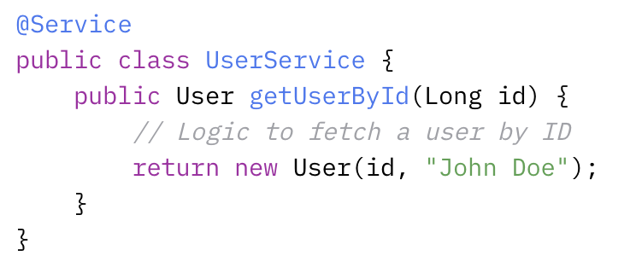
Components in Spring Boot
In Spring Boot, components are typically classes annotated with @Component, @Service, @Repository, or @Controller.
These annotations tell the Spring Inversion of Control (IoC) container to manage the class, handling its instantiation, dependency injection, and lifecycle
UserService is a self-contained component that provides a specific service (fetching user data).
Other parts of the application can use it without knowing how it retrieves the data, aligning with CBSE’s emphasis on encapsulation and modularity.

Slide 8
Interfaces
Interfaces in CBSE define the contract that components must follow.
They specify what services a component provides (and sometimes requires) without exposing its internal workings.
This abstraction enables loose coupling, as components can be swapped out as long as they adhere to the same interface.

Slide 9
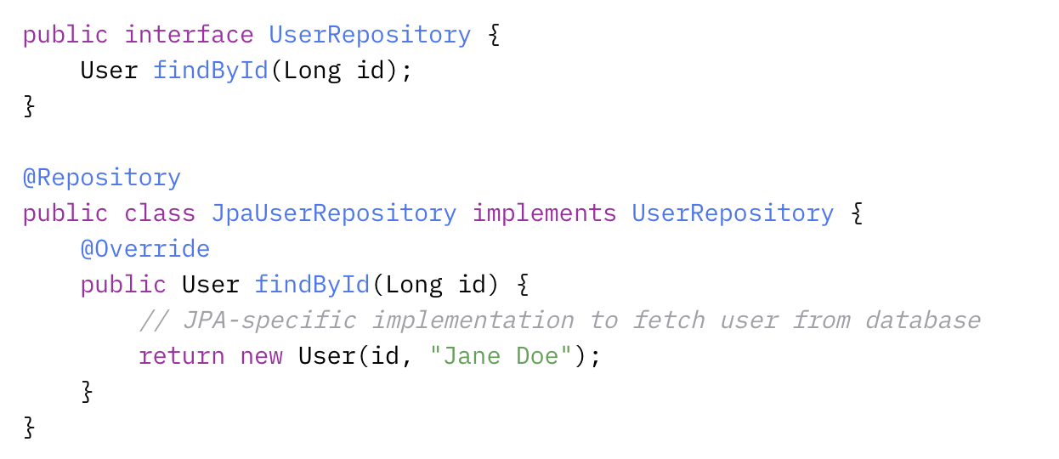
Interfaces in Spring Boot
In Spring, interfaces are commonly used to define service contracts, with concrete implementations injected at runtime.
The UserRepository interface acts as a contract, allowing different implementations (e.g., JPA, JDBC, or in-memory) to be used interchangeably.
This reflects CBSE’s focus on well-defined interfaces for component interaction.

Slide 10
Composition
Composition in CBSE involves assembling components into a complete system by connecting them through their interfaces.
This process leverages dependency relationships to create a functional whole, ensuring that components work together seamlessly.

Slide 11
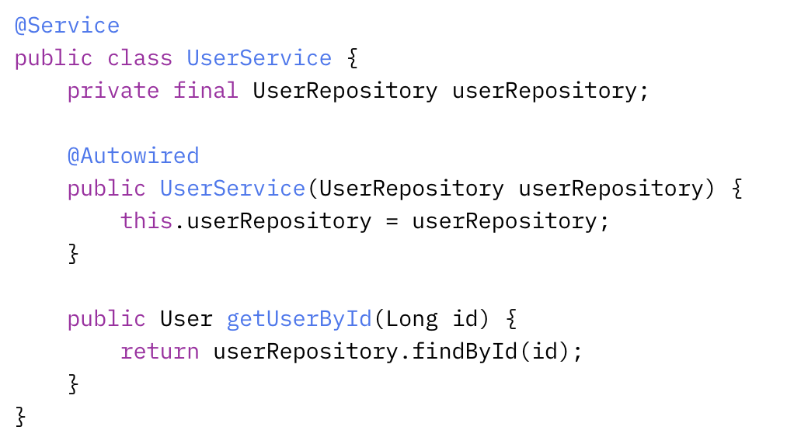
Composition in Spring Boot
Spring Boot uses dependency injection (DI) to compose components.
The UserService is composed with a UserRepository via constructor injection.
Spring’s IoC container manages this composition, connecting the components at runtime based on their interfaces.

Slide 12
Component Models
A component model is a framework or set of standards that governs how components are defined, implemented, and composed.
It provides:
Conventions: Rules for creating components (e.g., how to specify interfaces).
Interaction Mechanisms: How components communicate (e.g., method calls, events).
Lifecycle Management: How components are instantiated, used, and destroyed.

Slide 13
Component Models
Examples of component models include
  Enterprise JavaBeans (EJB)
  Microsoft’s COM
  Spring
A component model ensures consistency and interoperability across a system.

Slide 14
Spring Component Model
Relies on Plain Old Java Objects (POJOs) enhanced with annotations:
@Component (and its derivatives) identifies components.
@Autowired specifies dependencies.
Spring Boot’s auto-configuration further simplifies this by automatically setting up components based on classpath dependencies.

Slide 15
Component and Component Models
The component model defines the “rules of the game” for components.
Components are instances that conform to these rules, ensuring they can be managed and composed effectively within the system.

Slide 16
Middleware
Middleware is software that sits between the operating system and applications, providing services that simplify component interaction and system integration.
It handles:
Communication: Enabling components to talk to each other, even across networks (e.g., via RPC or messaging).
Data Management: Abstracting database access or caching.
Infrastructure Services: Offering security, transaction management, or load balancing.

Slide 17
Middleware
In CBSE, middleware acts as the “glue” that supports component composition and execution, especially in distributed systems.
Spring Example:
Spring Data: Acts as middleware by providing a consistent data access layer between components and databases.
Spring Cloud: Offers middleware features like service discovery (Eureka), load balancing (Ribbon), and circuit breaking (Hystrix) for distributed Spring Boot applications.
For instance, a Spring Boot app might use Spring Cloud to connect a UserService component on one server with a UserRepository component on another, abstracting the network complexity.

Slide 18
Components, Component Models, and Middleware
Components and Component Models: The component model defines how components are structured and interact. Components are the concrete realizations of this model.
Components and Middleware: Middleware provides the runtime environment and services that components rely on to function. A component like UserService might use middleware (e.g., Spring Data) to access a database without handling the low-level details itself.

Slide 19
Components, Component Models, and Middleware
Component Models and Middleware: The component model often assumes a specific middleware environment. Spring’s model, for instance, integrates tightly with its middleware (e.g., Spring Cloud), ensuring components can leverage distributed system features seamlessly.
Together, they form a layered system:
Components deliver customized functionality.
Component Models standardize their creation and composition.
Middleware enables their execution and interaction, especially in complex or distributed scenarios.

Slide 20
Part 2: Components in Spring Boot: Foundations
Objectives
Learn how Spring Boot implements CBSE principles.
Understand component definition and basic dependency injection.

Slide 21
Spring Boot Overview
Spring Boot is an extension of the Spring Framework that streamlines the development of production-ready applications by reducing configuration complexity and providing sensible defaults.
Key features include:
Auto-configuration: Spring Boot automatically configures components based on the dependencies present in the classpath.
Embedded Servers: Built-in support for web servers like Tomcat or Jetty allows applications to run without external server setup.
Opinionated Defaults: Provides pre-configured settings for common tasks, which developers can override as needed.

Slide 22
Spring Boot for CBSE
Spring Boot’s architecture is inherently component-based, making it an ideal framework for implementing CBSE principles:
Components are managed by the Spring IoC container, ensuring modularity and reusability.
Dependency injection facilitates loose coupling between components.
Auto-configuration and starter dependencies simplify the integration and composition of components into cohesive applications.

Slide 23
Components in Spring Boot
A component in Spring is any class that is managed by the Spring IoC container. These classes are typically annotated to indicate their role and enable automatic detection by Spring.
Core Annotations:
  @Component: Spring-managed bean.
  @Service: Encapsulates business logic.
  @Repository: Data access component.
  @Controller / @RestController: Components for HTTP requests handling.
Component Registration:
Spring Boot uses a process called component scanning to automatically detect and register components. By default, Spring scans the package containing the main application class and all its sub-packages.

Slide 24
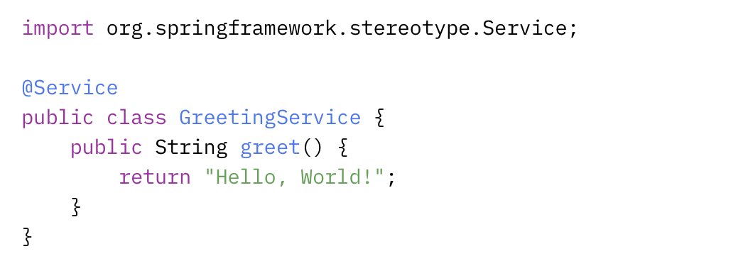
Components in Spring Boot
Example
The @Service annotation marks GreetingService as a component.
Spring Boot detects it during component scanning and registers it as a bean in the IoC container.

Slide 25
Inversion of Control (IoC) Container
The Spring’s component management system, embodying the IoC principle.
In IoC, the framework takes control of creating and managing objects, rather than the application code doing so manually.
Role of the IoC Container:
  Instantiates components (referred to as beans).
  Configures them by injecting dependencies and setting properties.
  Manages their lifecycle from creation to destruction.
  Stores beans in the application context, which serves as the runtime environment.

Slide 26
Dependency Injection (DI)
Dependency Injection is a design pattern where a component’s dependencies are provided by the framework rather than being instantiated within the component itself.
This enhances modularity, testability, and maintainability.
Types of Dependency Injection:
  Constructor Injection: Recommended for mandatory dependencies.
  Setter Injection: Suitable for optional dependencies or runtime changes.
  Field Injection: Direct injection into fields (less preferred due to testability concerns)

Slide 27
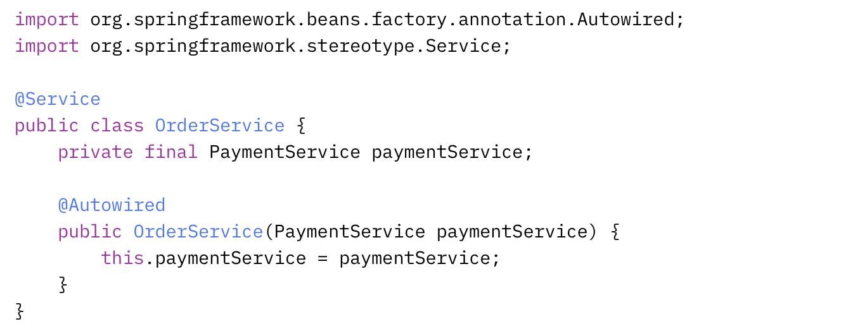
Constructor Injection

Slide 28
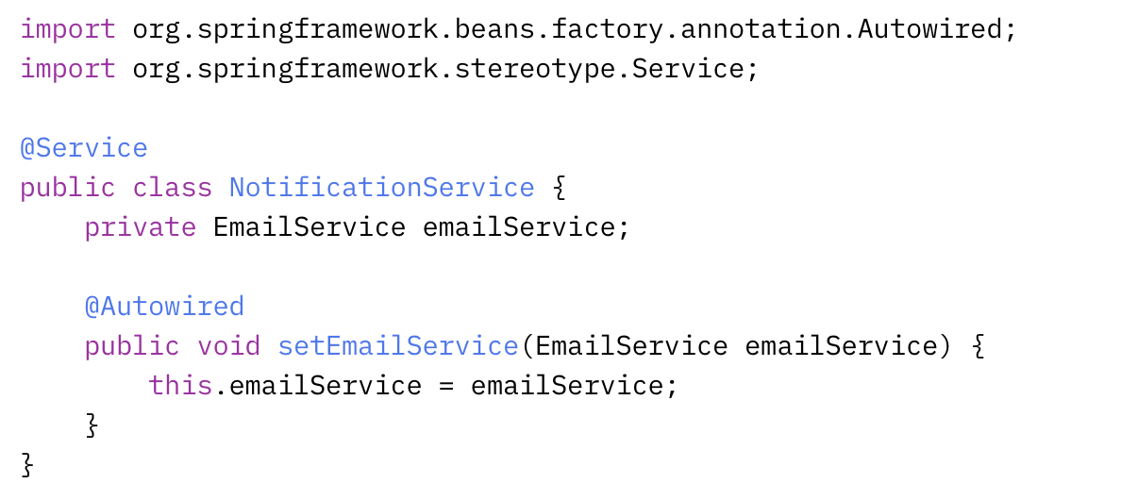
Setter Injection

Slide 29
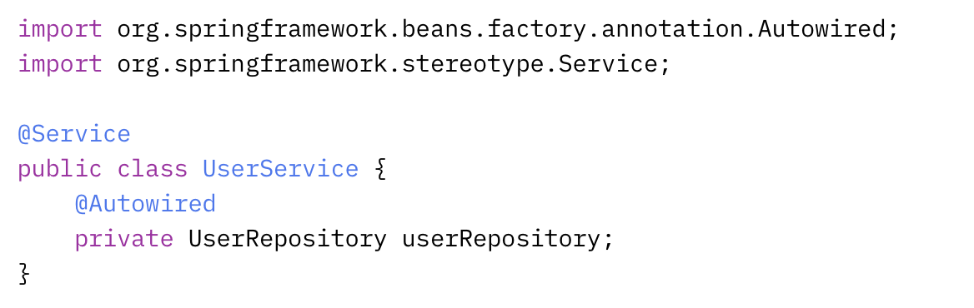
Field Injection

Slide 30
Advantages of DI
Advantages of DI:
  Decoupling: Components are independent of how their dependencies are created.
  Testability: Dependencies can be mocked or stubbed in tests.
  Flexibility: Dependencies can be swapped or reconfigured without altering component code.

Slide 31
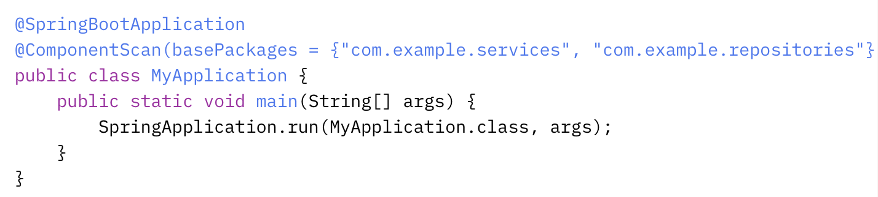
Component Discovery and Customization
Spring Boot’s components are discovered during component scanning, but it also offers customization options for fine-grained control.
Component Scanning: By default, Spring scans the package of the main application class and its sub-packages.
Customize this behavior with @ComponentScan:

Slide 32
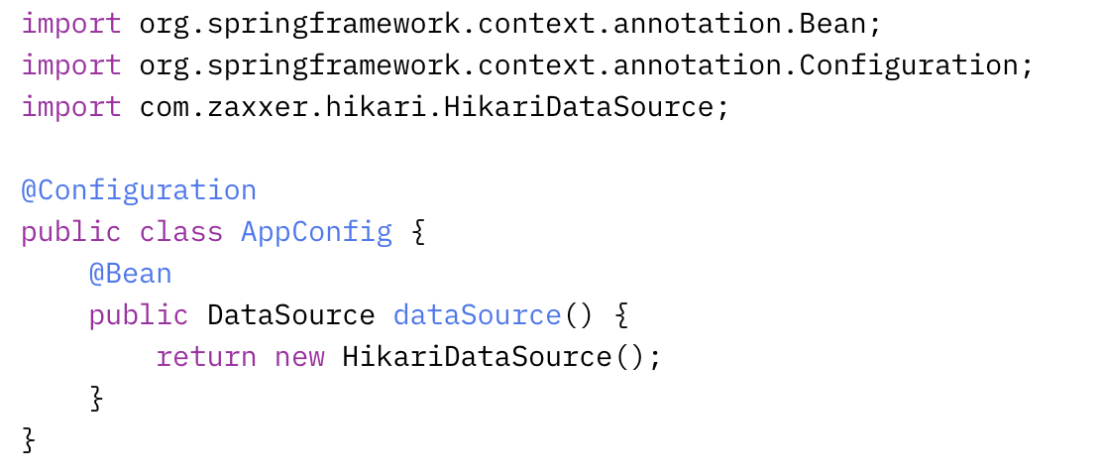
Component Discovery and Customization
Define beans explicitly in a configuration class using @Bean
This approach is useful for third-party classes or when more control is needed

Slide 33
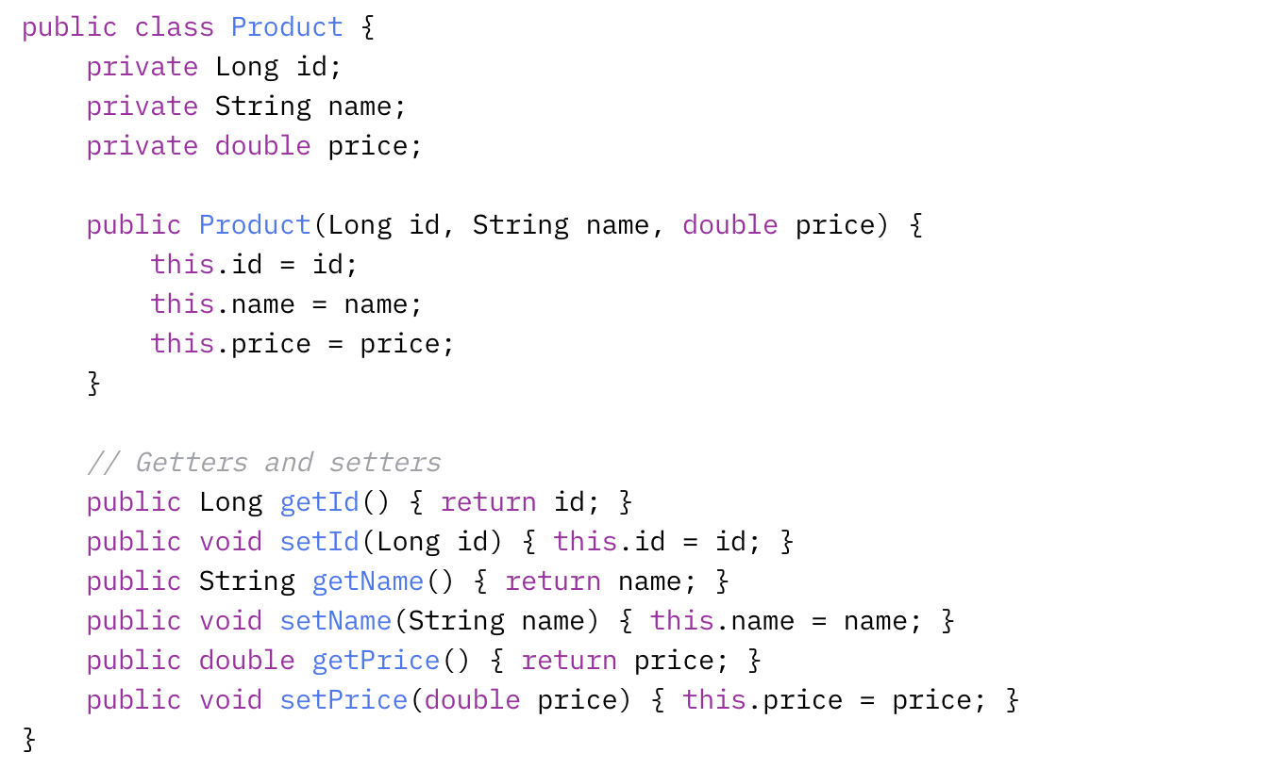
Practical Example: Building a Simple REST API

Slide 34
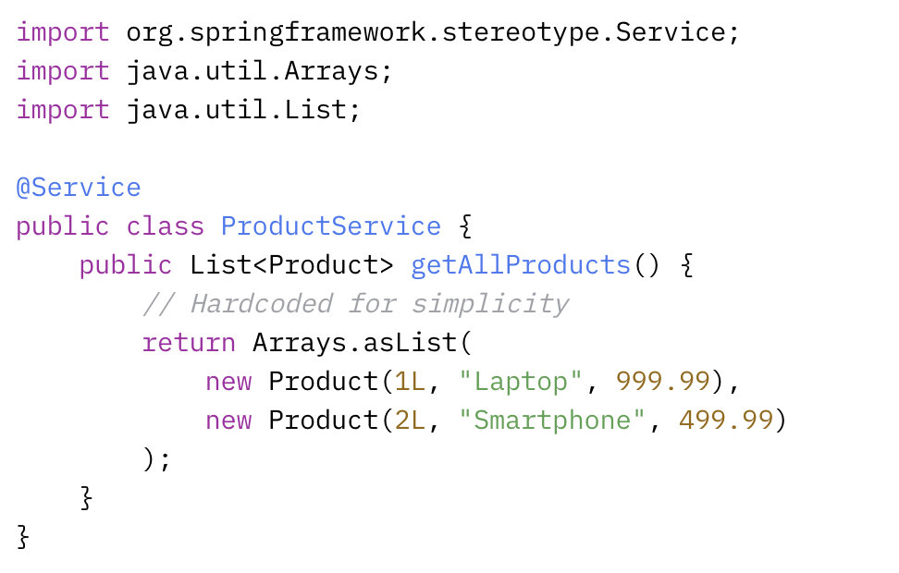
Practical Example: Building a Simple REST API

Slide 35
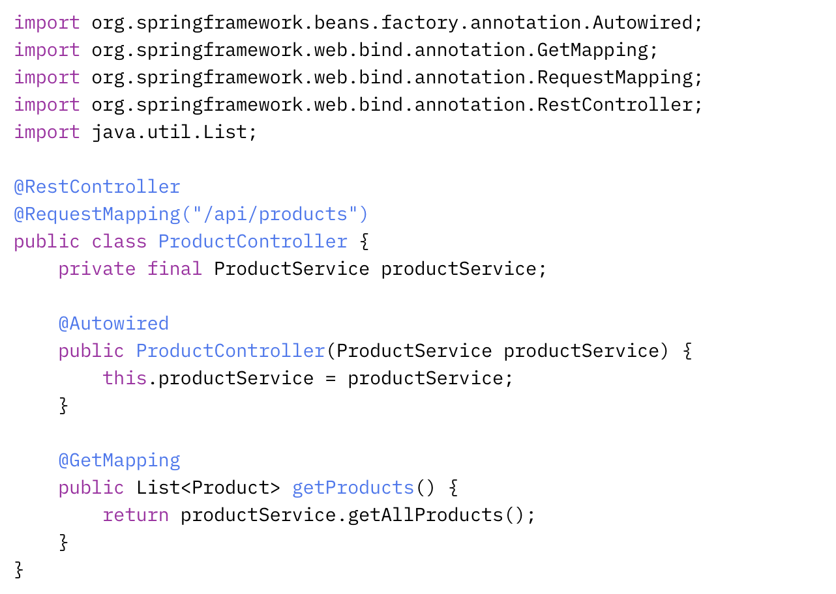
Practical Example: Building a Simple REST API

Slide 36
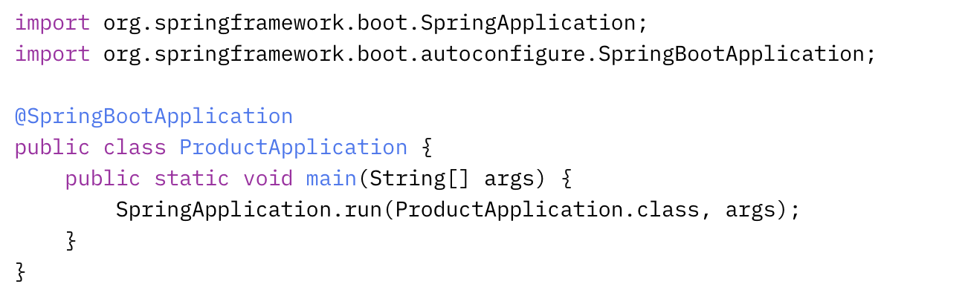
Practical Example: Building a Simple REST API

Slide 37
Part 3: Component Interfaces, Composition, and Lifecycle
Objectives
Understand the use of interfaces for component abstraction.
Explore component composition techniques and lifecycle management.

Slide 38
Interfaces in CBSE and Spring Boot
Interfaces are a cornerstone of CBSE because they establish a contract that components must follow.
This contract specifies what services a component offers (its capabilities) and what it requires (its dependencies).

Slide 39
Interfaces in CBSE and Spring Boot
By defining interactions through interfaces rather than concrete implementations, interfaces enable:
  Polymorphism: Different implementations of the same interface can be swapped seamlessly.
  Loose Coupling: Components depend on abstractions, reducing tight dependencies on specific implementations.
  Testability: Interfaces simplify mocking dependencies during unit testing.

Slide 40
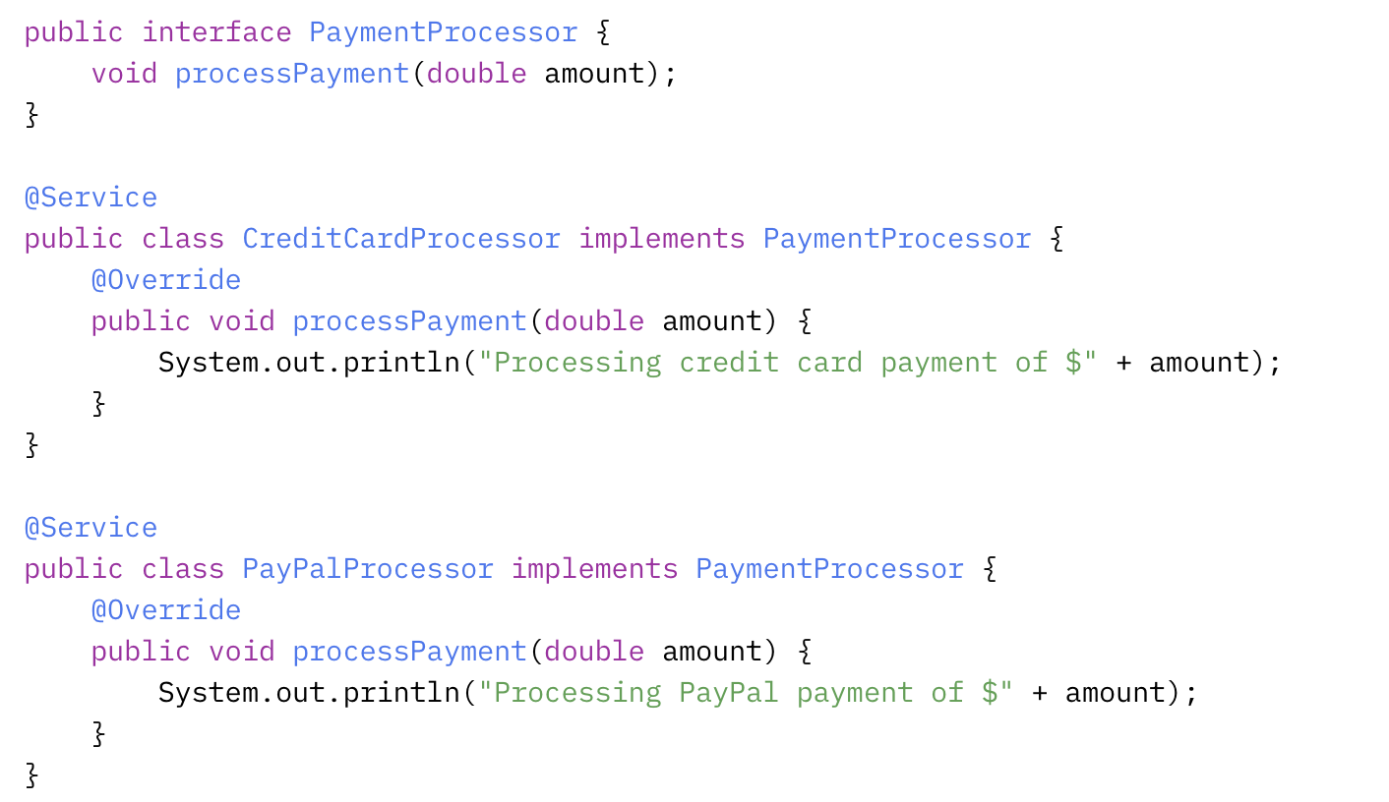
Spring Boot Example: Defining a Service Interface
The PaymentProcessor interface defines a contract for processing payments.
CreditCardProcessor and PayPalProcessor provide concrete implementations that can be used interchangeably.

Slide 41
Benefits of Using Interfaces
Flexibility: Switch between payment processors (e.g., credit card to PayPal) by injecting a different implementation.
Extensibility: Add new payment methods (e.g., CryptoProcessor) without altering existing code.
Testability: Mock the PaymentProcessor interface in tests to isolate dependent components.

Slide 42
Composition Techniques
In CBSE, composition refers to assembling components into a functional system by connecting them through their interfaces.
Spring Boot achieves this primarily through dependency injection (DI), a mechanism where the framework provides a component’s dependencies automatically.
Spring supports several DI techniques, each suited to different scenarios.

Slide 43
Best Practice for Dependency Injection
Prefer Constructor Injection: Use it for mandatory dependencies to ensure immutability and explicitness.
Use Setter Injection Sparingly: Reserve it for optional or reconfigurable dependencies.
Best Practice for Dependency Injection Opt for constructor or setter injection to improve testability and maintainability.

Slide 44
Component Lifecycle Management
Spring Boot’s Inversion of Control (IoC) container manages the entire lifecycle of components (beans), from instantiation to destruction.
Understanding this lifecycle allows developers to perform initialization tasks (e.g., loading resources) and cleanup tasks (e.g., closing connections) at the appropriate stages.

Slide 45
Key Phases of the Component Lifecycle
Creation
  The IoC container creates the bean instance.
  Dependencies are injected based on the chosen DI method (constructor, setter, or field).
Initialization
  After dependency injection, Spring invokes initialization logic.
  @PostConstruct: Annotate a method to run it after the bean is fully constructed.
Usage
  The bean is fully initialized and available for use by other components or services.
Destruction
  Before the application context closes, Spring invokes destruction logic.
  @PreDestroy: Annotate a method to run it before the bean is destroyed.

Slide 46
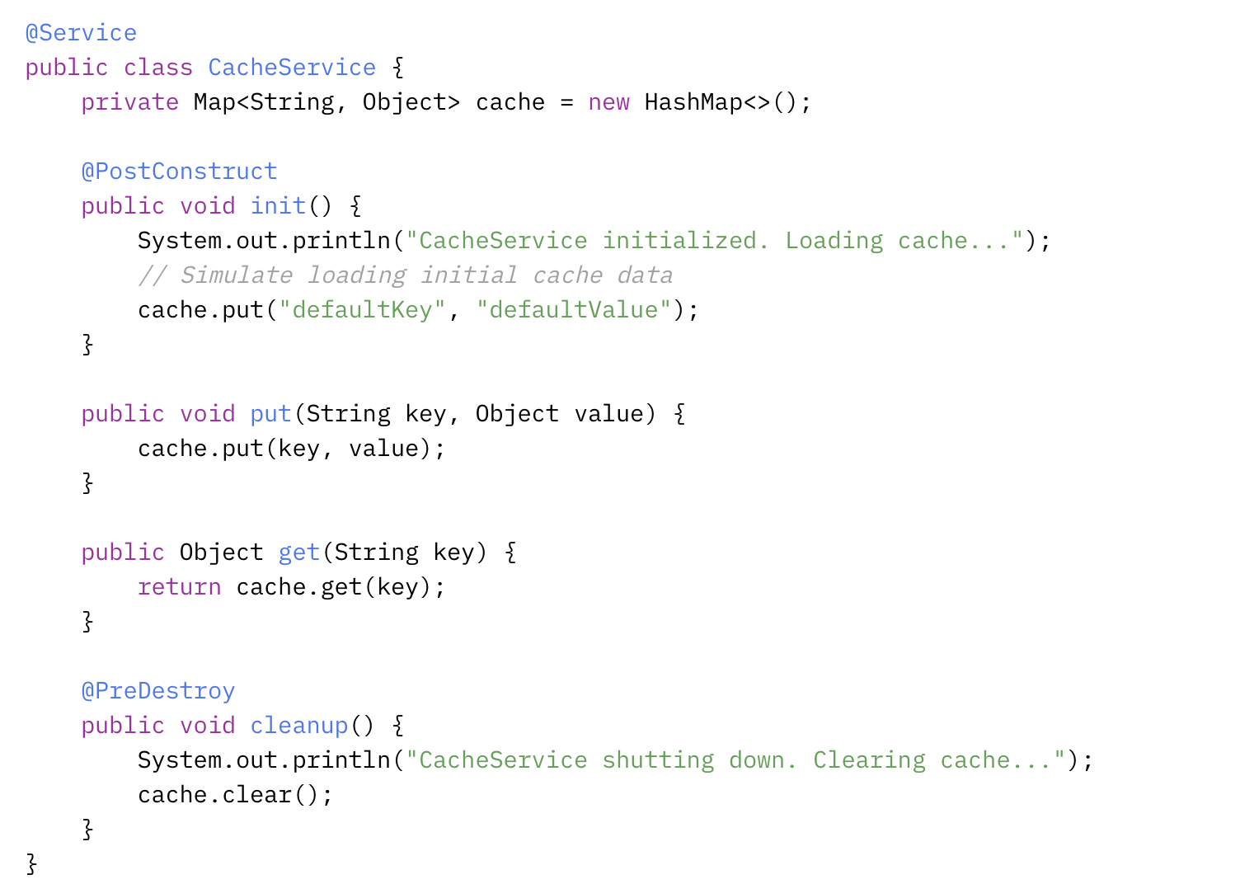

Slide 47
Why Lifecycle Management Matters
Resource Initialization: Set up connections, load configurations, or pre-populate data (e.g., cache).
Resource Cleanup: Release resources like database connections, file handles, or memory to prevent leaks.
Controlled Behavior: Ensure components start and stop gracefully, maintaining application stability.

Slide 48
Best Practices for Component Design
Define Interfaces for Abstraction
Favor Constructor Injection
Single Responsibility Principle
Leverage Lifecycle Hooks (@PostConstruct and @PreDestroy)
Avoid Circular Dependencies
Document Interfaces (e.g., JavaDoc)

Slide 49

Practical Example: Composing Components with Interfaces
Scenario
An OrderService depends on a PaymentProcessor (interface with multiple implementations) and a NotificationService. The system processes payments and sends notifications when an order is placed.
1. Payment processor interface

Slide 50
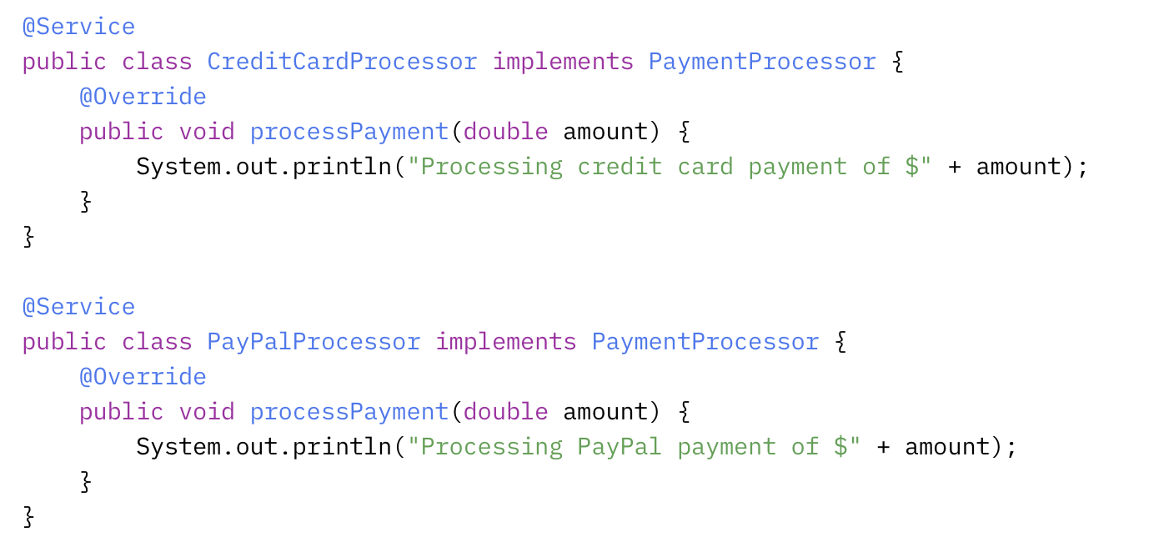
Practical Example: Composing Components with Interface
Implement concrete payment processors

Slide 51
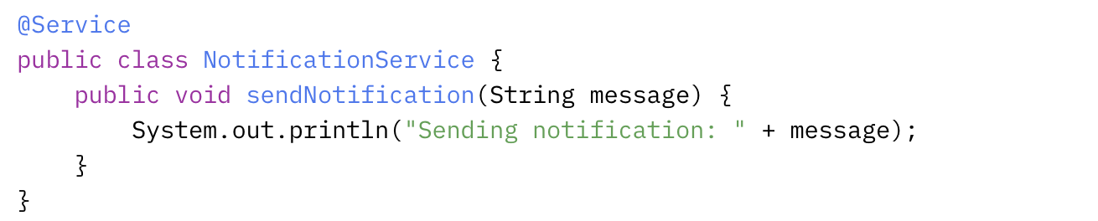
Practical Example: Composing Components with Interface
Define NotificationService

Slide 52
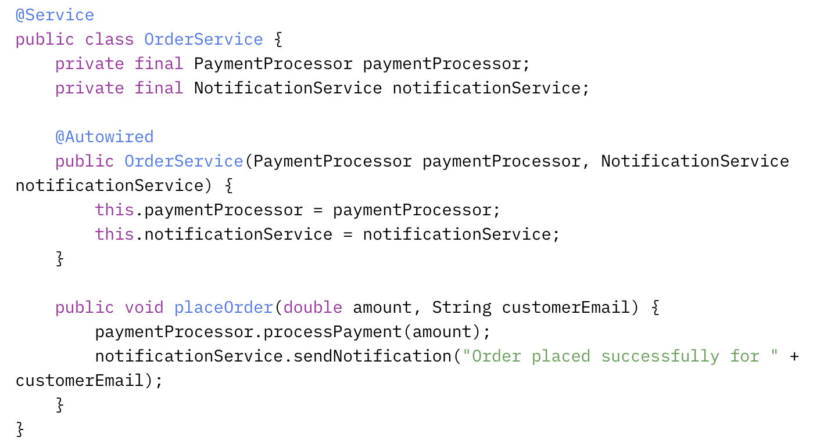
Practical Example: Composing Components with Interface
Compose the OrderService with dependencies

Slide 53
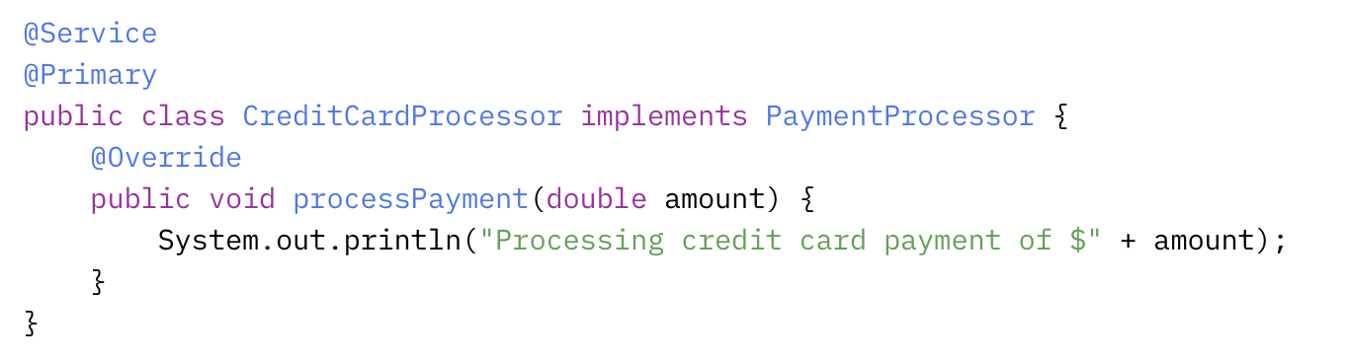
Practical Example: Composing Components with Interface
Resolve multiple implementations
Option 1: @Primary

Slide 54
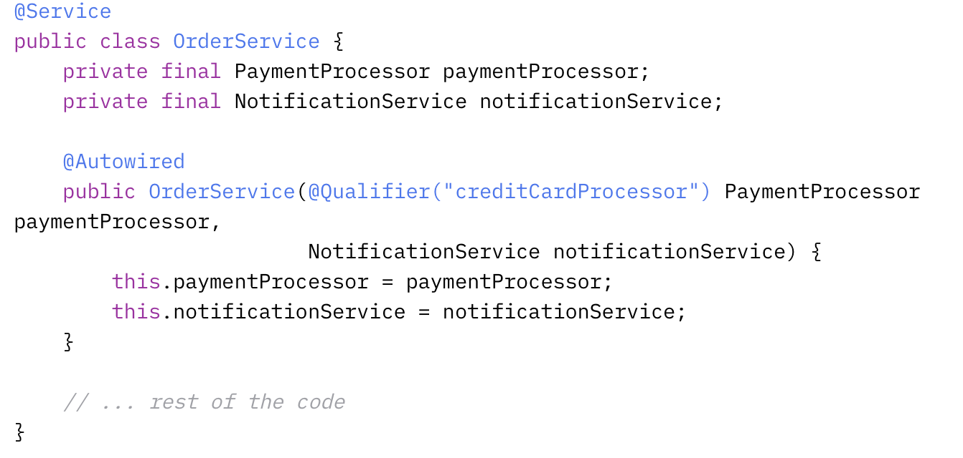
Practical Example: Composing Components with Interface
Resolve multiple implementations
Option 2: @Qualifier

