Slide 1





RECURRENT NEURAL NETWORK
INT301 Bio-computation, Week 9, 2025

Slide 2
Introduction
RNN were introduced in the late 80’s.
  Hochreiter discovers the ‘vanishing gradients’ problem in 1991.
Long Short Term Memory published in 1997.
  LSTM: a recurrent network to overcome this problem.

Slide 3
Motivation
Feed forward networks
  accept a fixed-sized vector as input
  produce a fixed-sized vector as output
  usually fixed amount of computational steps
Recurrent networks allow us to operate over sequences of vectors
  the idea behind RNNs is to make use of sequential information, as in a traditional neural network all inputs (and outputs) are assumed independent of each other
  but for many tasks that’s a very bad idea: if you want to predict the next word in a sentence you better know which words came before it

Slide 4






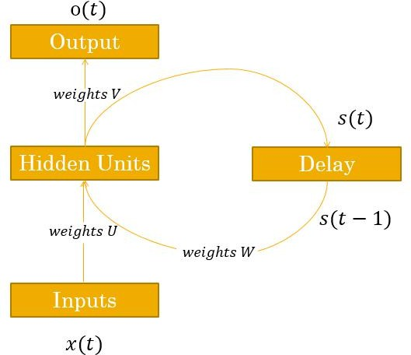
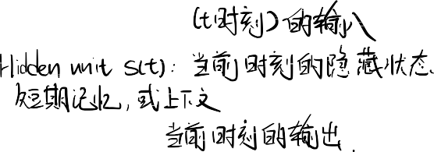





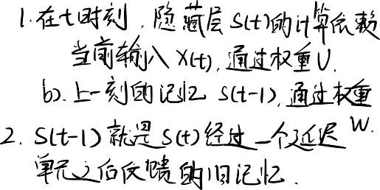
RNN Architecture
RNNs are called recurrent because they
它的输出不仅取决于“当前的输⼊”，还取决于“上⼀步的计
perform the same task for every element of a sequence, with the output being depended on the previous computations (memory).
inputs x(t)
outputs y(t)
hidden state s(t): memory of the network
a delay unit is introduced to hold activation until they are processed at the next step
The decision a recurrent net reached at time step t-1 affects the decision it will reach one moment later at time step t
  two sources of input: the present and the recent past, which combine to determine how they respond to new data
算结果”——这就是“记忆” (memory)

Slide 5





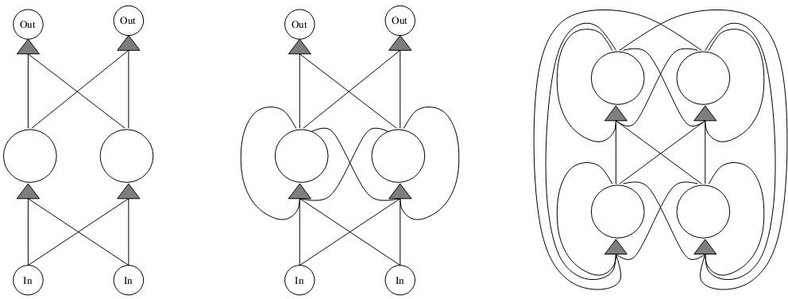



RNN Architecture
feed forward NN a simple RNN fully connected RNN
RNN topologies range from partly recurrent to fully recurrent
  partly recurrent is a layered network with distinct input and output layers where the recurrence is limited to the hidden layer
  in fully recurrent networks each node gets inputs from all other nodes

Slide 6
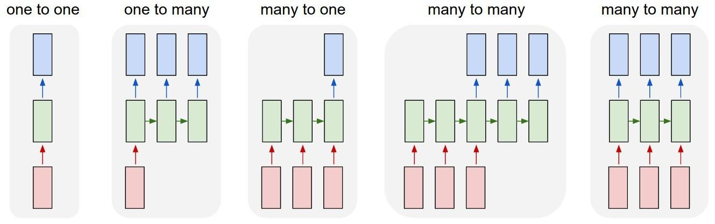
RNN Architecture
Vanilla mode of processing without RNN, from fixed-sized input to fixed- sized output (e.g. image classification).
Sequence output (e.g. image captioning takes an image and outputs a sentence of words).
Sequence input (e.g. sentiment analysis where a given sentence is classified as expressing positive or negative sentiment
Sequence input and sequence output (e.g. machine translation: an RNN reads a sentence in English and then outputs a sentence in French).
Synced sequence input and output (e.g. video classification where we wish to label each frame of the video).

Slide 7





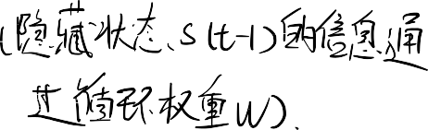
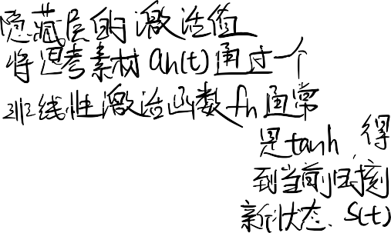
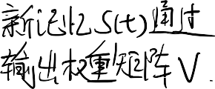
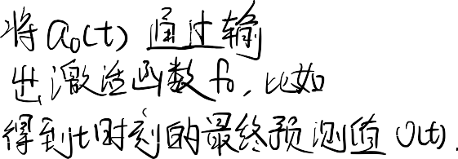

RNN Forward Pass
The network input at time t:
_{ℎ}() = 𝑈() + 𝑊( − 1)
The activation of hidden unit at time t:
() = _{ℎ}(_{ℎ}())
The hidden to the output at time t:
() = 𝑊()
The output of the network at time t is:
() = (())

Slide 8



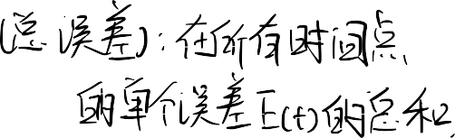







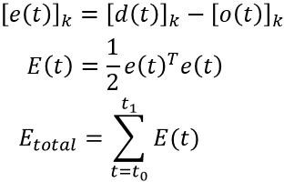
RNN Architecture
If a network training sequence starts at time ₀ and ends at ₁, one possible choice of the total loss function is the sum over time of the square error function

Slide 9
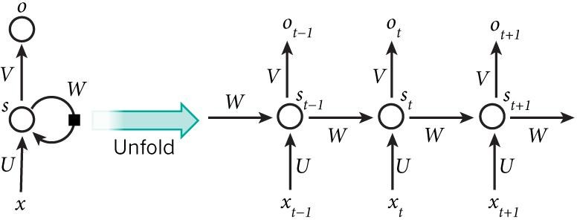
像 BP（反向传播）这样的标准算法⽆法在“带循环”的⽹络（如左图）上⼯作。
展开⽅式：
序列中的每⼀个时间点（t-1, t, t+1,
….），都对应这个“深”⽹络中的⼀层。
例⼦： 如果⼀个句⼦有 5 个词，我们就把 RNN 展开成⼀个 5 层的神经⽹络。
“随时间展开/展开” (Unfolding / Unrolling)！“展开”是⼀种“概念上”的转换。我们把那个带循环的 RNN（左图），“复制”成⼀个没有循环的、⾮常深的“前馈⽹络”（右图）。
RNN Architecture
■
The recurrent network can be converted into a feed forward network by unfolding over time
The above diagram shows a RNN being unrolled (or unfolded) into a full network. By unrolling we simply mean that we write out the network for the complete sequence.
For example, if the sequence we care about is a sentence of 5 words, the network would be unrolled into a 5-layer neural network, one layer for each word.
■
■
This means all the earlier theory about feed forward networks learning follows through

Slide 10








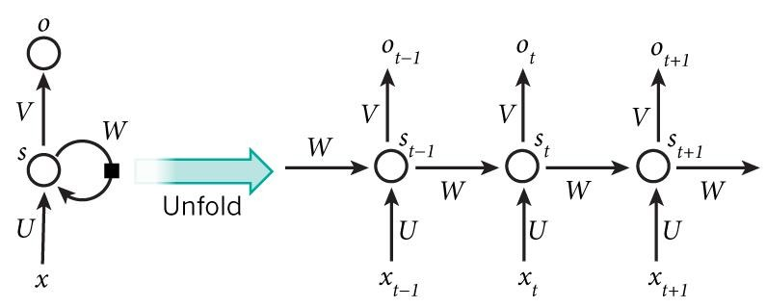
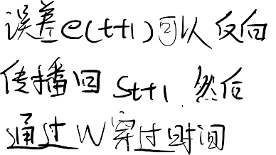

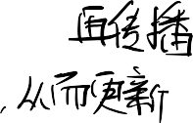






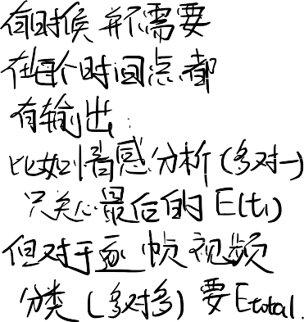
RNN Architecture
■
In RNN errors can be propagated more than 2 layers in order to capture longer history information.
■
■
This process is usually called unfolding.
“循环权重 W 在所有时间步中是被‘复制’（即‘共享’）的。”
In an unfolded RNN, recurrent weight is duplicated for arbitrary number of time steps
■
The above diagram has outputs at each time step, but depending on the task this may not be necessary.
For example: when predicting the sentiment of a sentence we may only care about the final output, not the sentiment after each word. Similarly, we may not need inputs at each time step. The main feature of an RNN is its hidden state, which captures some information about a sequence.

Slide 11

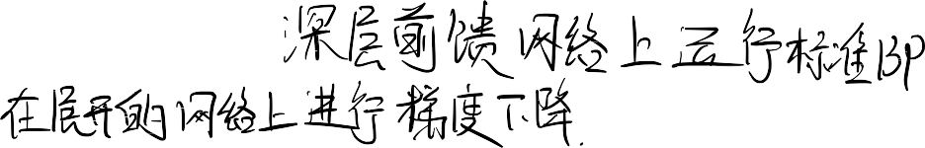
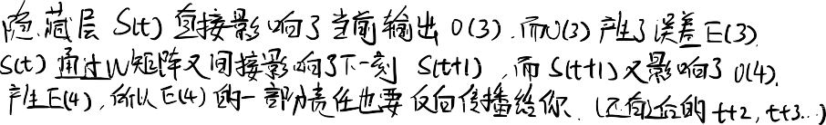
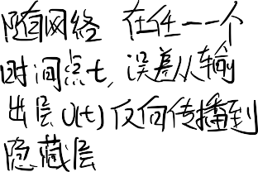


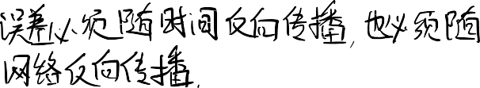
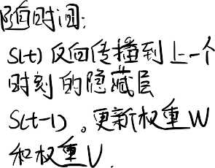
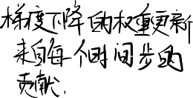
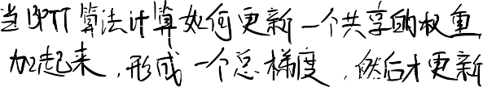





Back Propagation Through Time (BPTT)
BPTT learning algorithm is an extension of standard backpropagation that performs gradients descent on an unfolded network.
The gradient descent weight updates have contributions from each time step.
The errors have to be back-propagated through time as well as through the network
For recurrent networks, the loss function depends on the activation of the hidden layer through its influence on the output layer and through its influence on the hidden layer at the next step.

Slide 12






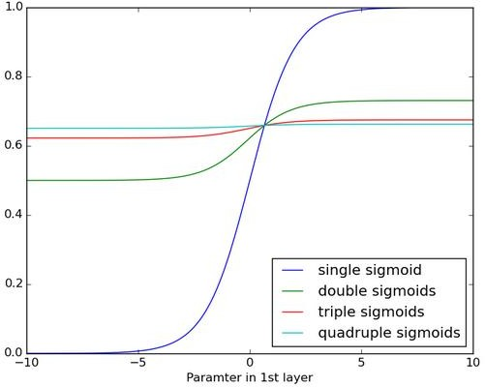
Vanishing Gradients
RNNs trained with BPTT have difficulties learning long-term dependencies (e.g. dependencies between steps that are far apart) due to what is called the vanishing gradients problem.
The figure shows the effects of applying a sigmoid function over and over again. The data is flattened until, for large stretches, it has no detectable slope.
Vanishing gradients can become too small for computers to work with or for networks to learn.

Slide 13
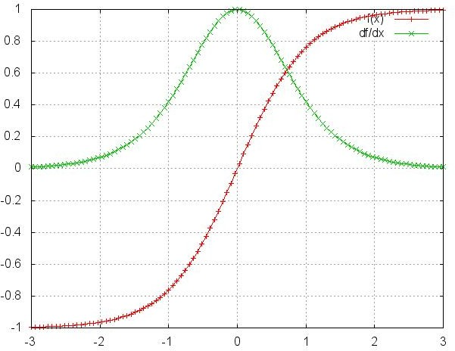
Vanishing Gradients
Sigmoid functions have derivatives of 0 at both ends
When this happens we say the corresponding neurons are saturated
  they have a zero gradient and drive other gradients in previous layers towards 0.
Gradient contributions from “far away” steps become zero, and the state at those steps doesn’t contribute to what you are learning
  forget old information: end up without learning long-range dependencies.

Slide 14
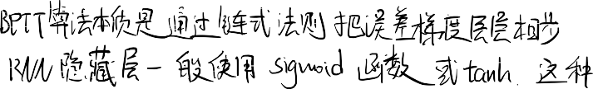
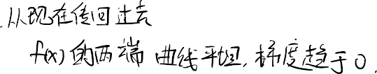





⽤ BPTT 训练的 RNN，在学习“⻓期依赖”时会遇到困难. “⻓期依赖” (long-term dependencies)： 就是指时间序列中，相隔很远的两个数据点之间的关联。
例⼦： 在句⼦“我 30 年前出⽣在法国...（此处省略 100 个词）...所以我能说⼀⼝流利的法语。”
模型必须“记住” 100 个词之前的“法国”，才能在最后正确预测出“法语”。这就是“⻓期依赖”。问题： 简单的 RNN（如 Elman ⽹络）做不到这⼀点。它很快就会“忘记”100 个词之前发⽣过什么。
当 BPTT 算法试图把误差从 t100（“法语”）传回 t1（“法国”）时，它需要 “穿过” 100 个时间步
（即“展开后”的 100 层⽹络）。
在每⼀步，它都需要乘以当前激活函数的“梯度”（即绿线 df/dx 的值）。
梯度（绿线）的最⼤值：即使在最理想的中⼼点，tanh 的梯度也最多只有 1.0（sigmoid 更惨，最多只有 0.25）。
梯度（绿线）的“常规”值：在“饱和区”，梯度接近 0。
梯度为 0 意味着什么？
当 BPTT 算法算出 t=11 处的梯度为 0 时，它等于在说：
“（t=1000 处的）最终误差，与 t=1 处（“法国”）发⽣了什么，完全没有关系。”
学习失败：
既然“梯度为 0”，算法就不会（也⽆法）更新 t=1 时的权重。
"Gradient contributions from 'far away' steps become zero"（来⾃遥远步骤的梯度贡献变为 0）。 "forget old information"（（算法被迫）忘记了旧信息）。

Slide 15
LSTM - introduction
LSTM 被发明出来，就是为了解决“梯度消失”问题。LSTM 在“反向传播”过程中，能够维持⼀个更“恒定”的误差流。在 Elman ⽹络中，梯度会连乘 0.1 * 0.1 * ... 然后“消失”；⽽在 LSTM 中，它被设计为可以像 1.0 * 1.0 * ... ⼀样流动，不会消失。Elman ⽹络（简单 RNN）的梯度传不回“法国”；⽽ LSTM 的梯度（误差）可以轻松地从“法语”⼀路“恒定地”传播回 100 个词之前的“法国”，从⽽让⽹络学会这个“⻓期”的关联。
"LSTM - same idea as RNN" （LSTM
— 和 RNN 是同样的想法）
LSTM was invented to solve the vanishing gradients problem.
LSTM maintain a more constant error flow in the back propagation process.
LSTM can handle large sequences that are linked remotely.

Slide 16
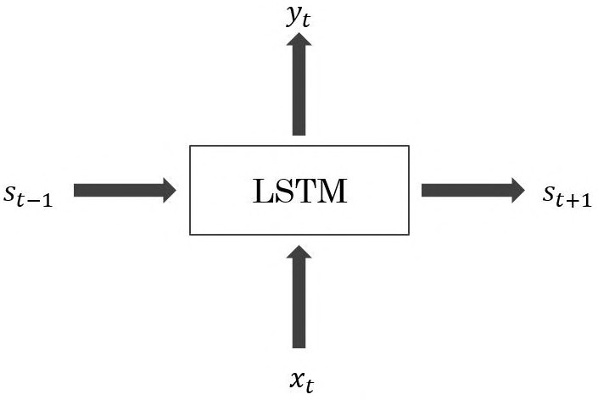
LSTM – same idea as RNN
它“吐”出 2 个东⻄（输出）：
它“吃”进 2 个东⻄（输⼊）：
x_t：当前时刻的输⼊（⽐如，当前的词“法语”）。
s_{t-1}：上⼀刻的“状态”（即“旧记忆”，⽐如 t-1 时刻的“思考结果”）。
y_t：当前时刻的输出（⽐如，对下⼀个词的“预测”）。
s_t：当前时刻的“新状态”（即“新记忆”，它将被传递到 t+1 时刻）。
(注：图中的 s_{t+1} 应该是指“将被传到下⼀刻”的状态，我们通常把它记为 s_t。)

Slide 17
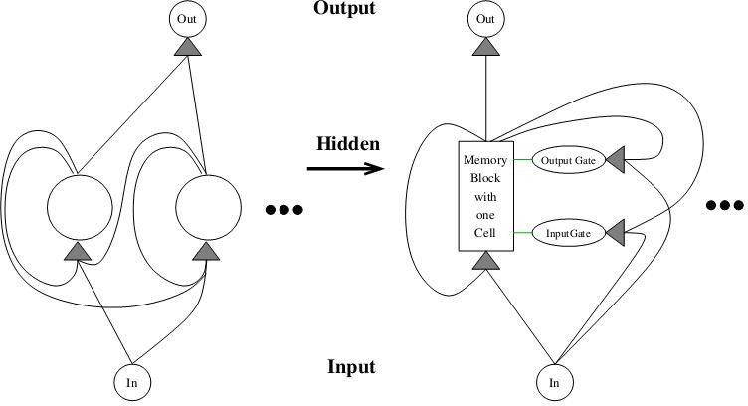
Elman ⽹络 (RNN)： 隐藏层是⼀个“简单”的单元（⽐如⼀个 tanh 激活函数）。我们已经知道，这种简单结构在 BPTT 训练中会导致“梯度消失”。
LSTM ⽹络：它“替换”了 RNN 的那个“简单”隐藏单元。取⽽代之的是⼀个“复杂的”、“内存块” (memory block)。这个“内存块”的核⼼是“记忆
细胞” (memory cell) 和“⾃适应⻔控单元” (adaptive gating units)（即输⼊⻔和输出⻔）。
LSTM Architecture
LSTM的隐藏层被⼀个“内存块” (Memory Block) 取代了。
这个“内存块”的内部要复杂得多，它包含：
“记忆细胞” (Memory Cell)： 真正存储“⻓期记忆”的地⽅（即我们之前讨论的 c(t)，或 CEC）。
“输⼊⻔” (Input Gate)： 控制“新信息”何时可以“写⼊”记忆。
“输出⻔” (Output Gate)： 控制“内部记忆”何时可以“读取”并影响输出。
The basic unit in the hidden layer of an LSTM network is a memory block, it replaces the hidden unit in a traditional RNN.
A memory block contains one or more memory cell and a pair of adaptive multiplicative gating units which gates input and output to all cells in the block.
Memory blocks allow cells to share the same gates thus reducing the number of parameters.
RNN with one FC hidden layer
LSTM network with memory blocks in hidden layer (only one is shown)

Slide 18



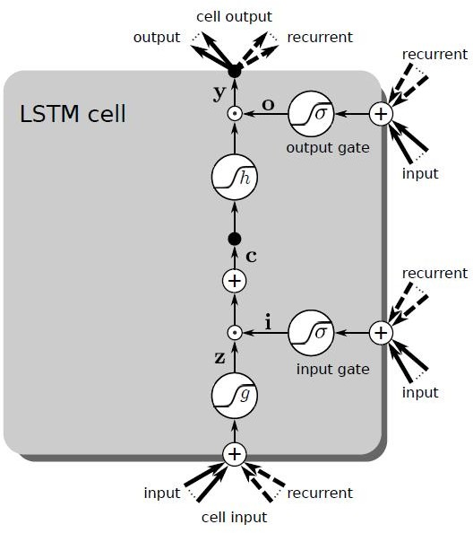



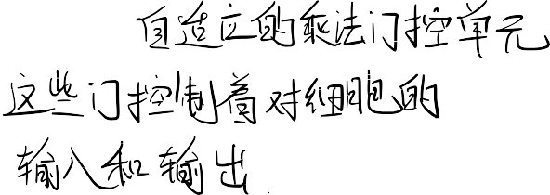
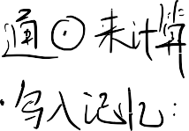






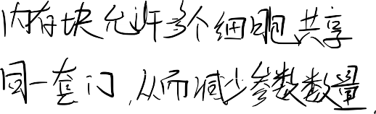
LSTM Architecture - overview

Slide 19



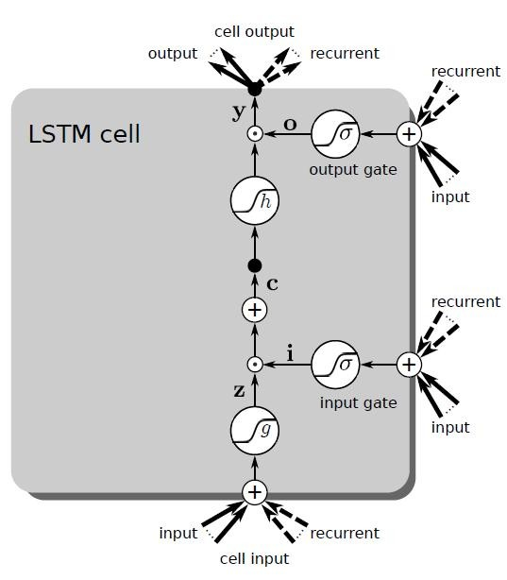
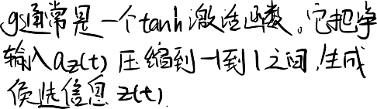


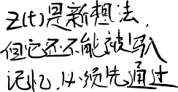


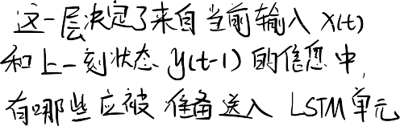

LSTM Architecture
– input
LSTM 单元如何决定“写⼊”什么新信息到它的“⻓期记忆” c(t) 中。这个“写⼊”操作被分成了两个独⽴的部分：
“候选信息” z(t)： 我们“可能”想写什么？
“输⼊⻔” i(t)： 我们“允许”写⼊多少？
z(t) 代表了“基于当前输⼊，我们新⽣成的、可能要存⼊记忆的‘想法’”。
The layer decides which information from the input should be forwarded into the LSTM cell.
By multiplying y(t−1) with the recurrent weight matrix Rz, the layer decides which information from the previous time step should be forwarded into the LSTM cell

Slide 20
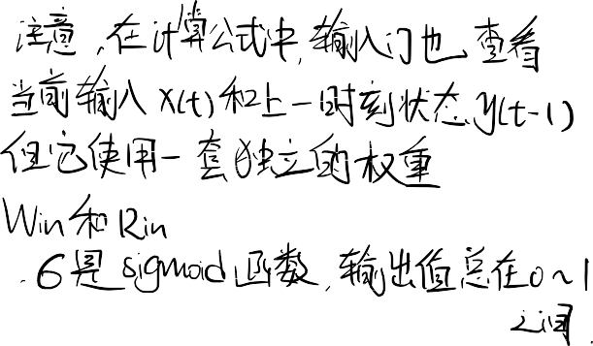


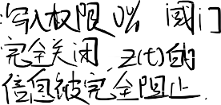

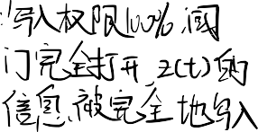



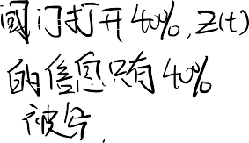

LSTM Architecture – input gate
“输⼊⻔” i(t) 的计算。i(t) 是⼀个“阀⻔”，它决定了 z(t) 这个“新想法”有多⼤⽐例（百分之⼏）可以被“允许”写⼊“⻓期记忆”。输⼊⻔控制着对“记忆细胞”的“写⼊权限”。
The input gate controls write accesses to memory cells.
This is realized by using the result of the squashing function σ as a factor which will be later multiplied by the squashed cell input z(t).
The range of function σ is (0,1) and can be interpreted in case of 0 as write access denied and in case of 1 as write access granted.
Note that all values in between are also possible.

Slide 21
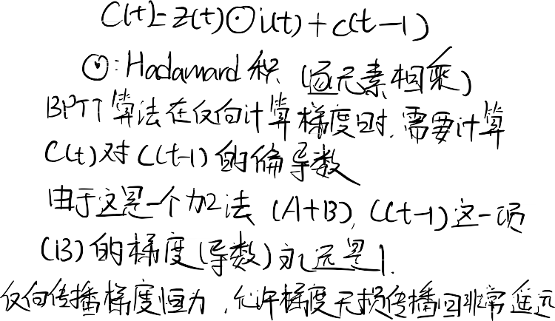





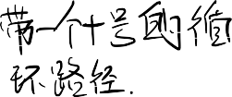






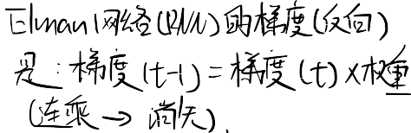
LSTM Architecture – CEC
每个‘记忆细胞’都包含⼀个节点，这个节点带有⼀个权重固定为 1 的‘⾃我循环’连接.
Each memory cell contains a node with a self-connected recurrent edge of fixed weight one, ensuring that the gradient can pass across many time steps without vanishing – which is called CEC (constant error carousel)
The CEC solves the vanishing error problem. In the absence of new input or error signals to the cell the CEC local error back flow remains constant, neither growing or decaying.

Slide 22


LSTM Architecture – output gate
LSTM 单元如何决定“对外输出”什么信息。这个“输出”操作和我们之前看的“写⼊”操作⼀ 样，也是⼀个“两步⾛”的过程：
“输出⻔” o(t)： 我们“允许”对外输出多少信息？（计算“阀⻔”⼤⼩）
“最终输出” y(t)： 结合“阀⻔”和“内部记忆”，计算出最终的输出。
The output gate controls read accesses from memory cells.
This is realized by using the result of the squashing function σ as a factor which will be later multiplied by the squashed cell content h(c(t)).
The range of function σ is (0,1) and can be interpreted in case of 0 as read access denied and in case of 1 as read access granted.
Note that all values in between are also possible.

Slide 23


LSTM Architecture – output
The value stored in the cell c(t) is squashed by function h, and whether this information gets output is decided by the output gate via o(t).

Slide 24
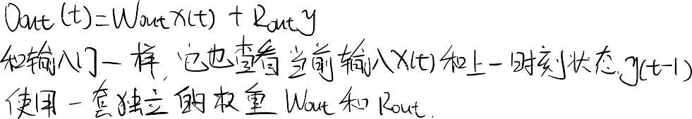



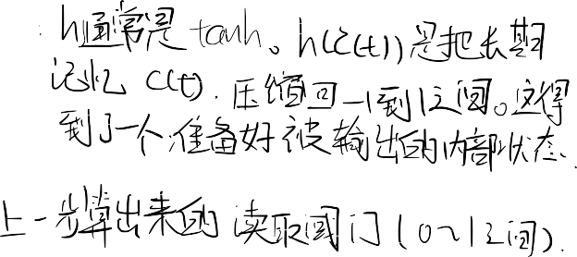



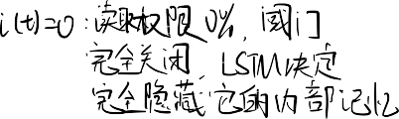

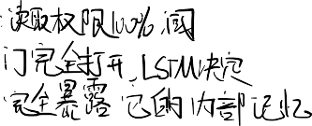


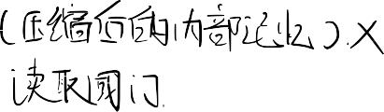




“输出⻔”(Output Gate) -> 计算“读取阀⻔” o(t)
“输出”(Output) -> 计算“最终输出” y(t)
“最终输出” y(t) 的计算。y(t) 就是 LSTM 单元在 t 时刻真正对外输出的值（⽐如，对下⼀个词的预测）。
存储在细胞 c(t) 中的值⾸先被函数 h “压缩”，然后，这个信息是否被允许输出，由“输出⻔” o(t) 来决定。
“输出⻔” o(t) 的计算。o(t) 是⼀个“阀⻔”，它决定了我们“⻓期记忆” c(t) 中的内容，有多⼤⽐例
（百分之⼏）可以被“允许”在此刻“读取”并发送到外部（作为 y(t)）。所以说，输出⻔控制着从“记忆细胞”中“读取”的权限。
假设“内部记忆” h(c(t)) 是 [1.0, 0.8]。
假设“输出⻔” o(t) 学会了只输出第⼆部分，所以 o(t) 是 [0, 1]。最终输出 y(t) = [1.0, 0.8] [0, 1] = [0, 0.8]。
结果： LSTM 成功地“隐藏”了它的第⼀部分记忆，只“选择性地”输出了第⼆部分。
LSTM 的“输出”机制是⼀个“两步⾛”的“受控读取”过程：
计算“阀⻔”：⽹络根据“当前输⼊”和“旧记忆”，计算出⼀个“输出⻔” o(t)
（0 到 1 之间）。
计算“输出”：⽹络取出“⻓期记忆” c(t)，⽤ tanh 压缩它，然后乘以 o(t)
这个“阀⻔”，得到最终的输出 y(t)。
y(t) 既是对外的“预测”，也会在下⼀刻 t+1 作为“循环状态”（即
y(t-1)）被反馈回来，⽤于计算 t+1 时刻的“⻔”和“候选信息”。

Slide 25

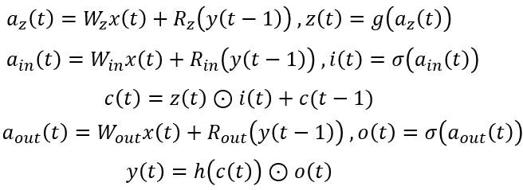
LSTM Forward Pass
The cell state is updated based on its current state and 3 inputs: , ,

Slide 26



























Slide 27


当 BPTT 算法在反向传播误差时（从 t 时刻传到 t-1 时刻），误差信号会“抵达”CEC（即 c(t)）。
因为 CEC 的数学本质是“加法”，它的导数（梯度）恒定为 1。
这使得误差信号可以“在 CEC 内部停留很⻓时间”，并“不衰减地” ("non-decaying") 被传播回⾮常遥远的过去。
LSTM Backward Pass
Errors arriving at cell outputs are propagated to the CEC
Errors can stay for a long time inside the CEC
This ensures non-decaying error
Can bridge time lags between input events and target signals

Slide 28
Advantages of LSTM
不衰减的误差反向传播
Non-decaying error backpropagation.
⻓周期的记忆
For long time lag problems, LSTM can handle noise and continuous values.
LSTM 可以处理那些“过去”和“现在”相隔很远的问题。
No parameter fine tuning.
⽆需参数微调
Memory for long time periods

Slide 29




Limitations of LSTM
如果你持续向⼀个序列输⼊信息（⽐如读⼀篇很⻓的⼩说），c(t) 的值会不断地“累加”，导致 c(t) 变得“⽆限⼤” ("unbounded fashion")。
⽆限⼤会导致输出端的压缩函数 h(c(t)) “饱和”
细胞状态 c(t) 倾向于“线性增⻓”
grows linearly
LSTM allows information to be stored across arbitrary time lags and error signals to be carried far back in time.
This potential strength however, can contribute to a weakness: the cells states c(t) often tend to grow linearly during the presentation of a time series.
If we present a continuous input stream, the cell state may grow in unbounded fashion causing saturation of the output squashing function h(c(t)).

Slide 30
Conclusions
RNNs - self connected networks
Vanishing gradients and long memory problems
LSTM - solves the vanishing gradients and the long memory limitation problem

Slide 31







THANK YOU
VISIT US
WWW.XJTLU.EDU.CN
FOLLOW US
@XJTLU

