Slide 1
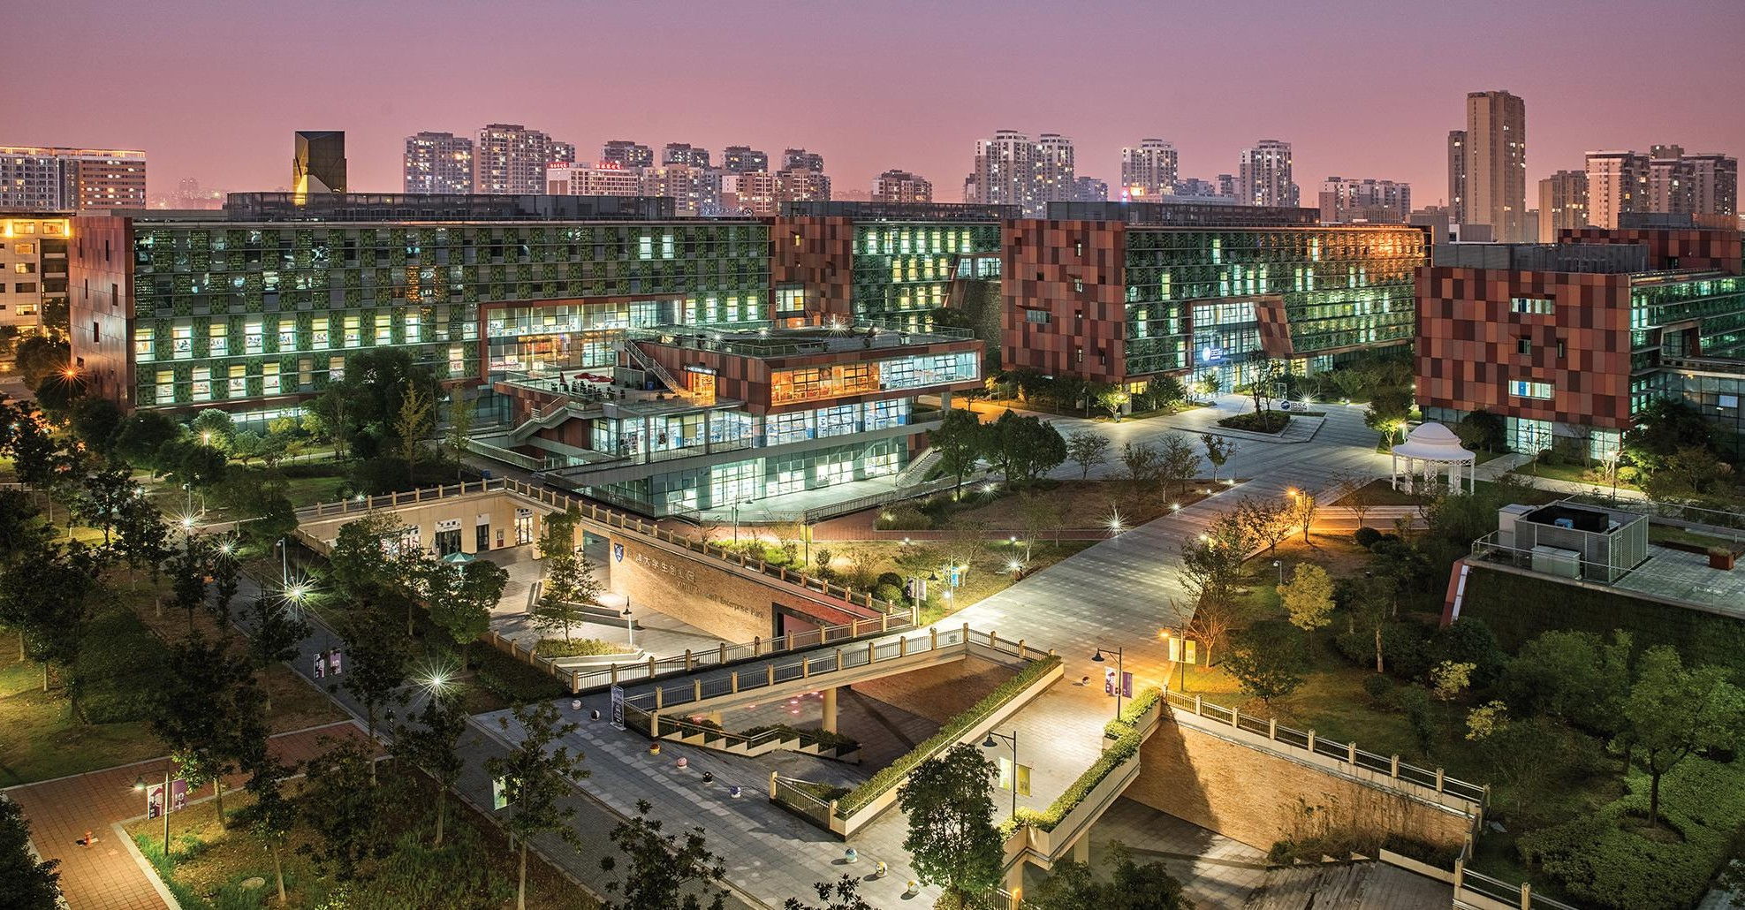

INTRODUCTION TO PRINCIPAL COMPONENT ANALYSIS (PCA)
INT301 Bio-computation, Week 10, 2025

Slide 2







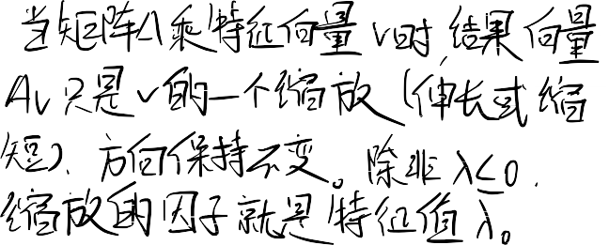

Preliminary Knowledge Eigenvalues and Eigenvectors
If v is a nonzero vector and λ is a number such that
Av = λv
then v is said to be an eigenvector of A with
eigenvalue λ.
Example
⬆2
1  ⬆1 _{= 3} ⬆1
⬇₁
₂ ⬇₁ ⬇₁
 ✗  ✗  ✗

Slide 3
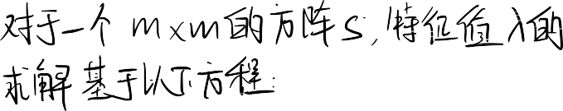




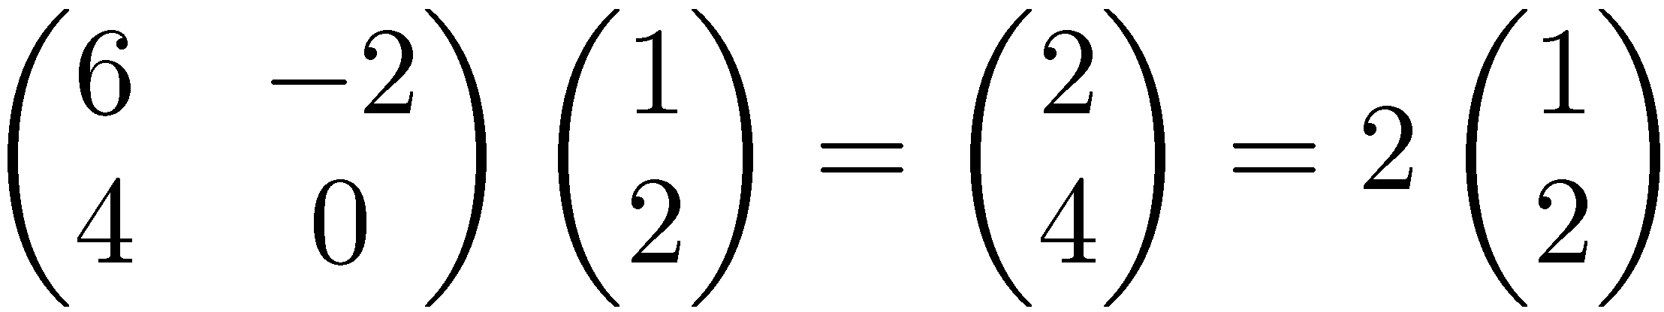


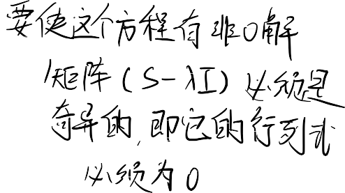

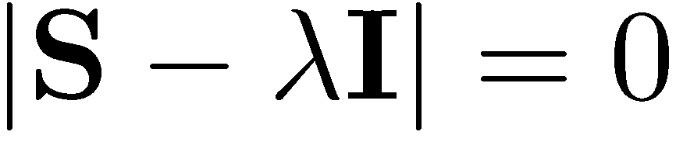







Preliminary Knowledge Eigenvalues and Eigenvectors
q Eigenvectors (for a square mm matrix S)
Example
eigenvector eigenvalue
q How many eigenvalues are there at most?
only has a non-zero solution if with at most m distinct λ values

Slide 4















Preliminary Knowledge Eigenvalues and Eigenvectors
For symmetric matrices, eigenvectors for distinct eigenvalues are orthogonal
^{Sv}{1,2} ^{= λ}{1,2}^{v}{1,2} ^{, and λ}1 ^{s λ}2 ^{ v}1 ^{• v}2 ⁼ ⁰
All eigenvalues of a real symmetric matrix are real.
All eigenvalues of a positive semidefinite matrix are non-negative
6w ϵA^{n} , w^{T} Sw  0, then if Sv = λv  λ  0

Slide 5












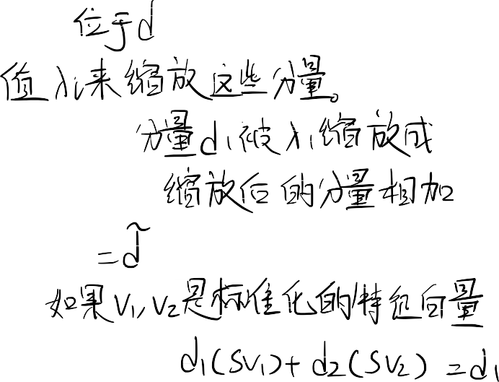




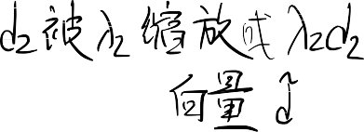












Preliminary Knowledge Eigenvalues and Eigenvectors
S = S ，Sv = λ v , (
λ = 2, λ = 0.5)
~
T
i i i 1 2
d
d
_{Sd =} ⬆S (1,1), S (1,2) ⬆d (1)  ₌ ⬆S (1,1)d (1) + S (1,2)d (2)  ₌ ~
d
⬇S (2,1), S (2,2)⬇d (2) ⬇S (2,1)d (1) + S (2,2)d (2)
 ✗ ✗  ✗
d
v₁

Slide 6






Preliminary Knowledge Eigenvalues and Eigenvectors
S = S ，Sv = λ v , (
λ = 2, λ = 0.5)
~
T
i i i 1 2
d
d
_{Sd =} ⬆S (1,1), S (1,2) ⬆d (1)  ₌ ⬆S (1,1)d (1) + S (1,2)d (2)  ₌ ~
d
⬇S (2,1), S (2,2)⬇d (2) ⬇S (2,1)d (1) + S (2,2)d (2)
 ✗ ✗  ✗
d
v₁
v₁
v₁
v₁
d
d
d
~ λ₁d₁
d
v₂
v₂
v₂
d
v₂
d₁
d₂
λ d
λ d
λ d
λ d
1 1
2 2
1 1
2 2
Projection on the eigenvectors
Scaling with eigenvalues
Vector addition

Slide 7







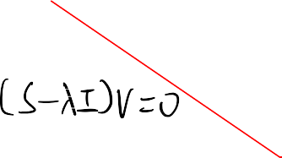





Preliminary Knowledge Eigenvalues and Eigenvectors
Let
1
S = ^{2}
Real, symmetric.
₁
₂
 
2 – λ 1

Then
S – λI = 
  (2 – λ) –1 = 0.
2

1 2 – λ 
The eigenvalues are 1 and 3 (nonnegative, real).
The eigenvectors are orthogonal (and real):
( 1 
(1
 
 
¹
Substitute these values and solve for eigenvectors.
–1

Slide 8
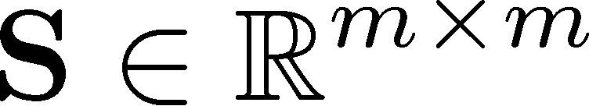
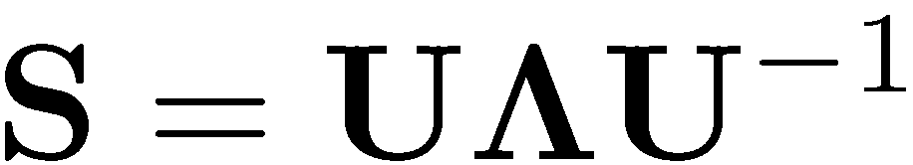


Diagonal Decomposition
Let be a square matrix with m linearly independent eigenvectors
Theorem: Exists an eigen decomposition
diagonal
Unique for distinct eigen- values
(matrix diagonalization theorem)
Columns of U are eigenvectors of
Diagonal elements of are eigenvalues of

Slide 9
Diagonal Decomposition
⬆

Write U with the eigenvectors as columns:U = ⬇v ...
_{v} 
⬇
⬇
1
m 
✗
Then, SU can be written
⬆  ⬆
 ⬆
⬆λ₁



^{λ}m ✗
SU = S ⬇v ... v  = ⬇λ v ... λ v  = ⬇v ...
_{v} 
m m   1
 
...


1
^{m}  
 
1 1
^{m} 

Thus SU=UΛ, or U^{–1}SU=Λ
Therefore S=UΛU^{–1}.

Slide 10
Diagonal Decomposition
Recall
S = ^{2}
^{1};λ = 1, λ = 3.
₁
₂
 
1 2
( 1  (1
1
The eigenvectors –  and  
form
U = ^{ 1}
₁
1
–1

¹


Inverting U, we have
_{U –1 =} 1/ 2
–1/ 2
Recall UU^{–1} =1.
1/ 2
1/ 2 


 1 11 01/ 2
–1/ 2 1/ 2 
Then, S=UΛU =
–1
 ₁₀

–1
 
31/ 2
 10

Slide 11
Diagonal Decomposition
Let’s divide U (and multiply U^{–1}) by
2
⬆ 1/ 2 1/
Then, S=
2 1/
Q
2 ⬆1
0⬆1/ 2 –1/
2 1/
2 
₂ ⬇₀
₃⬇
₂ 
⬇–1/
✗
✗1/

✗
Λ
(Q⁻¹= Q^{T} )

Slide 12
Symmetric
Diagonal Decomposition
Theorem: If is a symmetric matrix, there exists an eigen decomposition, where Q is orthogonal:
S = QΛQ^{T}
_{Q}-1_{= Q}T
■
Columns of Q are normalized eigenvectors
Columns are orthogonal.
(everything is real)

Slide 13
Singular Value Decomposition
For an m n matrix A of rank r, there exists a factorization (Singular Value Decomposition = SVD) as follows:
A = UΣV ^{T}
mm mn, nonnegative real nn
The columns of U are orthogonal eigenvectors of AA^{T}.
The columns of V are orthogonal eigenvectors of A^{T}A. Eigenvalues λ₁ … λ_{r} of AA^{T} are the eigenvalues of A^{T}A.
σ _{i} = λ_{i}
Σ = diag(σ₁...σ _{r} )
Singular values.

Slide 14
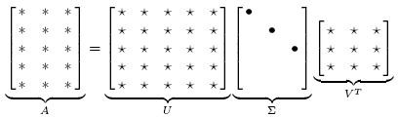
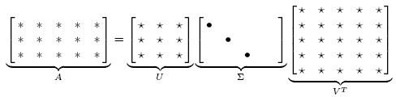
Singular Value Decomposition
Illustration of SVD dimensions and
sparseness

Slide 15
Singular Value Decomposition
⬆1 –1
₁ 
Let
A = ⬇ 0
⬇ 
⬇ 1 0 ✗
Thus m=3, n=2. Its SVD is
⬆
0 2 / 6 1/ 3 ⬆ 1 0 ⬆
⬇1/ 2 –1/ 6 1/
⬇1/ 2 1/ 6 –1/
 1/ 2 1/ 2
2 –1/ 2 ✗
⬇
⬇

3 ⬇0
3⬇

_{0 ✗}1/
3⬇ 0

✗

Slide 16



Dimensionality Reduction
One approach to deal with high dimensional data is by reducing their dimensionality.
Project high dimensional data onto a lower dimensional subspace using linear or non-linear transformations.
⬆ y₁ 
⬆ x₁ 
⬇ _{x}  Reduce dimensionality
⬇ _{y} 
2 
2 
x = ⬇
y = ⬇
(K<<N)
⬇ ... 
⬇ _{x} 
⬇ ... 
⬇ _{y} 
 N ✗  k ✗
Linear transformations are simple to compute
Y = U X (b = u ^{t} a )
i i i

Slide 17
Dimensionality Reduction
Find a basis in a low dimensional sub-space:
– Approximate vectors by projecting them in a low dimensional
sub-space:
⬆ a₁ 
⬇ _{a} 
(1) Original space representation:
⬇
2 
⬇ ... 
⬇_{a} 
x = a₁v₁ + a₂v₂ + ... + a_{N} v_{N}
 N ✗
where v₁, v₂ ,..., v_{n} is a basein theoriginal N-dimensionalspace
⬆b 
1
⬇_{b} 
⬇
2 
(2) Lower-dimensional sub-space representation:
⬇... 
⬇_{b} 
xˆ = b₁u₁ + b₂u₂ +... + b_{K} u_{K}
 k ✗
where u₁ , u₂ ,..., u_{K} is a basein the K -dimensionalsub-space(K<N)

Slide 18
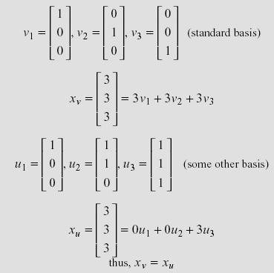
Dimensionality Reduction
If K=N, then
Example (K=N):
xˆ = x

Slide 19
Principal Component Analysis (PCA)
Each dimensionality reduction technique finds an appropriate transformation by satisfying certain criteria (e.g., information loss, data discrimination, etc.)
The goal of PCA is to reduce the dimensionality of the data while retaining as much as possible of the variation present in the dataset.

Slide 20
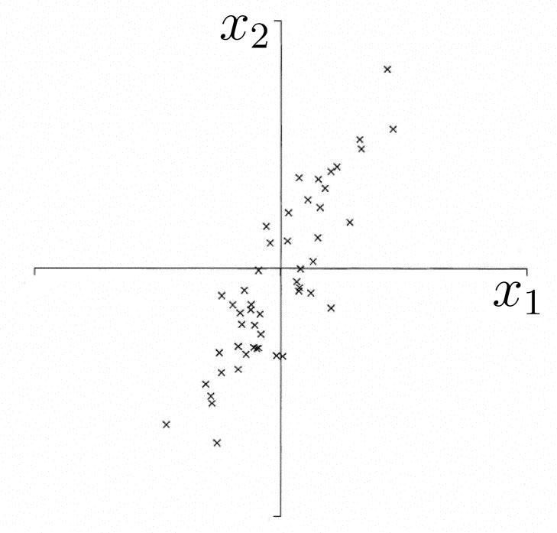
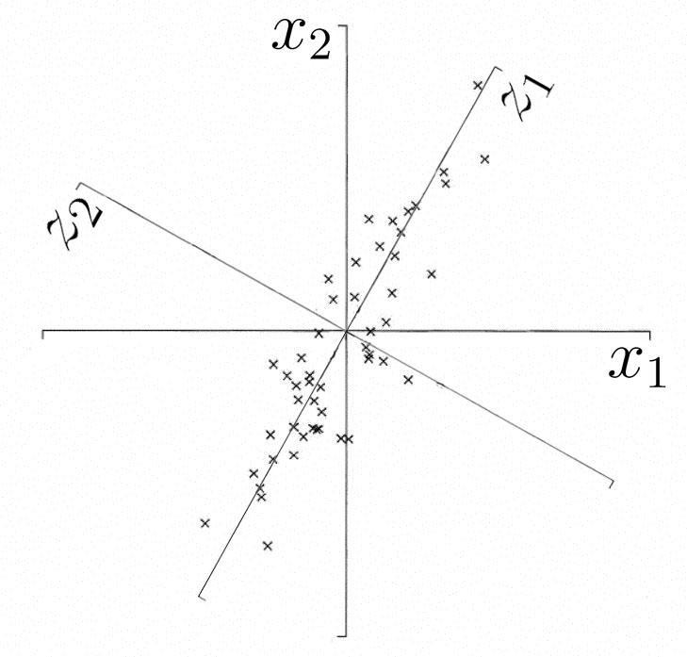
Principal Component Analysis (PCA)
Motivation
  Find bases which has high variance in data
  Encode data with small number of bases with low MSE
First PC is direction of maximum variance
Subsequent PCs are orthogonal to 1st PC and describe maximum residual variance
20

Slide 21
Principal Component Analysis (PCA)
Assume that
E[x] = 0 a = x^{T} q = q^{T} x
1
|| q ||= (q^{T} q) ² = 1
Find q’s maximizing variance!!
σ ² = E[a² ] – E[a]² = E[a² ]
= E[(q^{T} x)(x^{T} q)] = q^{T} E[xx^{T} ]q = q^{T} Rq
It can be shown that variance is maximized when q i s the principal component of R.
Principal component q can be obtained by eigenvector decomposition:
R = QΛQ^{T} , Q = [q₁,q₂ ,...,q _{j} ,...,q_{m} ], Λ = diag[λ₁,λ₂ ,...,λ _{j} ,...,λ_{m} ]
 Rq _{j} = λ_{j} q _{j}
j = 1, 2,..., m
Rq = λq

Slide 22
Principal Component Analysis (PCA)
5
2nd Principal Component, y₂
1st Principal Component, y₁
4
3
2
4.0
4.5
5.0
5.5
6.0

Slide 23
Principal Component Analysis (PCA)
5
^{x}i2
^{y}i,1
^{y}i,2
4
3
2
5.0 _{xi1} 5.5
4.0
4.5
6.0

Slide 24
Principal Component Analysis (PCA)
Advantage
  Reduce the dimension of the original data
    reduce time consumption in the training process, and improve efficiency
  Discard some information of the original data
    if this information is noise

Slide 25
Principal Component Analysis (PCA)
Limitation
  Discard some information of the original data
    if the discarded information is important, it is not appropriate to apply PCA
  The meaning of the principal component
    PC or basis may not be interpretable
  Linear model of PCA
    not suitable for nonlinear problem
  Assume first PC has higher importance

Slide 26
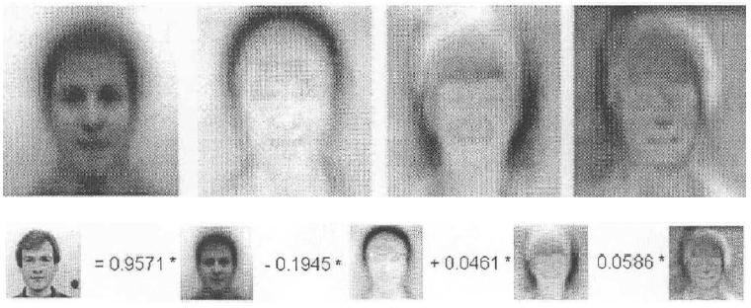
Case study: Eigenface
Face image: high-dimensional vector
face image = linear combination of eigenvectors The eigenvectors can be viewed as images.
Eigenfaces:
b₁
b₂
b₃
b₄
Original face image
26

Slide 27







THANK YOU
VISIT US
WWW.XJTLU.EDU.CN
FOLLOW US
@XJTLU
27

