Slide 1
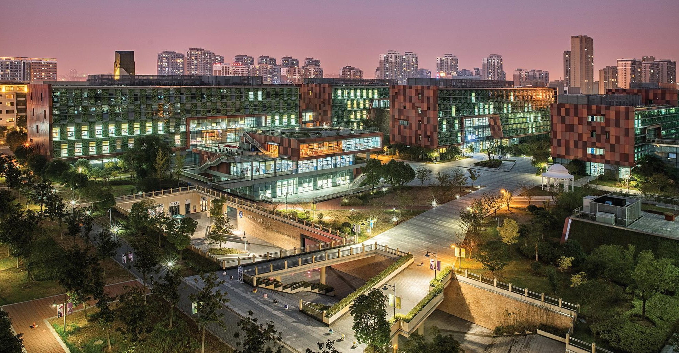

UNSUPERVISED LEARNING
INT301 Bio-computation, Week 10, 2025
1

Slide 2
Introduction
So far, we mainly studied neural networks that learn from their environment in a supervised manner
Neural networks can also learn in an unsupervised manner as well
Unsupervised learning discovers significant features or patterns in the input data through general rules that operate locally
Unsupervised learning networks typically consist of feed-forward connections and elements to facilitate
‘local’ learning
2

Slide 3
Hebbian Learning
A simple principle was proposed by Hebb in 1949 in the context of biological neurons
Hebbian principle
When a neuron repeatedly excites another neuron, then the threshold of the latter neuron is decreased, or the synaptic weight between the neurons is increased, in effect increasing the likelihood of the second neuron to excite
Hebbian learning rule Δw_{ji} = ηy_{j}x_{i}
  There is no desired or target signal required in the Hebb rule, hence it is unsupervised learning
3

Slide 4
Hebbian Learning
Consider the update of a single weight w (x and y are the pre- and post-synaptic activities)
w(n + 1) = w(n) + ηx(n)y(n)
For a linear activation function
w(n + 1) = w(n)[1 + ηx(n)x^{T}(n) ]
  Weights increase without bounds. If initial weight is negative, then it will increase in the negative. If it is positive, then it will increase in the positive range
Hebbian learning is intrinsically unstable, unlike
error-correction learning with BP algorithm
4

Slide 5
Hebbian Learning
Consider a single linear neuron with p inputs
y = w^{T}x = x^{T}w
and
Δw = η[x₁y x₂y … x_{p}y]^{T}
The dot product can be written as
y = |w||x| cos(α)
  α = angle between vectors x and w
    If α approaches 0 (x and w are ‘close’), y is large
    If α approaches 90 (x and w are ‘far’), y is zero

Slide 6
Hebbian Learning
A network trained with Hebbian learning creates a similarity measure (inner product) in its input space according to the information contained in the weights
  The weights capture (memorizes) the information in the data during training
During operation, when the weights are fixed, a large output y signifies that the present input is "similar" to the inputs x that created the weights during training

Slide 7
Oja’s Rule
The simple Hebbian rule causes the weights to increase (or decrease) without bounds
The weights need to be normalized to one as
w_{ji} (n) +ηx_{i} (n) y _{j} (n)
w (n +1) =
ji
Σ
[w_{ji} (n) +ηx_{i} (n) y _{j} (n)]
2
i
Oja proves that, for small η<<1, the above normalization can be approximated as:
w_{ji} (n +1) = w_{ji} (n) +ηy_{j} (n)[x_{i} (n) – y _{j} (n)w_{ji} (n)]
  This is Oja’s rule, or the normalized Hebbian rule
  It involves a ‘forgetting term’ that prevents the weights from growing without bounds

Slide 8
Oja’s Rule
It has been proved that using Lyapunov function analysis, Oja’s rule converges asymptotically, unlike Hebbian rule which is unstable
Oja’s rule creates a principal component in the input space as the weight vector when applied to a single neuron
How can we find other components in the input space with significant variance?

Slide 9
Dimensionality Reduction
One approach to deal with high dimensional data is by reducing their dimensionality.
Project high dimensional data onto a lower dimensional sub-space using linear or non-linear transformations.
⬆ y₁ 
⬆ x₁ 
⬇ _{x}  Reduce dimensionality
⬇ _{y} 
2 
2 
x = ⬇
y = ⬇
(K<<N)
⬇ ... 
⬇ _{x} 
⬇ ... 
⬇ _{y} 
?
 N ✗
 k ✗

Slide 10
Oja’s Rule
How to find the projection onto orthogonal direction?
  Deflation method: subtract the principal component from the input
Oja’s rule can be extended to extract multiple principal components

Slide 11
Oja’s Rule
Deflation procedure is adopted to compute the other eigenvectors
  Assume that the first component is already obtained, compute the projection of the first eigenvector on the input
y = w ^{T} x
1
Generate the modified input as
xˆ = x – w y = x – w w^{T} x
1 1 1
Repeat Oja’s rule on the modified data

Slide 12
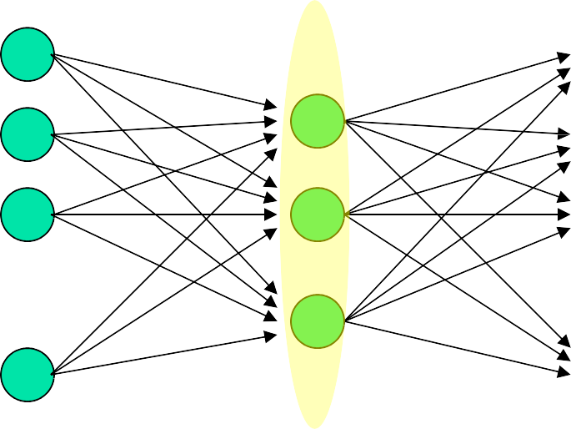
PCA in Neural Networks
Multi-layer networks with bottleneck layer
x₁
x₂ x₃
W_{L} W_{R}
y₁
y₂ y₃
x_{n} y_{n}
Train using auto-associative output: e = x – y
W_{L} spans the subspace of the first m principal eigenvectors.

Slide 13
PCA in Neural Networks
Using back-propagation for unsupervised learning
Try to make the output be the same as the input in a network with a central bottleneck.
  The activities of the hidden units in the bottleneck form an efficient code.
    The bottleneck does not have room for redundant features.
  Good for extracting independent features
output vector
code
input vector

Slide 14




PCA in Neural Networks
Back-propagation algorithm can be used for unsupervised learning to discover significant features that characterise input patterns.
This can be achieved by learning the identity mapping, passing the data through a bottleneck: auto-encoders
Input
Compressed Data
Output

Slide 15
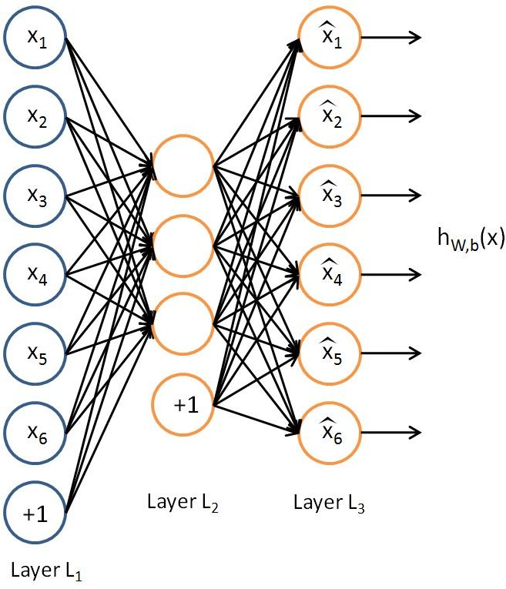
Auto-encoders (Rumelhart 86)
An Autoencoder is a feedforward neural network that learns to predict the input itself in the output.
() ₌ ()
The input-to-hidden part corresponds to an encoder
The hidden-to-output part corresponds to a decoder.

Slide 16
Auto-encoders (Rumelhart 86)
To reproduce the input patterns at output layer
Number of hidden layers and the sizes of the layers can vary
Auto-encoder tends to find a data description which resembles the PCA; while small number of neurons in the bottleneck layer of the diabolo network acts as an information compressor (code)

Slide 17
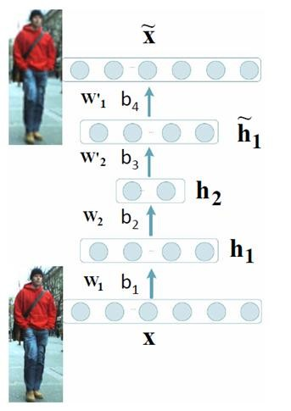
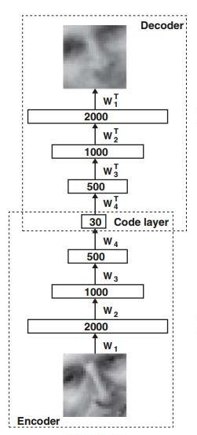
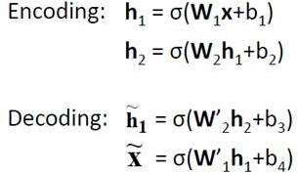
Deep Auto-encoder (Hinton 06)
A deep auto-encoder is constructed by extending the encoder and decoder of autoencoder with multiple hidden layers.

Slide 18
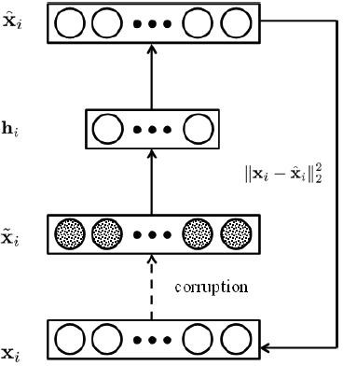


Denoising Auto-encoder (Vincent 08)
By adding stochastic noise, it can force auto-encoder to learn more robust features.
The loss function

Slide 19
Auto-encoders Network
The network tries to reproduce the input in the output, inducing an short encoding in the hidden layer.
This encoding retains the maximum amount of information about the input in a smaller dimensional space such that the input can be reconstructed.
Auto-encoder networks can be used for dimensionality reduction, compression, etc.

Slide 20
Clustering Revisit
Clustering analysis is the process of grouping a set of data into clusters
A cluster is a collection of data points where each observation is
  Similar to other observations in the same cluster;
  Dissimilar to observations in other clusters
Cluster analysis organizes data by abstracting the underlying structure either as a grouping of individuals, or as a hierarchy of groups.

Slide 21
Clustering Revisit
These groupings are based on measured or perceived similarities among the patterns.
Clustering is unsupervised. There are no category labels and other information about the source of data.
Typical applications
  As a stand-alone tool to get insight into data distribution
  As a preprocessing step for other algorithms

Slide 22
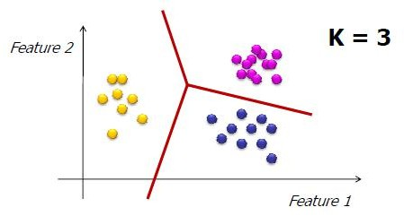
K-means algorithm Revisit
The k-means algorithm partitions the data into k mutually exclusive clusters

Slide 23
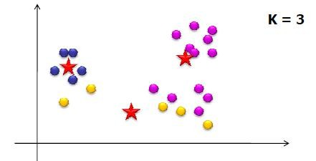
K-means algorithm Revisit
Objective: minimize the sum of squared distance to its “representative object” in each cluster
K
Σ Σ
d (x , µ )
2
j i
i=1 X _{j} ϵS_{i}
S_{i} is the i-th cluster (i=1,2,…K)
µ_{i} is the i-th centroid of the points in cluster S_{i} d is the distance function

Slide 24
K-means algorithm Revisit
Basically, the objective is to find the most compact
partitioning of the data set into k partitions
  Minimizing intra-cluster variance
  Maximizing inter-cluster variance
If we knew the cluster assignment of each point we could easily compute the centroid positions
If we knew the centroid positions we could easily assign each point to a cluster
But both are unknown

Slide 25
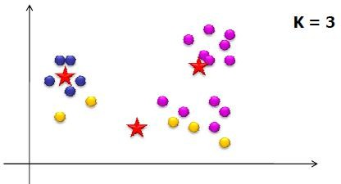
K-means algorithm Revisit
Choose the number of clusters - K
Randomly choose initial positions of K centroids
Assign each of the points to the “nearest centroid” (depends on distance measure)
Re-compute centroid positions
If solution converges  Stop!

Slide 26
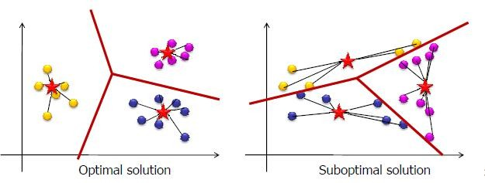
Things we need to consider
Does the algorithm guarantee convergence to an optimal solution?

Slide 27
Unsupervised Competitive Learning
In Hebbian networks, all neurons can “fire” at the same time
Competitive learning means that only a single neuron from each group fires at each time step
Output units compete with one another.
These are winner-takes-all (WTA) units
Competition is important for neural networks
  Competition between neurons has been observed in biological nerve systems
  Competition is important in solving many problems

Slide 28
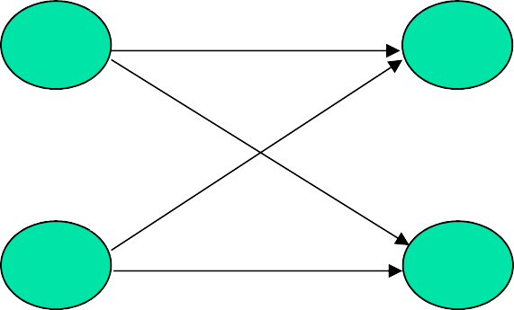
Unsupervised Competitive Learning
If these class nodes compete with each other, maybe only one will win eventually and all others lose (winner-takes- all). The winner represents the computed classification of the input
To classify an input pattern into one of the m classes
  idea case: only one node gives output 1, all the others are 0
  however, usually more than one nodes have non- zero output
x_1
c_1
x_n
INPUT
c_m
CLASSIFICATION

Slide 29
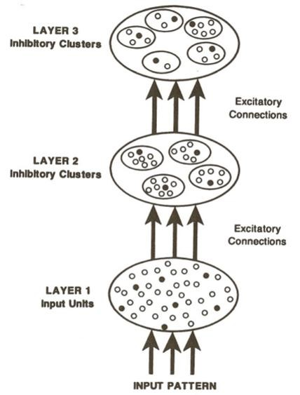
Unsupervised Competitive Learning
Units (active or inactive) are represented in the diagram as dots
  active units are represented by filled dots
  inactive ones by open dots
A unit in a given layer can
  receive inputs from all of the units in the next lower layer
  project outputs to all of the units in the next higher layer
Connections between layers are excitatory
Connections within layers are inhibitory
  each layer consists of a set of clusters of mutually inhibitory units
  the units within a cluster inhibit one another in such a way that only one unit per cluster may be active
The architecture of competitive learning mechanism29

Slide 30
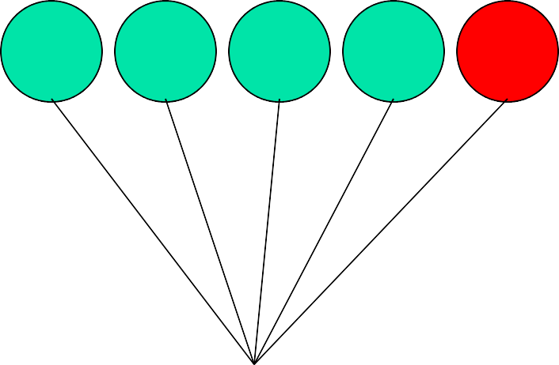
Winner-takes-all (WTA)
Among all competing nodes, only one will win and
all others will lose
winner
output
…
input (n-dimensional)

Slide 31
Winner-takes-all (WTA)
Easiest way to realize WTA: have an external, central arbitrator (a program) to decide the winner by comparing the current outputs of the competitors (break the tie arbitrarily)
This is biologically unsound (no such external arbitrator exists in biological nerve system)

Slide 32

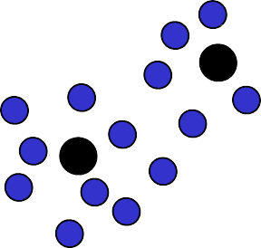










Simple Competitive Learning
initialize K prototype vectors
present a single example
identify the closest prototype, i.e., the so-called winner
move the winner even closer towards the example
Intuitively clear, plausible procedure
places prototypes in areas with high density of data
identifies the most relevant combinations of features
32

Slide 33
Simple Competitive Learning
Winner:
Note: the inner product of two normal vectors is related to the cosine of the angle between them
h =
Σ
w x
j
ji i
i
w_{j*}  x  w_{j}  x 6x
Winner = output node whose incoming weights are the shortest Euclidean distance from the input vector
Lateral inhibition
33

Slide 34
Simple Competitive Learning
(One possible) update rule for all neurons:
w = ηy (x – w )
The neuron with largest activation is then adapted to be more likely the input that caused the excitation
j*i j i
j*i
⇦ y _{j*} = 1

⇦ y _{j} = 0 if j s j *
Only the incoming weights of the winner node are modified.
Some units may never or rarely become a winner, and so
weight vector may not be updatedDEAD UNIT
34

Slide 35
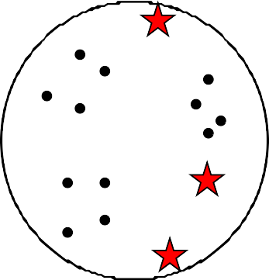
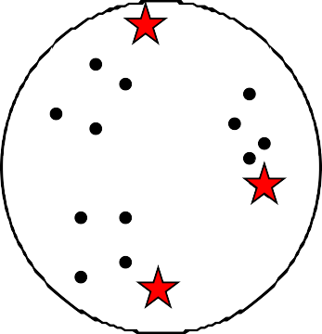
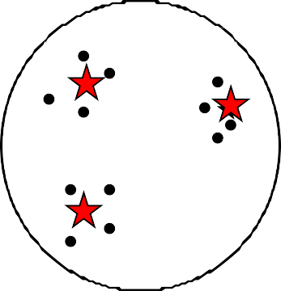
Simple Competitive Learning
Each output unit moves to the center of mass of a cluster of input vectors ➔
clustering

Slide 36
Enforcing fairer competition
Initial position of weight vector of an output unit may be in region with few (if any) patterns
Some units may never or rarely become a winner, and so weight vector may not be updated, thus preventing it finding richer part of pattern space
DEAD UNIT
More efficient to ensure a fairer competition where each unit has an equal chance of representing some part of training data

Slide 37


Leaky learning
Modify weights of both winning and losing units but at different learning rates
w(t +1) = w(t) + ^{ηw (x – w(t))}
η (x – w(t))
 L
where
which has the effect of slowly moving losing units towards denser regions pattern space.

Slide 38
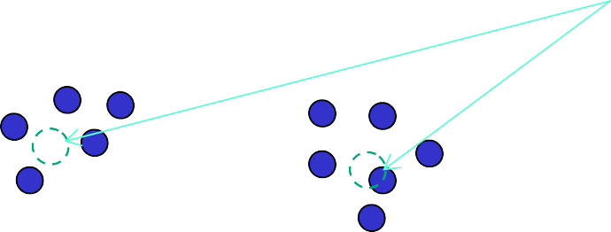



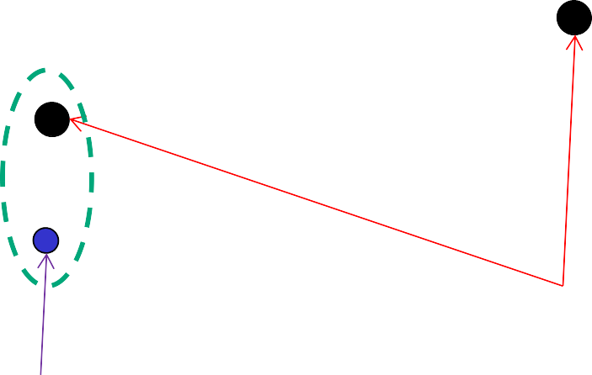

Leaky learning
Expected weights
Initial weights
Outlier

Slide 39





Leaky learning
winning unit
losing unit

Slide 40






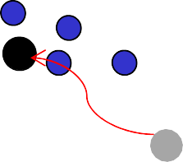
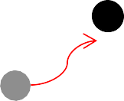

Leaky learning
move to denser regions

Slide 41
SCL Examples
6 Cases:
(0 1 1)
(0.2 0.2 0.2)
(0.4 0.6 0.5)
w = ηy (x – w
)
(1 1 0.5)
(0.5 0.5 0.5)
(0 0 0)
j*i
j i
j*i
 y = 1
⇦
j*
 y = 0
if j s j *
⇦
Learning Rate: 0.5
Initial Randomly-Generated Weight Vectors:
j
[ | 0.14 | 0.75 | 0.71 | ]
[ | 0.99 | 0.51 | 0.37 | ] | Hence, there are 3 | classes to | be | learned
[ | 0.73 | 0.81 | 0.87 | ]
Training on Input Vectors
Input vector # 1: [ 0.00 1.00 1.00 ]
Winning weight vector # 1: [ 0.14 0.75 Updated weight vector:
0.71 ] Distance: 0.41
[ 0.07 0.87 0.85 ][ 0.99 0.51 0.37 ] [ 0.73 0.81 0.87 ]
Input vector # 2: [ 1.00 1.00 0.50 ]
Winning weight vector # 3: [ 0.73 0.81 Updated weight vector:
0.87 ] Distance: 0.50
[ 0.07 0.87 0.85 ][ 0.99 0.51 0.37 ][ 0.87 0.90 0.69 ]
41

Slide 42
w_{j*i} = ηy _{j} (x_{i} – w_{j*i} )
SCL Examples
⇦ y _{j*} = 1
Input vector # 3: [ 0.20 0.20 0.20 ]
Winning weight vector # 2: [ 0.99 0.51 Updated weight vector:
 _{y}
= 0 if
j s j *
0.86
⇦
j
0.37 ] Distance:
[ 0.07 0.87 0.85 ][ 0.59 0.36 0.29 ][ 0.87 0.90 0.69 ]
Input vector # 4: [ 0.50 0.50 0.50 ]
Winning weight vector # 2: [ 0.59 0.36 Updated weight vector:
0.29 ] Distance: 0.27
[ 0.07 0.87 0.85 ][ 0.55 0.43 0.39 ][ 0.87 0.90 0.69 ]
Input vector # 5: [ 0.40 0.60 0.50 ]
Winning weight vector # 2: [ 0.55 0.43 Updated weight vector:
0.39 ] Distance: 0.25
[ 0.07 0.87 0.85 ][ 0.47 0.51 0.45 ][ 0.87 0.90 0.69 ]
Input vector # 6: [ 0.00 0.00 0.00 ]
Winning weight vector # 2: [ 0.47 0.51 Updated weight vector:
0.45 ] Distance: 0.83
[ 0.07 0.87 0.85 ][ 0.24 0.26 0.22 ][ 0.87 0.90 0.69 ]
Finish of Epoch 1
42

Slide 43
SCL Examples
Clusters after epoch 1:
Weight vector # 1: [ 0.07 0.87
Input vector # 1: [ 0.00
0.85 ]
1.00 1.00 ]
0.22 ]
Weight vector # 2: [ 0.24 0.26
Input | vector | # | 3: | [ | 0.20 | 0.20 | 0.20 | ]
Input | vector | # | 4: | [ | 0.50 | 0.50 | 0.50 | ]
Input | vector | # | 5: | [ | 0.40 | 0.60 | 0.50 | ]
Input | vector | # | 6: | [ | 0.00 | 0.00 | 0.00 | ]
Weight vector # 3: [ 0.87 0.90
Input vector # 2: [ 1.00
Weight Vectors after epoch 2:
0.69 ]
1.00 0.50 ]
[ | 0.03 | 0.94 | 0.93 | ]
[ | 0.19 | 0.24 | 0.21 | ]
[ | 0.93 | 0.95 | 0.59 | ]
Clusters after epoch 2: unchanged.

Slide 44
SCL Examples
6 Cases
(0.9 0.9 0.9) | (0.8 | 0.9 0.8)
(1 0.9 0.8) | (1 1 | 1)
(0.9 1 1.1) | (1.1 | 1 0.7)
other parameters:
Three Initial Weight Vectors Generated from Set: {0.8 Learning rate: 0.5
# Epochs: 10
1.0 1.2}
Run same case twice, but with different initial randomly- generated weight vectors.
The clusters formed are highly sensitive to the initial weight vectors.

Slide 45
SCL Examples
Initial Weight Vectors:
[ | 1.20 | 1.00 | 1.00 | ]
[ | 1.20 | 1.00 | 1.20 | ]
[ | 1.00 | 1.00 | 1.00 | ]
Clusters after 10 epochs:
Weight vector # 1: [ 1.07 0.97 0.73 ]
Input vector |  | # 3: |  | [ 1.00 |  | 0.90 | 0.80 | ]
Input vector |  | # 6: |  | [ 1.10 |  | 1.00 | 0.70 | ]
Weight vector # |  | 2: [ |  | 1.20 | 1.00 | 1.20 ]
Weight vector # |  | 3: [ |  | 0.91 | 0.98 | 1.02 ]
Input | vector | # | 1: | [ | 0.90 | 0.90 | 0.90 | ]
Input | vector | # | 2: | [ | 0.80 | 0.90 | 0.80 | ]
Input | vector | # | 4: | [ | 1.00 | 1.00 | 1.00 | ]
Input | vector | # | 5: | [ | 0.90 | 1.00 | 1.10 | ]
** Weight vector #3 is the big winner & #2 loses completely!!

Slide 46
SCL Examples
Initial Weight Vectors:
[ | 1.00 | 0.80 | 1.00 | ] | * Better balance of | initial | weights
[ | 0.80 | 1.00 | 1.20 | ]
[ | 1.00 | 1.00 | 0.80 | ]
Clusters after 10 epochs:
Weight vector # 1: [ 0.83 0.90 0.83 ]
Input vector | # 1: | [ 0.90 |  | 0.90 | 0.90 | ]
Input vector | # 2: | [ 0.80 |  | 0.90 | 0.80 | ]
Weight vector # | 2: [ | 0.93 | 1.00 | 1.07 ]
Input vector | # 4: | [ 1.00 |  | 1.00 | 1.00 | ]
Input vector | # 5: | [ 0.90 |  | 1.00 | 1.10 | ]
Weight vector # | 3: [ | 1.07 | 0.97 | 0.73 ]
Input vector | # 3: | [ 1.00 |  | 0.90 | 0.80 | ]
Input vector | # 6: | [ 1.10 |  | 1.00 | 0.70 | ]
** 3 clusters of equal size!!

Slide 47
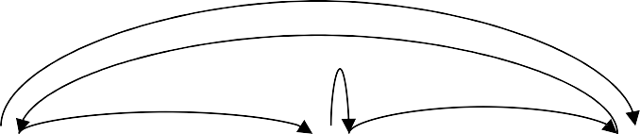
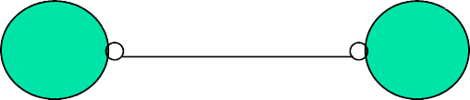
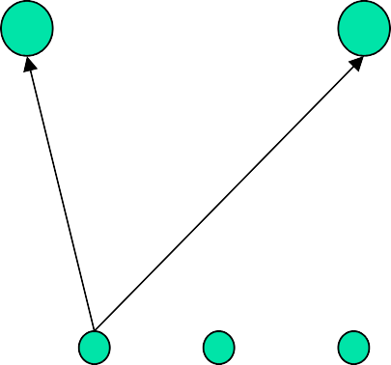


Maxnet
Lateral inhibition
output of each node feeds to others through inhibitory connections (with negative weights)
w_{ij} , w_{ji} < 0
x_{i} x_{j}
1
2
3
A specific competitive net that performs Winner Take All (WTA) competition is the Maxnet





1
2
3
4
5

Slide 48
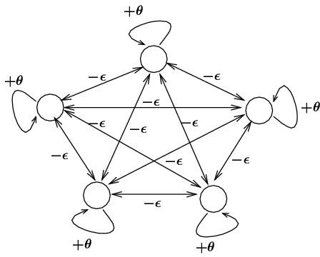
Maxnet
Maxnet
Lateral inhibition between competitors
₌ θ if i = j
weights : w
ji
– s otherwise

node function :
if x > 0
f ( x ) = ^{ x}
₀

otherwise

Slide 49
Maxnet
₌ θ if i = j
weights : w
ji
– s otherwise

node function :
if x > 0
f ( x ) = ^{ x}
₀
otherwise

Notes:
Competition: iterative process until the net stabilizes (at most one node with positive activation)
0 < s < 1 / m , where m is the # of competitors
s too small: takes too long to converge
s too big: may suppress the entire network (no winner)

Slide 50
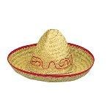
Mexican Hat Network
Among all competing nodes, only one will win and all others will lose
  The neuron with the largest activation level among all neurons in the output layer becomes the winner. This neuron is the only neuron that produces an output signal. The activity of all other neurons is suppressed in the competition.
We mainly deal with single winner WTA, but multiple winners WTA are possible
  The lateral connections produce excitatory or inhibitory effects, depending on the distance from the winning neuron
  This is achieved by the use of a Mexican Hat function, which describes synaptic weights between neurons in the output layer.

Slide 51
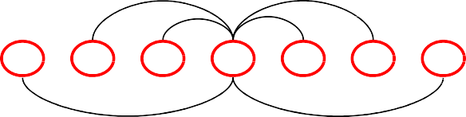


Mexican Hat Network
Architecture: For a given node,
  close neighbors: cooperative (mutually excitatory , w > 0)
  distant neighbors: competitive (mutually inhibitory, w < 0)
  too far away neighbors: irrelevant (w = 0)
Connection strength
w₂ w₂
1
Excitatory effect
w
w
0
Distance
Inhibitory effect
3
3
Inhibitory effect
Need a definition of distance (neighborhood):
  one dimensional: ordering by index (1,2,…n)
  two dimensional: lattice

Slide 52
Mexican Hat Network
Connection strength
1
Excitatory effect
0
Distance
Inhibitory effect
Inhibitory
Equilibrium: ^{effect}
negative input = positive input for all nodes
winner has the highest activation
its cooperative neighbors all have positive activations
its competitive neighbors all have negative (or zero) activations

Slide 53
Example
weights
c₁ if distance(i, j) < k (c₁ > 0)
c₂ if
if
₌ ⇦
distance(i, j) = k (0 < c₂ < c₁ ) distance(i, j) > k (c₃  0)
w
ij
⇦^{c}3
activation function
0 if x < 0
if 0  x  max
if x > max
f ( x) = ⇦x

⇦max
ramp function :
53

Slide 54
Vector Quantization
Application of competitive learning
Idea
  categorize a given set of input vectors into M classes using competitive learning algorithms
  represent any vector just by the class into which it falls
Important application of competitive learning (esp. in data compression)
  divides entire pattern space into a number of separate
subspaces
  set of M units represent set of prototype vectors:
CODEBOOK
  new pattern x is assigned to a class based on its closeness to a prototype vector using Euclidean distances

Slide 55
Vector Quantization
A codebook
  a set of centroids/codewords/codevector):
{m₁ , m₂ ,😐, m_{K} }
A quantization function:
q(x_{i} ) = m_{k}
Often, the nearest-neighbor function
K-means can be used to construct the codebook

Slide 56
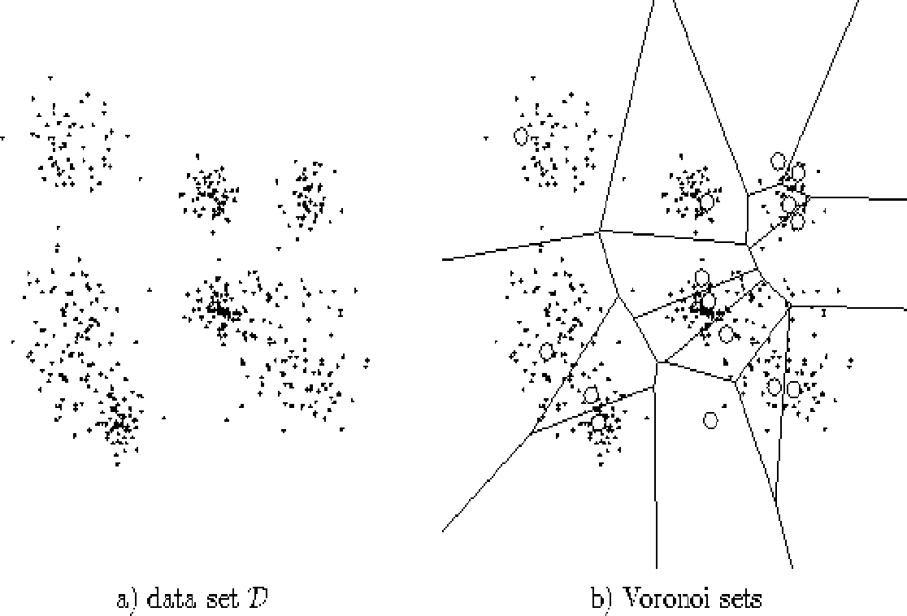


Vector Quantization
encoding region
partition of the space
Data
Voronoi diagram
code vectors
A Voronoi diagram is a partitioning of a plane into regions based on distance to points in a specific subset of the plane. For each seed there is a corresponding region consisting of all points closer to that seed than to any other. These regions are called Voronoi cells.
56

Slide 57
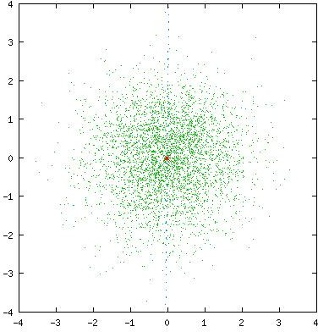
Vector Quantization
LBG design algorithm for VQ
  NOT within the scope of this module
Two-dimensional VQ animation
57

Slide 58







THANK YOU
VISIT US
WWW.XJTLU.EDU.CN
FOLLOW US
@XJTLU
58

