Slide 1
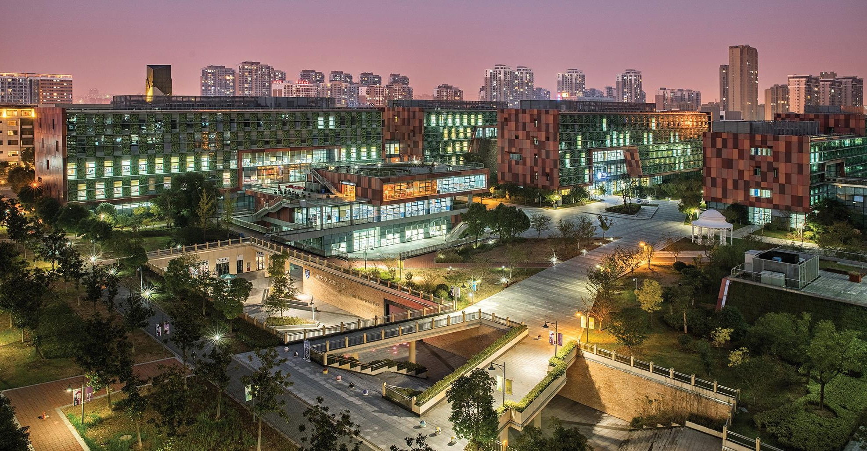

SELF-ORGANIZING FEATURE MAP
INT301 Bio-computation, Week 11, 2025

Slide 2
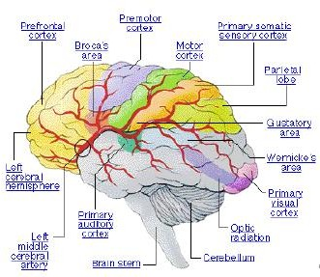
Self-Organizing Map – Biological Motivation
Brain is a self-organizing system that can learn by itself by changing (adding, removing, strengthening) the interconnections between neurons.
Neurons with similar functions are grouped together.

Slide 3
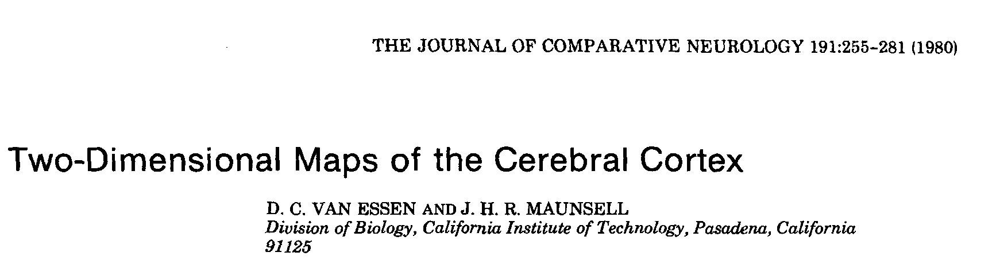
Self-Organizing Map – Biological Motivation
Neurons with similar functions are grouped together.
The brain processes multidimensional signals from the external world in a “2”-dimensional internal map.

Slide 4
Feature Maps
Result of the brain’s self-organization
  formation of feature maps in the brain that have a linear or planar topology (that is, they extend in one or two dimensions)
Examples:
  tonotopic map - sound frequencies are spatially mapped into regions of the cortex in an orderly progression from low to high frequencies.
  retinotopic map - visual field is mapped in the visual cortex with higher resolution for the centre of the visual field
  somatosensory map - mapping of touch

Slide 5
Feature Maps
Sensory experience is multidimensional
  E.g. sound is characterised by pitch, intensity, noise…
The brain maps the external multidimensional representation of the world into a similar 1 or 2 dimensional internal representation.
That is, the brain processes the external signals in a topology-preserving way.
So, if we are to have a hope of mimicking the way the brain learns, our system should be able to do the same thing.
5

Slide 6
Topographic Maps
Extend the ideas of competitive learning to incorporate the neighborhood around inputs and neurons
We want a nonlinear transformation of input pattern space onto output feature space which preserves neighbourhood relationship between the inputs
  A feature map where nearby neurons respond to similar inputs
  Neurons selectively tune to particular input patterns in such a way that the neurons become ordered with respect to each other so that a meaningful coordinate system for different input features is created

Slide 7
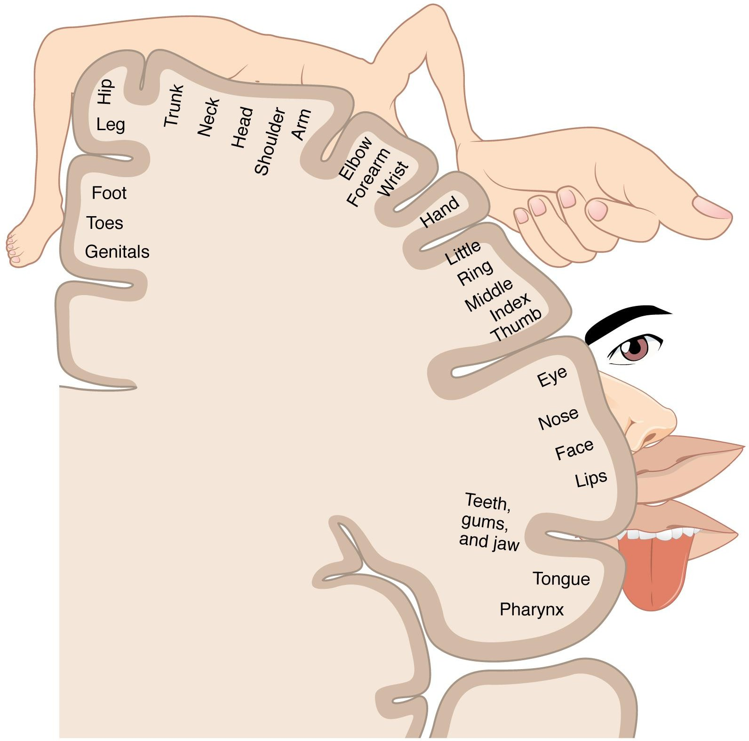
Topographic Maps
E.g. the cortical homunculus, a map of somatosensory areas of the brain

Slide 8












Topographic Maps
Spatial locations are indicative of the intrinsic statistical features of the input patterns: i.e., close in the input close in the output

Slide 9
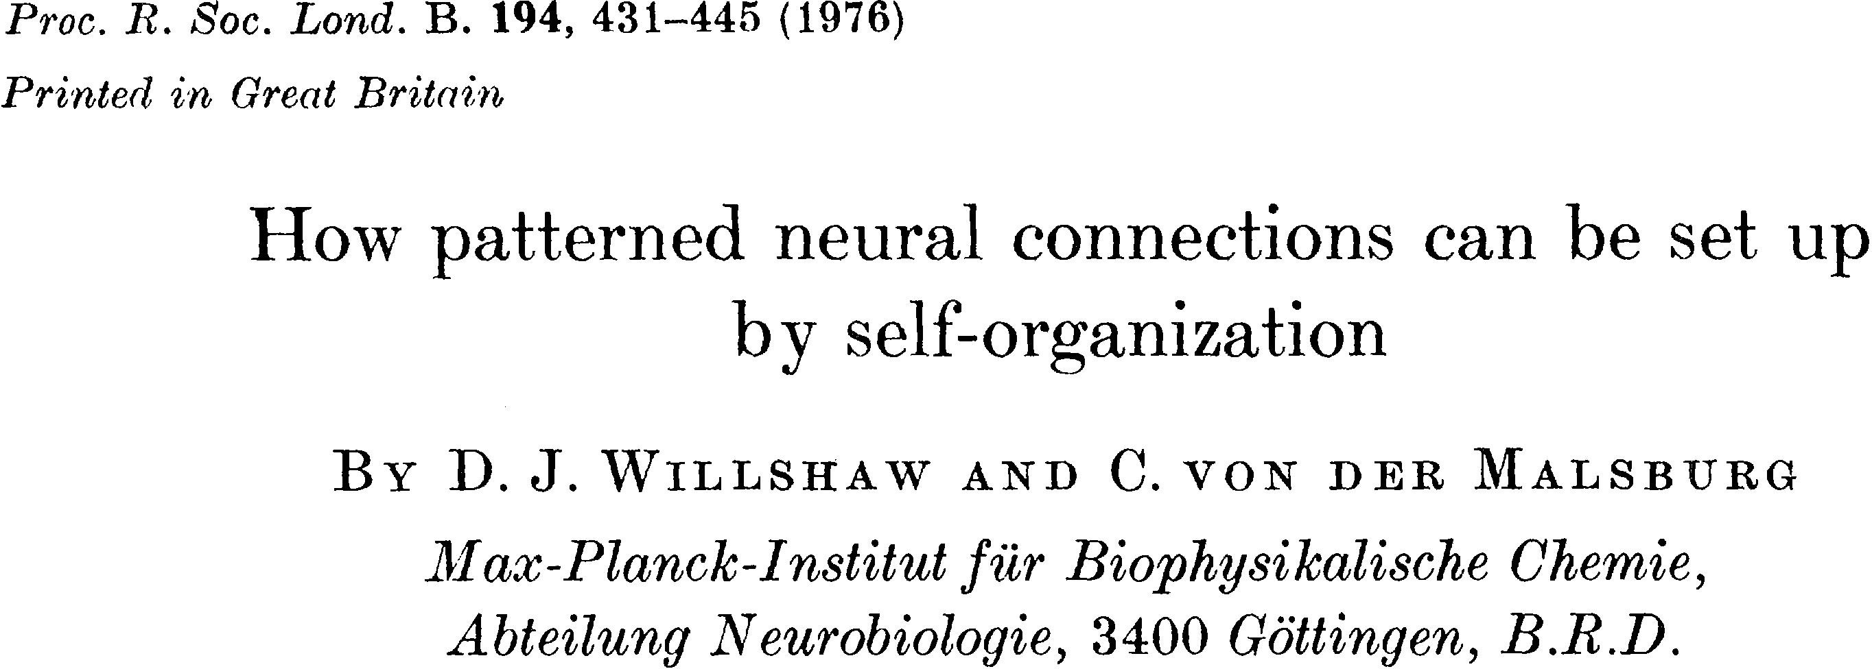
Topographic Maps
Activity-based self-organization (von der Malsburg)
Incorporation of competitive and cooperative mechanisms to generate feature maps using unsupervised learning networks

Slide 10
Topographic Maps
Biologically motivated: how can activity-based learning using highly interconnected circuits lead to orderly mapping of visual stimulus space onto cortical surface?
2 layer network each cortical unit fully connect to visual space via
cortical units
Hebbian units
Interconnections of cortical units described by ‘Mexican-hat’ function: short-range excitation and long-range inhibition
visual space

Slide 11
Topographic Maps
Activity-based self-organization (von der Malsburg): after learning, a topographic map appears. However, input dimension is the same as output dimension
Kohonen simplified this model and called it Kohonen’s self-organizing map (SOM) algorithm
  more general as it can perform dimensionality reduction
  SOM can be viewed as a vector quantization type algorithm

Slide 12
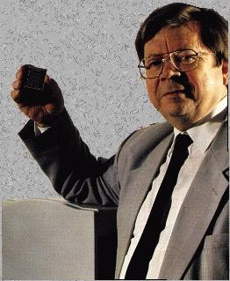
Self-Organizing Map (SOM)
a.k.a. as Kohonen networks
  represents the embodiment of the ideas we have discussed so far
  named after Dr. Eng. Teuvo Kohonen, Helsinki Uni of Technology

Slide 13
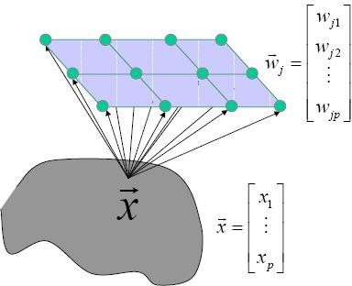
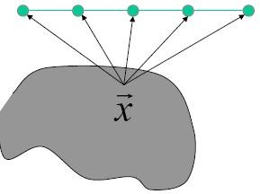
SOM
The idea in an SOM is to transform an input of arbitrary dimension into a 1 or 2 dimensional discrete map
Two possible architectures

Slide 14
SOM
The idea in an SOM is to transform an input of arbitrary dimension into a 1 or 2 dimensional discrete map
Again, 2 layers of neurons with all inputs connecting to each output. Output neurons are held in a one or (usually) 2D lattice, where position in the lattice defines the distance between the neurons

Slide 15
SOM
Once weights of net initialized, algorithm comprises 3 processes:
1. Competition
  Given an input pattern, outputs compete to see who is winner based on a discriminant function (e.g. similarity of input vector and weight vector)
2. Cooperation
  Winning neuron determines spatial location of a topological neighborhood within which output neurons excited
3. Synaptic Adaptation
  Excite neurons adapt weights so that value of discriminant function increases (a similar input would
result in enhanced response from winner)
15

Slide 16
SOM Training Algorithm
Competition
Cooperation
Synaptic Adaptation
Learning Principle
Competitive learning where winning ”spills over” to neighbors

Slide 17
Initialization
Grid: size and structure fixed a priori (most of the times, 2-dimensional grid are used)

Slide 18
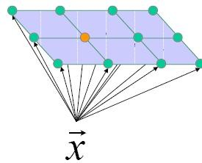
Competitive Process
Winner neuron
(1) ∗ = 𝑎𝑟𝑔 ( )
(2)
∗ = 𝑎𝑟𝑔 (
− )
A continuous input space of activation patterns is mapped onto a discrete output space of neurons by a process of competition among the neurons in the network.

Slide 19
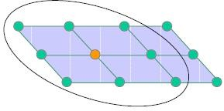
Cooperative Process
“ The winning neuron locates the center of a topological neighborhood of cooperating neurons”
“ … a neuron that is firing tends to excite the neurons in its immediate neighborhood more than those further away from it …”

Slide 20
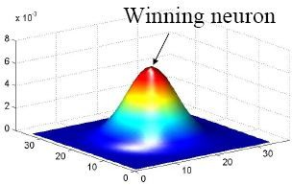
Cooperative Process
The topological neighborhood h_{j,i}
symmetric around the winning neuron and achieve its maximum value at the winning neuron
the amplitude decreases monotonically with the increasing lateral distance
_{d} 2
( 
h = exp – ^{j ,i} 
j ,i
2σ ² 


Slide 21
Cooperative Process
The topological neighborhood h_{j,i} shrinks with time
(
_{d} 2

( t 
σ (t) = σ exp  –
h (t) = exp –
j ,i
2σ ² (t)



0
τ
j ,i
 1 
 
Neighbors of the winning node are also allowed to update, even if they are not close to winning!

Slide 22
Neighborhood
Large neighborhood
  Good global ordering
  Bad local fit
Small neighborhood
  Bad global ordering
  Good local fit
By gradually shrinking the neighborhood we can get the best of both!
  Ordering phase (large neighborhood)
  Convergence phase (small neighborhood)
22

Slide 23
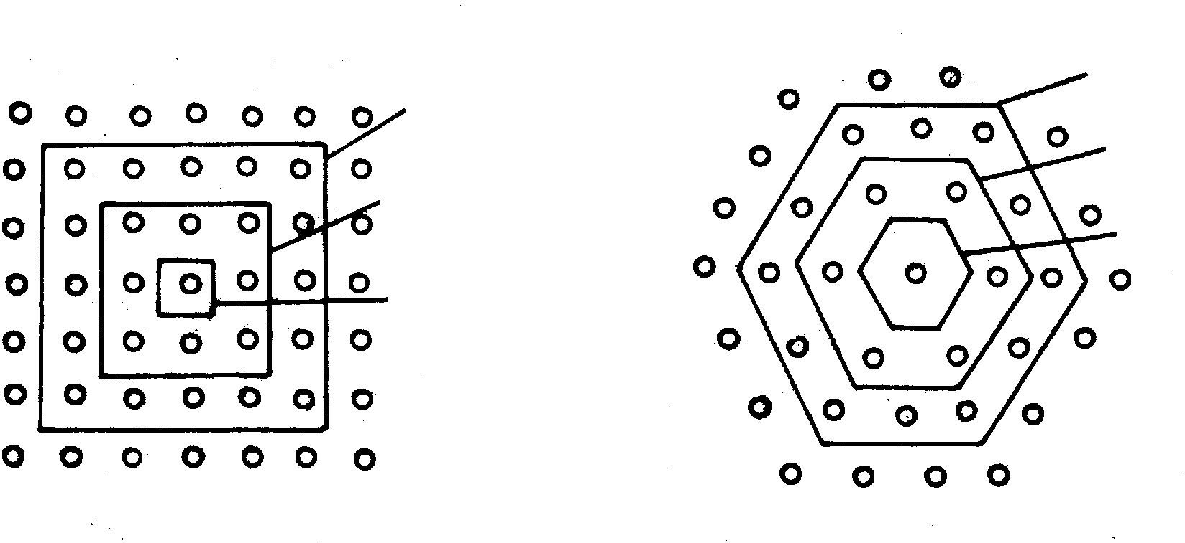
Neighborhood
N_{j*}(0)
N_{j*}(0)
N_{j*}(1)
N_{j*}(1)
N_{j*}(2)
N_{j*}(2)
Using a planar array of neurons with rectangular or hexagonal neighborhoods, an input vector x is applied simultaneously to all nodes.

Slide 24
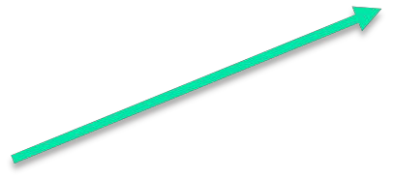
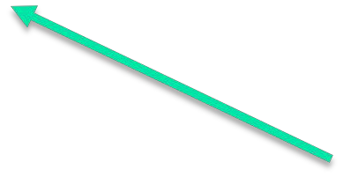
Adaptive Process
Update the weights in relation to the inputs
w _{j} (t +1) = w _{j} (t) +η (t)h_{j, i} (t)(x – w _{j} (t))
Learning rate
Neighborhood function
_{d} 2
( – t 
( 
η(t) = η₀ exp
_{τ} 
h (t) = exp – ^{j ,i} 
 1 
j ,i
2σ ² (t) 


Slide 25
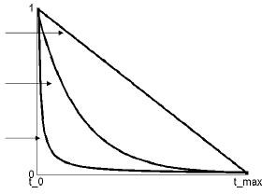
Learning Rate
Possible options:
η(t) = –at + b
η(t) = exp(–at) + b
η(t) = ¹ + b
at

Slide 26
Summary
Initialization
Draw an input sample x
Winner neuron j*
𝑎𝑟𝑔( ) 𝑎 𝑎𝑟𝑔(
−
)
Update
w _{j} (t +1) = w _{j} (t) +η(t)h_{j ,i} (t)(x – w _{j} (t))
(
_{d} 2

( 
h (t) = exp  –
j ,i
η(t) = η exp
– t
j ,i
2σ ² (t)

0
 _{τ} 


 1 

Slide 27
Property of SOM
Approximate the input space
Topological ordering
Density matching
Feature selection (features of the underlying distribution)

Slide 28

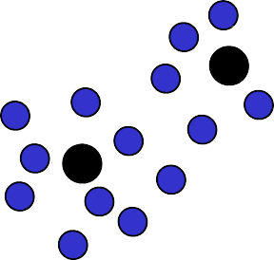










Unsupervised Competitive Learning
Recall:
initialize K prototype vectors
present a single example
identify the closest prototype, i.e., the so-called winner
move the winner even closer towards the example
Intuitively clear, plausible procedure
places prototypes in areas with high density of data
identifies the most relevant combinations of features
28

Slide 29
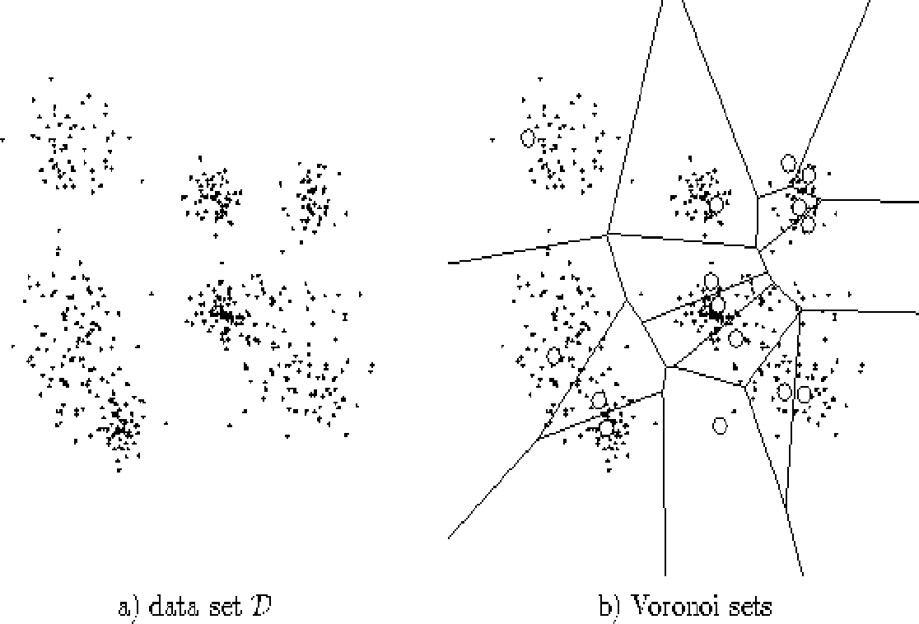


Recall:
Vector Quantization
encoding region
partition of the space
Data
Voronoi diagram
code vectors
A Voronoi diagram is a partitioning of a plane into regions based on distance to points in a specific subset of the plane. For each seed there is a corresponding region consisting of all points closer to that seed than to any other. These regions are called Voronoi cells.
29

Slide 30
More on Vector Quantization
In VQ techniques, a number of local Voronoi centers are formed to represent input vectors.
For a set of M reference vectors, {w₁,…,w_{M}}, an input vector x is considered being best matched by w_{k} in the sense that an appropriately defined distortion measure such as the squared Euclidean distance ||x-w_{k}||² is minimal.
The reference vectors partition the input space R^{L} into the Voronoi cells/polygons defined as
V = {x ϵ R^{L} | || x – w |||| x – w ||, 6l}
k k l
30

Slide 31
Vector Quantizer
V = {x ϵ R^{L} | || x – w |||| x – w ||, 6l}
k k l
input space is divided into a number of distinct regions, and for each region a reconstruction vector is defined
•
The collection of possible reference vectors is called the codebook of the quantizer, and its members are called code vectors.
The SOM algorithm provides an approximation method for computing the Voronoi vectors in unsupervised manner.
•
•
•
Code vectors
31

Slide 32
Learning Vector Quantizer (LVQ)
input
class labels
SOM
LVQ
teacher
LVQ is a supervised learning technique that uses class information to move the Voronoi vectors slightly, so as to improve the quality of the classifier decision regions.
31

Slide 33
LVQ1
An input vector x is picked at random from the input space.
If the class labels of the input vector x and a Voronoi vector w agree, the Voronoi vector w is moved in the direction of the input vector x.
If the class labels of the input vector x and the Voronoi vector w disagree, the Voronoi vector w is moved away from the input vector x.
if the winner belongs to the right class
w^{new} = w^{old} +η(x – w)
if the winner belongs to the wrong
class
w^{new} = w^{old} –η(x – w)
33

Slide 34










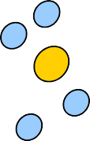








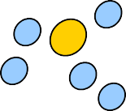

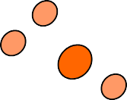











LVQ2
Initialize prototype vectors (for different classes)
Present a single example
Identify closest correct
and closest wrong prototypes
Move the corresponding winner towards / away from the example
34

Slide 35
LVQ Discussion
Stopping criteria
  Codebook vectors have stabilized
  Or maximum number of epochs has been reached
Advantages
  Appear plausible, intuitive, flexible
  Fast and easy to implement
  Frequently applied in a variety of problems involving the classification of structured data
Disadvantages
  Not stable for overlapping classes
■ Very sensitive to initialization
35

Slide 36







THANK YOU
VISIT US
WWW.XJTLU.EDU.CN
FOLLOW US
@XJTLU
36

