Slide 1


ASSOCIATIVE MEMORIES & HOPFIELD NETWORK
INT301 Bio-computation, Week 12, 2025

Slide 2
Memory in Computer System
Standard computer memory is accessed through assigned addresses.
When a user searches for a file, the CPU must convert the request to a numerical instruction and then search through the memory for the corresponding address
A computer's memory is most commonly referred to as RAM (random access memory).

Slide 3
Associative Memory & Pattern Association
An associative memory is a content- addressable structure that maps a set of input patterns to a set of output patterns.
That is, memory can be directly accessed by the content, rather than the physical address in the memory.

Slide 4
Associative Memory & Pattern Association
Associative memory is often linked to pattern association
  Associating patterns which are
    similar
    contrary
    in close proximity (spatial)
    in close succession (temporal)
  Associative recall
    evoke associated patterns
    recall a pattern by part of it
    evoke/recall with incomplete/noisy patterns

Slide 5
Associative Memories
Two types of associative memory: auto- associative and hetero-associative.
Auto-association
  retrieves a previously stored pattern that most closely resembles the current pattern.
Hetero-association
  the retrieved pattern is, in general, different from the input pattern not only in content but possibly also in type and format.

Slide 6








Associative Memories
Auto-association
memory
Hetero-association
Former
US President
memory
memory

Slide 7
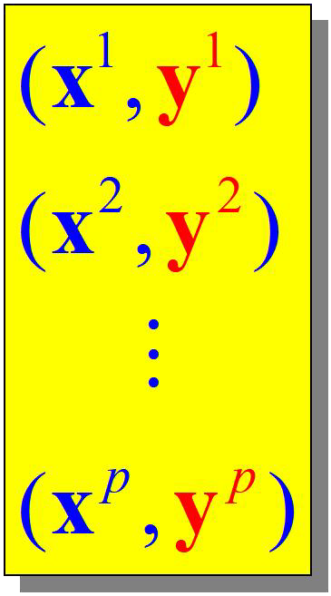
Associative Memories
Stored Patterns
x^{i} Ξ y^{i} x^{i} s y^{i}
Autoassociative
Heteroassociative
x^{i} ϵ R^{n}
y^{i} ϵ R^{m}

Slide 8
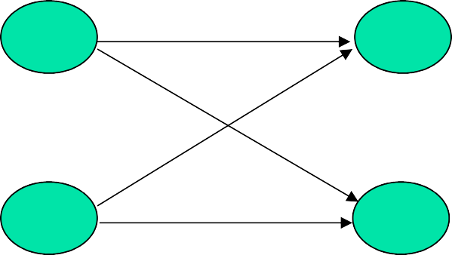
Simple AM
Network structure: single layer
  one output layer of non-linear units and one input layer
  similar to the simple network for classification
w_11
s_1 x_1 y_1 t_1
w_1m w_n1
w_nm
s_n
x_n
y_m
t_m
Goal of learning:
  to obtain a set of weights w_ij
  from a set of training pattern pairs {s :t}
  such that when s is applied to the input layer, t is computed at the output layer
8

Slide 9
Simple AM
Similar to Hebbian learning for classification
Algorithm: (bipolar or binary patterns)
For each training samples s :t
w_{ij} = s_{i}  t _{j}
w_{ij}
increases if both input and output are ON
(binary) or have the same sign (bipolar)
If w_{ij} = 0 initially, then after updates for all P training patterns
P
w_{ij} = Σs_{i} ( p)t _{j} ( p)
W = {w_{ij} }
p=1
Instead of obtaining W by iterative updates, it can be computed from the training set by calculating the outer product of s and t.
9

Slide 10


Simple AM
Outer product: Let s and t be row vectors. Then for a particular training pair s:t
⬆s₁ 
⬇ 
⬇ 
⬇ 
⬆s₁t₁......s₁t_{m}  ⬆w₁₁......w_{1m} 
⬇



⬇s t ......s t 
[ ]
⬇
⬇
2 1 2 m _{ = ⬇}
W(p) = s^{T} (p)
t(p) =
t ,......t =
1
m
 ⬇
⬇ 
⬇  ⬇ 
^{s}n ✗
s_{n}t₁......s_{n}t_{m ✗ }w_{n1}......w_{nm ✗}
P
and W ( P) = Σ s^{T} ( p)
t ( p)
p =1
It involves 3 nested loops p, i, j (order of p is irrelevant)
p= 1 to P
i = 1 to n
j = 1 to m
/* for every training pair */
/* for every row in W */
/* for every element j in row i */
w_{ij} := w_{ij} + s_{i} ( p)  t _{j} ( p)
10

Slide 11
Simple AM
Does this method provide a good association?
  Recall with training samples (after the weights are learned or computed)
Apply s(k) to one layer, hope appear on the other, e.g. f (s(k)W ) = t(k)
t(k)
May not always succeed (each weight contains some information from all samples)
P P
s(k )W = s(k )Σs^{T} ( p) t( p) = Σs(k )s^{T} ( p)t( p)
p=1 p=1
= s(k ) s^{T} (k ) t(k ) + Σs(k ) s^{T} ( p) t( p)
psk
= s(k ) ² t(k ) + Σs(k ) s^{T} ( p) t( p)
psk
principal term
cross-talk term
11

Slide 12
Simple AM
Principal term gives the association between s(k) and t(k).
Cross-talk represents correlation between s(k):t(k) and other training pairs. When cross-talk is large, s(k) will recall something other than t(k).
If all s(p) are orthogonal to each other, then ^{s(k)sT ( p) = 0} , no sample other than s(k):t(k) contribute to the result.
However, there are at most n orthogonal vectors in an n- dimensional space.
Cross-talk increases when P increases.
12

Slide 13
Example 1: hetero-associative
Binary pattern pairs s :t with |s| = 4 and |t| = 2.
Total weighted input to output units: y _ in _{j}
Activation function: threshold
⁼ Σ ^{x} i ^{w} ij
i
if y _ in_{j} > 0
if y _ in_{j}  0
y = ^{1}
₀
j

Weights are computed (sum of outer products of all training pairs)
P
W =
Training samples:
Σ
s
T
( p)t ( p)
i j
p=1
s(p)
t(p)
p=1 | (1 0 0 0) | (1, 0)
p=2 | (1 1 0 0) | (1, 0)
p=3 | (0 0 0 1) | (0, 1)
p=4 | (0 0 1 1) | (0, 1)
13

Slide 14



Example 1: hetero-associative
(1 
 ₀ 
(1 0 
 ₀ ₀ 
(1 
₁ 
(1 0 
₁ ₀ 
 ₍₁
0) = 

 0 0 
 ₀ ₀ 
 ₍₁
0) = 

 0 0 
 ₀ ₀ 
s^{T} (1) t(1) = 
s^{T} (2)
t(2) = 
 0 
 ₀ 
 0 
 ₀ 
 
( 0 
 ₀ 

( 0 0 
 ₀ ₀ 

 
( 0 
 ₀ 
 
( 0 0 
 ₀ ₀ 
s^{T} (3) t(3) =  (0
1) = 

 0 0 
 ₀ ₁ 
s^{T} (4)
t(4) =  (0
1) = 

 0 1 
 0 1 
 0 
1 
₁ 
 
 
 
 
¹ 
( 2 0
 
0 
P
Computing the weights W =
Σ
p=1
s ^{T} ( p)t ( p)
i j
W = ^{1}
 ₀ ₁ 
 
 0 2
14

Slide 15
Example 1: hetero-associative
x=(1 0 0 0)
x=(0 1 0 0) similar to S(1) and S(2)
( 2 0
( 2 0
₁ ₀ 
₁ ₀ 
(1 0 0 0)
 
= (2 0)
(0 1 0 0)
 = (1 0)

0 1

 0 1 
 ₀ ₂
 ₀ ₂
 
y₁ = 1, y₂ = 0
 
y₁ = 1, y₂ = 0
x=(0 1 1 0)
(1 0 0 0), (1 1 0 0) class (1, 0)
(0 0 0 1), (0 0 1 1) class (0, 1)
( 2 0 
₁ ₀ 
(0 1 1 0)
 = (1 1)
 0 1 
 ₀ ₂ 

y₁ = 1, y₂ = 1

(0 1 1 0) is not sufficiently similar to any class
15

Slide 16
Example 2: auto-associative
Same as hetero-associative nets, except t(p) =s (p).
Used to recall a pattern by its noisy or incomplete version. (pattern completion/pattern recovery)
A single pattern s = (1, 1, 1, -1) is stored (weights computed by outer product)
⬆1 1 1 – 1
⬇1 1 1 – 1
⬇1 1
⬇– 1 – 1
W = ⬇

1 – 1
– 1 1 ✗
training pat. noisy pat missing info more noisy
(111 –1)W = (4 4 4 – 4)  (111 –1)
(–111 –1)W = (2 2 2 – 2)  (111 –1)
(0 01 –1)W = (2 2 2 – 2)  (111 –1)
(–1 –11 –1)W = (0 0 0 0) not recognized
16

Slide 17
Example 2: auto-associative
W is always a symmetric matrix
Diagonal elements will dominate the computation when multiple patterns are stored (= P).
When P is large, W is close to an identity matrix. This causes output = input, which may not be any stoned pattern. The pattern correction power is lost.
Replace diagonal elements by zero:
⬆0 1 1 –1
⬇1 0 1 –1
(1 1 1 –1)W ' = (3 3 3 – 3)  (1 1 1 –1)
(–1 1 1 –1)W ' = (3
1 1 –1)  (1 1 1 –1)
2 1 –1)  (1 1 1 –1)
¹ 17
W ' = ⬇

1 0 –1
⬇1
(0 0
(–1 –1
1 –1)W ' = (2
1 –1)W ' = (1
₀ 
–1 1)  wrong
⬇–1 –1–1

✗

Slide 18
The Hopfield Network
In 1982, Hopfield, a Caltech physicist, mathematically tied together many of the ideas from previous research.
A fully connected, symmetrically weighted network where each node functions both as input and output node.
Used for
  Associated memories
  Combinatorial optimization
Major contribution of John Hopfield to NN
  Treating a network as a dynamic system
  Introduced the notion of energy function and attractors into NN research

Slide 19
The Hopfield Network
Different forms: discrete & continuous
We will focus on the discrete Hopfield model, because its mathematical description is more straightforward.
In the discrete model, the output of each neuron is either 1 or –1.
In its simplest form, the output function is the sign function, which yields 1 for arguments  0 and –1 otherwise.

Slide 20
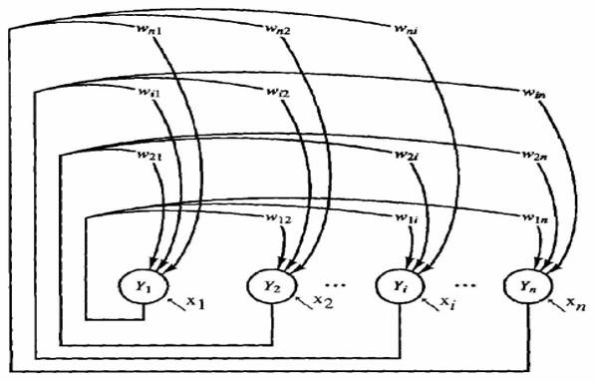
Discrete Hopfield Network
Architecture:
  single layer (units serve as both input and output)
  nodes are threshold units (binary or bipolar)
  weights: fully connected, symmetric, and zero diagonal
^{w}ij ^{= w} ji
^{w}ii
= 0
x_{i} are external inputs, which may be transient or permanent
20

Slide 21
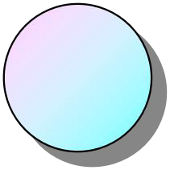


Discrete Hopfield Network
^{w}ij ^{= w}ji w_{ii} = 0
w1n
w2n
w3n
w13 w12
w23
wn3 wn2
wn1
w32 w31
w21
. . .
1
2
3
n
I1
I2
I3
In
v1
v2
v3
vn

Slide 22
Discrete Hopfield Network
Storage is performed according to the following equation:
P
₌ 1 _{Σ}
_{x} p _{x} p i j
w
ij
N
p=1
The weight matrix is symmetrical, i.e., w_{ij} = w_{ji}.
The constraint condition w_{ii} =0 is important for the network behavior. It can be mathematically proven that under these conditions the network will reach a stable activation state within an infinite number of iterations.

Slide 23
Discrete Hopfield Network
In the discrete version of the model, each component of an input or output vector can only assume the values 1 or –1.
The output of a neuron i at time t is then computed according to the following formula:
( 
N
v_{i} (t) = sgnΣw_{ij} v _{j} (t –1) 
 j =1

This recursion can be performed over and over again.

Slide 24
Discrete Hopfield Network
What does such a stable state look like?
The network associates input patterns with themselves, which means that in each iteration, the activation pattern will be drawn towards one of those patterns.
After converging, the network will most likely present one of the patterns that it was initialized with.
Therefore, Hopfield networks can be used to restore incomplete or noisy input patterns.

Slide 25

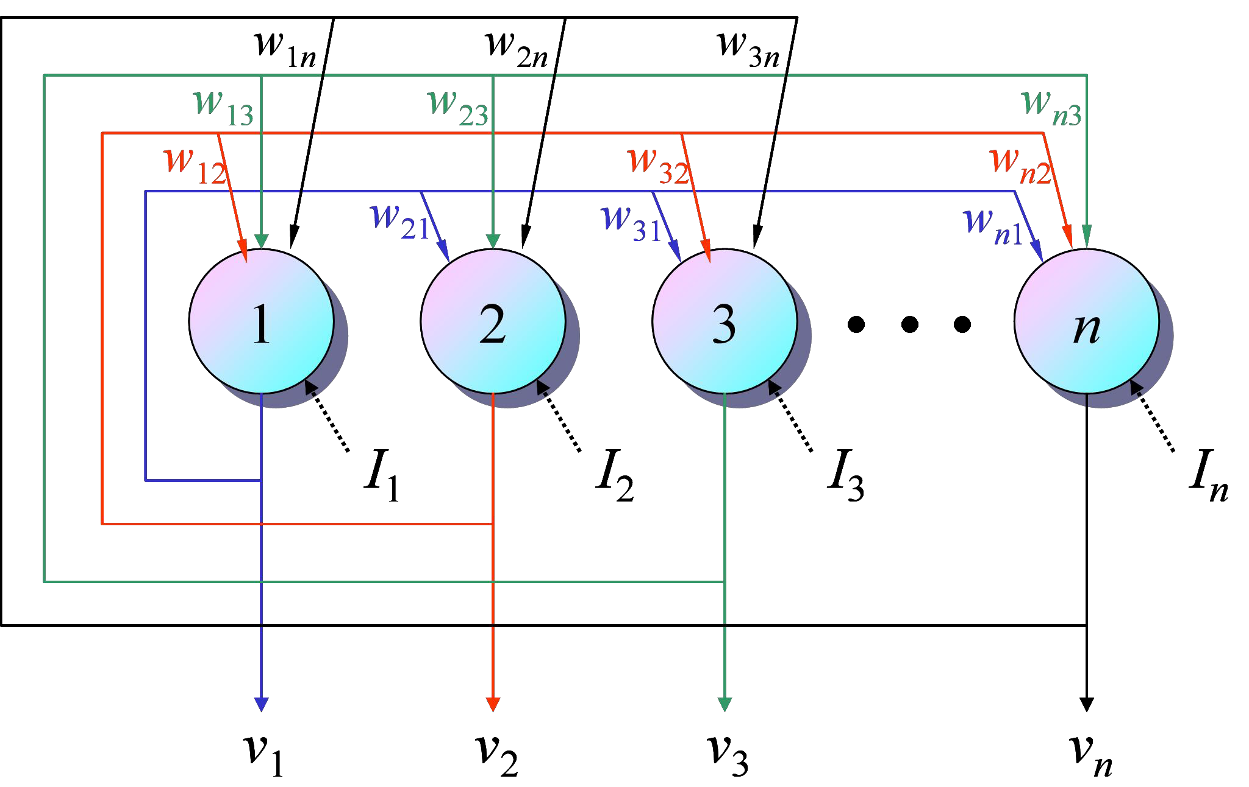
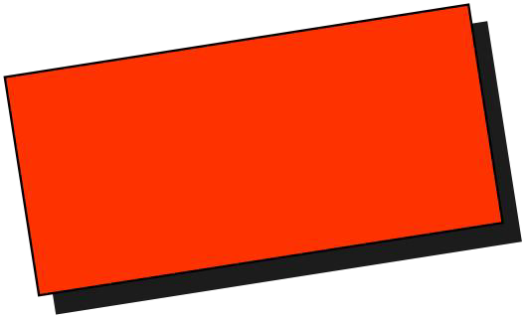
Discrete Hopfield Network
Recall
  Use an input vector to recall a stored vector
  Each time, randomly select a unit for update
  Periodically check for convergence (stable state)
Asynchronous mode update rule
Stable?
n
H_{i} (t +1) = Σw_{ij} v _{j} (t) + I_{i}
j =1
j si
 1 H (t +1)  0
v (t +1) = sgn[H (t +1)] = 
i
i i

–1 H (t +1) < 0
i
25

Slide 26


Example:
  A 4 node network, stores 2 patterns (1 1 1 1) and (-1 -1 -1 -1)
  Weights:
Corrupted input pattern: (1 1 1 -1)
Node selection node 2:
node 4:
output pattern (1 1 1 -1)
(1 1 1 1)
No more change of state will occur, the correct pattern is recovered
Equal distance: (1 1 -1 -1)
node 2:
node 3:
node 4:
net = 0, no change
net = 0, change state from -1 to 1
net = 0, change state from -1 to 1
(1 1 -1 -1)
(1 1 1 -1)
(1 1 1 1)
No more change of state will occur, the correct pattern is recovered
If a different node selection order is used, the stored pattern (-1 -1 -1 -1) may be recalled

Slide 27
Missing input element: (1 0 -1 -1)
Node selection
node 2:
node 1: net = -3, change state to -1
output pattern
(1 -1 -1 -1)
(-1 -1 -1 -1)
No more change of state will occur, the correct pattern is recovered
Missing input element: (0 0 0 -1)
the correct pattern (-1 -1 -1 -1) is recovered This is because the AM has only 2 attractors
(1 1 1 1) and (-1 -1 -1 -1)
When spurious attractors exist (with more memories), pattern completion may be incorrect

Slide 28
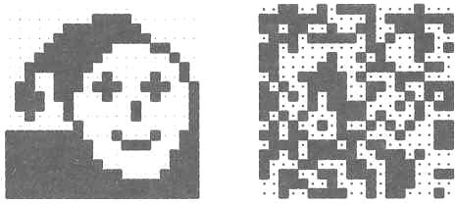
Example
Image reconstruction (Ritter, Schulten, Martinetz 1990)
A 2020 discrete Hopfield network was trained with 20 input patterns, including the one shown in the left figure and 19 random patterns as the one on the right.

Slide 29
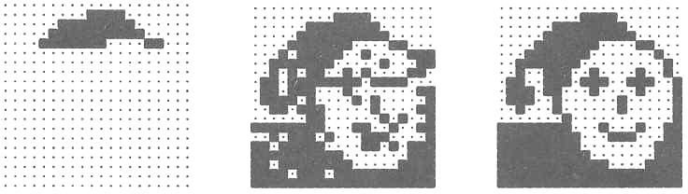
Example
After providing only one fourth of the “face” image as initial input, the network is able to perfectly reconstruct that image within only two iterations.

Slide 30
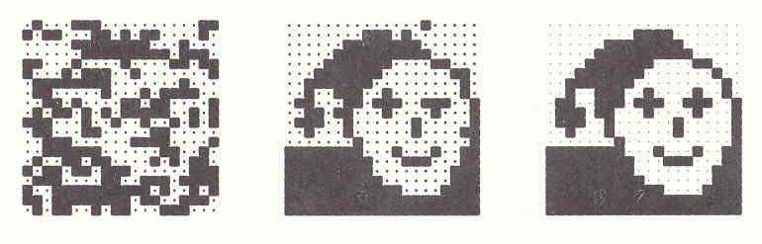
Example
Adding noise by changing each pixel with a probability p = 0.3 does not impair the network’s performance.
After two steps the image is perfectly reconstructed.

Slide 31
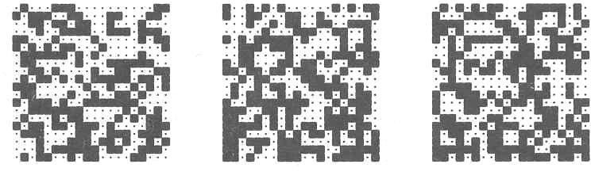
Example
However, for noise created by p = 0.4, the network is unable to restore the original image.
Instead, it converges against one of the 19 random patterns.

Slide 32
Discrete Hopfield Network
Possible 8 states for the three-neuron Hopfield network
y₂
(–1,1,–1)
(1,1,–1)
(–1,1,1)
(1,1,1)
y₁
0
(–1,–1,–1)
(1,–1,–1)
(–1,–1,1)
(1,–1,1)
y₃
32

Slide 33
Discrete Hopfield Network
The stable state is determined by the weight matrix W, the current input vector X, and the threshold matrix q. If the input vector is partially incorrect or incomplete, the initial state will converge into the stable state after a few iterations.
Suppose, for instance, that the network is required to memorize two opposite states, (1, 1, 1) and (-1, -1, -1). Thus,
⬆1
⬆–1
₌ ⬇₁
or Y ^{T} = 1 1 1
1
_{Y} T
= –1 –1 –1
Y
Y = ⬇–1
2
1
⬇ 
⬇1✗
2
⬇ 
⬇–1✗
33

Slide 34
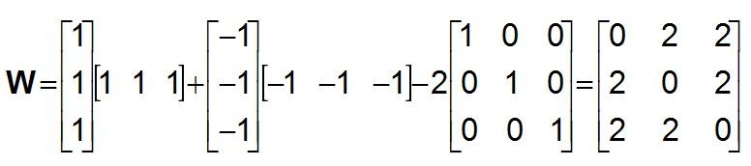
Discrete Hopfield Network
To build the weight matrix
p

p
Σ i^{k k}j
Σ
⇦
x x i s j
i = j
W =
k k T
x (x ) – pI
w =
 k =1
⇦_{0}
ij
k =1
Determine the weight matrix as follows:
Next, the network is tested by the sequence of input vectors, X₁ and X₂, which are equal to the output (or target) vectors Y₁ and Y₂, respectively.

Slide 35
Discrete Hopfield Network
Activate the Hopfield network by applying input vector X and calculate the actual output vector Y
⬆0 2
Y = sign ⇦⬇2 0
2
2⬆1 ⬆0ü ⬆1
₂⬇₁ – ⬇₀⇦ ₌ ⬇₁
1
⬇
⬇  ⬇ ^{ý} ⬇ 
0✗⬇1✗
⇦_{⬇2}
⬇0✗⇦ ⬇1✗

J
⬆0 2 2⬆–1 ⬆0ü ⬆–1
0 2⬇–1 – ⬇0⇦ = ⬇–1
⇦⬇2 2
Y = sign⇦⬇2
2
⬇
⬇  ⬇ ^{ý} ⬇ 
0⬇–1 ⬇0⇦ ⬇–1
 ✗ ✗  ✗J  ✗
Compare the result with the initial input vector X

Slide 36
Discrete Hopfield Network
The remaining six states are all unstable. However, stable states (also called fundamental memories) are capable of attracting states that are close to them.
The fundamental memory (1, 1, 1) attracts unstable states (-1, 1, 1), (1, -1, 1) and (1, 1, -1). Each of these unstable states represents a single error, compared to the fundamental memory (1, 1, 1).
The fundamental memory (-1, -1, -1) attracts unstable
states (-1, -1, 1), (-1, 1, -1) and (1, -1, -1).
Thus, the Hopfield network can act as an error correction network.

Slide 37
Example 1: Weights Matrix
2 – 2 0 0
⬇– 2 2 0 
0 0 2 – 2
0 0 – 2
1
T
⬆
x = (1, –1, –1,1)
₀
x¹ (x¹ )^{T} + x² (x² )^{T} = ⬇
⬇
x² = (–1,1, –1,1)^{T}
⬇
₂

✗
⬆ 1 –1 –1 1
⬇–1 1 1 –1

⬇–1 1 1 –1
⬇ 
 1 –1 –1 1✗
⬆ 1 –1 1 –1
⬇–1 1 –1 
⬇ 1 –1 1 –1
⬇–1 1 –1 1
✗
W = Σx^{k} (x^{k} )^{T} – pI
k =1
p
x¹ (x¹ )^{T} = ⬇
⬆ 0 –2 0 0
⬇–2 0 0 
⬇ 0 0 0 –2
 0 0 –2 0
₀
₁
W = 
x² (x² )^{T} = 



37

Slide 38
Example 2: Spurious State
Use a 4-node Hopfield network to store 3 patterns: (1 1 -1 -1), (1 1 1 1) and (-1 -1 1 1)
weights:
(
0 1 –1/ 3 –1/ 3



1 0 –1/ 3 –1/ 3
–1/ 3 –1/ 3 0 1
1 0




–1/ 3 –1/ 3

Corrupted input pattern: (-1 -1 -1 -1)
  if node 4 is randomly selected:
(-1/3 -1/3 1 0) (-1 -1 -1 -1)^{T} + (-1) = 1/3 + 1/3 –1 – 0 –1 = -4/3
  no change of state for node 4
  same for all other nodes, net stabilized at (-1 -1 -1 -1)
  a spurious state is recalled
38

Slide 39
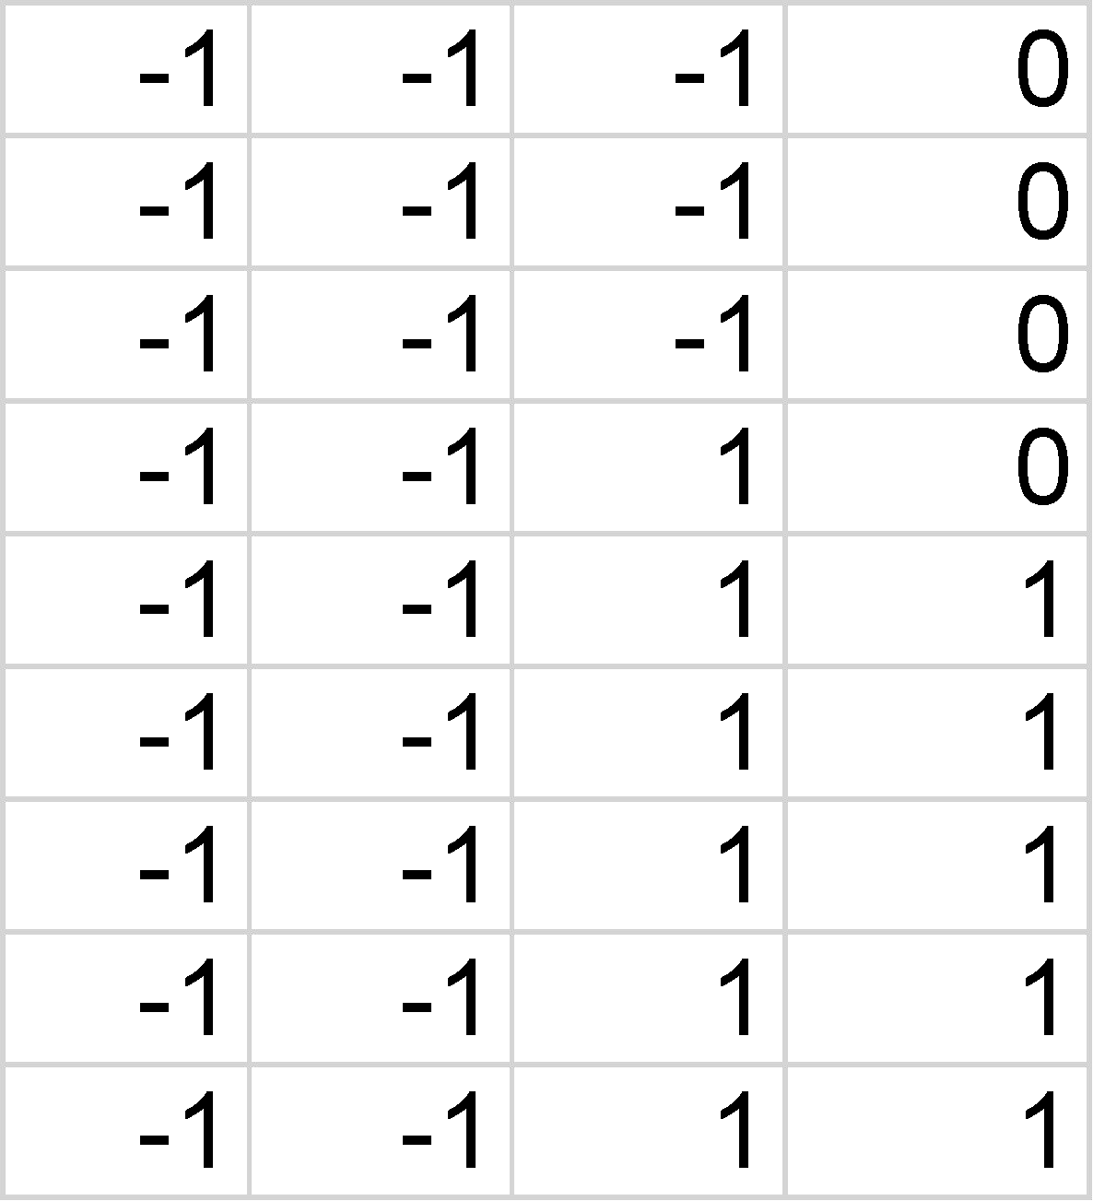
Example 2: Spurious State
For input pattern (-1 -1 -1 0)
  if node 4 is selected first
(-1/3 -1/3 1 0) (-1 -1 -1 0) ^{T} + (0) = 1/3 + 1/3 – 1 – 0 – 0 = -1/3
  node 4 changes state to -1: (-1 -1 -1 -1)
  network stabilizes at (-1 -1 -1 -1)
  however, if the node selection sequence is 1>2>3>4, the net stabilizes at state (-1 -1 1 1): a correct pattern
(
0 1 –1/ 3 –1/ 3

1 0 –1/ 3 –1/ 3



^{W = }–1/ 3 –1/ 3


0 1
–1/ 3 –1/ 3 1 0

Slide 40
Limitations of Hopfield Network
The number of patterns that can be stored and accurately recalled is severely limited
  net may converge to a novel spurious pattern
Exemplar pattern will be unstable if it shares many bits in common with another exemplar pattern

Slide 41






THANK YOU
VISIT US
WWW.XJTLU.EDU.CN
FOLLOW US
@XJTLU

