Slide 1


RADIAL-BASIS FUNCTION NETWORKS
INT301 Bio-computation, Week 8, 2025
1

Slide 2



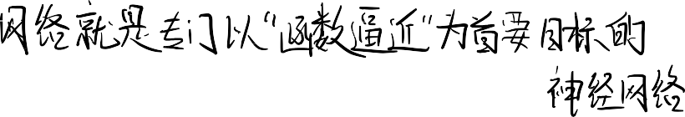
神经⽹络的设计可以被看作是⼀个 “曲线拟合”或“函数逼近”的问题。 训练⼀个神经⽹络，本质上就是在寻找
⼀个⾮常复杂的函数 f，让这个函数 f能够尽可能地“拟合”我们所有的训练数据
神经⽹络执⾏的最常⻅任务是分类和预测。
分类 (Classification)： 就是给事物“贴标签”。⽐如，给
⼀张图⽚打上“猫”或“狗”的标签；或者判断⼀封邮件是
“垃圾邮件”还是“⾮垃圾邮件”。
Introduction
预测 (Prediction)： 通常指“回归”(Regression)，即预测
⼀个连续的数值。⽐如，根据房屋的⾯积、地段来预测它的“价格”；或者预测明天的“股票价格”。
与其像传统神经⽹络（如多层感知机 MLP）那样模拟“神经元激活”，RBF ⽹络从
⼀开始就在数学上被设计为⼀个强⼤的“通⽤函数逼近器”。
The most common tasks performed by neural networks are classification and prediction.
These tasks involve input-output mappings, and the network is designed to learn the mapping from knowledge of the problem environment.
Thus, the design of a neural network can be viewed as a curve-fitting or function approximation problem.
This viewpoint is the motivation for radial-basis function networks
2

Slide 3




1. 插值 (Interpolating)：
“学习”等同于在空间中找到⼀个“插值表
⾯”这个表⾯能“最佳拟合”训练数据
在严格的数学定义⾥，“插值”意味着这个表⾯必须精确地穿过每⼀个训练数据点。
2. 最佳拟合 (Best Fit)：
这通常是⼀个更宽松、更实⽤的⽬标。它不要求表⾯穿过每⼀个点（因为数据点可能有噪
声），⽽是要求这个表⾯尽可能地靠近所有点，以捕捉到数据的总体趋势。
The Interpolation Problem
“最佳拟合”的曲⾯，就是那个能让这个“平均误差”（即损失函数）最⼩的曲⾯。
For the problem of curve-fitting (approximation in high-dimensional spaces), learning is equivalent to finding an interpolating surface in the space that provides a best fit to the training data, measured by preselected statistical criteria.
Curve-fitting or interpolation problem
3

Slide 4





Radial-Basis Functions
The radial-basis functions technique suggests constructing of interpolation functions F of the following
form:
F (x) = Σ w_{i}ф(|| x – x_{i} ||)
i=1
N
where:
ф(|| x - x_{i} ||) is a set of nonlinear radial-basis
functions, x_{i} are the centers of these functions, and ||•|| is
the Euclidean norm.
⼀个 RBF 是⼀个实值函数，它的值仅仅取决于（输⼊）到原点的距离。
A radial basis function (RBF) is a real-valued function whose value depends only on the distance from the origin
■
Alternative form: depends on the distance from a center c
取决于到某个中⼼点 c 的距离。
Any function that satisfies the property is a radial basis
function
只要函数的值只跟“到中⼼的距离”有关，它就是 RBF。⾼斯函数只是其中最常⽤的⼀种。
4

Slide 5




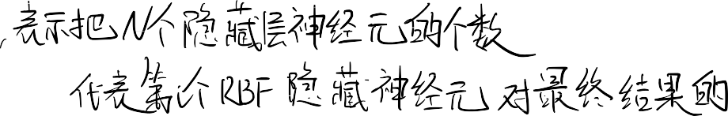





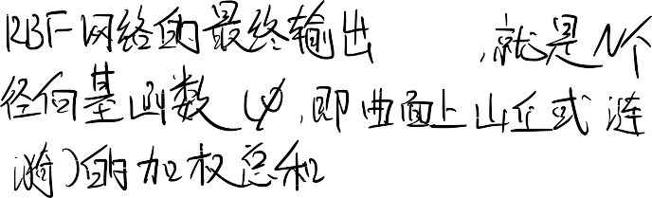
















Slide 6
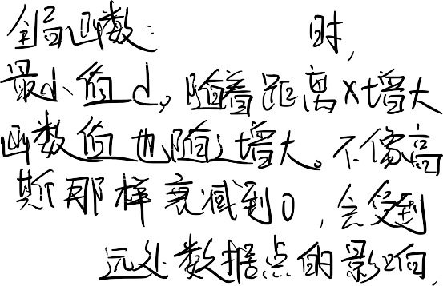




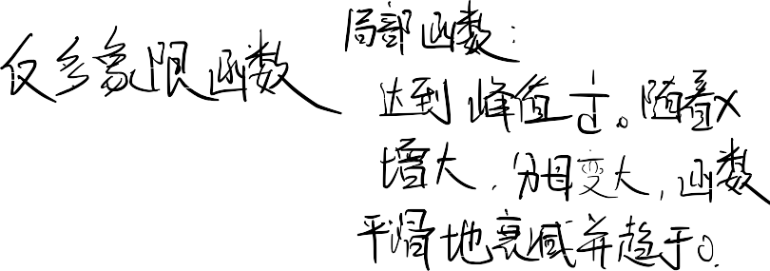
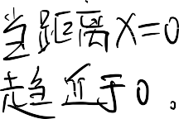
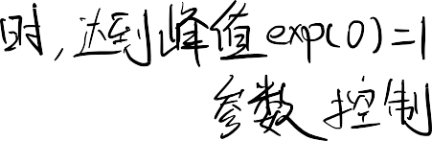


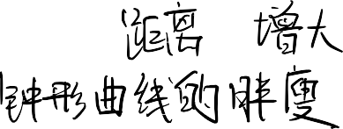


Radial-Basis Functions
Several widely used basis functions:
- multiquadratics:
ф( x ) = ( x² + d² )^{1/2}
for some d>0
inverse multiquadratics:
ф( x ) = 1 / ( x² + d² )^{1/2} for some d>0
Gaussian:
ф( x ) = exp( - x² / 2σ² ) for some σ>0
5

Slide 7

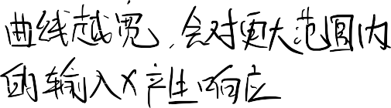

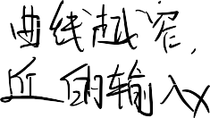






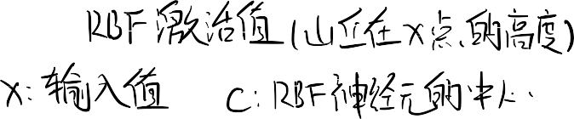

Gaussian Function
⾼斯 RBF 的函数值，随着与中⼼点距离的增加⽽“单调递减”
A Gaussian RBF monotonically
1
decreases with distance from the center. Gaussian--like RBFs are local (give a significant response only in a neighborhood near the center) and are more commonly
0.9
0.8
0.7
0.6
0.5
0.4
0.3
0.2
used.
类⾼斯 RBF 是“局部”的（即，只在靠近中⼼的“邻域”内才会给出显著响应）
0.1
0
-0.6 -0.4 -0.2 0 0.2 0.4 0.6 0.8
c = 0 and radius r = 1
-1 -0.8
1
They are also more biologically plausible because their response
is finite.
局部” (local) 意味着这个 RBF 神经元是⼀个“局部探测器”。它只关⼼那些与它⾃⼰的“中⼼点 c”⾮常接近的输⼊ x。如果输⼊ x 离它的中⼼ c 很远，这个神经元就基本“不激活”（输出值接近 0）。这使得 RBF ⽹络⾮常⾼效，因为它允许⽹络将⼀个复杂的问题分解为多个“局部”的⼩问题来解决。
6

Slide 8






Regularization Networks
The regularization network models the interpolation function F as a linear superposition of multivariate Gaussian functions, which number is equal to the number of the given input examples N:
where: w_{i} are the weights.
7

Slide 9
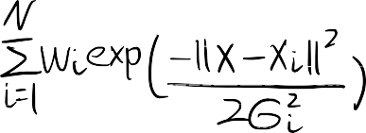




















“插值函数 F” (interpolation function F)： 这就是 RBF ⽹络的最终输出 F(x)，也就是我们想拟合的那条“最佳曲线”或“最佳曲⾯”。 “线性叠加” (linear superposition)： 这是⼀个物理和数学上的术语，你完全可以把它理解为“加权求和” (weighted sum)。
“多变量⾼斯函数” (multivariate Gaussian functions)： 这就是我们⼀直讨论的“⾼斯⼭丘”。“多变量”仅仅意味着输⼊ $x$ 可以是多维的（⽐如 [⾯积, 房龄]），⽽不只是⼀个单独的数字。
“RBF的隐藏层的神经元节点数量等于给定输⼊样本的数量 N” (which number is equal to ... N)：它规定了这种 RBF ⽹络的隐藏层结构。
如果你有 N 个训练数据点（⽐如 1000 个房屋样本），那么你的 RBF 隐藏层就必须正好有 N 个神经元（1000 个⾼斯函数）。第 i 个⾼斯函数（第 i 个神经元）的中⼼ xi，就直接被设定为第 i 个训练数据点的位置。
在这个模型⾥，你不需要⽤ K-Means 聚类或其他算法去“寻找“中⼼点c”了。你直接把每⼀个训练数据点都当作⼀个 RBF 神经元的中⼼。
固定中⼼和宽度：
中⼼ xi：直接⽤N个训练数据点。（已固定）
宽度 \sigma_i ：通常会使⽤某种“启发式规则”来预先设定好（⽐如，所有 sigma_i 都设为同⼀个值，这个值可能与数据点之间的平均距离有关）。（已固定）
求解权重 wi：
由于 RBF 的“形状”（中⼼和宽度）都已固定，整个⽹络F(x)对 wi 来说就成了⼀个线性模型。
学习任务就简化为：找到⼀组最佳的 wi，使得总误差最⼩。

Slide 10














Regularization Networks
⽆论你想“拟合”或“学习”的那个“真实规则” f(x) 有多复杂（⽐如⼀个奇形怪状的曲⾯），只要它是“连续”的（即没有突然的断裂或跳变），RBF ⽹络都能模拟它。
The important characteristic:
u it is a universal approximator in that it can approximate arbitrarily well any multivariate continuous function on a compact set, given a sufficiently large number of units.
8

Slide 11
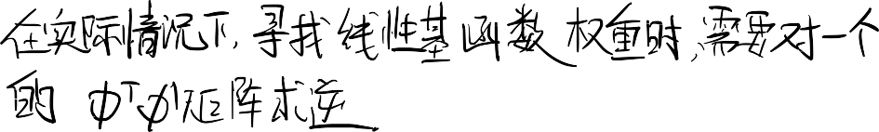






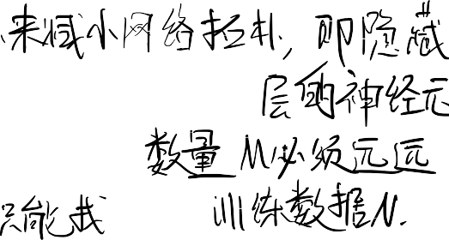
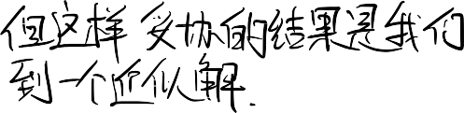

Problems with the Regularization Networks
⾼斯函数的数量”与“训练样本的数量”之间“⼀⼀对应”的这种⽅式，通常在计算上是极其低效的
The one-to-one correspondence between the number of Gaussian functions and the number of the training examples often become computationally inefficient, in the sense that it may require combining a very large number of basis functions (since often a large number of training examples are provided).
In practical situations finding of the linear basis function weights needs to invert very large Ф ^{T}Ф matrices.
In order to avoid such problems the network topology
should be reduced.
This means that we will attempt to find a solution that approximates the solution produced by the regularization network.
9

Slide 12
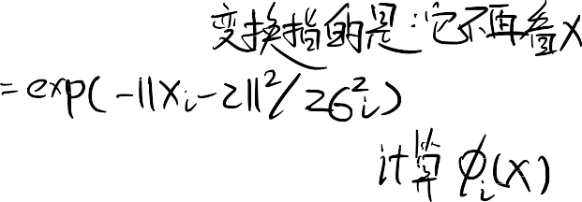
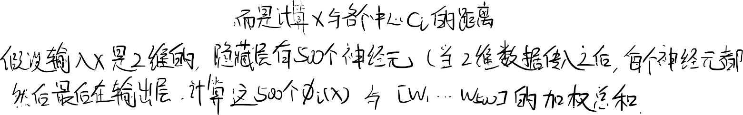


RBF Network Structure
输⼊层：不做任何计算，将样本向量直接传递给下⼀层
An RBF network architecture consists of 3 layers:
- input layer: which passes the example vectors to the
next layers
隐藏层： 对输⼊施加⼀个“⾮线性变换函数”，并将其扩展到通常⾮常⾼维的隐藏空间中
- hidden layer: applies a non-linear transformation function to the inputs, and expands them in the usually
very high-dimensional hidden space
对给定的向量施加⼀个“线性变换”
- output layer: applies a linear transformation to the given
vector
这个“⾮线性变换函数”就是径向基函数（RBF），⽐如⾼斯函数。
10

Slide 13













Radial Basis Function Network
φ ( X )
1
X
w₁
x1
φ ( X )
2
y =
M
Σ
i = 1
w φ
w
i i
( X )
2
Output
y
x2
w
Σ
3
x3
φ
3
( X )
...
w _{m}
1
x
...
φ ( X )
M
Increased dimension:
K->M
φ ( X ) : Nonlinear function
i
Hidden layer: applies a non-linear transformation from the input space to the hidden space.
Output layer: applies a linear transformation from the hidden space to the output space.
11

Slide 14
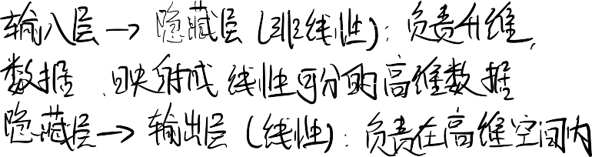

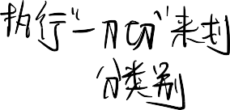

当样本被投射到更⾼维空间时，它们在那
⾥变得“线性可分”的可能性，远⼤于在低维空间中。
RBF Network: the Rationale
我们可以⽤⼀个⾮线性函数（即 RBF），将⼀个困难的⾮线性插值问
题，转变成⼀个更容易的、只涉及线性映射的问题。
Rationale behind RBF: when the examples are cast in higher-dimensional space they are more likely to be linearly separable there than in a lower-
dimensional space.
RBF ⽹络被设计为：执⾏从输⼊空间到隐藏空间的⾮线性映射，然
后再执⾏从隐藏空间到输出空间的线性映射。
A nonlinear function can be taken to transform a difficult nonlinear interpolation problem into an easier one that involves linear mapping.
That is why, the RBF networks are designed to perform nonlinear mappings from the input space to the hidden space, and next a linear mapping from the hidden space to the output space.
12

Slide 15







Function Mapping by RBF
Networks
RBF ⽹络将插值函数 F 建模为“有限数量的多变量⾼斯函数”的“线性叠加”（即加权求和）
The radial-basis function network models the interpolation function F as a linear superposition of a finite number of multivariate Gaussians as follows:
M
ǁx − t ǁ²
F(x)=Σw_{i}exp (− ^{i} )
2σ²
i=1
i
函数的数量 M ⼩于 训练集中的数据点数量 N
where: w_{i} are the weights, and the number of
basis functions M is less than the number of points in the training set, i.e., M < N.
The basis function centers t_{i} are determined in
advance.
13

Slide 16


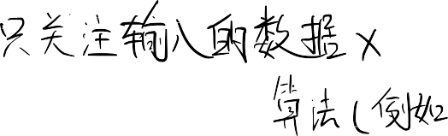



















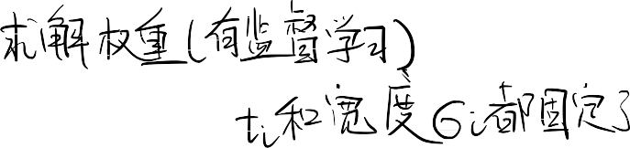






















Slide 17




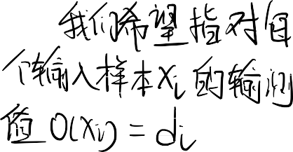



我们可以_{R}使⽤_{B}⼀个_{F}直接的数_{L}学公_{e}式来_{a}⼀次_{r}性_{n}解出_{i}“最_{n}佳权_{g}重”，这个⽅法就是“伪逆法”
⼀旦 RBF ⽹络的中⼼ t_i 和宽度 \sigma_i 固定了（在“阶段 1”中，⽐如⽤ K-Means 聚类确定了），我们不需要使⽤缓慢的“梯度下降”来迭代训练权重。
Weights can be computed by the pseudo-inverse method.
For an example ( x_{i} , d_{i} ) , consider the output of the network
o(x_{i} ) = w₁φ₁ (|| x_{i} – t₁ ||) +... + w_{M}φ_{M} (|| x_{i} – t_{M} ||)
We would like o(x_{i} ) = d_{i} for each example, that is
w₁φ₁ (|| x_{i} – t₁ ||) +... + w_{M}φ_{M} (|| x_{i} – t_{M} ||) = d_{i}
This can be re-written in matrix form for one example
[φ₁ (|| x_{i} – t₁ ||) ···φ
]T
(|| x_{i} – t_{M} ||)]·[w₁ ··· w_{M} = d
M i
14

Slide 18

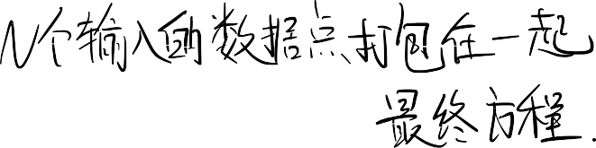

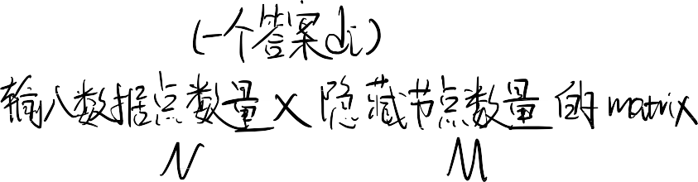









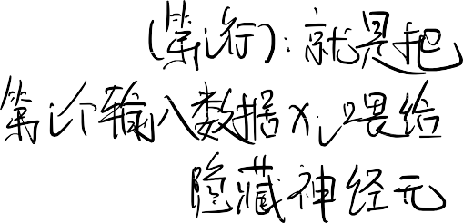


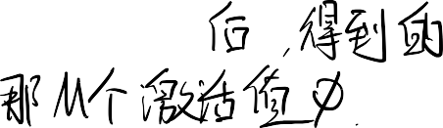
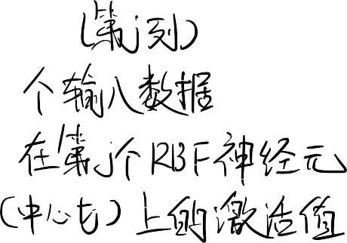




RBF Learning
「φ₁ (|| x₁ – t₁ ||)...φ_{n} (|| x₁ – t_{M} ||)

|...
|[w ...w
]T
= [d ...d
]T
| |
1
M
1
N
|φ₁ (|| x_{N} – t₁ ||)...φ_{n} (|| x_{N} – t_{M} ||)|]
for all the examples at the same time.
「φ₁ (|| x₁ – t₁ ||)
... φ_{M} (|| x₁ – t_{M} ||) 
... |
|
... φ_{M} (|| x_{N} – t_{M} ||)|]
Let
Ф = |
|
|φ₁ (|| x_{N} – t₁ ||)
「w₁ 「d₁


then we can write
Ф|... | = |... |
| | | |
|^{w}M |] |^{d}N |]
15

Slide 19



RBF Learning
Φ is the NxM design matrix of basis functions
|| x – t ||²
ф = exp(– ^{i} )
2σ ²
i
「φ₁ (|| x₁ – t₁ ||)
... φ_{M} (|| x₁ – t_{M} ||) 
... |
|
... φ_{M} (|| x_{N} – t_{M} ||)|]
Ф = |
|
|φ₁ (|| x_{N} – t₁ ||)
16

Slide 20




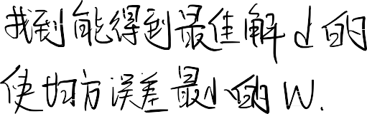




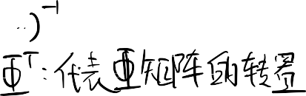


Radial-Basis Functions
「w₁ 「d₁
 
ФW = Ф|... | = |... | = d
| | | |
|w_{M} |] |d _{N} |]
The unknown weights can be found by solving the following linear matrix equation using pseudo-inverse:
W = (Ф^{T}Ф)^{–1} Ф^{T} d
where: W is the weight vector, d is the response vector, and Ф is the design matrix
17

Slide 21





RBF Learning
If Ф⁺
is the pseudo-inverse of the matrix Ф we
obtain the weights using the following formula
[w ...w ]^{T} = Ф⁺[d ...d ]^{T}
1 M 1 N
Pseudo inverse
Ф has a unique pseudo-inverse Ф⁺
ФФ ⁺Ф = Ф Ф⁺ФФ⁺ = Ф⁺ Ф⁺Ф = (Ф⁺Ф)^{T} ФФ⁺ = (ФФ⁺ )^{T}
satisfying the conditions:
18

Slide 22


RBF Training Algorithm
Initialization: Examples {( x_{e}, d_{e} )}_{e=1}
N
Determine:
  the network structure with a number n of basis functions φ_{i}, i=1,2,...,M
  the basis function centers t_{i}, i=1,2,...,M
    e.g.: using k-means clustering algorithm
  the basis function variances σ_{i} , i=1,2,...,M
2
19

Slide 23
RBF Training Algorithm
Compute:
  the outputs from each example with the Gaussian basis functions:
− || − ||²
= exp( )
2²
// at each i-th hidden unit where i=1,2,...,M; e=1,2,...,N
the correlation matrix: Ф^{T}Ф and pseudo inverse (Ф^{T}Ф)^{–1}
the vector:
the weights:
Ф^{T} d
W = (Ф^{T}Ф)^{–1} Ф^{T} d
Note: The radial-basis function centers t_{i} and variances σ_{i}² may be trained along with the output weights but this takes a long time. Thus they are often determined in advance.
20

Slide 24
RBF - Center Selection
x₂
x₁
Data points
Centers
21

Slide 25
Finding RBF Centers
Random Selection
  The simplest approach is to choose the centers randomly from the given training examples.
  If the training examples are distributed in representative way this approach gives good results.
22

Slide 26






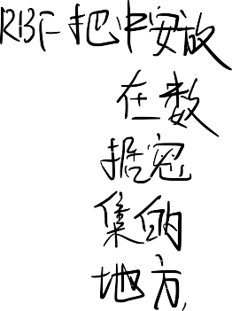
使⽤ K-means 算法来选择中⼼ ti 依赖于这样⼀个假设：相似的输⼊应该会产
⽣相似的输出，因此这些相似的输⼊对应该被捆绑到训练集中的‘簇’⾥。
Finding RBF Centers
K-means Clustering
K-Means 算法的本质就是去寻找“数据密度⾼”的区域的“质⼼”
The use of the K-means clustering algorithm for the selection of the centers t_{i} relies on the assumption that similar inputs should produce similar outputs, and these similar input pairs should be bundled together into clusters within the training set.
The K-means clustering places the RBF centers only in regions of the input space where there are significant amounts of training examples.
23

Slide 27



What is Cluster Analysis?
Cluster: a collection of data objects
  Similar to one another within the same cluster
  Dissimilar to the objects in other clusters
Cluster analysis
  Finding similarities between data according to the characteristics found in the data and grouping similar data objects into clusters
24

Slide 28





What is Cluster Analysis?
Clustering analysis is an important human activity
Early in childhood, we learn how to distinguish between cats and dogs
Unsupervised learning: no predefined classes
Typical applications
  As a stand-alone tool to get insight into data distribution
  As a preprocessing step for other algorithms
25

Slide 29




Quality: What Is Good Clustering?
A good clustering method will produce high quality clusters with
  high intra-class similarity
    similar to one another within the same cluster
  low inter-class similarity
    dissimilar to the objects in other clusters
The quality of a clustering method is also measured by its ability to discover some or all of the hidden patterns
26

Slide 30
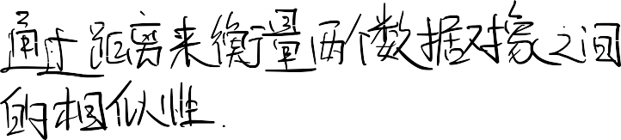

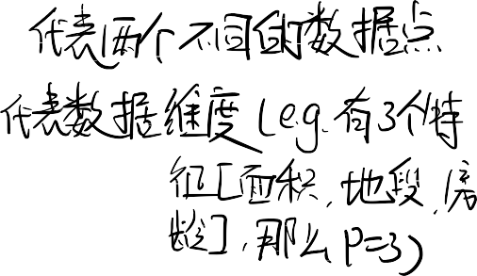

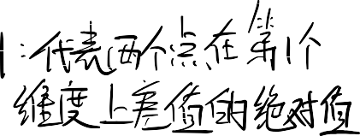



Similarity and Dissimilarity Between Objects
Distances are normally used to measure the similarity or dissimilarity between two data objects
A popular one: Minkowski distance:
d(i, j) = ^{q} (| x – x |^{q} +| x – x |^{q} +...+ | x – x |^{q} )
i1 j1 i2 j2 ip jp
where i = (x_{i1}, x_{i2}, …, x_{ip}) and j = (x_{j1}, x_{j2}, …, x_{jp}) are two p-dimensional data objects, q is a positive integer
If q = 1, d is Manhattan distance
d(i, j)=|x_{i1}–x_{j1}|+|x_{i2} –x_{j2}|+...+|x_{ip} –x_{jp} |
If q = 2, d is Euclidean distance:
d(i, j) = (| x – x
|² +| x
– x |² +...+ | x
– x |² )
i1 j1
i2 j2
ip jp
27

Slide 31


K-means clustering algorithm
该算法将数据点划分（“分割”）成 K 个“不相交”的⼦集
The algorithm partitions data points into K disjoint subsets.
The clustering criteria:
  the cluster centers are set in the high density regions of data
  a data point is assigned to the cluster with which it has the minimum distance to the center
Mathematically, this is equivalent to minimizing the sum-of- square clustering function
K
J =
Σ Σ
j =1 nϵS _{j}
|| x_{n} – c _{j} ||
2
where
S _{j} : the jth cluster containing N _{j} data points
c = ¹ Σx : the mean of the data points in cluster S
j n
j
N
j nϵS _{j}
28

Slide 32
K-means clustering algorithm
Step 1: Initially randomly assign data points to one of K clusters. Each data points will then have a cluster label. Step 2: Calculate the mean of each cluster C.
Step 3: Check whether each data point has the right cluster label.
For each data point, calculate its distances to all K centers. If the minimum distance is not the value for this data point to its cluster center, the cluster identity of this data point will then be updated to the one that gives the minimum distance.
Step 4: After each epoch checking (one turn for all data points), if no updating occurs, i.e, J reaches the minimum value, then stop; otherwise, go back to Step 2.
29

Slide 33


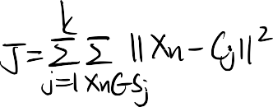

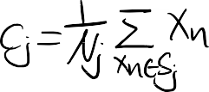
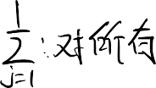

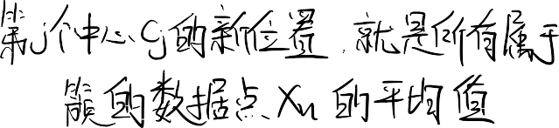















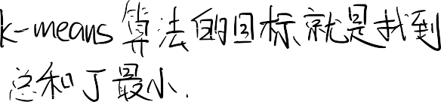


“分配”步骤 (Assignment step):
"a data point is assigned to the cluster with which it has the minimum distance to the center"
（⼀个数据点会被分配给那个“离它距离最近”的中⼼。）
遍历你所有 N 个数据点。对于每⼀个数据点，你都要计算它到所有 K 个当前“中⼼点 cj”的距离（通常是欧⼏⾥得距离），然后把它“分配”给最近的那个中⼼。
“更新”步骤 (Update step):
"the cluster centers are set in the high density regions of data"
（簇的中⼼被设置在数据的“⾼密度区域”。）
在（1）中，所有的数据点都被“分配”给了某个中⼼。现在，对于每⼀个中⼼ $\mathbf{c}_j$，我们重新计算它的位置，把它移动到所有“分配”给它的那些数据点的**“正中央”（即平均值**或“质⼼”）。
这个算法就是不断地重复“（1）分配 （2）更新 $\to$（1）分配 （2）更新...”，直到中⼼点的位置不再变化为⽌。

Slide 34
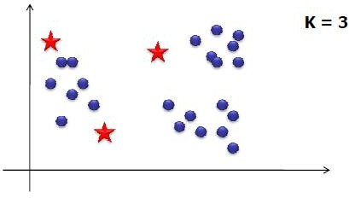
K-means algorithm description
Choose the number of clusters - K
Randomly choose initial positions of K centroids
Assign each of the points to the “nearest centroid” (depends on distance measure)
30

Slide 35
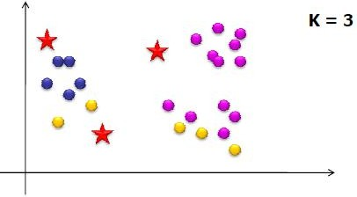
K-means algorithm description
Choose the number of clusters - K
Randomly choose initial positions of K centroids
Assign each of the points to the “nearest centroid” (depends on distance measure)
31

Slide 36
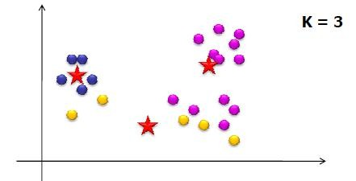
K-means algorithm description
Choose the number of clusters - K
Randomly choose initial positions of K centroids
Assign each of the points to the “nearest centroid” (depends on distance measure)
Re-compute centroid positions
If solution converges  Stop!
32

Slide 37
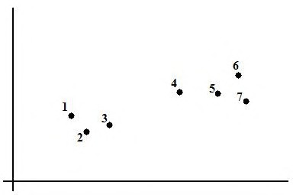
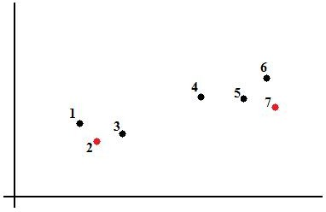
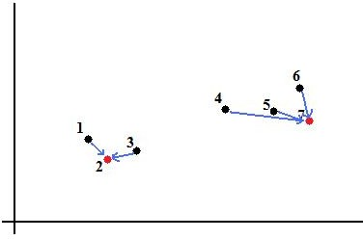
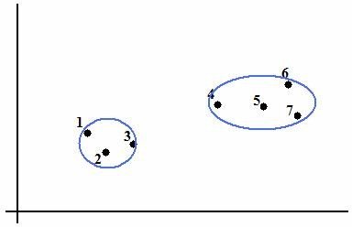
K-means Clustering
33

Slide 38








Issues
The numbers of clusters must be specified in advance
This method is not suitable for clusters with non-convex shapes
This method is sensitive to noise and outlier elements
34

Slide 39
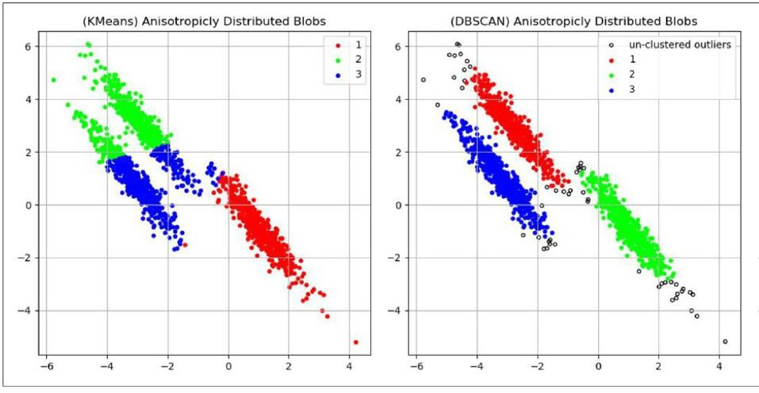
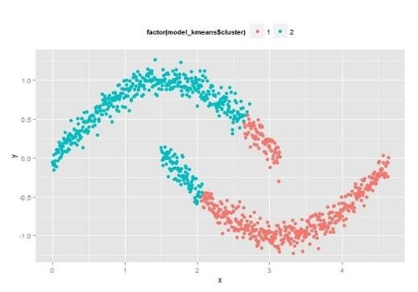
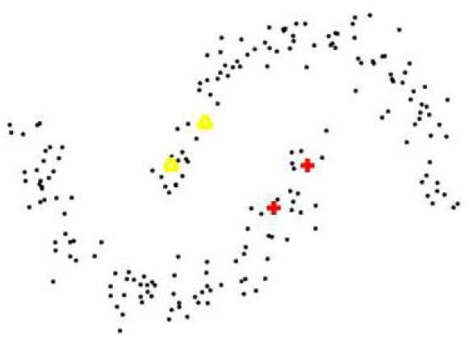
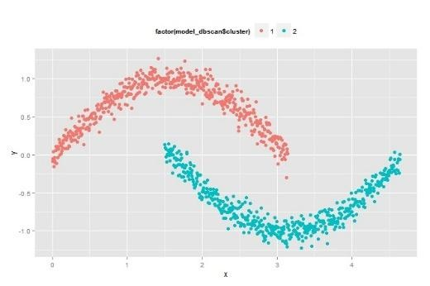
Issues
This method is not suitable for clusters with non-convex shapes
This method is sensitive to noise and outlier elements
35

Slide 40




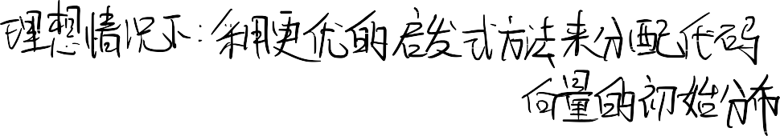

Two ways to improve k-means
Repeated k-means
  Try several random initializations and take the best.
Better initialization
  Use some better heuristic to allocate the initial distribution of code vectors.
    Designing good initialization is not any easier than designing good clustering algorithm at the first place!
36

Slide 41

RBF Networks vs. MLP
Similarities
  The RBF Networks and the MLP are layered feedforward networks that produce nonlinear function mappings;
  They are both proven to be universal approximators;
Differences
  An RBF network has only one hidden layer, while MLP networks have one or more hidden layers depending on the application task;
  The nodes in the hidden and output layers of MLP use the same activation function, while RBF uses different activation functions at each node (Gaussians parameterized by different centers and variances);
  The hidden and output layers of MLP are both nonlinear, while only the hidden layer of RBF is nonlinear (the output layer is linear);
  The activation functions in the RBF nodes compute the Euclidean distance between the input examples and the centers, while the activation functions of MLP compute inner products from the input examples and the incoming weights;
  MLP constructs global approximations while RBF construct local
approximations.
37

Slide 42



都是前馈⽹络： 两者都是“分层”的，并且信息“前向”传递（没有环路）。
都能⾮线性拟合： 它们的主要⼯作都是“函数拟合”，即学习输⼊到输出的⾮线性映射关系（⽐如拟合复杂的曲线或曲⾯）。
都是“万能逼近器”： 理论上都已被证明，只要给予⾜够多的神经元，它们都能以任意精度逼近任何连续函数。
⽹络深度（结构）：
RBF： 通常只有⼀个隐藏层。
MLP： 可以有⼀个或多个隐藏层（即“深度学习”中的“深度”）。
输出层（计算）：
MLP： 隐藏层和输出层都是⾮线性的（输出层通常也有⼀个激活函数，如 Sigmoid 或 Softmax）。 RBF： 只有隐藏层是⾮线性的（⾼斯函数）；输出层是线性的（它只是⼀个简单的“加权求和” ）。
3. 神经元激活⽅式（核⼼区别）：
MLP： 激活是基于“内积” (inner products)。
RBF： 激活是基于“欧⼏⾥得距离” (Euclidean distance)。即
，它计算的是输⼊和权重的“加权总和”。
，它计算的是输⼊ x 和中⼼ c 有多“近”。
激活函数的“个性”：
MLP： 所有隐藏神经元使⽤完全相同的激活函数（⽐如⼤家都是 ReLU）。
RBF： 每个隐藏神经元使⽤不同的激活函数（因为每个⾼斯函数 $\phi_i$ 都有⾃⼰独⼀⽆⼆的“中⼼” ci 和“宽度” ）。
拟合⽅式（全局 vs 局部）：
MLP： 构建的是“全局”近似。⼀个输⼊会激活所有神经元。改变⼀个权重会（在某种程度上）影响整个函数的形状。
RBF： 构建的是“局部”近似。⼀个输⼊只会激活它“附近”的少数 RBF 神经元（“⾼斯⼭丘”）。它像“打补丁”⼀样，⽤很多“局部”函数拼凑出“全局”函数。

Slide 43



RBF Training Algorithm
Initialization: Examples {( x_{e}, d_{e} )}_{e=1}
N
Determine:
  the network structure with a number n of basis functions φ_{i}, i=1,2,...,M
  the basis function centers t_{i}, i=1,2,...,M
    e.g.: using k-means clustering algorithm
  the basis function variances σ_{i} , i=1,2,...,M
2
Compute:
  the outputs from each example with the Gaussian basis functions:
the weights:
W = (Ф^{T}Ф)^{–1} Ф^{T} d
38

Slide 44







THANK YOU
VISIT US
WWW.XJTLU.EDU.CN
FOLLOW US
@XJTLU
39

