Slide 1


TIME-SERIES PREDICTION AND ELMAN NETWORK
INT301 Bio-computation, Week 9, 2025

Slide 2



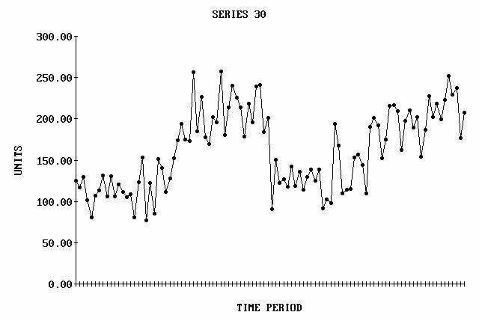




Time Series
What is a time series?
时间序列是指⼀系列按时间排序的、可⽐较的观测值 yt，这些观测值是在相等的时间间隔下记录的。
– Time Series is a series of timely ordered, comparable observations y_{t} recorded in equidistant time intervals
Examples:
Stock prices
Temperature readings
Y_{t} represents the t^{th} period observation, t=1,2 … n

Slide 3
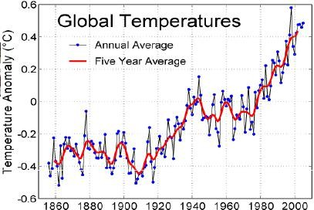
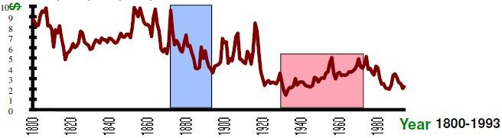
Examples of Time Series
Global Warming
Real Copper Prices in $ per KG

Slide 4
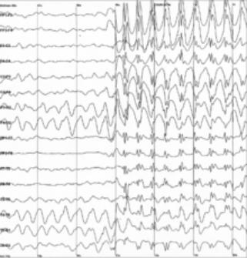
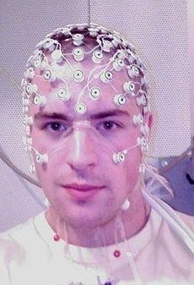
Electroencephalography (EEG)

Slide 5

Time Series Models
Modeling of a time series
⼀个时间序列中，连续时间点上的值通常是相关的。否则，预测是不可能的。
Values of a time series at successive time indices are often correlated. Otherwise, prediction is impossible.
The statistical properties do not change with respect
to time
这个序列的统计特性不会随着时间⽽改变。
宽义平稳
（WSS）随机过程
WSS (wide-sense stationarity) random process
  The mean and autocovariance do not vary
with respect to time
Variance is finite for all times
1. “均值和⾃协⽅差不随时间变化”
均值恒定： 序列的“平均⽔平线”是平的，不会随着时间向上或向下“漂移”（⽐如⼀个持续上涨的股价序列，就不是平稳的）。
⾃协⽅差恒定： “今天”和“昨天”的关联⽅式（⾃协⽅差），与“10 年前的那⼀天”和“10 年前的前⼀天”的关联⽅式是⼀样的。这保证了“规律”的稳定性。
2. “⽅差在所有时间都是有限的”
這是⼀個技術條件，意思是數據的波動不會“爆炸”到無限⼤。

Slide 6
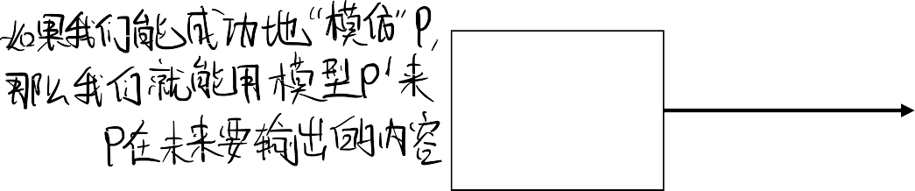

未知的动态（过程）” (Unknown dynamics (process)) P: P 代表了产⽣我们数据的“真实世界规则”, ⽐如：P 可能代表“（⼀个城市⾥）所有复杂的、影响天⽓变化的物理规律”；或者“（⼀个经济体中）所有影响股票市场的复杂⼈类⾏为和经济法则”。P 是我们永远⽆法完全知道的。
“观测到的时间序列” (Observed time-
Time Series Models
series)：
这是 P 这个“⿊匣⼦”吐出的“输出”。⽐如：我们观测到的“温度读数”或“股票价格”。这个输出就是我们⼿头的数据，即 {x(t0), x(t1),
…., }
In statistics and machine learning, a time-series is often described by a sequence of vectors (or scalars) which depend on time t:
{x(t₀ ), x(t₁ ),···, x(t_{i–1} ), x(t_{i} ), x(t_{i+1} ),··· }
It’s the output of some process P that we are interested in:
Observed time-series
P
“时间序列建模”（⽆论是⽤统计学还是 Elman ⽹络）的最终⽬的，就是建⽴⼀个“模型” P'，让 P' 尽最⼤可
Unknown dynamics (process)
能地去“模仿”那个“未知的真实过程”
P。
6

Slide 7






这代表了那个“真实过程 P”在每⼀毫秒、每⼀纳秒都在连续不断地产⽣输出。⽐如“真实的⽓温”是⼀条平滑的、连续的曲线。但是我们不可能记录下那个连续的“真实信号”。我们只能“每隔⼀段时间”
（⽐如每⼩时）去“看⼀眼”（即“采样”）。这就是所谓的“时间间隔”。例如，如果这个间隔是 delta t，然后单位是 1 ⼩时，那么我们得到的数据就是：
Time Series Models
The continuous signal x(t) is sampled at discrete points to get a series
In uniform sampling, if sampling period is delta t
{x[t]} = {x(0), x(t), x(2t), x(3t),···}

Slide 8







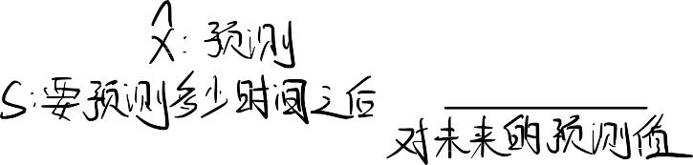
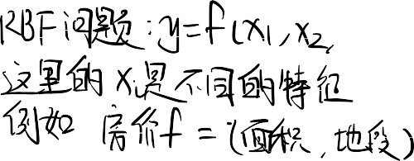



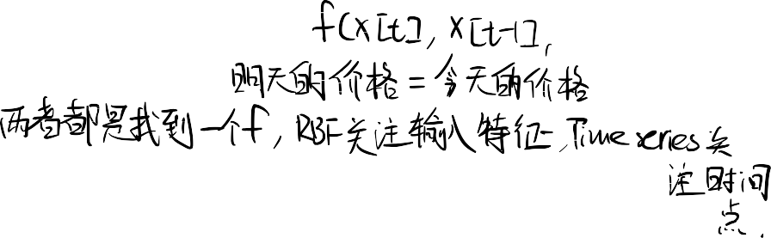

Problem of Predicting the Future
Extending backward from time t, we have time series {x[t], x[t −1], · · ·}. From this, we now want to estimate x at some future time
xˆ[t + s] = f (x[t], x[t –1],···)
s is called the horizon of prediction. At beginning, let's predict just one time sample into the future,  s = 1.
This is a function approximation problem.
Here’s how we’ll solve it:
Assume a generative model.
For every point x[t_{i}] in the past, train the generative model with what preceded t_{i} as the inputs and what followed t_{i} as the desired.
Now run the model to predict xˆ[t + s] from (x[t], x[t –1],···)

Slide 9








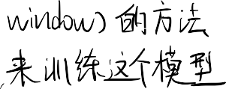



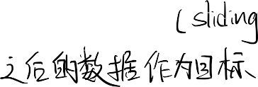





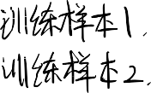

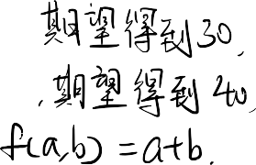















防患于未然 (Prevention)：
如果能预测到坏事（⽐如机器故障、⾦融危机）要发⽣，我们就能识别出先兆，提前采取纠正措施来避免它发⽣。
减损 (Mitigation)：
对于那些不可避免的坏事（⽐如台⻛、特定经济周期），预测能让我们提前做好准备，从⽽减轻它们带来的冲击和损失。
获利 (Proﬁting)：
这是最直接的动⼒。在⾦融市场（股票、汇率）中，如果你能⽐别⼈更准地预测未来价格，你就能赚钱。
数据有限 (Limited quantity of data)：
有时候历史数据太短了，不够⽤来训练复杂的模型（⽆法很好地划分训练集和测试集）。
噪声 (Noise)：
数据⾥往往混杂着错误的、随机的波动。模型很容易被这些噪声“带偏”，学到错误的规律。
⾮平稳性 (Non-stationarity)：
这是最⼤的敌⼈。 正如我们之前所说，如果“基本⾯”（规则）随着时间改变了（⽐如市场结构变了），那么基于历史数据训练的模型就会失效。
⽅法选择困难：
到底是⽤传统的统计学⽅法（如 ARIMA），还是⽤⼈⼯智能（神经⽹络）？这往往需要权衡。

Slide 10
Time Series Prediction
Time series examples
  Financial (e.g. stocks, exchange rates)
  Physically observed (e.g. weather, river flow)
Why is it important?
  Preventing undesirable events by forecasting the event, identifying the circumstances preceding the event, and taking corrective action so the event can be avoided;
  Forecasting undesirable, yet unavoidable, events to preemptively lessen their impact;
  Profiting from forecasting (e.g., financial markets)

Slide 11

Time Series Prediction
Why is it difficult?
  Limited quantity of data
    observed data series sometimes too short to partition
  Noise
    erroneous data points
  Non-stationarity
    fundamentals change over time, nonstationary
Forecasting method selection
  statistics, artificial intelligence
在输⼊序列上使⽤⼀个“滑动窗⼝”
通过这种⽅式，神经⽹络不需要理解“时间”，它只需要学习这种固定的“输⼊向量
-> 输出值”的映射关系即可。
Neural networks have been widely used as time series forecasters: most often these are feed-forward networks which employ a sliding window over the input sequence.
The neural network sees the time series X₁,…,X_{n} in the form of many mappings of an input vector to an output value.

Slide 12

Time Series Prediction with ANN
A number of adjoining data points of the time series (the input window X_{t-s}, X_{t-s+1},…, X_{t}) are mapped to the interval [0,1] and used as activations for the input of the input layer.
The size s of the input window corresponds to the number of input units of the neural network.
In the forward path, the activations are propagated over hidden layers to output units. The error used for the BP training is computed by comparing the value of the output unit with the value of the time series at time t+1.
Training a MLP network with BP learning algorithm usually requires that all representations of the input set (called one epoch) are presented many times.

Slide 13
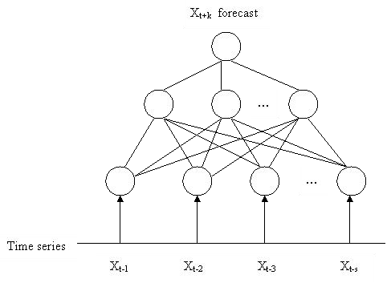
Time Series Prediction with ANN

Slide 14





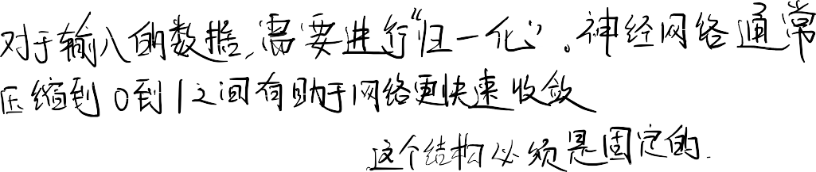












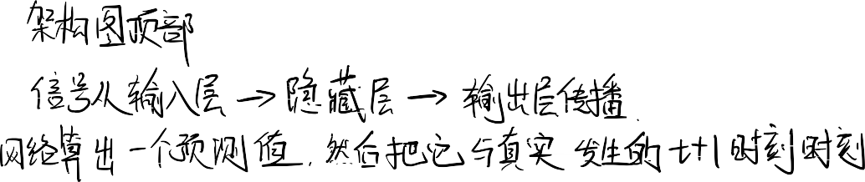
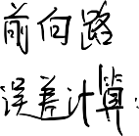











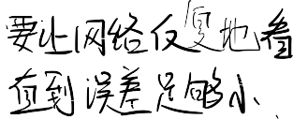









Slide 15
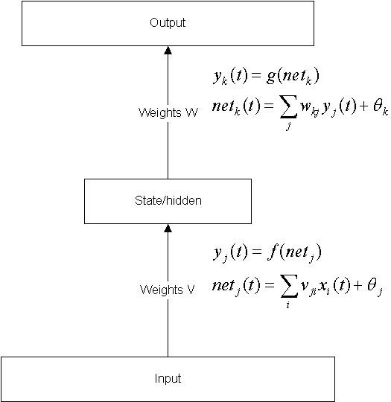
Revisit of feed forward NN
Output
A feed forward NN with hidden nodes, trained by
e.g. BP, develops internal representations for the input signals that recode those signals in a manner that enables the network to produce the correct output.
State/hidden
Input
13

Slide 16



Motivation for dynamic networks
Sometimes, we require our model to be sensitive to inputs that were presented some time ago.
In other words, our requirement is not met by a function (no matter how complex it may be) and demands a model which maintains a state, or memory, over several presentations.
Which applications need memory?
简单的 f(x) ->y 映射是不够的。
我们需要⼀个能够“维持”⼀个“状态”
(state) 或 “记忆” (memory) 的模型。
sequential input (e.g. language understanding, robot exploration, ...),
sequential output (e.g. speech, route planning, ...), or combinations of the above.
14

Slide 17



Sequence Learning
动态⽹络：它们学习的是涉及 “序列” (sequence) 的映射。⽐如：输⼊ (⼀个信号) -> 输出 (⼀个序列)；或者更常⻅的是：输⼊ (⼀个序列) -> 输出 (⼀个序列)。
MLP & RBF networks are static networks, i.e., they learn a mapping from a single input signal to a single output response for an arbitrary large number of pairs.
Dynamic networks learn a mapping from a single input signal to a sequence of response signals, for an arbitrary number of pairs (signal, sequence).
Typically the input signal to a dynamic network is an element of the sequence and then the network produces the rest of the sequence as a response.
To learn sequences we need to include some form of memory (short term memory) to the network.
15

Slide 18
Sequence Learning
We can introduce memory effects with two principal ways:
  Implicit: e.g., Time lagged signal as input to a static network or as recurrent connections
  Explicit: e.g., Temporal Backpropagation Method
In the implicit form, we assume that the environment from which we collect examples of (input signal, output sequence) is stationary. For the explicit form the environment could be non-stationary, i.e. the network can track the changes in the structure of the signal.
16

Slide 19
隐式记忆 (Implicit)
⽅式 1： "Time lagged signal as input to a static network"
（“将‘时延信号’作为‘静态⽹络’的输⼊”）
这正是“滑动窗⼝ MLP”！我们的输⼊是 [x_t-1, x_t-2, ..., x_t-s]。这个“输⼊向量”本身就是⼀种“记忆”，它把“过去 s 步”的历史“显式地”编码（“滞后”）并“喂”给了⼀个本身没有记忆的“静态⽹络”。
⽅式 2： "as recurrent connections"
（“作为‘循环连接’”）
这就是 Elman ⽹络。我们不再通过⼀个巨⼤的“输⼊向量”来“喂”给⽹络历史，⽽是给⽹络⼀个“内部循环”。这个“循环连接”允许⽹络将上⼀个时间点的“状态”（它的“记忆”）反馈给⾃⼰，⽤来和当前时间点的“新输⼊”相结合。
显式记忆 (Explicit)
这是⼀个更复杂的概念（如“时间反向传播”），它允许⽹络“回顾”更久远的历史。但⽬前，“隐式记忆”的“循环连接”是我们要关注的重点。
最后的关键点 (平稳性)：
“隐式”⽅法（⽐如“滑动窗⼝”）通常假设环境是“平稳的” (stationary)，即 f 这个规则是固定不变的。
“显式”⽅法（或更强⼤的循环⽹络）可以跟踪“⾮平稳” (non-stationary) 的信号，因为⽹络的“状态/记忆”本身可以随着时间⽽演变和适应。

Slide 20
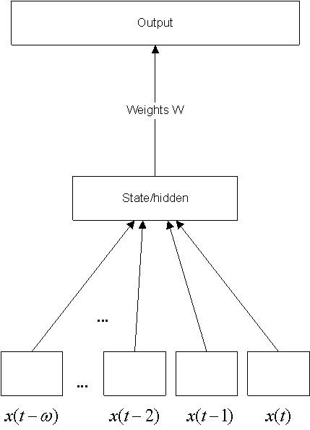
Time Delayed Networks
output
Signals can be buffered externally and presented at additional input nodes (input banks).
This is called
Time Delayed Networks
Time Delayed Networks illustrate the implicit representation approach for sequence learning, which combine a static network (e.g. MLP / RBF) with a memory structure.
State/hidden

Slide 21
Dynamical Neural Networks
Introducing time
Recurrent networks can explicitly deal with inputs that are presented sequentially, as they would almost always be in real problems.
Recurrent networks are fundamentally different from feed forward networks in that they not only operate upon an input but also a state.
The ability of the net to reverberate and sustain activity can serve as a working memory.
Such nets are Dynamical Neural Networks.

Slide 22
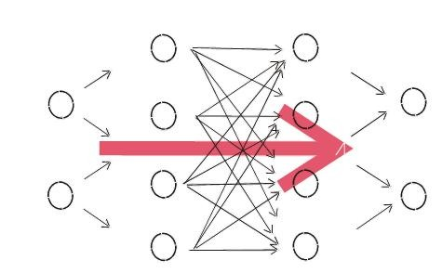
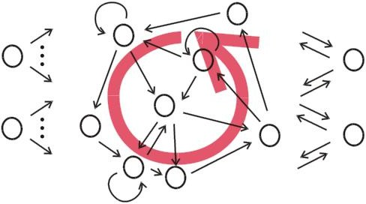

From feed-forward to recurrent NN
在 t 时刻，隐藏层计算出⼀个“激活值”（即它的 “思考结果”）。
因为有这个“循环”，这个“思考结果”不会在 t+1时刻消失，⽽是会被“拷⻉”并“反馈”回隐藏层，作为 t+1 时刻的“额外输⼊”。
Connections only "from left to right", no connection cycle
Activation is fed forward from input to output through "hidden layers"
No memory
At least one connection cycle
Activation can "reverberate", persist even with no input
System with memory
Mathematically, RNNs implement dynamical systems.

Slide 23

Elman Network
Elman neural network was proposed by Jeffrey
L. Elman, 1990.
It is a simple recurrent neural network
Elman network has a powerful prediction capability

Slide 24
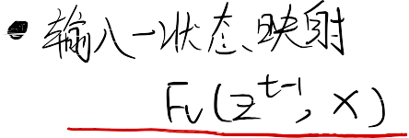


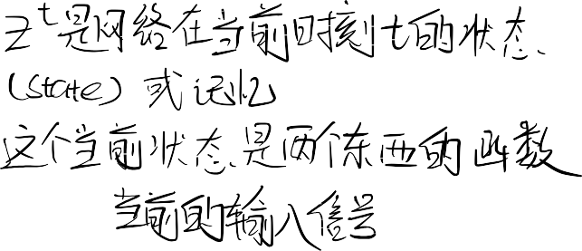

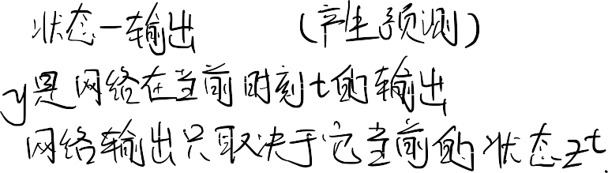


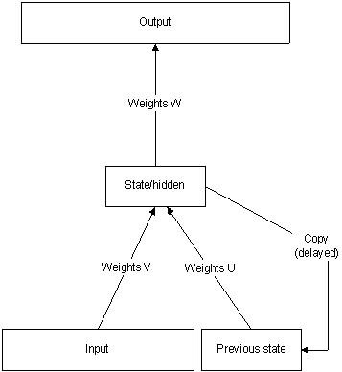

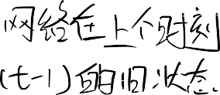
Elman Network
Elman ⽹络的核⼼思想是，它的输出不仅取决于“当前的输⼊”，还取决于⼀个“内部状态”（即“记忆”），这个“内部状态”会随时间不断更新。
Elman network which typically distinguishes between a state-output function and an input-state mapping.
y = F_{w} (z)
z^{t} = F (z^{t –1} , x)
v
where y is the output, x is the input and z is the state. t is an index in time.

Slide 25
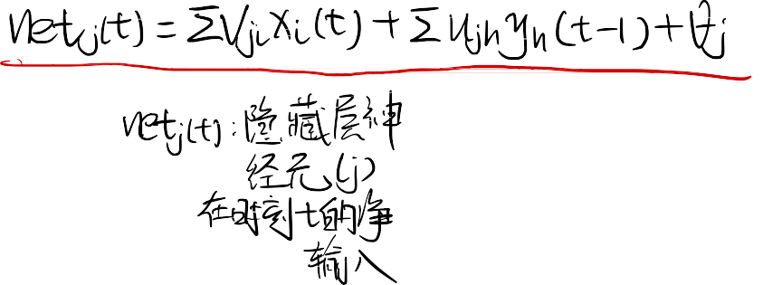
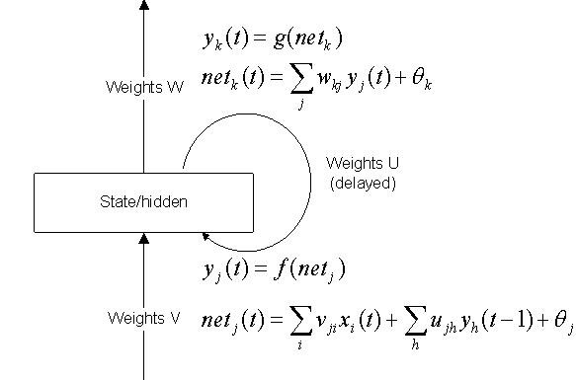
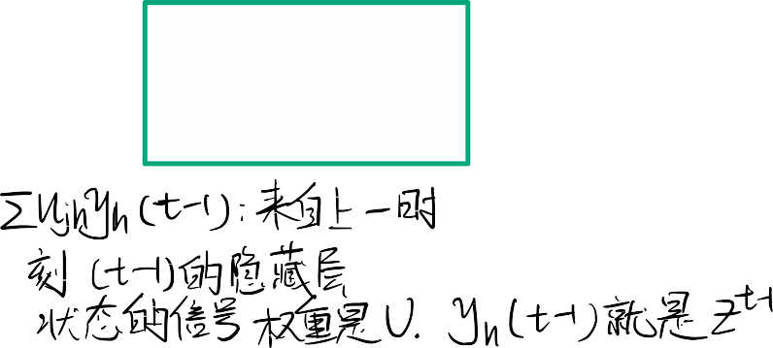
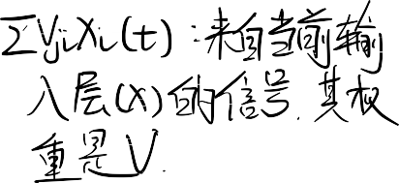
In Elman net, the internal representations are now engaged in the next step as an additional input.
Output
Note that all equations are the same as for the feed forward case. The only difference is that we have another set of weights (U) which feed activations from the hidden nodes to the
hidden nodes. Importantly, the feedback is delayed.
Weights U (delayed)
State/hidden
Input
22

Slide 26














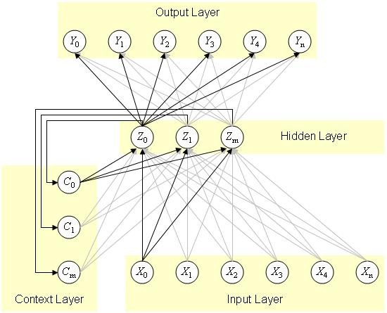

Elman Network
Four layers of Elman network
Input layer
Hidden layer forming internal representation
Context layer
The value of the context neuron is used as an extra input signal for all the neurons in the hidden layer one time step later. In an Elman network, the weights from the hidden layer to the context layer are set to one and are f i xed because the values of the context neurons have to be copied exactly
Output layer linear combination

Slide 27
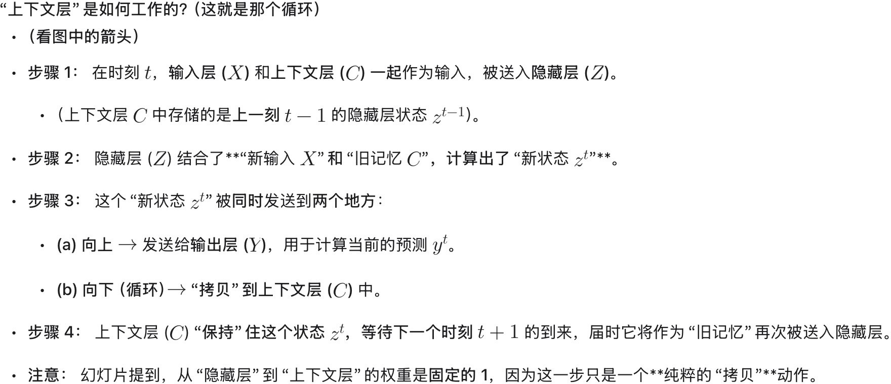




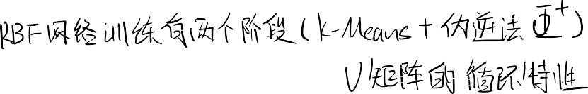
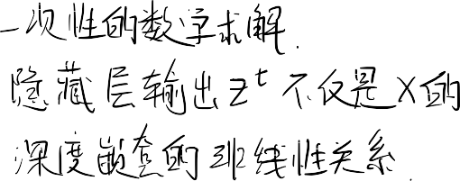











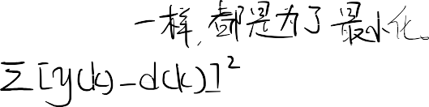





Slide 28
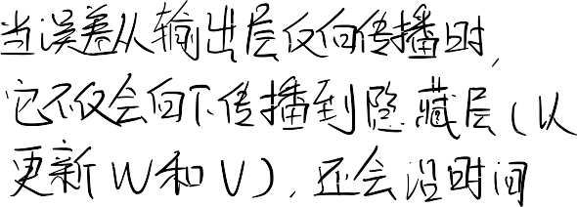





Learning algorithm for Elman Network
Elman network adopts BP algorithm
  The error function：
E = Σ[ y(k ) – d (k )]²
k =1
n
where d (k ) is the expected output (target)

Slide 29







THANK YOU
VISIT US
WWW.XJTLU.EDU.CN
FOLLOW US
@XJTLU

