Slide 1



INT305 Machine Learning Lecture 2
Linear Methods for Regression, Optimization
Sichen Liu Department Intelligence Science
Sichen.Liu@xjtlu.edu.cn

Slide 2
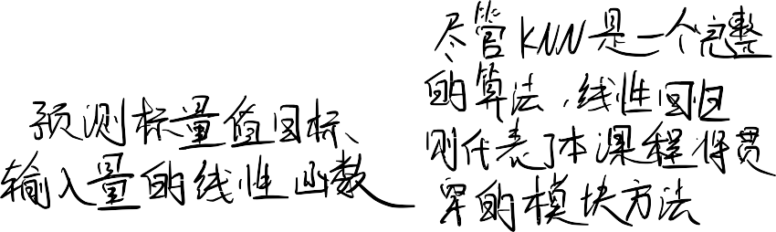



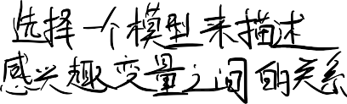
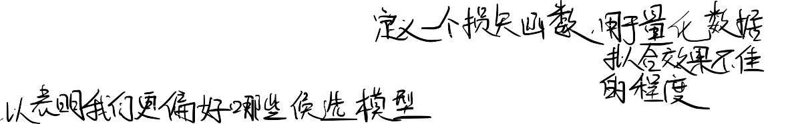



Overview
Second learning algorithm of the course: linear regression.
  Task: predict scalar-valued targets (e.g. stock prices)
  Architecture: linear function of the inputs
While KNN was a complete algorithm, linear regression exemplifies a modular approach that will be used through this course:
  choose a model describing the relationships between variables of interest
  define a loss function quantifying how bad the fit to the data is
  choose a regularizer saying how much we prefer different candidate models (or explanations of data)
  fit a model that minimizes the loss function and satisfies the constraint/penalty imposed by the regularizer, possibly using an optimization algorithm
Mixing and matching these modular components give us a lot of new ML methods.

Slide 3
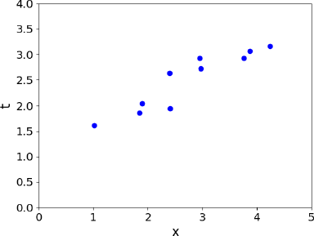








Supervised Learning Setup
In supervised learning:
There is input x ∈ 𝒳, typically a vector of features (or covariates)
There is target 𝑡 ∈ 𝒯, (also called response, outcome, output, class)
Objective is to learn a function 𝑓: 𝒳 → 𝒯 such that 𝑡 ≈ 𝑦 = 𝑓 x based on some
data 𝒟 = { x ^{𝑖} , 𝑡 ^{𝑖} 𝑓𝑜𝑟 𝑖 = 1, 2, ⋯ , 𝑁}

Slide 4
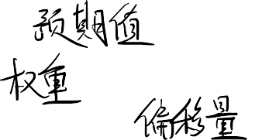
Linear Regression - Model
Model: In linear regression, we use a linear function of the features x = 𝑥₁, ⋯ , 𝑥_{𝐷} ∈ ℝ^{𝐷} to make predictions 𝑦 of the target value 𝑡 ∈ ℝ:
𝑦 = 𝑓 x
= ∑ 𝑤_{j}𝑥_{j} + 𝑏
j
𝑦 is the prediction
w is the weights
𝑏 is the bias (or intercept)
w and 𝑏 together are the parameters
We hope that our prediction is close to the target: 𝑦 ≈ 𝑡.

Slide 5
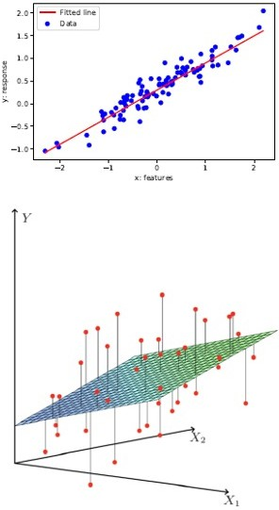

What is Linear? 1 feature vs D features
If we have only 1 feature:
𝑦 = 𝑤𝑥 + 𝑏 where 𝑤, 𝑥, 𝑏 ∈ ℝ.
𝑦 is linear in 𝑥.
If we have only 𝐷 features:
𝑦 = w^{𝗍}x + 𝑏 where w, x ∈ ℝ^{𝐷}, 𝑏 ∈ ℝ
𝑦 is linear in x.
Relation between the prediction 𝑦 and inputs x is linear in both cases.

Slide 6




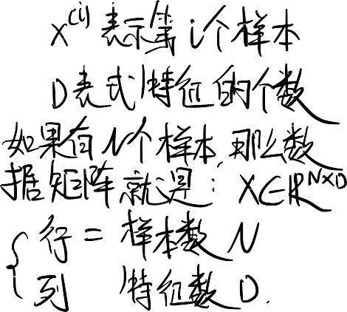


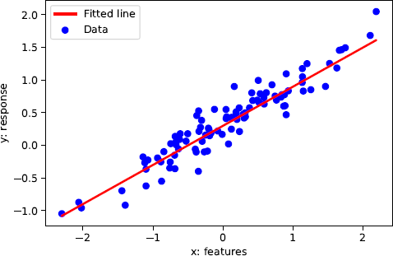




Linear Regression
We have a dataset 𝒟 = { x ^{𝑖} , 𝑡 ^{𝑖} 𝑓𝑜𝑟 𝑖 = 1,2, ⋯ 𝑁} where,
x^{(𝑖)} = (𝑥 ^{𝑖} , 𝑥 ^{𝑖} , ⋯ 𝑥^{(𝑖)})^{𝗍}∈ ℝ^{𝐷} are the inputs (e.g. age, height)
1 2 𝐷
𝑡^{(𝑖)} ∈ ℝ is the target or response (e.g. income)
Predict 𝑡^{(𝑖)} with a linear function of x^{(𝑖)}:
_{𝑡}(𝑖) _{≈ 𝑦} 𝑖
• = w^{𝗍}x ^{𝑖} + 𝑏
Different w, 𝑏 define different lines.
We want the “best” line w, 𝑏 .
How to quantify “best”?

Slide 7
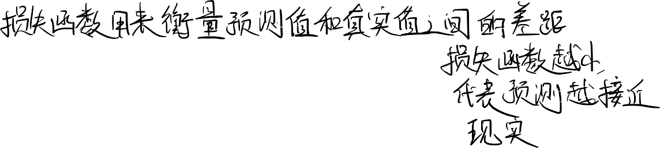










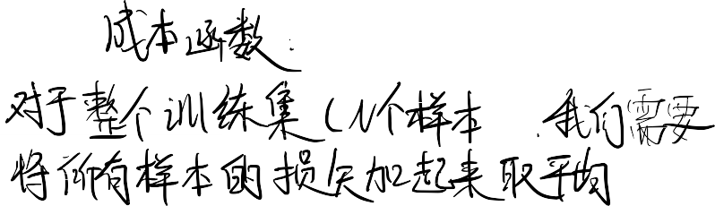

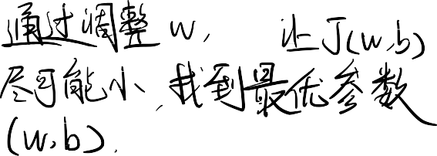



Linear Regression - Loss Function
A loss function ℒ(𝑦, 𝑡) defines how bad it is if, for some example x, the algorithm predicts 𝑦, but the target is actually 𝑡.
Squared error loss function:
ℒ 𝑦, 𝑡 = ¹ (𝑦 − 𝑡)²
2
𝑦 − 𝑡 is the residual, and we want to make this small in magnitude.
The ¹ factor is just to make the calculations convenient.
2
Cost function: loss function averaged over all training examples.
𝑁
𝒥 w, 𝑏 = ¹ ∑(𝑦 ^{𝑖}
_{− 𝑡}(𝑖)₎2
2𝑁
𝑖=1
𝑁
= ¹ ∑(w^{𝗍}x ^{𝑖} + 𝑏 − 𝑡^{(𝑖)})²
2𝑁
𝑖=1
Terminology varies. Some call “cost” empirical or average loss.

Slide 8


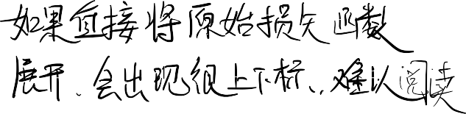

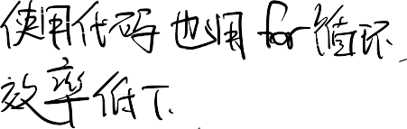
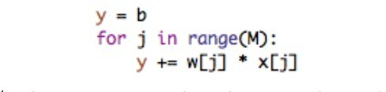
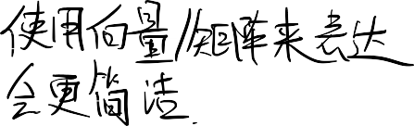



Vectorization
Notation-wise,
1 _{∑𝑁}
(𝑦 ^{𝑖} − 𝑡^{(𝑖)})² gets messy if we expand 𝑦^{(𝑖)}:
2𝑁
𝑖=1
𝑁 𝐷
¹ ∑(∑ 𝑤 𝑥 ^{𝑖} + 𝑏 − 𝑡^{(𝑖)})²
2𝑁
j j
𝑖=1 j=1
The code equivalent is to compute the prediction using a for loop:
Excessive super/sub scripts are hard to work with, and Python loops are slow, so we vectorize algorithms by expressing them in terms of vectors and matrices.
w = (𝑤₁, ⋯ 𝑤_{𝐷})^{𝗍} x = (𝑥, ⋯ 𝑥_{𝐷})^{𝗍}
𝑦 = w^{𝗍}x + 𝑏
This is simpler and executes much faster:

Slide 9


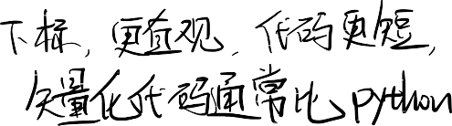

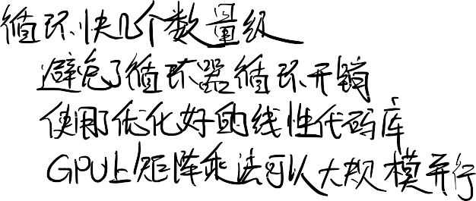
Vectorization
Why vectorize?
The equations, and the code, will be simple and more readable. Gets rid of dummy variables/indices!
Vectorized code is much faster
  Cut down on Python interpreter overhead
  Use highly optimized linear algebra libraries (hardware support)
  Matrix multiplication very fast on GPU (Graphics Processing Unit)
Switching in and out of vectorized form is a skill you gain with practice.
Some derivations are easier to do element-wise
Some algorithms are easier to write/understand using for-loops and vectorize later for performance

Slide 10


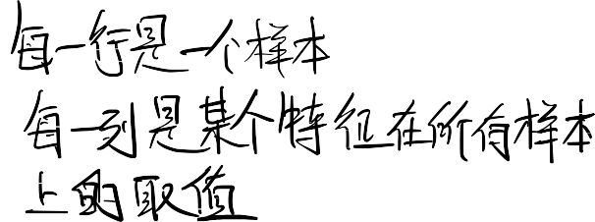
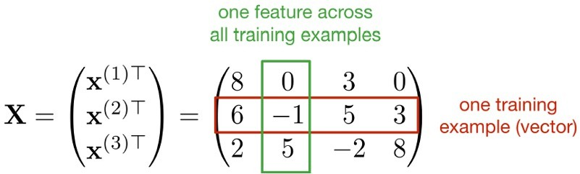
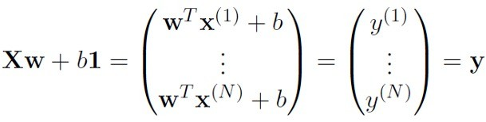
Vectorization
We can organize all the training examples into a design matrix X with one row per training example, and all the targets into the target vector t.
Computing the predictions for the whole dataset:

Slide 11


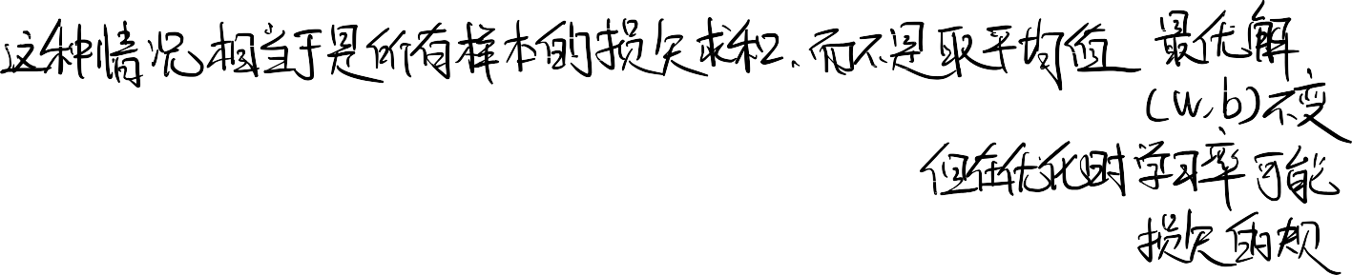
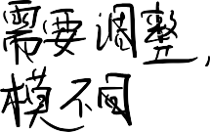
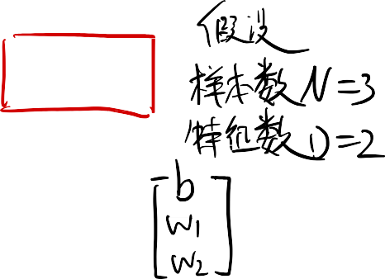










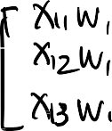












Vectorization
Computing the squared error cost across the whole dataset:
y = Xw + 𝑏1
𝒥 = ¹ y − t
2
2𝑁
Sometimes we may use 𝒥 = ¹ y − t
², without a normalizer. This would correspond
2
to the sum of losses, and not the averaged loss. The minimizer does not depend on 𝑁
(but optimization might!).
We can also add a column of 1’s to design matrix, combine the bias and the weights, and conveniently write
1
1
1
_{[x}(1)]𝗍
_{[x}(2)]𝗍
⋮
𝑏
𝑤₁
𝑤₂
⋮
X =
_{∈ ℝ}𝑁×(𝐷+1)
and
w =
_{∈ ℝ}𝐷+1
Then, our predictions reduce to y = Xw.

Slide 12
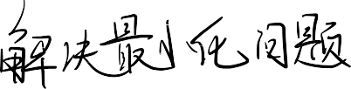

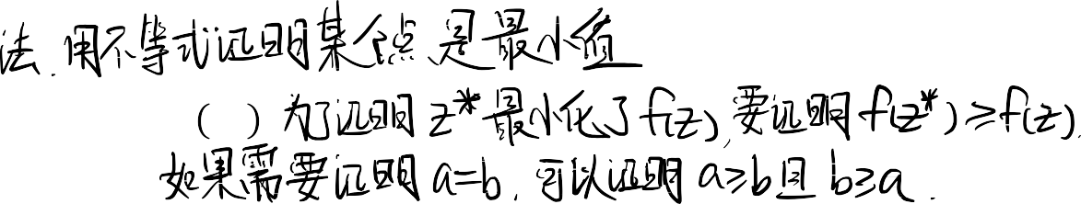


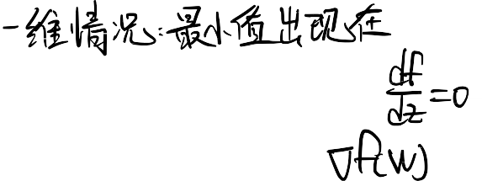





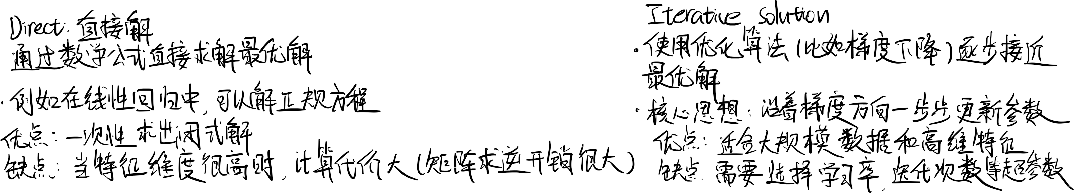
Solving the Minimization Problem
We define a cost function. This is what we’d like to minimize. Two commonly applied mathematical approaches:
Algebraic, e.g., using inequalities:
  To show 𝑧∗ minimizes 𝑓(𝑧), show that ∀𝑧, 𝑓 𝑧 ≥ 𝑓 𝑧∗
  To show that 𝑎 = 𝑏, show that 𝑎 ≥ 𝑏 and 𝑏 ≥ 𝑎
Calculus: minimum of a smooth function (if it exists) occurs at a critical point, i.e. point where the derivative is zero.
  Multivariate generalization: set the partial derivatives to zero (or equivalently the gradient).
Solutions may be direct or iterative
Sometimes we can directly find provably optimal parameters (e.g., set the gradient to zero and solve in closed form). We call this a direct solution.
We may also use optimization techniques that iteratively get us closer to the solution. We will get back to this soon.

Slide 13
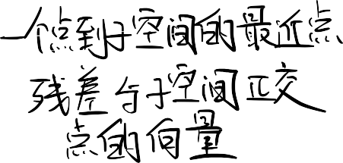






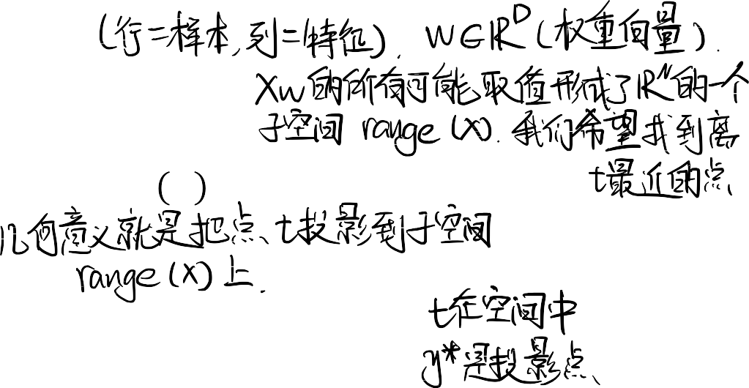


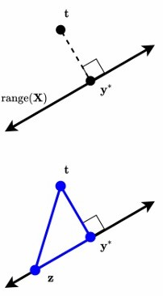
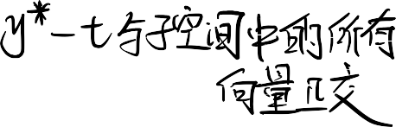
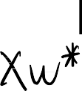














Direct Solution I: Linear Algebra
We seek w to minimize Xw − t ², or equivalently Xw − t
range X = Xw|w ∈ ℝ^{𝐷} is a 𝐷-dimensional subspace of ℝ^{𝑁}
Recall that the closest point y∗ = Xw∗ in subspace range X of ℝ^{𝑁} to arbitrary point
t ∈ ℝ^{𝑁} is found by orthogonal projection.
  We have y∗ − t t Xw, ∀w ∈ ℝ^{𝐷}
  Why is y∗ the closest point to t?
    Consider any z = Xw
    By Pythagorean theorem and the trivial inequality (𝑥² ≥ 0):
z − t ² = y∗ − t
≥ y∗ − t
2 ₊
2
2
y∗ − z

Slide 14




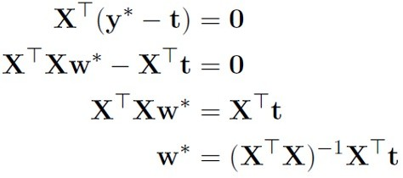
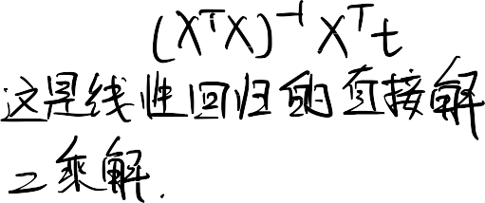






Direct Solution I: Linear Algebra
From the previous slide, we have y∗ − t t Xw, ∀w ∈ ℝ^{𝐷}
Equivalently, the columns of the design matrix X are all orthogonal to y∗ − t , and we have that:
While this solution is clean and the derivation easy to remember, like many algebraic solutions, it is somewhat ad hoc.
On the hand, the tools of calculus are broadly applicable to differentiable loss
functions…

Slide 15

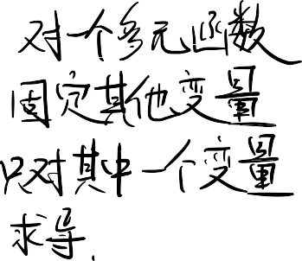


Direct Solution II: Calculus
Partial derivative: derivative of a multivariate function with respect to one of its arguments.
_{= lim} 𝑓 𝑥₁ + ℎ, 𝑥₂ − 𝑓(𝑥₁, 𝑥₂)
𝜕 𝑓 𝑥 , 𝑥
1 2
𝜕𝑥₁ ℎ
ℎ→0
To compute, take the single variable derivative, pretending the other arguments are constant.
Example: partial derivatives of the prediction 𝑦
𝜕𝑦 ₌ 𝜕 𝜕𝑦 ₌ 𝜕
∑ 𝑤 ! 𝑥 ! + 𝑏 ∑ 𝑤 ! 𝑥 ! + 𝑏
𝜕𝑤_{j} 𝜕𝑤_{j}
j j j j
𝜕𝑏
𝜕𝑏
_{j}!
_{j}!
= 𝑥_{j}
= 1

Slide 16



Direct Solution II: Calculus
For loss derivatives, apply the chain rule:
𝜕ℒ ₌ 𝑑ℒ 𝜕𝑦
𝜕ℒ ₌ 𝑑ℒ 𝜕𝑦
𝜕𝑤_{j} 𝑑𝑦 𝜕𝑤_{j}
𝜕𝑏 𝑑𝑦 𝜕𝑏
= 𝑦 − 𝑡
₌ 𝑑
¹ (𝑦 − 𝑡)² 4 𝑥
𝑑𝑦 2
j
= (𝑦 − 𝑡)𝑥_{j}
For cost derivatives, use linearity and average over data points:
𝜕𝒥 ₌ 1
𝑁
𝑖 (𝑖)
(𝑖)
𝜕𝒥 1
𝜕𝑏 𝑁
𝑁
_{𝑁} 8 (𝑦 − 𝑡 )𝑥_{j}
(𝑖)
(𝑖)
𝜕𝑤
= 8 𝑦 − 𝑡
j 𝑖=1
𝑖=1
Minimum must occur at a point where partial derivatives are zero.
^{𝜕𝒥} = 0 ∀: , ^{𝜕𝒥} = 0.
𝜕𝑤_{j} 𝜕𝑏
(If 𝜕𝒥⁄𝜕𝑤_{j} ≠ 0, you could reduce the cost by changing 𝑤_{j})

Slide 17
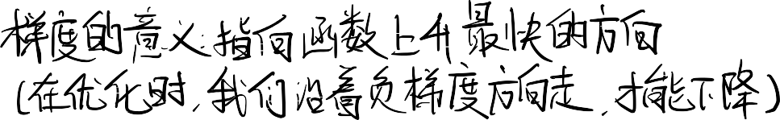
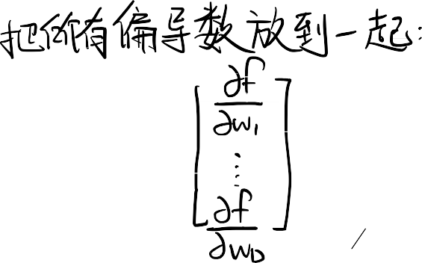

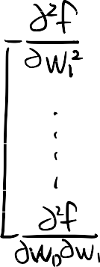
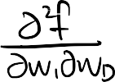



Direct Solution II: Calculus
The derivation on the previous slide gives a system of linear equations, which we can solve efficiently.
As is often the case for models and code, however, the solution is easier to
characterize if we vectorize our calculus.
We call the vector of partial derivatives the gradient.
Thus, the “gradient of 𝑓: ℝ^{𝐷} → ℝ”, denoted A𝑓(w), is:
₍ 𝜕 𝜕
𝑓 w , ⋯ , 𝑓 w )^{𝗍}
𝜕𝑤₁ 𝜕𝑤_{𝐷}
The gradient points in the direction of the greatest rate of increase.
Analogue of second derivative (the “Hessian” matrix):
A²𝑓 w ∈ ℝ^{𝐷×𝐷} is a matrix with A²𝑓 w =
𝛛2
𝑓 w .
𝑖j
𝛛w_{𝑖}𝛛w_{j}

Slide 18
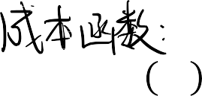










Direct Solution II: Calculus
We seek w to minimize 𝒥 w
₌ 1
Xw − t
2
2
Taking the gradient with respect to w (see course notes for additional details) we get:
A_{w}𝒥 𝑤 = X^{𝗍}Xw − X^{𝗍}t = 0
We get the same optimal weights as before:
w∗ = (X^{𝗍}X)^{–1}X^{𝗍}t
Linear regression is one of only a handful of models in this course that permit direct solution.

Slide 19
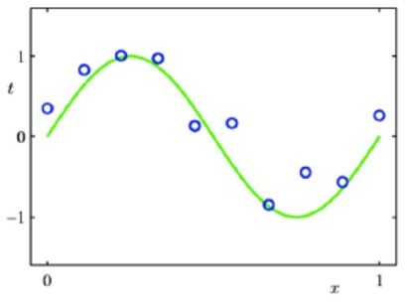
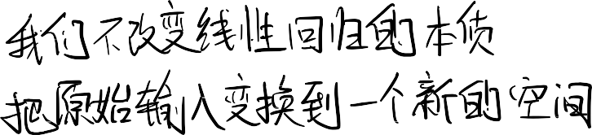
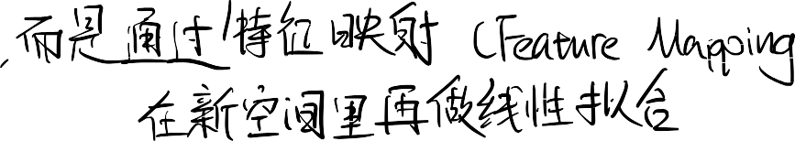


Polynomial Feature Mapping
The relation between the input and output may not be linear.
We can still use linear regression by mapping the input features to another space using feature mapping (or basis expansion). 𝜑 x : ℝ^{𝐷} → ℝ^{𝑑} and treat the mapped feature (in ℝ^{𝑑} ) as the input of a linear regression procedure.
Let us see how it works when x ∈ ℝ and we use a polynomial feature mapping.

Slide 20

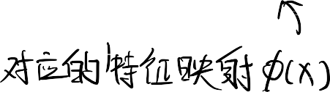
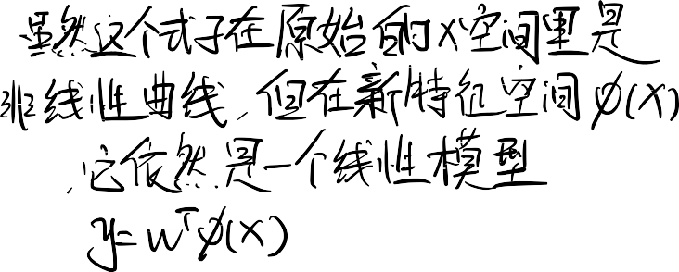



Polynomial Feature Mapping
If the relationship does not look linear, we can fit a polynomial.
Find the data using a degree-M polynomial function of the form:
𝑀
𝑦 = 𝑤₀ + 𝑤₁𝑥 + 𝑤₂𝑥² + ⋯ + 𝑤_{𝑀}𝑥^{𝑀} = ∑ 𝑤_{𝑖}𝑥^{𝑖}
𝑖=0
Here the feature mapping is 𝜑 𝑥 = [1, 𝑥, 𝑥², … , 𝑥^{𝑀}]^{𝗍}.
We can still use linear regression to find w, since 𝑦 = 𝜑 𝑥 ^{𝗍}w is linear with 𝑤₀, 𝑤₁, …
In general, 𝜑 can be any function. Another example:
𝜑 𝑥 = [1, sin 2π𝑥 , cos 2π𝑥 , sin 4π𝑥 , ⋯ ]^{𝗍}

Slide 21
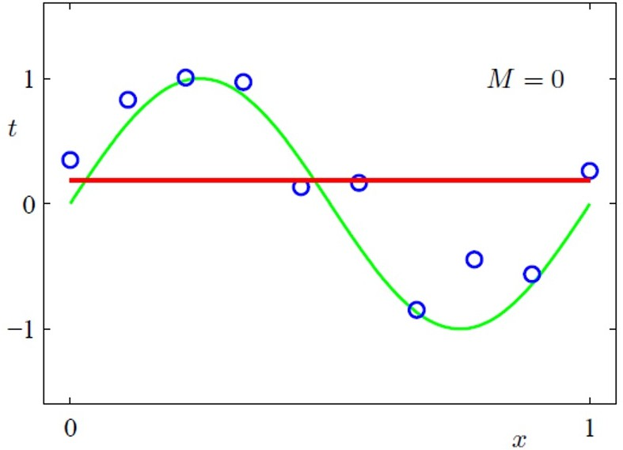
Polynomial Feature Mapping with M = 0
𝑦 = 𝑤₀
- Pattern Recognition and Machine Learning, Christopher Bishop.

Slide 22
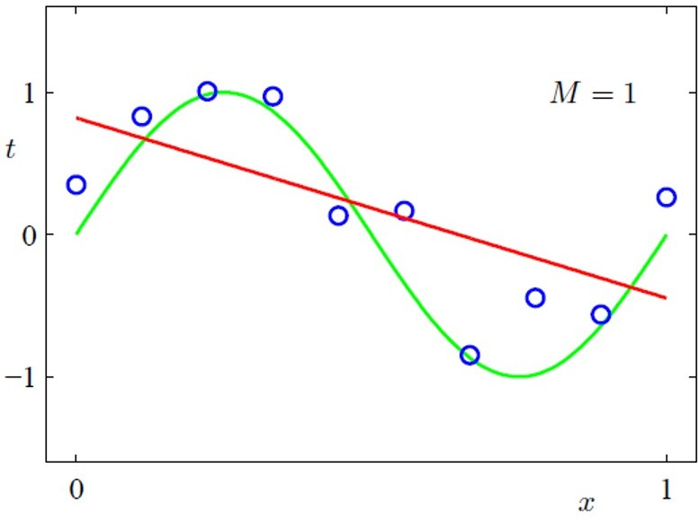
Polynomial Feature Mapping with M = 1
𝑦 = 𝑤₀ + 𝑤₁𝑥
- Pattern Recognition and Machine Learning, Christopher Bishop.

Slide 23
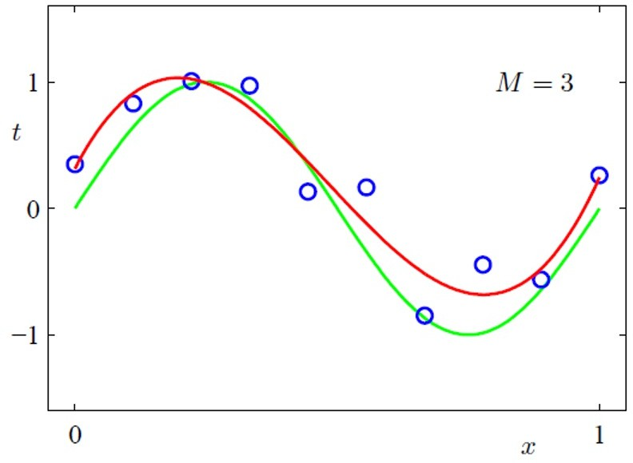
Polynomial Feature Mapping with M = 3
𝑦 = 𝑤_{𝑜} + 𝑤₁𝑥 + 𝑤₂𝑥² + 𝑤₃𝑥³
- Pattern Recognition and Machine Learning, Christopher Bishop.

Slide 24
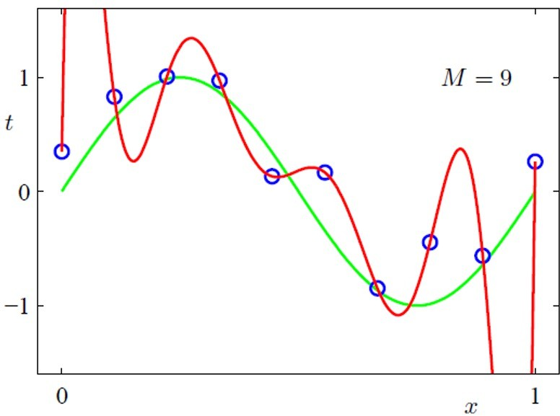
Polynomial Feature Mapping with M = 9
𝑦 = 𝑤₀ + 𝑤₁𝑥 + 𝑤₂𝑥² + 𝑤₃𝑥³ + ⋯ + 𝑤_{𝖾}𝑥^{𝖾}
- Pattern Recognition and Machine Learning, Christopher Bishop.

Slide 25



Model Complexity and Generalization
Underfitting (M=0): model is too simple – does not fit the data. Overfitting (M=9): model is too complex – fits perfectly.
Good model (M=3): achieves small test error (generalizes well).

Slide 26





Model Complexity and Generalization
As M increases, the magnitude of coefficients gets larger.
For M=9, the coefficients have become finely tuned to the data.
Between data points, the function exhibits large oscillations.

Slide 27







Regularization
The degree M of the polynomial controls the model’s complexity.
The value of M is a hyperparameter for polynomial expansion, just like k in KNN. We can tune it using a validation set.
Restricting the number of parameters / basis functions (M) is a crude approach to control the model complexity.
Another approach: keep the model large, but regularize it.
  Regularizer: a function that quantifies how much we prefer one hypothesis vs. another.

Slide 28





















L2 Regularization
We can encourage the weights to be small by choosing as our regularizer the 𝐿²
penalty. ₌ 1
ℛ w w ² = ¹ ∑ 𝑤².
2 2
2 j j
Note: To be precise, the 𝐿² norm is Euclidean distance, wo we’re regularizing the squared 𝐿²
norm.
The regularized cost function makes a tradeoff between fit to the data and the norm of the weights.
𝜆
2
j
𝒥_{𝑟𝑒g} w = 𝒥 w + 𝜆ℛ w = 𝒥 w + ∑ 𝑤
2
j
If you fit training data poorly, 𝒥 is large. If your optimal weights have high values, ℛ is large.
Large 𝜆 penalizes wight values more.
Like 𝑀, 𝜆 is a hyperparameter we can tune with a validation set.

Slide 29

L2 Regularization
The geometric picture:

Slide 30





























L2 Regularized Least Squares: Ridge regression
For the least squares problem, we have 𝒥 w =
1
2𝑁
Xw − t
2.
When 𝜆 > 0 (with regularization), regularized cost gives
The case 𝜆 = 0 (no regularization) reduces to least squares solution!
Note that it is also common to formulate this problem as 𝑎𝑟𝑔𝑚𝑖𝑛_{w} ¹
Xw − t
2 ₊
2
2
𝜆 2
w ² in which case the solution is w^{Ridge} = (X^{𝗍}X + 𝜆I)^{–1}X^{𝗍}t.
2
𝜆

Slide 31
Conclusion so far
Linear regression exemplifies recurring themes of this course:
Choose a model and a loss function
Formulate an optimization problem
Solve the minimization problem using one of two strategies
  Direct solution (set derivatives to zero)
  Gradient descent (next topic)
Vectorize the algorithm, i.e. represent in terms of linear algebra
Make a linear model more powerful using features
Improve the generalization by adding a regularizer

Slide 32












Gradient Descent
Now let’s see a second way to minimize the cost function which is more broadly applicable: gradient descent.
Many times, we do not have a direct solution: Taking derivatives of 𝒥 w.r.t w and
setting them to 0 doesn’t have an explicit solution.
Gradient descent is an iterative algorithm, which means we apply an update repeatedly until some criterion is met.
We initialize the weights to something reasonable (e.g., all zeros) and repeatedly adjust them in the direction of steepest descent.

Slide 33










Gradient Descent
Observe:
  If 𝜕𝒥⁄𝜕𝑤_{j} > 0, then increasing 𝑤_{j} increases 𝒥.
  If 𝜕𝒥⁄𝜕𝑤_{j} < 0, then increasing 𝑤_{j} decreases 𝒥.
The following update always decreases the cost function for small enough 𝛼 (unless
𝜕𝒥⁄𝜕𝑤_{j} = 0):
𝑤 ➛ 𝑤 − 𝛼 ^{𝜕𝒥}
j j
𝜕𝑤_{j}
𝛼 > 0 is a learning rate (or step size). The larger it is, the faster w changes.
  We’ll see later how to tune the learning rate, but values are typically small, e.g.,
0.01 or 0.0001.
If cost is the sum of 𝑁 individual losses rather than their average, smaller learning rate will be needed (𝛼′ = 𝛼⁄𝑁).

Slide 34












Gradient Descent
This gets its name from the gradient:
𝜕𝒥
𝜕𝒥
𝜕𝑤₁
⋮
𝜕𝒥
𝜕𝑤_{𝐷}
∇_{w}𝒥 = 𝜕> =
This is the direction of fastest increase in 𝒥.
Update rule in vector form:
> ← > − 𝛼 ^{𝛛𝒥}
𝛛w
And for linear regression we have:
𝛼
𝑁
(𝑖) (𝑖) (𝑖)
> ← > − _{𝑁} 8 𝑦 − 𝑡 B
𝑖=1
So gradient descent updates w in the direction of fastest decrease.
Observe that once it converges, we get a critical point, i.e. ^{𝛛𝒥} = 0.
𝛛w

Slide 35








Gradient Descent for Linear Regression
The squared error loss of linear regression is a convex function.
Even for linear regression, where there is a direct solution, we sometimes need to use GD.
Why gradient descent, if we can find the optimum directly?
  GD can be applied to a much broader set of models
  GD can be easier to implement than direct solutions
  For regression in high-dimensional space, GD is more efficient than direct solution
    Linear regression solution:(C^{𝗍}C)^{–1} C^{𝗍}D
    Matrix inversion is an 𝒪(𝐷³) algorithm
    Each GD update costs 𝒪(𝑁𝐷)
    Or less with stochastic GD (SGD, in a few slides)
    Huge difference if 𝐷 ≫ 1

Slide 36























Gradient Descent under the L2 Regularization
Gradient descent update to minimize 𝒥:
w ➛ w − 𝛼
𝛛 _{𝒥}
𝛛w
The gradient descent update to minimize the 𝐿² regularized cost 𝒥 + 𝜆ℛ results in weight decay:
w ➛ w − 𝛼 𝛛 (𝒥 + 𝜆ℛ)
𝛛w
𝜕𝒥 _{+ 𝜆} 𝜕ℛ
= w − 𝛼
𝜕w 𝜕w
= w − 𝛼 ^{𝜕𝒥} + 𝜆w
𝜕w
= (1 − 𝛼𝜆)w − 𝛼 ^{𝜕𝒥}
𝜕w

Slide 37
















Learning Rate (Step Size)
In gradient descent, the learning rate 𝛼 is a hyperparameter we need to tune. Here are some things that can go wrong:
𝛼 too small: slow progress
𝛼 too large: oscillations
𝛼 much too large: instability
Good values are typically between 0.001 and 0.1. You should do a grid search if you want good performance (i.e. try 0.1, 0.03, 0.01, …).

Slide 38













Training Curves
To diagnose optimization problems, it’s useful to look at training curves: plot the training cost as a function of iteration.
Warning: in general, it’s very hard to tell from the training curves whether an optimizer has converged. They can reveal major problems, but they can’t guarantee convergence.

Slide 39

















Stochastic Gradient Descent
So far, the cost function 𝒥 has been the average loss over the training examples:
𝑁 𝑁
𝒥 v = ¹ ∑ ℒ ^{𝑖} = ¹ ∑ ℒ(𝑦 𝑥 ^{𝑖} , v , 𝑡^{(𝑖)})
𝑁 𝑁
𝑖=1 𝑖=1
(v denotes the parameters; e.g., in linear regression, w = (w, 𝑏))
By linearity,
𝜕𝒥 1
𝑁
_{𝜕ℒ}(𝑖)
𝜕w ⁼ 𝑁 ∑ 𝜕w
𝑖=1
Computing the gradient requires summing over all of the training examples. This is known as batch training.
Batch training is impractical if you have a large dataset 𝑁 ≫ 1 (e.g. millions of training examples.)!

Slide 40






Stochastic Gradient Descent
Stochastic gradient descent (SGD): update the parameters based on the gradient for a single training example,
1- Choose 𝑖 uniformly at random,
_{𝜕ℒ}(𝑖)
2- w ➛ w − 𝛼
𝜕w
Cost of each SGD update is independent of 𝑁!
SGD can make significant progress before even seeing all the data!
Mathematical justification: if you sample a training example uniformly at random, the stochastic gradient is an unbiased estimate of the batch gradient:
_{𝜕ℒ}(𝑖)
𝑁
_{𝜕ℒ}(𝑖)
1 𝜕𝒥
𝔼
𝜕w ⁼ 𝑁 ∑ 𝜕w ⁼ 𝜕w
𝑖=1

Slide 41






Stochastic Gradient Descent
Problems with using single training example to estimate gradient:
  Variance in the estimate may be high
  We can’t exploit efficient vectorized operations
Compromise approach:
  Compute the gradients on a randomly chosen medium-sized set of training examples ℳ ⊂ 1, ⋯ , 𝑁 , called a mini-batch.
Stochastic gradients computed on larger mini-batches have smaller variance.
The mini-batch size ℳ is a hyperparameter that needs to be set.
  Too large: requires more compute: e.g., it takes more memory to store the activations, and longer to compute each gradient update
  Too small: can’t exploit vectorization, has high variance
  A reasonable value might be ℳ = 100.

Slide 42








Stochastic Gradient Descent
Batch gradient descent moves directly downhill (locally speaking).
SGD takes steps in a noisy direction, but moves downhill on average.
batch gradient descent
stochastic gradient descent

Slide 43

















SGD Learning Rate
In stochastic training, the learning rate also influences the fluctuations, due to the stochasticity of the gradients.
Small learning rate Large learning rate
Typical strategy:
  Use a large learning rate early in training so you can get close to the optimum
  Gradually decay the learning rate to reduce the fluctuations

Slide 44








Conclusion
In this lecture, we looked at linear regression, which exemplifies a modular approach that will be used throughout this course:
  Choose a model describing the relationships between variables of interest (linear)
  Define a loss function quantifying how bad the fit to the data is (squared error)
  Choose a regularizer to control the model complexity/overfitting (𝐿², 𝐿^{𝑝}
regularization)
  Fit/Optimize the model (gradient descent, stochastic gradient descent, convexity)
By mixing and matching these modular components, we can obtain new ML methods.
Next lecture: apply this framework to classification.

