Slide 1

INT305 Machine Learning
Lecture 3
Linear Classifiers, Logistic Regression, Multiclass Classification
Sichen Liu
Department Intelligence Science
Sichen.Liu@xjtlu.edu.cn

Slide 2
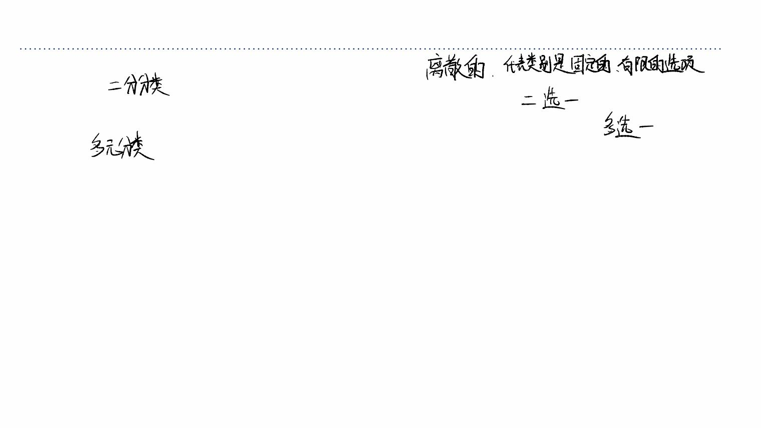
Overview
• Classification: predicting a discrete-valued target
ØBinary classification: predicting a binary-valued target
ØMulticlass classification: predicting a discrete(>2)-valued target
• Examples of binary classification
ØPredict whether a patient has a disease, given the presence or absence of various
symptoms
ØClassify e-mails as spam or non-spam
ØPredict whether a financial transaction is fraudulent

Slide 3
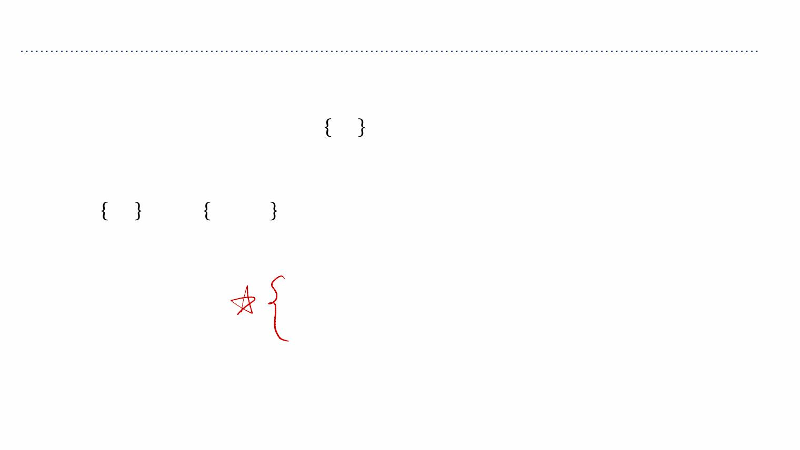
Overview
Binary linear classification
• Classification: given a ꢀ-dimensional input ꢁ∈ℝ! predict a discrete-valued target
• Binary: predict a binary target ꢂ∈ 0,1
ØTraining examples with ꢂ=1are called positive examples, and training
examples with ꢂ=0are called negative examples. Sorry.
Øꢂ∈ 0,1 or ꢂ∈ −1, +1 is for computational convenience.
• Linear: model prediction ꢃis a linear function of ꢁ, followed by a threshold ꢄ:
ꢅ=ꢆ⊺ꢁ+ꢇ
1 ꢈꢉꢅ≥ꢄ
0 ꢈꢉꢅ<ꢄ
ꢃ=2

Slide 4
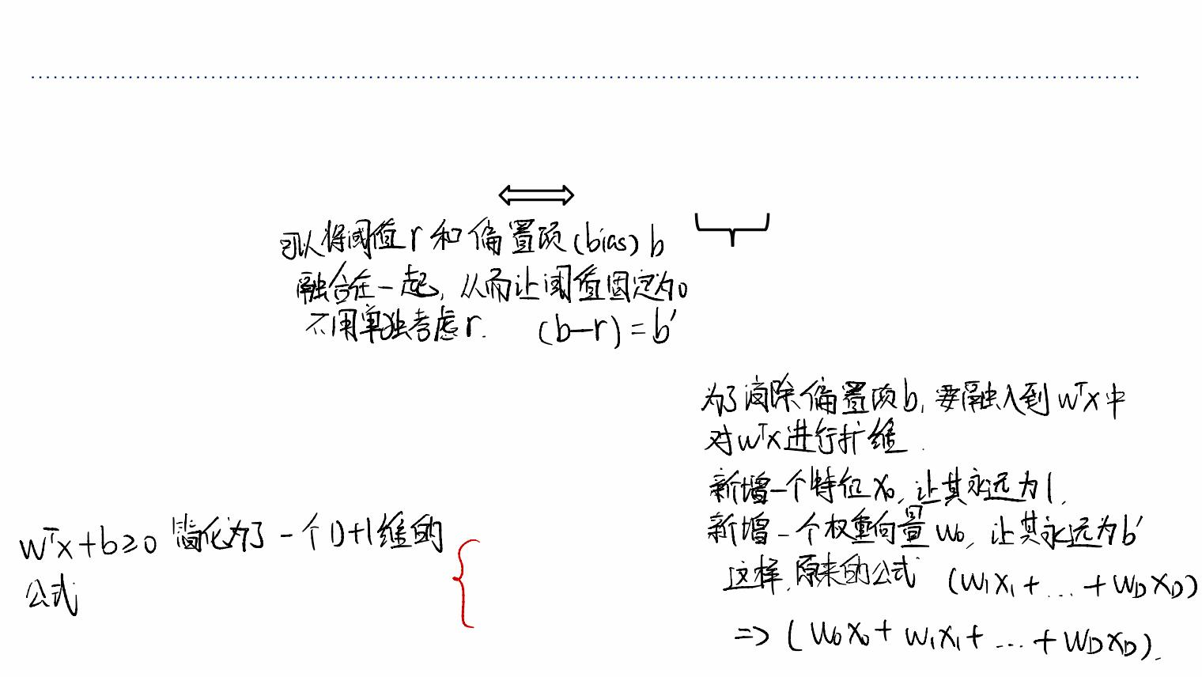
Simplifications
Eliminating the threshold
• We can assume without loss of generality (WLOG) that the threshold ꢄ=0:
ꢆ⊺ꢁ+ꢇ ≥ꢄ
ꢆ⊺ꢁ+ꢇ−ꢄ ≥ 0
≜ꢊ#
Eliminating the bias
• Add a dummy feature ꢋ which always takes the value 1. the weight ꢊ =ꢇis
#
#
equivalent to a bias (same as linear regression)
Simplified model
• Receive input ꢁ∈ℝ!$%with ꢋ# =1:
ꢅ=ꢆ⊺ꢁ
1 ꢈꢉꢅ≥0
0 ꢈꢉꢅ<0
ꢃ=2

Slide 5

Examples
• Let’s consider some simple examples to examine the properties of our
model
• Let‘s focus on minimizing the training set error, and forget about whether
our model will generalize to a test set.

Slide 6
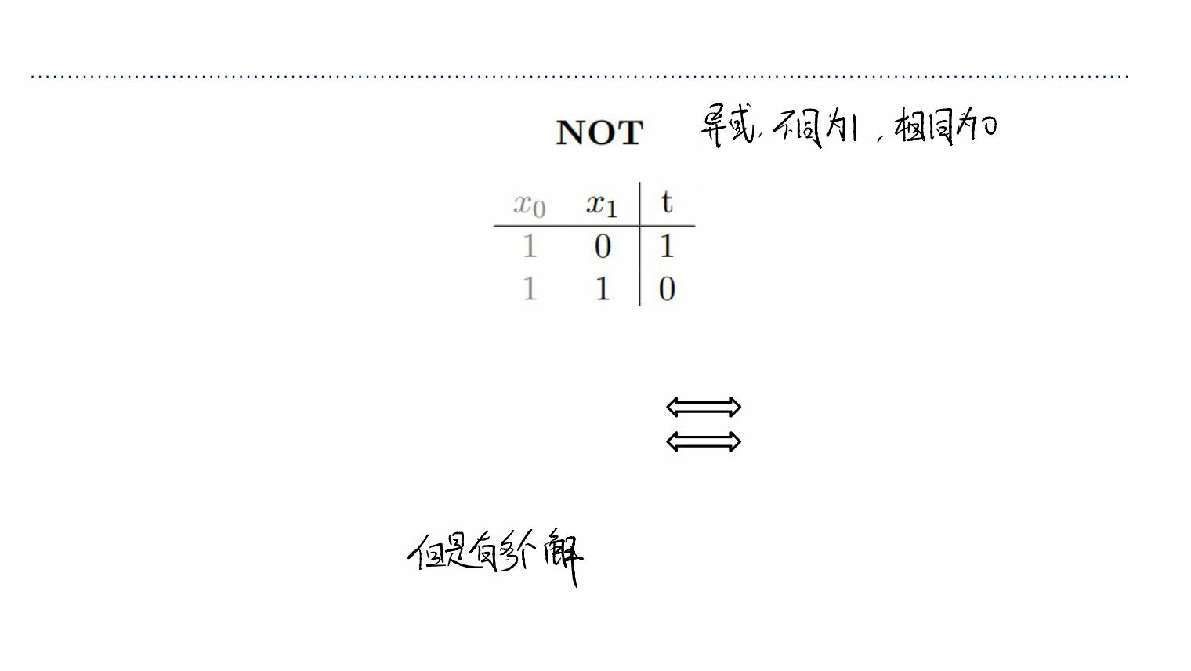
Examples
• Suppose this is our training set, with the dummy feature ꢋ#included.
• Which conditions on ꢊ#, ꢊ%guarantee perfect classification?
ØWhen ꢋ =0, need: ꢅ=ꢊ ꢋ +ꢊ ꢋ ≥0 ꢊ ≥0
%
# # % %
#
ØWhen ꢋ =1, need: ꢅ=ꢊ ꢋ +ꢊ ꢋ <0
ꢊ +ꢊ <0
%
# # % %
# %
• Example solution: ꢊ =1, ꢊ =−2
#
%
• Is this the only solution?

Slide 7
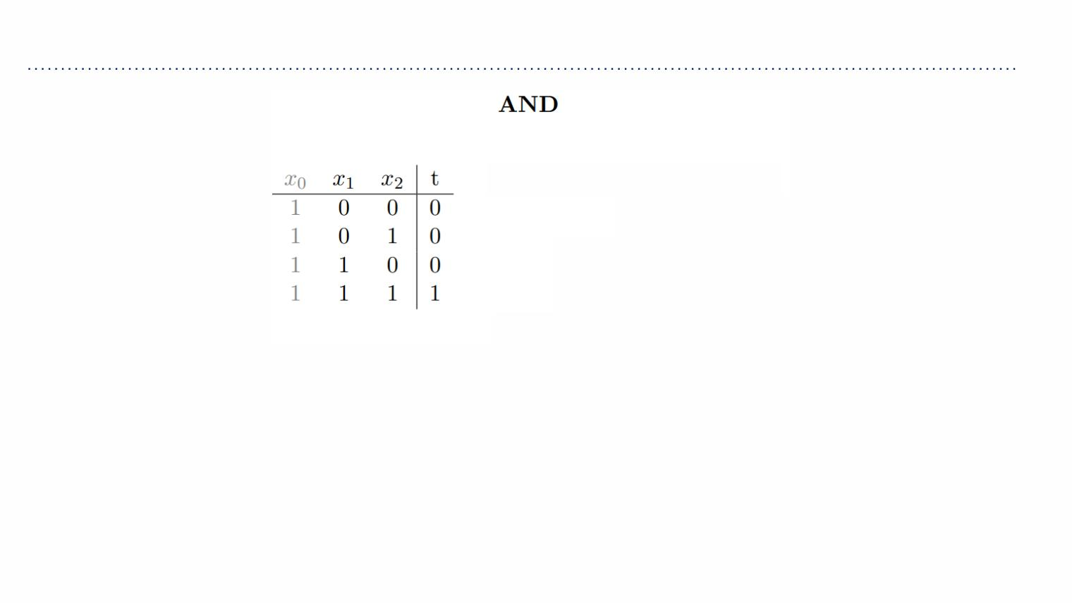
Examples
ꢅ=ꢊ ꢋ +ꢊ ꢋ +ꢊ ꢋ
# # % % & &
Need: ꢊ# <0
Need: ꢊ +ꢊ <0
# &
Need: ꢊ +ꢊ <0
# %
Need: ꢊ +ꢊ +ꢊ ≥0
# % &
Example solution: ꢊ = −1.5,ꢊ = 1,ꢊ =1
#
%
&

Slide 8
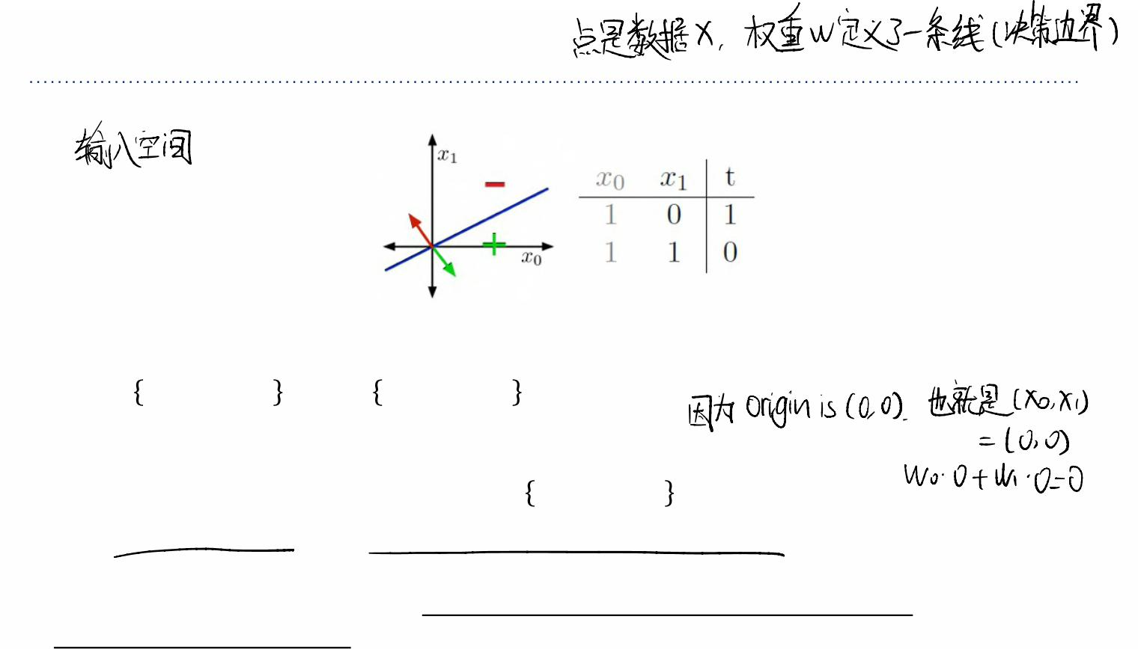
The Geometric Picture
Input Space, or Data Space for NOT example
• Training examples are points
• Weights (hypotheses) ꢆcan be represented by half-spaces
⊺
⊺
ꢌ = ꢁ:ꢆ ꢁ≥0 , ꢌ = ꢁ:ꢆ ꢁ<0
$
'
ØThe boundaries of these half-spaces pass through the origin (why?)
• The boundary is the decision boundary: ꢁ: ꢆ⊺ꢁ=0
ØIn 2-D, it’s a line, but in high dimensions it is a hyperplane
• If the training examples can be perfectly separated by a linear decision rule, we say
data is linearly separable.

Slide 9
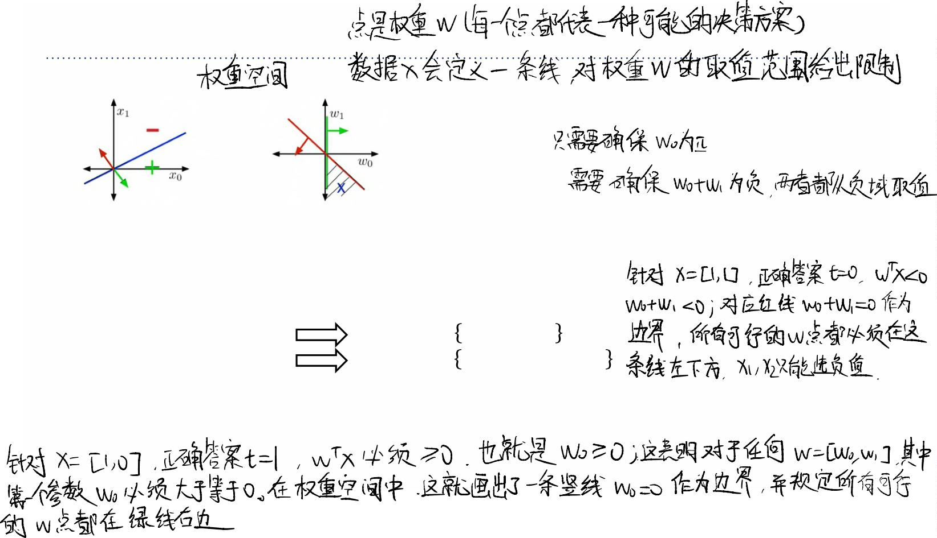
The Geometric Picture
Weight Space
ꢊ# ≥0
ꢊ +ꢊ <0
# %
• Weights (hypotheses) ꢆare points
• Each training example ꢁspecifies a half-space ꢆmust lie in to be correctly classified:
ꢆ⊺ꢁ≥0if ꢂ=1.
• For NOT example:
Øꢋ =1, ꢋ =0, ꢂ=1
(ꢊ ,ꢊ )∈ ꢆ:ꢊ ≥0
#
%
# %
#
Øꢋ =1, ꢋ =1, ꢂ=0
(ꢊ ,ꢊ )∈ ꢆ:ꢊ +ꢊ <0
#
%
# %
# %
• The region satisfying all the constraints is the feasible region; if this region is nonempty,
the problem is feasible, otw it is infeasible.

Slide 10

The Geometric Picture
• The AND example requires three dimensions, including the dummy one.
• To visualize data space and weight space for a 3-D example, we can look at a 2-D slice.
• The visualizations are similar.
ØFeasible set will always have a corner at the origin.

Slide 11
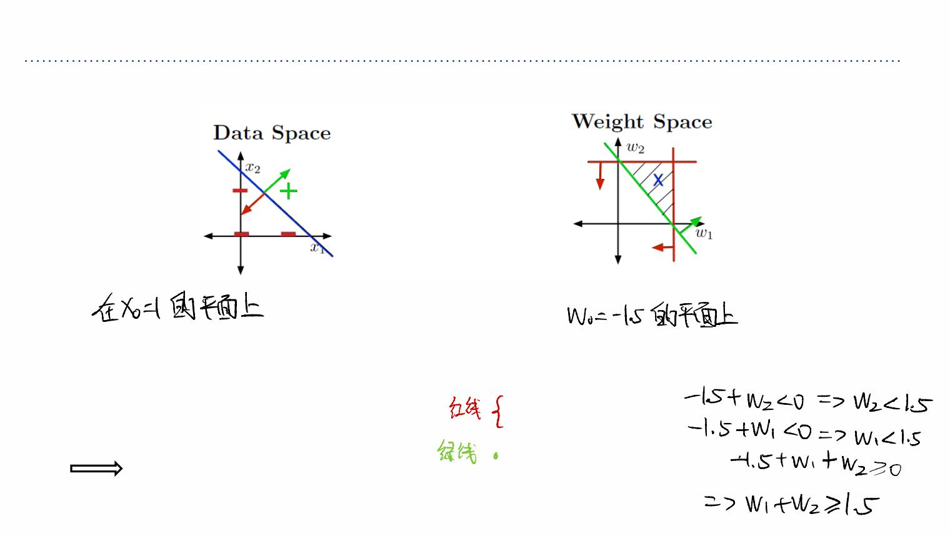
The Geometric Picture
Visualizations of the AND example
- Slice for ꢋ# =1and
- Slice for ꢊ# = −1.5for the constraints
- Example sol: ꢊ = −1.5,ꢊ = 1,ꢊ =1 - ꢊ <0
#
%
&
#
- Decision boundary:
- ꢊ +ꢊ <0
# &
ꢊ ꢋ +ꢊ ꢋ +ꢊ ꢋ =0
- ꢊ +ꢊ <0
# # % % & &
# %
- ꢊ +ꢊ +ꢊ ≥0
−1.5 + ꢋ +ꢋ =0
# % &
% &

Slide 12

Summary | Binary Linear Classifiers
• Summary: targets ꢂ ∈ {0,1}, inputs ꢁ∈ℝ!$%with ꢋ# =1, and model is defined by
weights ꢆand
ꢅ=ꢆ⊺ꢁ
1 ꢈꢉꢅ≥0
0 ꢈꢉꢅ<0
ꢃ=2
• How can we find good values for ꢆ?
• If training set is linearly separable, we could solve for ꢆusing linear programming
ØWe could also apply an iterative procedure known as the perceptron algorithm (but
this is primarily of historical interest).
• If it‘s not linearly separable, the problem is harder
ØData is almost never linearly separable in real life.

Slide 13

Towards Logistic Regression
Towards Logistic Regression

Slide 14
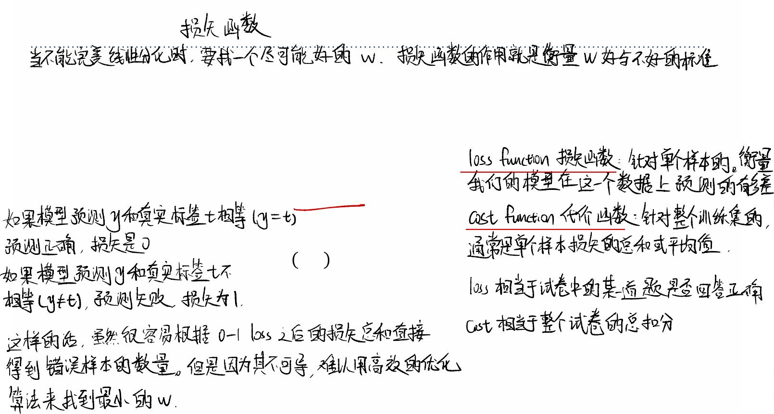
Loss Functions
• Instead: define loss function then try to minimize the resulting cost function
ØRecall : cost is loss averaged (or summed) over the training set
• Seemingly obvious loss function: 0-1 loss
0 ꢈꢉꢃ=ꢂ
1 ꢈꢉꢃ≠ꢂ
ꢍ#'% ꢃ,ꢂ =2
=ꢎ[ꢃ ≠ꢂ]

Slide 15
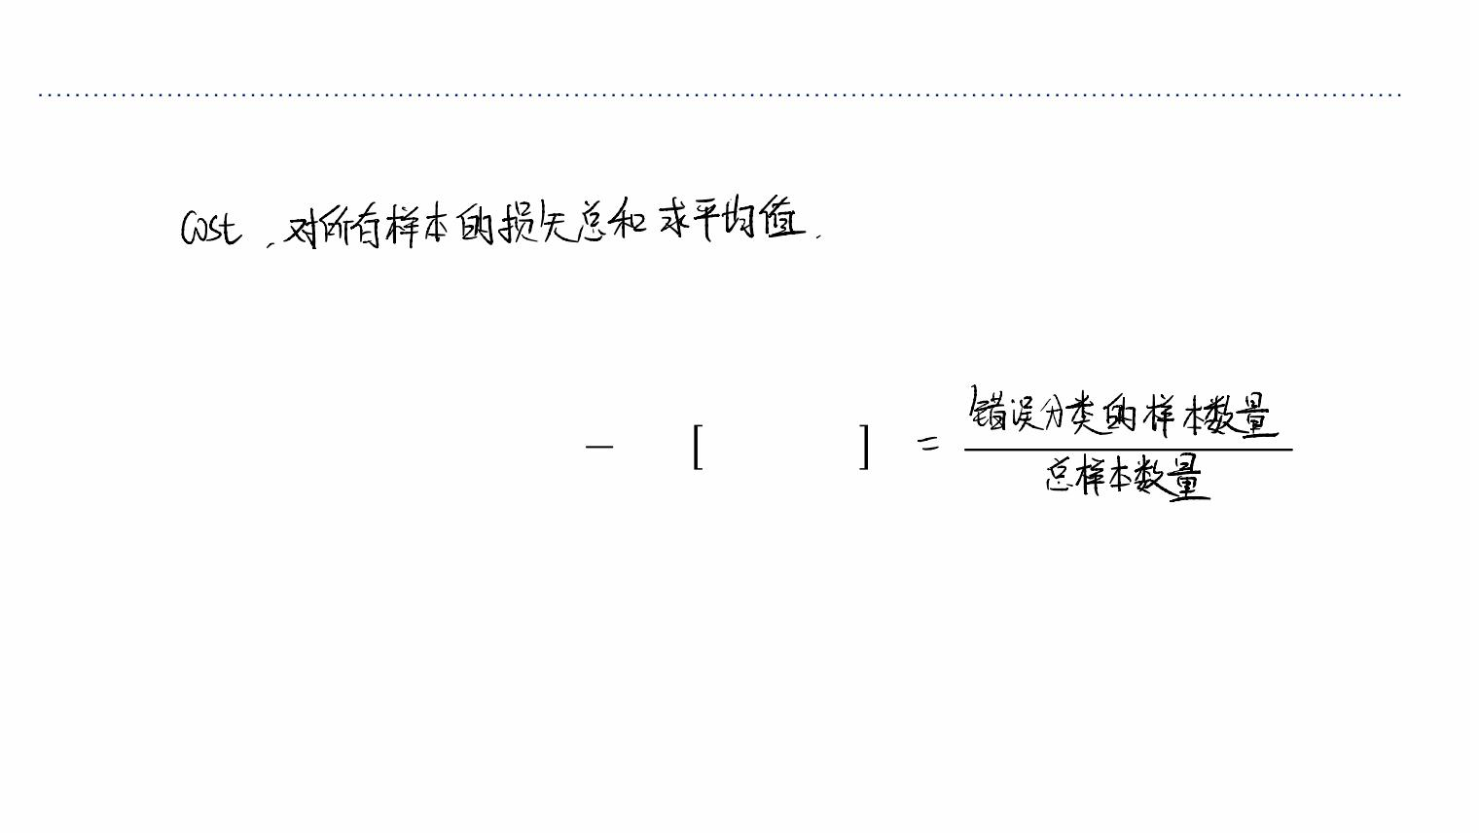
Attempt 1: 0-1 loss
• Usually, the cost ꢏis the averaged loss over training examples; for 0-1 loss, this is the
misclassification rate:
1
*
(() (()
ꢏ= Kꢎꢃ ≠ꢂ
ꢐ
()%

Slide 16
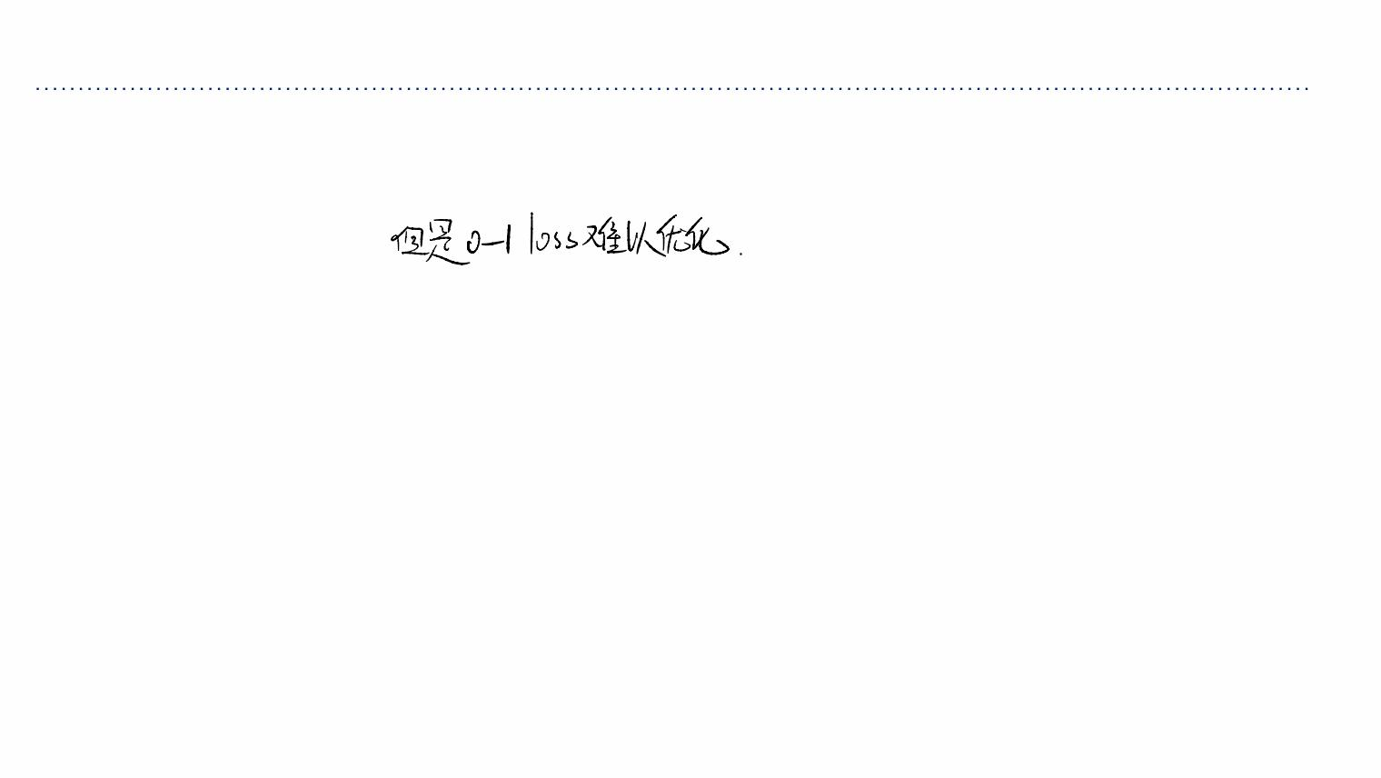
Attempt 1: 0-1 loss
• Problem: how to optimize? In general, a hard problem (can be NP-hard)
• This is due to the step function (0-1 loss) not being nice (continuous/smooth/convex
etc)

Slide 17
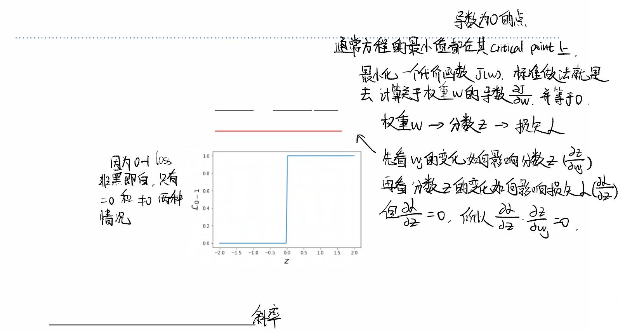
Attempt 1: 0-1 loss
• Minimum of a function will be at its critical points.
• Let’s try to find the critical point of 0-1 loss.
• Chain rule:
ꢑꢍ ꢑꢍ ꢑꢅ
#'%
=
#'%
ꢑꢊ ꢑꢅ ꢑꢊ
-
-
• But ꢑꢍ#'%⁄ꢑꢅis zero everywhere it’s defined!
Øꢑꢍ#'%⁄ꢑꢊ- =0means that changing the weights by a very small amount
probably has no effect on the loss.
ØAlmost any point has 0 gradient!

Slide 18

Attempt 2: Linear Regression
• Sometimes we can replace the loss function we care about with one which is easier to
optimize. This is known as relaxation with a smooth surrogate loss function.
• One problem with ꢍ#'%: defined in terms of final prediction, which inherently involves
a discontinuity.
• Instead, define loss in terms of ꢆ ꢁdirectly.
⊺
ØRedo notation for convenience: ꢅ=ꢆ⊺ꢁ

Slide 19
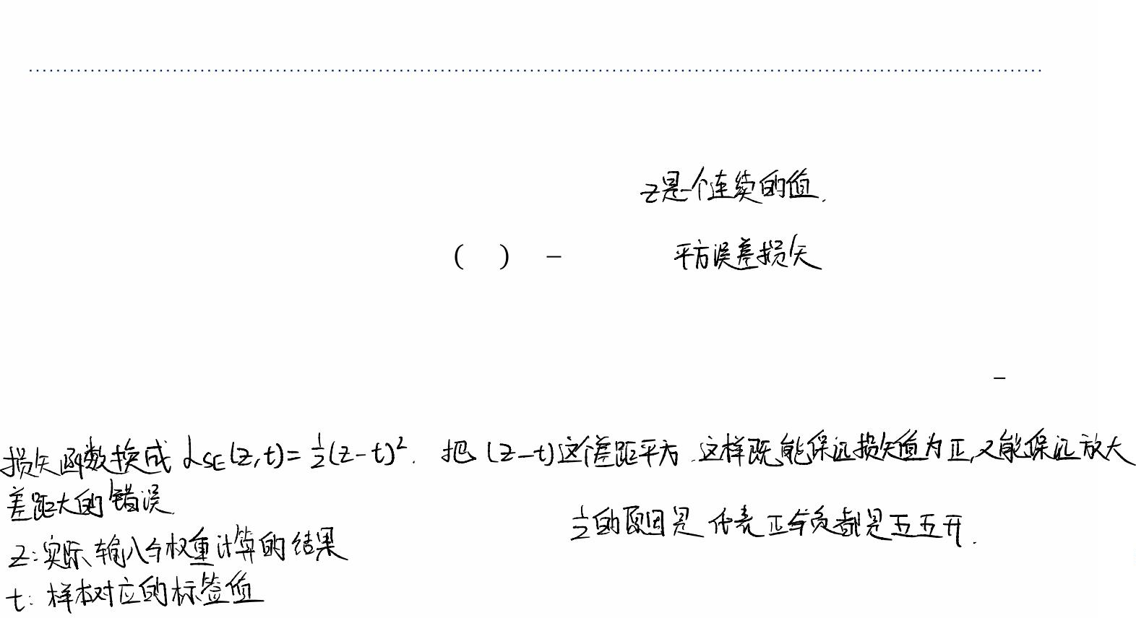
Attempt 2: Linear Regression
• We already know how to fit a linear regression model. Can we use this instead?
ꢅ=ꢆ⊺ꢁ
1
&
ꢍ ꢅ,ꢂ = (ꢅ −ꢂ)
./
2
• Doesn’t matter that the targets are actually binary. Treat them as continuous values.
• For this loss function, it makes sense to make final predictions by thresholding ꢅat
%
&
(why?)

Slide 20
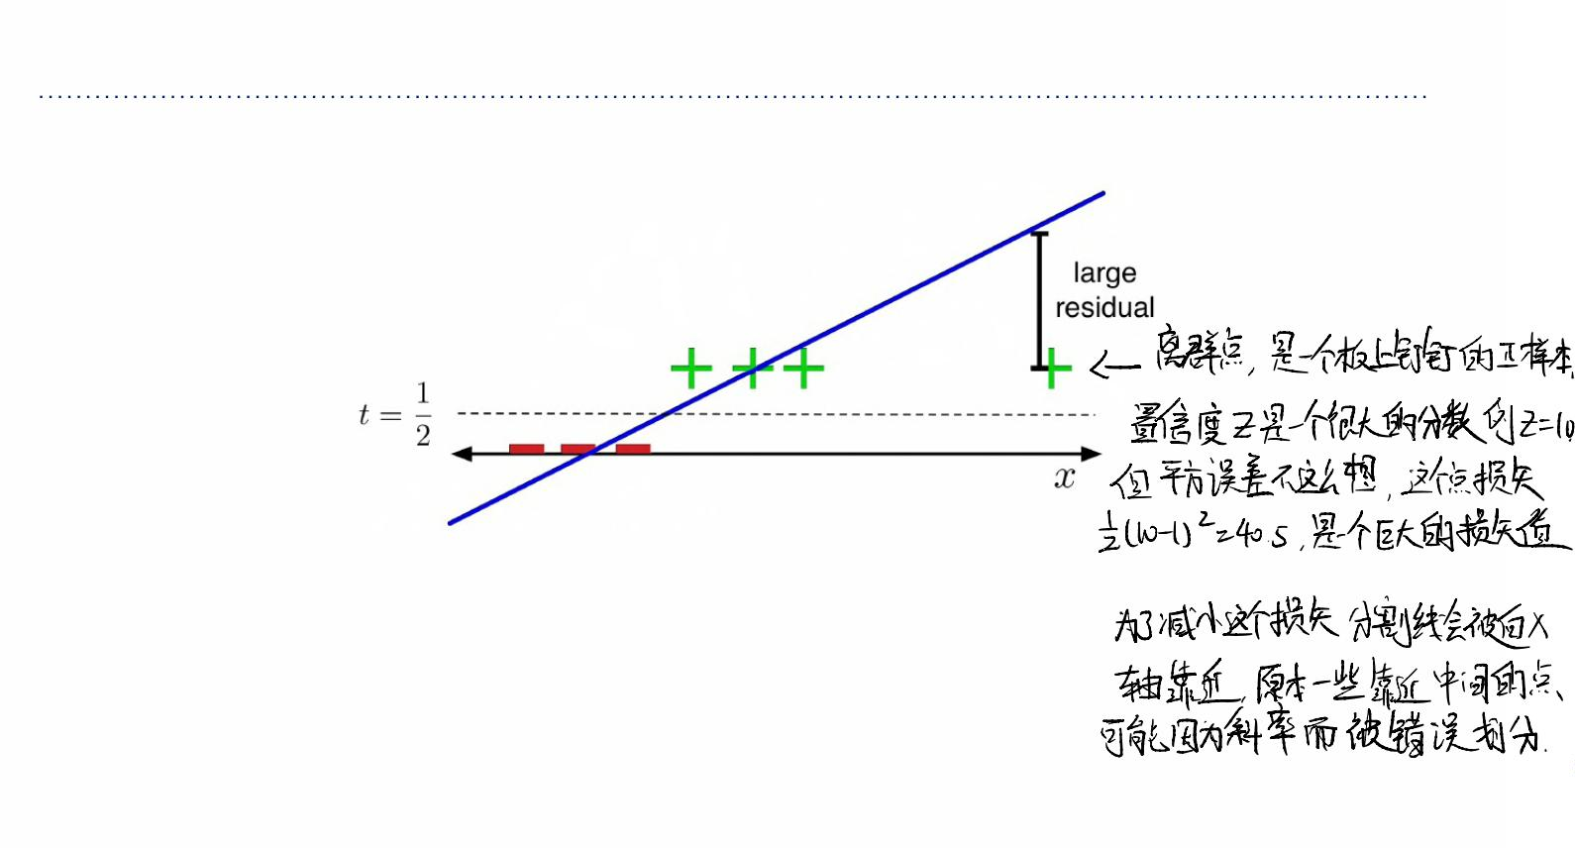
Attempt 2: Linear Regression
The problem:
• The loss function hates when you make correct predictions with high confidence!
• It ꢂ=1, it’s more unhappy about ꢅ=10than ꢅ=0.

Slide 21




























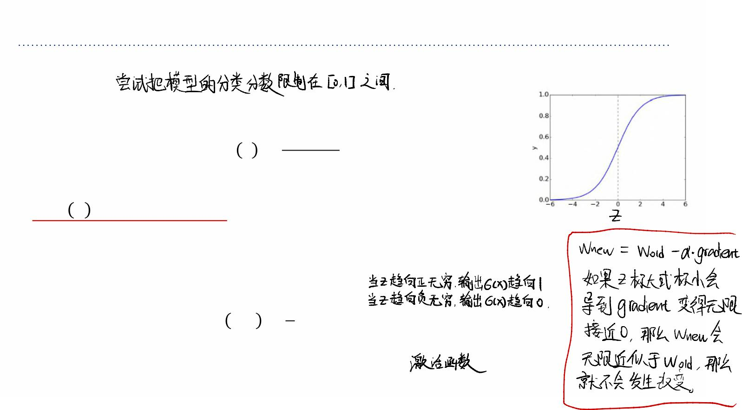
Attempt 3: Logistic Activation Function
• There’s obviously no reason to predict values outside [0, 1]. Let’s squash ꢃinto this
interval.
• The logistic function is a kind of sigmoid, or S-shaped function:
1
ꢒ ꢅ =
1+ꢓ^{'0}
'%
⁄
• ꢒ ꢃ = log(ꢃ (1−ꢃ))is called the logit.
• A linear model with a logistic nonlinearity is known as log-linear:
ꢅ=ꢆ⊺ꢁ
ꢃ = ꢒ(ꢅ)
1
&
ꢍ ꢃ,ꢂ = (ꢃ −ꢂ)
./
2
• Used in this way, ꢒis called an activation function.

Slide 22
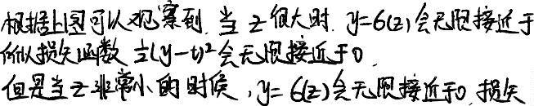

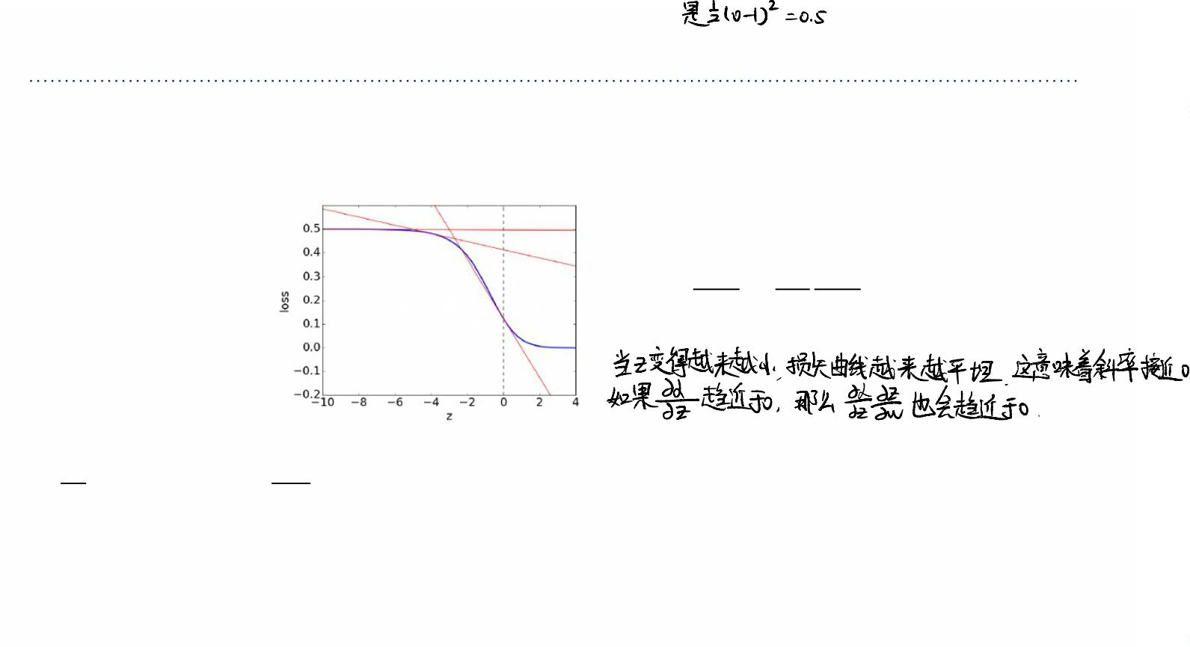
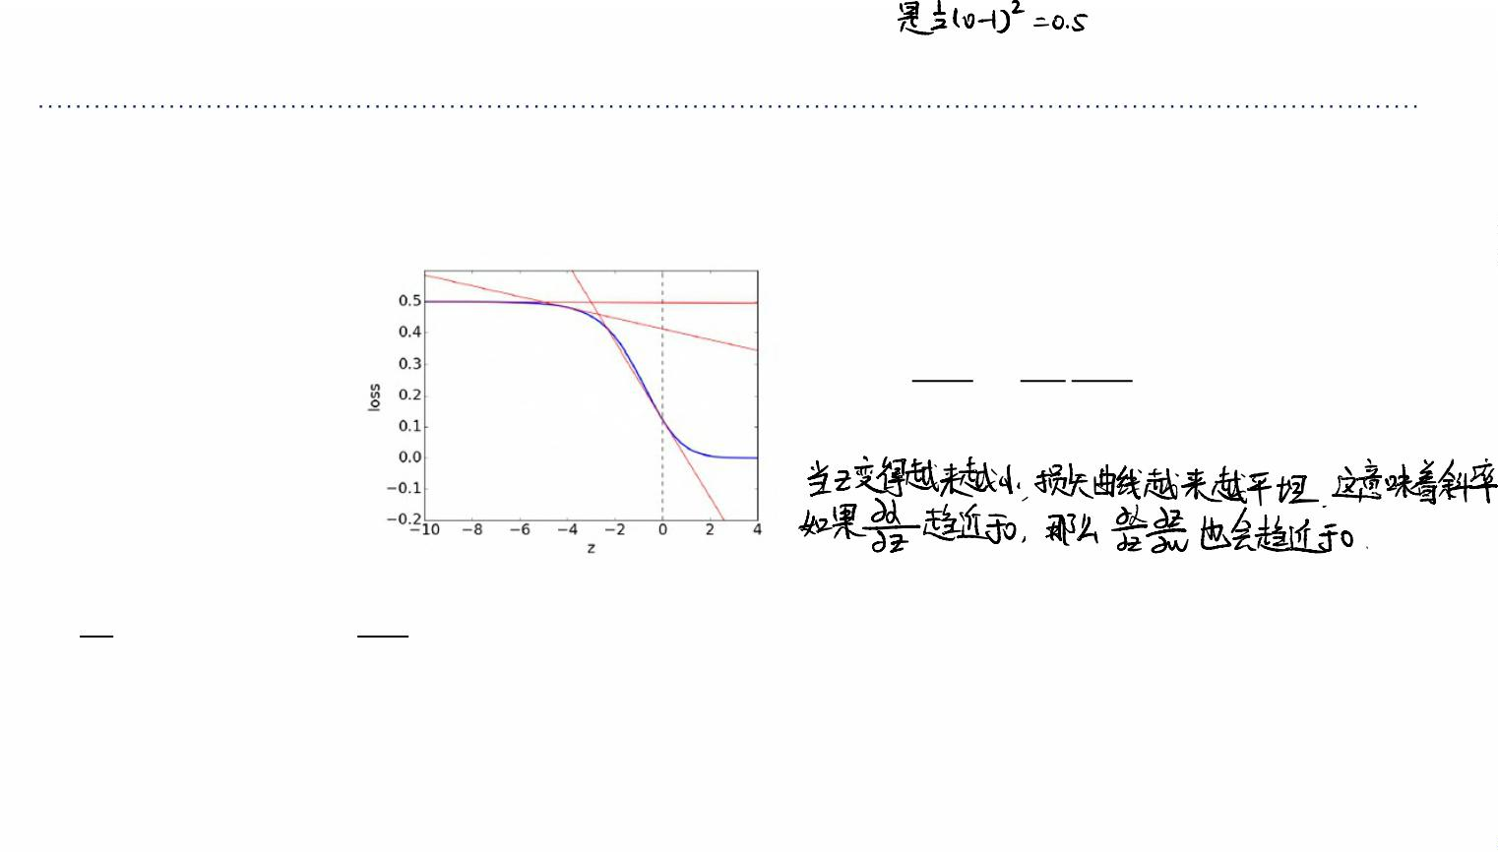
Attempt 3: Logistic Activation Function
The problem:
(plot of ℒ./as a function of ꢅ, assuming ꢂ=1)
ꢑꢍ ꢑꢍ ꢑꢅ
=
ꢑꢊ ꢑꢅ ꢑꢊ
-
-
• For ꢅ≪0, we have ꢒ(ꢅ) ≈ 0.
1ꢀ
1ꢀ
• ≈0(check) è ≈0èderivative w.r.t. ꢊ is small èꢊ is like a critical point.
10
13
!
-
-
• If the prediction is really wrong, you should be far from a critical point (which is your
candidate solution).

Slide 23
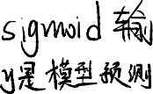


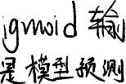












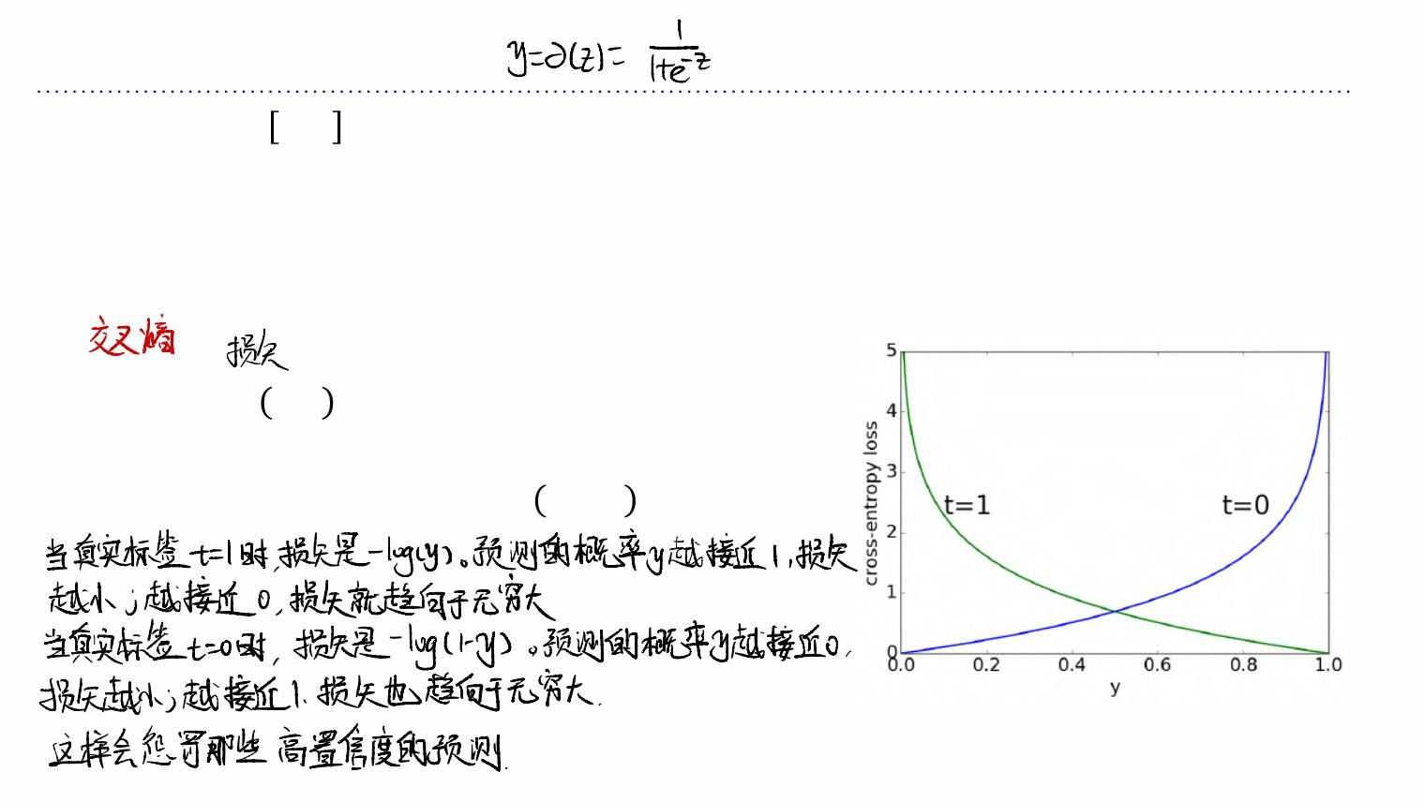
Logistic Regression
• Because ꢃ∈ 0,1, we can interpret it as the estimated probability that ꢂ=1. If ꢂ=0,
then we want to heavily penalize ꢃ≈1.
• The pundits who were 99% confident Clinton would win were much more wrong than
the ones who were only 90% confident.
• Cross-entropy loss (aka log loss) captures this intuition:
−logꢃ ꢈꢉꢂ=1
−log(1 − ꢃ) ꢈꢉꢂ=0
ꢍ_{4/} ꢃ,ꢂ =2
= −ꢂlogꢃ − 1−ꢂ log(1 − ꢃ)

Slide 24
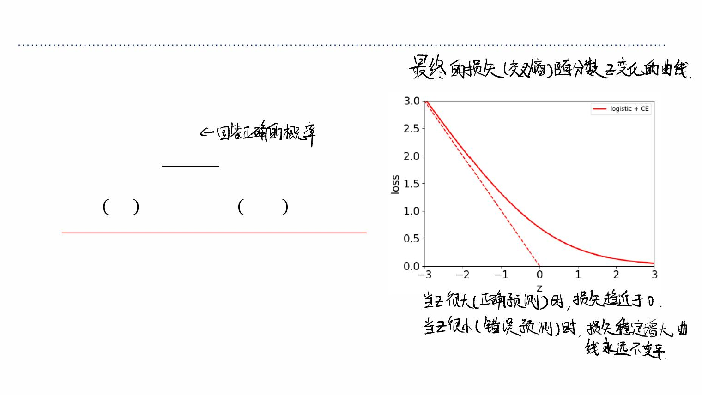
Logistic Regression
Logistic regression:
ꢅ=ꢆ⊺ꢁ
ꢃ = ꢒ(ꢅ)
1
=
1+ꢓ^{'0}
ꢍ_{4/} ꢃ,ꢂ = −ꢂlogꢃ − 1−ꢂ log(1 − ꢃ)
Plot is for target ꢂ=1.

Slide 25
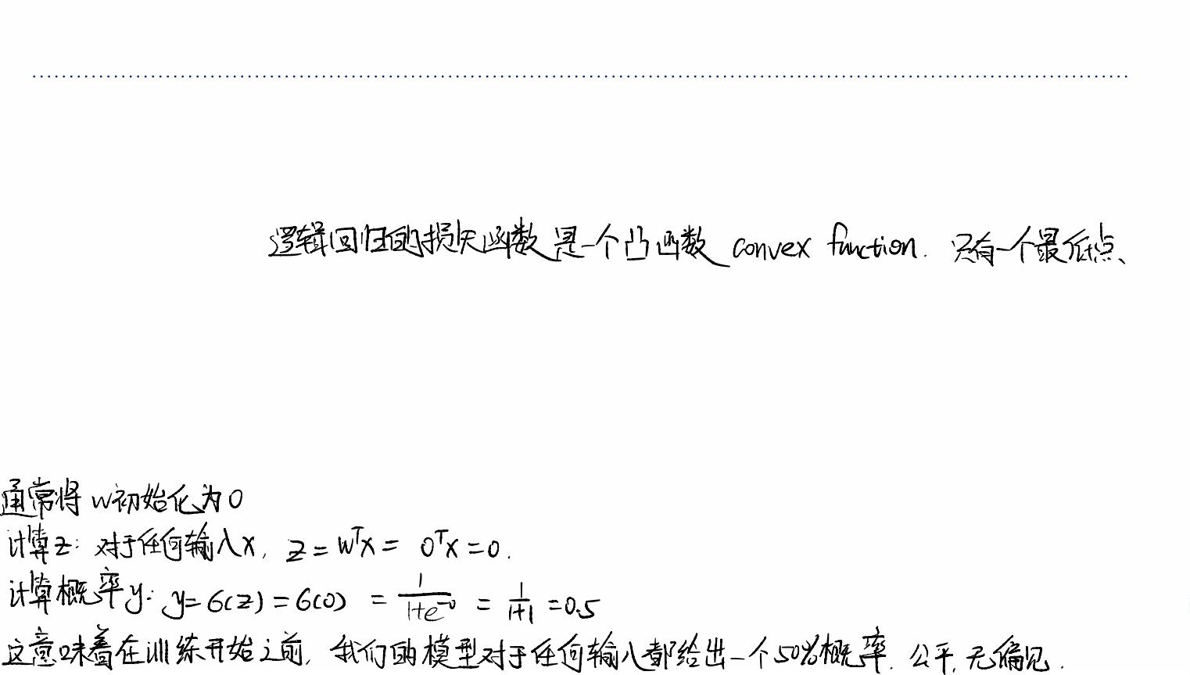
Gradient Descent for Logistic Regression
• How do we minimize the cost ꢏfor logistic regression? No direct solution.
ØTaking derivatives of ꢏw.r.t. ꢆand setting them to 0 doesn’t have an explicit
solution.
• However, the logistic loss is a convex function in ꢆ, so let’s consider the gradient
descent method from the last lecture.
ØRecall: we initialize the weights to something reasonable and repeatedly adjust
them in the direction of steepest descent.
ØA standard initialization is ꢆ=0. (why?)

Slide 26
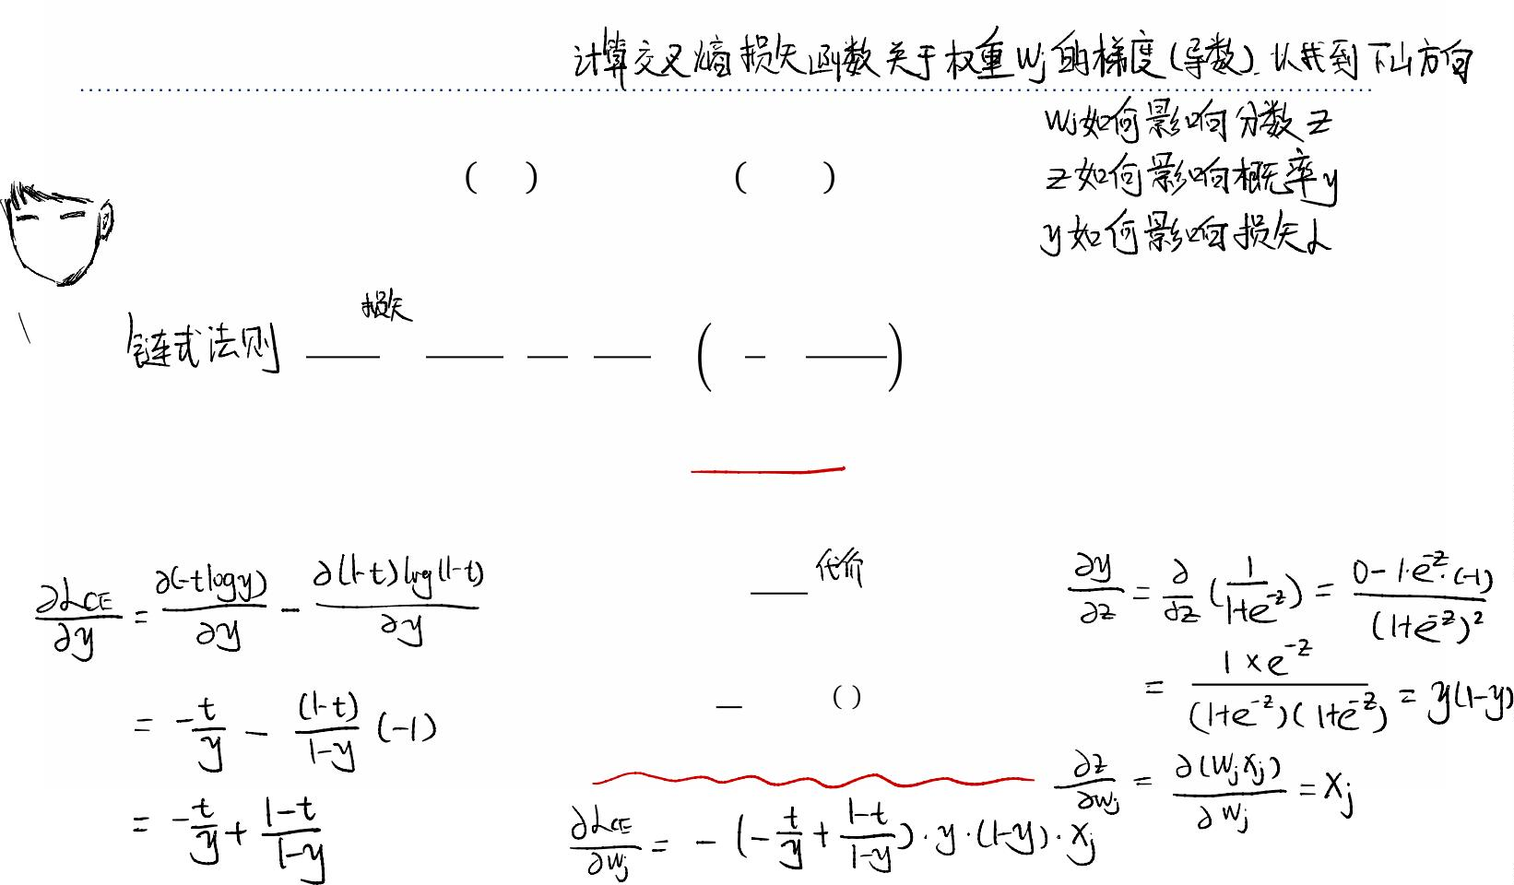










Gradient of Logistic Loss
Back to logistic regression:
ꢍ_{4/} ꢃ,ꢂ = −ꢂlogꢃ − 1−ꢂ log(1 − ꢃ)
'0
⊺
ꢃ = 1⁄(1+ꢓ ) and ꢅ=ꢆ ꢁ
Therefore
ꢑꢍ ꢑꢍ ꢑꢃ ꢑꢅ ꢂ 1−ꢂ
ꢁꢂ
ꢃꢄ
= V V = − + Vꢃ(1−ꢃ)Vꢋ
ꢑꢊ ꢑꢃ ꢑꢅ ꢑꢊ ꢃ 1−ꢃ
-
-
-
= (ꢃ −ꢂ)ꢋ₋
(verify this)
Gradient descent (coordinatewise) update to find the weights of logistic regression:
ꢑꢕ
ꢊ ←ꢊ −ꢔ
- -
ꢑꢊ₋
ꢔ
*
( (()
(()
-
=ꢊ − K(ꢃ −ꢂ )ꢋ
-
ꢐ
()%

Slide 27
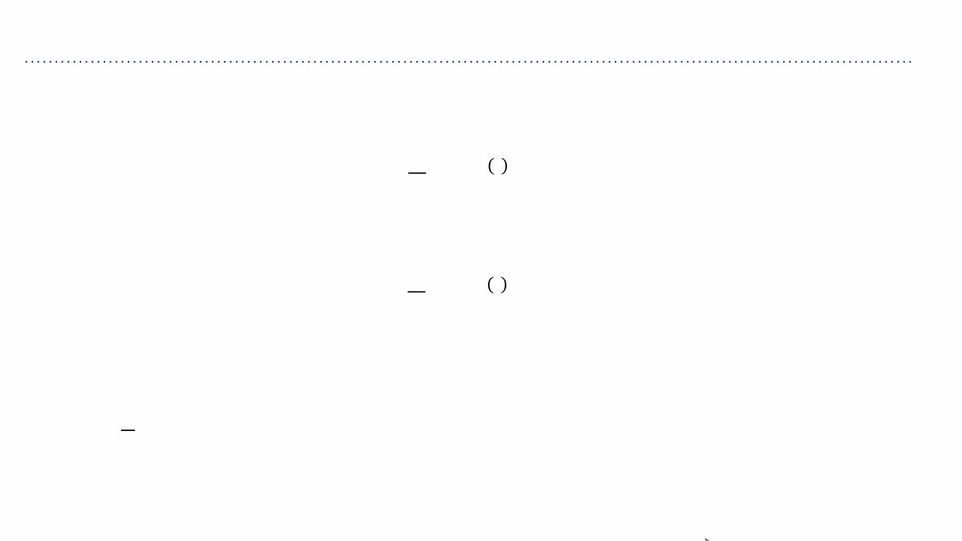
Gradient Descent for Logistic Regression
Comparison of gradient descent updates:
• Linear regression:
*
ꢔ
( (() (()
ꢆ←ꢆ− K(ꢃ −ꢂ )ꢁ
ꢐ
()%
• Logistic regression:
*
ꢔ
( (() (()
ꢆ←ꢆ− K(ꢃ −ꢂ )ꢁ
ꢐ
()%
• Not a coincidence! These are both examples of generalized linear models. But we
won’t go in further detail.
%
• Notice in front of sums due to averaged losses. This is why you need smaller learning
*
9 ⁄
rate when cost is summed losses (ꢔ =ꢔ ꢐ).

Slide 28
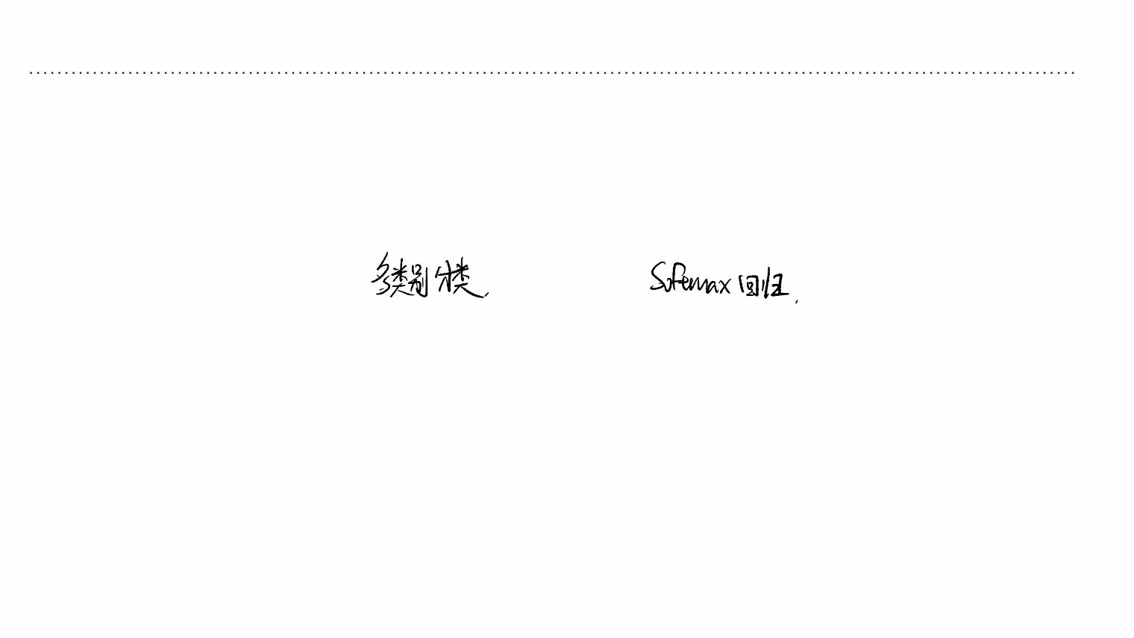
Multiclass Classification
Multiclass Classification and Softmax Regression

Slide 29
Overview
• Classification: predicting a discrete-valued target
ØBinary classification: predicting a binary-valued target
ØMulticlass classification: predicting a discrete-(>2)-valued target
• Examples of multi-class classification
ØPredict the value of a handwritten digit
ØClassify e-mails as spam, travel, work, personal

Slide 30
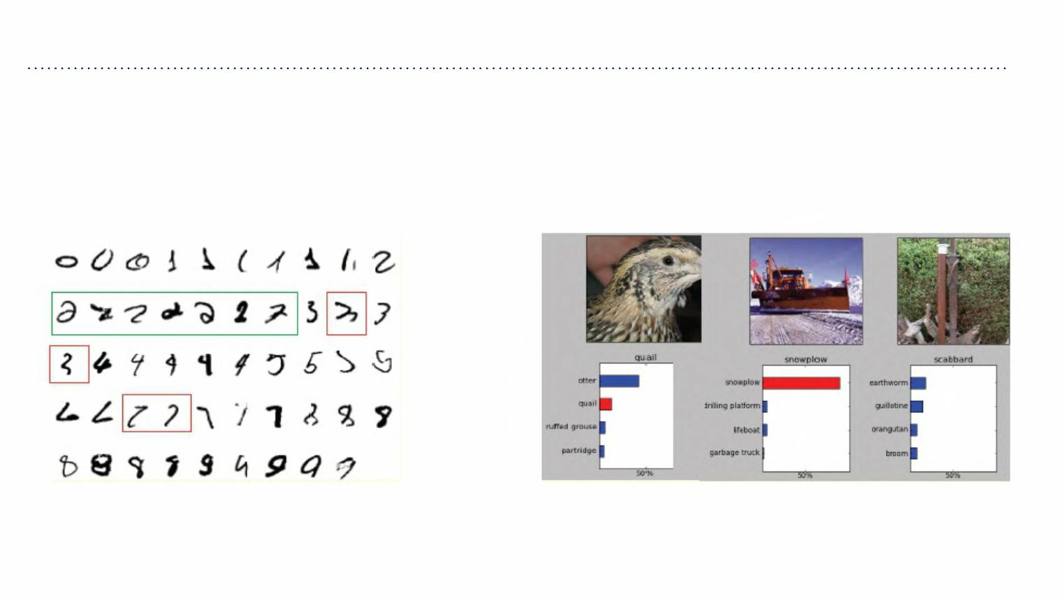
Multiclass Classification
• Classification tasks with more than two categories:

Slide 31
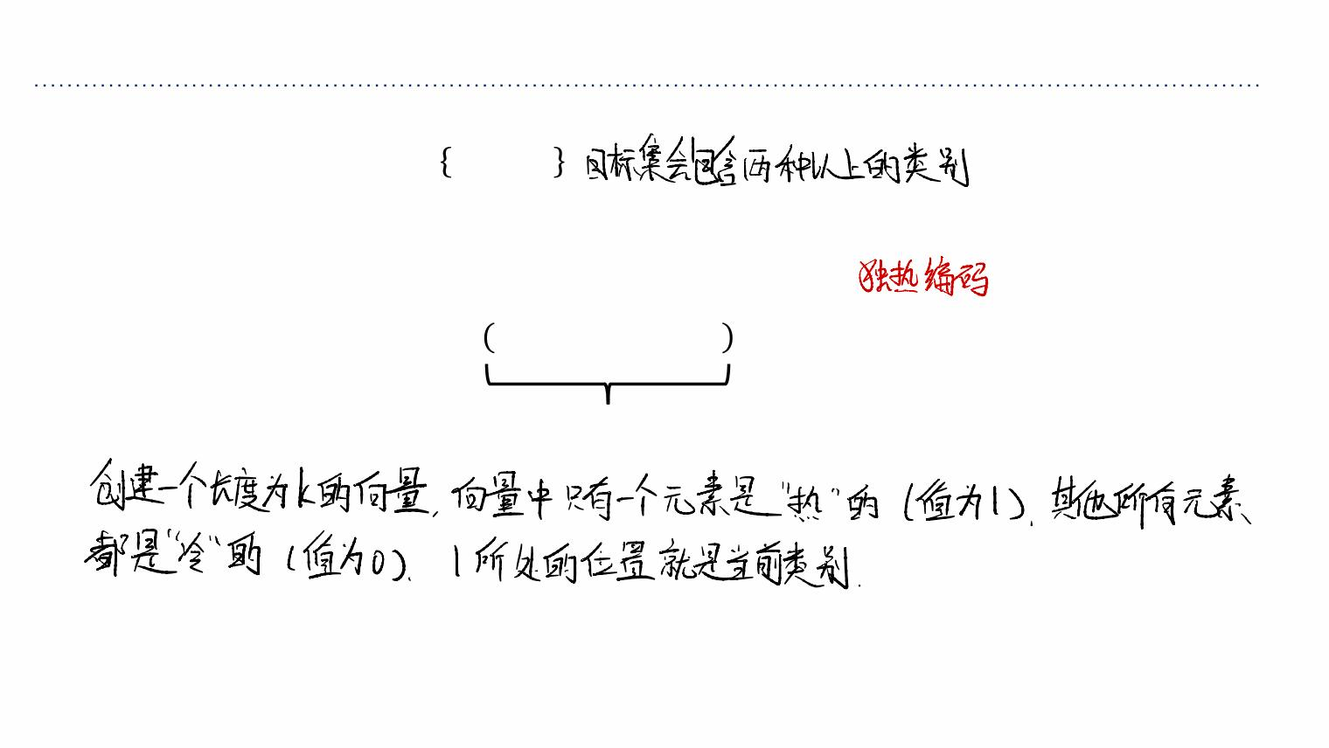
Multiclass Classification
• Targets form a discrete set 1,⋯,ꢖ .
• It’s often more convenient to represent them as one-hot vectors, or a one-of-K
encoding:
ꢗ= 0,⋯,0,1,0⋯,0 ∈ℝ:
entry ꢘis 1

Slide 32

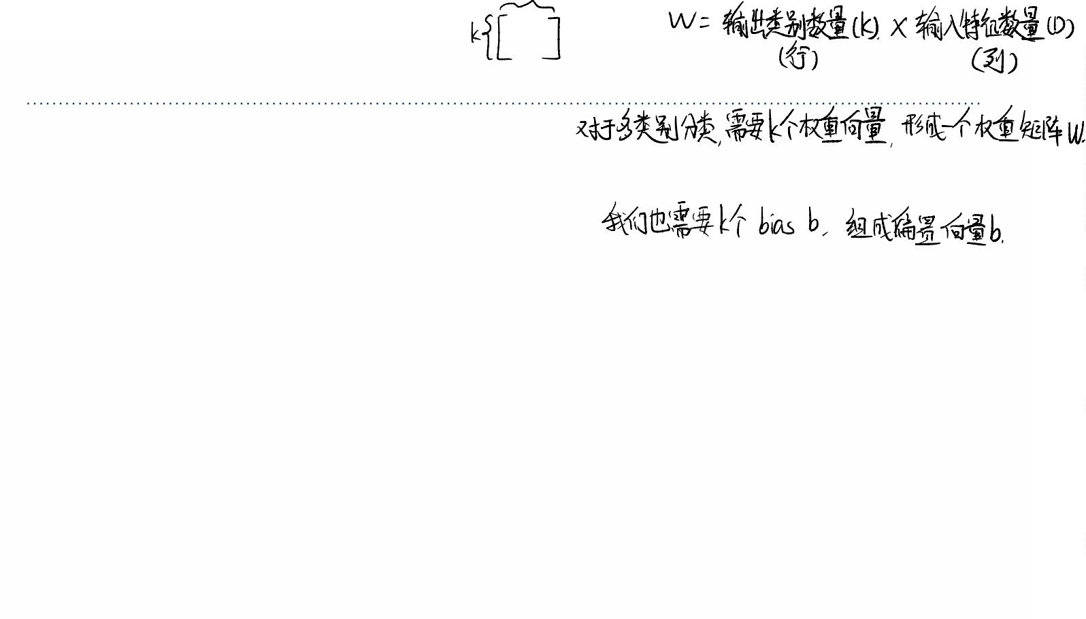
Multiclass Linear Classification
• We can start with a linear function of the inputs.
• Now there are ꢀinput dimensions and ꢖoutput dimensions, so we need ꢖ×ꢀ
weights, which we arrange as a weight matrix ꢙ.
• Also, we have a ꢖ-dimensional vector ꢚof biases.
• A linear function of the inputs:
!
ꢅ =Kꢊ ꢋ +ꢇ for ꢘ =1,2,⋯,ꢖ
<
<- - <
-)%
• We can eliminate the bias ꢚby taking ꢙ∈ℝ^{:×(!$%)}and adding a dummy variable
ꢋ# =1. So, vectorized:
ꢛ=ꢙꢁ+ꢚ or with dummy ꢋ# =1 ꢛ=ꢙꢁ

Slide 33
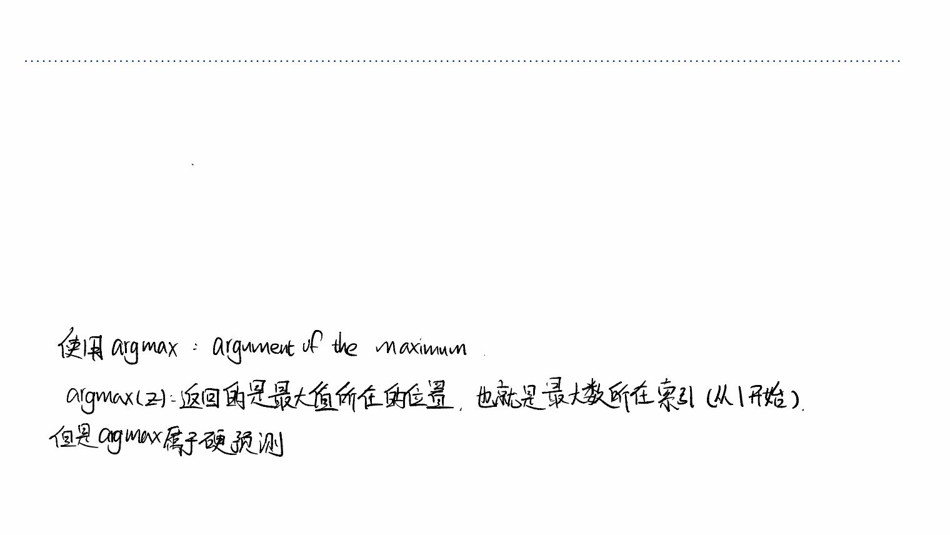
Multiclass Linear Classification
• How can we turn this linear prediction into a one-hot prediction?
• We can interpret the magnitude of ꢅ as a measure of how much the model prefers ꢘ
<
as its prediction.
• If we do this, we should set
1 ꢈ = argmax ꢅ
0 otherwise
ꢃ₍ =2
< <

Slide 34



















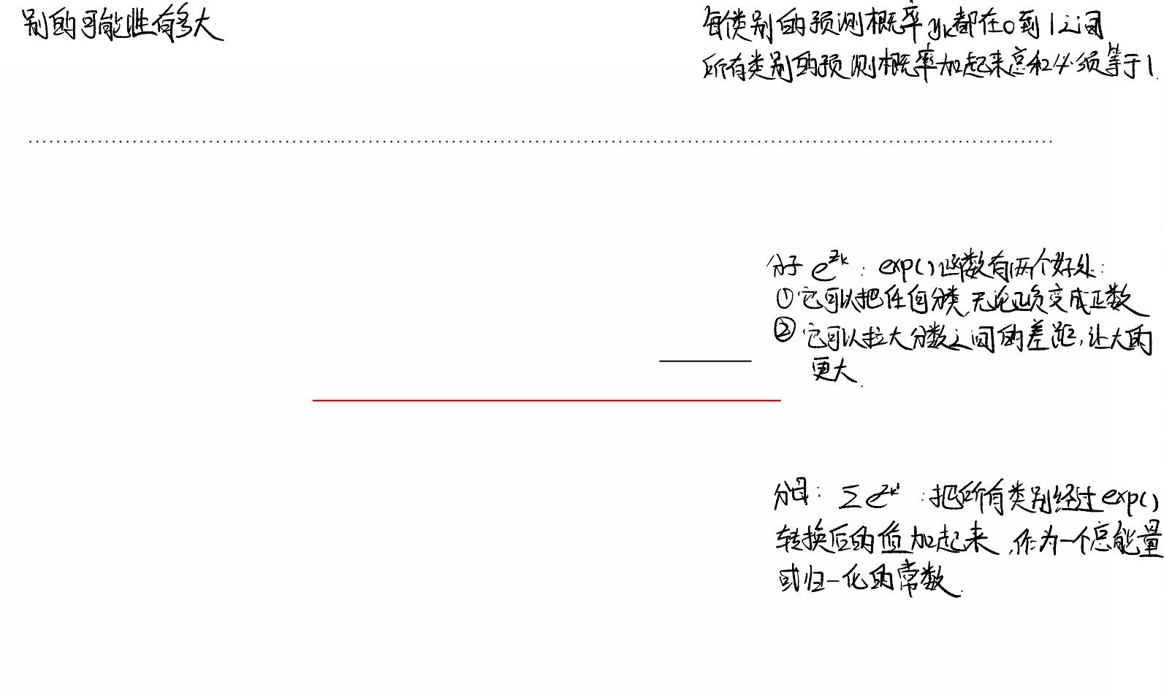
Softmax Regression
• We need to soften our predictions for the sake of optimization.
• We want soft predictions that are like probabilities, i.e., 0≤ꢃ ≤1and
∑ ꢃ =1.
< <
<
• A natural activation function to use is the softmax function, a multivariable
generalization of the logistic function:
ꢓ⁰
ꢃ = softmax(ꢅ ,⋯,ꢅ ) =
"
<
%
: <
0
∑ ꢓ
"#
<#
ØOutputs can be interpreted as probabilities (positive and sum to 1)
ØIf ꢅ is much larger than the others, then softmax(ꢛ) ≈1and it behaves like
<
<
argmax.

Slide 35
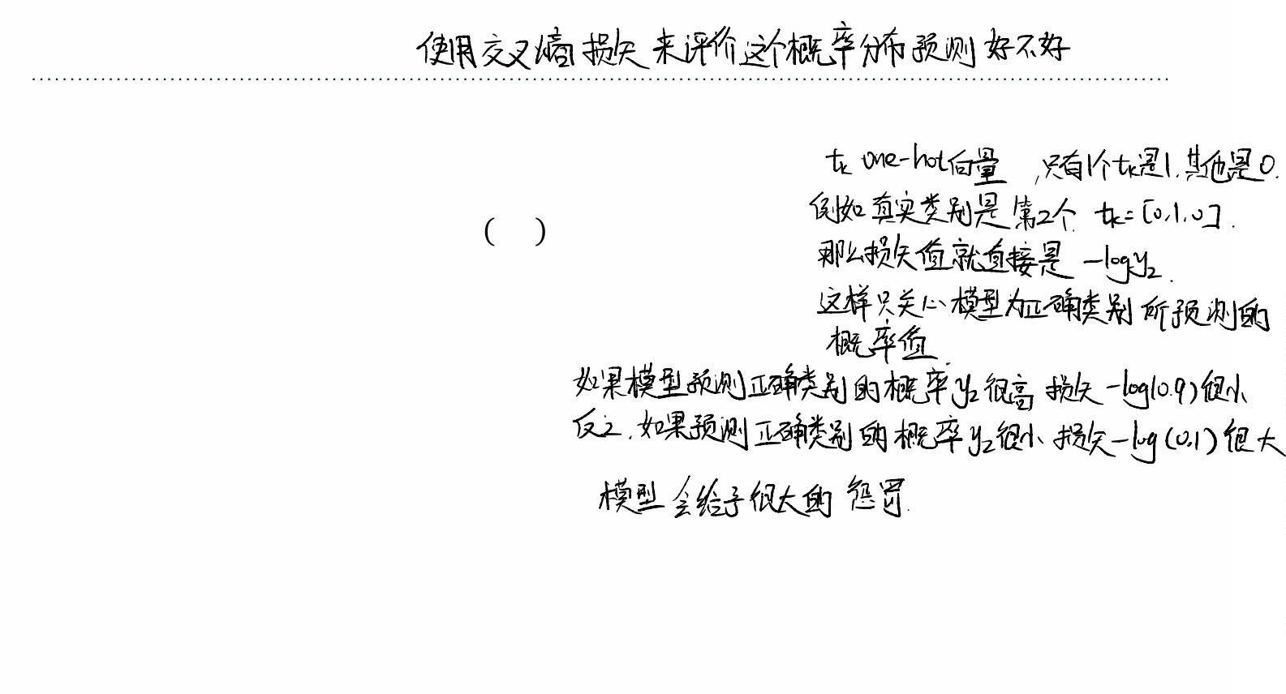
Softmax Regression
• If a model outputs a vector of class probabilities, we can use cross-entropy as the loss
function:
:
ꢍ ꢜ,ꢗ = −Kꢂ logꢃ
4/
< <
<)%
⊺
=−ꢗ (logꢜ),
where the log is applied elementwise.
• Just like with logistic regression, we typically combine the softmax and cross-entropy
into a softmax-cross-entropy function.

Slide 36
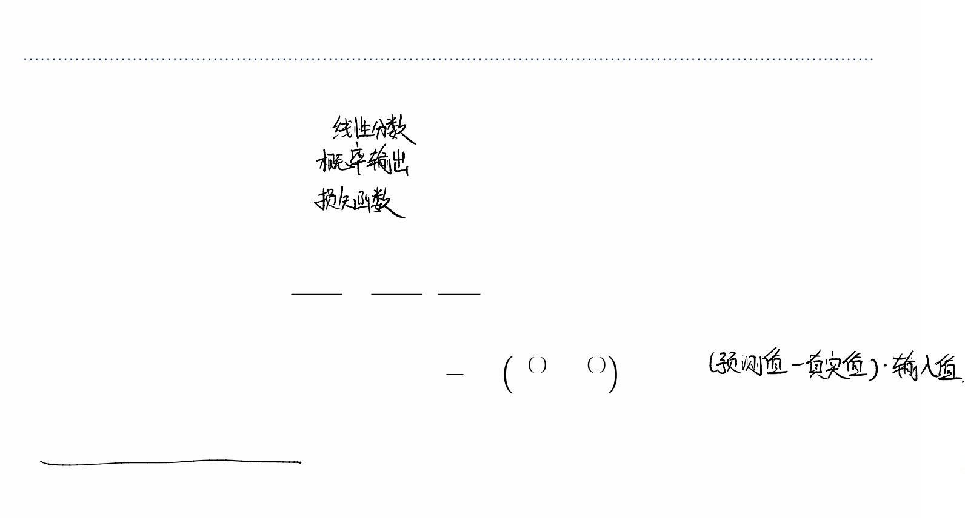
Softmax Regression
• Softmax regression (with dummy ꢋ# =1):
ꢛ=ꢙꢁ
ꢜ = softmax(ꢛ)
⊺
ꢍ =−ꢗ (logꢜ)
4/
• Gradient descent updates can be derived for each row of ꢙ:
ꢑꢍ ꢑꢍ ꢑꢅ
4/
4/ <
= V =(ꢃ −ꢂ )Vꢁ
ꢑꢆ ꢑꢅ ꢑꢆ
< <
<
<
<
1
*
(
<
(
<
(()
ꢆ ←ꢆ −ꢔ K ꢃ −ꢂ ꢁ
<
<
ꢐ
()%
• Similar to linear/logistic reg (no coincidence) (verify the update)

Slide 37
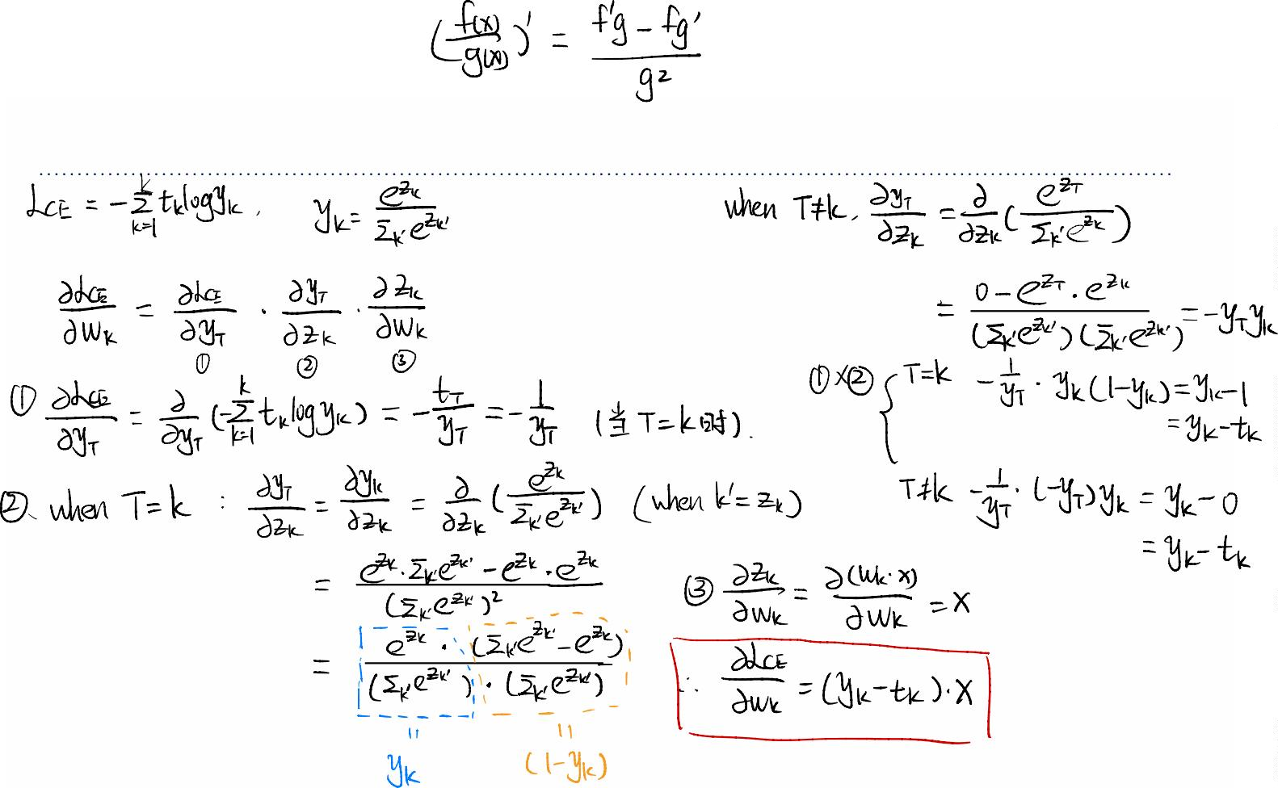



Prove the gradient ?

Slide 38
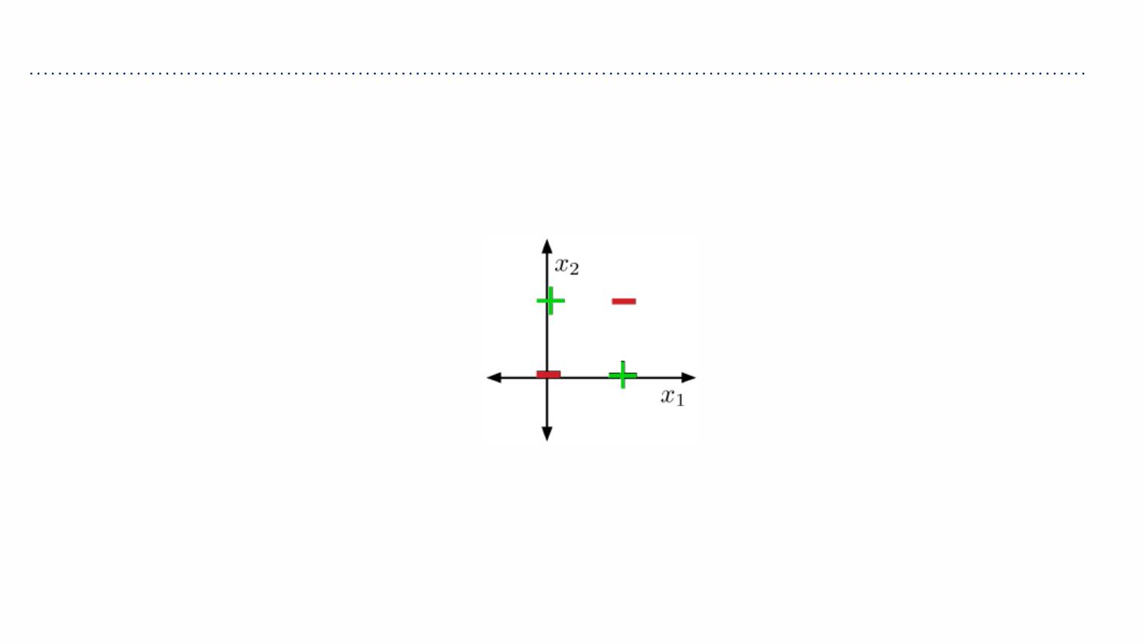
Limits of Linear Classification
Some datasets are not linearly separable, e.g. XOR
Visually obvious, but how to show this?

Slide 39
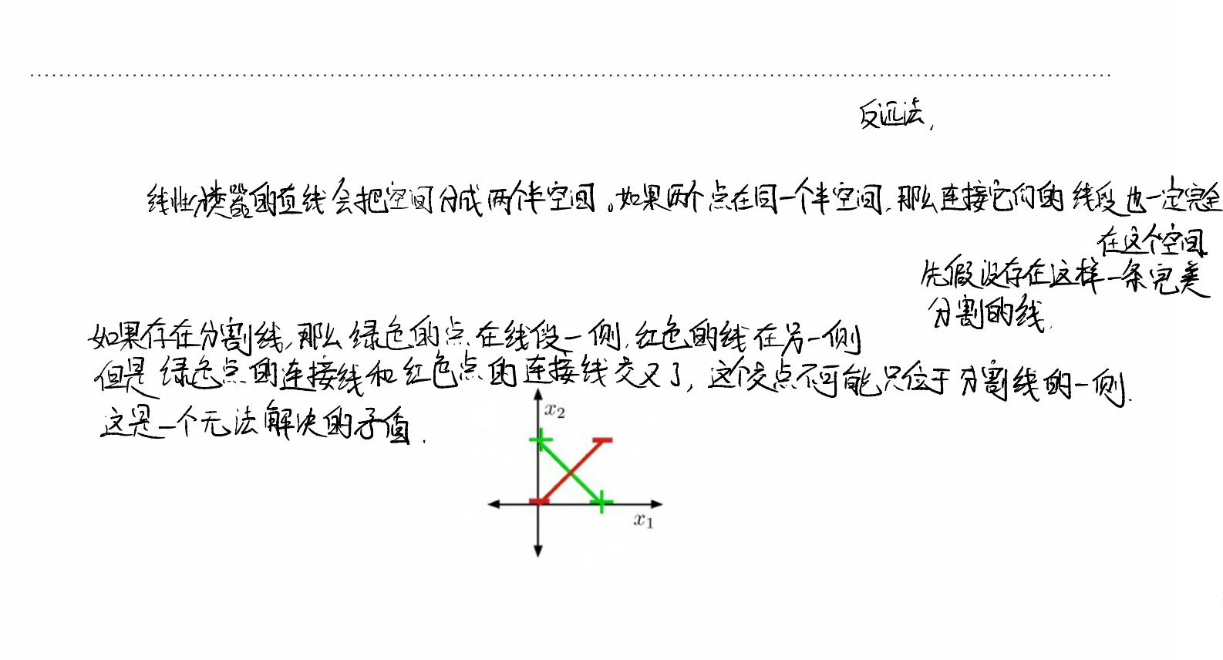
Limits of Linear Classification
Showing that XOR is not linearly separable (proof by contradiction)
• If two points lie in a half-space, line segment connecting them also lie in the same half-
space.
• Suppose there were some feasible weights (hypothesis). If the positive examples are in
the positive half-space, then the green line segment must be as well.
• Similarly, the red line segment must line within the negative half-space.
• But the intersection can’t lie in both half-spaces. Contradiction!

Slide 40
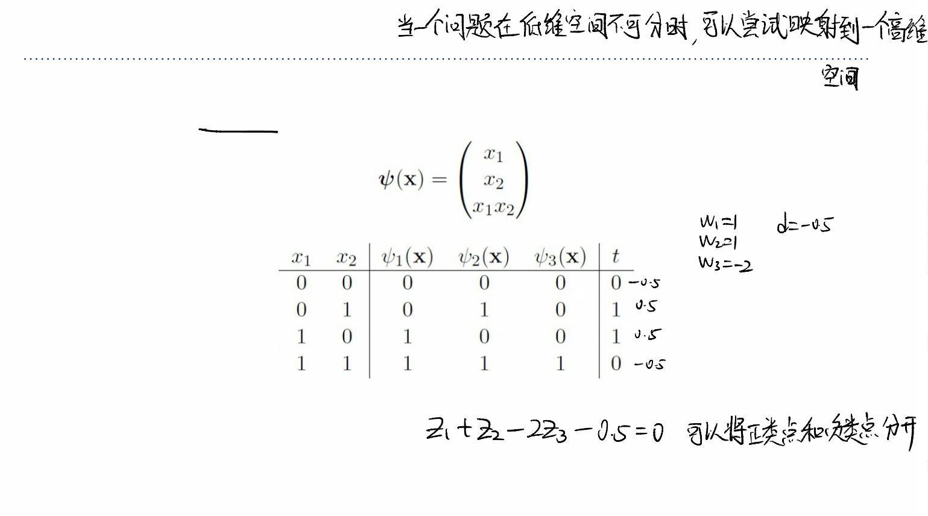
Limits of Linear Classification
• Sometimes we can overcome this limitation using feature maps, just like for linear
regression. E.g., for XOR:
• This is linearly separable. (Try it!)

Slide 41
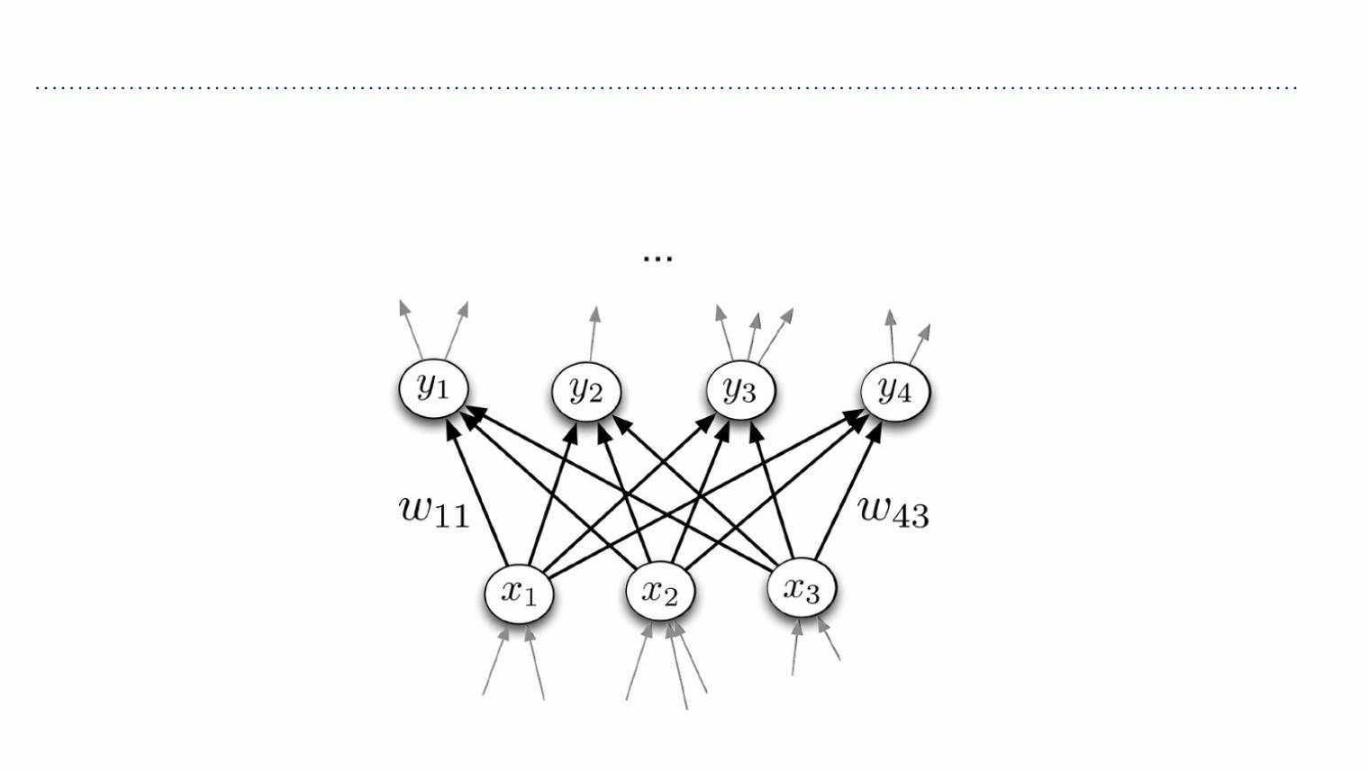
Next time...
Feature maps are hard to design well, so next time we’ll see how to learn nonlinear
feature maps directly using neural networks…

