Slide 1

INT305 Machine Learning
Lecture 4
Support Vector Machine, SVM Loss and Softmax Loss
Sichen Liu
Department Intelligence Science
Sichen.Liu@xjtlu.edu.cn

Slide 2
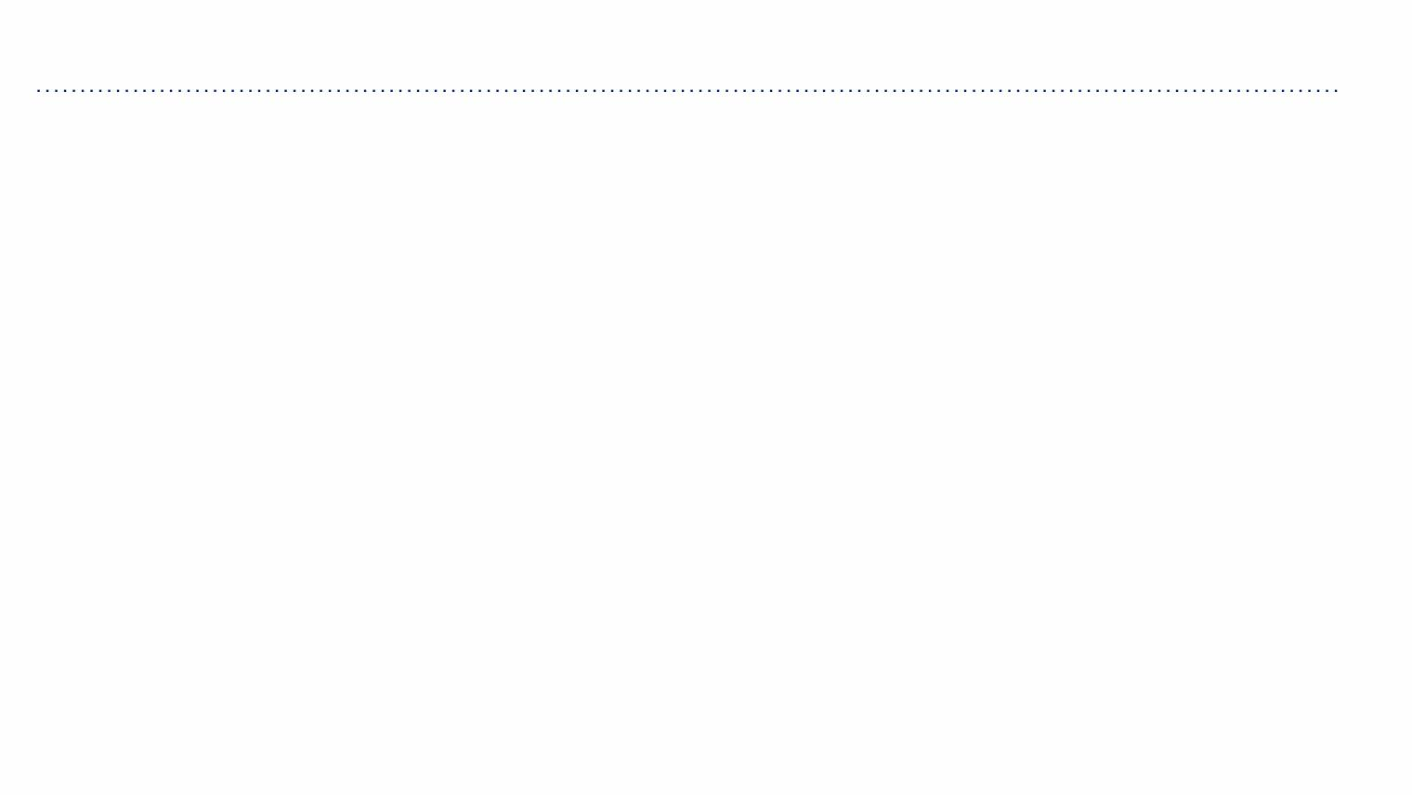
Binary Classification with a Linear Model
• Classification: Predict a discrete-valued target
• Binary classification: Targets ꢀ ∈ {−1,+1}
• Linear model:
ꢃ=ꢁ⊺+ꢂ
ꢄ = sign(ꢃ)
• Question: How should we choose ꢁand ꢂ?

Slide 3
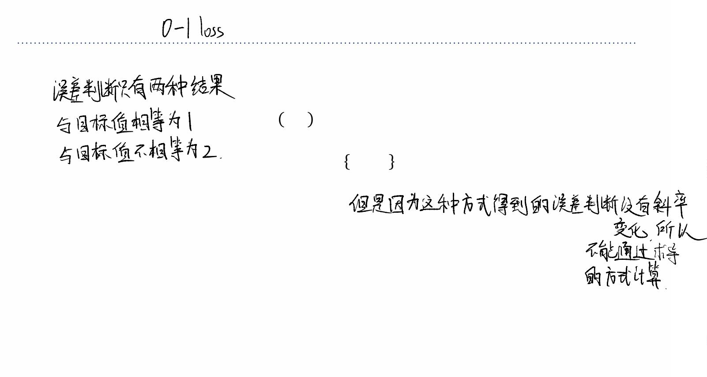
Zero-One Loss
• We can use the 0-1 loss function, and find the weights that minimize it over data points
0 ꢆꢇꢄ=ꢀ
1 ꢆꢇꢄ≠ꢀ
ꢅ$%& ꢄ,ꢀ =7
=ꢈ ꢄ≠ꢀ .
• But minimizing this loss is computationally difficult, and it can’t distinguish different
hypotheses that achieve the same accuracy.
• We investigated some other loss functions that are easier to minimize, e.g., logistic
regression with the cross-entropy loss ℒ"#.
• Let’s consider a different approach, starting from geometry of binary classifiers.

Slide 4
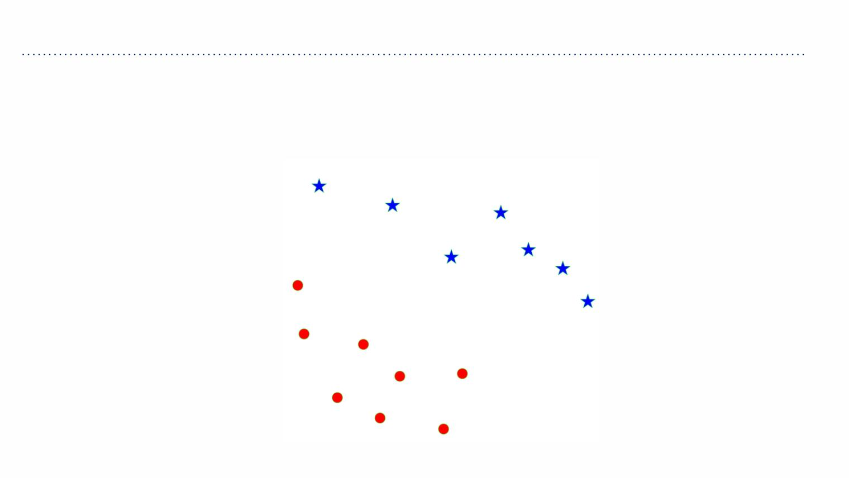
Separating Hyperplanes
Suppose we are given these data points from two different classes and want to find a
linear classifier that separates them.

Slide 5
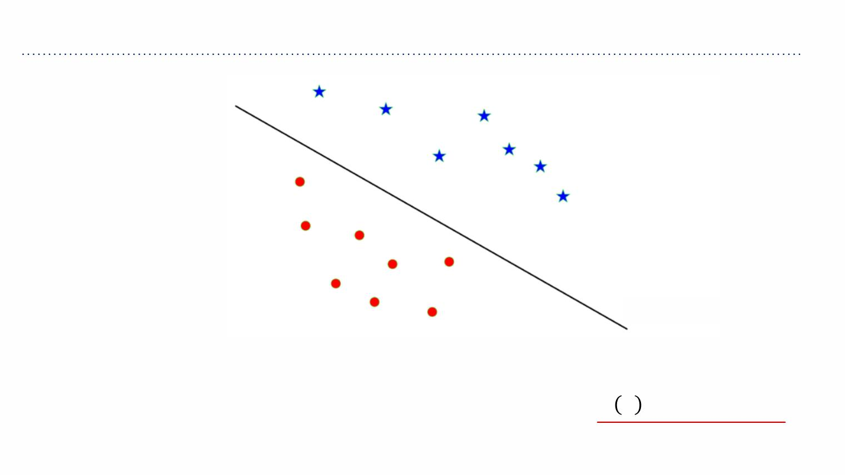
Separating Hyperplanes
ꢂ+ꢍ⊺ꢌ=0
• The decision boundary looks like a line because ꢉ∈ℝ',but think about it as a ꢊ−1
dimensional hyperplane.
• Recall that a hyperplane is described by points ꢉ∈ℝ such that ꢇ ꢋ =ꢁ ꢌ+ꢂ=0.
(
⊺

Slide 6
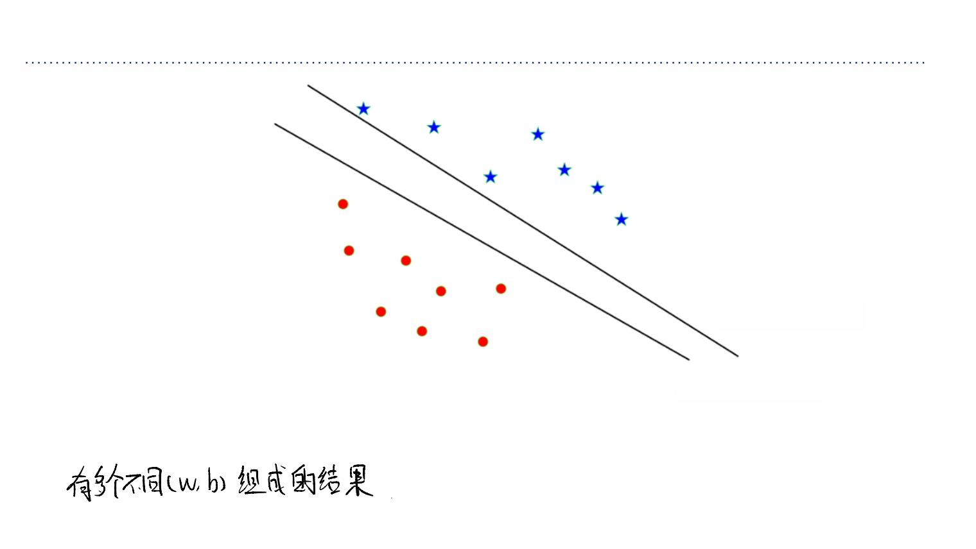
Separating Hyperplanes
⊺
ꢂ +ꢍ ꢌ=0
' '
⊺
ꢂ +ꢍ ꢌ=0
& &
• There are multiple separating hyperplanes, described by different parameters (ꢁ, ꢂ).

Slide 7
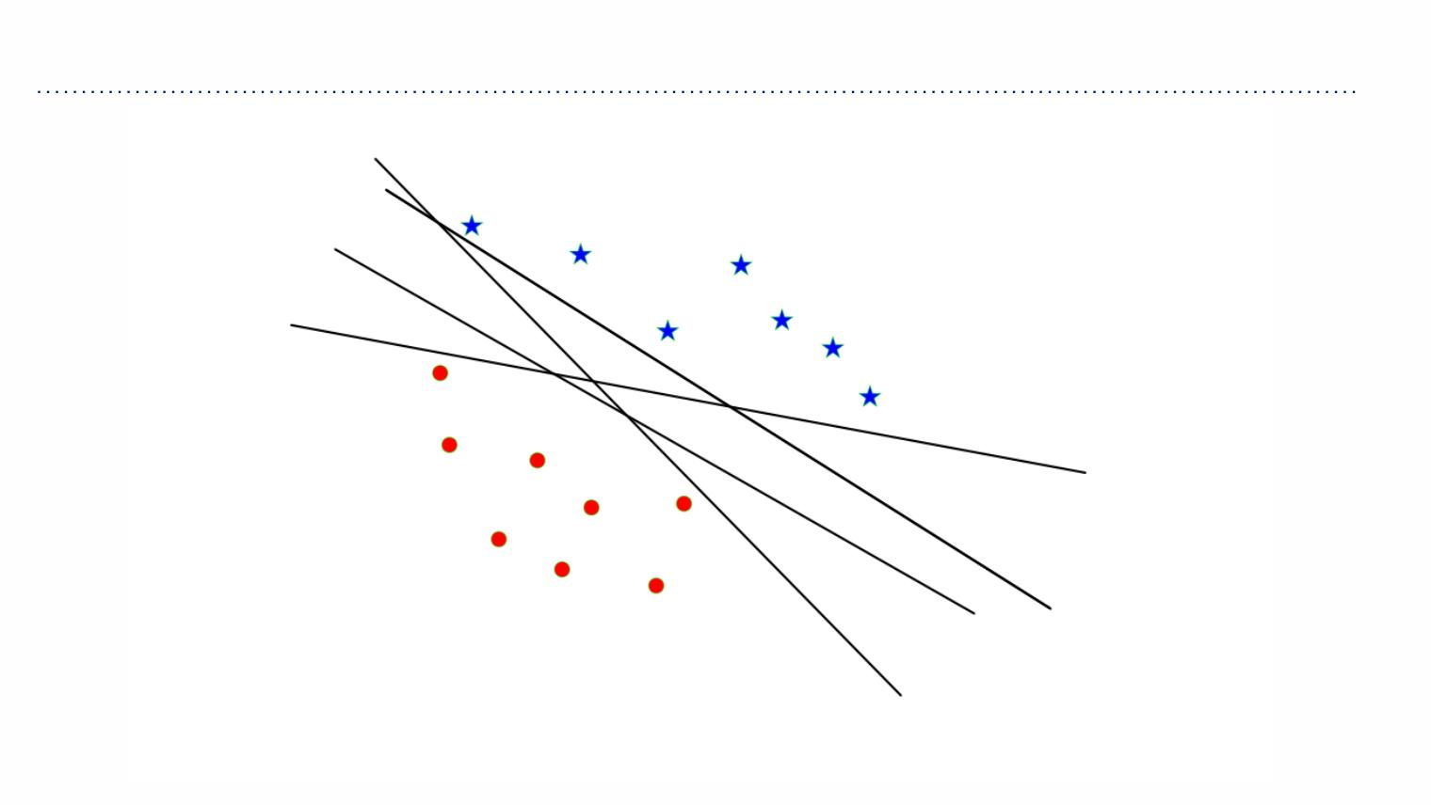
Separating Hyperplanes

Slide 8
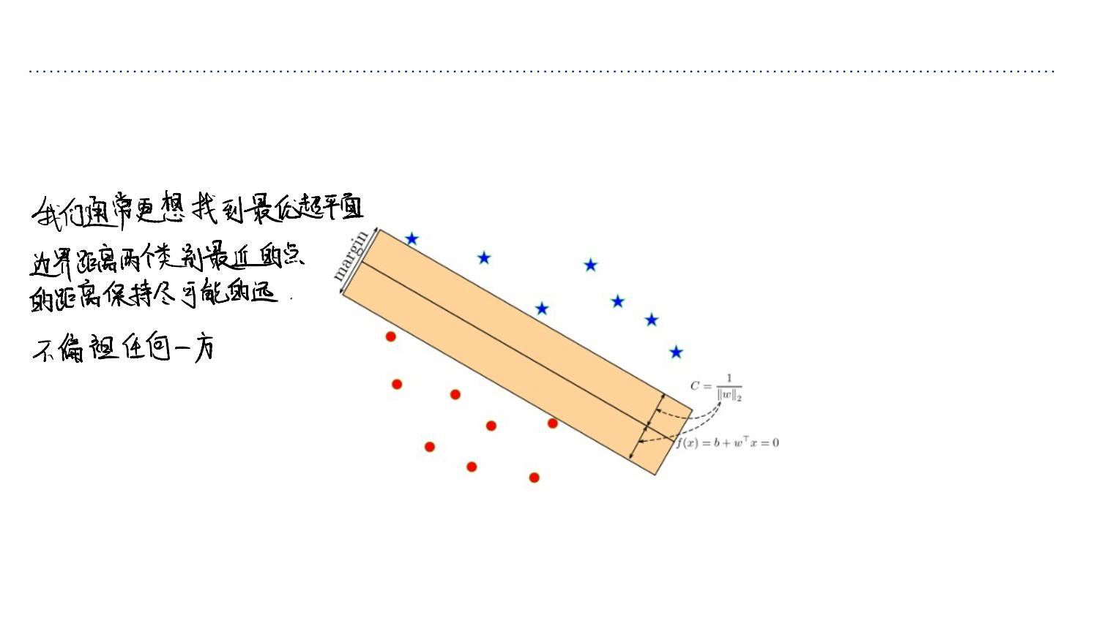
Optimal Separating Hyperplane
Optimal Separating Hyperplane: A hyperplane that separates two classes and maximizes
the distance to the closest point from either class, i.e., maximize the margin of the
classifier.
Intuitively, ensuring that a classifier is not too close to any data points leads to better
generalization on the test data.

Slide 9
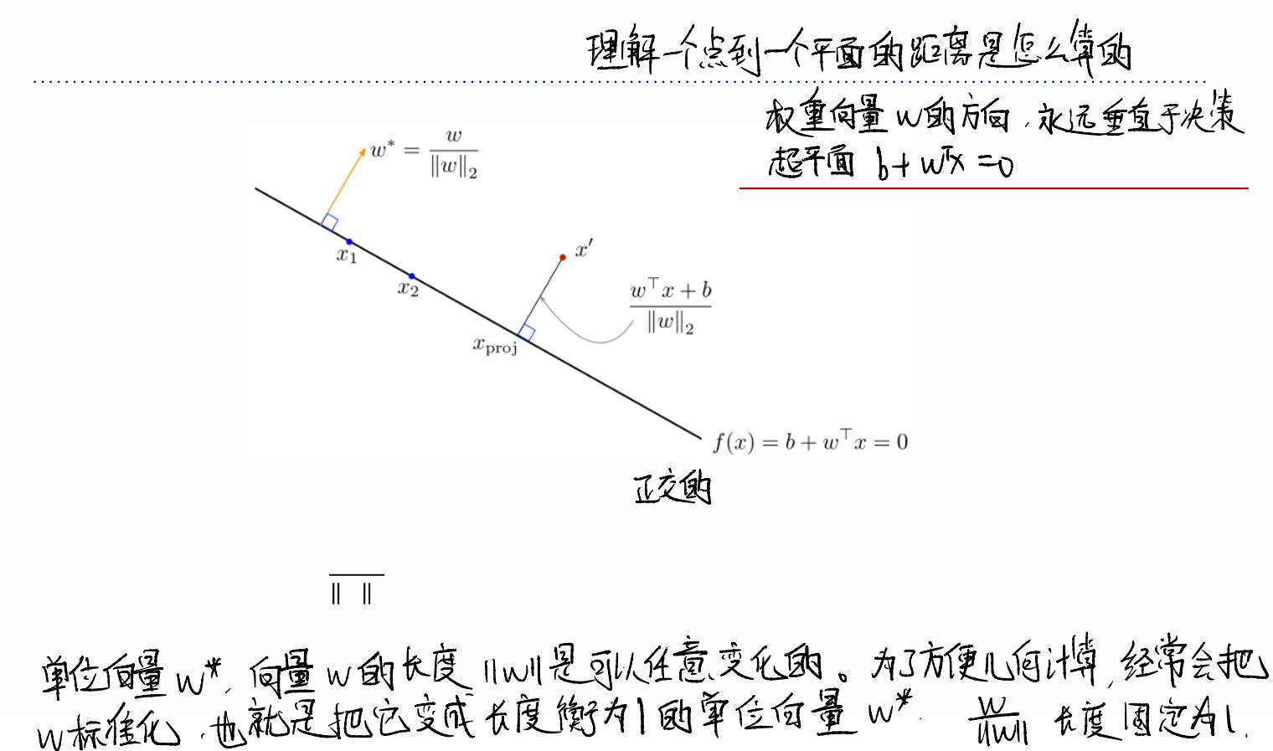
Geometry of Points and Planes
• Recall that the decision hyperplane is orthogonal (perpendicular) to ꢁ.
• The vector ꢁ∗ =
ꢀ
is a unit vector pointing in the same direction as ꢁ.
ꢀ
!
∗
• The same hyperplane could equivalently be defined in terms of ꢁ .

Slide 10
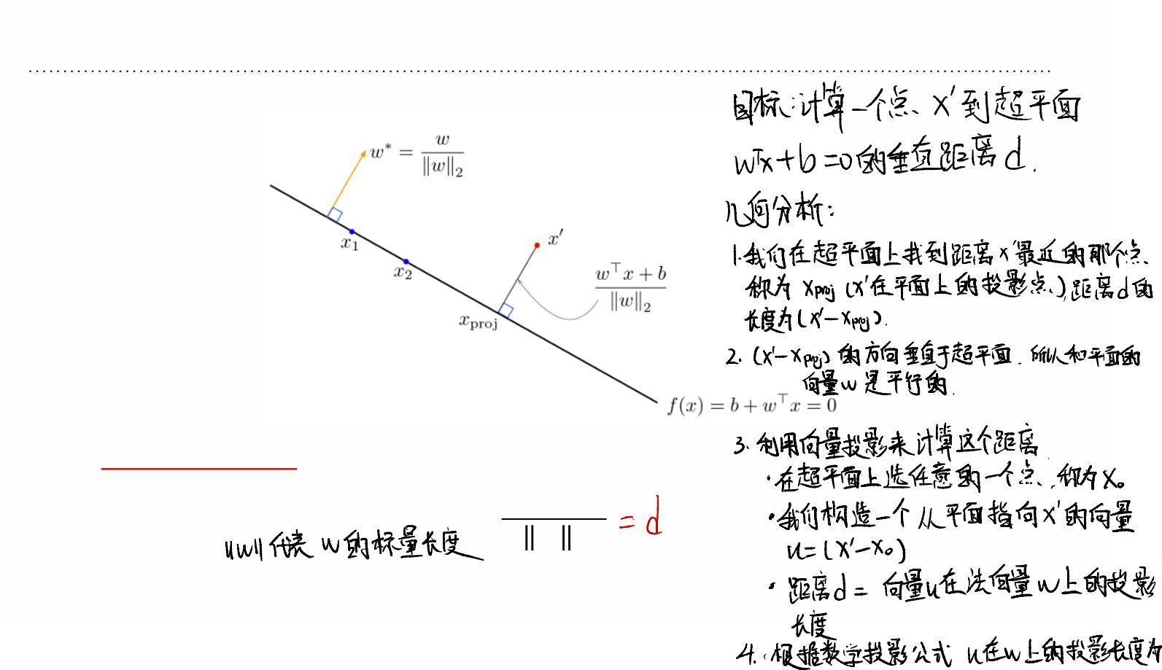


Geometry of Points and Planes
The (signed) distance of a point ꢉ⁺to the hyperplane is
⊺ +
ꢁ ꢉ +ꢂ
ꢁ
'

Slide 11
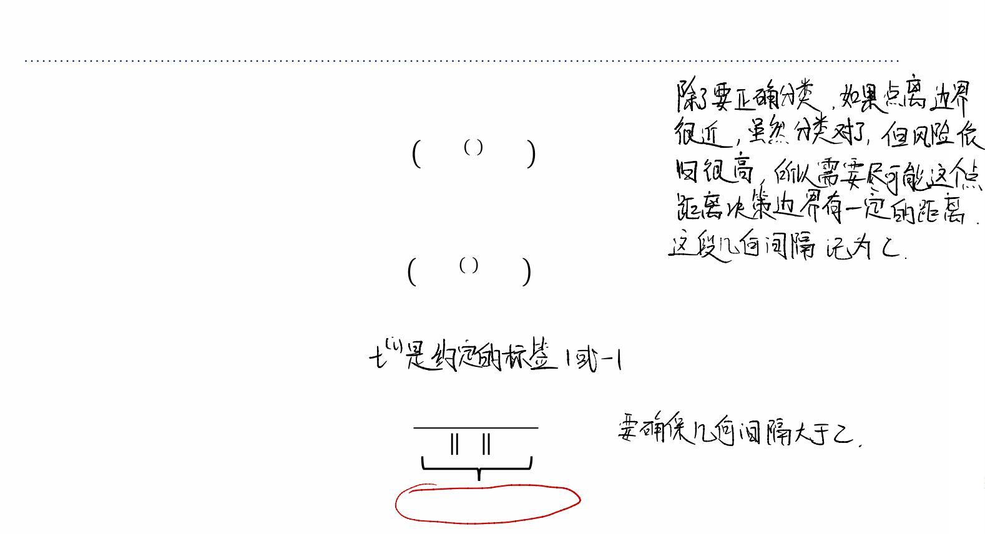
Maximizing Margin as an Optimization Problem
• Recall: the classification for the ꢆ-th data point is correct when
sign ꢁ⊺ꢉ, +ꢂ =ꢀ^{(,)}
• This can be rewritten as
(,) ⊺ ,
ꢀ ꢁ ꢉ +ꢂ >0
• Enforcing a margin of ꢎ:
⊺ (,)
(ꢁ ꢉ +ꢂ)
ꢁ
(,)
ꢀ F
≥ꢎ
'
signed distance

Slide 12
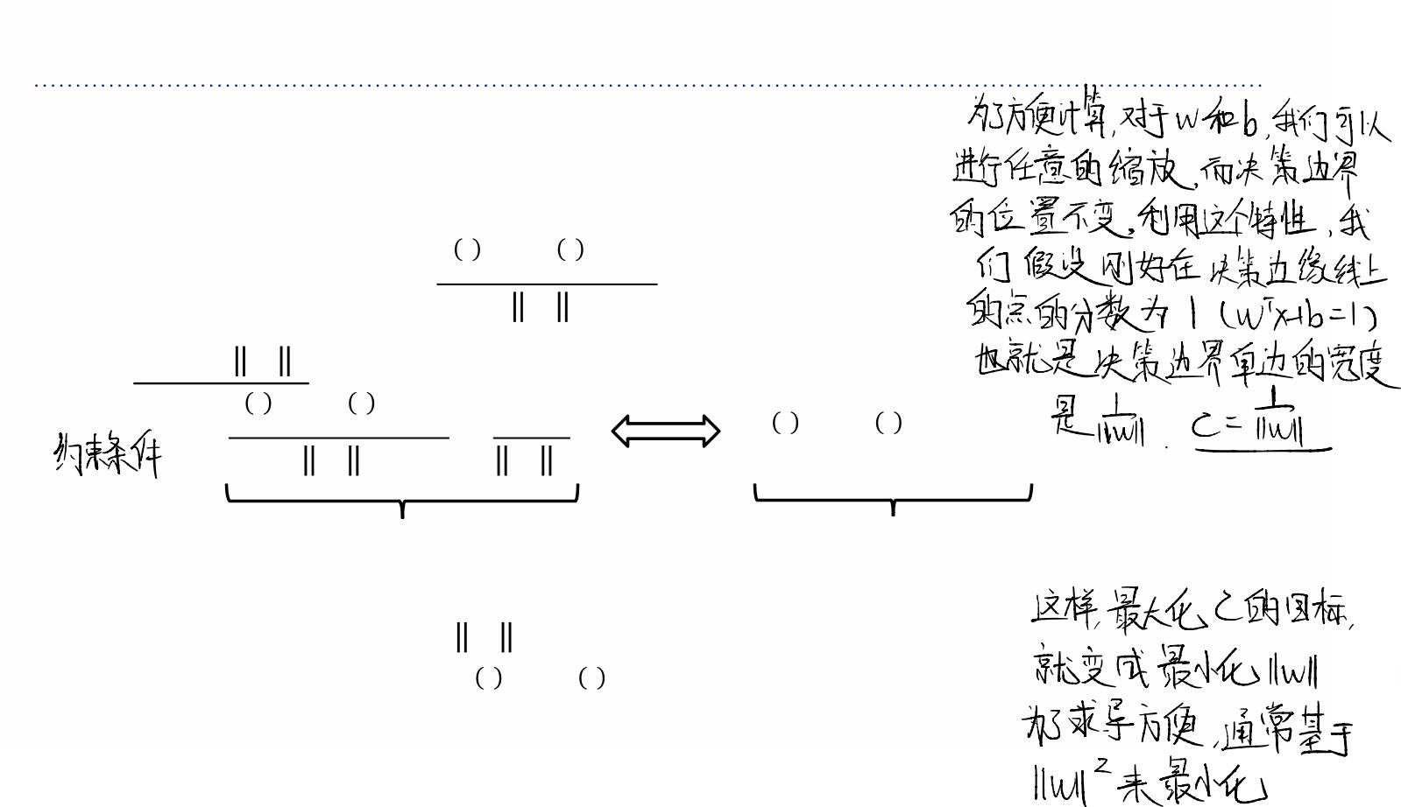
Maximizing Margin as an Optimization Problem
Max-margin objective:
max ꢎ
ꢀ, ꢁ
, ⊺ ,
ꢀ (ꢁ ꢉ +ꢂ)
ꢁ
ꢆ =1,⋯,ꢏ
s. t.
≥ꢎ
'
Plug in ꢎ=1⁄ ꢁ 'and simplify:
, ⊺ ,
ꢀ (ꢁ ꢉ +ꢂ) 1
, ⊺ ,
ꢀ (ꢁ ꢉ +ꢂ)≥1
≥
ꢁ
'
ꢁ
'
geometric margin constraint
algebraic margin constraint
Equivalent optimization objective:
min ꢁ
'
'
, ⊺ ,
s. t. ꢀ (ꢁ ꢉ +ꢂ)≥1
ꢆ =1,⋯,ꢏ

Slide 13
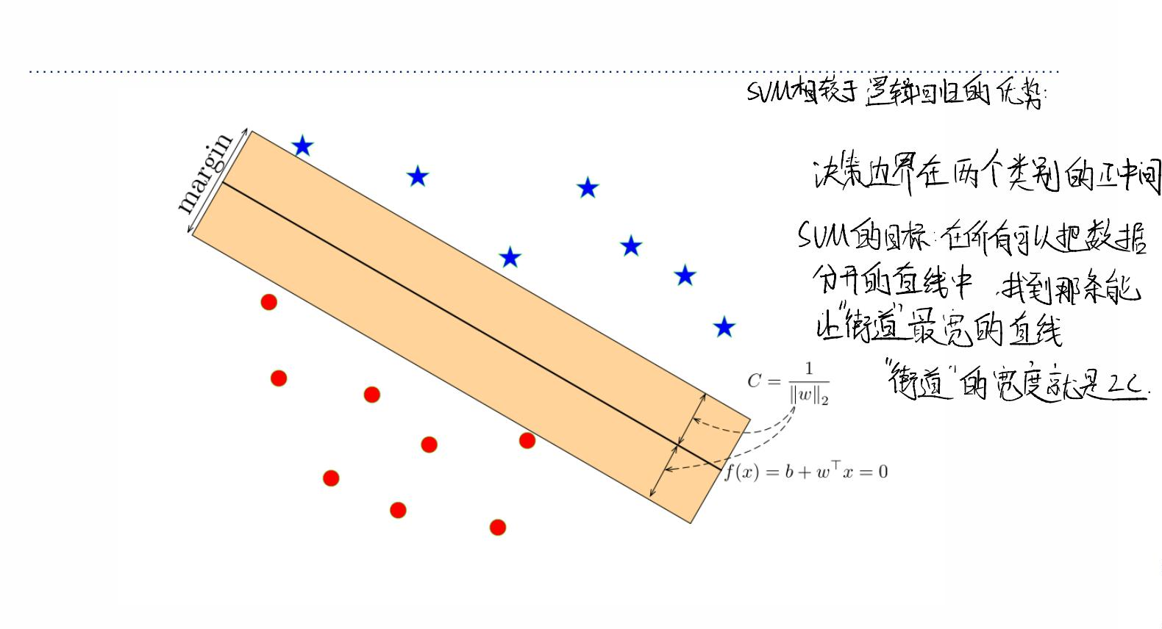
Maximizing Margin as an Optimization Problem

Slide 14
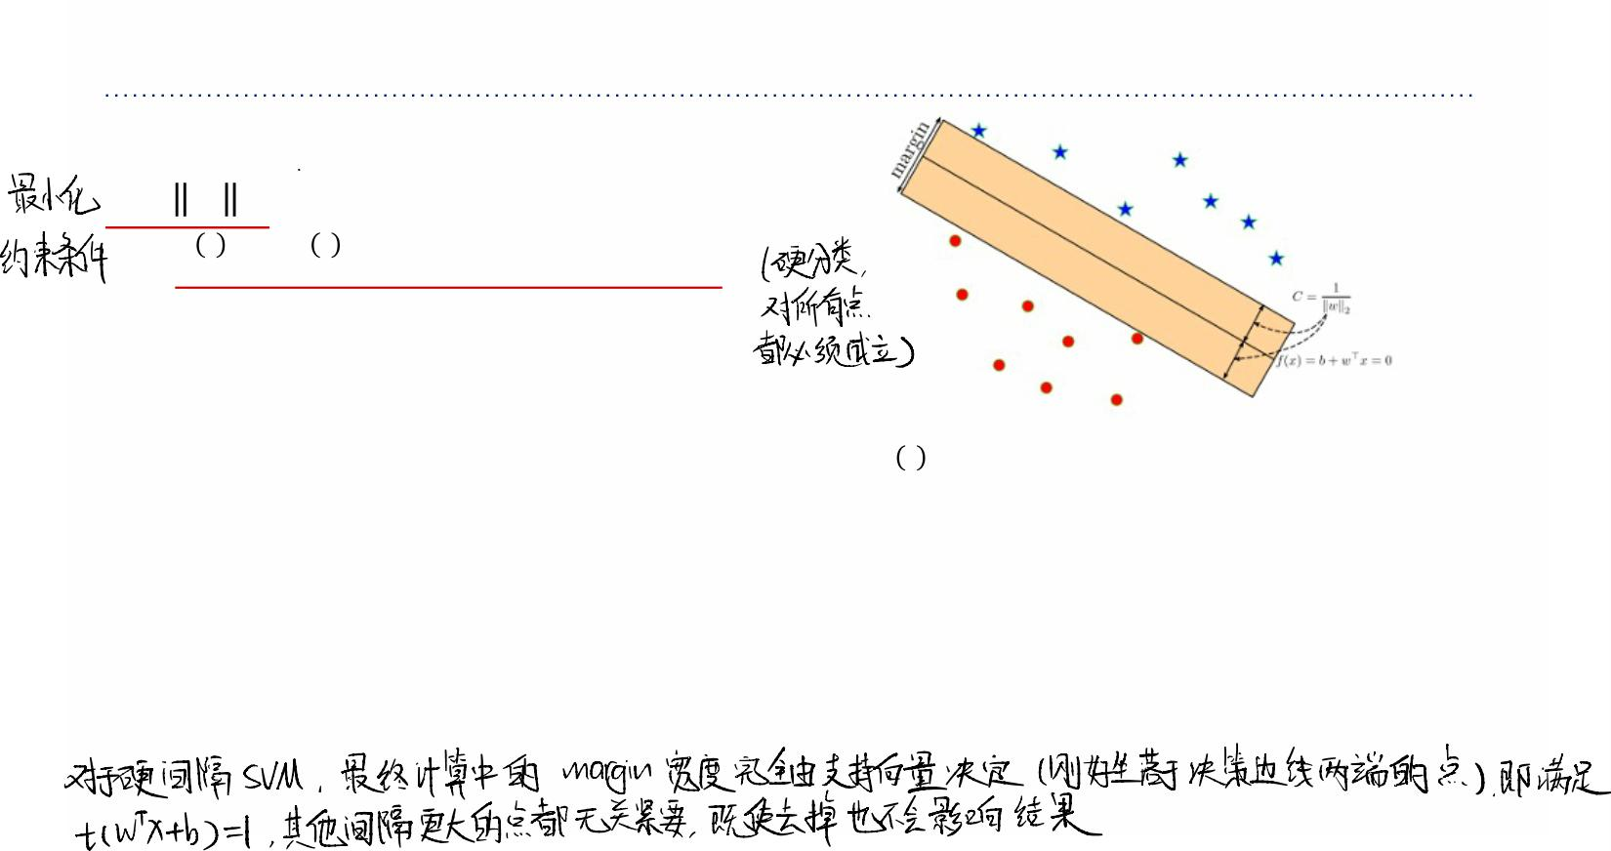











Maximizing Margin as an Optimization Problem
Algebraic max-margin objective:
min ꢁ
'
'
, ⊺ ,
s. t. ꢀ (ꢁ ꢉ +ꢂ)≥1
ꢆ =1,⋯,ꢏ
• Observe: if the margin constraint is not tight for ꢉ, , we could remove it from the
training set and the optimal ꢁwould be the same.
• The important training examples are the ones with algebraic margin 1, and are called
support vectors.
• Hence, this algorithm is called the (hard) Support Vector Machine (SVM) (or Support
Vector Classifier).
• SVM-like algorithms are often called max-margin or large-margin.

Slide 15
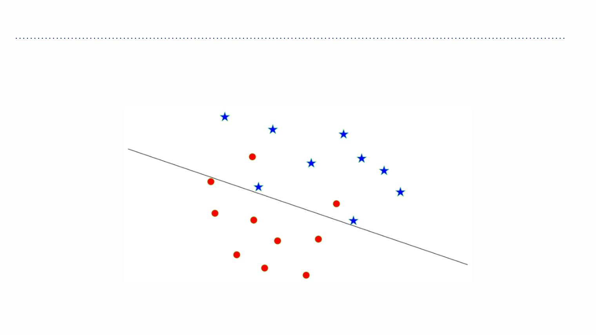
Non-Separable Data Points
How can we apply the max-margin principle if the data are not linearly separable?

Slide 16









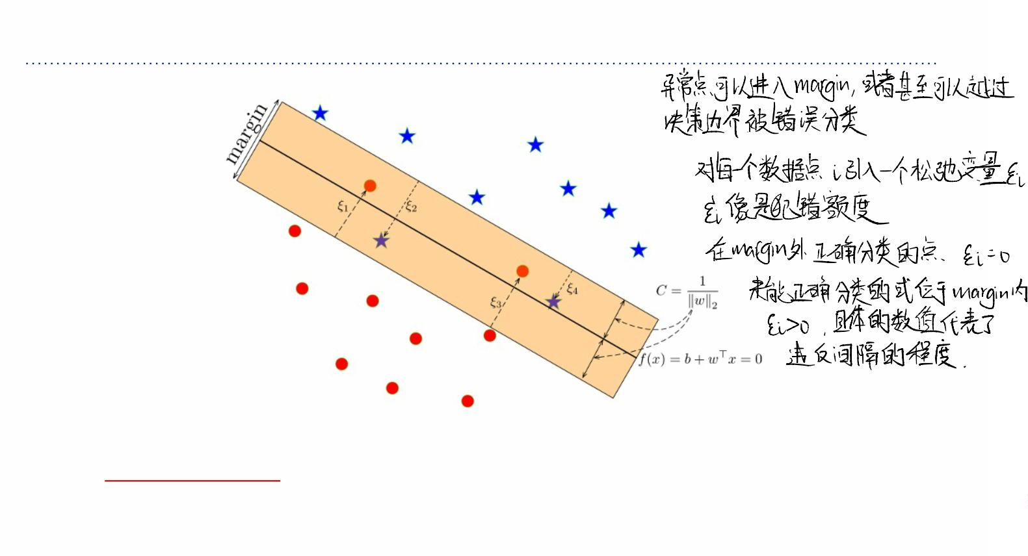
Maximizing Margin for Non-Separable Data Points
Main idea:
• Allow some points to be within the margin or even be misclassified; we represent this
with slack variables ꢐ,.
• But constrain or penalize the total amount of slack.

Slide 17
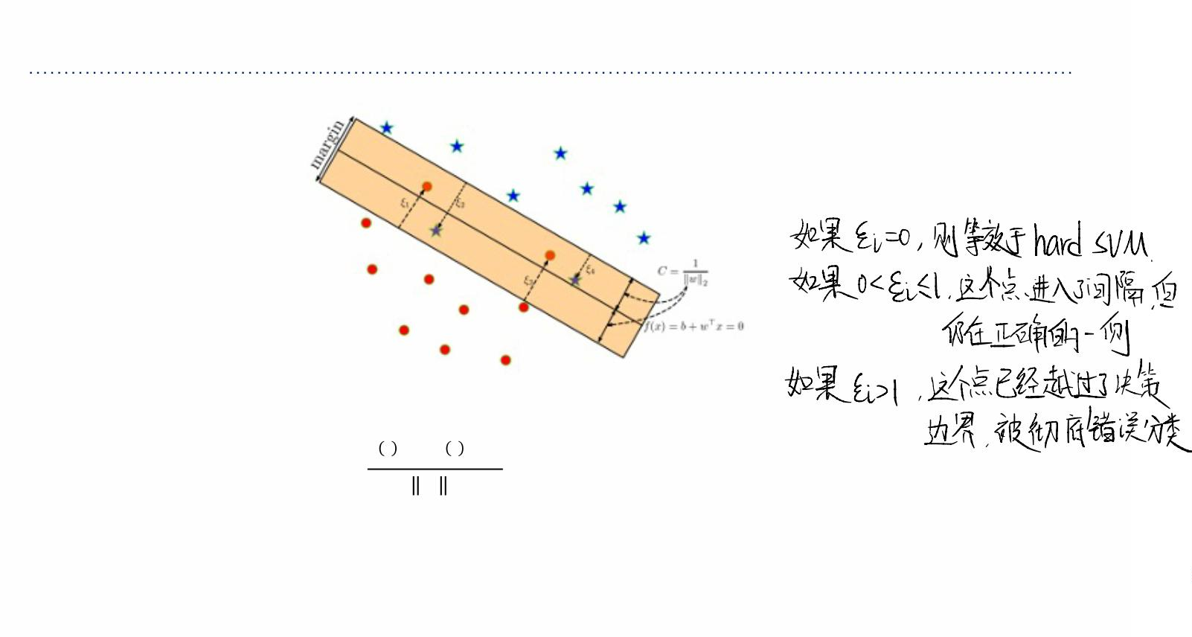
Maximizing Margin for Non-Separable Data Points
• Soft margin constraint:
" ⊺ "
/ (ꢀ ꢁ 12)
≥ ꢎ(1−ꢐ,),
ꢀ
!
for ꢐ, ≥0.
∑ ꢐ .
• Penalize
, ,

Slide 18
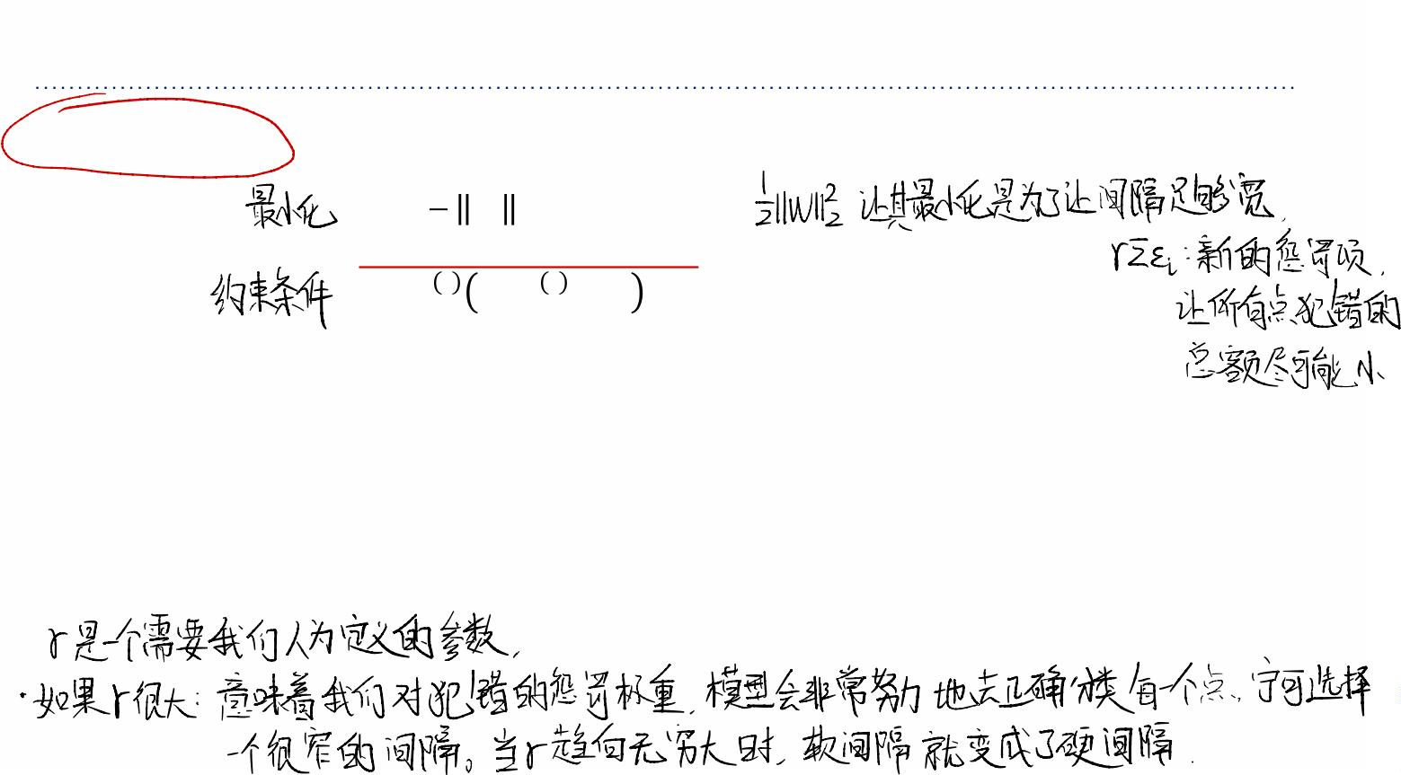




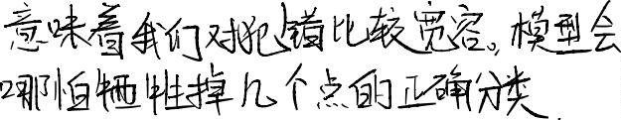










Maximizing Margin for Non-Separable Data Points
Soft-margin SVM objective:
1
4
'
min ꢁ +ꢑSꢐ
2
'
,
!, ", #
,3&
, ⊺ ,
s.t.ꢀ ꢁ ꢉ +ꢂ ≥ 1−ꢐ ꢆ =1,⋯,ꢏ
,
ꢂ! ≥0
ꢆ =1,⋯,ꢏ
• ꢑis a hyperparameter that trades off the margin with the amount of slack.
ØFor ꢑ=0, we’ll get ꢁ=0. (why?)
ØAs ꢑ→∞, we get the hard-margin objective.
• Note: it is also possible to constrain ∑,ꢐ, instead of penalizing it.

Slide 19


















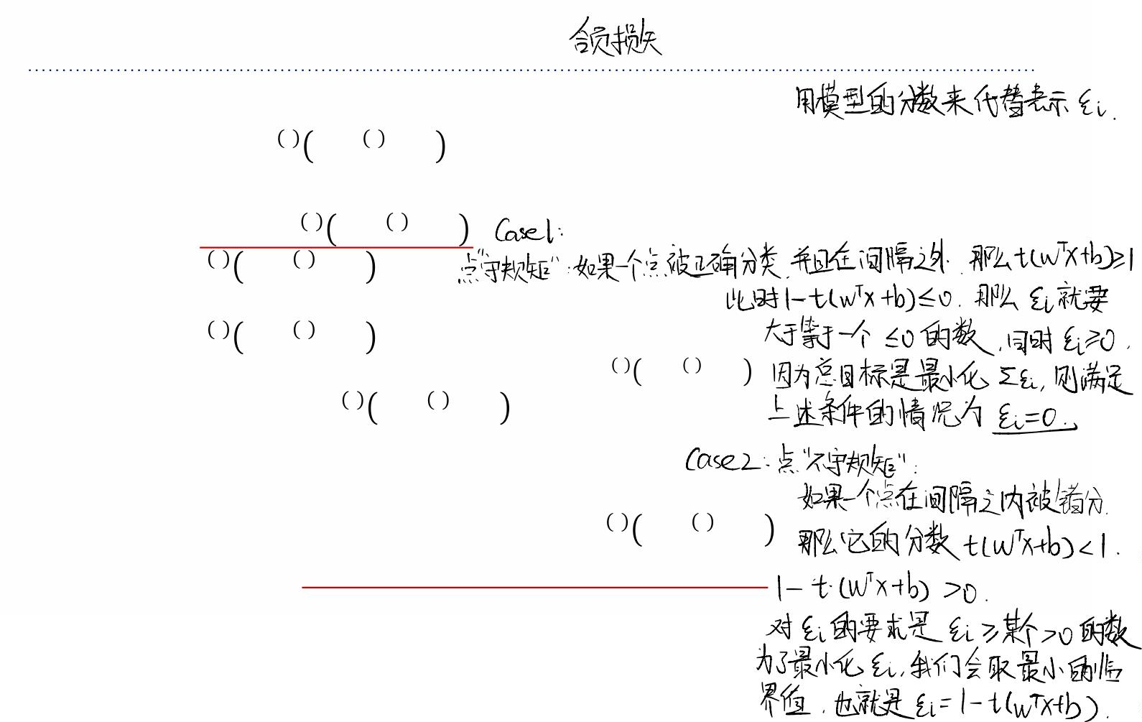
From Margin Violation to Hinge Loss
Let’s simplify the soft margin constraint by eliminating ꢐ,. Recall:
, ⊺ ,
ꢀ ꢁ ꢉ +ꢂ ≥ 1−ꢐ ꢆ =1,⋯,ꢏ
,
ꢂ! ≥0
ꢆ =1,⋯,ꢏ
, ⊺ ,
• Rewrite as ꢐ ≥ 1−ꢀ ꢁ ꢉ +ꢂ .
,
• Case 1: 1−ꢀ , ꢁ⊺ꢉ, +ꢂ ≤0
Ø The smallest non-negative ꢂ that satisfies the constraint is ꢂ =0.
!
!
• Case 2: 1−ꢀ , ꢁ⊺ꢉ, +ꢂ >0
! ⊺ !
Ø The smallest ꢂ that satisfies the constraint is ꢂ =1−ꢃ ꢀ ꢄ +ꢁ .
!
!
, ⊺ ,
• Hence, ꢐ = max{0,1 − ꢀ ꢁ ꢉ +ꢂ }.
,
• Therefore, the slack penalty can be written as
4
4
, ⊺ ,
Sꢐ = Smax{0,1 − ꢀ ꢁ ꢉ +ꢂ }
,
,3&
,3&

Slide 20
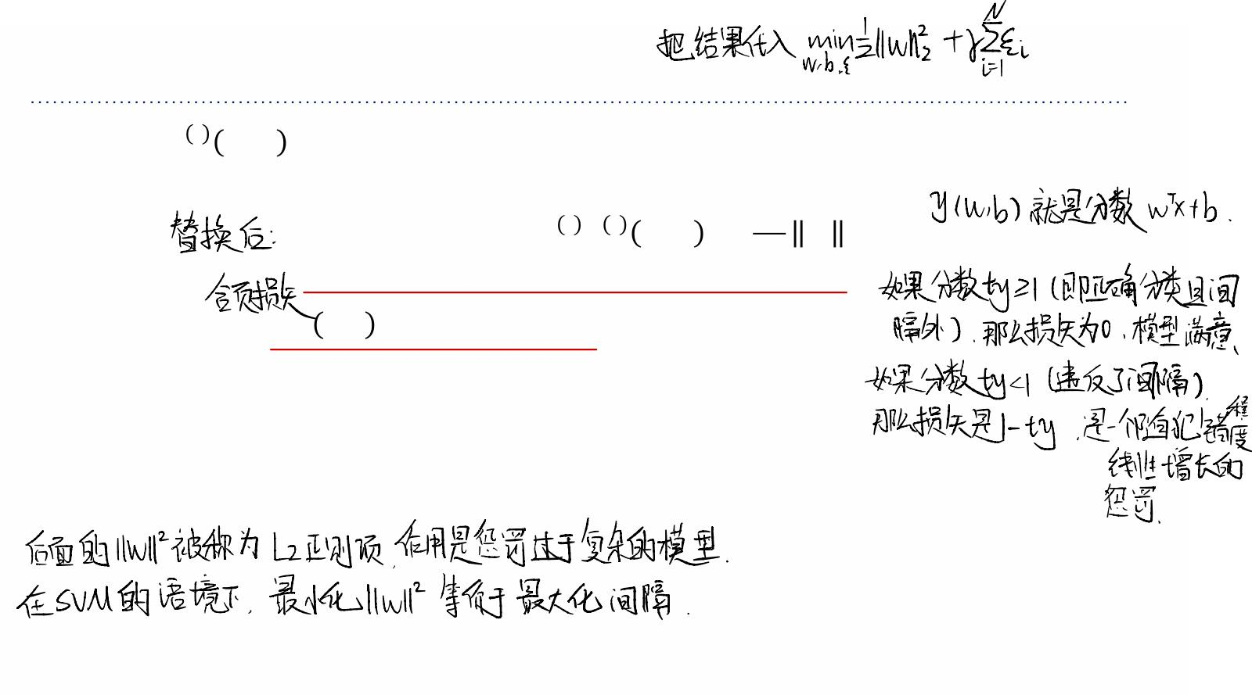
From Margin Violation to Hinge Loss
,
⊺
If we write ꢄ ꢁ,ꢂ =ꢁ ꢉ+ꢂ, then the optimization problem can be written as
4
1
, ,
'
min S max{0,1 − ꢀ ꢄ ꢁ,ꢂ }+ ꢁ
'
!, ", #
2ꢑ
,3&
• The loss function ℒ₅ ꢄ,ꢀ = max{0,1 − ꢀꢄ}is called the hinge loss.
• The second term is the ꢒ'-norm of the weights.
• Hence, the soft-margin SVM can be seen as a linear classifier with hinge loss and an ꢒ'
regularizer.

Slide 21











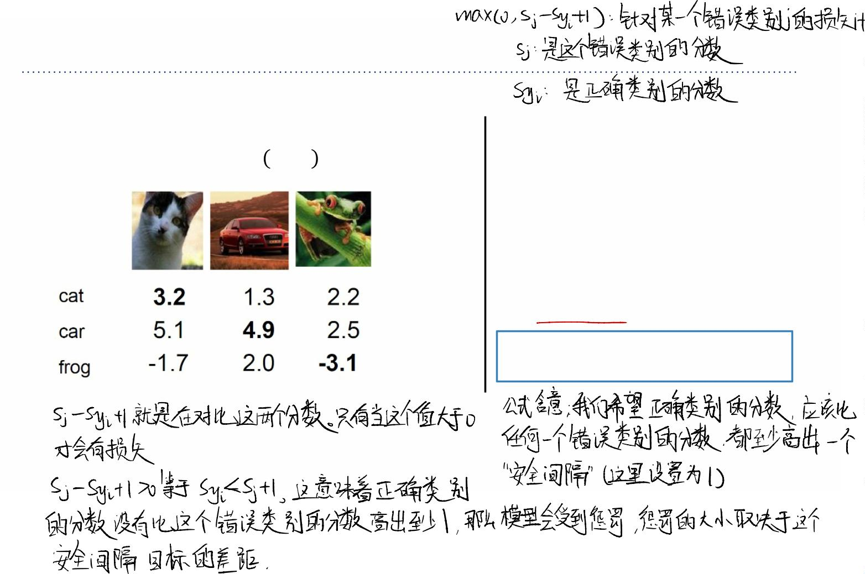
Multiclass SVM Loss
Suppose: 3 training examples, 3 classes.
Multiclass SVM loss:
With some W the scores ꢇ ꢌ,ꢓ =ꢓꢌare:
Given an example (ꢋ,,ꢔ,),
where ꢋ is the image and ꢔ is
,
,
the (integer) label.
and using the shorthand for the
scores vector: ꢕ = ꢇ(ꢋ,,ꢓ)
The SVM loss has the form:
ꢒ =S max(0, ꢕ −ꢕ +1)
,
6 ꢂ
"
67ꢂ"

Slide 22
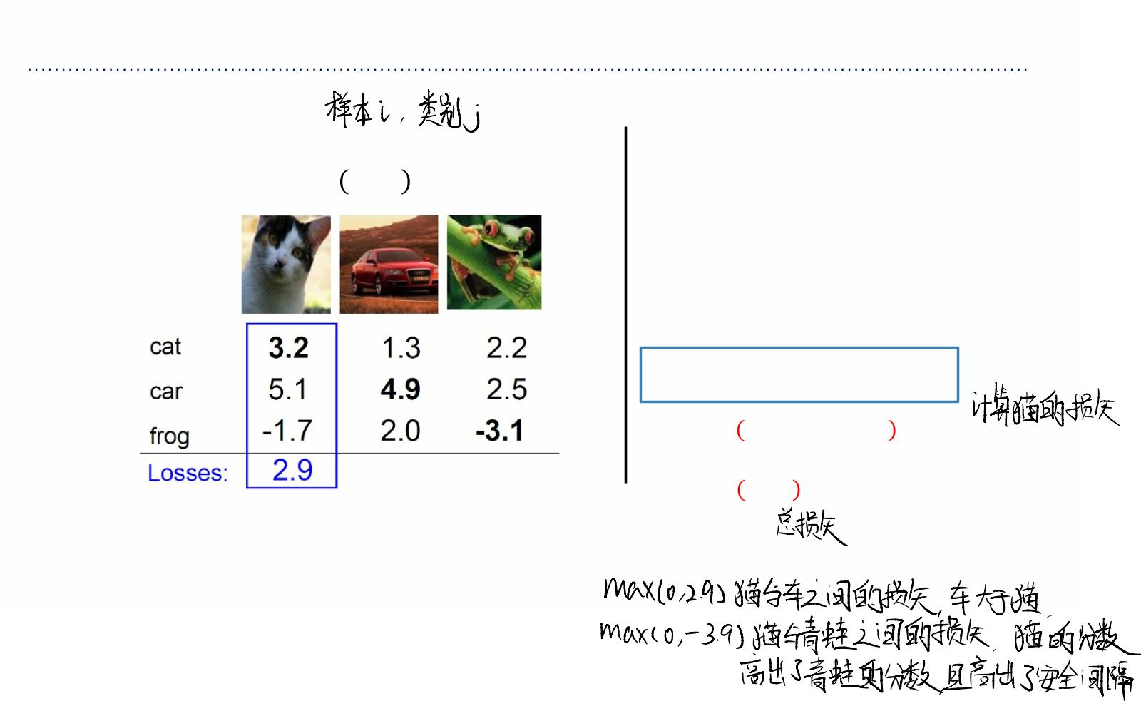
Multiclass SVM Loss
Suppose: 3 training examples, 3 classes.
Multiclass SVM loss:
With some W the scores ꢇ ꢌ,ꢓ =ꢓꢌare:
Given an example (ꢅ!,ꢆ!),
where ꢅ is the image and ꢆ is the
!
!
(integer) label.
and using the shorthand for the scores
vector: ꢇ = ꢈ(ꢅ!,ꢉ)
The SVM loss has the form:
ꢊ =5 max(0, ꢇ −ꢇ +1)
!
#$ꢀ
# ꢀ
!
!
= max 0,5.1−3.2+1
+max(0, −1.7 − 3.2 + 1)
= max 0,2.9 + max(0, −3.9)
= 2.9+0
= 2.9

Slide 23
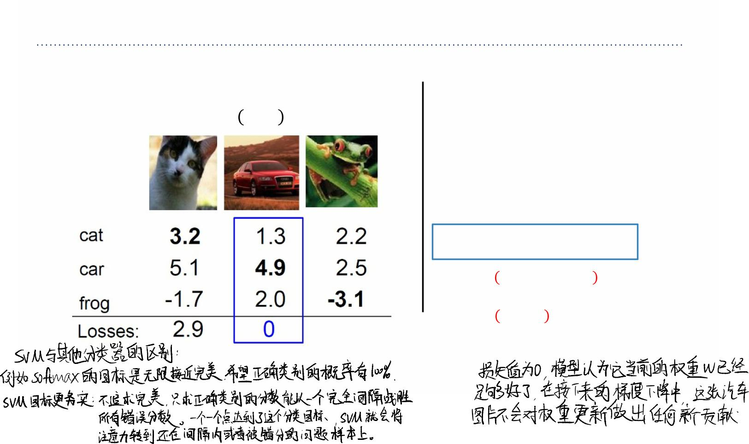
Multiclass SVM Loss
Suppose: 3 training examples, 3 classes.
Multiclass SVM loss:
With some W the scores ꢇ ꢌ,ꢓ =ꢓꢌare:
Given an example (ꢅ!,ꢆ!),
where ꢅ is the image and ꢆ is the
!
!
(integer) label.
and using the shorthand for the scores
vector: ꢇ = ꢈ(ꢅ!,ꢉ)
The SVM loss has the form:
ꢊ =5 max(0, ꢇ −ꢇ +1)
!
#$ꢀ
# ꢀ
!
!
= max 0,1.3 − 4.9 + 1
+max(0,2.0 − 4.9 + 1)
= max 0, −2.6 + max(0, −1.9)
=0+0
=0

Slide 24
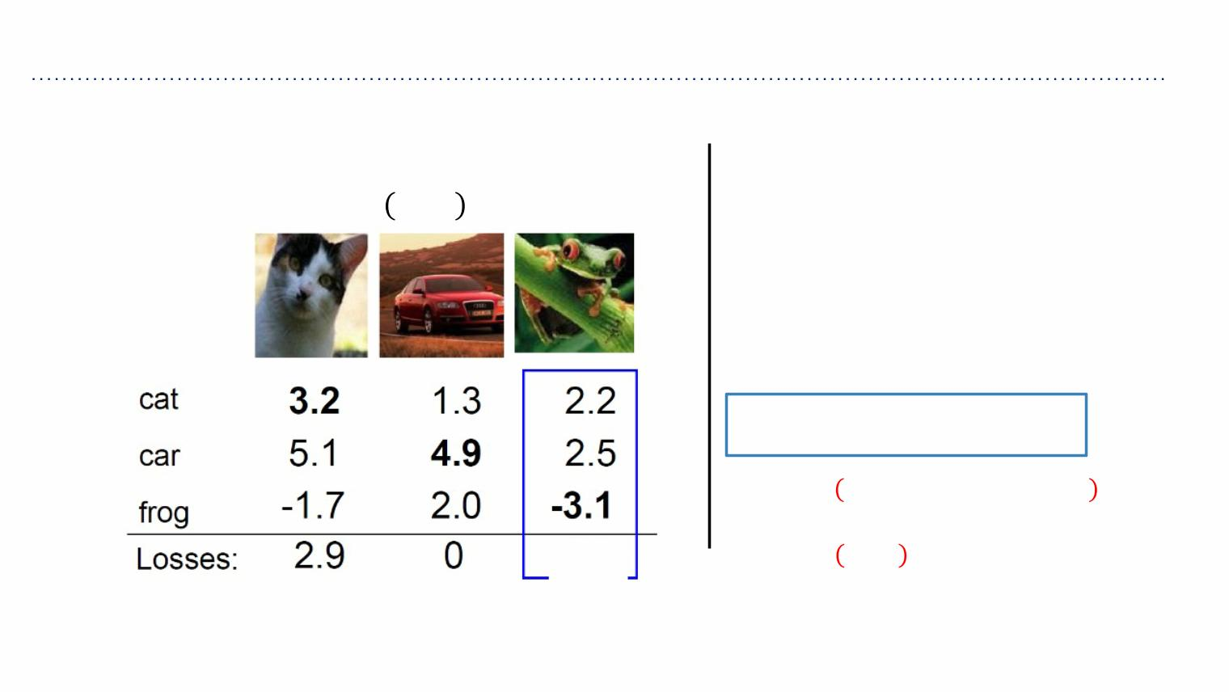
Multiclass SVM Loss
Suppose: 3 training examples, 3 classes.
Multiclass SVM loss:
With some W the scores ꢇ ꢌ,ꢓ =ꢓꢌare:
Given an example (ꢅ!,ꢆ!),
where ꢅ is the image and ꢆ is the
!
!
(integer) label.
and using the shorthand for the scores
vector: ꢇ = ꢈ(ꢅ!,ꢉ)
The SVM loss has the form:
ꢊ =5 max(0, ꢇ −ꢇ +1)
!
#$ꢀ
# ꢀ
!
!
= max 0,2.2 −（− 3.1）+1
+max(0,2.5−（− 3.1）+1)
12.9
= max 0,6.3 + max(0,6.6)
= 6.3+6.6
= 12.9

Slide 25
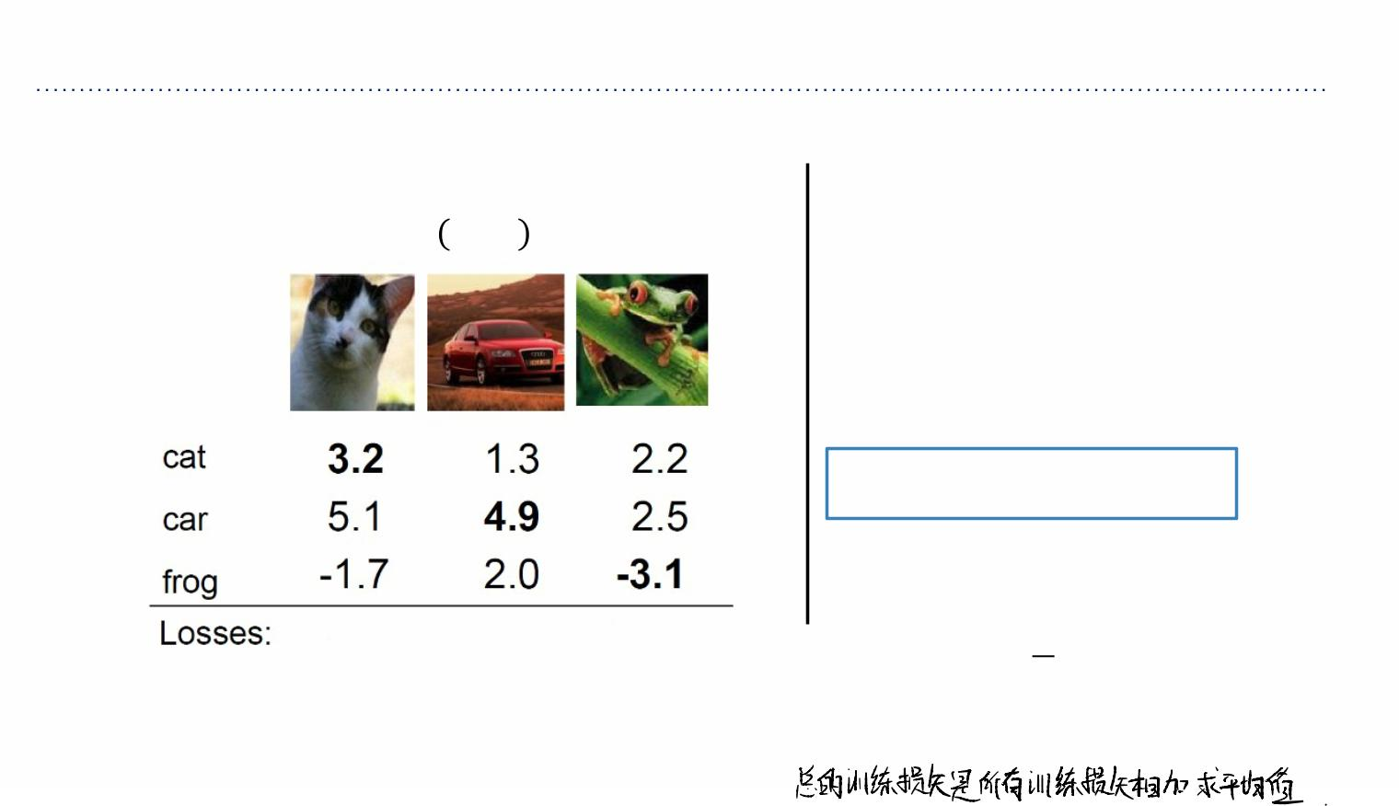
Multiclass SVM Loss
Suppose: 3 training examples, 3 classes.
Multiclass SVM loss:
With some W the scores ꢇ ꢌ,ꢓ =ꢓꢌare:
Given an example (ꢅ!,ꢆ!),
where ꢅ is the image and ꢆ is the
!
!
(integer) label.
and using the shorthand for the scores
vector: ꢇ = ꢈ(ꢅ!,ꢉ)
The SVM loss has the form:
ꢊ =5 max(0, ꢇ −ꢇ +1)
!
#$ꢀ
# ꢀ
!
!
and the full training loss is the mean over
all examples in the training data:
1 (
2.9 0 12.9
ꢊ= 5 ꢊ
ꢋ
!&'
!
ꢊ = (2.9 + 0 + 12.9)/3
= ꢌ.ꢍꢎ

Slide 26
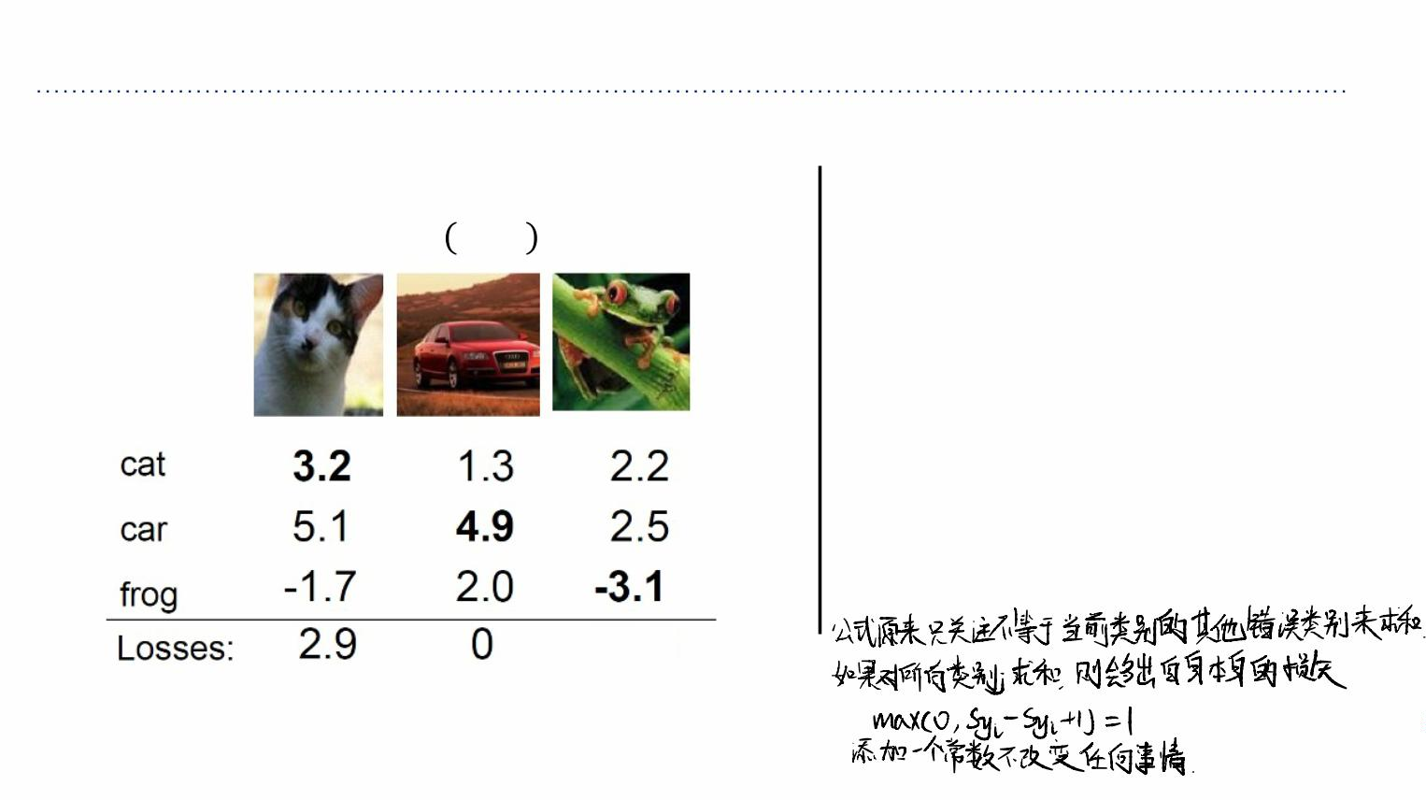
Multiclass SVM Loss
Suppose: 3 training examples, 3 classes.
Multiclass SVM loss:
With some W the scores ꢇ ꢌ,ꢓ =ꢓꢌare:
Given an example (ꢅ!,ꢆ!),
where ꢅ is the image and ꢆ is the
!
!
(integer) label.
and using the shorthand for the scores
vector: ꢇ = ꢈ(ꢅ!,ꢉ)
The SVM loss has the form:
ꢊ =5 max(0, ꢇ −ꢇ +1)
!
#$ꢀ
# ꢀ
!
!
Q: what if the sum was instead over all
classes? (including j=y_i)
12.9

Slide 27
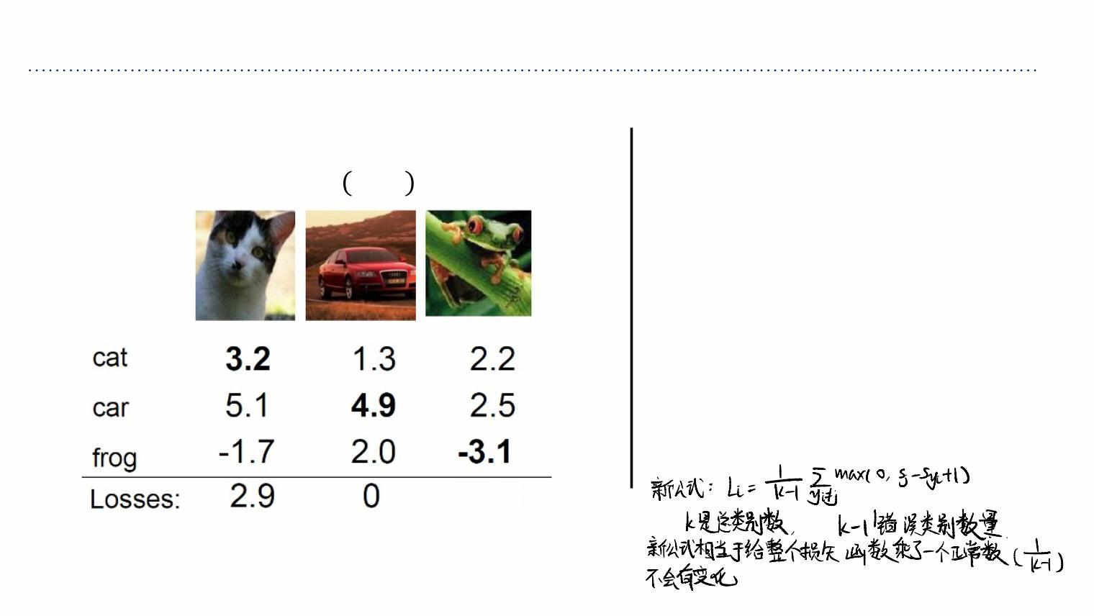
Multiclass SVM Loss
Suppose: 3 training examples, 3 classes.
Multiclass SVM loss:
With some W the scores ꢇ ꢌ,ꢓ =ꢓꢌare:
Given an example (ꢅ!,ꢆ!),
where ꢅ is the image and ꢆ is the
!
!
(integer) label.
and using the shorthand for the scores
vector: ꢇ = ꢈ(ꢅ!,ꢉ)
The SVM loss has the form:
ꢊ =5 max(0, ꢇ −ꢇ +1)
!
#$ꢀ
# ꢀ
!
!
Q2: what if we used a mean instead of a
sum here
12.9

Slide 28
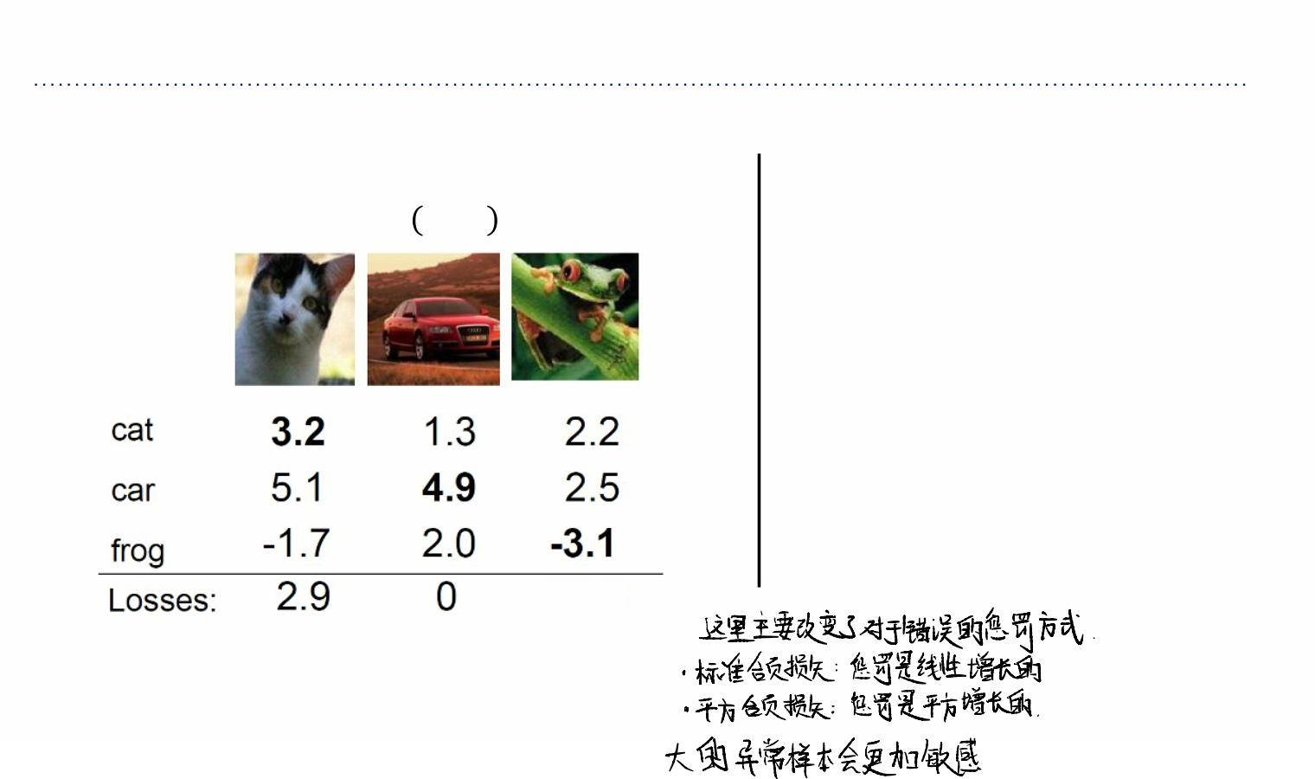







Multiclass SVM Loss
Suppose: 3 training examples, 3 classes.
Multiclass SVM loss:
With some W the scores ꢇ ꢌ,ꢓ =ꢓꢌare:
Given an example (ꢅ!,ꢆ!),
where ꢅ is the image and ꢆ is the
!
!
(integer) label.
and using the shorthand for the scores
vector: ꢇ = ꢈ(ꢅ!,ꢉ)
The SVM loss has the form:
ꢊ =5 max(0, ꢇ −ꢇ +1)
!
#$ꢀ
# ꢀ
!
!
Q3: what if we used
)
ꢊ =5 max(0, ꢇ −ꢇ +1)
12.9
!
#$ꢀ
!
# ꢀ
!

Slide 29
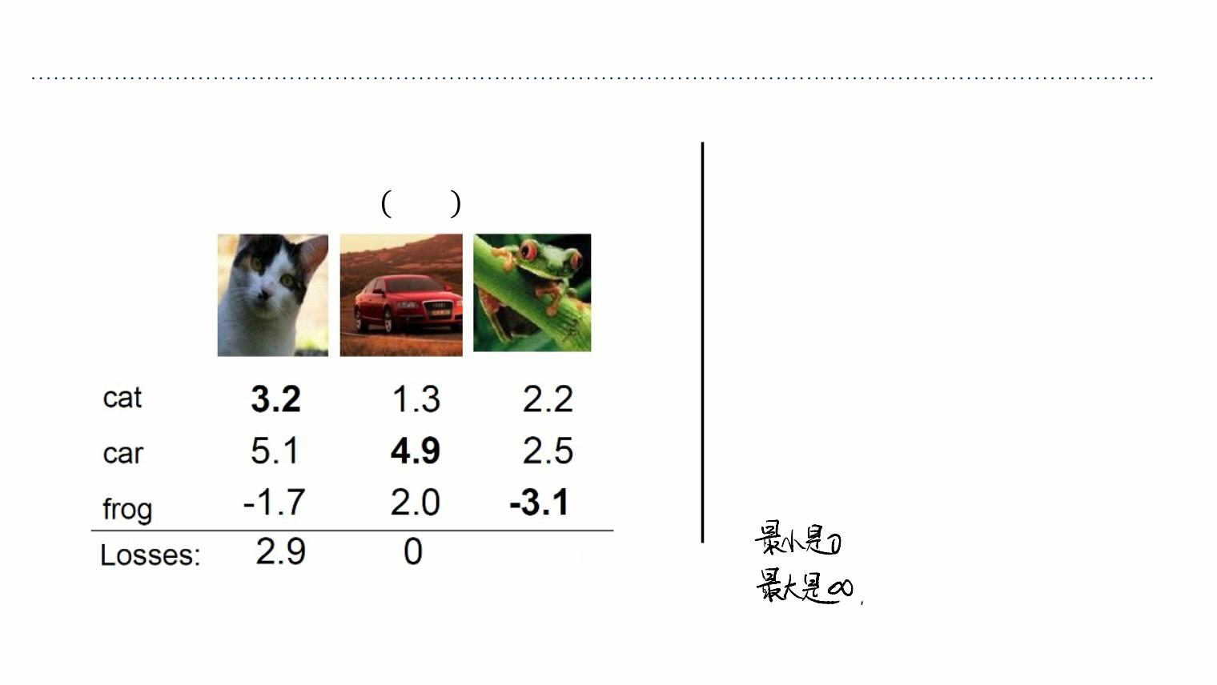
Multiclass SVM Loss
Suppose: 3 training examples, 3 classes.
Multiclass SVM loss:
With some W the scores ꢇ ꢌ,ꢓ =ꢓꢌare:
Given an example (ꢅ!,ꢆ!),
where ꢅ is the image and ꢆ is the
!
!
(integer) label.
and using the shorthand for the scores
vector: ꢇ = ꢈ(ꢅ!,ꢉ)
The SVM loss has the form:
ꢊ =5 max(0, ꢇ −ꢇ +1)
!
#$ꢀ
# ꢀ
!
!
Q4: what is the min/max possible loss
12.9

Slide 30
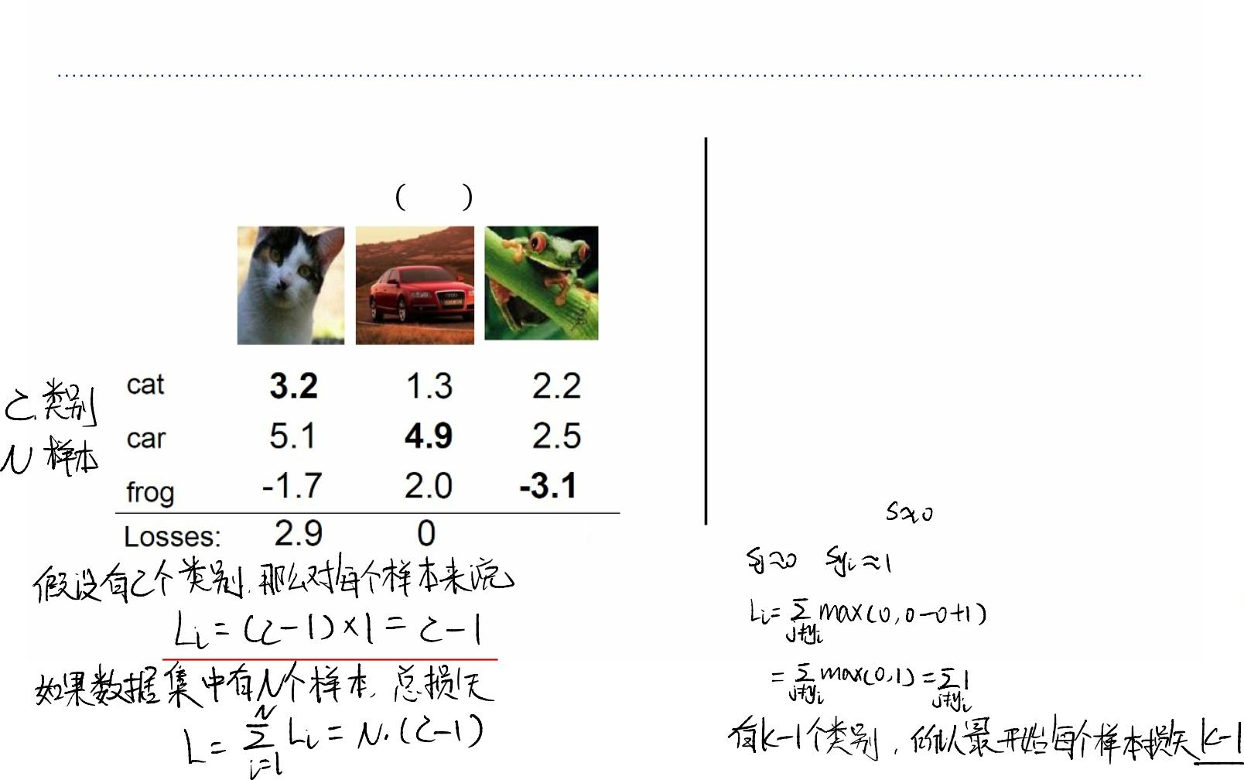
Multiclass SVM Loss
Suppose: 3 training examples, 3 classes.
Multiclass SVM loss:
With some W the scores ꢇ ꢌ,ꢓ =ꢓꢌare:
Given an example (ꢅ!,ꢆ!),
where ꢅ is the image and ꢆ is the
!
!
(integer) label.
and using the shorthand for the scores
vector: ꢇ = ꢈ(ꢅ!,ꢉ)
The SVM loss has the form:
ꢊ =5 max(0, ꢇ −ꢇ +1)
!
#$ꢀ
# ꢀ
!
!
Q5: usually at initialization W are small
numbers so all s ~=0. What is the loss?
12.9

Slide 31
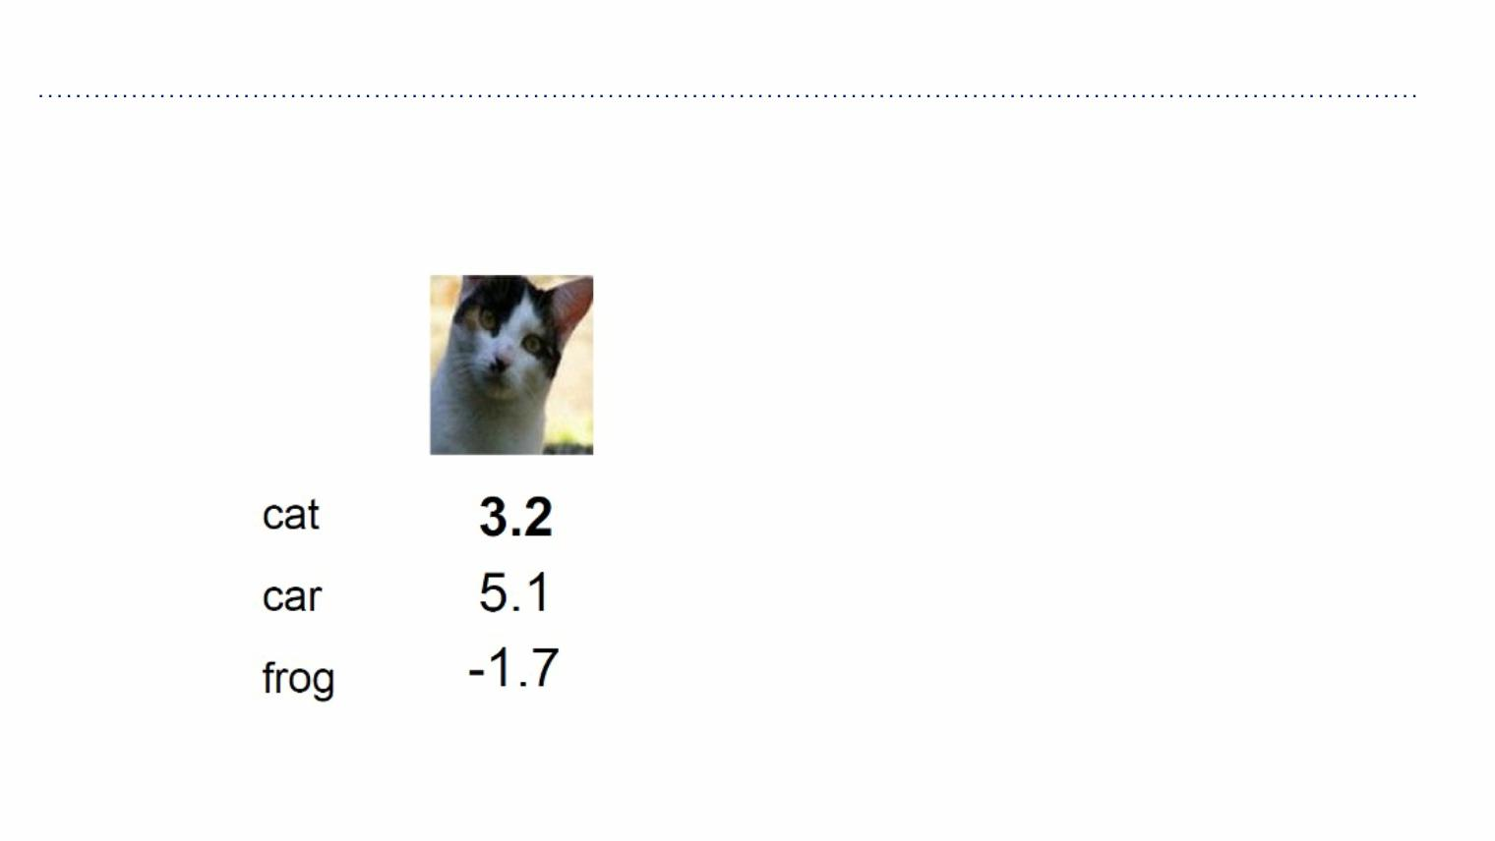
Softmax
Softmax Classifier (Multinomial Logistic Regression)

Slide 32
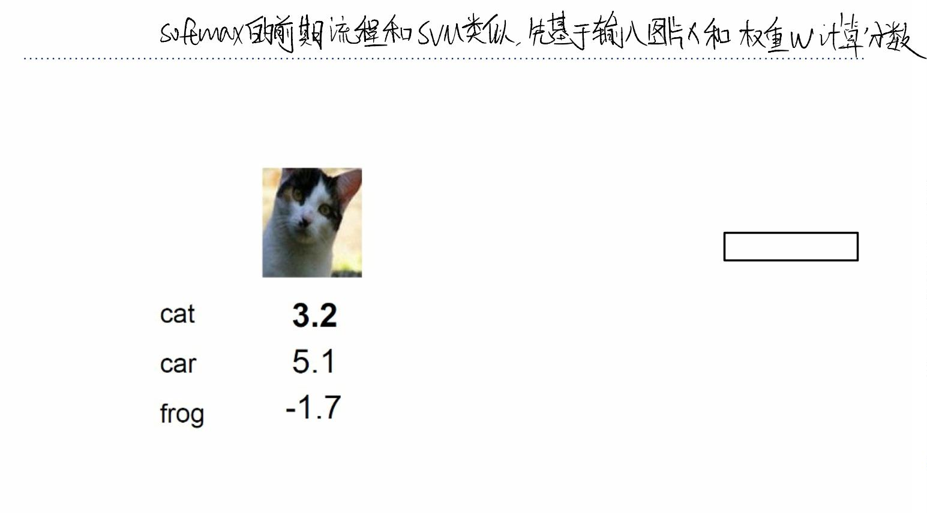
Softmax
Softmax Classifier (Multinomial Logistic Regression)
scores = unnormalized log probabilities of the classes.
ꢕ = ꢇ(ꢋ,;ꢓ)

Slide 33
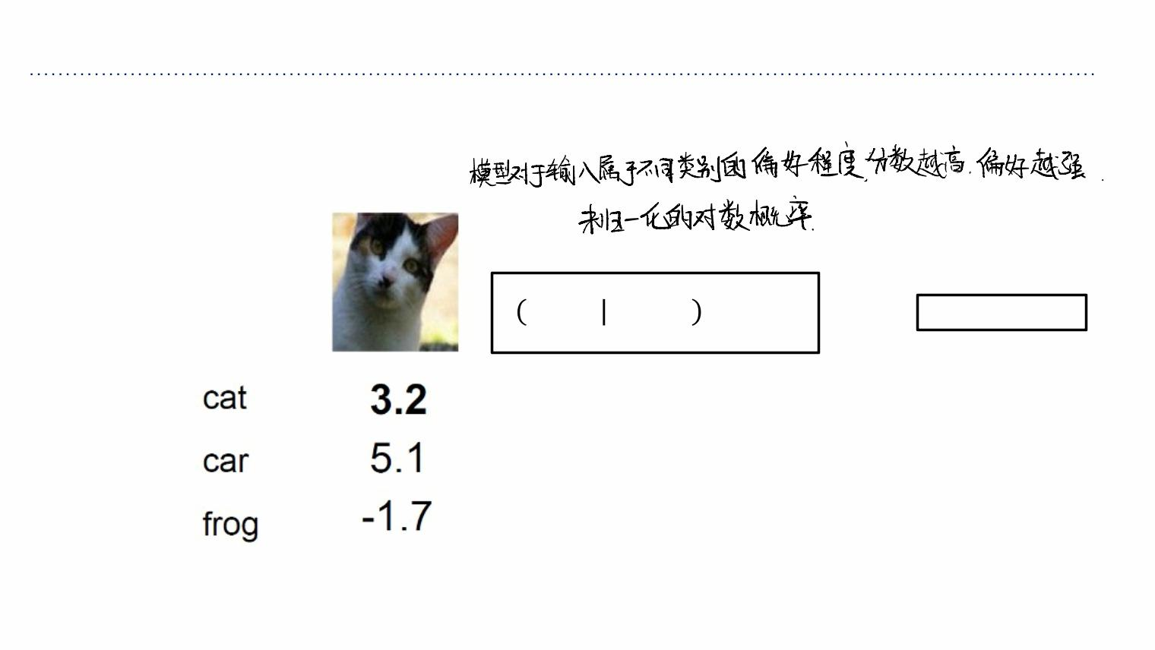
Softmax
Softmax Classifier (Multinomial Logistic Regression)
scores = unnormalized log probabilities of the classes.
ꢚ⁹
ꢖ ꢗ=ꢘꢙ=ꢋ, =
$
∑₆ꢚ⁹
where ꢕ = ꢇ(ꢋ,;ꢓ)
%

Slide 34
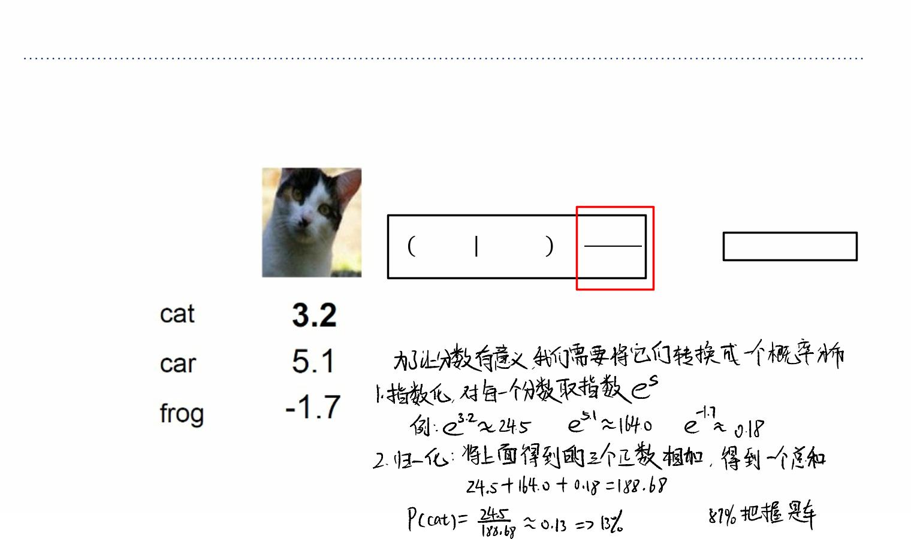







Softmax
Softmax Classifier (Multinomial Logistic Regression)
scores = unnormalized log probabilities of the classes.
ꢚ⁹
ꢖ ꢗ=ꢘꢙ=ꢋ, =
$
∑₆ꢚ⁹
where ꢕ = ꢇ(ꢋ,;ꢓ)
%
Softmax function

Slide 35
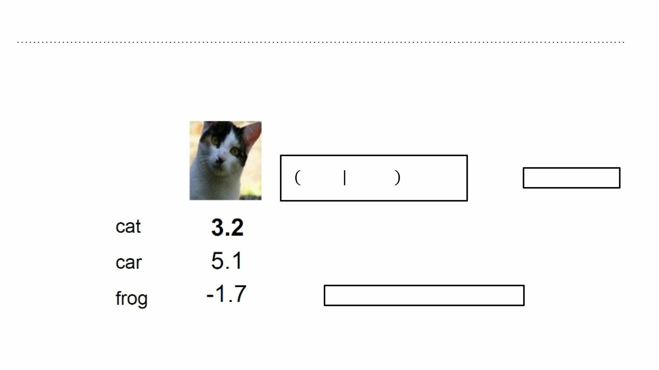
Softmax
Softmax Classifier (Multinomial Logistic Regression)
scores = unnormalized log probabilities of the classes.
ꢚ⁹
ꢖ ꢗ=ꢘꢙ=ꢋ, =
$
∑₆ꢚ⁹
where ꢕ = ꢇ(ꢋ,;ꢓ)
%
Want to maximize the log likelihood, or (for a loss
function) to minimize the negative log likelihood of
the correct class:
ꢒ =−logꢖ(ꢗ =ꢔ |ꢙ =ꢋ )
,
,
,

Slide 36
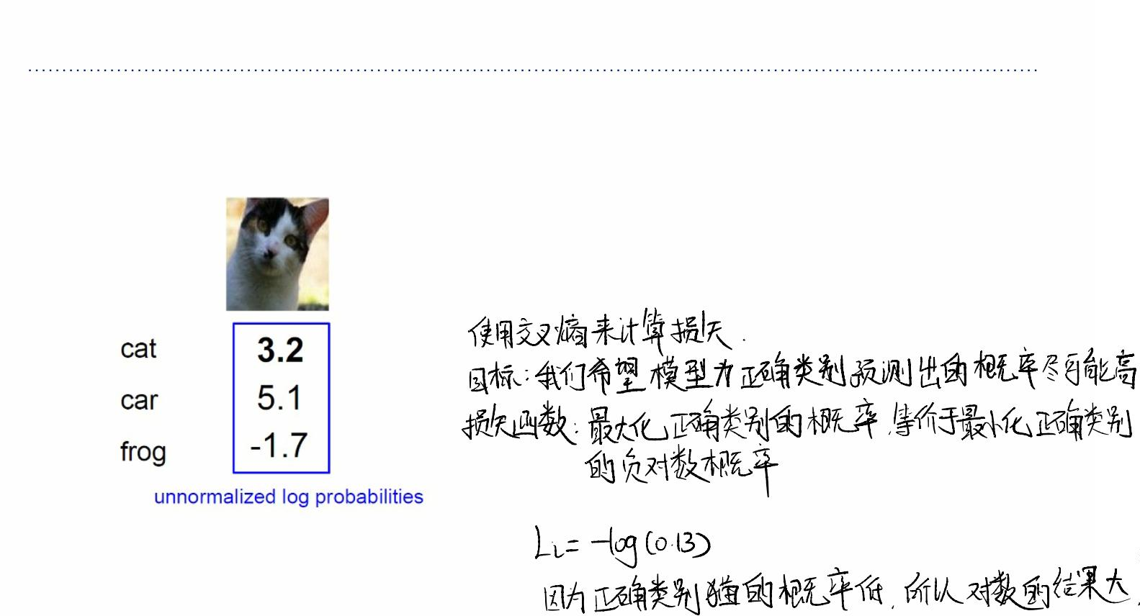



Softmax
Softmax Classifier (Multinomial Logistic Regression)
ꢚ
⁹ꢀ
"
ꢒ = −log( )
,
∑ ꢚ
9
%
6

Slide 37
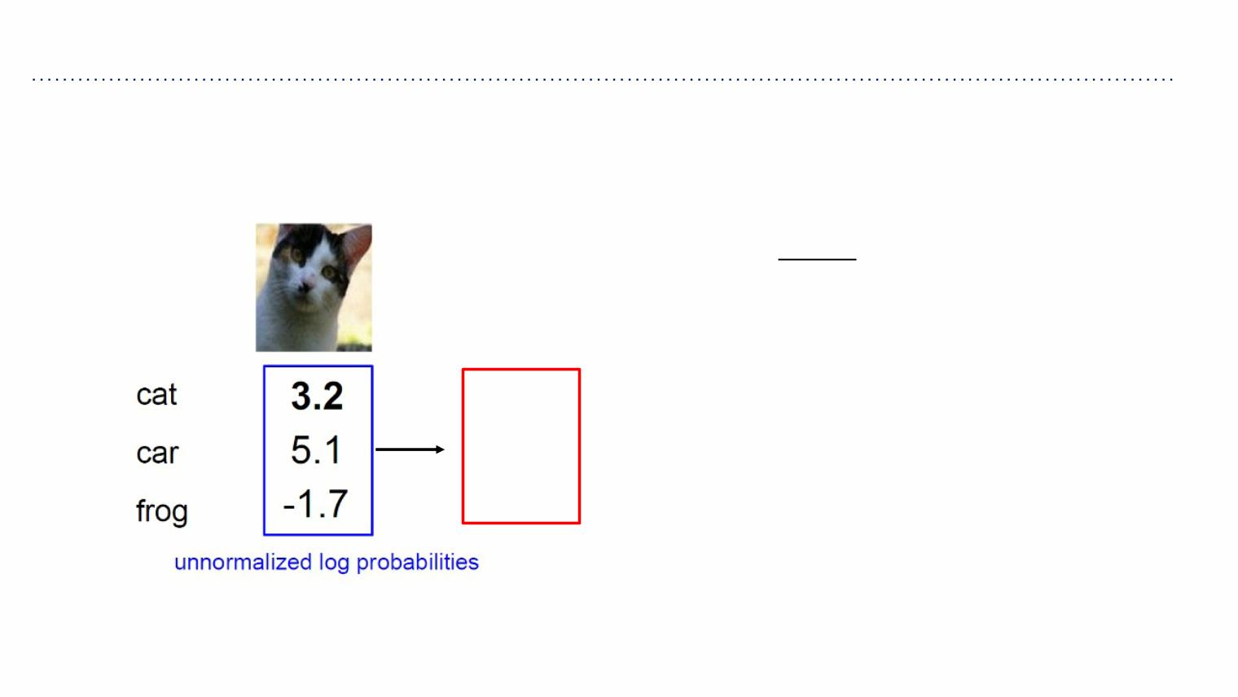
Softmax
Softmax Classifier (Multinomial Logistic Regression)
ꢚ
⁹ꢀ
"
ꢒ = −log( )
,
∑ ꢚ
9
%
6
unnormalized probabilities
24.5
exp
164.0
0.18

Slide 38
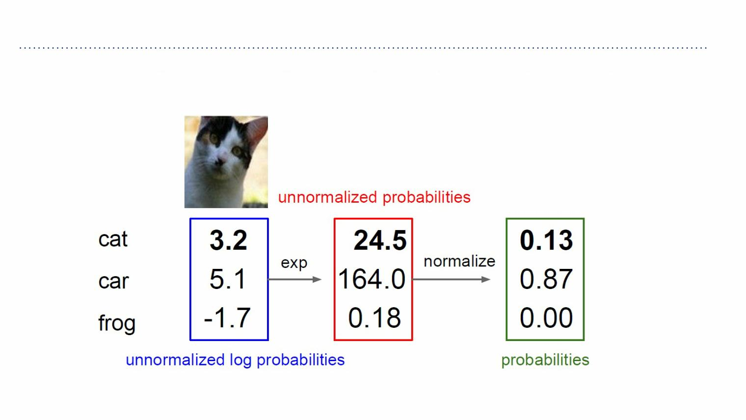
Softmax
Softmax Classifier (Multinomial Logistic Regression)
ꢒ = −log( )
ꢚ
⁹ꢀ
"
,
∑ ꢚ
9
%
6

Slide 39
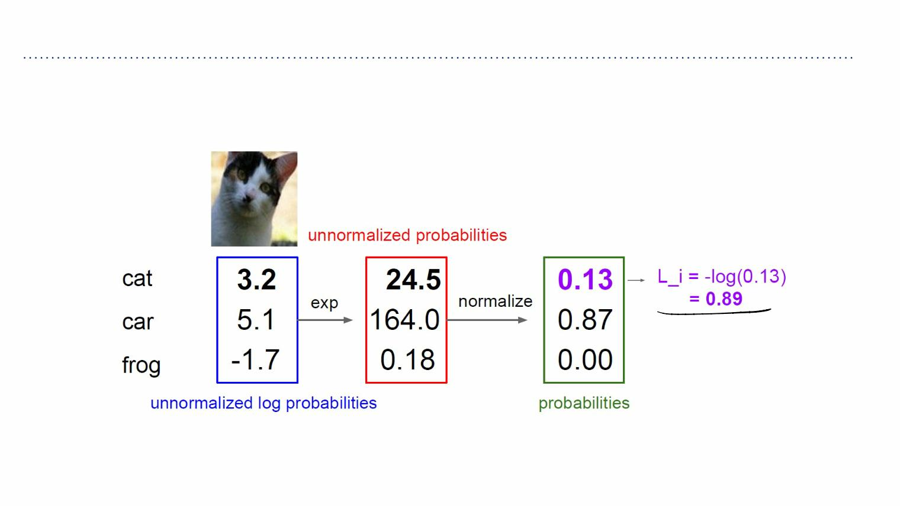
Softmax
Softmax Classifier (Multinomial Logistic Regression)
ꢒ = −log( )
ꢚ
⁹ꢀ
"
,
∑ ꢚ
9
%
6

Slide 40
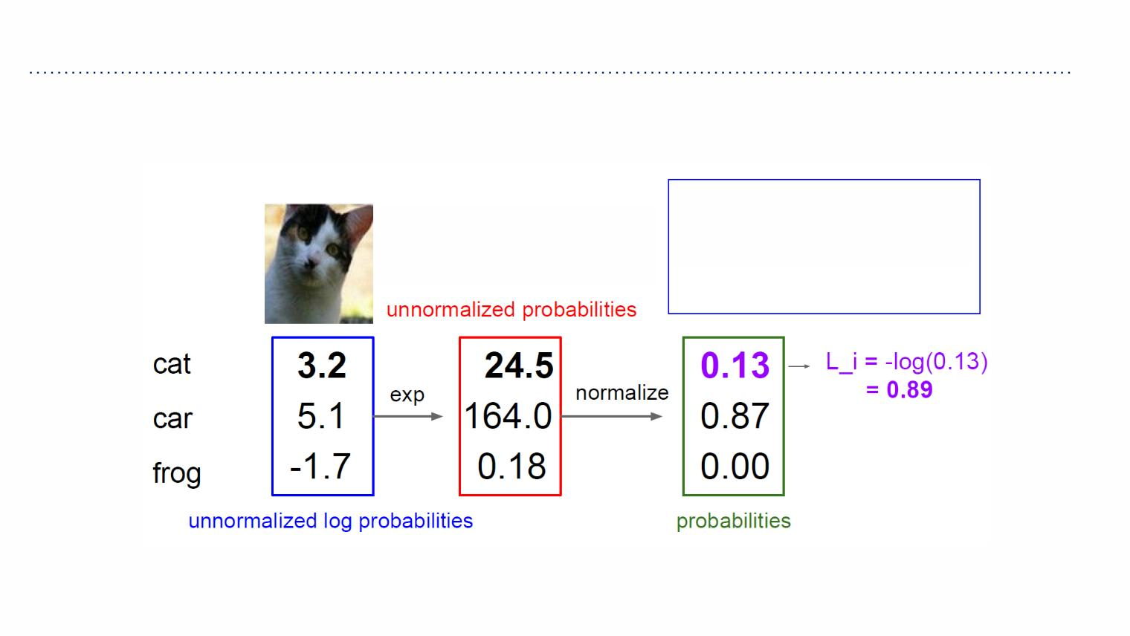
Softmax
Softmax Classifier (Multinomial Logistic Regression)
ꢚ
⁹ꢀ
Q: What is the min/max
possible loss L_i?
"
ꢒ = −log( )
,
∑ ꢚ
9
%
6

Slide 41
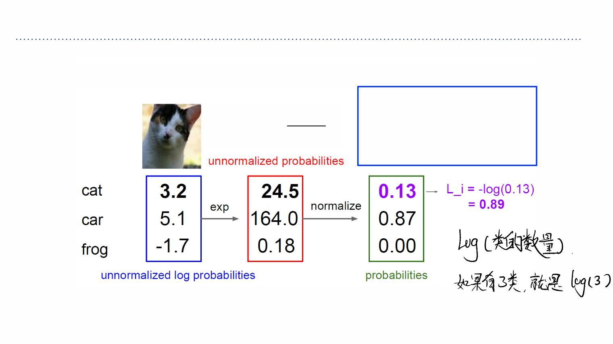
Softmax
Softmax Classifier (Multinomial Logistic Regression)
Q5: usually at initialization
ꢚ
⁹ꢀ
W are small numbers, so
all s ~= 0. What is the loss?
"
ꢒ = −log( )
,
∑ ꢚ
9
%
6

Slide 42
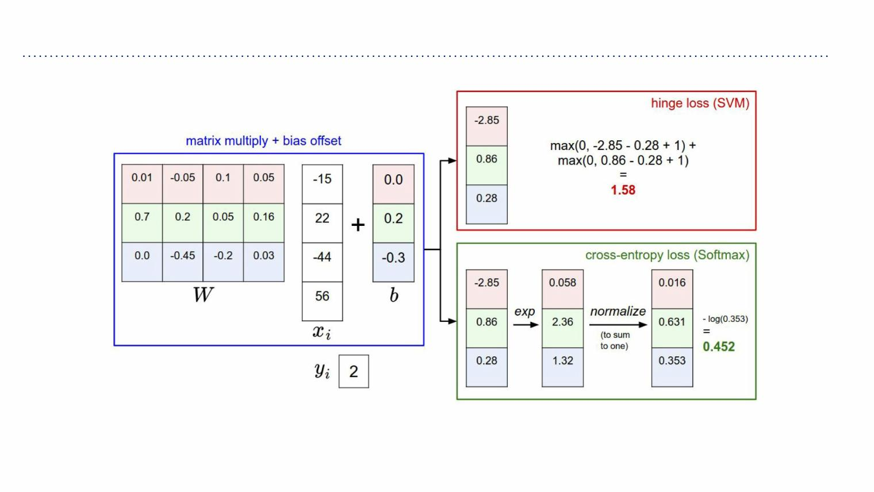
SVM & Softmax

Slide 43
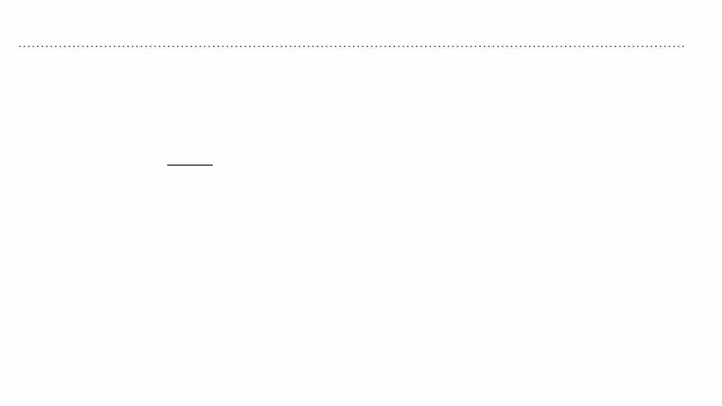
SVM & Softmax
Softmax vs. SVM
ꢚ
⁹ꢀ
"
ꢒ = −log( )
ꢊ =5 max(0, ꢇ −ꢇ +1)
!
,
9
# ꢀ!
∑ ꢚ
%
#$ꢀ
6
!

Slide 44
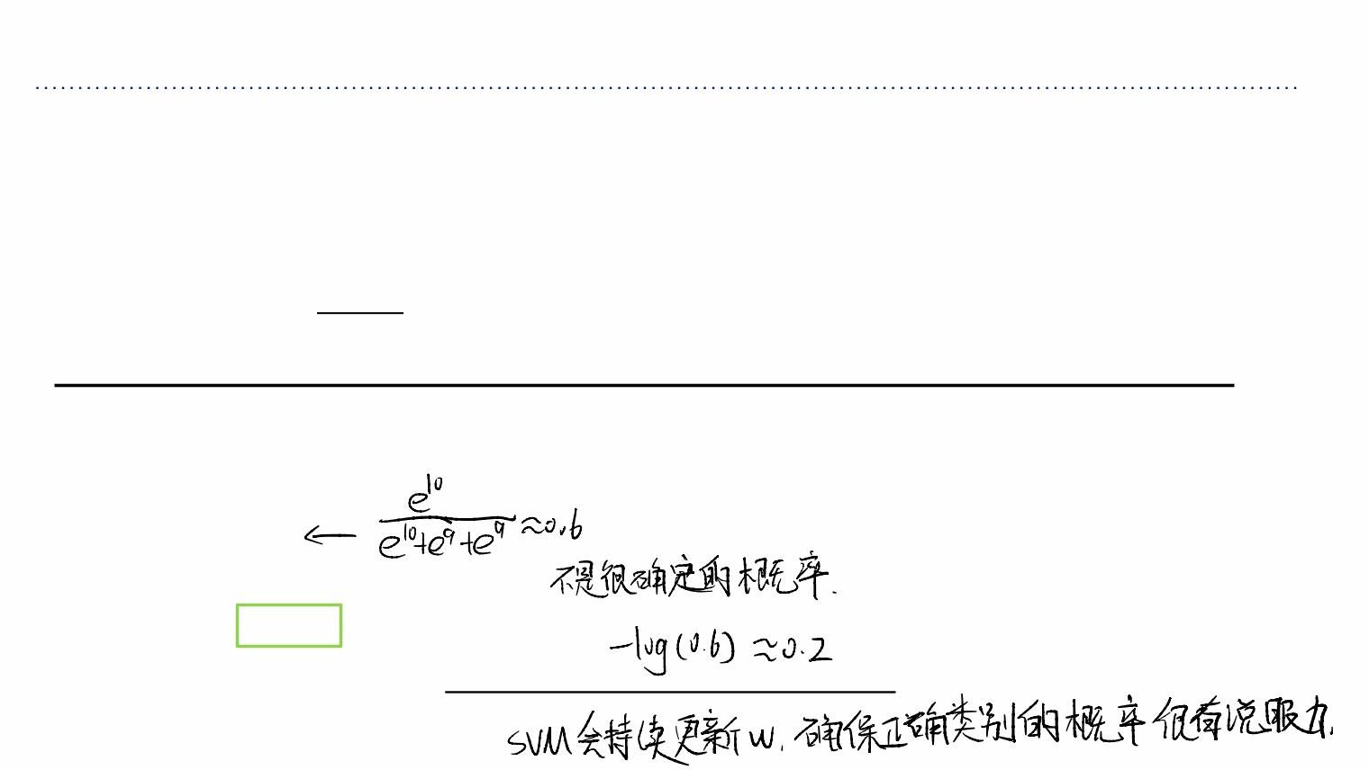
SVM & Softmax
Softmax vs. SVM
ꢚ
⁹ꢀ
"
ꢒ = −log( )
ꢊ =5 max(0, ꢇ −ꢇ +1)
!
,
9
# ꢀ!
∑ ꢚ
%
#$ꢀ
6
!
assume scores:
[10, -2, 3]
[10, 9, 9]
Q: suppose I take a datapoint and I jiggle a bit
(changing its score slightly). What happens to
the loss in both cases?
[10, -100, -100]
and ꢄ, =0

