Slide 1

INT305 Machine Learning
Lecture 5
Neural Network and Back Propagation
Sichen Liu
Department Intelligence Science
Sichen.Liu@xjtlu.edu.cn

Slide 2

Neural network
Neural Network: without the brain stuff
(Before) Linear score function: ꢀ=ꢁꢂ

Slide 3

Neural network
Neural Network: without the brain stuff
(Before) Linear score function: ꢀ=ꢁꢂ
ꢀ = ꢁ max(0,ꢁ ꢂ)
(Now) 2-layer Neural Network:
!
"

Slide 4


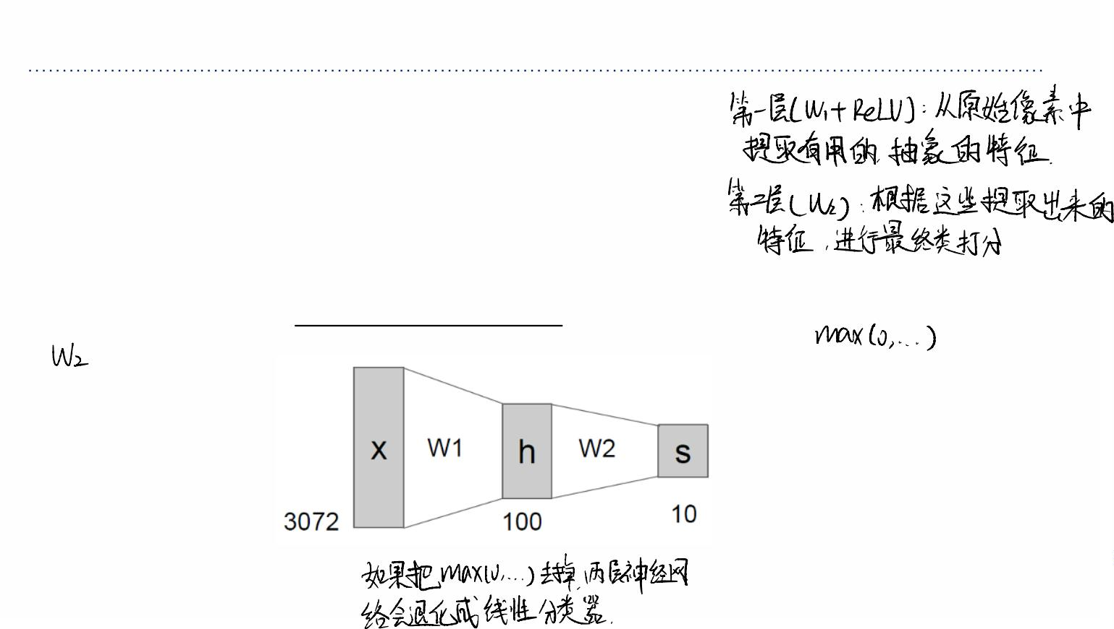
第⼀步：
第⼀部分和先前的线性函数⼀模⼀样！这⾥的 W₁是第⼀个权重矩阵。它把
输⼊的 x (3072 个像素值) 转换成⼀个中间结果。根据图示，这个中间结果是
⼀个有 100 个数值的向量 h。我们可以把这 100 个数值看作是⽹络从原始像
素中学到的“特征”或者“模式”。它们不再是原始的像素了，⽽是更⾼层次的组
合，⽐如“可能存在曲线的边缘”、“可能有⼀块蓝⾊的区域”等等。
Neural network
Neural Network: without the brain stuff
(Before) Linear score function:^{ꢀ=ꢁꢂ}
(Now) 2-layer Neural Network:ꢀ = ꢁ max(0,ꢁ ꢂ)
!
"
第⼆步：
第三步：
这是它与线性函数最根本的区别！这个函数叫做
激活函数 (Activation Function)，⽽ max(0, z) 是
其中最常⽤的⼀种，它的名字叫 ReLU (Rectiﬁed
Linear Unit)，中⽂叫“修正线性单元”。
它的⼯作原理超级简单：如果⼀个数是正数，就
保持不变；如果⼀个数是负数，就把它变成 0。
这是为了引⼊⾮线性 (non-linearity)。这就好⽐我
们给了模型⼀个“开关”，让它能够学会更复杂
的、弯弯曲曲的决策边界。没有这个激活函数，
⽆论我们叠加多少层线性函数，最终结果都等价
于⼀个线性函数，就像把⼏个直尺⾸尾相连，得
到的还是⼀根更⻓的直尺。但有了 ReLU 这个“关
节”，我们就可以把直尺折叠，去拟合更复杂的形
状！
经过 ReLU 激活函数处理后，我们
得到了⼀个包含了⾮负特征的向量
h。
现在，我们再⽤第⼆个权重矩阵 W₂
对这个特征向量 h（100个值）进⾏
⼀次线性变换，最终得到 10 个类别
的分数 s。
这⼀步就相当于，模型根据前⾯学
到的“曲线边缘”、“蓝⾊区域”等特
征，来做最终的判断：“嗯，根据这
些特征来看，这张图有 90% 的可能
是猫，10% 的可能是狗。”

Slide 5

最内层：max(0, W₁x)
和之前⼀样，这是我们的第⼀个隐藏层。它接收原始的图⽚像素 x，通过 W₁ 计算，再
Neural network 经过 ReLU 激活，输出了第⼀组⽐较初级的特征（⽐如⼀些边缘、颜⾊块等）。
Neural Network: without the brain stuff
(Before) Linear score function:
ꢀ=ꢁꢂ
(Now) 2-layer Neural Network:
ꢀ = ꢁ max(0,ꢁ ꢂ)
!
"
or 3-layer Neural Network:
ꢀ = ꢁ max(0,ꢁ max(0,ꢁ ꢂ))
#
!
"
中间层：max(0, W₂...)
最外层：W₃(...)
现在是关键的⼀步！它不再直接把这些初级特征⽤
于最终分类，⽽是把它们作为输⼊，再进⾏⼀次相
同的操作：乘以第⼆个权重矩阵 W₂，然后再次通过
ReLU 激活函数。
这是我们的输出层。它接收第⼆个隐藏层输出
的那些复杂的组合特征，然后乘以 W₃，最终
计算出每个类别的最终分数 f。
这⼀层就是第⼆个隐藏层。它的作⽤是把第⼀层学
到的简单特征（边缘、⾊块）进⾏组合，从⽽学习
到更复杂、更有意义的特征（⽐如“眼睛的轮廓”、
“⻦的喙”）。
每增加⼀个“隐藏层”，⽹络就获得了从上⼀层特征中学习更⾼级、
更抽象特征的能⼒。这就是“深度学习”中“深度 (Deep)”的来源——
我们通过堆叠更多的层来构建⼀个更深的⽹络

Slide 6
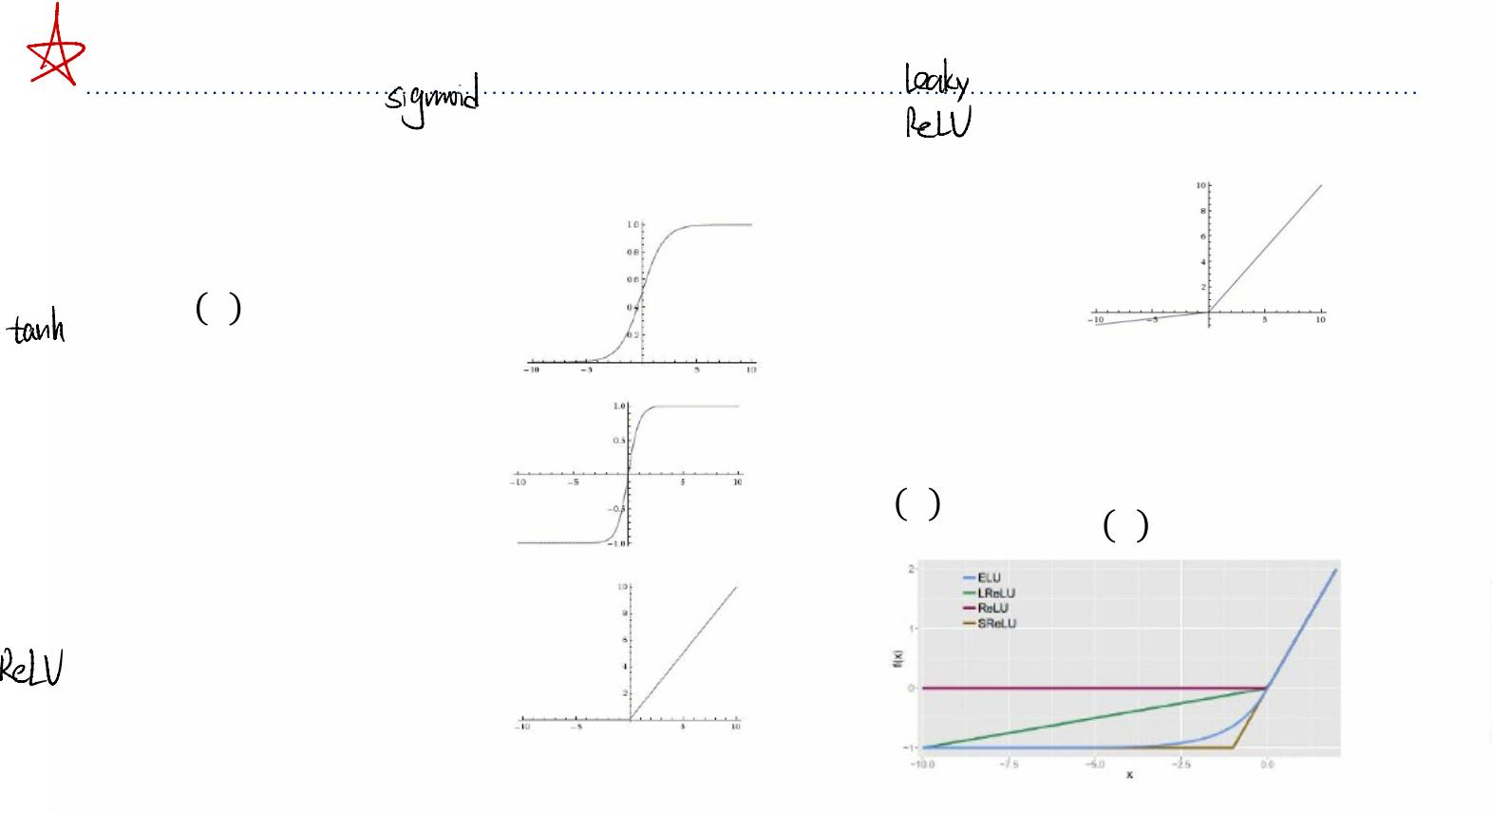
可以把激活函数想象成每个神经元的“性格开关”或者“决策模型”。
它决定了接收到信号后，这个神经元应该被“激活”到什么程度，以
及应该向下⼀层传递什么样的信息。它的核⼼使命，我们再强调⼀
遍，就是引⼊⾮线性，让⽹络能够学习复杂的数据模式。
Activation functions
它能把任何输⼊的数值都“压缩”
到 0 和 1 之间。这⾮常有⽤，⽐
Activation Functions ^{如在需要输出⼀个概率值（概率}
当输⼊是负数时，它不再输出 0，⽽是输出⼀个很
⼩的值（⽐如 0.1x）。这就好⽐给“死掉”的神经元
做了⼀点⼼肺复苏，让它还有机会被重新激活。
总是在0到1之间）的场景下。
Sigmoid
Leaky ReLU
_{ꢃ ꢂ = 1⁄(1+ꢄ}$%₎
max(0.1ꢂ, ꢂ)
和 Sigmoid 很像，但它把数值“压缩”到 -1 和
1 之间。它的输出是以 0 为中⼼的，这⼀点⽐
Sigmoid 更好，通常能让模型收敛得更快。
⊺
⊺
Maxout
max(ꢅ ꢂ+ꢆ ,ꢅ ꢂ+ꢆ )
"
" !
!
tanh
tanh(ꢂ)
ELU
ꢂ ꢇꢀꢂ>0
ꢈ(exp ꢂ −1) ꢇꢀꢂ≤0
ꢀ ꢂ =7
ReLU
max(0, ꢂ)
计算超级快，⽽且在正数区域不会有
梯度消失的问题，所以学习得很快。
有个叫“Dying ReLU”的问题。如果
⼀个神经元的输⼊总是负数，它就会
⼀直输出 0，梯度也永远是 0，这个
神经元就再也⽆法学习了
Maxout 这是⼀个更⼴义的激活函
数，它本身是可以学习的。可以看作
是 ReLU 和 Leaky ReLU 的泛化版
本，效果很好，但计算开销和参数数
量也更⼤了。
ELU 是 Leaky ReLU 的⼀个更平
滑的升级版，既解决了“Dying
ReLU”问题，⼜具有接近 0 均值
的输出。但计算会⽐ ReLU 复杂
⼀点。

Slide 7
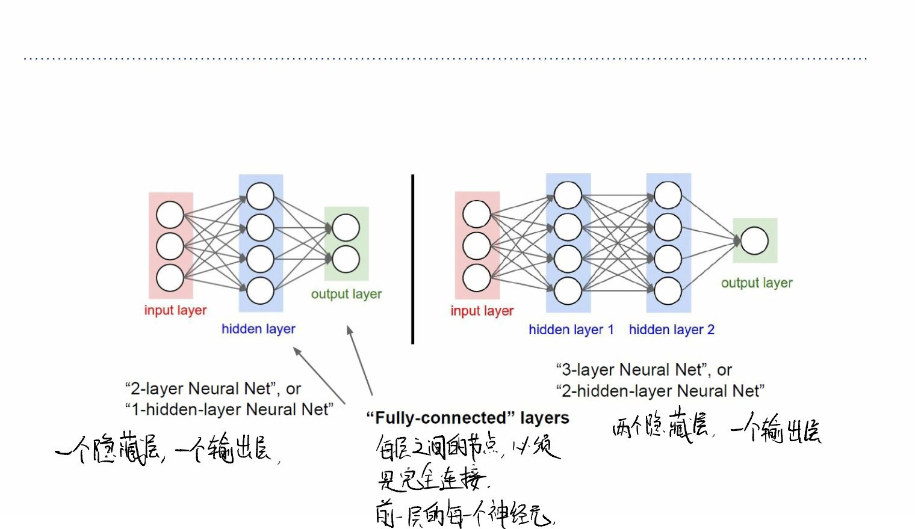





Neural network
Neural Networks: Architectures

Slide 8
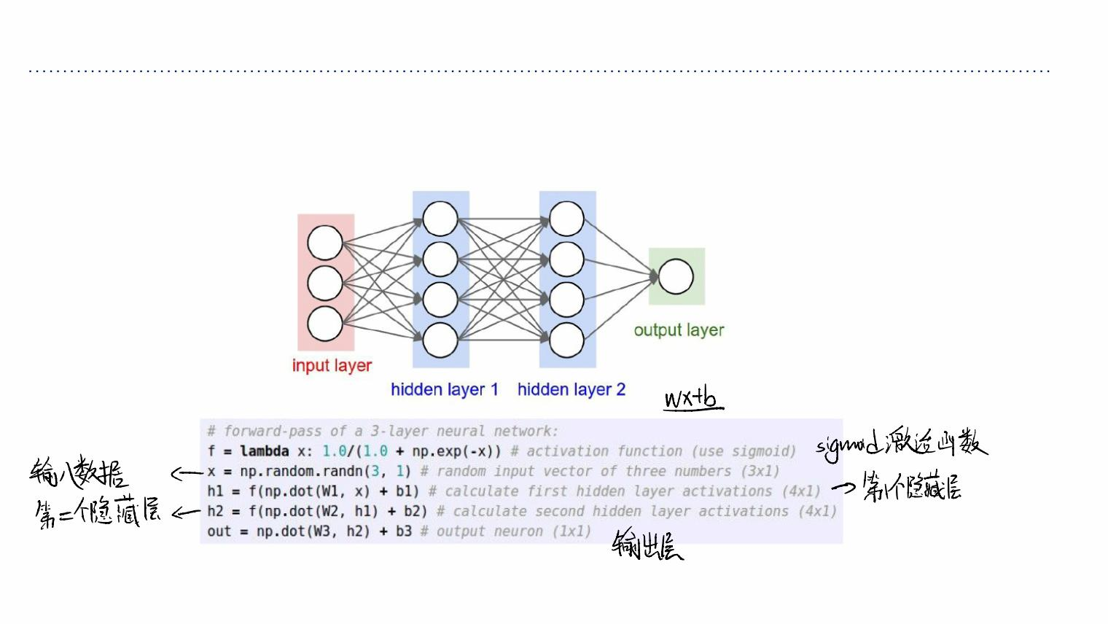
Neural network
Example Feed-forward computation of a Neural Network

Slide 9
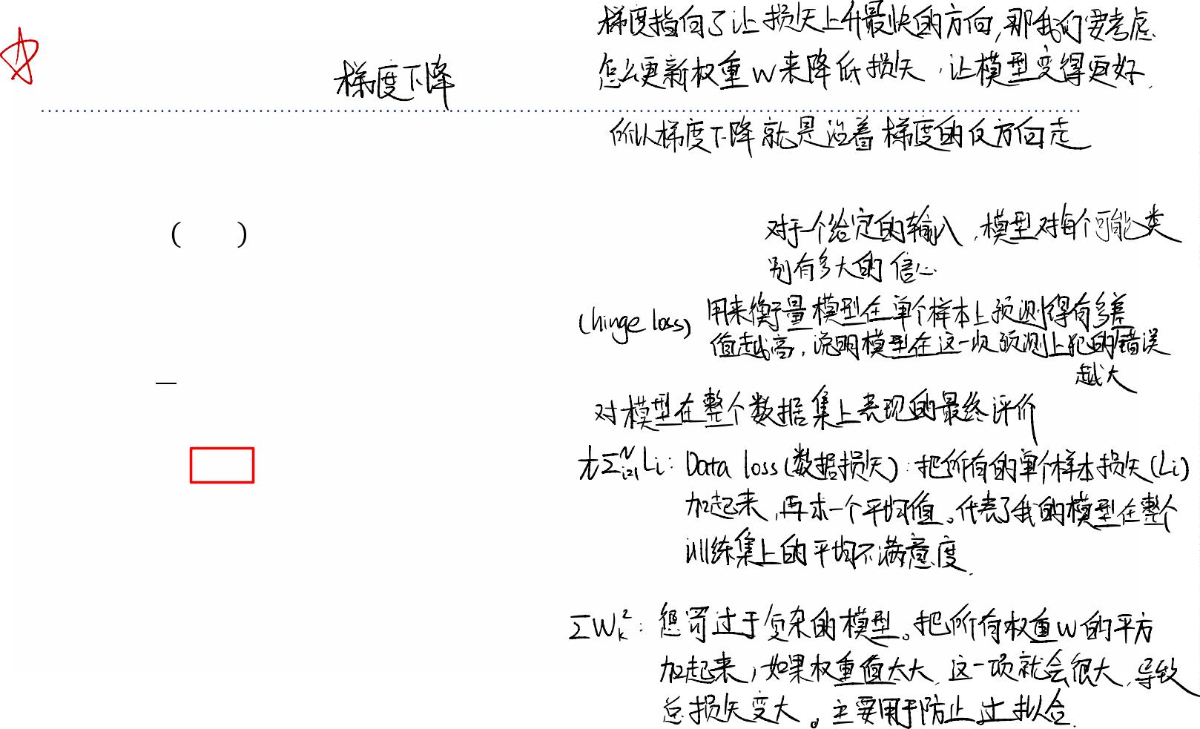
Gradient Descent
Where we are…
ꢉ=ꢀ ꢂ;ꢁ =ꢁꢂ
scores function
SVM loss
ꢊ =B max(0, ꢉ −ꢉ +1)
'
()*
( *
!
!
1 ,
!
data loss + regularization
ꢊ= B ꢊ +B ꢁ
ꢋ
'+"
'
-
-
want ∇.ꢊ

Slide 10
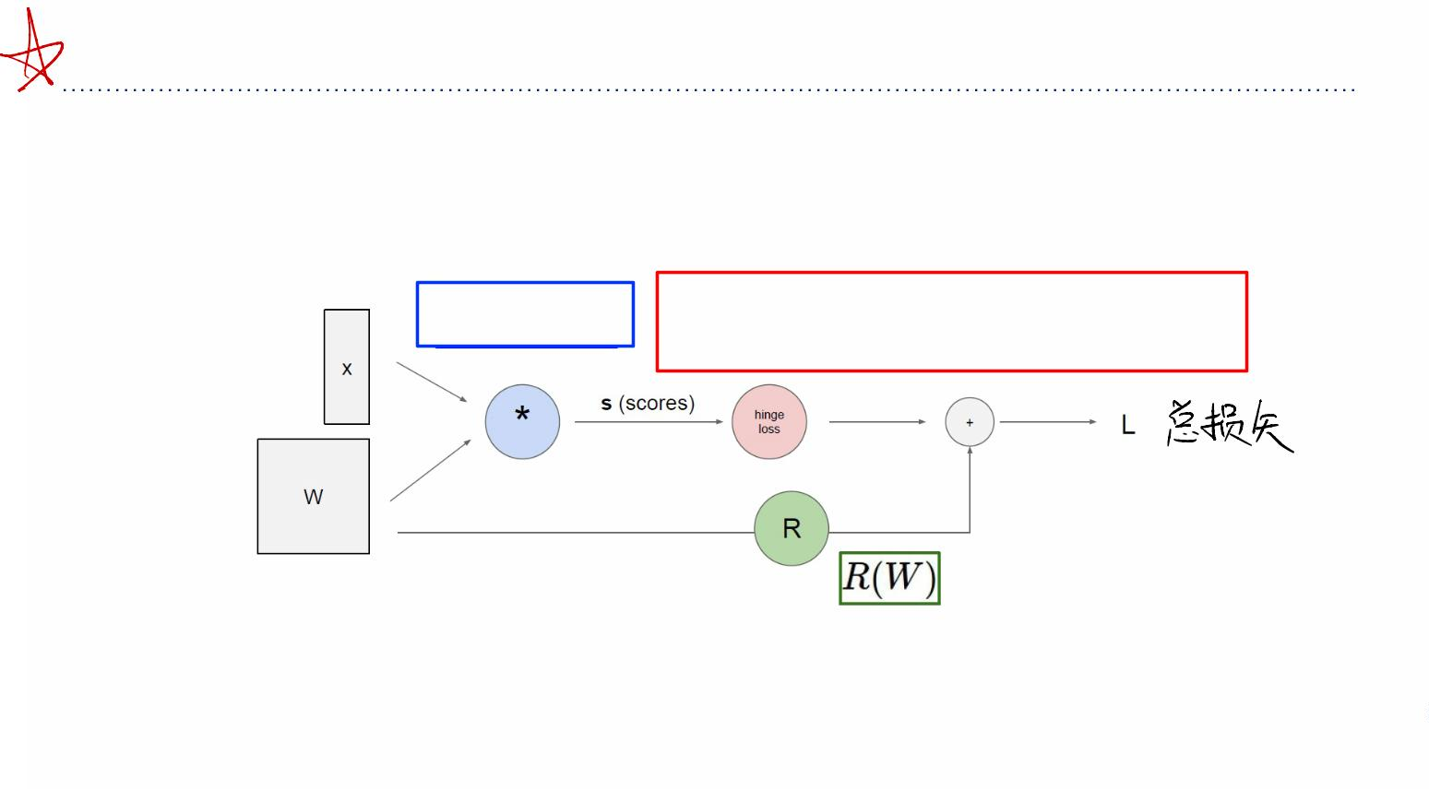
Computational Graph
Computational Graph
ꢀ=ꢁꢂ
ꢀ =# max(0, ꢁ −ꢁ +1)
!
" $
!
"#$!

Slide 11
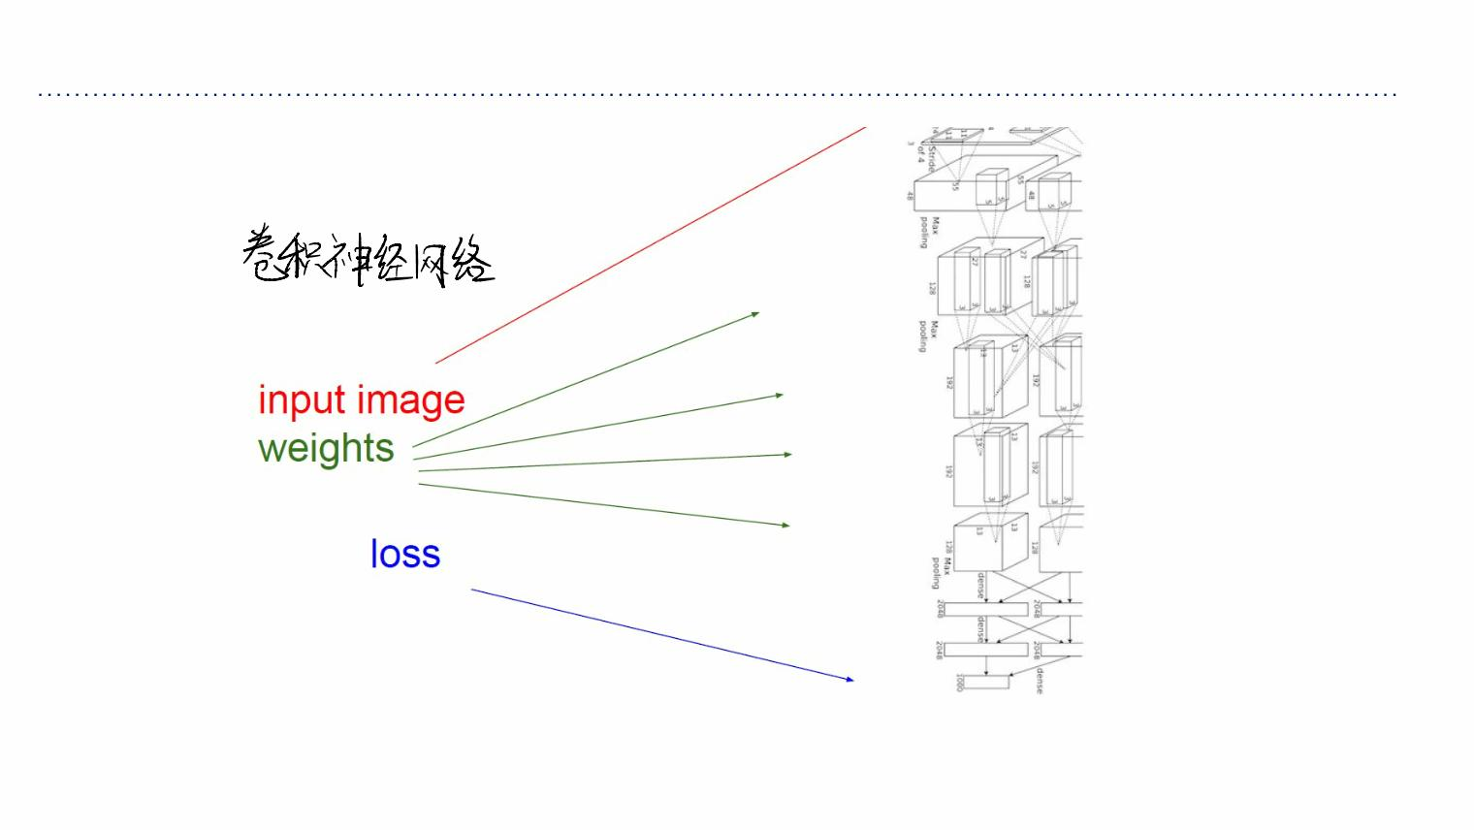
Computational Graph
Convolutional Network
(AlexNet)

Slide 12
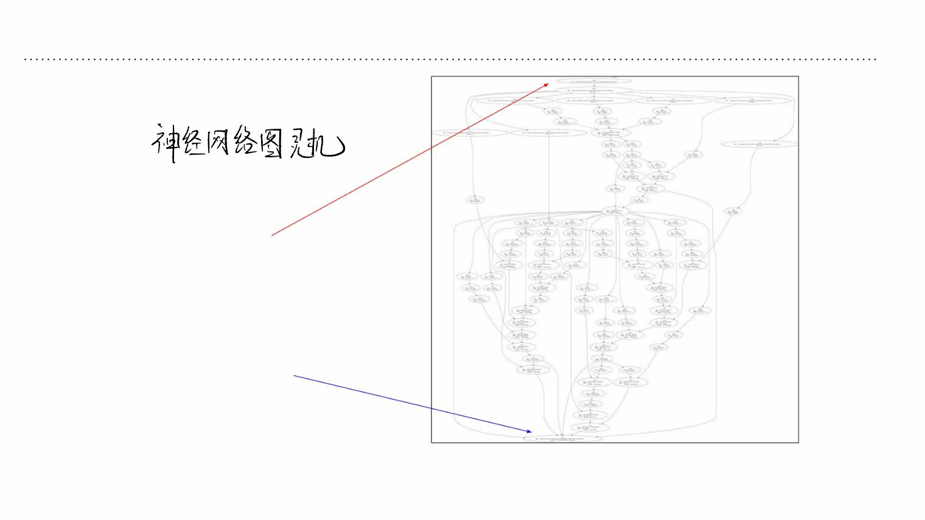
Computational Graph
Neural Turing Machine
input tape
loss

Slide 13
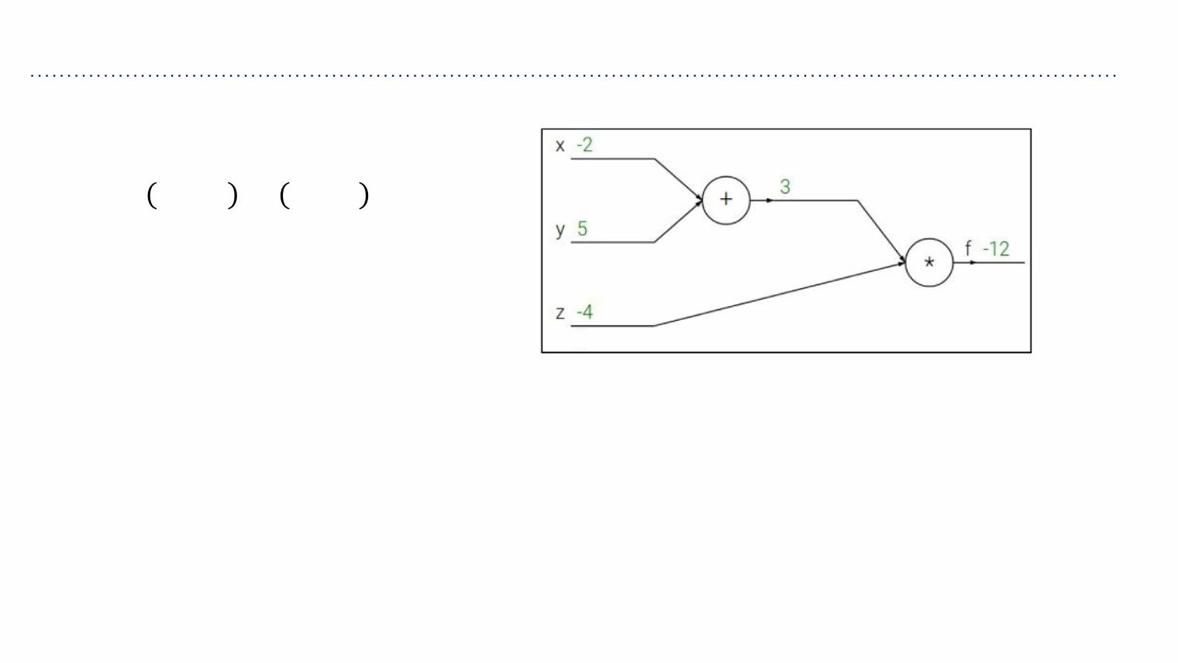
Example 1
ꢀ ꢂ,ꢌ,ꢍ = ꢂ+ꢌ ꢍ
e.g. x = -2, y = 5, z = -4

Slide 14
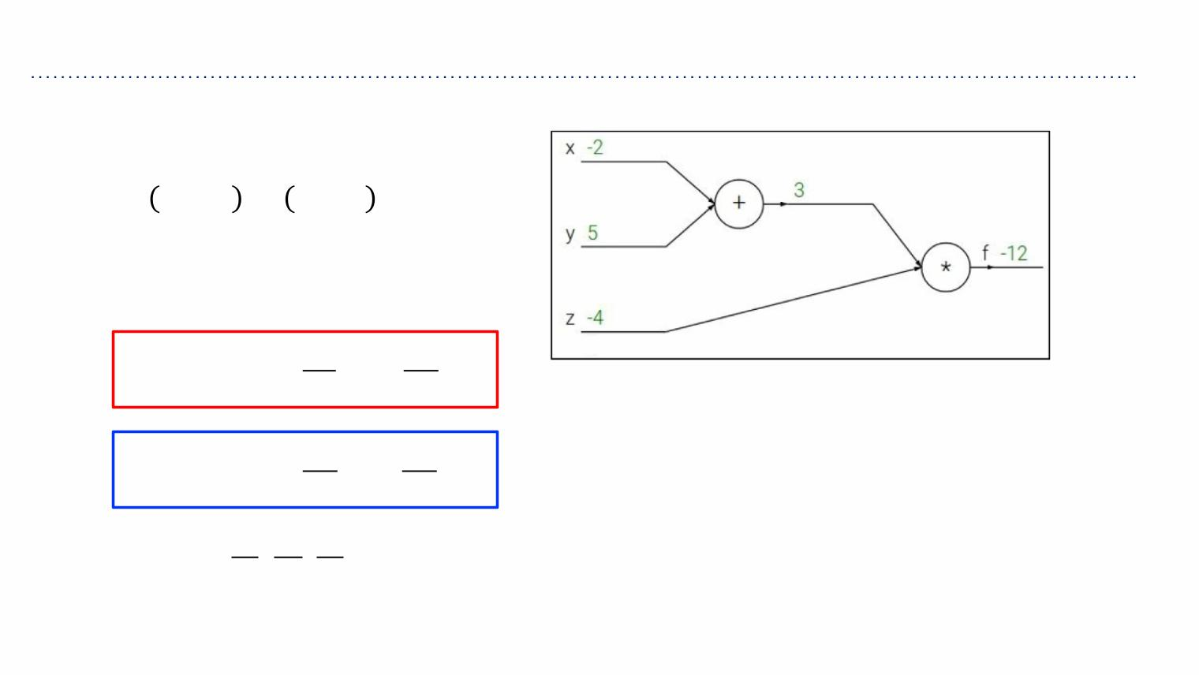
Example 1
ꢀ ꢂ,ꢌ,ꢍ = ꢂ+ꢌ ꢍ
e.g. x = -2, y = 5, z = -4
ꢏꢎ ꢏꢎ
ꢎ =ꢂ+ꢌ =1, =1
ꢏꢂ ꢏꢌ
ꢏꢀ ꢏꢀ
ꢀ=ꢎꢍ
=ꢍ, =ꢎ
ꢏꢎ ꢏꢍ
/0 /0 /0
Want: , ,
/% /* /1

Slide 15
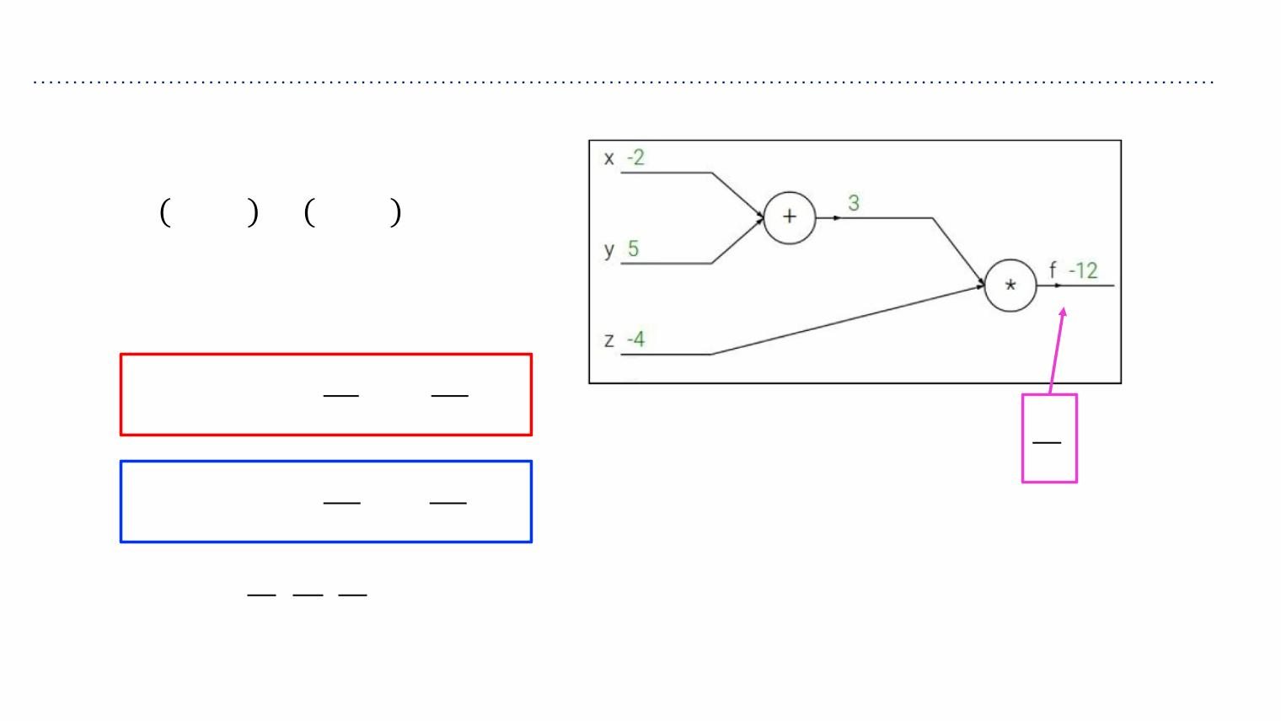
Example 1
ꢀ ꢂ,ꢌ,ꢍ = ꢂ+ꢌ ꢍ
e.g. x = -2, y = 5, z = -4
ꢏꢎ ꢏꢎ
ꢎ =ꢂ+ꢌ =1, =1
ꢏꢂ ꢏꢌ
/0
/0
ꢏꢀ ꢏꢀ
ꢀ=ꢎꢍ
=ꢍ, =ꢎ
ꢏꢎ ꢏꢍ
/0 /0 /0
Want: , ,
/% /* /1

Slide 16

Example 1
ꢀ ꢂ,ꢌ,ꢍ = ꢂ+ꢌ ꢍ
e.g. x = -2, y = 5, z = -4
ꢏꢎ ꢏꢎ
1
ꢎ =ꢂ+ꢌ =1, =1
ꢏꢂ ꢏꢌ
/0
/0
ꢏꢀ ꢏꢀ
ꢀ=ꢎꢍ
=ꢍ, =ꢎ
ꢏꢎ ꢏꢍ
/0 /0 /0
Want: , ,
/% /* /1

Slide 17
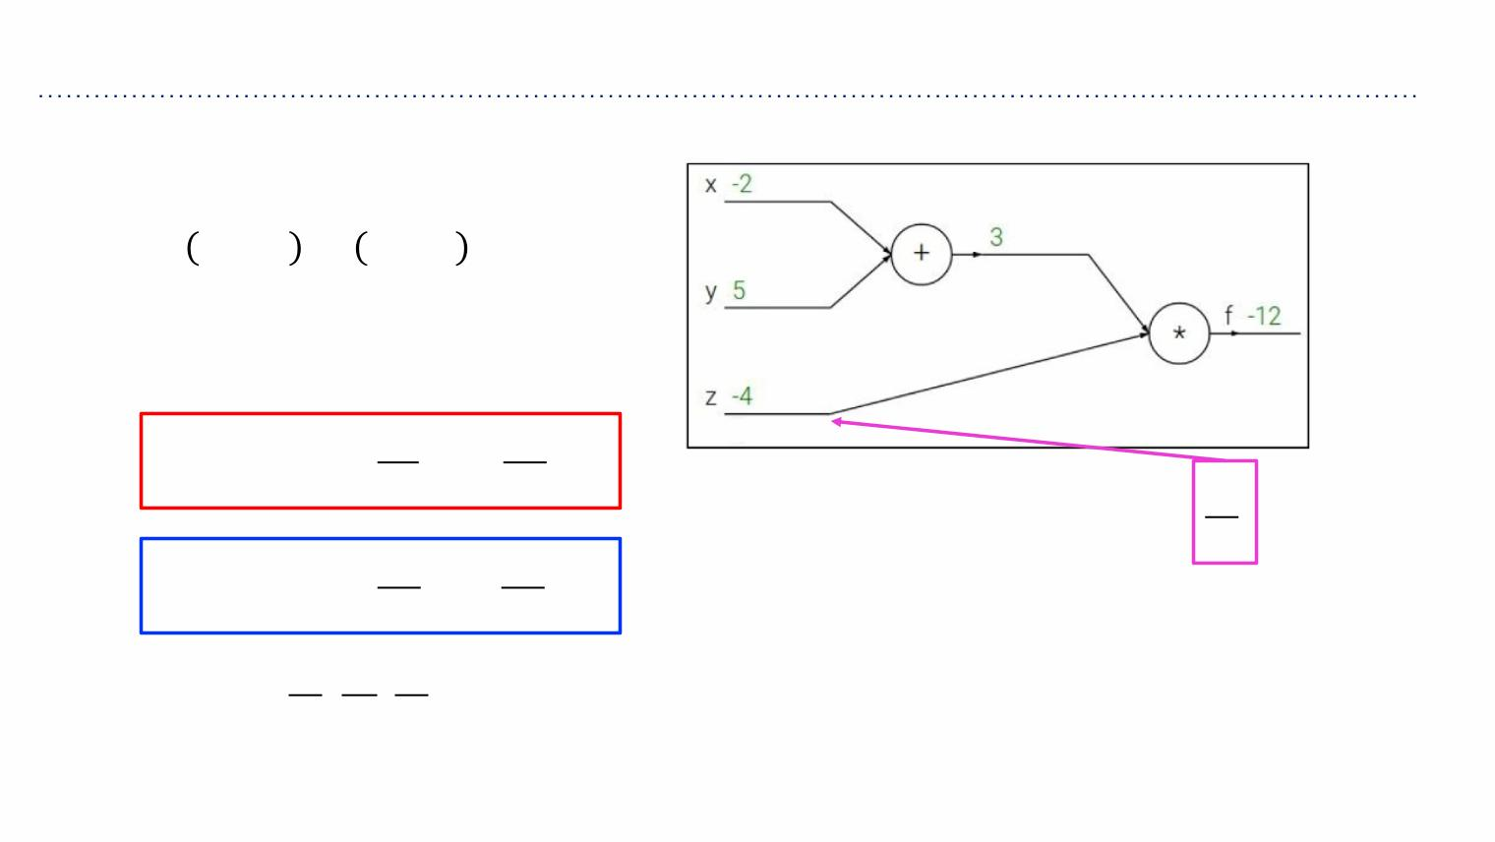
Example 1
ꢀ ꢂ,ꢌ,ꢍ = ꢂ+ꢌ ꢍ
e.g. x = -2, y = 5, z = -4
ꢏꢎ ꢏꢎ
1
ꢎ =ꢂ+ꢌ =1, =1
ꢏꢂ ꢏꢌ
/0
/1
ꢏꢀ ꢏꢀ
ꢀ=ꢎꢍ
=ꢍ, =ꢎ
ꢏꢎ ꢏꢍ
/0 /0 /0
Want: , ,
/% /* /1

Slide 18
Example 1
ꢀ ꢂ,ꢌ,ꢍ = ꢂ+ꢌ ꢍ
e.g. x = -2, y = 5, z = -4
ꢏꢎ ꢏꢎ
1
3
ꢎ =ꢂ+ꢌ =1, =1
ꢏꢂ ꢏꢌ
/0
/1
ꢏꢀ ꢏꢀ
ꢀ=ꢎꢍ
=ꢍ, =ꢎ
ꢏꢎ ꢏꢍ
/0 /0 /0
Want: , ,
/% /* /1

Slide 19
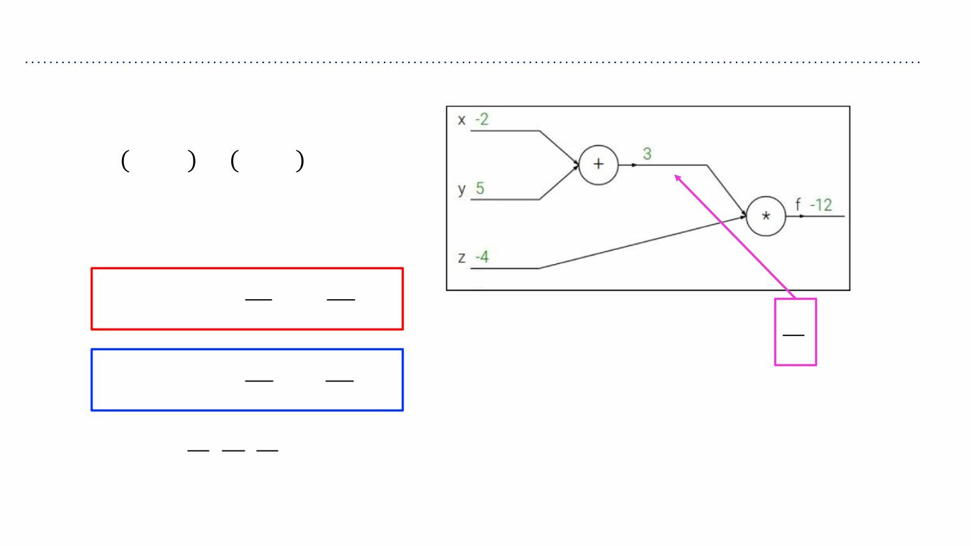
Example 1
ꢀ ꢂ,ꢌ,ꢍ = ꢂ+ꢌ ꢍ
e.g. x = -2, y = 5, z = -4
ꢏꢎ ꢏꢎ
1
3
ꢎ =ꢂ+ꢌ =1, =1
ꢏꢂ ꢏꢌ
/0
/2
ꢏꢀ ꢏꢀ
ꢀ=ꢎꢍ
=ꢍ, =ꢎ
ꢏꢎ ꢏꢍ
/0 /0 /0
Want: , ,
/% /* /1

Slide 20
Example 1
ꢀ ꢂ,ꢌ,ꢍ = ꢂ+ꢌ ꢍ
e.g. x = -2, y = 5, z = -4
ꢏꢎ ꢏꢎ
-4
1
3
ꢎ =ꢂ+ꢌ =1, =1
ꢏꢂ ꢏꢌ
/0
/2
ꢏꢀ ꢏꢀ
ꢀ=ꢎꢍ
=ꢍ, =ꢎ
ꢏꢎ ꢏꢍ
/0 /0 /0
Want: , ,
/% /* /1

Slide 21
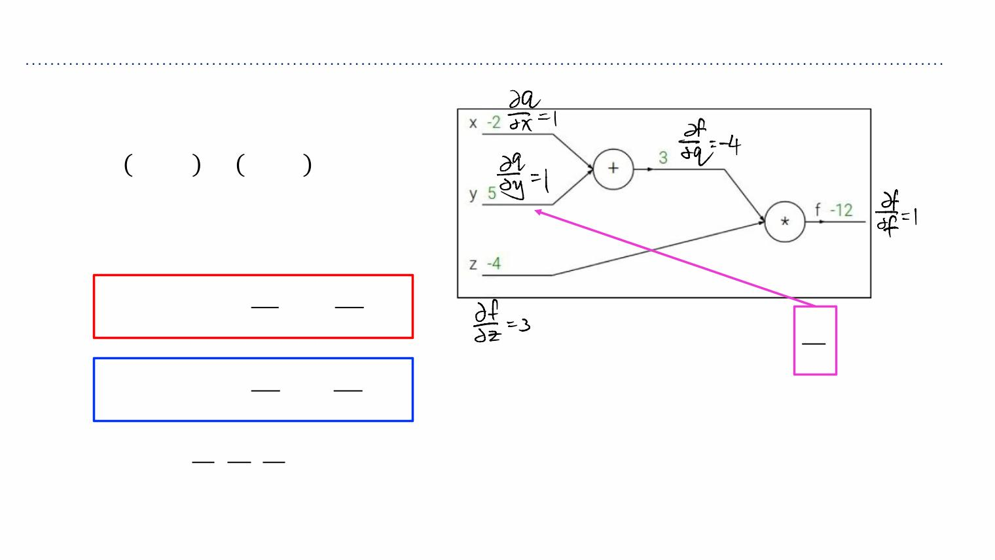
Example 1
ꢀ ꢂ,ꢌ,ꢍ = ꢂ+ꢌ ꢍ
e.g. x = -2, y = 5, z = -4
ꢏꢎ ꢏꢎ
-4
1
3
ꢎ =ꢂ+ꢌ =1, =1
ꢏꢂ ꢏꢌ
/0
/*
ꢏꢀ ꢏꢀ
ꢀ=ꢎꢍ
=ꢍ, =ꢎ
ꢏꢎ ꢏꢍ
/0 /0 /0
Want: , ,
/% /* /1

Slide 22
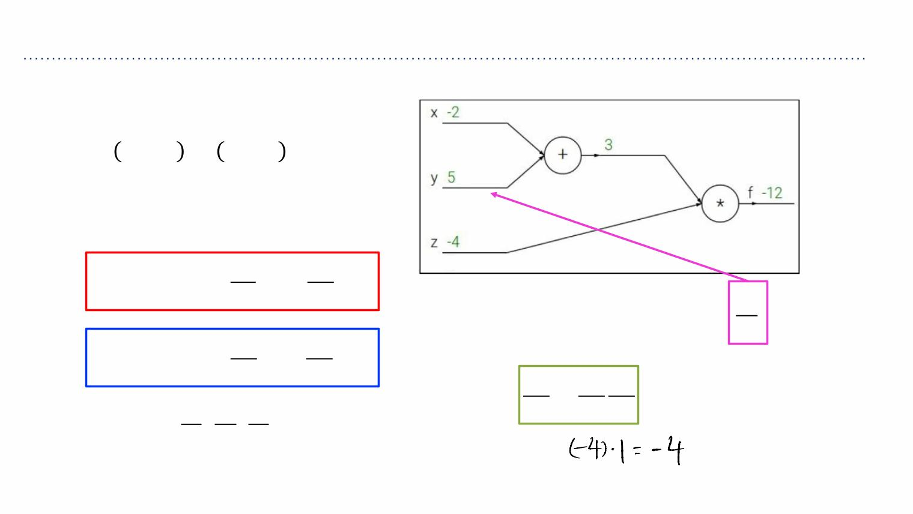
Example 1
ꢀ ꢂ,ꢌ,ꢍ = ꢂ+ꢌ ꢍ
-4
e.g. x = -2, y = 5, z = -4
-4
1
ꢏꢎ ꢏꢎ
3
ꢎ =ꢂ+ꢌ =1, =1
ꢏꢂ ꢏꢌ
/0
/*
ꢏꢀ ꢏꢀ
Chain rule:
ꢀ=ꢎꢍ
=ꢍ, =ꢎ
ꢏꢎ ꢏꢍ
ꢏꢀ ꢏꢀ ꢏꢎ
=
/0 /0 /0
ꢏꢌ ꢏꢎ ꢏꢌ
Want: , ,
/% /* /1

Slide 23
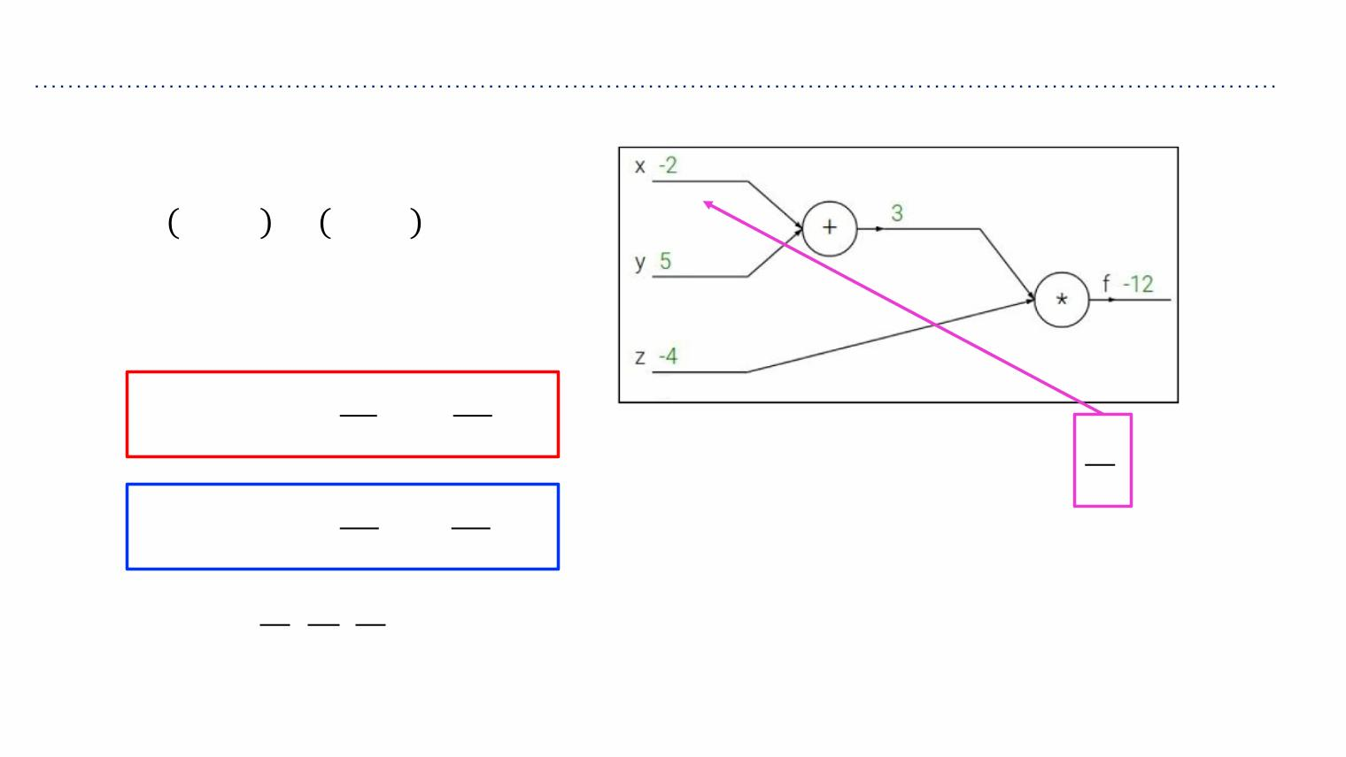
Example 1
ꢀ ꢂ,ꢌ,ꢍ = ꢂ+ꢌ ꢍ
e.g. x = -2, y = 5, z = -4
ꢏꢎ ꢏꢎ
-4
-4
1
3
ꢎ =ꢂ+ꢌ =1, =1
ꢏꢂ ꢏꢌ
/0
/%
ꢏꢀ ꢏꢀ
ꢀ=ꢎꢍ
=ꢍ, =ꢎ
ꢏꢎ ꢏꢍ
/0 /0 /0
Want: , ,
/% /* /1

Slide 24
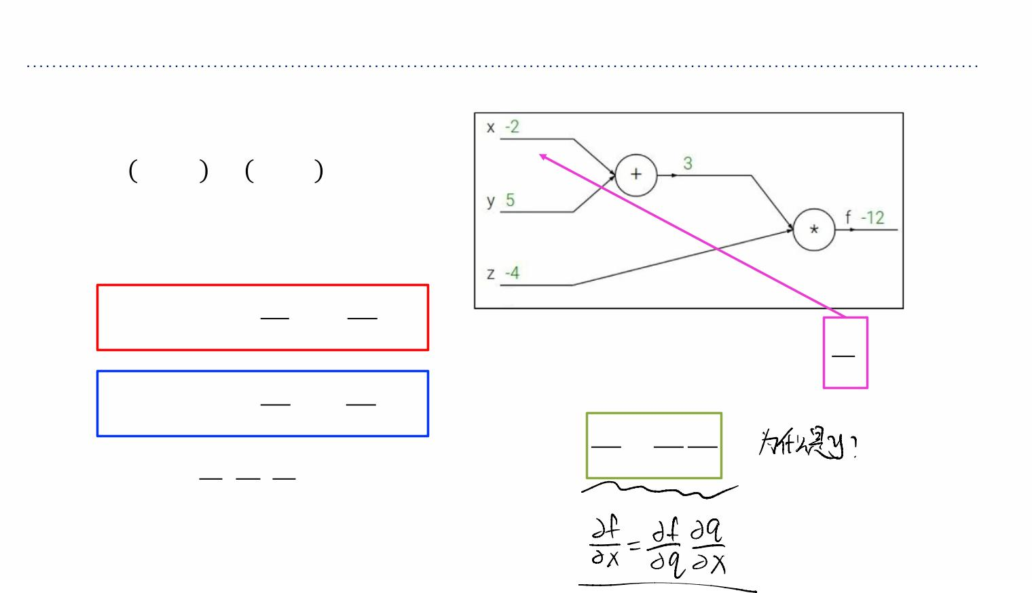
Example 1
ꢀ ꢂ,ꢌ,ꢍ = ꢂ+ꢌ ꢍ
e.g. x = -2, y = 5, z = -4
ꢏꢎ ꢏꢎ
-4
-4
-4
1
3
ꢎ =ꢂ+ꢌ =1, =1
ꢏꢂ ꢏꢌ
/0
/%
ꢏꢀ ꢏꢀ
Chain rule:
ꢏꢀ ꢏꢀ ꢏꢎ
ꢀ=ꢎꢍ
=ꢍ, =ꢎ
ꢏꢎ ꢏꢍ
=
/0 /0 /0
ꢏꢌ ꢏꢎ ꢏꢌ
Want: , ,
/% /* /1

Slide 25
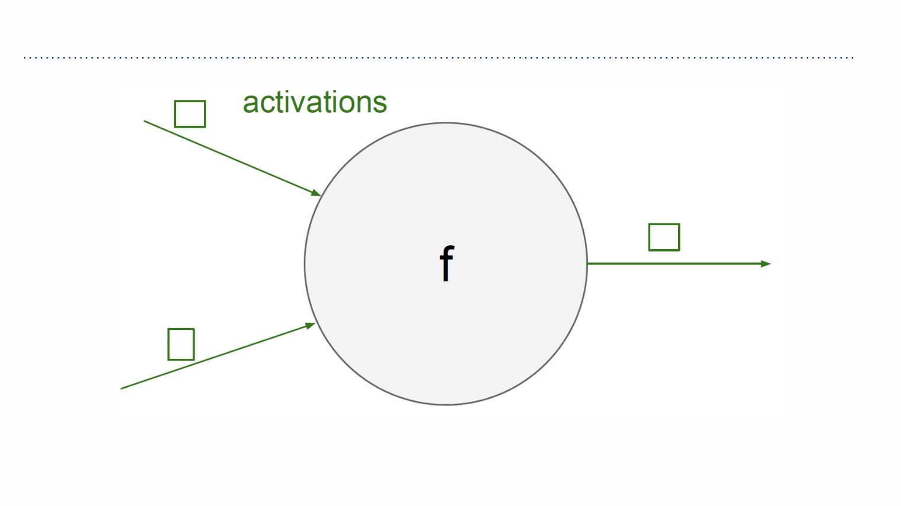
Chain rule
ꢁ
ꢀ
ꢌ

Slide 26
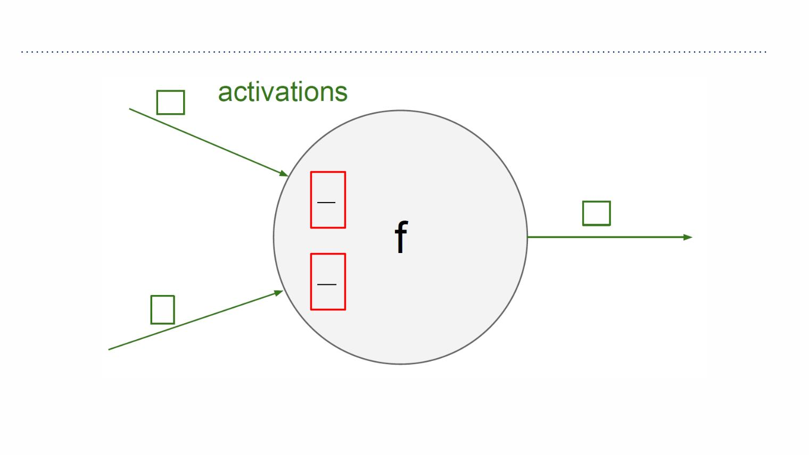
Chain rule
ꢁ
“local gradient”
/1
/%
ꢀ
/1
/*
ꢌ

Slide 27
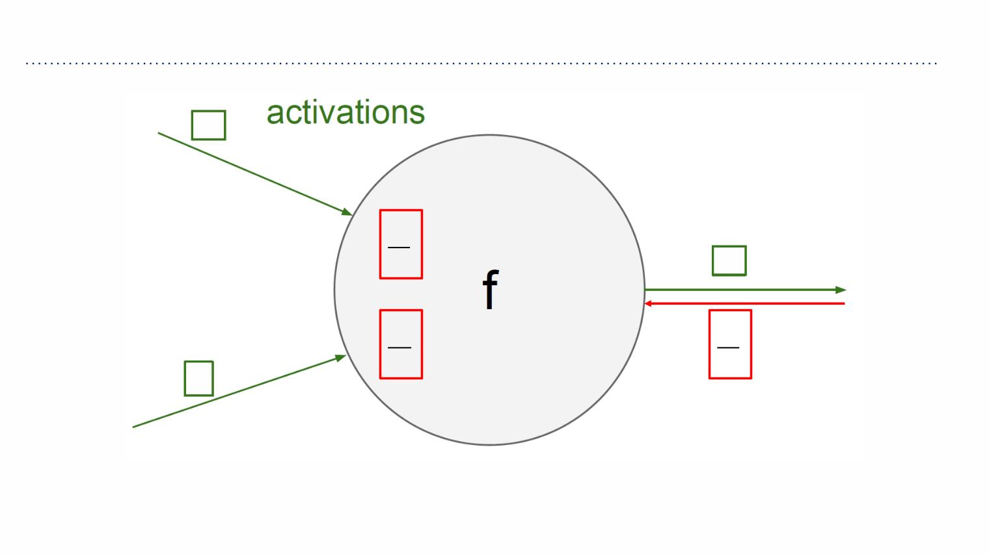
Chain rule
ꢁ
“local gradient”
/1
/%
ꢀ
/1
/*
/3
/1
ꢌ
gradients

Slide 28
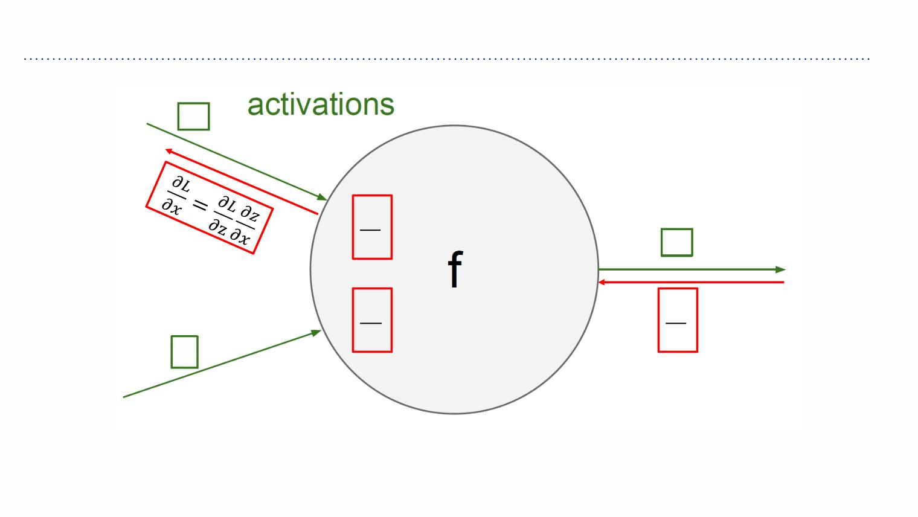
Chain rule
ꢁ
“local gradient”
/1
/%
ꢀ
/1
/*
/3
/1
ꢌ
gradients

Slide 29
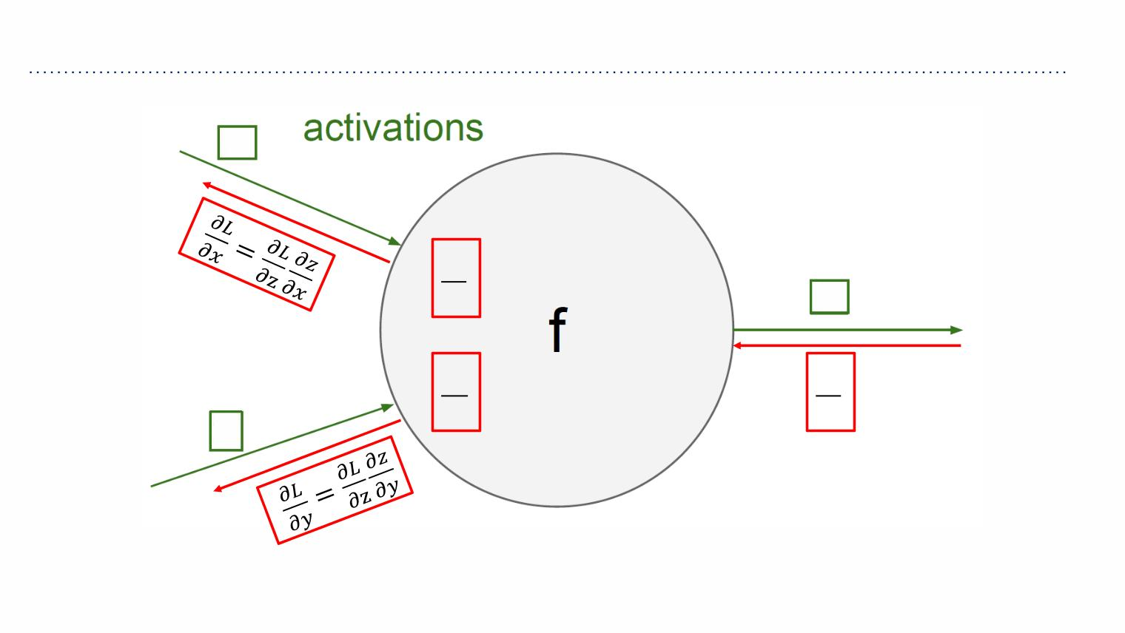
Chain rule
ꢁ
“local gradient”
/1
/%
ꢀ
/1
/*
/3
/1
ꢌ
gradients

Slide 30
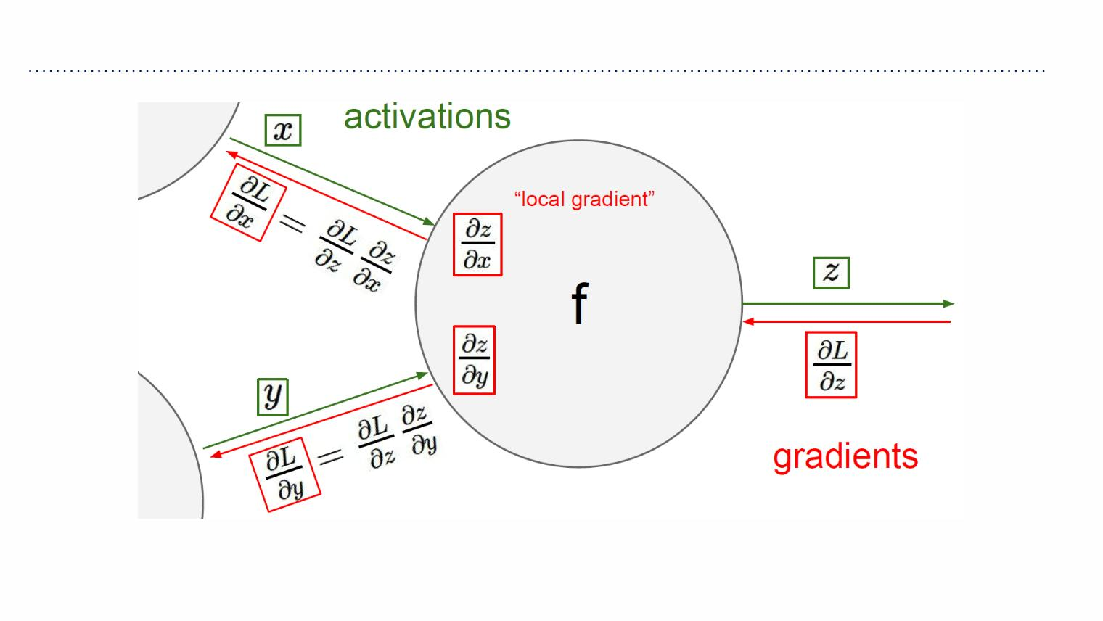
Chain rule

Slide 31
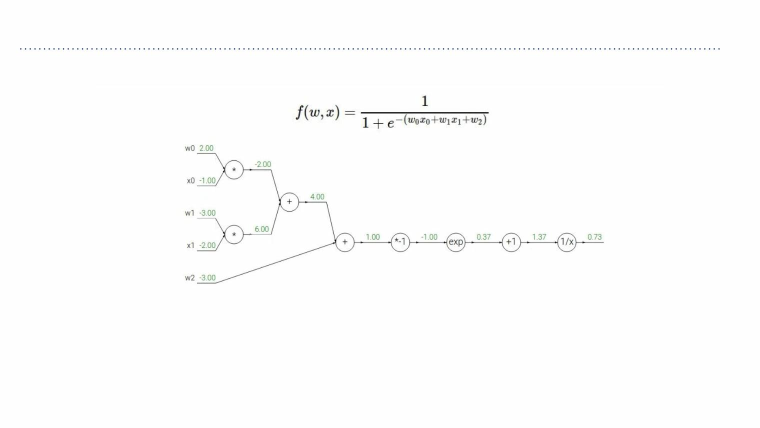
Chain rule
Another example:

Slide 32
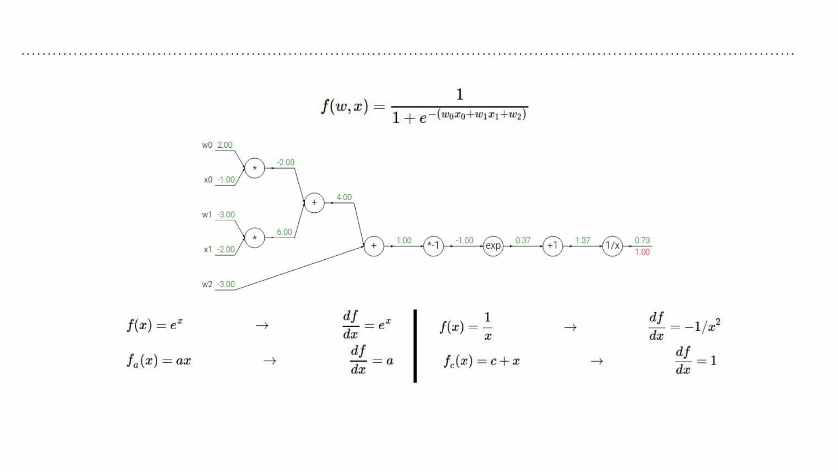
Chain rule
Another example:

Slide 33
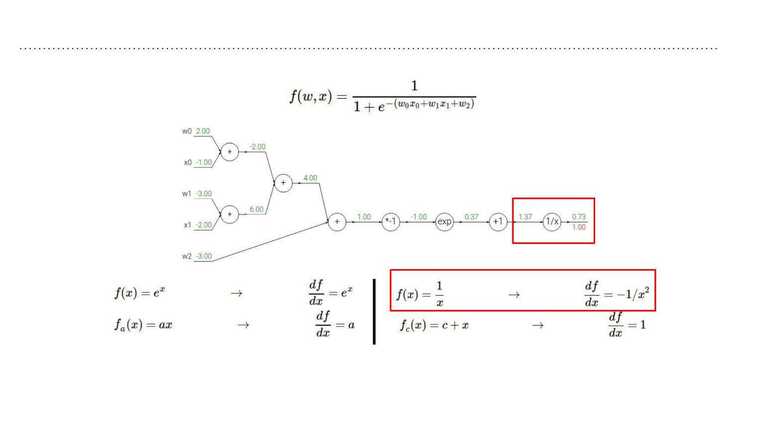
Chain rule
Another example:

Slide 34
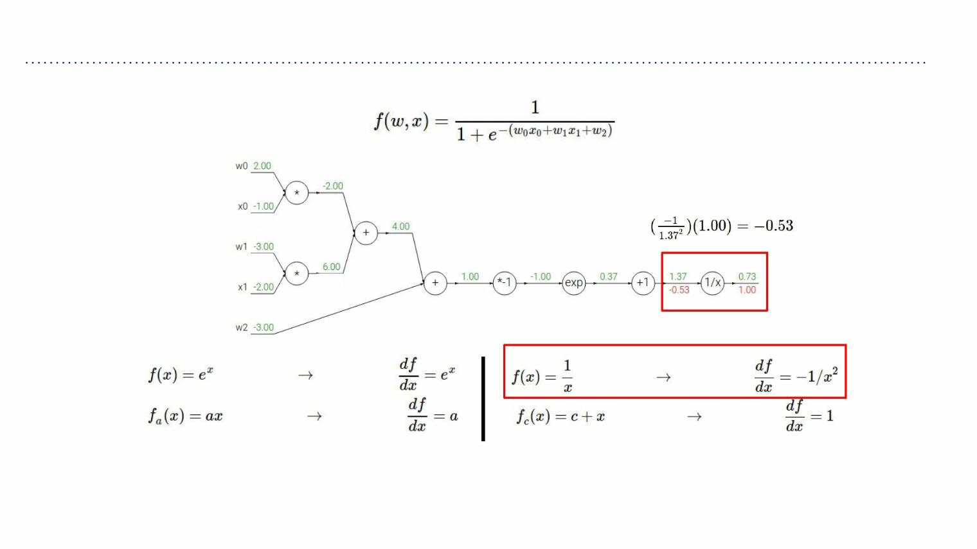
Chain rule
Another example:

Slide 35
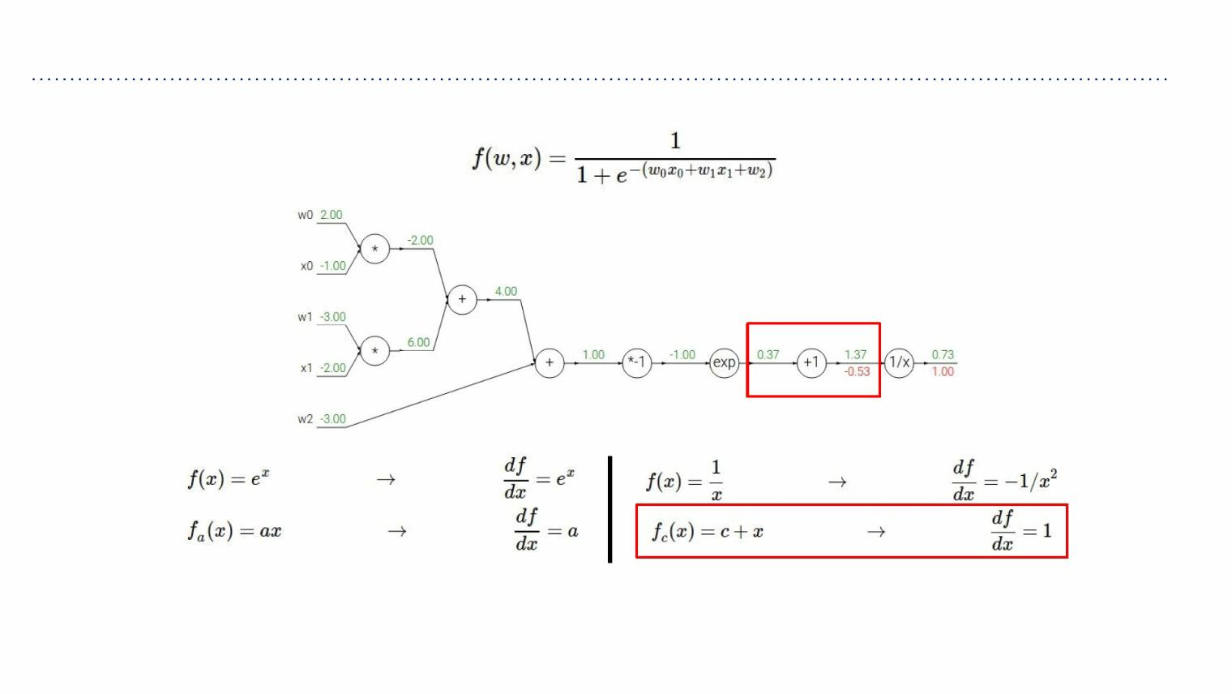
Chain rule
Another example:

Slide 36
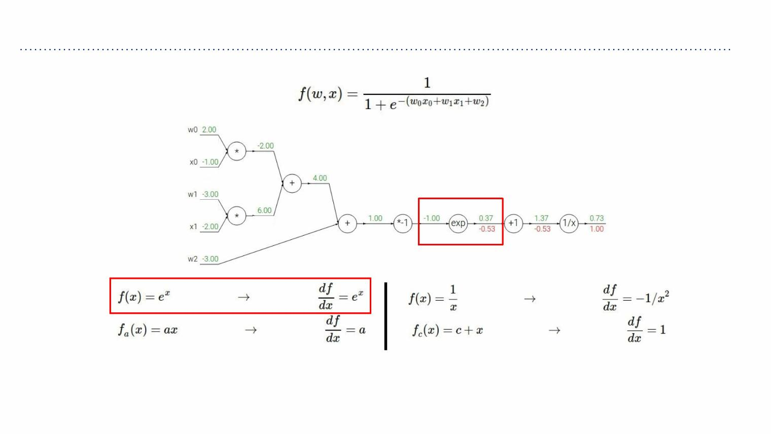
Chain rule
Another example:

Slide 37
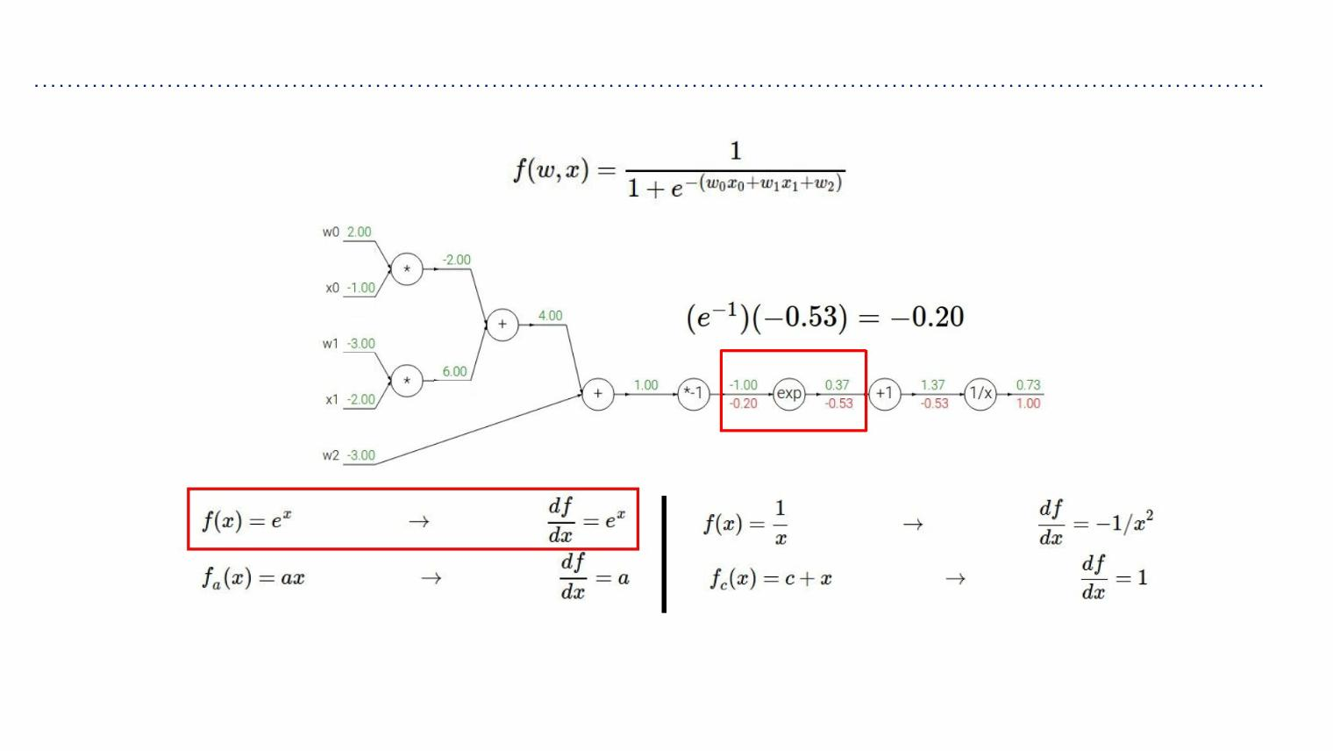
Chain rule
Another example:

Slide 38
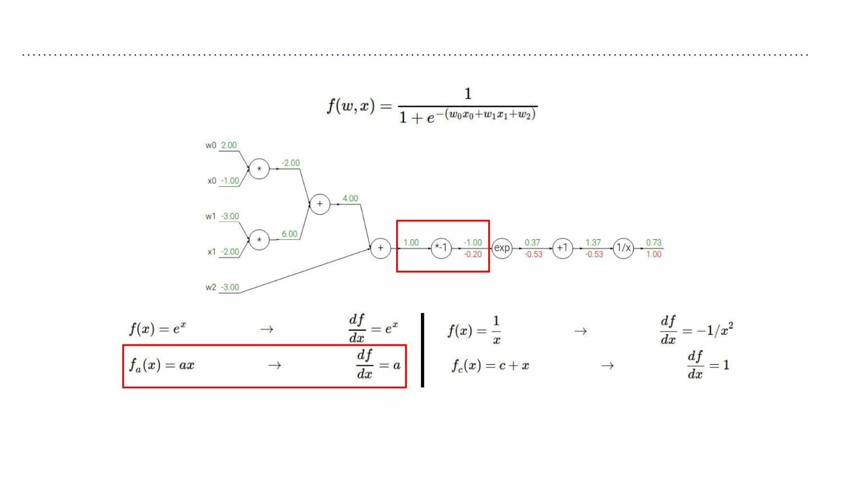
Chain rule
Another example:

Slide 39
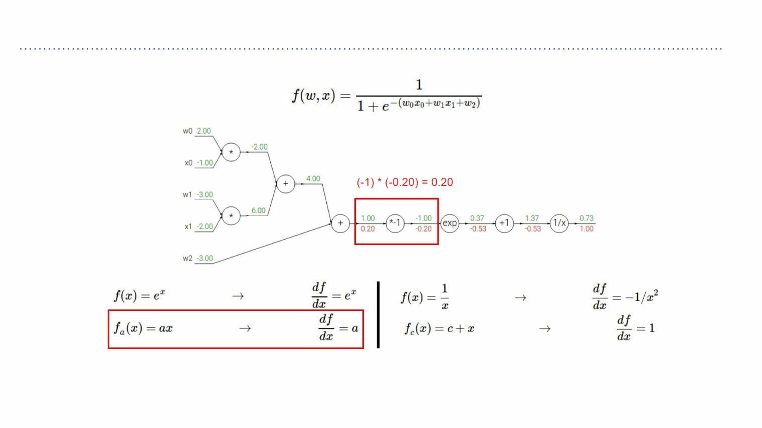
Chain rule
Another example:

Slide 40
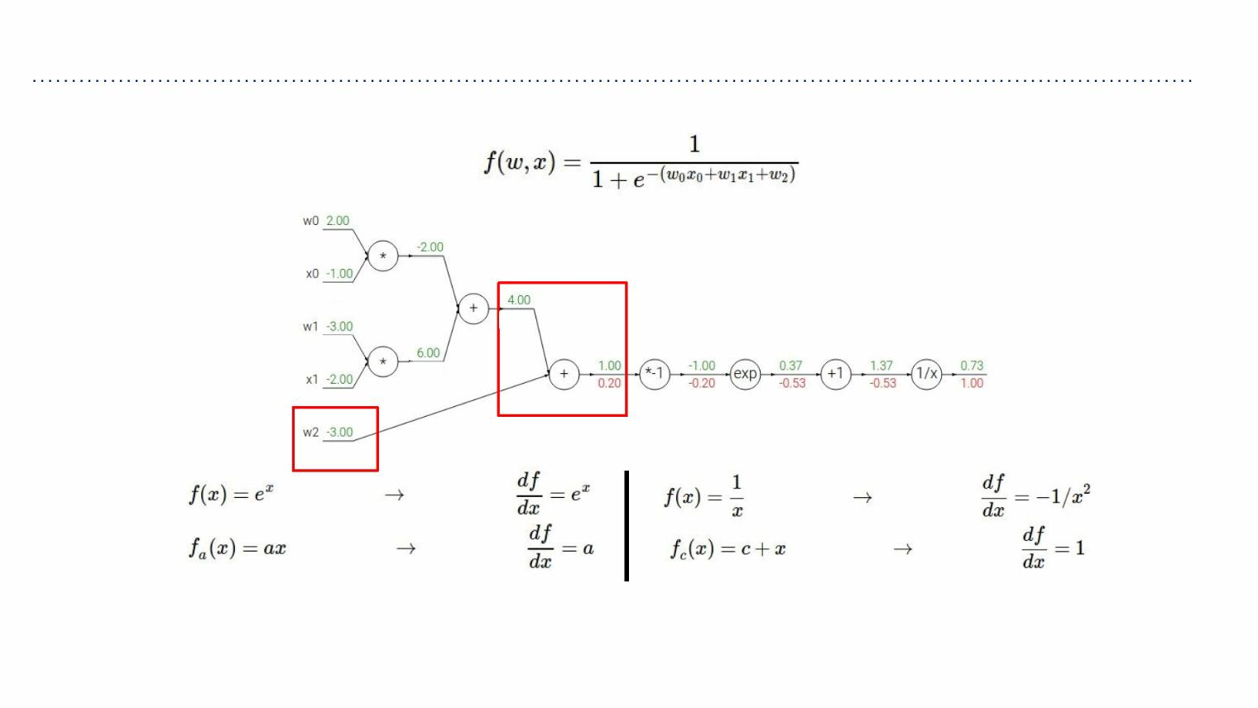
Chain rule
Another example:

Slide 41
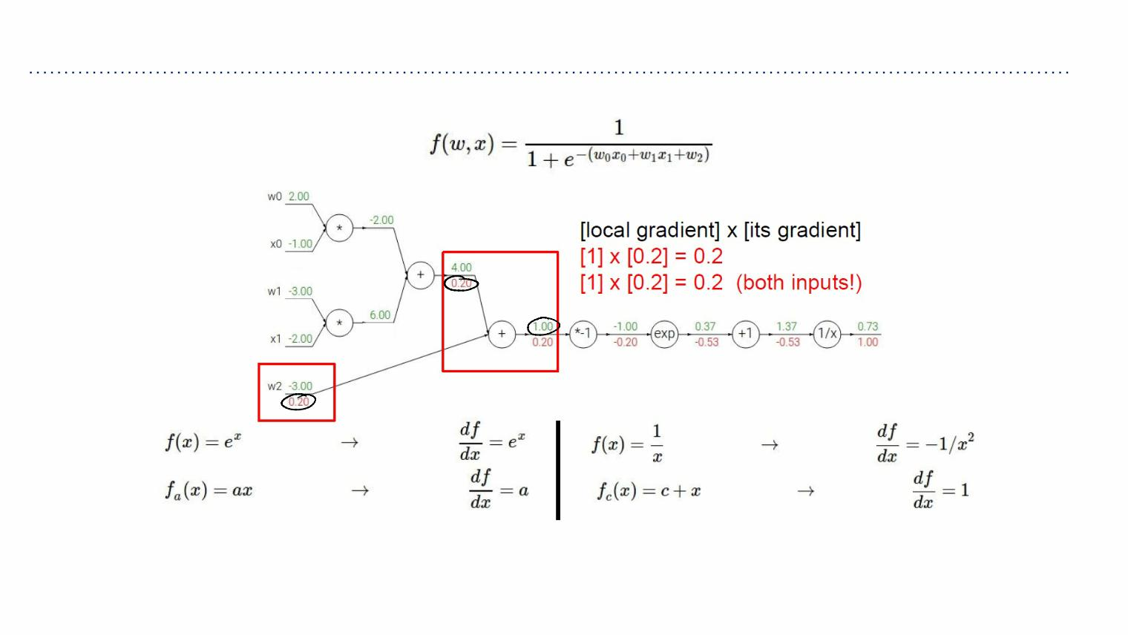
Chain rule
Another example:

Slide 42
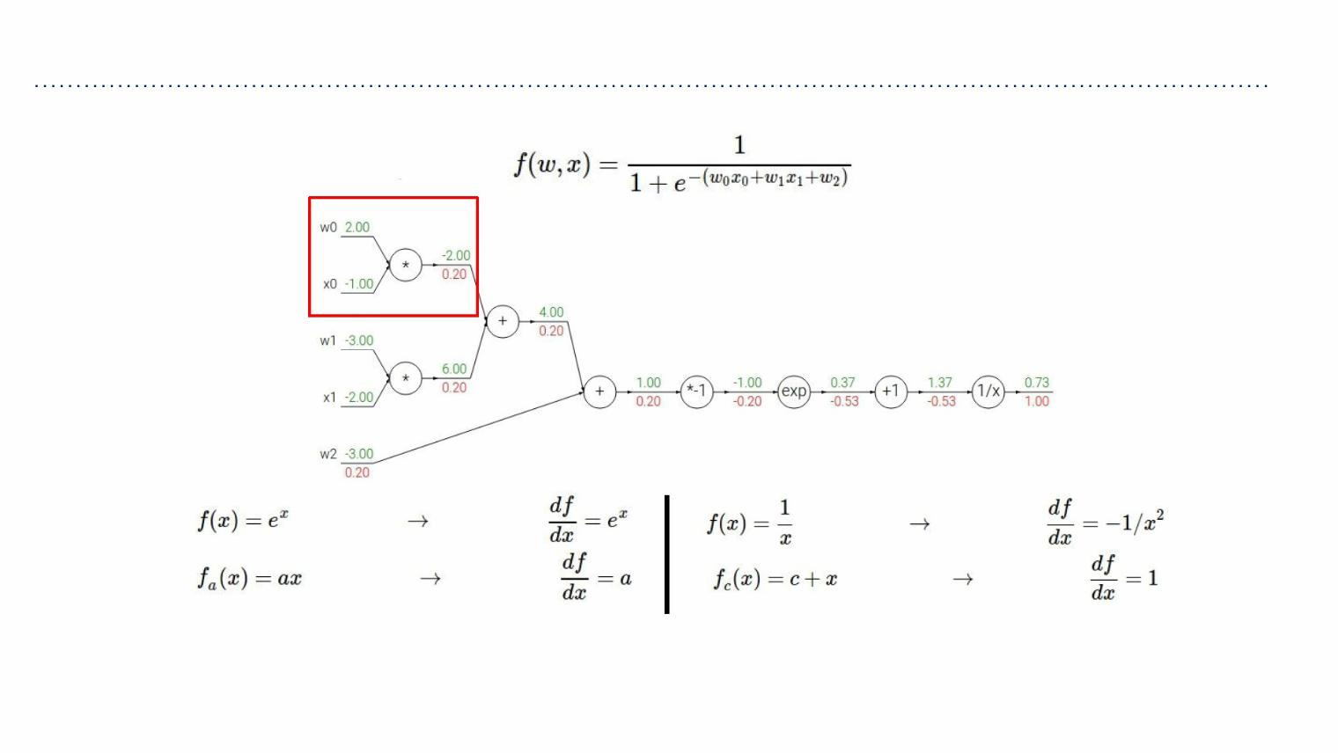
Chain rule
Another example:

Slide 43
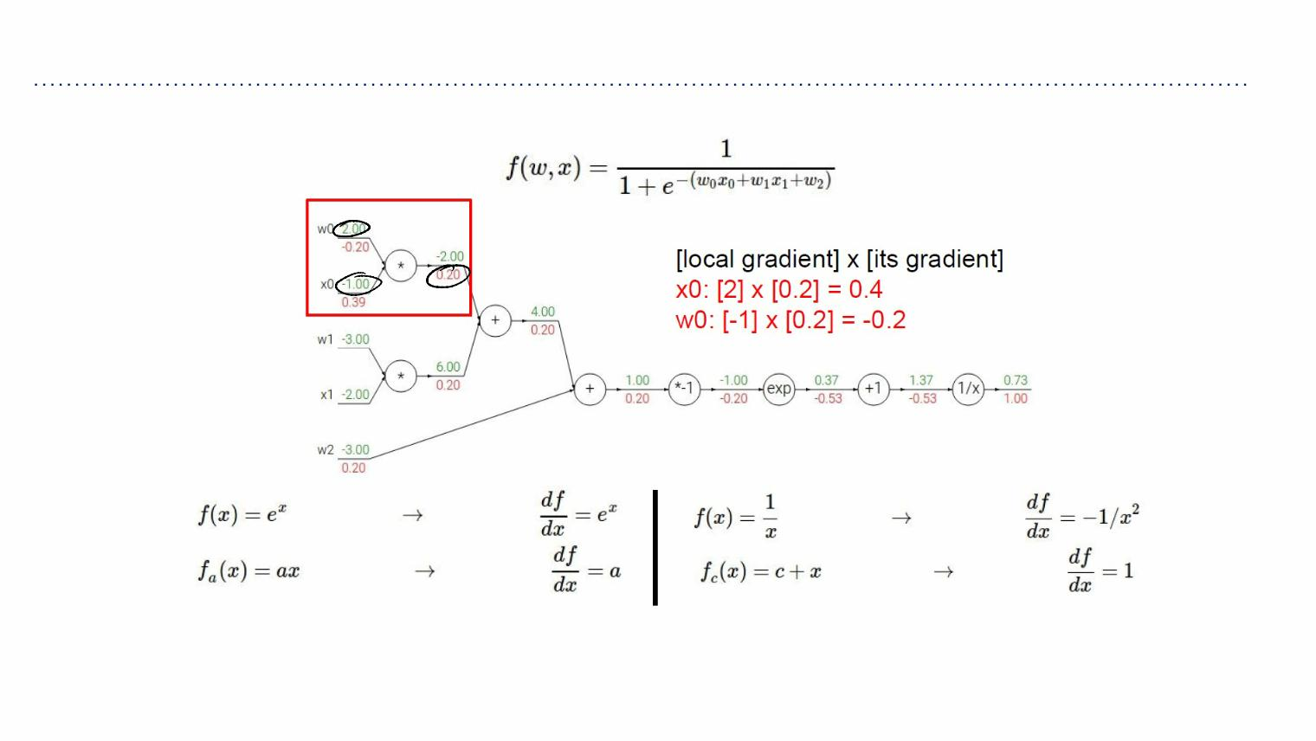
Chain rule
Another example:

Slide 44
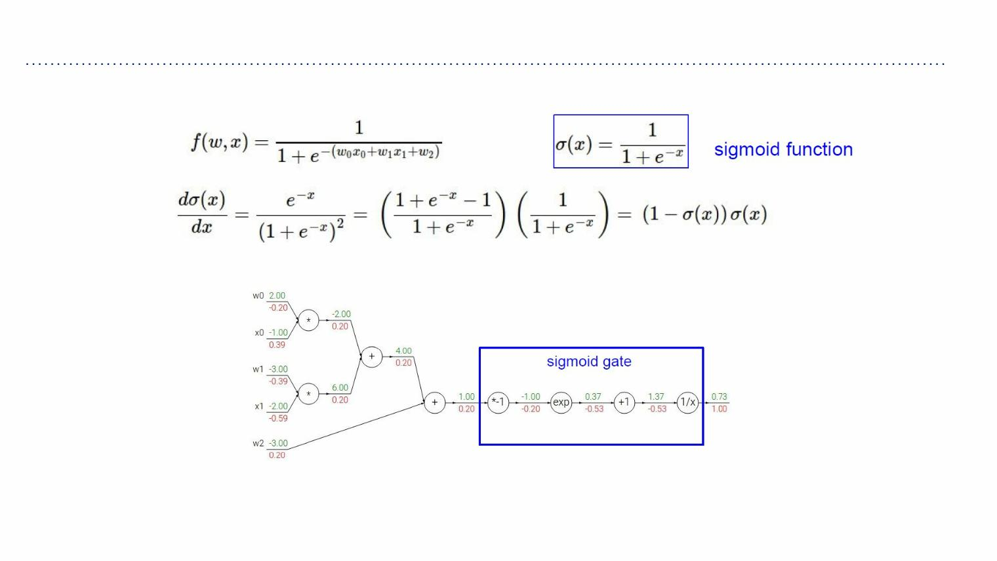
Sigmoid

Slide 45
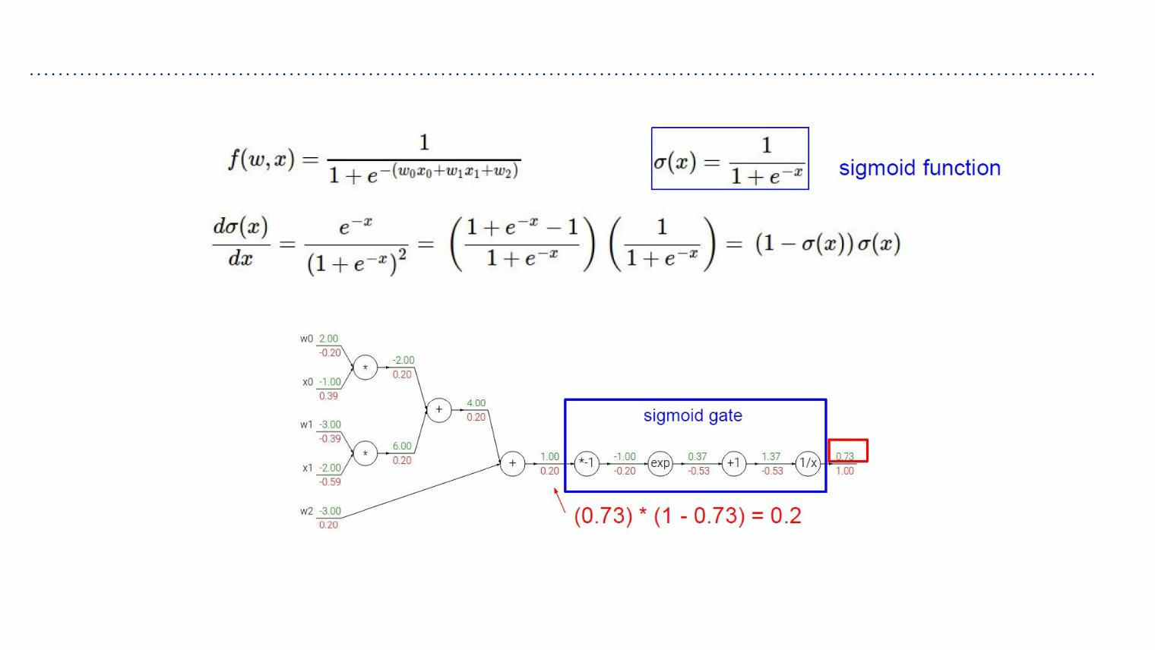
Sigmoid

Slide 46
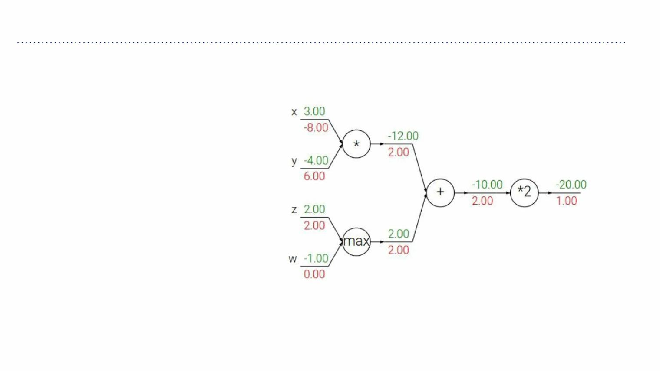
Pattern in backward flow
Patterns in backward flow
addgate: gradient distributor
maxgate: gradient router
mulgate: gradient… “switcher”?

Slide 47
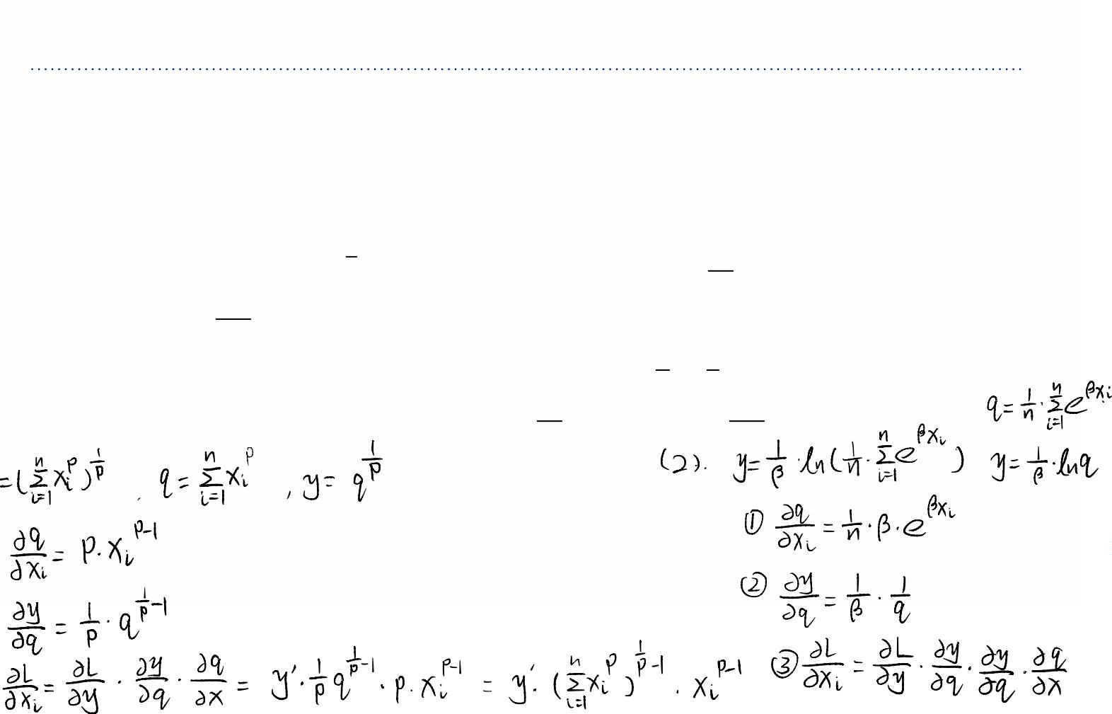
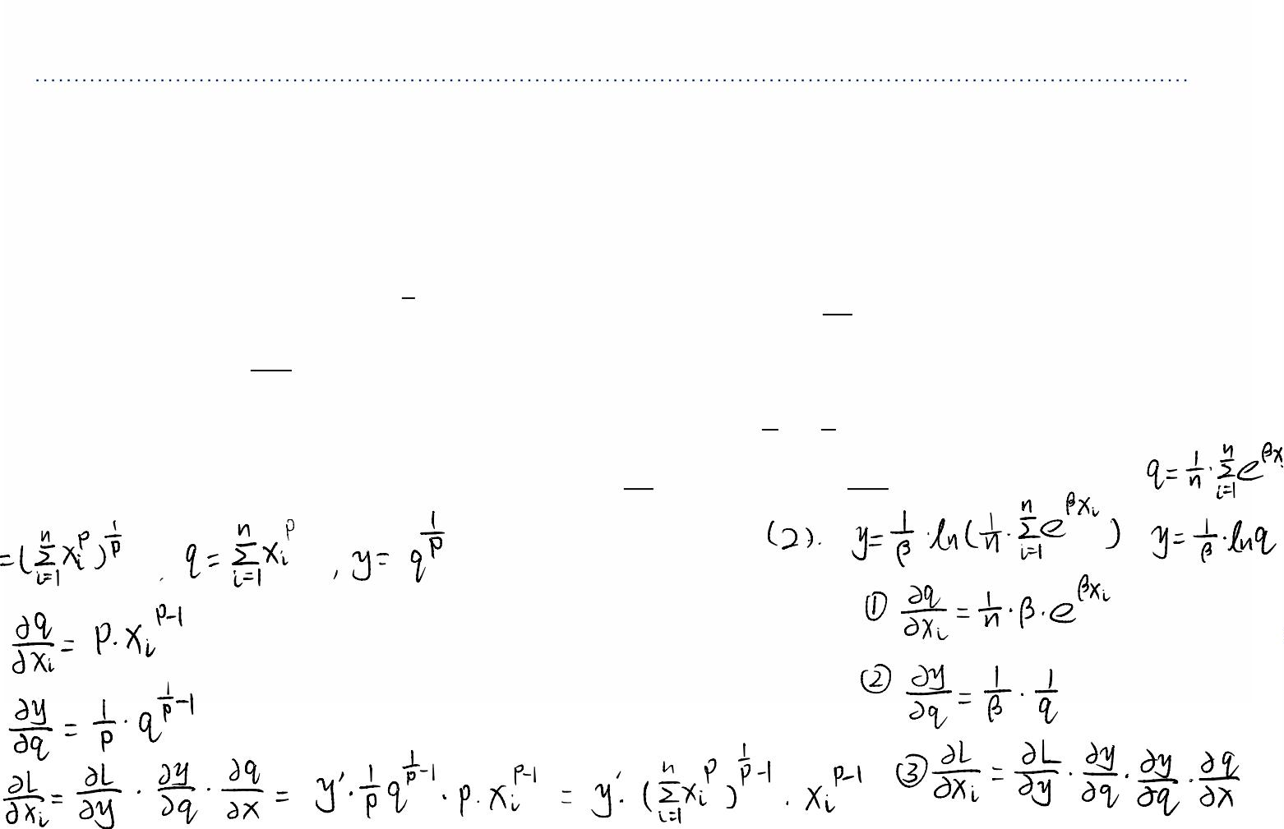


Exercise 1
Pooling units take n values ꢂ', i ∈ [1,n] and compute a scalar
output whose value is invariant to permutations of the inputs.
1. The Lp-pooling module takes positive inputs and computes
5
' '
"
#
6
/3
6
y= (∑ ꢂ ) , assuming we know that ꢌ =
, what is ꢂ =
'
/*
/3
?
/%!
" "
2. The log-average module computes y= ln( ∑ exp(ꢐꢂ )),
7 8
6
'
'
assuming we know that ꢌ⁶ =
/3
/*
, what is ꢂ =
/3
/%!
?
'

Slide 48

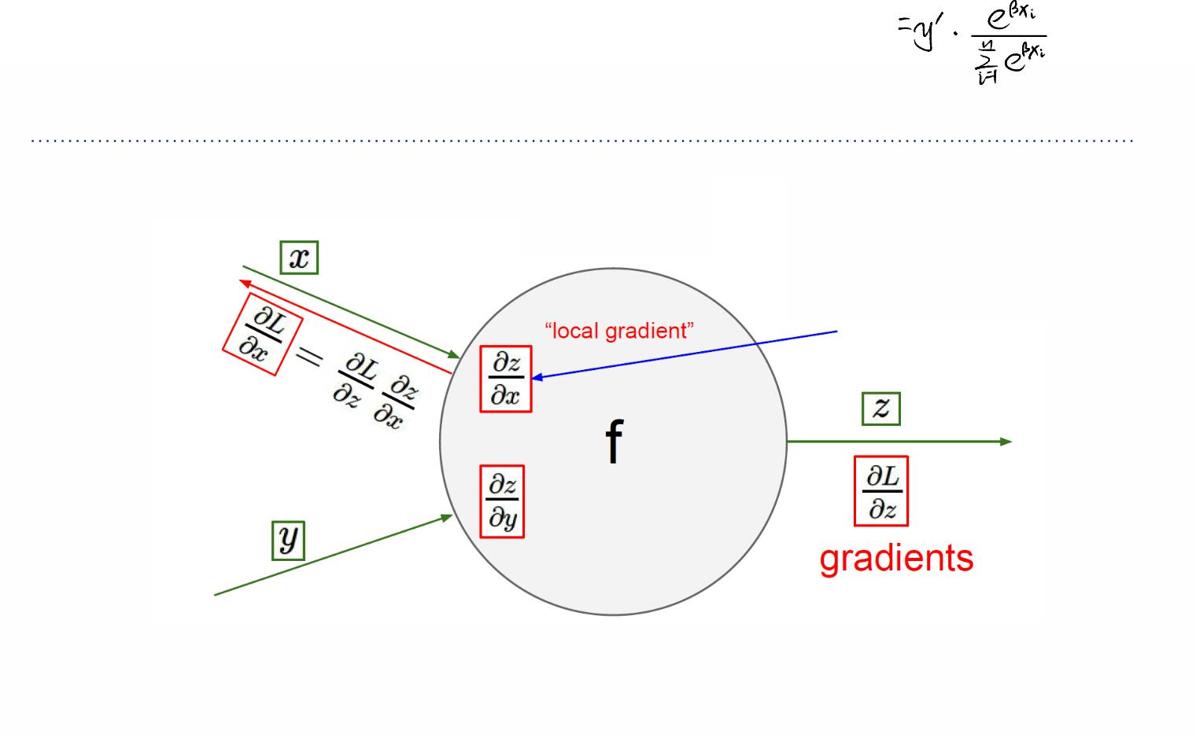
Gradients for vector
Gradients for vectorized code (x, y, z are
now vectors)
This is now the Jacobian
matrix (derivative of
each element of z w.r.t.
each element of x)

Slide 49
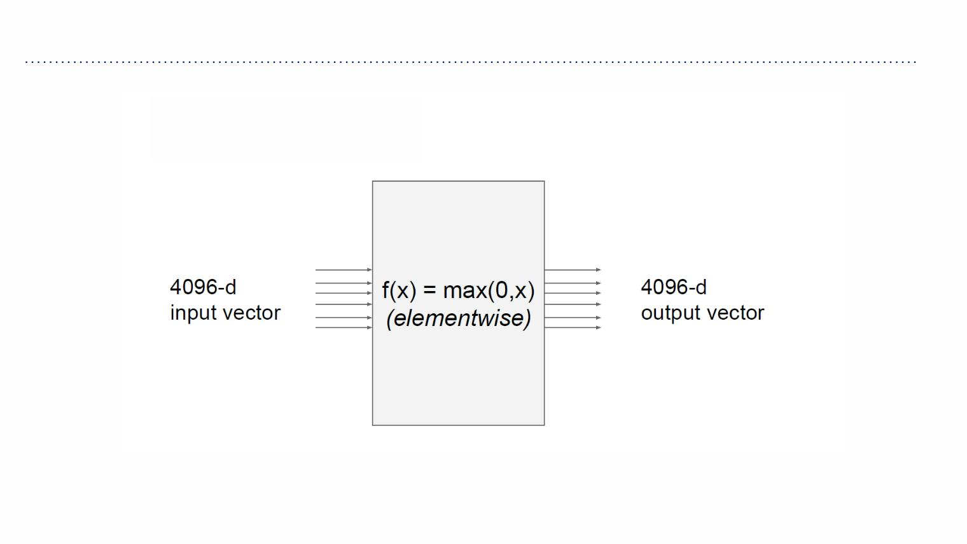
Gradients for vector
Vectorized operation

Slide 50
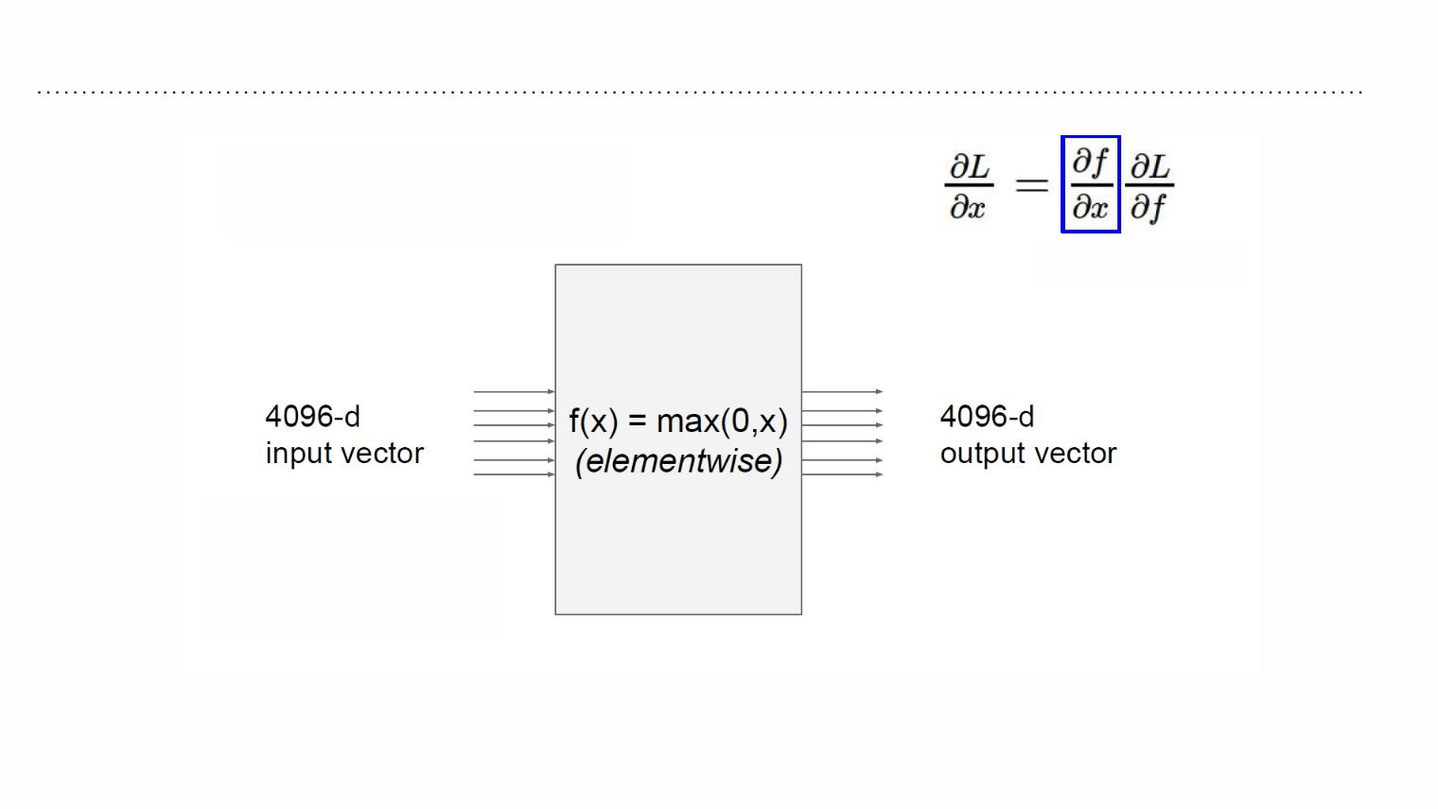
Gradients for vector
Vectorized operation
Jacobian matrix
Q: what is the size
of the Jacobian
matrix

Slide 51
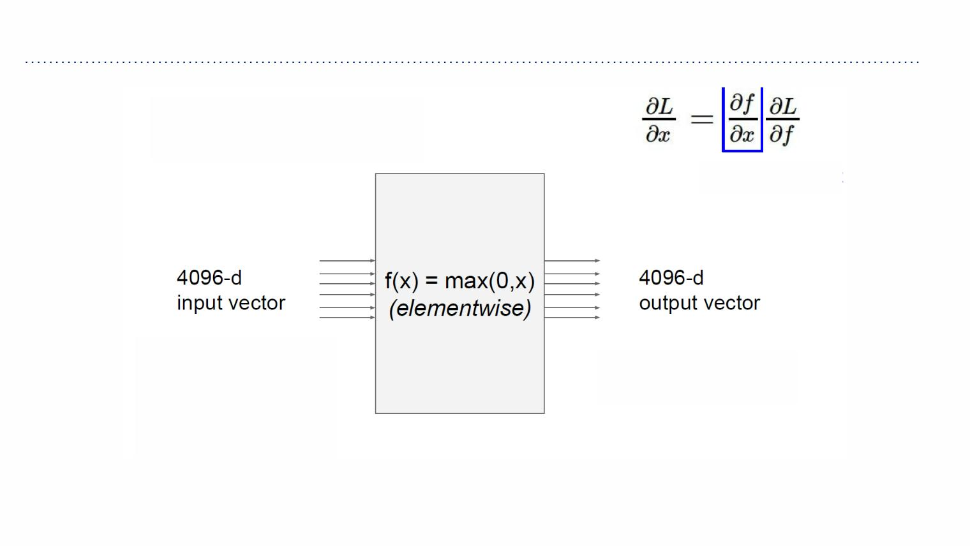
Gradients for vector
Vectorized operation
Jacobian matrix
Q: what is the size
of the Jacobian
matrix
Q2: what does it look
like?
[4096 x 4096!]

Slide 52
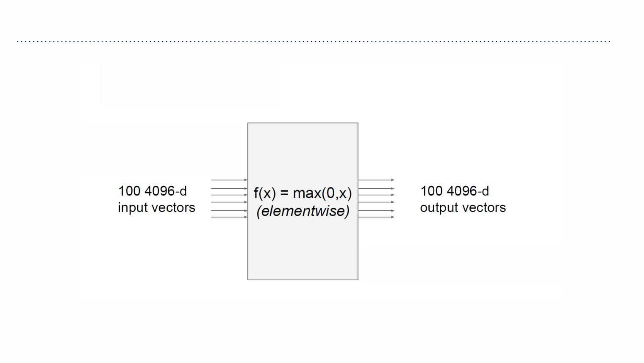
Gradients for vector
Vectorized operation
in practice we process an
entire minibatch (e.g. 100)
of examples at one time:
i.e. Jacobian would technically be a
[409,600 x 409,600] matrix :\

Slide 53

Gradients for vector
! ∑⁸
!
A vectorized example: ꢀ ꢂ,ꢁ = ꢁQꢂ = (ꢁ Qꢂ)
'+"
'

Slide 54

Gradients for vector
! ∑⁸
!
A vectorized example: ꢀ ꢂ,ꢁ = ꢁQꢂ = (ꢁ Qꢂ)
'+"
'
_{∈ℝ}$ ∈ℝ$×$

Slide 55
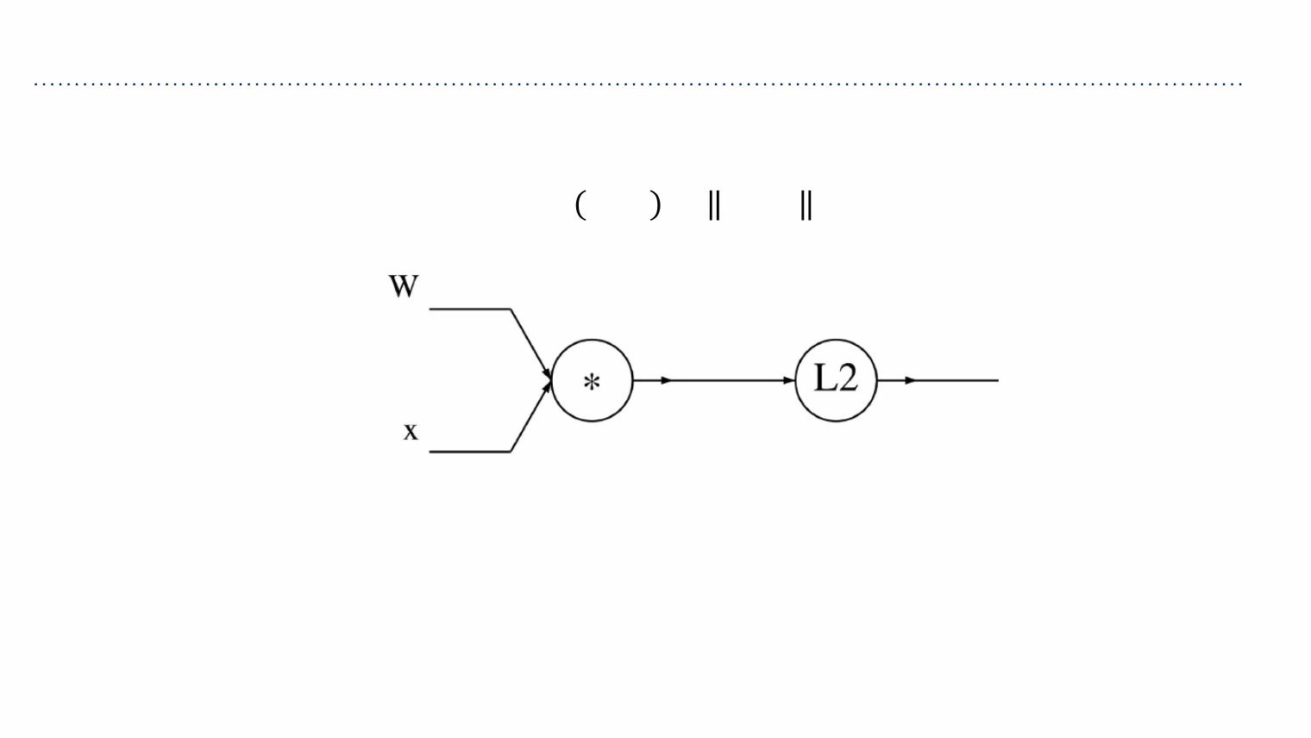
Gradients for vector
! ∑⁸
!
A vectorized example: ꢀ ꢂ,ꢁ = ꢁQꢂ = (ꢁ Qꢂ)
'+"
'

Slide 56
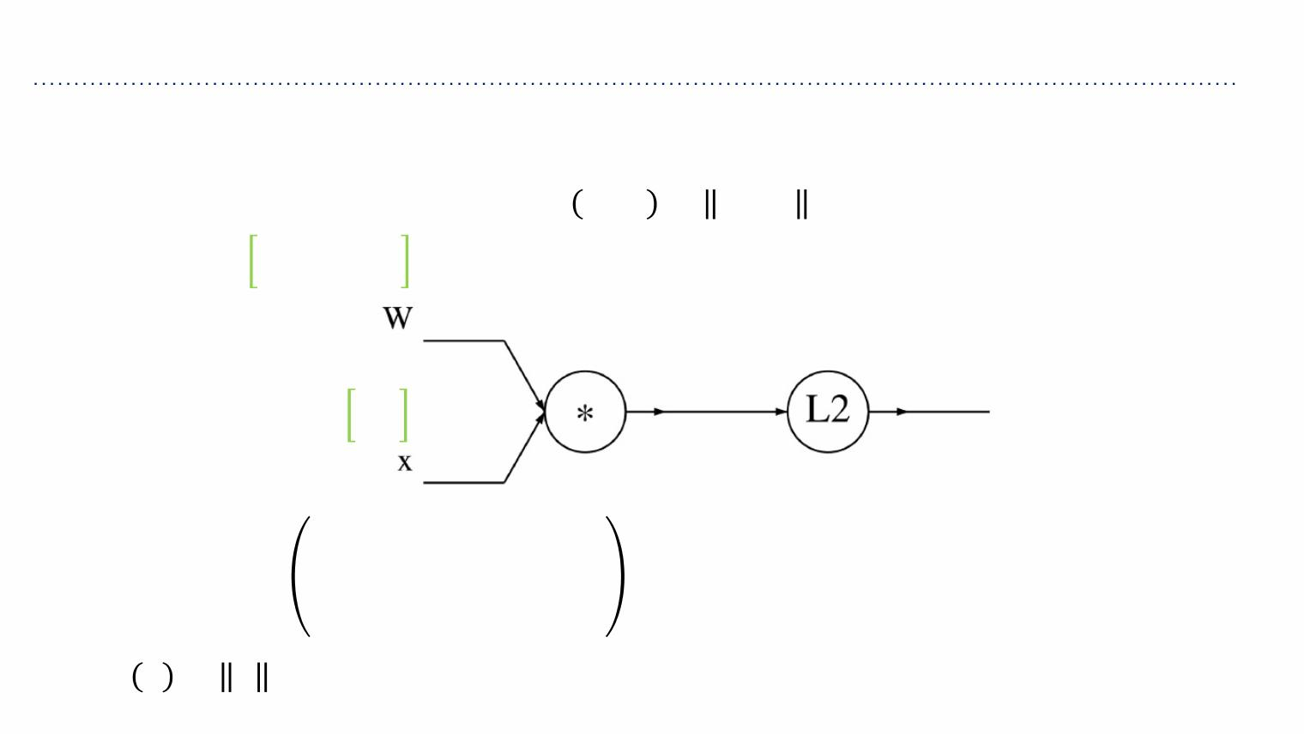
Gradients for vector
! ∑⁸
!
A vectorized example: ꢀ ꢂ,ꢁ = ꢁQꢂ = (ꢁ Qꢂ)
0.1 0.5
−0.3 0.8
'+"
'
0.2
0.4
ꢁ ꢂ +⋯+ꢁ ꢂ
"," "
",8 8
ꢎ =ꢁQꢂ =
⋮
ꢁ ꢂ +⋯+ꢁ ꢂ
8," "
! !
8,8 8
!
ꢀ ꢎ = ꢎ =ꢎ +⋯+ꢎ
"
8

Slide 57
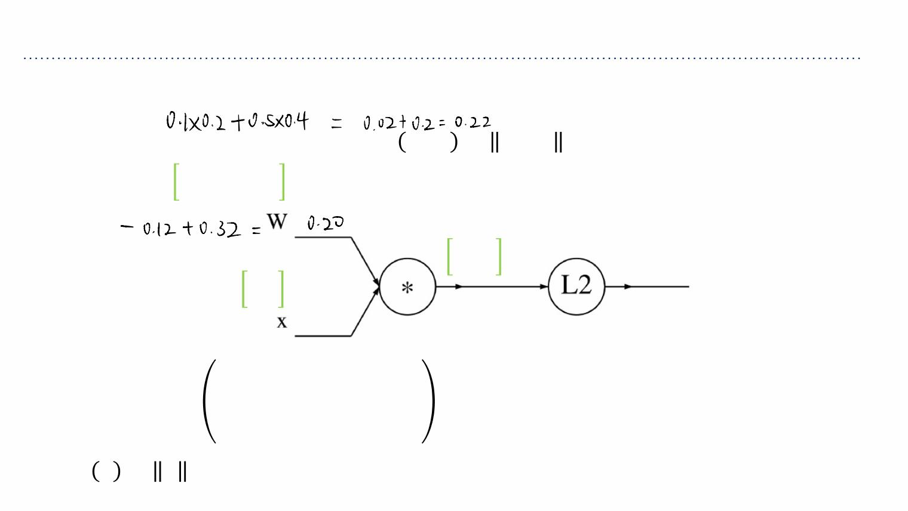
Gradients for vector
! ∑⁸
!
A vectorized example: ꢀ ꢂ,ꢁ = ꢁQꢂ = (ꢁ Qꢂ)
0.1 0.5
−0.3 0.8
'+"
'
0.22
0.26
0.2
0.4
0.116
ꢁ ꢂ +⋯+ꢁ ꢂ
"," "
",8 8
ꢎ =ꢁQꢂ =
⋮
ꢁ ꢂ +⋯+ꢁ ꢂ
8," "
! !
8,8 8
!
ꢀ ꢎ = ꢎ =ꢎ +⋯+ꢎ
"
8

Slide 58
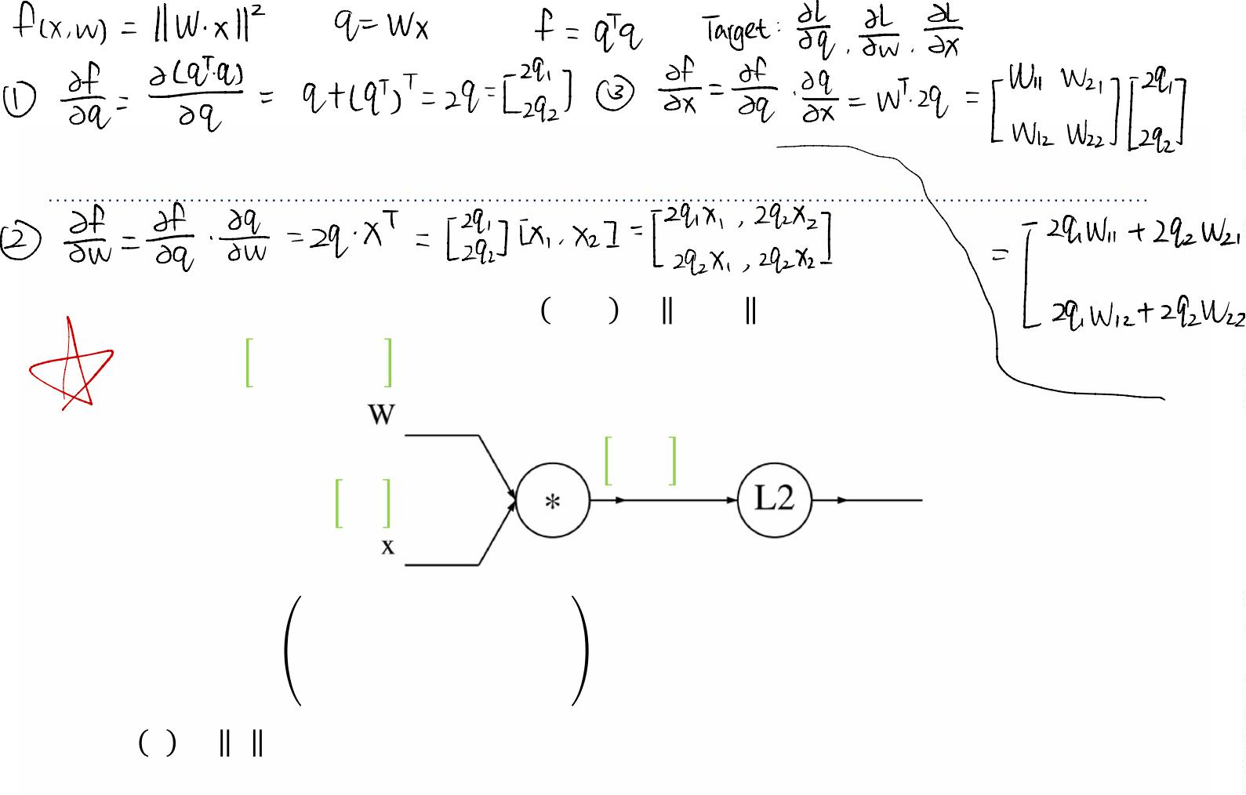
Gradients for vector
! ∑⁸
!
A vectorized example: ꢀ ꢂ,ꢁ = ꢁQꢂ = (ꢁ Qꢂ)
0.1 0.5
−0.3 0.8
'+"
'
0.22
0.26
0.2
0.4
0.116
1.00
ꢁ ꢂ +⋯+ꢁ ꢂ
"," "
",8 8
ꢎ =ꢁQꢂ =
⋮
ꢁ ꢂ +⋯+ꢁ ꢂ
8," "
! !
8,8 8
!
ꢀ ꢎ = ꢎ =ꢎ +⋯+ꢎ
"
8

Slide 59

Gradients for vector
! ∑⁸
!
A vectorized example: ꢀ ꢂ,ꢁ = ꢁQꢂ = (ꢁ Qꢂ)
0.1 0.5
−0.3 0.8
'+"
'
0.22
0.26
0.2
0.4
0.116
1.00
ꢁ ꢂ +⋯+ꢁ ꢂ
ꢏꢀ
"," "
",8 8
= 2ꢎ'
ꢎ =ꢁQꢂ =
⋮
ꢏꢎ'
ꢁ ꢂ +⋯+ꢁ ꢂ
8," "
! !
8,8 8
∇₂ꢀ=2q
!
ꢀ ꢎ = ꢎ =ꢎ +⋯+ꢎ
"
8

Slide 60

Gradients for vector
! ∑⁸
!
A vectorized example: ꢀ ꢂ,ꢁ = ꢁQꢂ = (ꢁ Qꢂ)
0.1 0.5
−0.3 0.8
'+"
'
0.22
0.26
0.2
0.4
0.116
1.00
0.44
0.52
ꢁ ꢂ +⋯+ꢁ ꢂ
ꢏꢀ
"," "
",8 8
= 2ꢎ'
ꢎ =ꢁQꢂ =
⋮
ꢏꢎ'
ꢁ ꢂ +⋯+ꢁ ꢂ
8," "
! !
8,8 8
∇₂ꢀ=2q
!
ꢀ ꢎ = ꢎ =ꢎ +⋯+ꢎ
"
8

Slide 61

Gradients for vector
! ∑⁸
!
A vectorized example: ꢀ ꢂ,ꢁ = ꢁQꢂ = (ꢁ Qꢂ)
0.1 0.5
−0.3 0.8
'+"
'
0.22
0.26
0.2
0.4
0.116
1.00
0.44
0.52
ꢏꢎ₋
ꢏꢁ_{',(}
ꢁ ꢂ +⋯+ꢁ ꢂ
=ꢑ ꢂ
-+' (
"," "
",8 8
ꢎ =ꢁQꢂ =
⋮
ꢁ ꢂ +⋯+ꢁ ꢂ
8," "
! !
8,8 8
!
ꢀ ꢎ = ꢎ =ꢎ +⋯+ꢎ
"
8

Slide 62

Gradients for vector
! ∑⁸
!
A vectorized example: ꢀ ꢂ,ꢁ = ꢁQꢂ = (ꢁ Qꢂ)
0.1 0.5
−0.3 0.8
'+"
'
0.22
0.26
0.2
0.4
0.116
1.00
0.44
0.52 ꢂꢃ!
=ꢅ ꢁ
ꢂꢄ",$
!%" $
ꢁ ꢂ +⋯+ꢁ ꢂ
"," "
",8 8
ꢂꢆ
ꢂꢄ",$
ꢂꢆ ꢂꢃ!
ꢂꢃ ꢂꢄ
! ! ",$
ꢎ =ꢁQꢂ =
⋮
=-
ꢁ ꢂ +⋯+ꢁ ꢂ
8," "
! !
8,8 8
= -(2ꢃ )(ꢅ ꢁ)
!
! !%" $
ꢀ ꢎ = ꢎ =ꢎ +⋯+ꢎ
!
"
8
=2ꢃꢁ
" $

Slide 63

Gradients for vector
! ∑⁸
!
A vectorized example: ꢀ ꢂ,ꢁ = ꢁQꢂ = (ꢁ Qꢂ)
0.1 0.5
−0.3 0.8
'+"
'
0.088 0.176
0.104 0.208
0.22
0.26
0.2
0.4
0.116
1.00
0.44
0.52 ꢂꢃ!
=ꢅ ꢁ
ꢂꢄ",$
ꢂꢆ
ꢂꢄ",$
!%" $
ꢁ ꢂ +⋯+ꢁ ꢂ
"," "
",8 8
ꢂꢆ ꢂꢃ!
ꢂꢃ ꢂꢄ
! ! ",$
ꢎ =ꢁQꢂ =
⋮
=-
ꢁ ꢂ +⋯+ꢁ ꢂ
8," "
! !
8,8 8
= -(2ꢃ )(ꢅ ꢁ)
!
! !%" $
ꢀ ꢎ = ꢎ =ꢎ +⋯+ꢎ
!
"
8
=2ꢃꢁ
" $

Slide 64

Gradients for vector
! ∑⁸
!
A vectorized example: ꢀ ꢂ,ꢁ = ꢁQꢂ = (ꢁ Qꢂ)
0.1 0.5
−0.3 0.8
'+"
'
∇.ꢀ =2ꢎQꢂ⊺
0.088 0.176
0.104 0.208
0.22
0.26
0.2
0.4
0.116
1.00
0.44
0.52 ꢂꢃ!
=ꢅ ꢁ
ꢂꢄ",$
ꢂꢆ
ꢂꢄ",$
!%" $
ꢁ ꢂ +⋯+ꢁ ꢂ
"," "
",8 8
ꢂꢆ ꢂꢃ!
ꢂꢃ ꢂꢄ
! ! ",$
ꢎ =ꢁQꢂ =
⋮
=-
ꢁ ꢂ +⋯+ꢁ ꢂ
8," "
! !
8,8 8
= -(2ꢃ )(ꢅ ꢁ)
!
! !%" $
ꢀ ꢎ = ꢎ =ꢎ +⋯+ꢎ
!
"
8
=2ꢃꢁ
" $

Slide 65
Gradients for vector
! ∑⁸
!
A vectorized example: ꢀ ꢂ,ꢁ = ꢁQꢂ = (ꢁ Qꢂ)
0.1 0.5
−0.3 0.8
'+"
'
∇.ꢀ =2ꢎQꢂ⊺
0.088 0.176
0.104 0.208
0.22
0.26
Always check: The
0.116
1.00
gradient with respect
to a variable should
have the same shape as
the variable
0.2
0.4
0.44
0.52 ꢂꢃ!
=ꢅ ꢁ
ꢂꢄ",$
ꢂꢆ
ꢂꢄ",$
!%" $
ꢁ ꢂ +⋯+ꢁ ꢂ
"," "
",8 8
ꢂꢆ ꢂꢃ!
ꢎ =ꢁQꢂ =
⋮
=-
ꢂꢃ ꢂꢄ
ꢁ ꢂ +⋯+ꢁ ꢂ
! ! ",$
8," "
! !
8,8 8
= -(2ꢃ )(ꢅ ꢁ)
!
! !%" $
ꢀ ꢎ = ꢎ =ꢎ +⋯+ꢎ
!
"
8
=2ꢃꢁ
" $

Slide 66

Gradients for vector
! ∑⁸
!
A vectorized example: ꢀ ꢂ,ꢁ = ꢁQꢂ = (ꢁ Qꢂ)
0.1 0.5
−0.3 0.8
'+"
'
0.088 0.176
0.104 0.208
0.22
0.26
0.2
0.4
0.116
1.00
0.44
0.52 ꢂꢃ!
ꢂꢁ"
=ꢄ!,"
ꢁ ꢂ +⋯+ꢁ ꢂ
"," "
",8 8
ꢎ =ꢁQꢂ =
⋮
ꢁ ꢂ +⋯+ꢁ ꢂ
8," "
! !
8,8 8
!
ꢀ ꢎ = ꢎ =ꢎ +⋯+ꢎ
"
8

Slide 67

Gradients for vector
! ∑⁸
!
A vectorized example: ꢀ ꢂ,ꢁ = ꢁQꢂ = (ꢁ Qꢂ)
0.1 0.5
−0.3 0.8
'+"
'
0.088 0.176
0.104 0.208
0.22
0.26
0.2
0.4
0.116
1.00
0.44
0.52 ꢂꢃ!
ꢂꢁ"
=ꢄ!,"
ꢁ ꢂ +⋯+ꢁ ꢂ
"," "
",8 8
ꢂꢆ ꢂꢆ ꢂꢃ
ꢎ =ꢁQꢂ =
⋮
=-
!
ꢂꢁ ꢂꢃ ꢂꢁ
ꢁ ꢂ +⋯+ꢁ ꢂ
"
!
! "
8," "
! !
8,8 8
= -2ꢃ ꢄ
!
! !,"
ꢀ ꢎ = ꢎ =ꢎ +⋯+ꢎ
"
8
!

Slide 68

Gradients for vector
! ∑⁸
!
A vectorized example: ꢀ ꢂ,ꢁ = ꢁQꢂ = (ꢁ Qꢂ)
0.1 0.5
−0.3 0.8
'+"
'
∇%ꢀ =2ꢁ⊺Qꢎ
0.088 0.176
0.104 0.208
0.22
0.26
0.2
0.4
−0.112
0.636
0.116
1.00
0.44
0.52 ꢂꢃ!
ꢂꢁ"
=ꢄ!,"
ꢁ ꢂ +⋯+ꢁ ꢂ
ꢂꢆ ꢂꢆ ꢂꢃ
!
"," "
",8 8
=-
ꢂꢁ ꢂꢃ ꢂꢁ
ꢎ =ꢁQꢂ =
⋮
"
! "
ꢁ ꢂ +⋯+ꢁ ꢂ
!
8," "
! !
8,8 8
= -2ꢃ ꢄ
! !,"
!
!
ꢀ ꢎ = ꢎ =ꢎ +⋯+ꢎ
"
8

