Slide 1


INT305 Machine Learning Lecture 6
Convolutional Neural Network
Sichen Liu Department Intelligence Science
Sichen.Liu@xjtlu.edu.cn

Slide 2
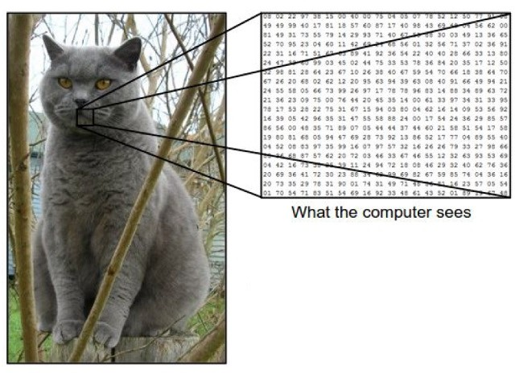
The problem
The problem:
semantic gap
Images are represented as 3D arrays of numbers, with integers between [0, 255].
图像以三维数值数组表示，其中包含介于整数之间的数值
E.g.,
300 x 100 x 3
(3 for 3 color channels RGB)

Slide 3


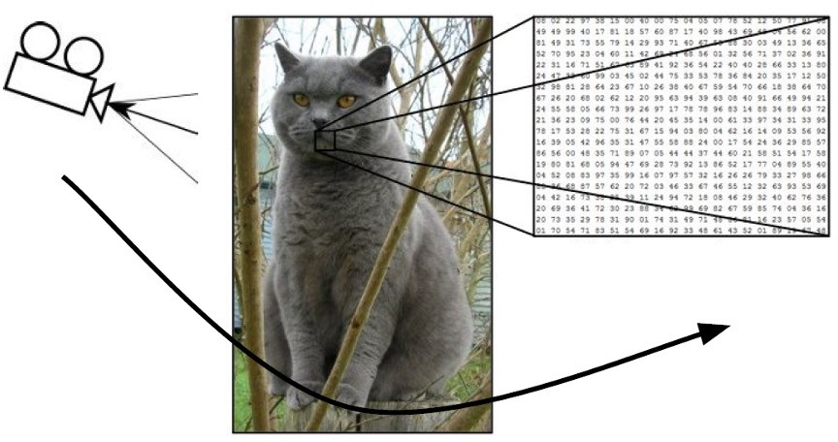
Challenges (1)
Challenges: Viewpoint Variation

Slide 4

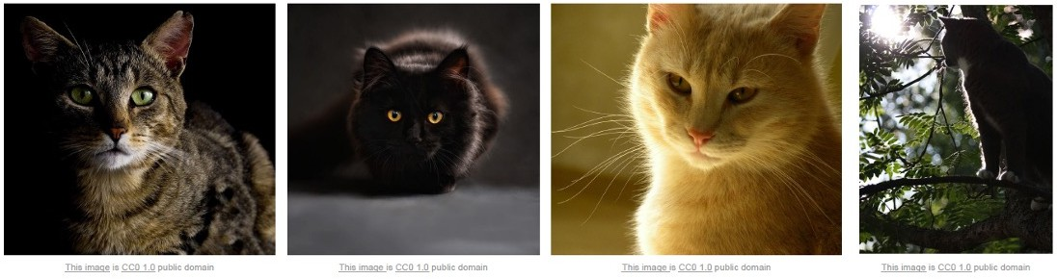
Challenges (2)
Challenges: Illumination

Slide 5


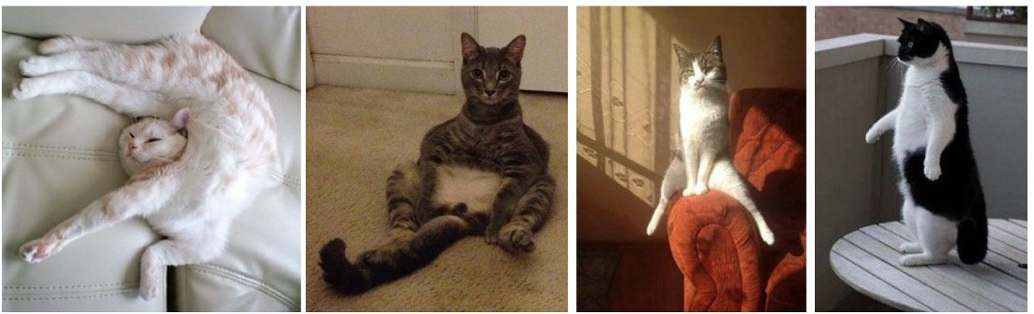
Challenges (3)
Challenges: Deformation

Slide 6

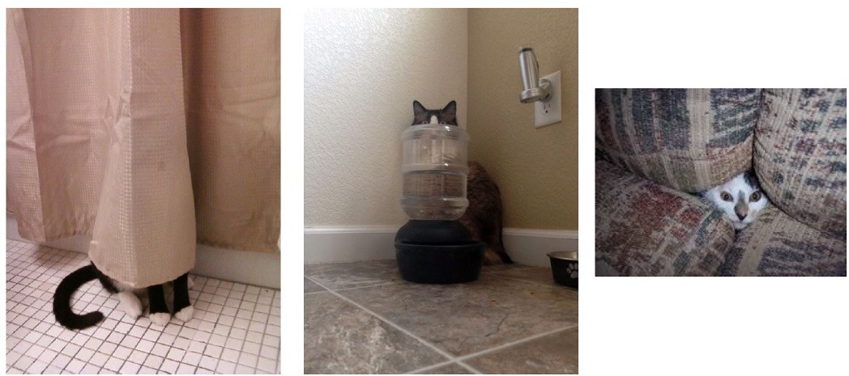
Challenges (4)
Challenges: Occlusion

Slide 7

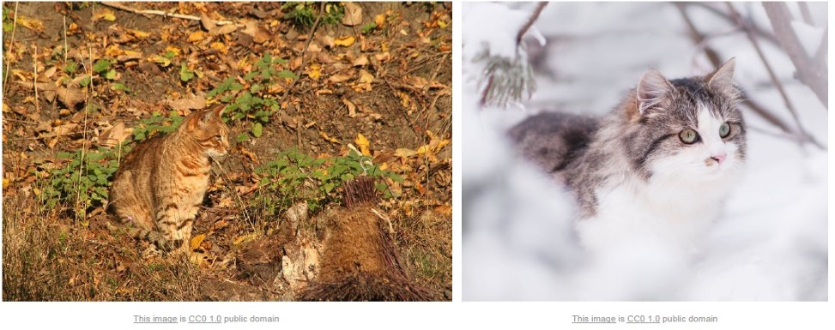
Challenges (5)
Challenges: Background Clutter

Slide 8

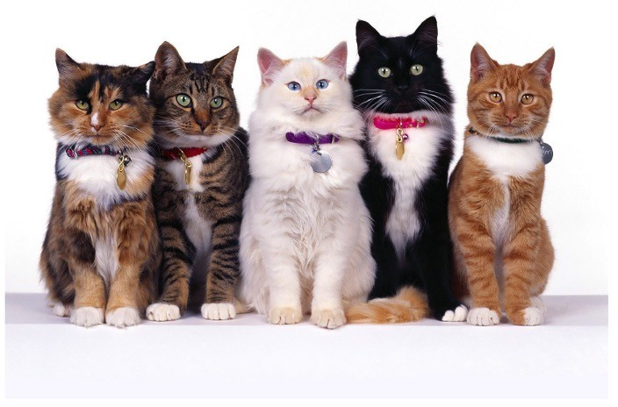
Challenges (6)
Challenges: Intraclass variation

Slide 9
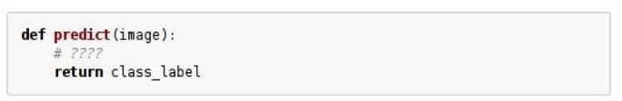
An image classifier
An image classifier
Unlike e.g. sorting a list of numbers,
no obvious way to hard-code the algorithm for recognizing a cat, or other classes.

Slide 10
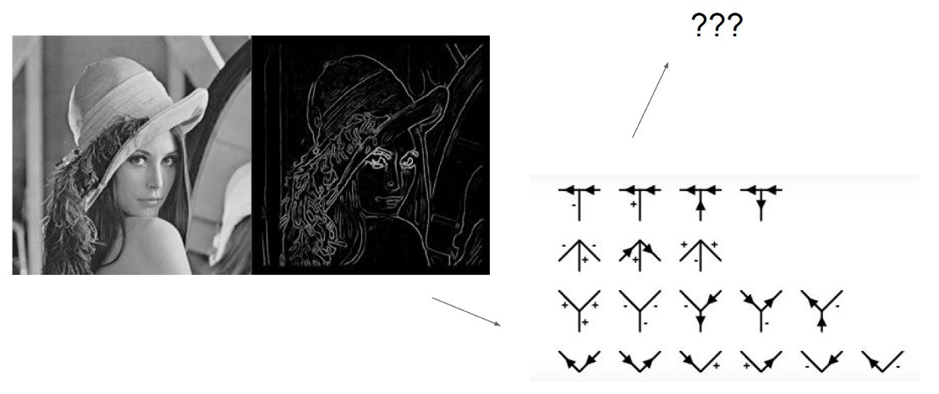
Attempts
Attempts have been made

Slide 11
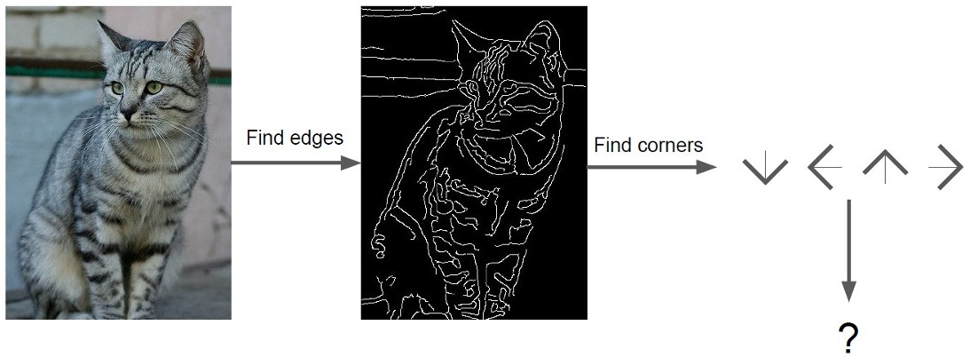
Attempts
Attempts have been made

Slide 12

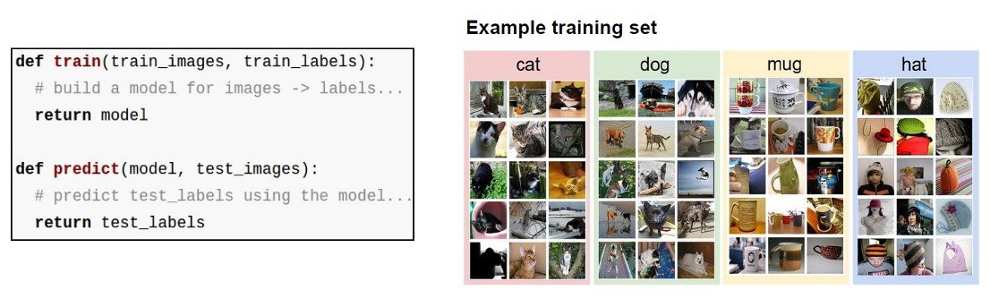


Data-driven approach
Data-driven approach:
Collect a dataset of images and labels
Use Machine Learning to train an image classifier
Evaluate the classifier on a withheld set of test images

Slide 13
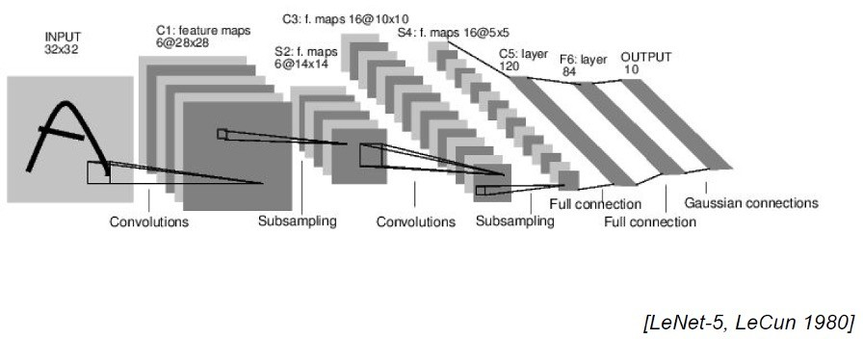
Convolutional Neural Networks
CNN

Slide 14
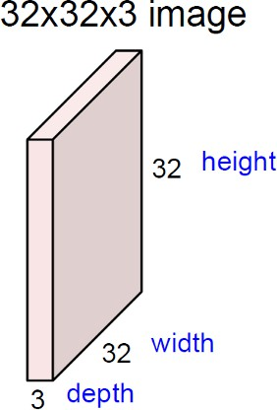
Convolution Layer
CNN

Slide 15

Convolution Layer
CNN
将滤波器与图像进⾏卷积操作，即“在图像空间上滑动滤波器，逐点计算内积”
5x5x3 filter
Convolve the filter with the image i.e. “slide over the image spatially, computing dot products”

Slide 16
CNN
滤波器始终覆盖输⼊数据的整个深度维度
Convolution Layer
Filters always extend the full depth of the input volume
32x32x3
5x5x3 filter
Convolve the filter with the image i.e. “slide over the image spatially, computing dot products”

Slide 17
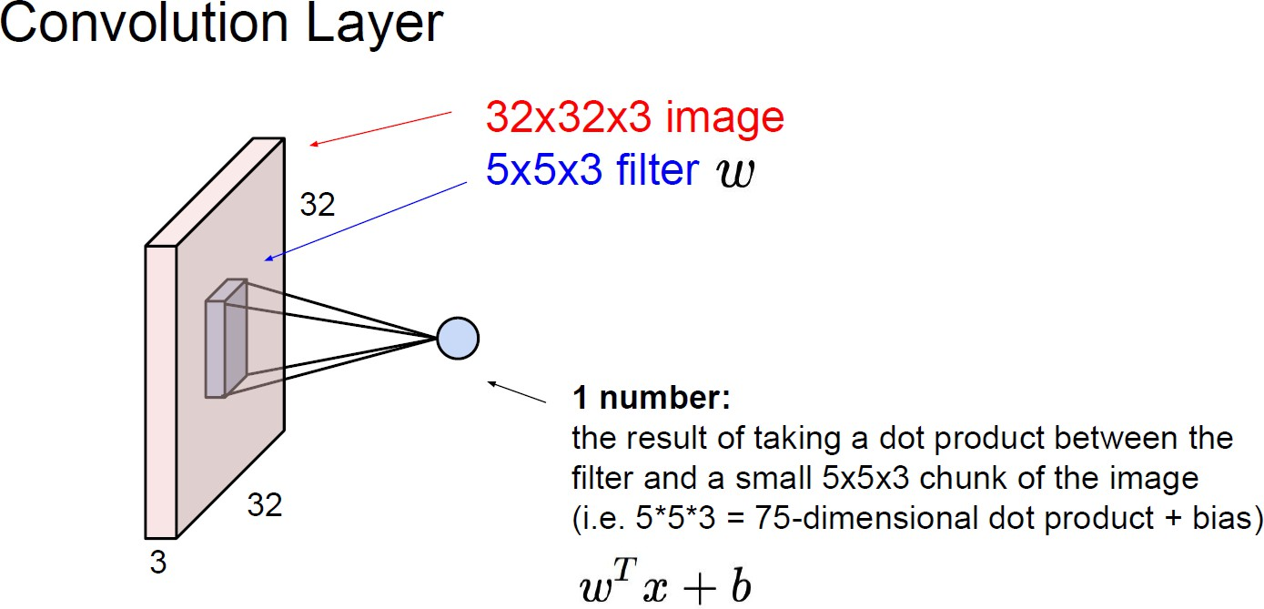


Convolution Layer
CNN
𝑤
滤波器与图像中5x5x3⼩块进⾏点积运算的结果
（即75维点积运算+偏置项）
The result of taking a dot product between the filter and a small 5x5x3 chunk of the image (i.e. 5*5*3=75-dimensional dot product + bias)
𝑤^{𝗍}𝑥 + 𝑏

Slide 18
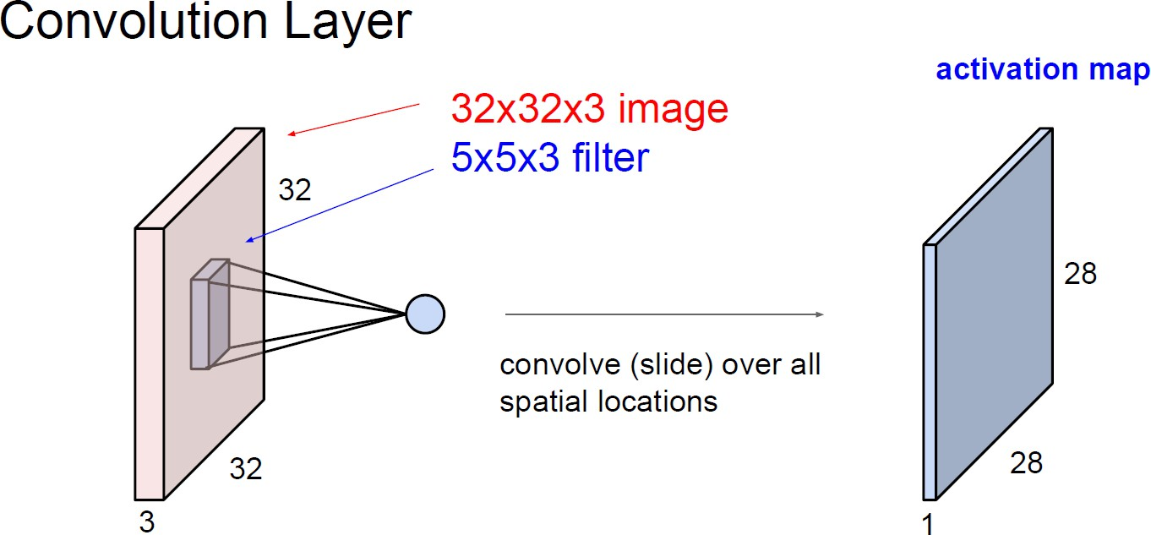
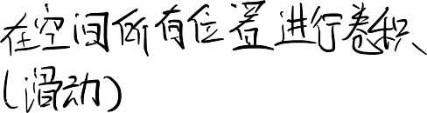
Convolution Layer
CNN
activation map
convolve (slide) over all spatial locations

Slide 19
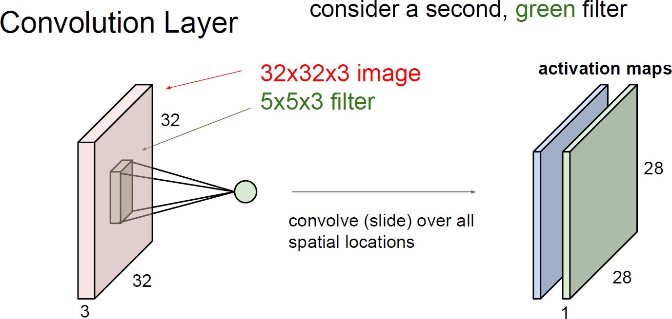
Convolution Layer
CNN
activation map
convolve (slide) over all spatial locations

Slide 20
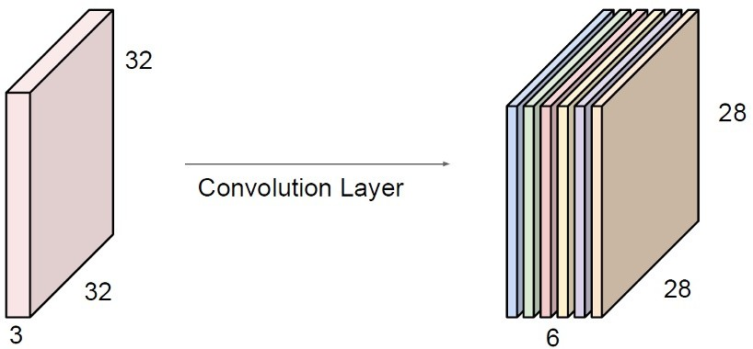
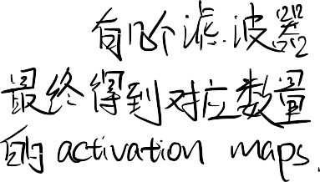





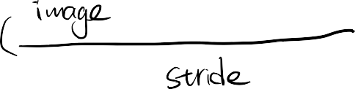


For example, if we had 6 5x5 filters, we’ll get 6 separate activation maps:
CNN
activation maps
We stack these up to get a “new image” of size 28x28x6!

Slide 21
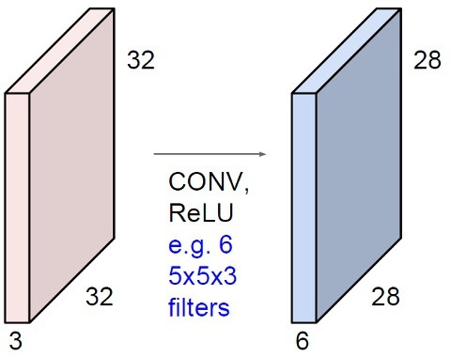
Preview: ConvNet is a sequence of Convolution Layers, interspersed with activation functions
预览：ConvNet是由卷积层序列组成，其间穿插激活函数的结构。
CNN

Slide 22
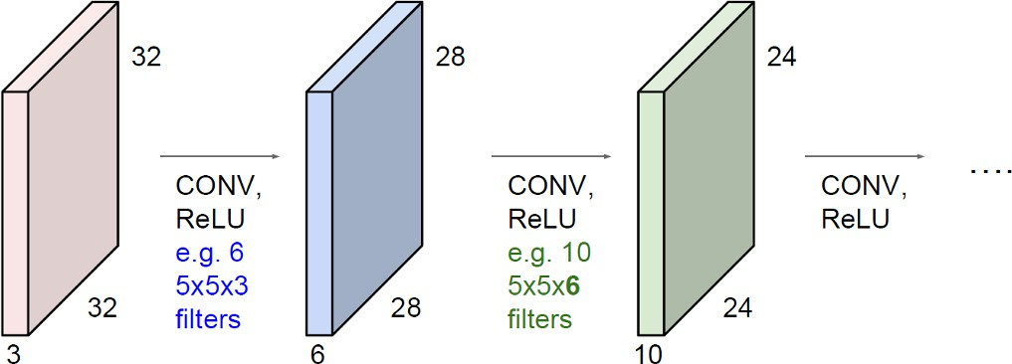














Preview: ConvNet is a sequence of Convolution Layers, interspersed with activation functions
CNN

Slide 23
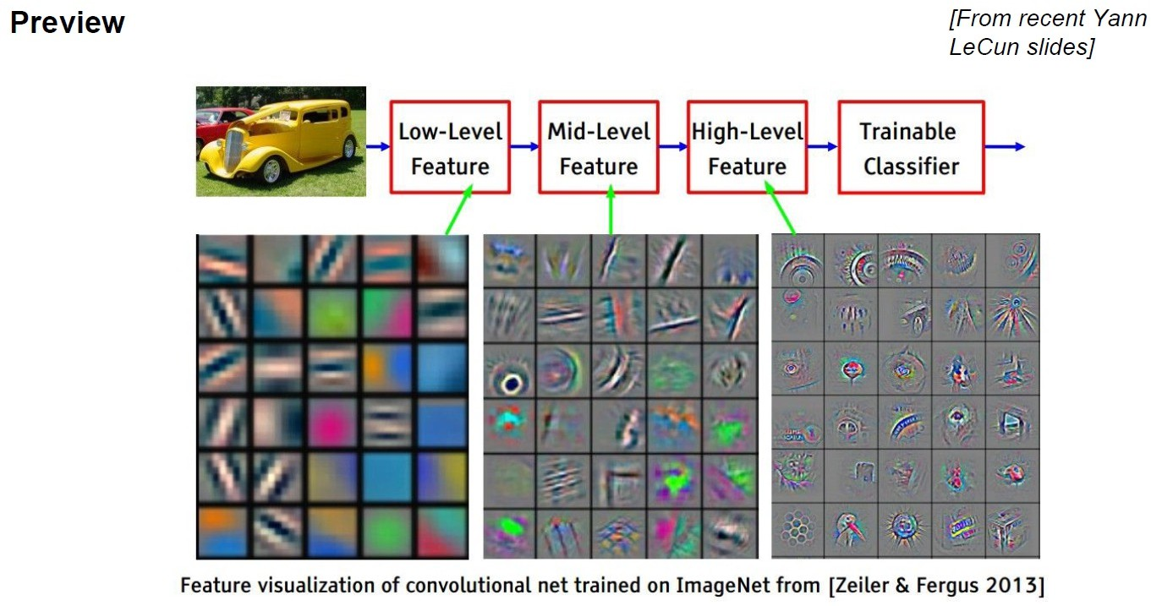
Preview
CNN

Slide 24
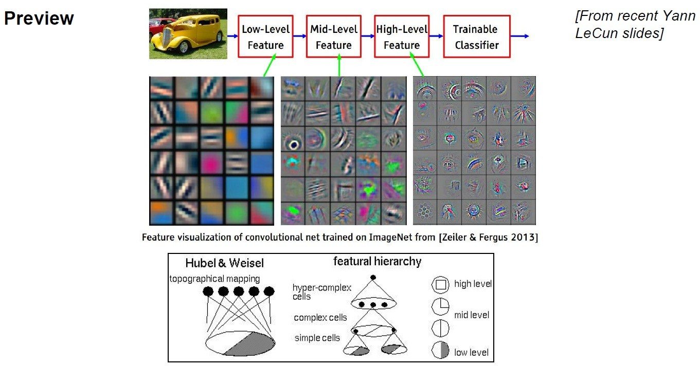
Preview
CNN

Slide 25





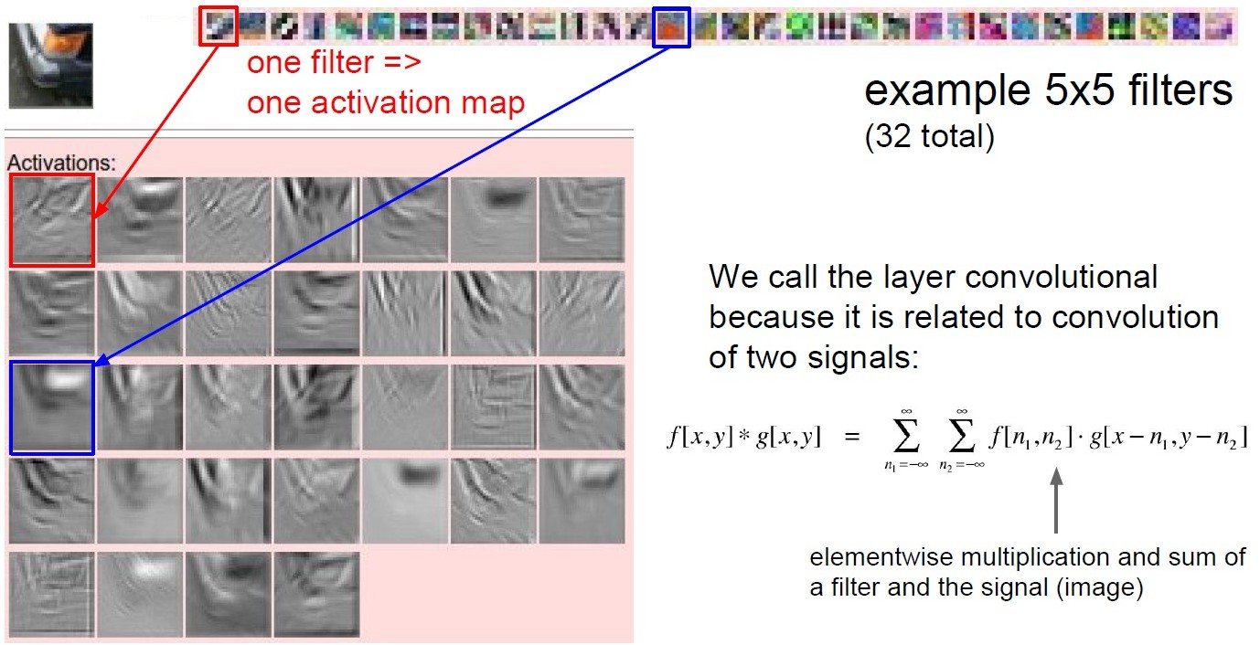




CNN
We call the layer convolutional because it is related to convolution of two signals:
elementwise multiplication and sum of a filter and the signal (image)

Slide 26
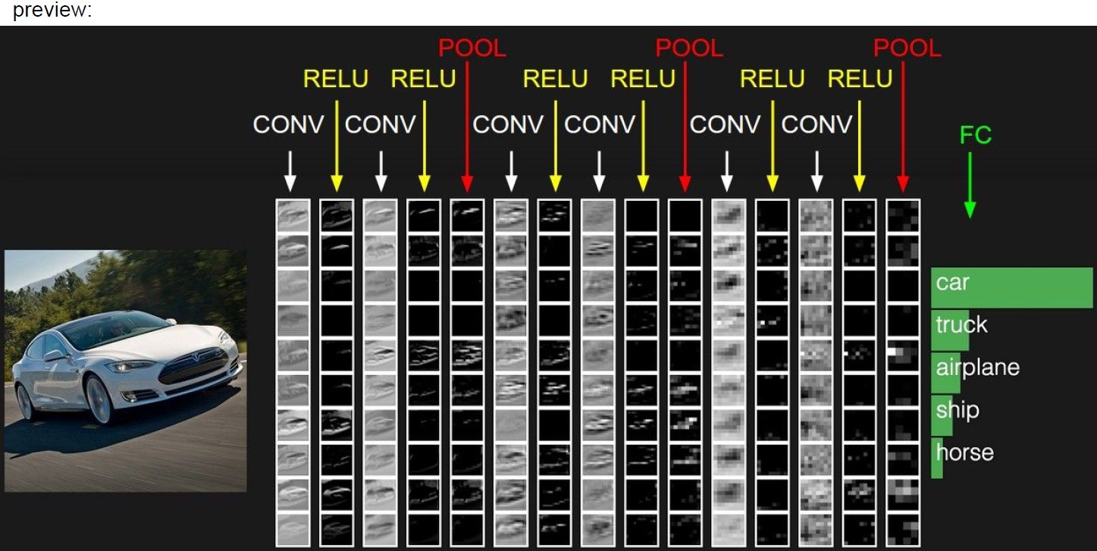

Preview:
CNN
CONV -> RELU：在上⼀步被浓缩过的特征图上，继续寻找更⾼级、更抽象的特征组合（⽐如 “⻋灯+格栅”的组合）。
POOL：再次进⾏“总结和压缩”，特征图变得更⼩。

Slide 27
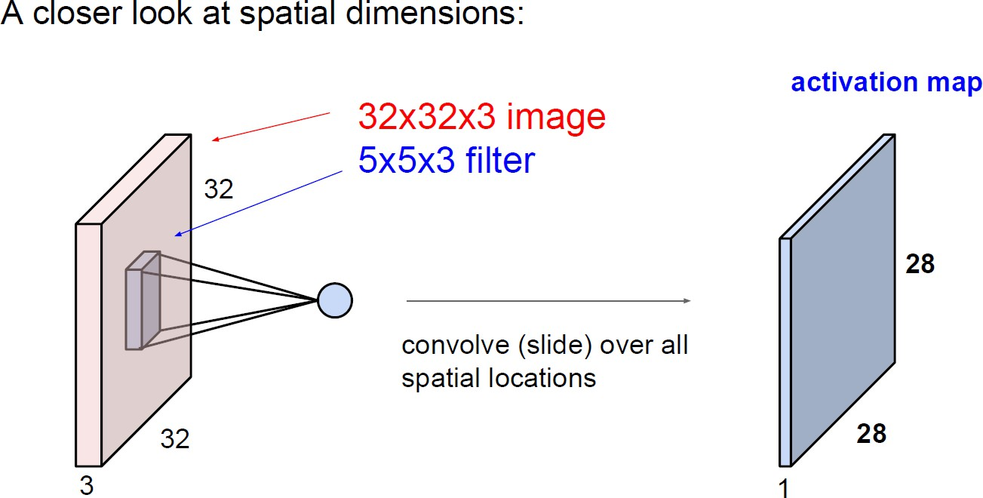
A closer look at spatial dimensions:
CNN
convolve (slide) over all spatial locations

Slide 28
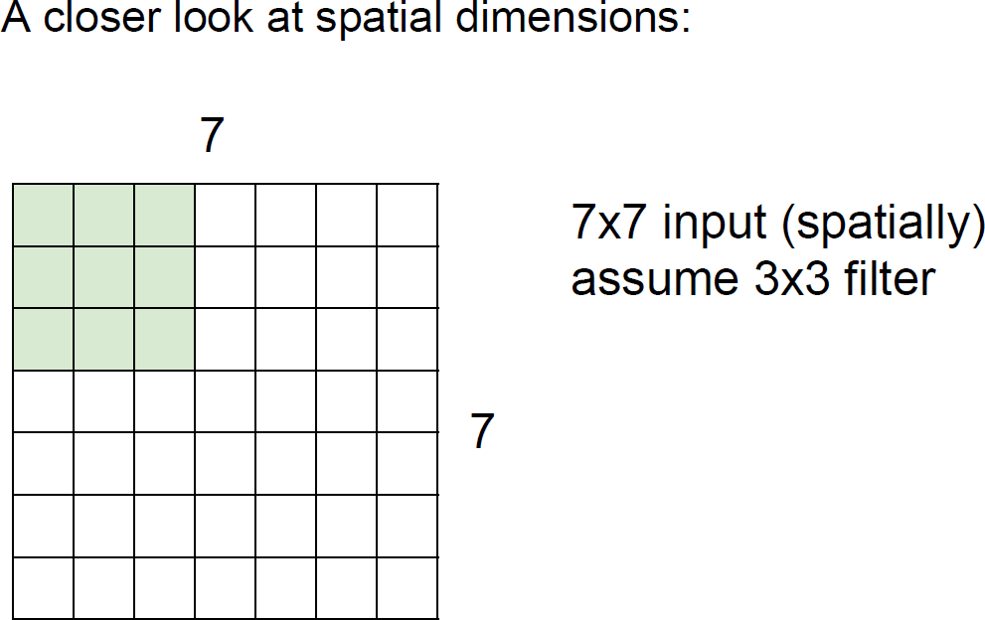
CNN
A closer look at spatial dimensions:
7x7 input (spatially) assume 3x3 filter

Slide 29
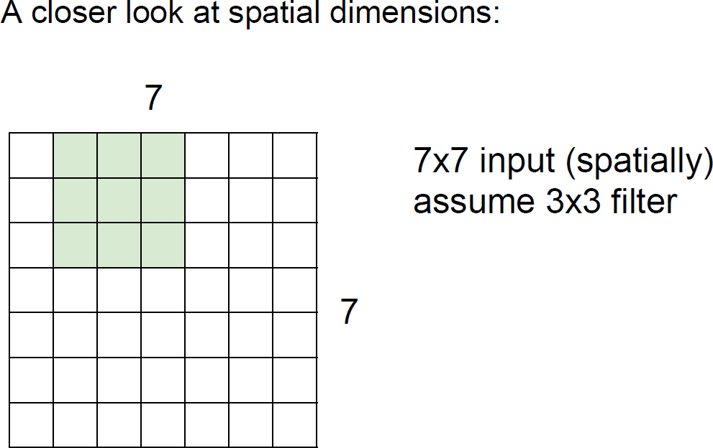
CNN
A closer look at spatial dimensions:
7x7 input (spatially) assume 3x3 filter

Slide 30
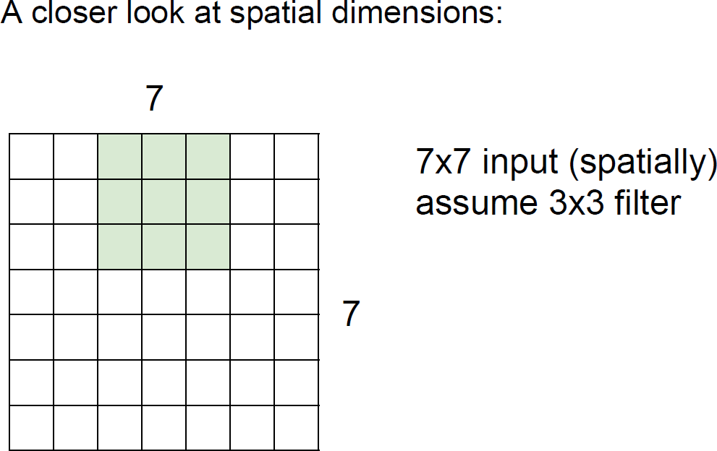
CNN
A closer look at spatial dimensions:
7x7 input (spatially) assume 3x3 filter

Slide 31
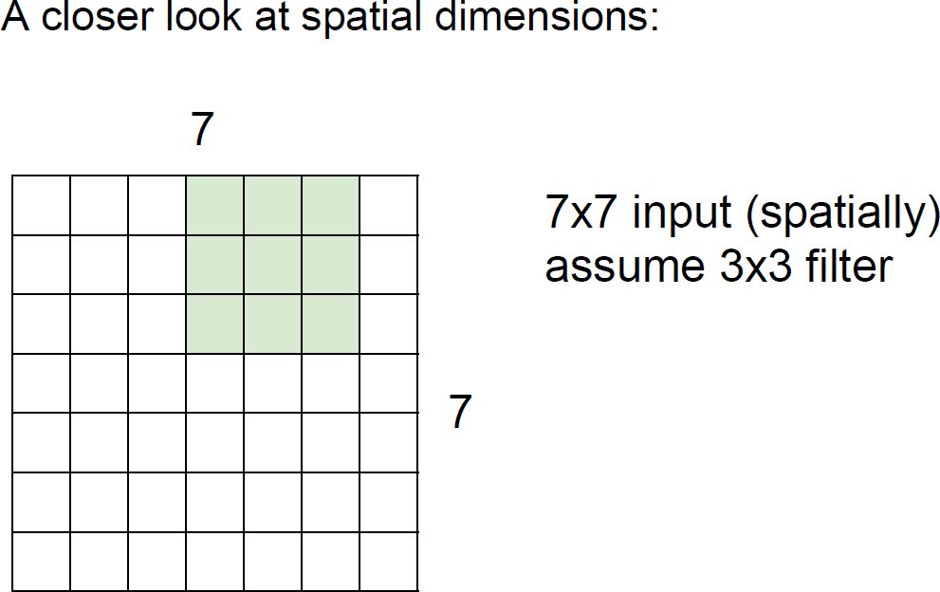
CNN
A closer look at spatial dimensions:
7x7 input (spatially) assume 3x3 filter

Slide 32
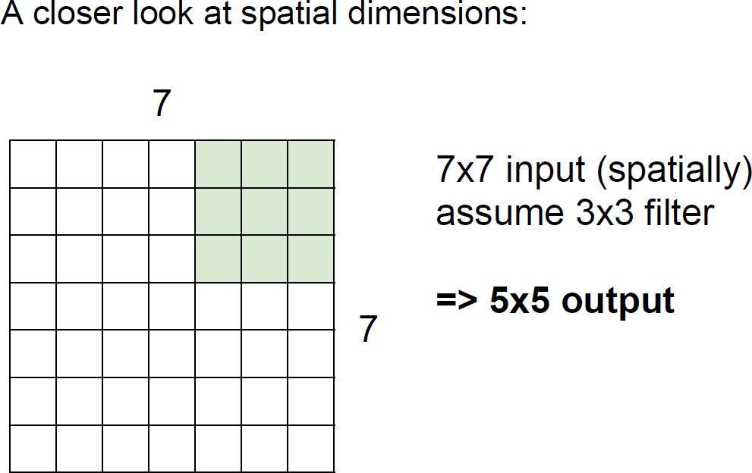
A closer look at spatial dimensions:
CNN
7x7 input (spatially) assume 3x3 filter
=> 5x5 output

Slide 33
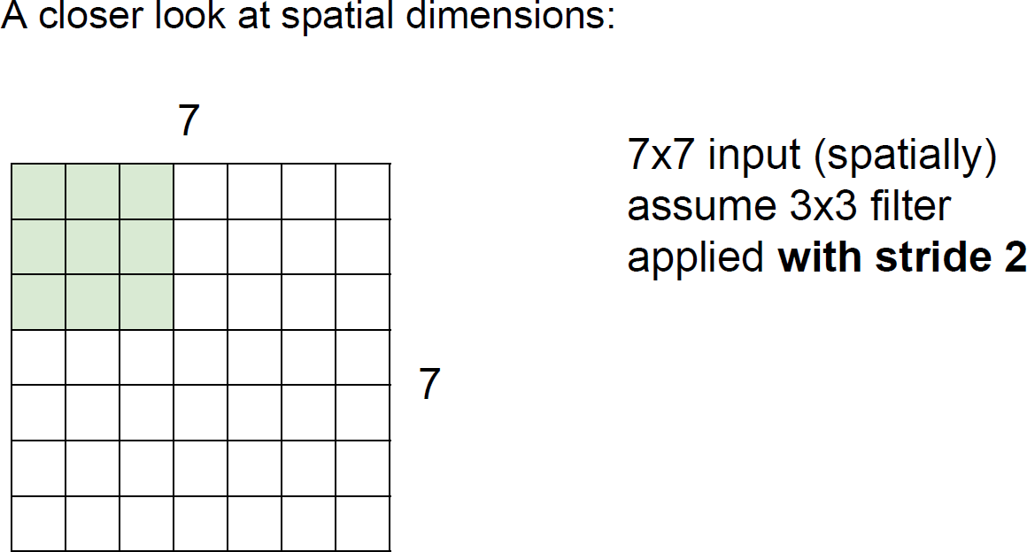

CNN
A closer look at spatial dimensions:
7x7 input (spatially) assume 3x3 filter applied with stride 2

Slide 34
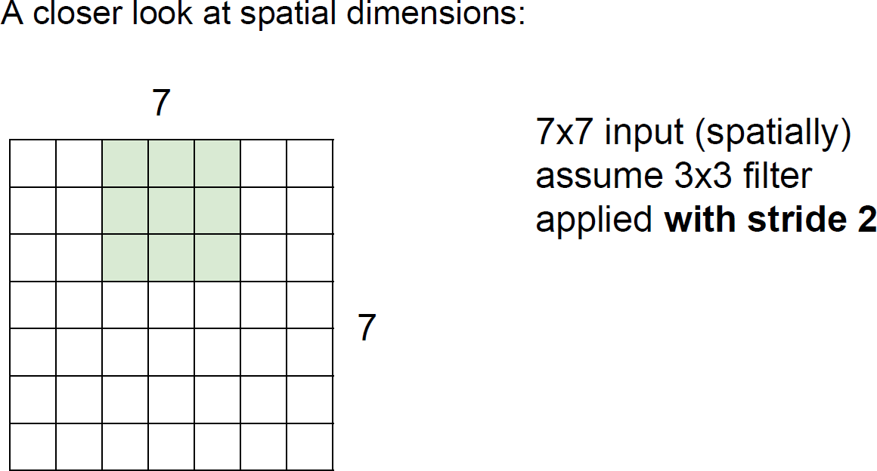
CNN
A closer look at spatial dimensions:
7x7 input (spatially) assume 3x3 filter applied with stride 2

Slide 35
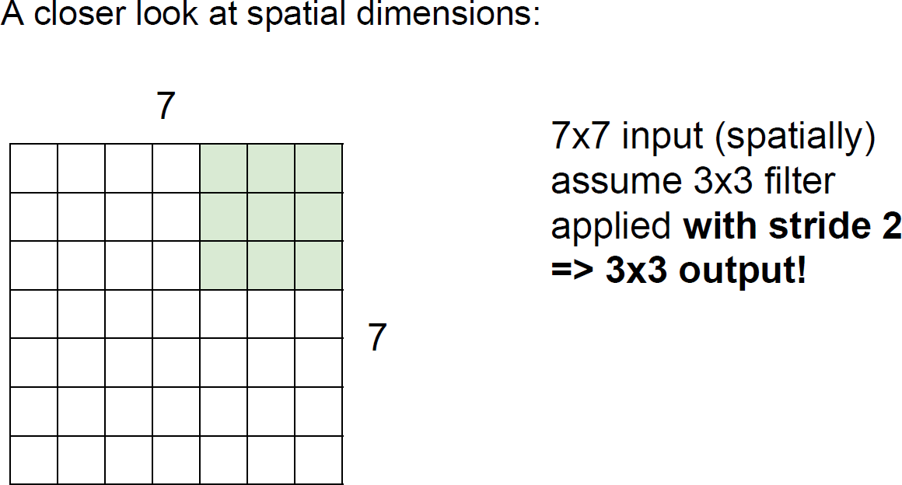
A closer look at spatial dimensions:
CNN
7x7 input (spatially) assume 3x3 filter applied with stride 2
=> 3x3 output!

Slide 36
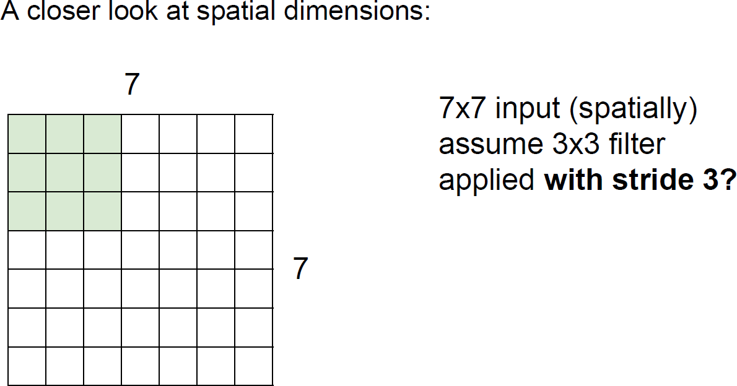

A closer look at spatial dimensions:
CNN
7x7 input (spatially) assume 3x3 filter
applied with s tride 3?

Slide 37
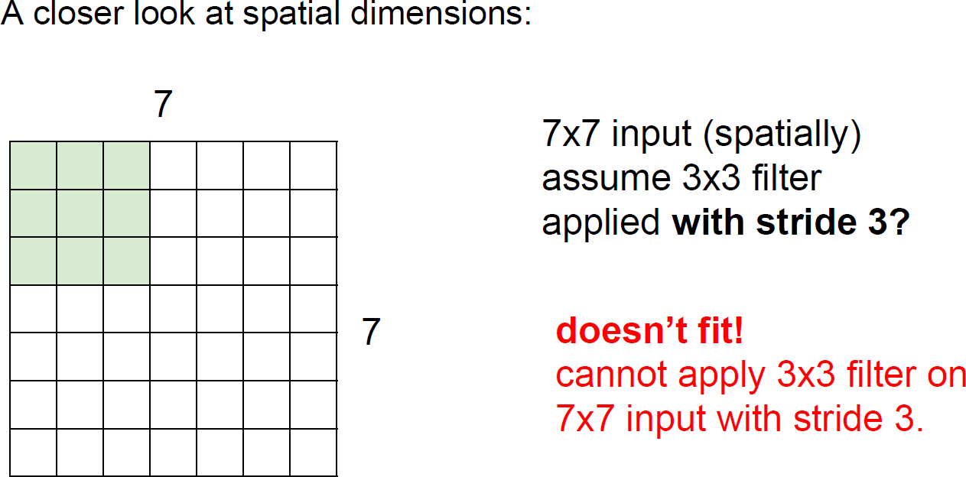
A closer look at spatial dimensions:
CNN
7x7 input (spatially) assume 3x3 filter applied with stride 3?
doesn‘t fit!
Cannot apply 3x3 filter on 7x7 input with stride 3.

Slide 38
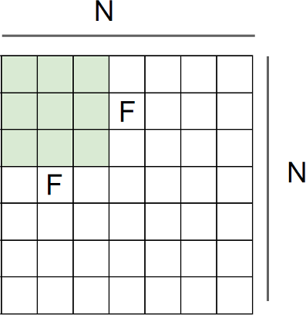

Output size:
(N - F)/stride +1
CNN
e.g., N=7, F=3:
stride 1 => (7 - 3)/1 + 1 = 5
stride 2 => (7 - 3)/2 + 1 = 3
stride 3 => (7 - 3)/3 + 1 = 2.33 :\

Slide 39
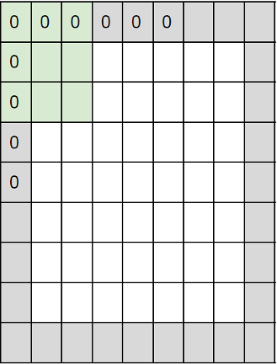


In practice: Common to zero pad the border
CNN
e.g., input 7x7
3x3 filter, applied with stride 1
pad with 1 pixel border => what is the output?
(recall:)
(N - F) / stride + 1

Slide 40

In practice: Common to zero pad the border
CNN
e.g., input 7x7
3x3 filter, applied with stride 1
pad with 1 pixel border => what is the output?
7x7 output!

Slide 41


In practice: Common to zero pad the border
CNN
e.g., input 7x7
3x3 filter, applied with stride 1
pad with 1 pixel border => what is the output?
7x7 output!
in general, common to see CONV layers with stride 1, filters of size FxF, and zero-padding with (F-1)/2. (will preserve size spatially)
e.g., F = 3 => zero pad with 1 F = 5 => zero pad with 2 F = 7 => zero pad with 3

Slide 42

CNN
例如，32x32的输⼊通过5x5滤波器重复卷积会导致空间维度快速收缩
（32→28→24…）。收缩速度过快效果不佳，会影响模型性能。
Remember back to …
E.g. 32x32 input convolved repeatedly with 5x5 filters shrinks volumes spatially! (32 -> 28 -> 24 …). Shrinking too fast is not good, doesn’t work well.

Slide 43
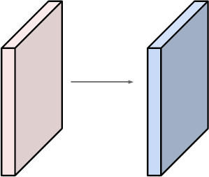
Examples time:
CNN
Input volume: 32x32x3
10 5x5 filters with stride 1, pad 2
Output volume size:?

Slide 44

Examples time:
CNN
Input volume: 32x32x3
10 5x5 filters with stride 1, pad 2
Output volume size:
(32+2*2-5)/1+1=32 spatially, so 32x32x10

Slide 45
Examples time:
CNN
Input volume: 32x32x3
10 5x5 filters with stride 1, pad 2
Number of parameters in this layer?

Slide 46

Examples time:
CNN
Input volume: 32x32x3
10 5x5 filters with stride 1, pad 2
Number of parameters in this layer? Each filter has 5*5*3 +1 = 76 params
=> 76*10=760
(+1 for bias)

Slide 47












Summary. To summarize, the Conv layer:
CNN
Accepts a volume of size 𝘸₁×𝐻₁×𝐷₁
Requires four hyperparameters:
Number of filters 𝐾,
Their spatial extent 𝐹,
The stride 𝑆,
The amount of zero padding 𝑃.
拿⼀个的滤波器（⽐如“边缘探测器”），在扫描整张图⽚时，⽤的是同⼀组权重。它不会在左上⻆⽤⼀套权重，到右下⻆⼜换⼀套。
这就是“参数共享”：⼀个滤波器（⼀组参数）被共享给图
⽚的所有位置使⽤。
Produces a volume of size 𝘸₂×𝐻₂×𝐷₂ where:
𝘸₂ = (𝘸₁ − 𝐹 + 5𝑃)⁄𝑆 + 1
𝐻₂ = (𝐻₁ − 𝐹 + 5𝑃)⁄𝑆 + 1 (i.e. width and height are computed equally by symmetry)
𝐷₂ = 𝐾
With parameter sharing, it introduces 𝐹 * 𝐹 * 𝐷₁ weights per filter, for a total of (𝐹 * 𝐹 * 𝐷₁) * 𝐾
weights and 𝐾 biases.
In the output volume, the 𝑑-th depth slice (of size 𝘸₂×𝐻₂) is the result of performing a valid convolution of the 𝑑-th filter over the input volume with a stride of 𝑆, and then offset by 𝑑-th bias.
输出⽅块中的第 d 个切⽚（D-th depth slice），就是⽤第 d 个滤波器
（d-th ﬁlter）在整个输⼊⽅块上做完卷积（滑动、乘加）并加上偏置项 d-th bias 后的结果。

Slide 48
Summary. To summarize, the Conv layer:
CNN
Accepts a volume of size 𝘸₁×𝐻₁×𝐷₁
Requires four hyperparameters:
  Number of filters 𝐾,
  Their spatial extent 𝐹,
  The stride 𝑆,
  The amount of zero padding 𝑃.
Common settings:
K = (powers of 2, e.g., 32, 64, 128, 512)
- F = 3, S = 1, P = 1
- F = 5, S = 1, P = 2
- F = 5, S = 2, P = ? (whatever fits)
- F = 1, S = 1, P = 0
Produces a volume of size 𝘸₂×𝐻₂×𝐷₂ where:
  𝘸₂ = (𝘸₁ − 𝐹 + 5𝑃)⁄𝑆 + 1
  𝐻₂ = (𝐻₁ − 𝐹 + 5𝑃)⁄𝑆 + 1 (i.e. width and height are computed equally by symmetry)
  𝐷₂ = 𝐾
With parameter sharing, it introduces 𝐹 * 𝐹 * 𝐷₁ weights per filter, for a total of (𝐹 * 𝐹 * 𝐷₁) * 𝐾
weights and 𝐾 biases.
In the output volume, the 𝑑-th depth slice (of size 𝘸₂×𝐻₂) is the result of performing a valid convolution of the 𝑑-th filter over the input volume with a stride of 𝑆, and then offset by 𝑑-th bias.

Slide 49
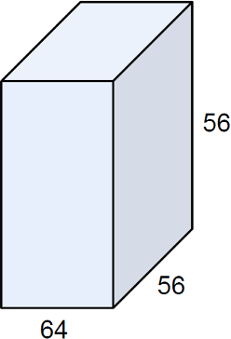
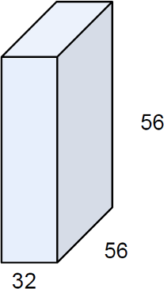
(btw, 1x1 convolution layers make perfect sense)
CNN
1x1 CONV with 32 filters
(each filter has size 1x1x64, and performs a 64-dimensional dot product)

Slide 50
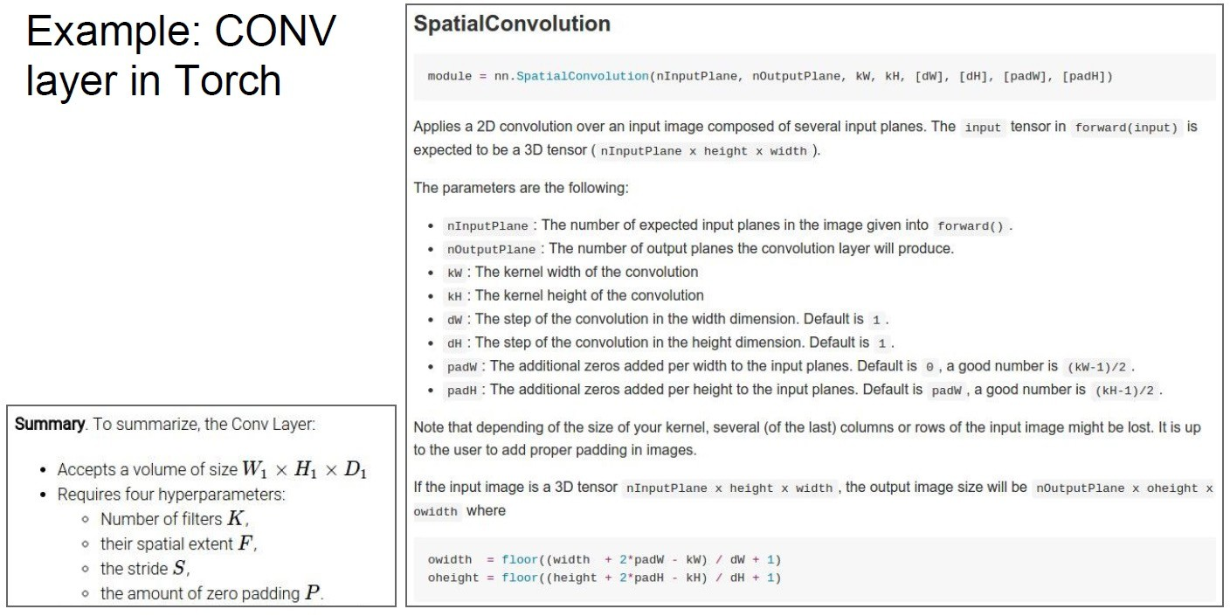
CNN

Slide 51
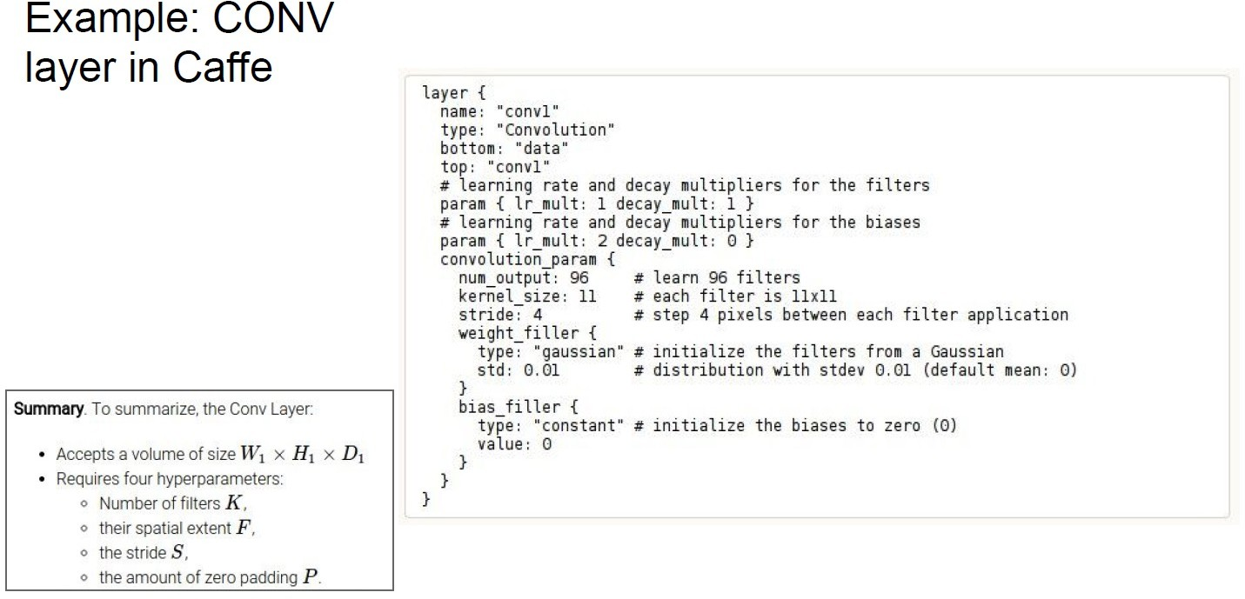
CNN

Slide 52
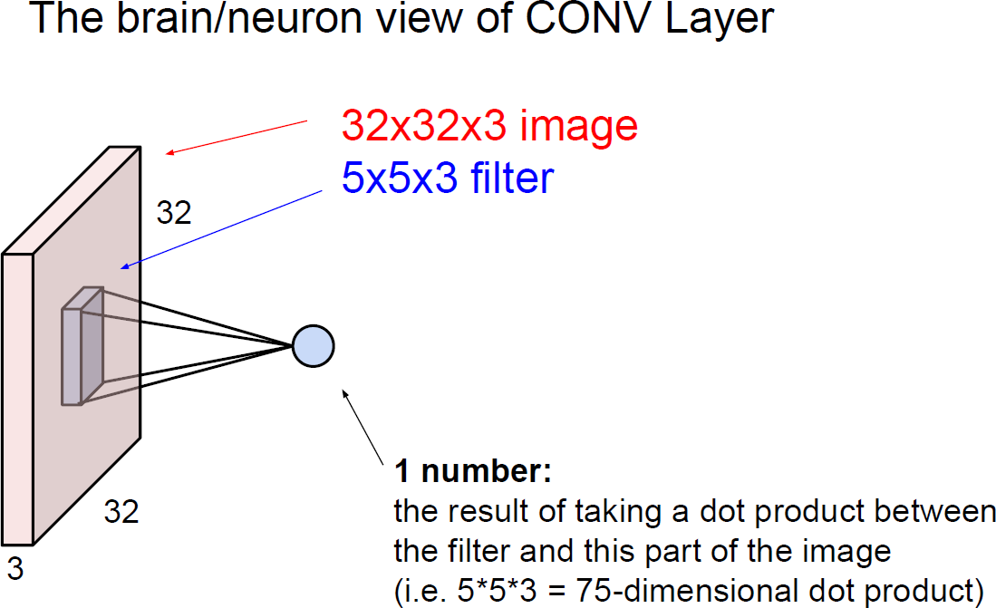
The brain/neuron view of CONV Layer
CNN
the result of taking a dot product between the filter and this part of the image (i.e.
5*5*3 = 75-dimensional dot product)

Slide 53
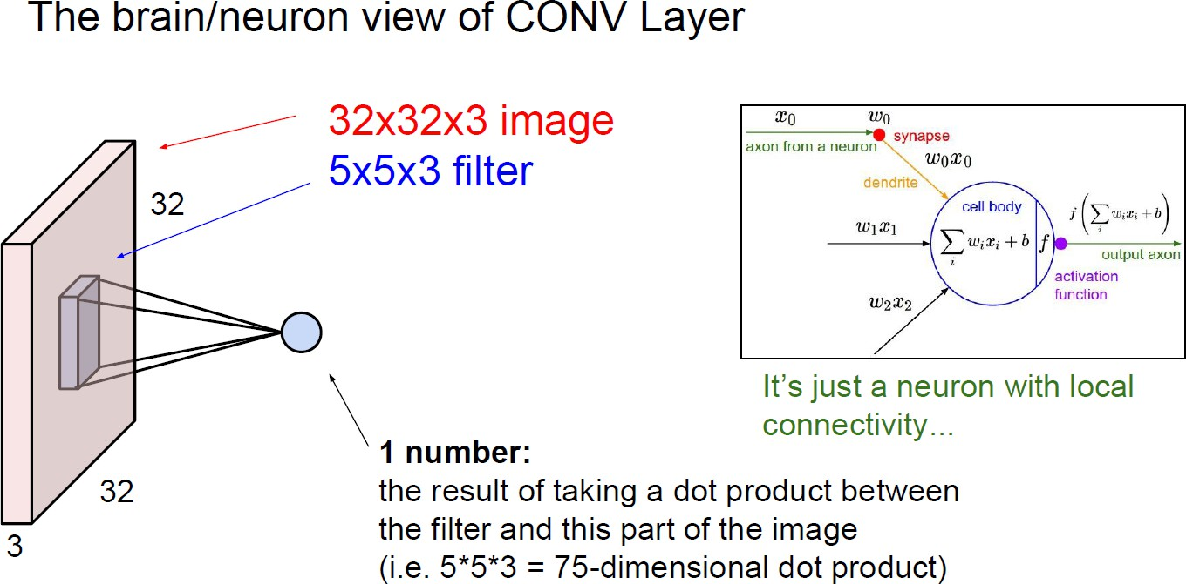
The brain/neuron view of CONV Layer
CNN
It’s just a neuron with local connectivity…
the result of taking a dot product between the filter and this part of the image (i.e.
5*5*3 = 75-dimensional dot product)

Slide 54
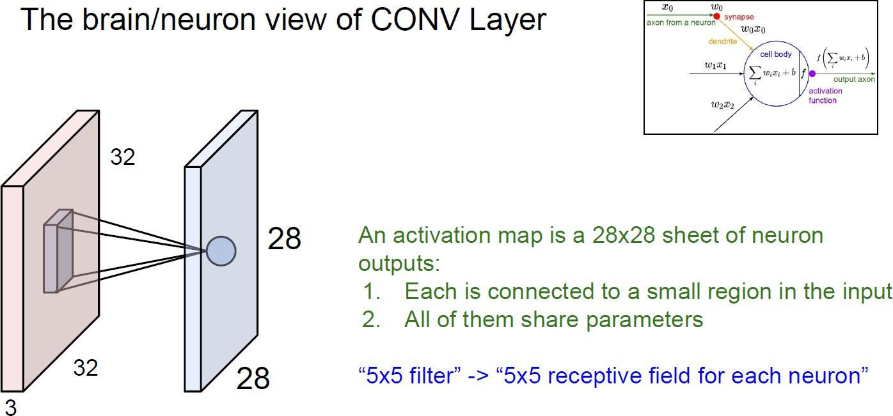
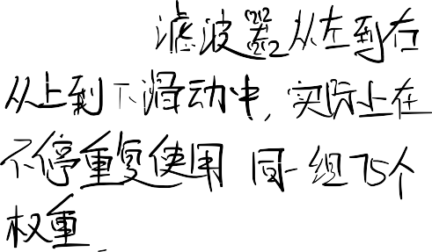
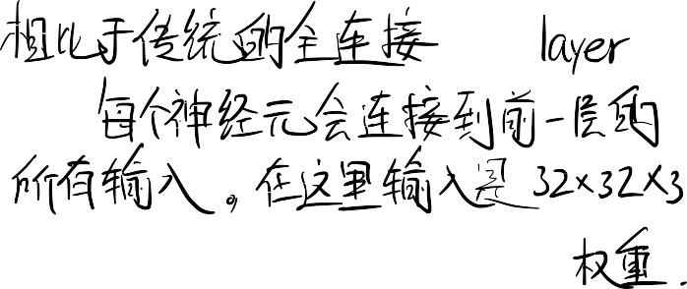




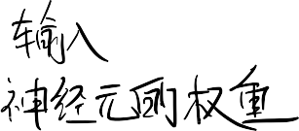









The brain/neuron view of CONV Layer
CNN
An activation map is a 28x28 sheet of neuron outputs:
Each is connected to a small region in the input
All of them share parameters
“5x5 filter” -> “5x5 receptive field for each neuron”

Slide 55


The brain/neuron view of CONV Layer
CNN
E.g., with 5 filters, CONV layer consists of neurons arranged in a 3D grid (28x28x5)
There will be 5 different neurons all looking at the same region in the input volume
⼀个卷积层（CONV Layer）就是⼀⼤群“克隆”神经元的集合。
"克隆"体现在哪⾥？(参数共享)：滤波器 1 在 (x,y) 位置的那个神经元，和它在 (x+1, y) 位置的那个神经元，是“克隆”的（共享同⼀组权重）。
"不同"体现在哪⾥？(多滤波器)：在同⼀个 (x,y) 位置，滤波器 1 的神经元和 滤波器 2 的神经元是不同的（它们权重不同，在寻找不同的特征）。

Slide 56

two more layers to go: POOL/FC
CNN

Slide 57

Pooling layer
CNN
池化层使特征表示更⼩且更易于处理，并对每个激活图独⽴进⾏运算。
makes the representations smaller and more manageable
operates over each activation map independently:

Slide 58


MAX POOLING
CNN

Slide 59



CNN
Accepts a volume of size 𝘸₁×𝐻₁×𝐷₁
Requires three hyperparameters:
  Their spatial extent 𝐹,
  The stride 𝑆,
Produces a volume of size 𝘸₂×𝐻₂×𝐷₂ where:
  𝘸₂ = (𝘸₁ − 𝐹)⁄𝑆 + 1
  𝐻₂ = (𝐻₁ − 𝐹)⁄𝑆 + 1
  𝐷₂ = 𝐷₁
Introduces zero parameters since it computes a fixed function of the input
Note that it is not common to use zero-padding for Pooling layers

Slide 60
CNN
Accepts a volume of size 𝘸₁×𝐻₁×𝐷₁
Requires three hyperparameters:
  Their spatial extent 𝐹,
  The stride 𝑆,
Common settings:
F = 2, S = 2
F = 3, S = 2
Produces a volume of size 𝘸₂×𝐻₂×𝐷₂ where:
  𝘸₂ = (𝘸₁ − 𝐹)⁄𝑆 + 1
  𝐻₂ = (𝐻₁ − 𝐹)⁄𝑆 + 1
  𝐷₂ = 𝐷₁
Introduces zero parameters since it computes a fixed function of the input
Note that it is not common to use zero-padding for Pooling layers

Slide 61

Fully Connected Layer (FC layer)
CNN
- Contains neurons that connect to the entire input volume, as in ordinary Neural Networks

Slide 62

Case Study: LeNet-5
CNN
Conv filters were 5x5, applied at strid 1
Subsampling (Pooling) layers were 2x2 applied at stride 2
i.e. architecture is [CONV-POOL-CONV-POOL-CONV-FC]

Slide 63

Case Study: AlexNet
CNN
Input: 227x227x3
First layer (CONV1)：96 11x11 filters applied at stride 4
Q: what is the output volume size? Hint: (227-11)/4+1=55

Slide 64




Input: 227x227x3
CNN
First layer (CONV1)：96 11x11 filters applied at stride 4
Output volume [55x55x96]
Q: what is the total number of parameters in this layer?

Slide 65

Input: 227x227x3
CNN
First layer (CONV1)：96 11x11 filters applied at stride 4
Output volume [55x55x96]
Parameters: (11*11*3)*96 = 35K

Slide 66




CNN
Input: 227x227x3 image After CONV1: 55x55x96
Second layer (POOL1): 3x3 filters applied at stride 2 Output volume: 27x27x96
Q: what is the number of parameters in this layer?

Slide 67







CNN
Input: 227x227x3 image After CONV1: 55x55x96
Second layer (POOL1): 3x3 filters applied at stride 2 Output volume: 27x27x96
Parameters: 0!

Slide 68

CNN

Slide 69

CNN
Details/Retrospectives:
First use of ReLU
Used Norm layers (not common anymore)
Heavy data augmentation
Dropout 0.5
Batch size 128
SGD Momentum 0.9
Learning rate 1e-2, reduced by 10 Manually when val accuracy plateaus
L2 weight decay 5e-4
- 7 CNN ensemble: 18.2% -> 15.4%

Slide 70

1. 最⼤的改变：CONV1 (第⼀层卷积)
AlexNet 的做法 (旧)：11x11 的超⼤滤波器，stride 4（步⻓4）。
缺点：这太“激进”了！11x11 的⼤“⽹”和 4 格⼀“跳”的步⻓，导致它在第⼀层就错过了很多图⽚中的细节和⼩特征。
ZFNet 的做法 (新)：7x7 的滤波器，stride 2（步⻓2）。
优点：如图表左上⻆所示，更⼩的滤波器（filter size 7）和更⼩的步⻓（stride 2），意味着⽹络在第⼀层可以更“仔细”、更“温柔”地扫描图
⽚。它能捕捉到那些被 AlexNet 忽略的细节，为后续的特征提取打下更好的基础。
CNN
结果：你可以看到，经过第⼀层卷积后，AlexNet 的特征图很⼩（55x55），⽽ ZFNet 的特征图更⼤（110x110），保留了更多的空间信息。
AlexNet but:
CONV1: change from (11x11 stride 4) to (7x7 stride 2) CONV3,4,5: instead of 384, 384, 256 filters use 512, 1024, 512
ImageNet top 5 error: 15.4% -> 14.8%
2. 另⼀个改变：更“深”的中间层
AlexNet 的做法 (旧)：中间的 CONV3, 4, 5 层的滤波器数量分别是 384, 384, 256。
ZFNet 的做法 (新)：把这些层的滤波器数量⼤幅增加到了 512, 1024, 512。
优点：我们之前学过，滤波器的数量（K）决定了输出的“深度”（D₂）。通过增加 K，ZFNet 给了⽹络更强⼤的“特征容量”，让它可以在中间层学习到更丰富、更复杂的特征组合。

Slide 71

"Only 3x3 CONV stride 1, pad 1" (只⽤ 3x3 卷积)
3x3：这是能捕捉“上/下/左/右/中”概念的最⼩滤波器尺⼨。 stride 1：步⻓为1，保证“仔仔细细”地扫描。
pad 1：这是天才之举！ 我们来算⼀下⻩⾦公式 (W - F + 2P) / S + 1： (W - 3 + 2*1) / 1 + 1 = W - 3 + 2 + 1 = W
这意味着，只要经过 3x3, pad 1 的卷积，特征图的空间尺⼨ (W, H) 永远不会改变！
这有什么⽤？ 这让 VGGNet 可以随⼼所欲地“堆叠”卷积层（⽐如连堆 3 个 conv3-256），⽽不⽤担⼼图⽚尺⼨在中间被“意外”缩⼩。
CNN
Only 3x3 CONV stride 1, pad1 And 2x2 MAX POOL stride 2
best model
11.2% top 5 error in ILSVRC 2013
->
7.3% top 5 error
"And 2x2 MAX POOL stride 2" (只⽤ 2x2 池化)
VGGNet 只在它“想”缩⼩尺⼨的时候，才显式地插⼊⼀个 2x2, stride 2 的池化层。我们再算⼀次⻩⾦公式 (W - F) / S + 1：
(W - 2) / 2 + 1 = W/2 - 1 + 1 = W/2
这意味着，每⼀次池化，特征图的⻓宽都“⼲净利落”地缩⼩⼀半。224 -> 112 -> 56 -> 28 -> 14 -> 7。

Slide 72

CNN

Slide 73

CNN

Slide 74

"Note: Most memory is in early CONV" (⼤部分“内存”消耗在“早期的”卷积层)
看“memory”列：CONV3-64 层的激活图 (activations) 尺⼨是 224*224*64。这个⽅块本身就要占⽤ 3.2M 的内存（这还只是⼀个开始！）。
为什么？ 因为 VGG 为了保持尺⼨不变，在前⾯⼏层⼀直维持着 224x224 和 112x112 这样超⼤的空间分辨率。这些巨⼤的“中间产物”（激活图）在训练时必须全部保存在显存中，导致内存开销极其恐怖。
CNN
Note:
Most memory is in early CONV
Most params are in late FC
"Note: Most params are in late FC" (⼤部分“参数”消耗在“晚期的”全连接层)
看“params”列：所有的 CONV 层（由于 3x3 很⼩，且参数共享）加起来的参数都还好。但是，看第⼀个 FC 层！
它的输⼊是 7x7x512（来⾃最后⼀个 POOL 层），输出是 4096。
我们学的“神经元”知识派上⽤场了：它需要 (7*7*512) * 4096 = 102,760,448 (超过 1 亿) 个权重！
结果：TOTAL params: 138M (1.38 亿)。VGGNet 是⼀个**极其“臃肿”和“沉重”**的庞然⼤物。它的参数量⼏乎是 AlexNet 的 10 倍！

Slide 75

CNN
Inception module
ILSVRC 2014 winner (6.7% top 5 error)

Slide 76

CNN
Fun features:
Only 5 million params! (Removes FC layers completely)
Compared to AlexNet:
12X less params
2x more compute
- 6.67% (vs. 16.4%)
12x less params (⽐ AlexNet 少 12 倍参数)
2x more compute (但计算量更密集) 6.67% (vs. 16.4%) (错误率完胜！)

Slide 77

CNN
ILSVRC 2015 winner (3.6% top 5 error)

Slide 78

CNN

Slide 79

CNN

Slide 80

CNN
ILSVRC 2015 winner (3.6% top 5 error)
2-3 weeks of training on 8 GPU machine
at runtime: faster than a VGGNet! (even though it has 8x more layers)

Slide 81

CNN
spatial dimension only 56x56!

Slide 82

CNN

Slide 83
1. "ConvNets stack CONV, POOL, FC layers"
（CNN 就是 CONV, POOL, FC 层的堆叠）
我们的认证： 正确！我们称它们为“三剑客”（CONV, ReLU, POOL）和“决策者”(FC)。这就是经典 CNN 架构的“⻣架”，我们在 AlexNet 和 VGGNet 中都看到了这个清晰的结构。
2. "Trend towards smaller filters and deeper architectures"
（趋势是使⽤更⼩的滤波器和更深的⽹络架构）
我们的认证： 太对了！这正是我们看到的 VGGNet (2014) 对 AlexNet (2012) 和 ZFNet (2013) 的“⾰命”。
AlexNet ⽤了“激进”的 11x11 滤波器。
ZFNet 改良为 7x7。
CNN
VGGNet 则定下了“极简主义”的规矩：只⽤ 3x3！
为了弥补⼩滤波器的“视野”问题，VGGNet 把⽹络堆叠到了史⽆前例的 16-19 层（deeper architectures），并证明了“深度”是王道。
Summary
ConvNets stack CONV, POOL, FC layers
Trend towards smaller filters and deeper architectures
Trend towards getting rid of POOL/FC layers (just CONV)
Typical architectures look like
[(CONV-RELU)*N-POOL?]*M-(FC-RELU)*K, SOFTMAX
where N is usually up to ~5, M is large, 0<=K<=2.
4. "Typical architectures look like..."
（经典架构的“配⽅”）
[(CONV-RELU)*N - POOL?] * M - (FC-
RELU)*K, SOFTMAX
我们的认证： 这是⼀个对 AlexNet 和
VGGNet 的完美“公式”总结！
[(CONV-RELU)*N - POOL?]: 这就是⼀个
“模块”。⽐如 VGGNet ⾥ CONV- RELU 堆叠 N=2 或 3 次，然后跟上⼀个 POOL 层。
*M: 整个⽹络就是把这个“模块”重复 M 次
（⽐如 5 次）。
(FC-RELU)*K, SOFTMAX: 最后，接上
K=2 或 3 个全连接层，并⽤
SOFTMAX 输出分类。
- but recent advances such as ResNet/GoogLeNet challenge this paradigm
3. "Trend towards getting rid of POOL/FC layers (just CONV)"
（趋势是抛弃 POOL/FC 层，（更多地）只⽤ CONV）我们的认证： 我们亲眼⻅证了！
抛弃 FC 层：这正是 GoogLeNet (2014) 的“神来之笔”！它⽤“全局平均池化 (Global Average Pooling)”替换掉了 VGGNet ⾥那“臃肿”的 1 亿参数的 FC 层，让模型参数从 138M 锐减到 5M！
抛弃 POOL 层：这个趋势（⽐如⽤ stride=2 的卷积层来代替池化层）在这⼏张幻灯⽚⾥尚未明确体现，但它预示了更现代的⽹络设 计。
5. "...but recent advances such as ResNet/GoogLeNet challenge this paradigm"
（但是，像 ResNet/GoogLeNet 这样的进展正在挑战这个“经典配⽅”）
我们的认证： 绝对正确！
GoogLeNet (我们刚看过)：它⽤“Inception 模块”
（1x1, 3x3, 5x5 并⾏计算）和“全局平均池化”，彻底打破了上⾯那个“线性堆叠”的“经典配⽅”。
ResNet (幻灯⽚提到的新⽹络)：它引⼊了“残差连接”
（跳跃连接），允许⽹络盖得更深（⼏百上千层），这是对这个“经典配⽅”的⼜⼀次颠覆。

