Slide 1

INT305 Machine Learning
Lecture 7
Decision Trees & Bias-Variance Decomposition
Siyue Yu
Department Intelligence Science
siyue.yu02@xjtlu.edu.cn

Slide 2

Today
• Decision Trees
➢Simple but powerful learning algorithm
➢Used widely in Kaggle competitions
简单但强⼤的学习算法
⼴泛⽤于Kaggle竞赛
让我们从信息论（熵，互信息等）中激发概念。
➢Let us motivate concepts from information theory (entropy, mutual
information, etc.)
• Bias-variance decomposition
➢Let us motivate methods for combining different classifiers.

Slide 3
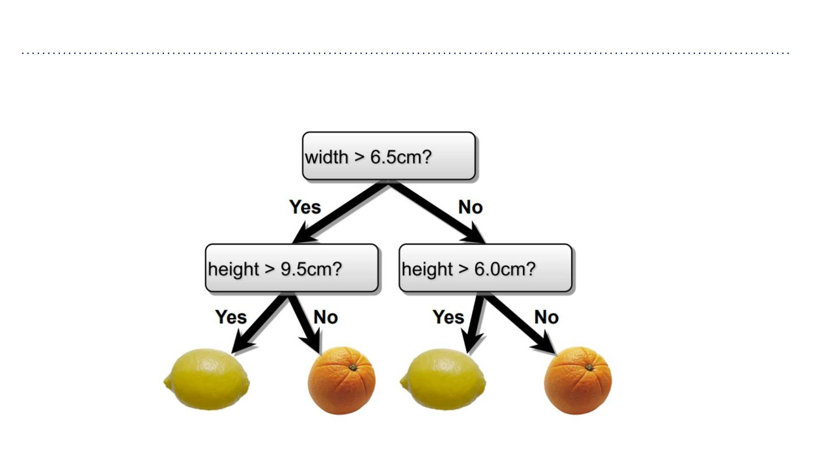
Decision Trees
• Make predictions by splitting on features according to a tree structure.

Slide 4
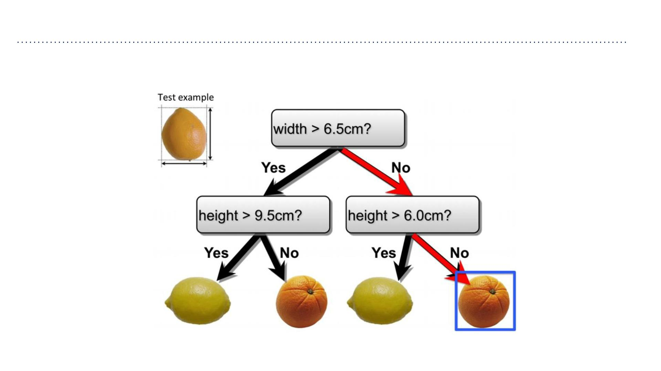
Decision Trees
• Make predictions by splitting on features according to a tree structure.
通过根据树结构对要素进⾏分割来进⾏预测。

Slide 5
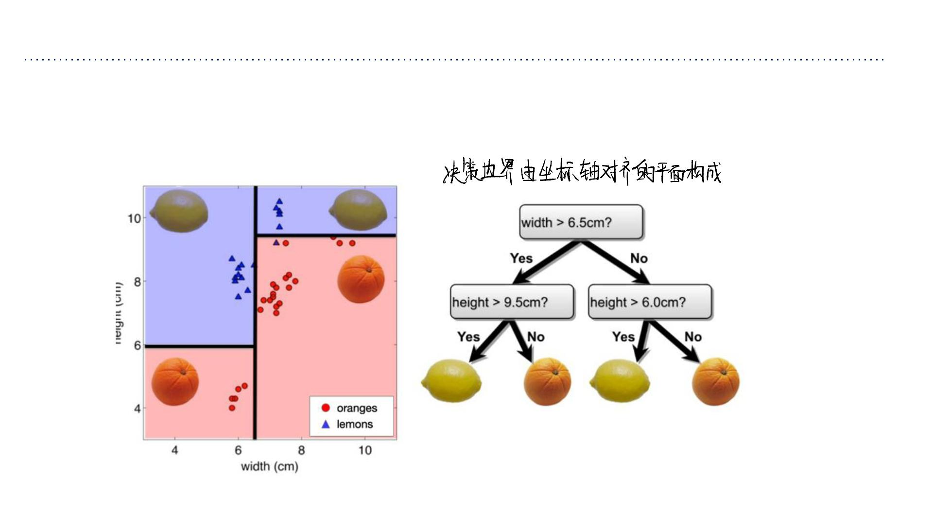
Decision Trees—Continuous Features
• Split continuous features by checking whether that feature is greater than or less than
some threshold.
通过检查特征是否⼤于或⼩于某个阈值来拆分连续特征。
• Decision boundary is made up of axis-aligned planes.

Slide 6
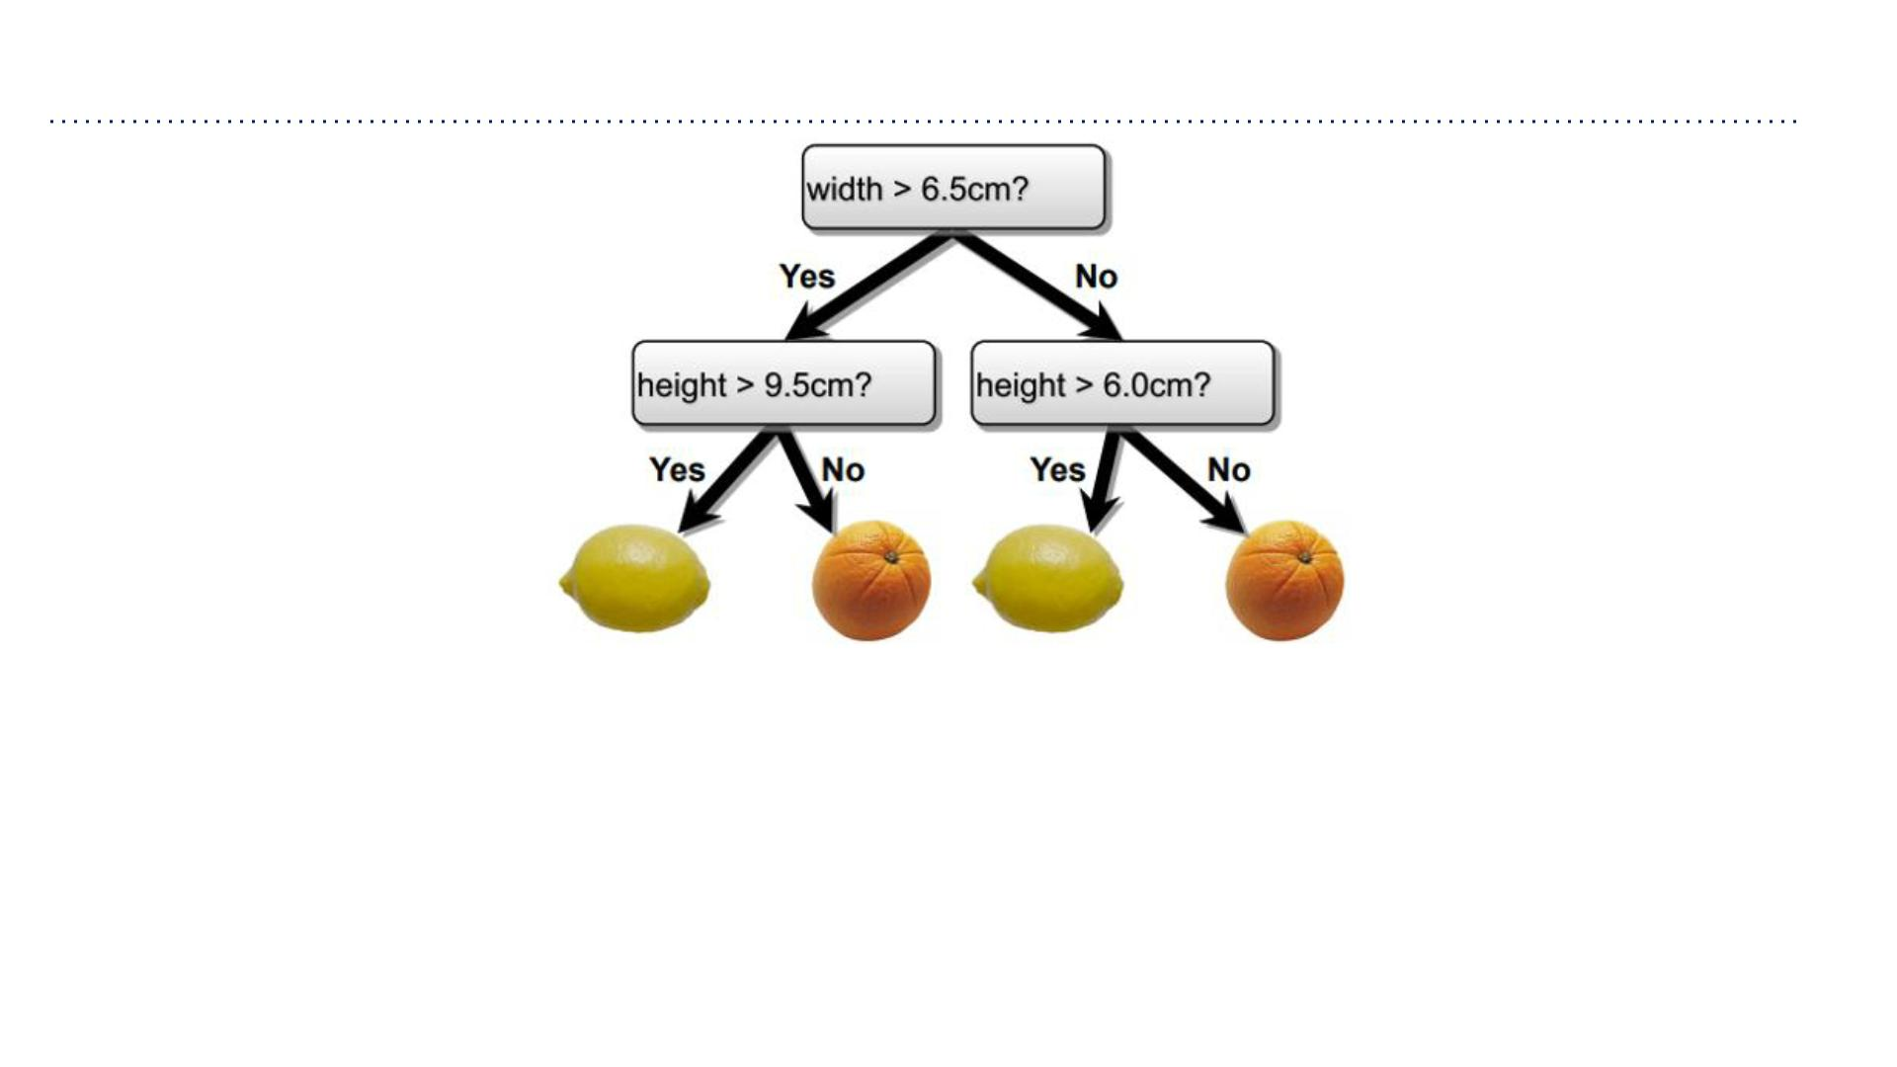
Decision Trees
• Internal nodes test a feature
• Branching is determined by the feature value
• Leaf nodes are outputs (predictions)
内部节点测试特征
分⽀由特征值决定
叶节点是输出（预测）

Slide 7
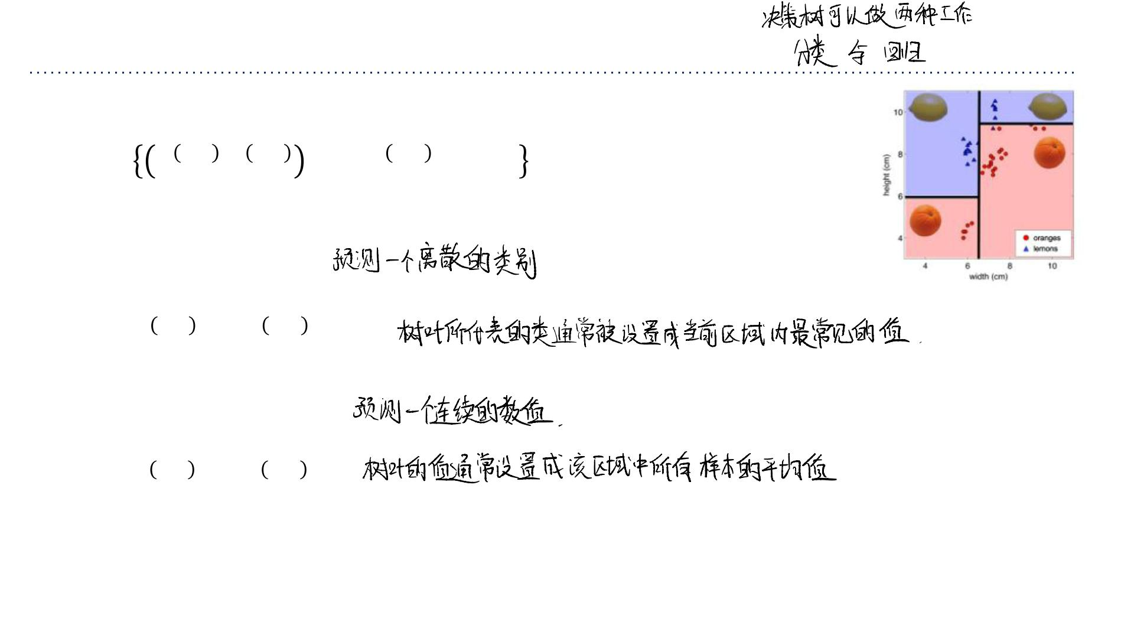
Decision Trees—Classification and Regression
从“树根”⾛到“树叶”的每⼀条路径，都定义了输⼊空间中的⼀个区域 Rm
• Each pa th from root to a leaf defines a region ꢀꢁ of input space
• Let ꢂꢁ ,ꢃ ꢁ ,⋯,(ꢂꢁ ,ꢃ^{(ꢁ )}) be the training examples that
1
1
ꢄ
ꢄ
fall into ꢀꢁ
• Classification tree (we will focus on this):
➢discrete output
➢leaf value ꢅꢁ typically set to the most common value in
ꢁ
ꢁ
ꢄ
{ꢃ ,⋯,ꢃ }
1
• Regression tree:
➢Continuous output
➢leaf value ꢅꢁ typically set to the mean value in
ꢁ
ꢁ
ꢄ
{ꢃ ,⋯,ꢃ }
1

Slide 8
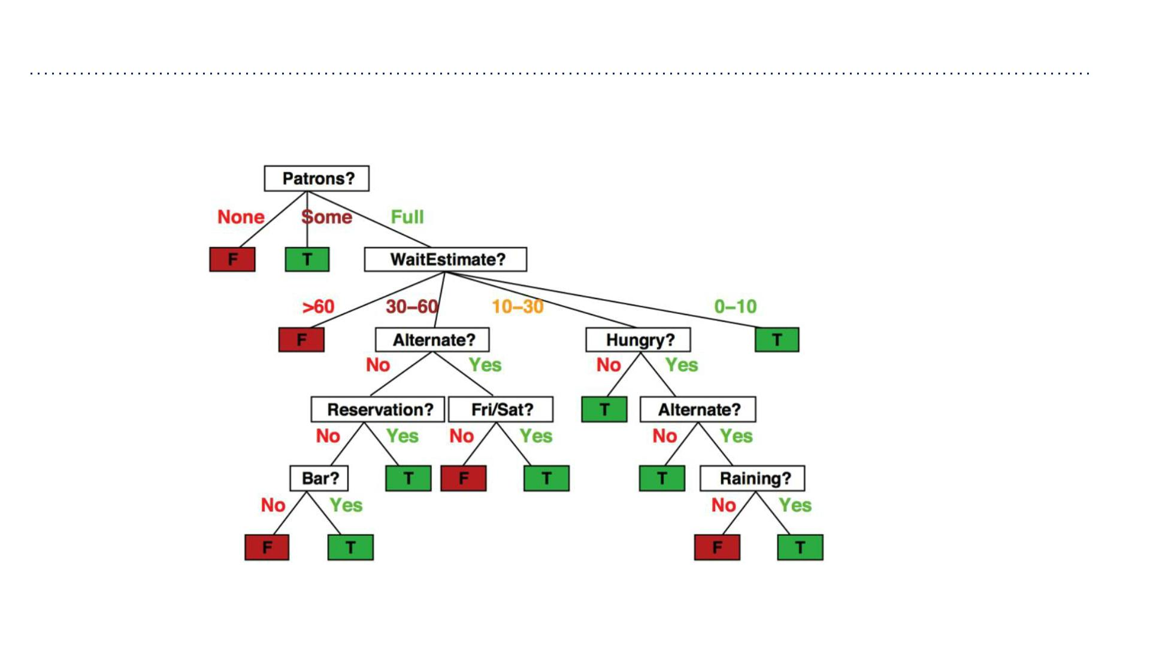
Decision Trees—Discrete Features
• Will I wait at this restaurant for dinnar?

Slide 9
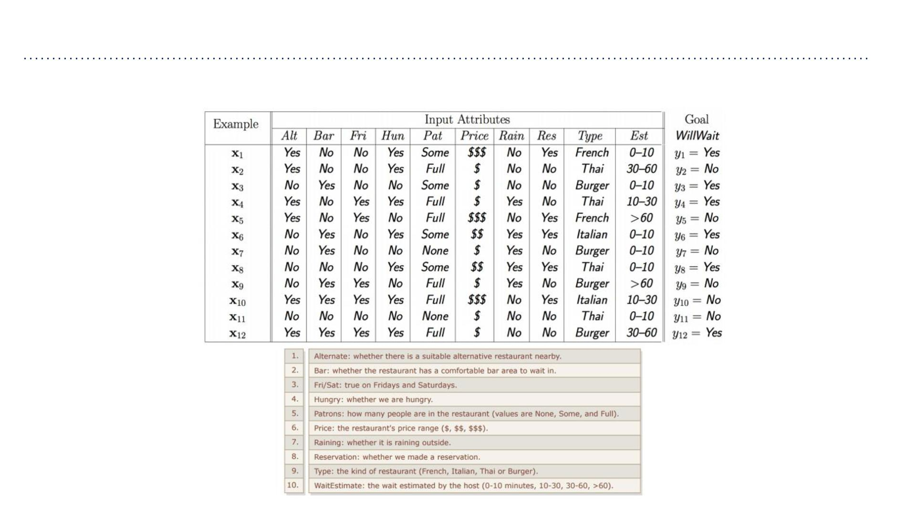
Decision Trees—Discrete Features
• Split discrete features into a partition of possible values. 将离散特征分割为可能值的划分。
Features:

Slide 10
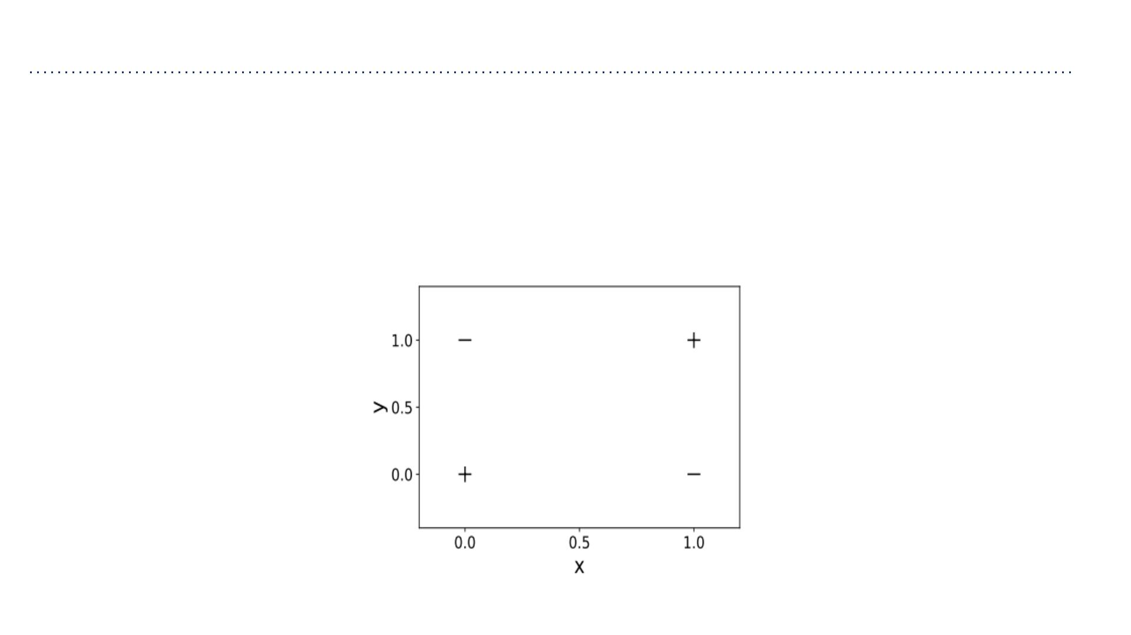
Attempts
The drawing below shows a dataset. Each example in the dataset has two
inputs features ꢂand ꢅ, and maybe classified as a positive example (labelled +)
or a negative example (labelled −). Draw a decision tree which correctly
classifies each example in the dataset.

Slide 11
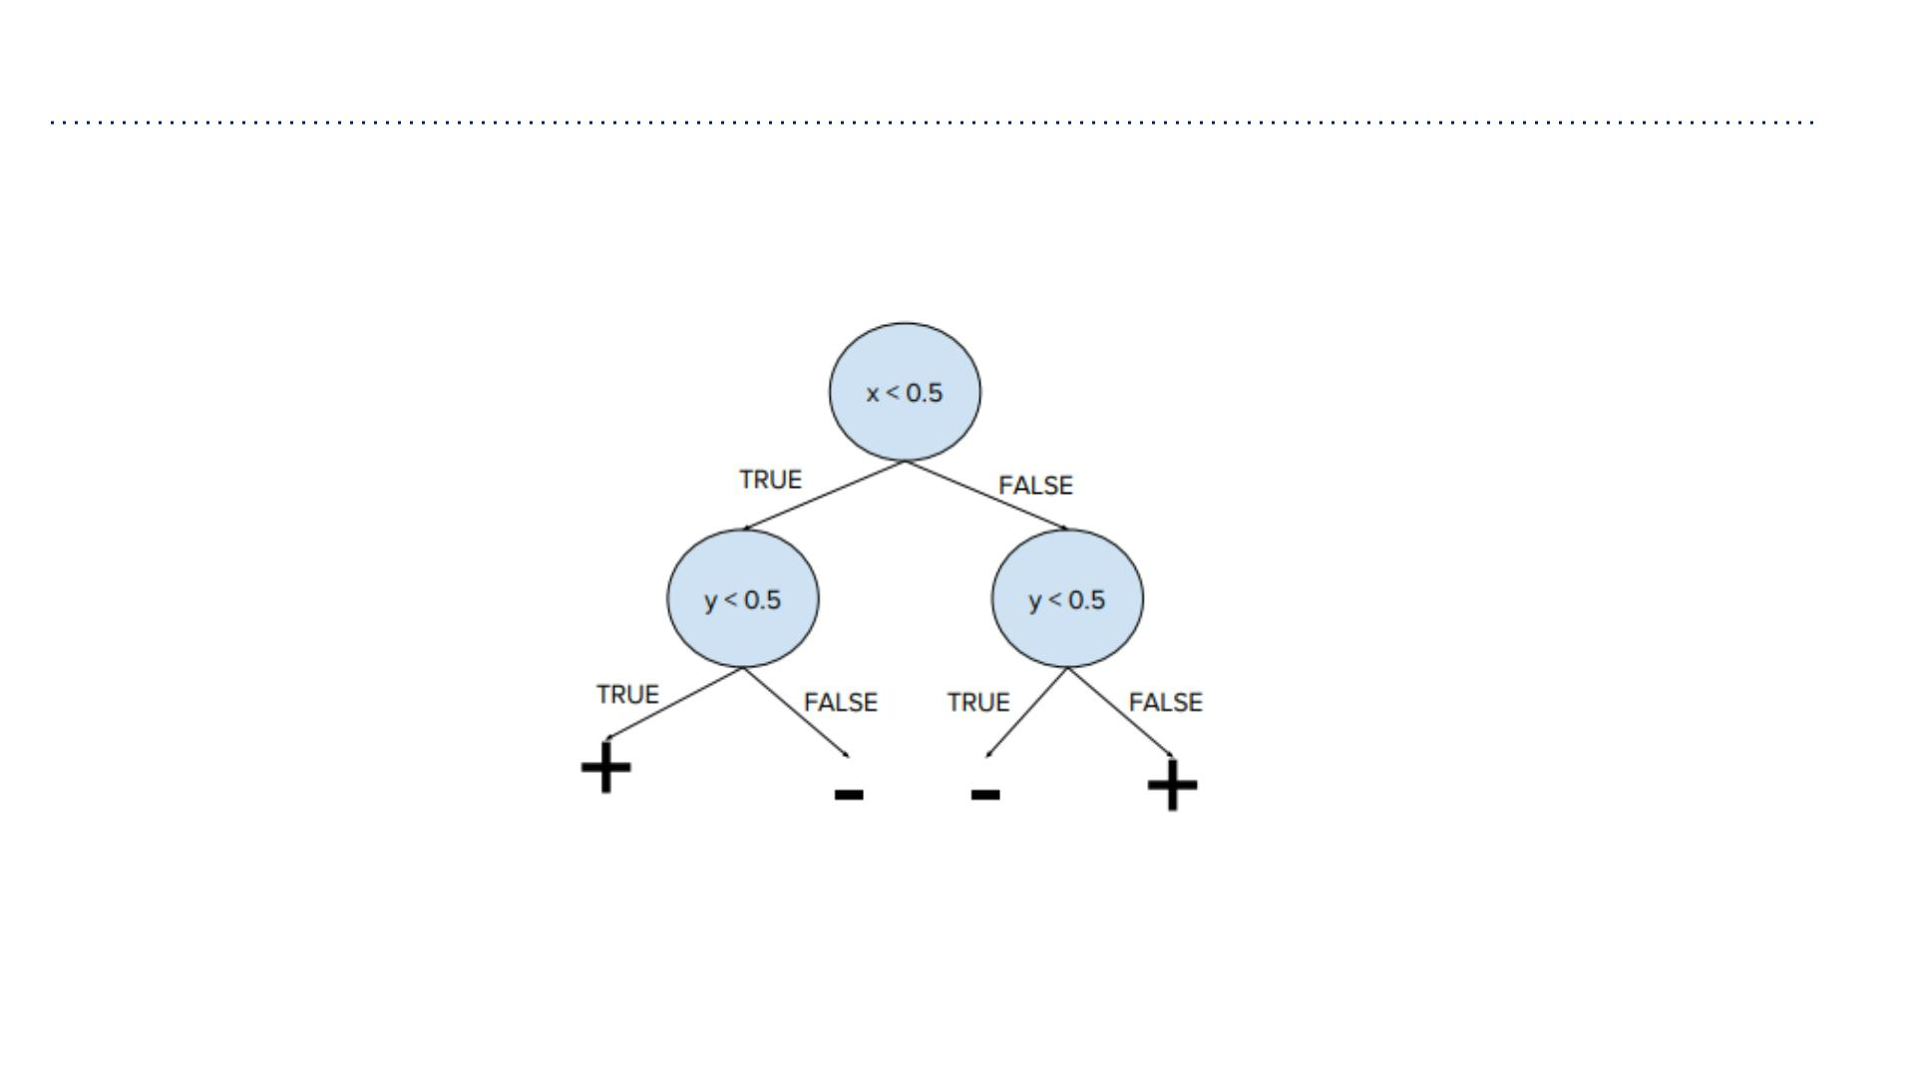
Attempts

Slide 12

Learning Decision Trees
对于任何训练集，我们都能构建⼀个为每个训练点精确⽣
成单⼀叶节点的决策树，但其泛化能⼒很可能不佳。
• For any training set we can construct a decision tree that has exactly the one leaf for
every training point, but it probably won’t generalize.
➢Decision trees are universal function approximators.
决策树是通⽤函数逼近器。
• But, finding the smallest decision tree that correctly classifies a training set is NP
complete.
寻找能够正确分类训练集的最⼩决策树是⼀个NP完全问题。
➢If you are interested, check: Hyafil & Rivest’76.
• So, how do we construct a useful decision tree?

Slide 13

Learning Decision Trees
从整个训练集和⼀个空的决策树开始。
• Resort to a greedy heuristic:
选择⼀个能最⼤程度上减少损失的特征和候选划分点。
在该特征上进⾏区分，并在⼦分区上进⾏递归执⾏。
➢Start with the whole training set and an empty decision tree.
➢Pick a feature and candidate split that would most reduce the loss.
➢Split on that feature and recurse on subpartitions.
• Which loss should we use?
➢Let’s see if misclassification rate is a good loss.

Slide 14
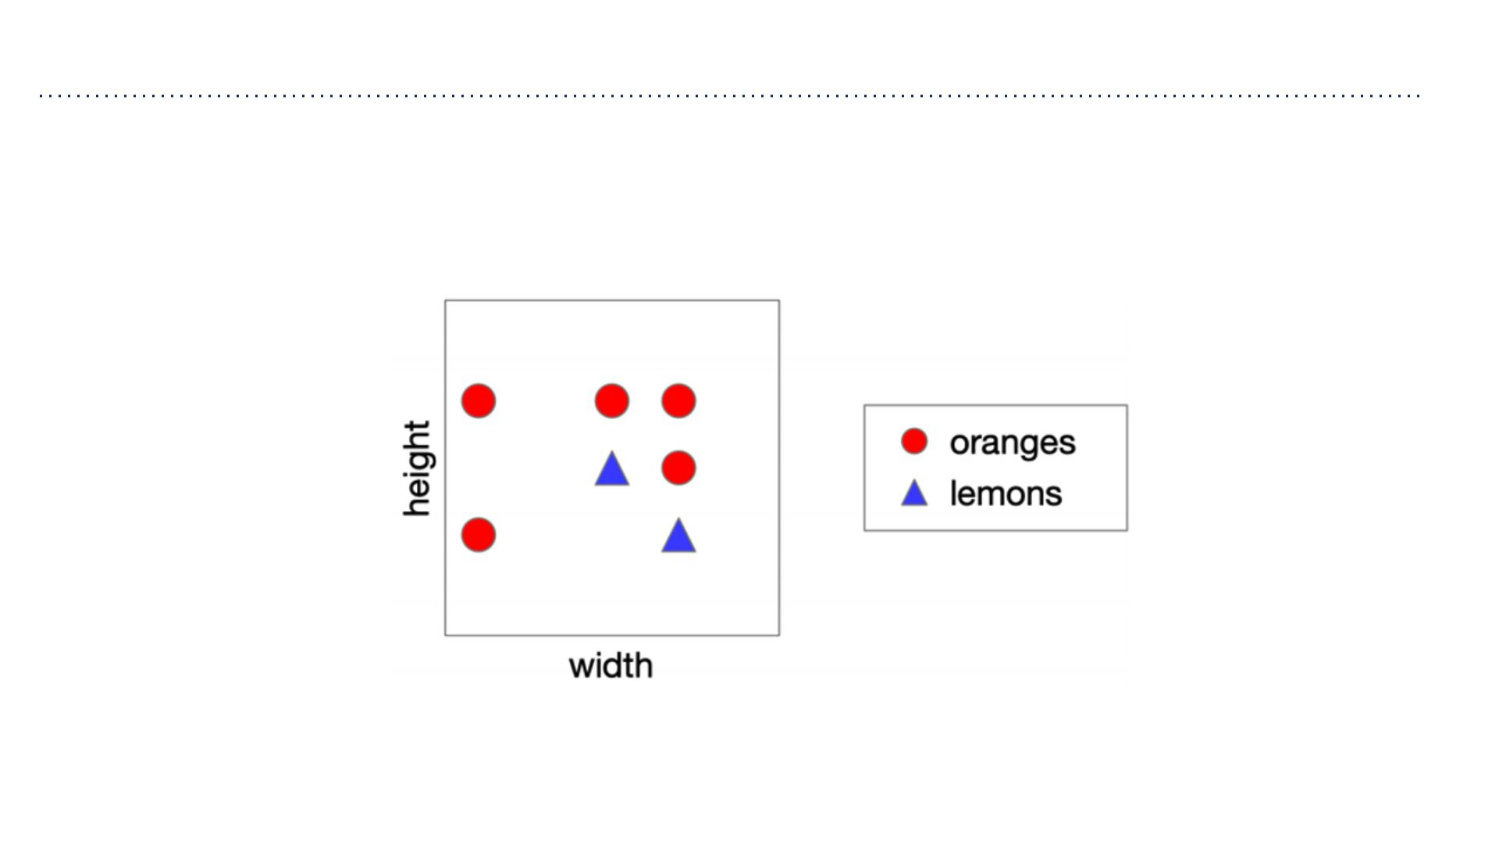
Choosing a Good Split
• Consider the following data. Let’s split on width.

Slide 15
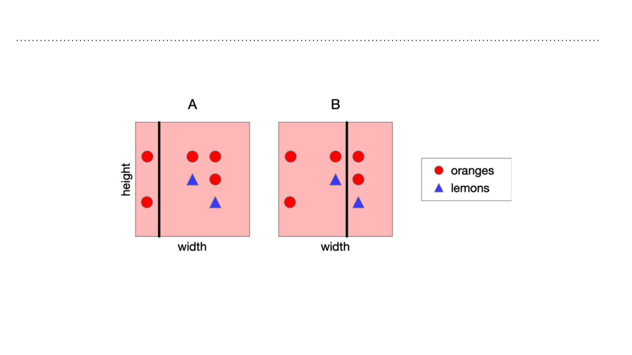
Choosing a Good Split
• Recall: classify by majority.
• A and B have the same misclassification rate, so which is the best split? Vote!

Slide 16
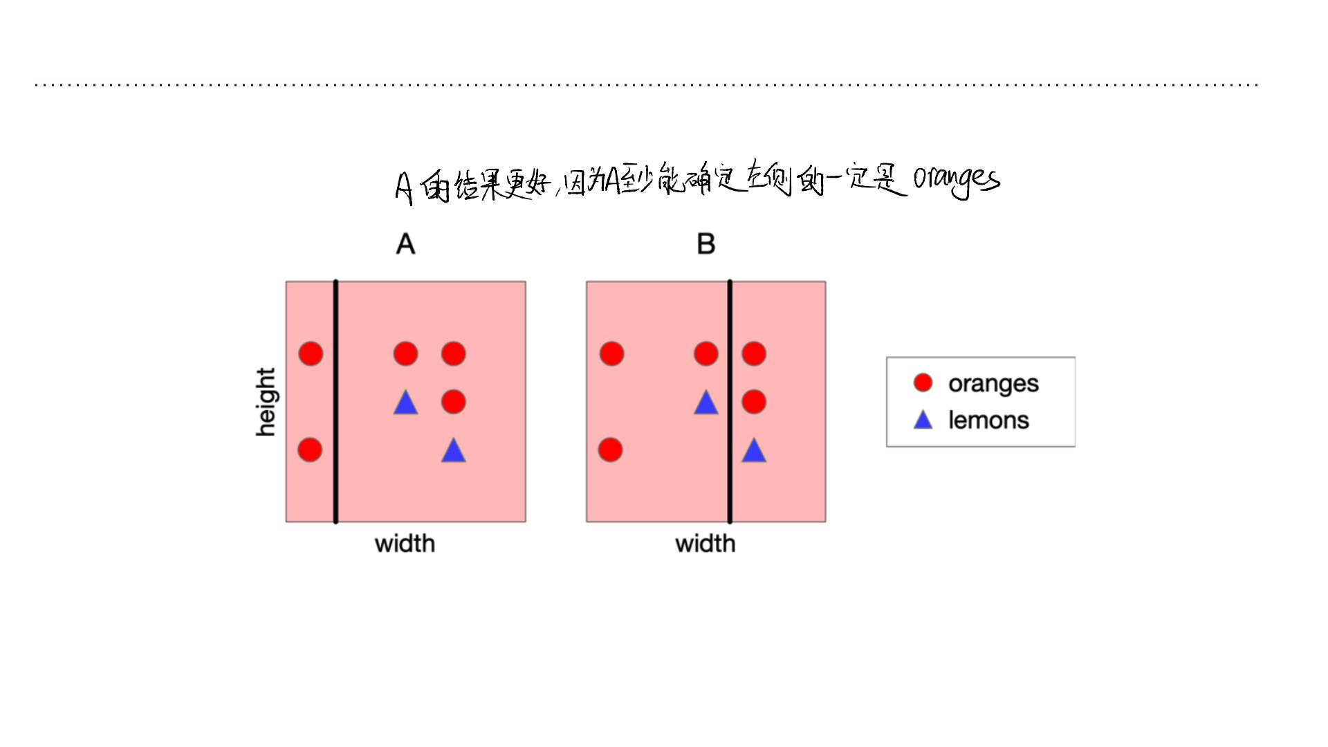
Choosing a Good Split
• A feels like a better split, because the left-hand region is very certain about whether
the fruit is an orange.
• Can we quantify this?

Slide 17
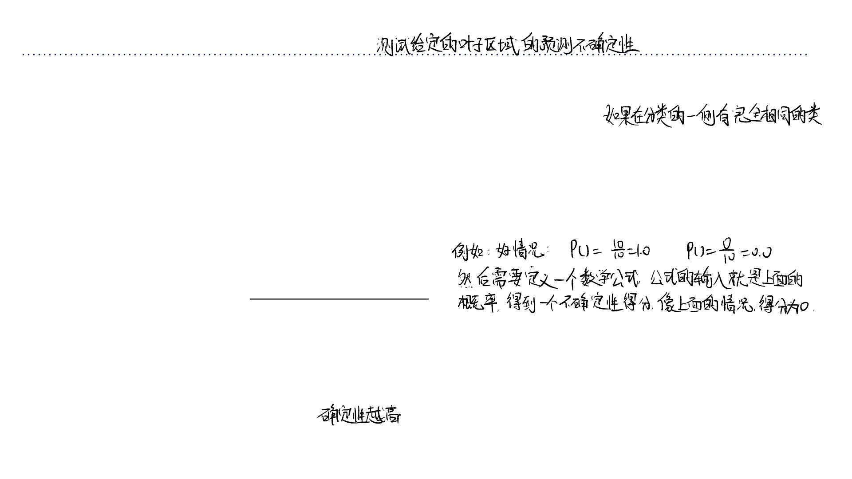
Choosing a Good Split
• How can we quantify uncertainty in prediction for a given leaf node?
➢If all examples in leaf have same class: good, low uncertainty
➢If each class has same amount of examples in leaf: bad, high uncertainty
• Idea: use counts at leaves to define probability distributions; use a probabilistic notion
of uncertainty to decide splits.
⽤叶⼦节点⾥的“计数”来定义“概率分布”；然后⽤⼀个基于概率的“不确定性”概念来
决定如何分裂。
• A brief detour through information theory…
• 熵 (Entropy) 就是那个能衡量“混乱程度”（即不确定性）的数学公式。
• 决策树在构建时，会评估所有可能的分裂⽅式（⽐如“按年龄 > 30岁”分，还是“按收⼊ > 5万”分）。
• 它会选择那个能让分裂后的⼦节点“熵”的总和最⼩（也就是“纯度”最⾼）的分裂⽅式。这个“熵减少的量”通常被称为信息增益 (Information
Gain)。

Slide 18
Quantifying Uncertainty
离散随机变量的熵是⼀个数值，⽤于量化其可能结果中固有的不确定性
• The entropy of a discrete random variable is a number that quantifies the uncertainty
inherent in its possible outcomes.
• The mathematical definition of entropy that we give in a few slides may seem arbitrary,
but it can be motivated axiomatically.
➢ If you’re interested, check: Information Theory by Robert Ash.
• To explain entropy, consider flipping two different coins…

Slide 19
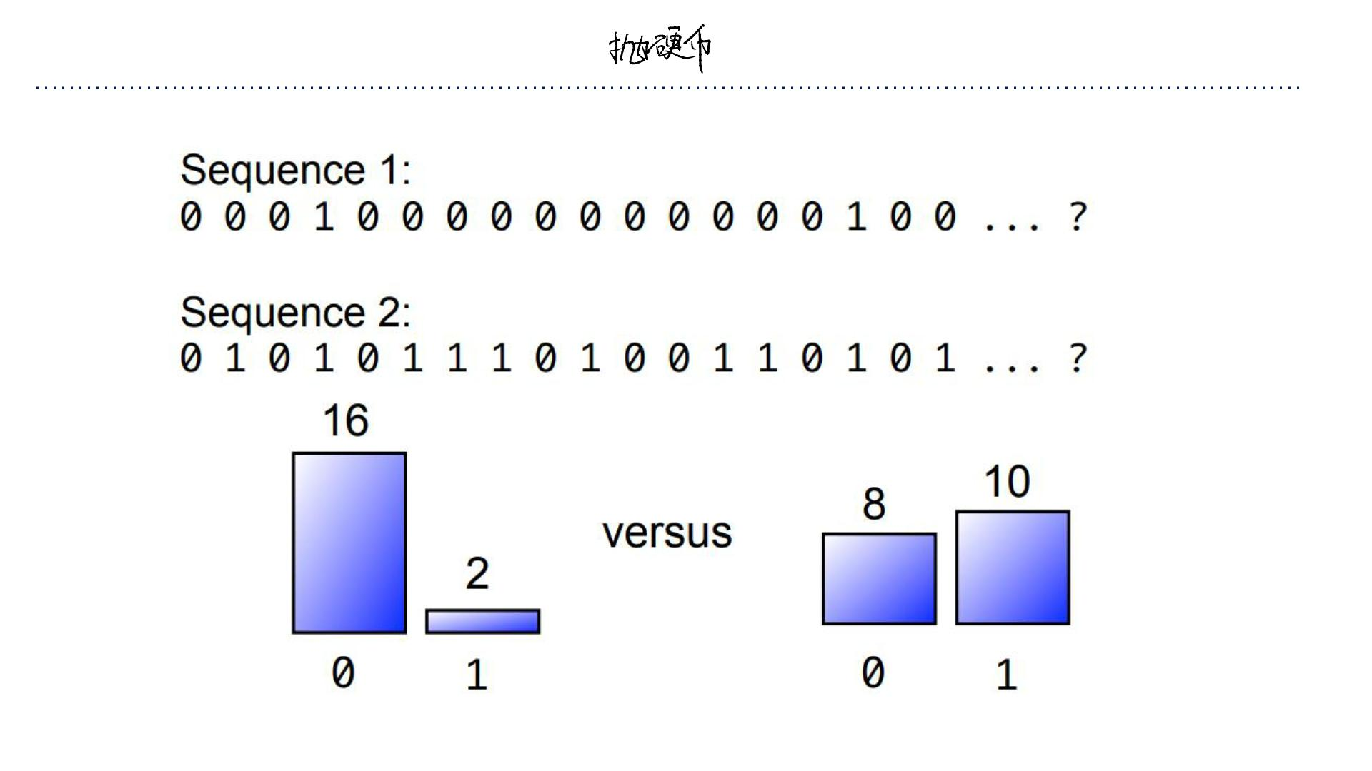
We Flip Two Different Coins

Slide 20
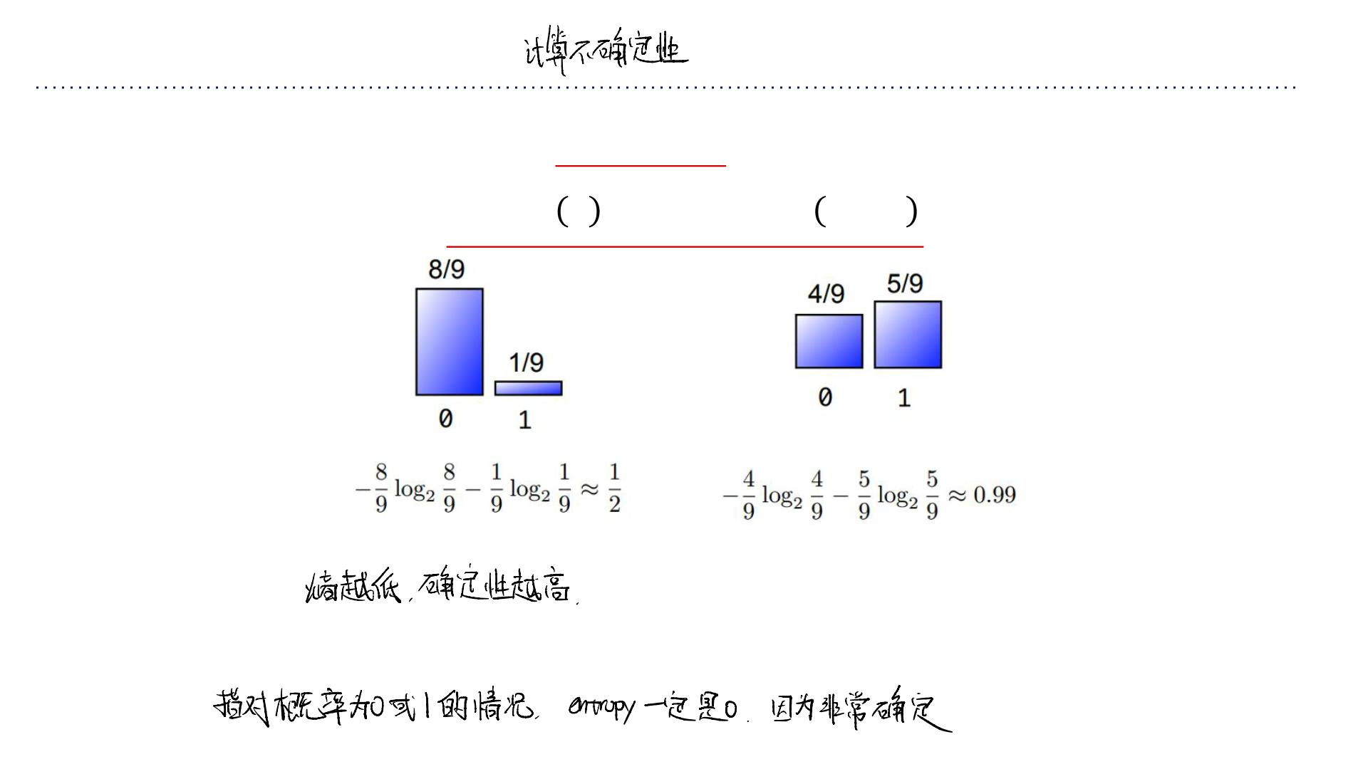
Quantifying Uncertainty
• The entropy of a loaded coin with probability ꢆof heads is given by
−ꢆlog ꢆ −(1− ꢆ)log 1−ꢆ
2
2
• Notice: the coin whose outcomes are more certain has a lower entropy
• In the extreme case ꢆ=0or ꢆ=1, we were certain of the outcome before observing.
So, we gained no certainty by observing it, i.e., entropy is 0.

Slide 21
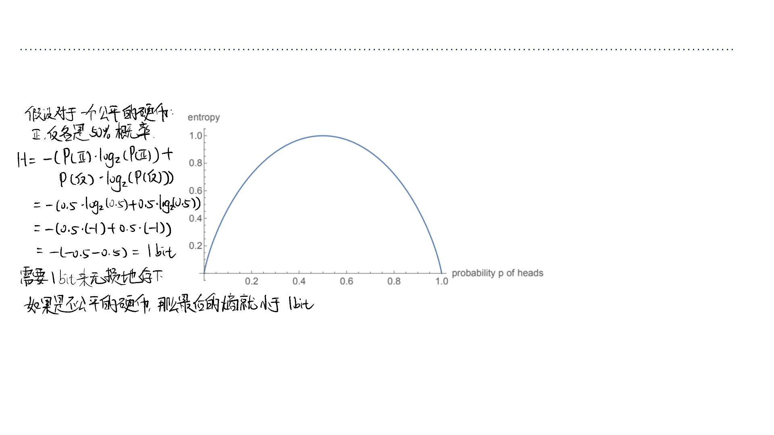
“熵” (Entropy) = “预期的信息量” (Expected Information Content)
• “预期”在概率论中就是指“平均值”。
• 所以，熵就是“平均的意外程度”。
Quantifying Uncertainty
•
C
a
n
a
l
s
o
t
h
i
n
k
o
f
e
n
t
r
o
p
y
a
s
t
h
e
e
x
p
e
c
t
e
d
i
n
f
o
r
m
a
t
i
o
n
c
o
n
t
e
n
t
o
f
a
r
a
n
d
o
m
d
r
a
w
f
r
o
m
a
p
r
o
b
a
b
i
l
i
t
y
distribution.
• “坏”的叶⼦节点 (50% 是A, 50% 是 B)： ⽆论你抽到A 还是 B，都“有点意外”
（因为你有⼀半的概率猜错）。所以它的“平均意外程度”（熵）很⾼。
• “好”的叶⼦节点 (100% 是A, 0% 是 B)： 你抽到A“毫不意外”（信息量为0）。你
永远抽不到 B。所以它的“平均意外程度”（熵）为 0。
熵 = 信息的物理下限 (Entropy = The Physical Limit)
“熵”不仅是⼀个数学概念，它是⼀个物理上的硬限制。
• 熵 = “数据压缩的极限”。
• 它告诉你，要⽆损地存储来⾃某个概率分布的数据，
你平均最少需要多少个 bit。
•
C
l
a
u
d
e
S
h
a
n
n
o
n
s
h
o
w
e
d
:
y
o
u
c
a
n
n
o
t
s
t
o
r
e
t
h
e
o
u
t
c
o
m
e
o
f
a
r
a
n
d
o
m
d
r
a
w
u
s
i
n
g
f
e
w
e
r
e
x
p
e
c
t
e
d
b
i
t
s
than the entropy without losing information.
• So units of entropy are bits; a fair coin flip has 1 bit of entropy.
“总熵下降得最多” 就等于：
1. “不确定性消除得最多”
2. “获得的信息最多”

Slide 22
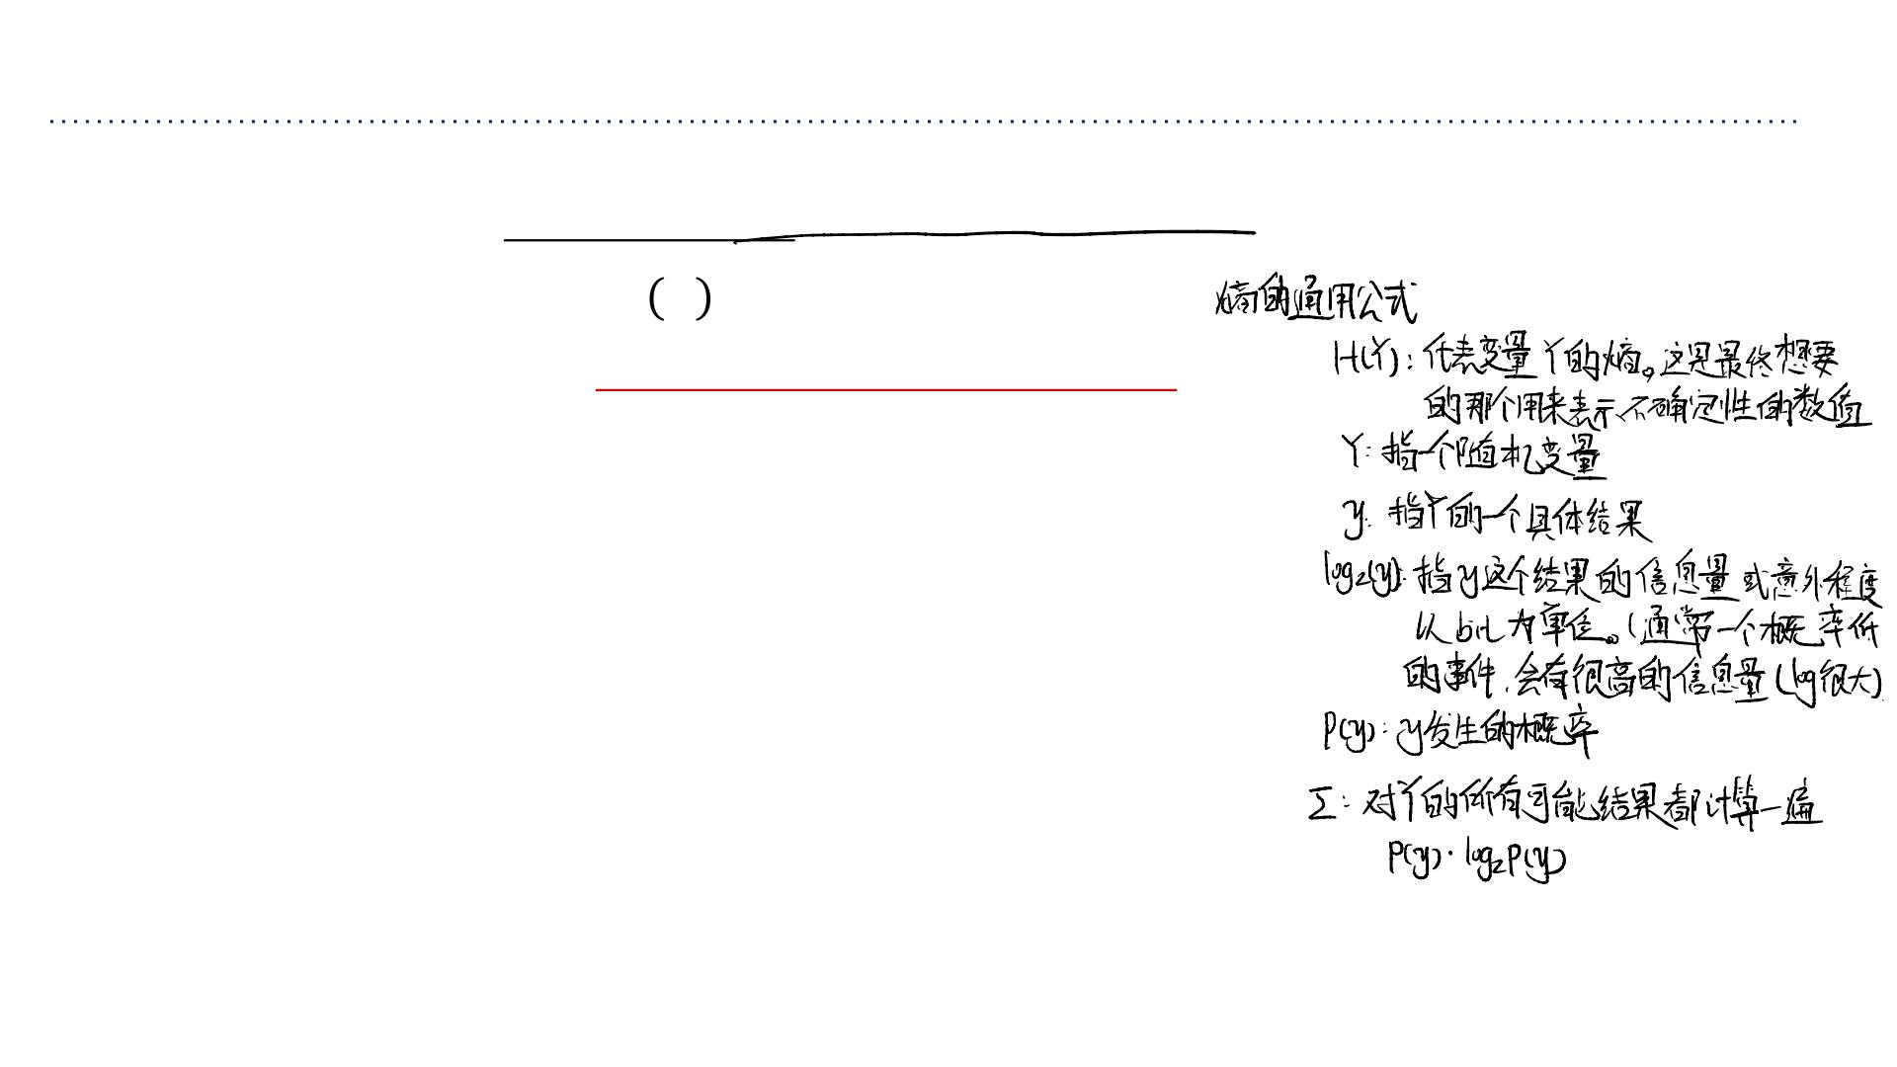
Entropy
• More generally, the entropy of a discrete random variable ꢇis given by
ꢈ ꢇ = − ෍ ꢆ(ꢅ)log₂ꢆ(ꢅ)
ꢉ∈ꢊ
• “High Entropy”
➢Variable has a uniform like distribution over many outcomes
➢Flat histogram
➢Values sampled from it are less predictable
• “Low Entropy”
➢Distribution is concentrated on only a few outcomes
➢Histogram is concentrated in a few areas
➢Values sampled from it are more predictable

Slide 23
Entropy
• Suppose we observe partial information ꢋabout a random variable ꢇ
➢For example, ꢋ = sign(ꢇ).
ꢀ所能传递的关于ꢁ的信息期望量
我们试图定义通过观测ꢀ ꢁ
➢等价表述为：观测 后对 不确定性的期望减少量
• We want to work towards a definition of the expected amount of information that will
be conveyed about ꢇby observing ꢋ.
➢Or equivalently, the expected reduction in our uncertainty about ꢇafter observing ꢋ.
“⾼熵” (High Entropy) = ⾼度混乱
“低熵” (Low Entropy) = ⾼度有序
“变量的概率分布在许多结果上⾮常均匀”
意思是：每⼀种可能性发⽣的概率都差不多⼤。
“扁平的直⽅图 (Flat histogram)”
“概率分布集中在少数⼏个结果上”
意思是：只有⼀两种可能性概率⾮常⾼，其他的可能性都微乎其微。
“直⽅图集中在少数⼏个区域（有⾼峰）”
意思是：如果把所有可能性的概率画成柱状图，这些柱⼦都差不多
⾼。
意思是：柱状图上会有⼀两个⾼⾼耸起的柱⼦，其他的都⾮常矮。
“从中抽取的样本可预测性很⾼”
“从中抽取的样本可预测性很低”
意思是：你很容易猜下⼀次会发⽣什么（⼤概率就是那个概率最⾼
的）。
意思是：你很难猜下⼀次会发⽣什么。
经典例⼦： 掷⼀个公平的 6 ⾯骰⼦。点数 1 到 6 的概率都是 1/6。你完全
⽆法预测下⼀次会掷出⼏，这就是⾼度不确定的（⾼熵）系统。
经典例⼦： 掷⼀个作弊的骰⼦，它有 90% 的概率会掷出“6”。这个系统就⾮
常有序，不确定性很低（低熵），因为你⼏乎总能猜对结果是“6”。

Slide 24
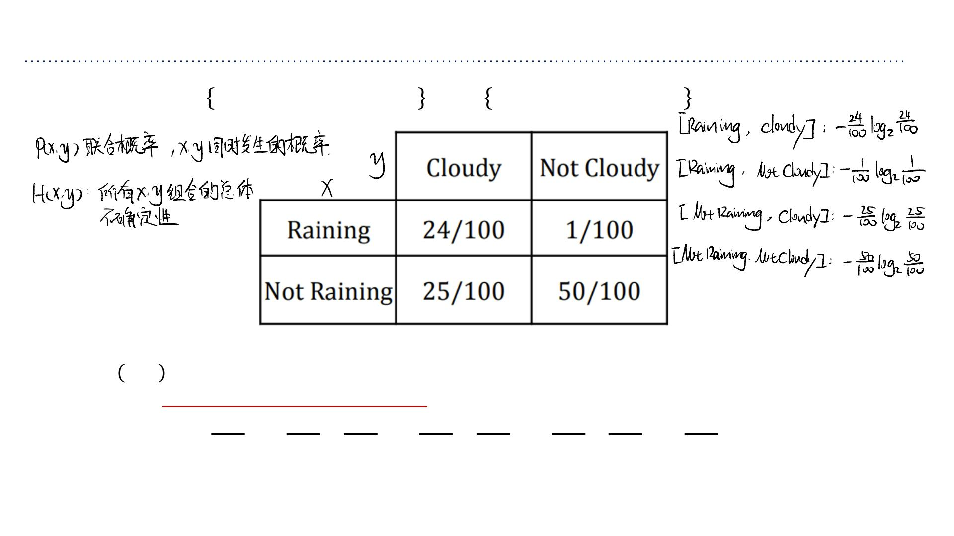
Entropy of a Joint Distribution
• Example: ꢋ= Raining, Not raining , ꢇ= Cloudy, Not cloudy
ꢈ ꢋ,ꢇ = − ෍ ෍ꢆ(ꢂ,ꢅ)log₂ꢆ(ꢂ, ꢅ)
ꢌ∈ꢍ ꢉ∈ꢊ
24 24 1 1 25 25 50 50
=− log − log − log − log
2
2
2
2
100 100 100 100 100 100 100 100
≈1.56bits

Slide 25
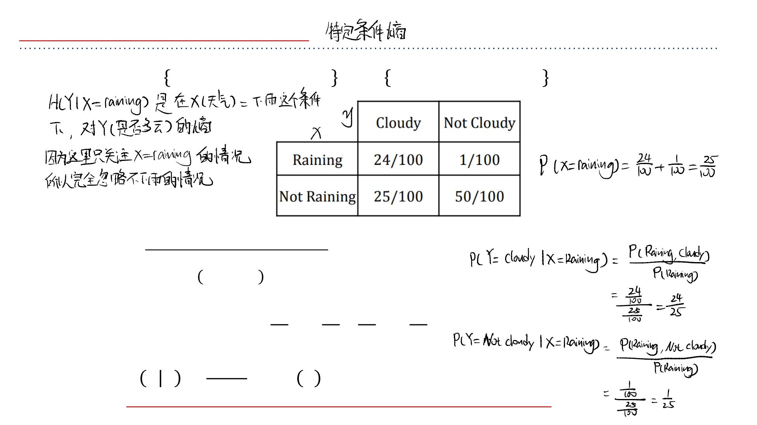
Specific Conditional Entropy
我们不再看整个系统的混乱程度，⽽是看“当我们知道了某个信息
之后，剩下的不确定性还有多少？
• Example: ꢋ= Raining, Not raining , ꢇ= Cloudy, Not cloudy
• What is the entropy of cloudiness ꢇ, given that it is raining?
ꢈ ꢇ|ꢋ =ꢂ = − ෍ ꢆ(ꢅ|ꢂ)log₂ꢆ(ꢅ|ꢂ)
ꢉ∈ꢊ
24 24 1 1
=− log − log
2
2
25 25 25 25
≈ 0.24bits
• We used: ꢆ ꢅꢂ =
ꢎ(ꢌ,ꢉ)
and ꢆ ꢂ =σ ꢆ(ꢂ, ꢅ) (sum in a row)
ꢉ
ꢎ(ꢌ)

Slide 26
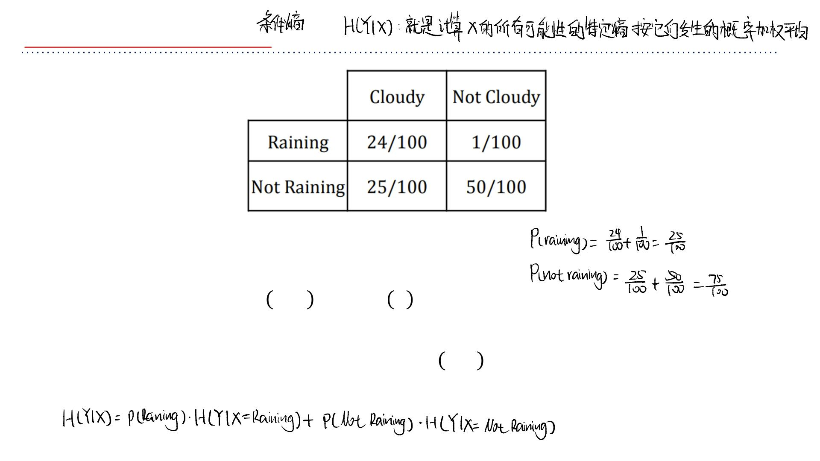
Conditional Entropy
• The expected conditional entropy:
ꢈ ꢇ|ꢋ =෍ꢆ ꢂ ꢈ(ꢇ|ꢋ = ꢂ)
ꢌ∈ꢍ
= −෍෍ꢆ ꢂ,ꢅ log₂ꢆ(ꢅ|ꢂ)
ꢌ∈ꢍ ꢉ∈ꢊ

Slide 27
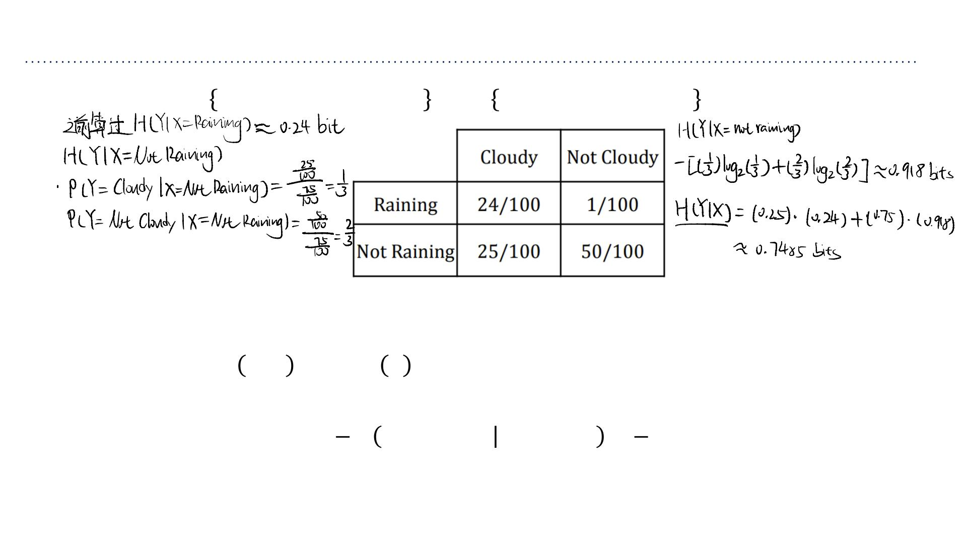
Conditional Entropy
• Example: ꢋ= Raining, Not raining , ꢇ= Cloudy, Not cloudy
• What is the entropy of cloudiness ꢇ, given the knowledge of whether or not it is
raining?
ꢈ ꢇ|ꢋ =෍ꢆ ꢂ ꢈ(ꢇ|ꢋ = ꢂ)
ꢌ∈ꢍ
1
3
= ꢈ cloudiness is raining + ꢈ(cloudiness|not rainig)
4
4
≈ 0.75bits

Slide 28
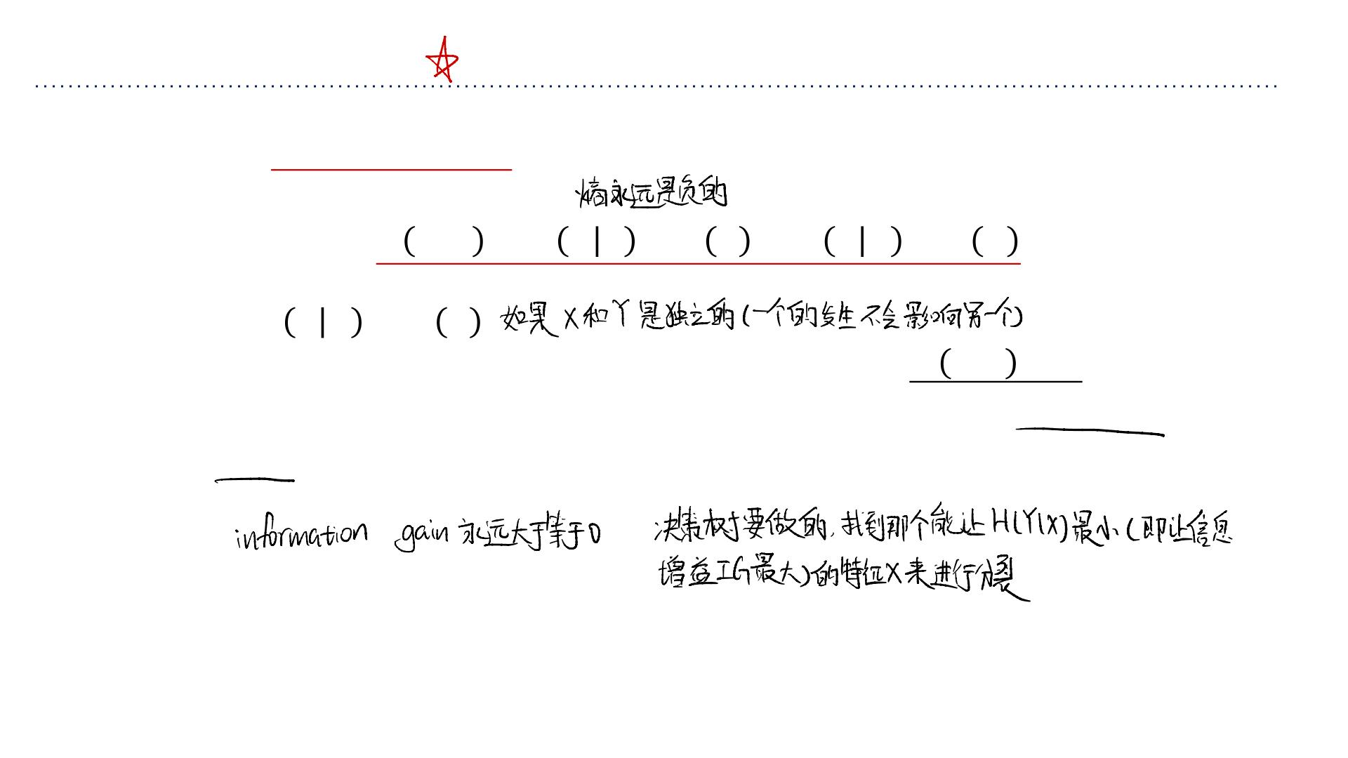
Conditional Entropy
• Some useful properties
➢ꢈis always non-negative
➢Chain rule: ꢈ ꢋ,ꢇ =ꢈ ꢋꢇ +ꢈ ꢇ =ꢈ ꢇꢋ +ꢈ ꢋ
➢If ꢋand ꢇindependent, then ꢋdoes not affect our uncertainty about
ꢇ:ꢈ ꢇꢋ =ꢈ ꢇ
➢But knowing ꢇmakes our knowledge of ꢇcertain: ꢈ ꢇ|ꢇ =0
➢By knowing ꢋ, we can only decrease uncertainty about ꢇ: ꢈ(ꢇ|ꢋ) ≤
ꢈ(ꢇ)

Slide 29
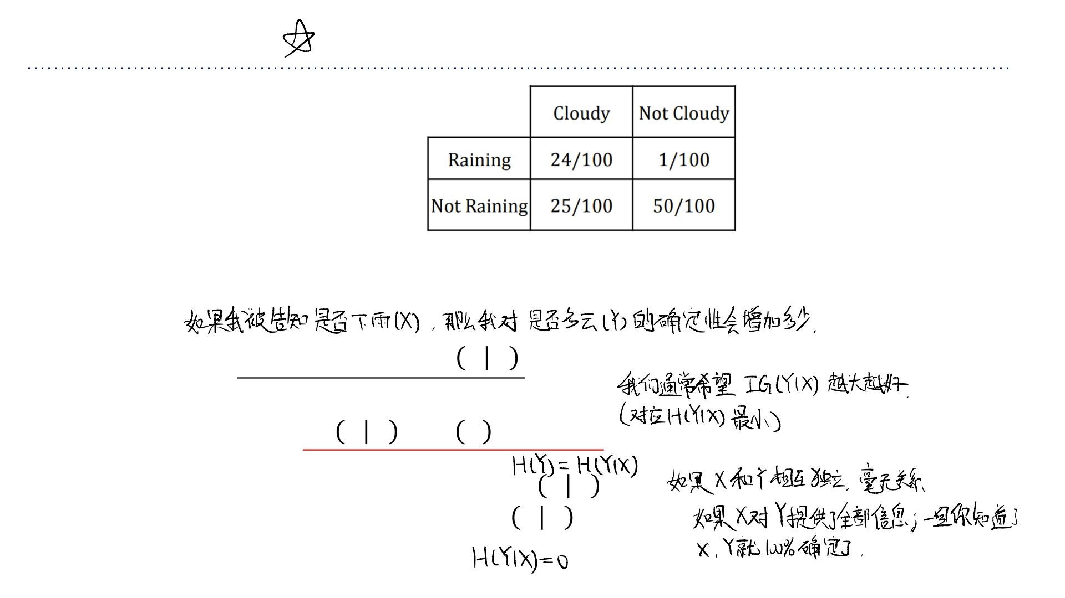
Information Gain
信息增益 (Information Gain): 这是它在决策树领域
的常⽤名字。
我对 Y（是否多云）的原始不确定性，减去我看
到了 X（是否下⾬）之后，对 Y 平均还剩下的不
确定性。
互信息 (Mutual Information): 这是它在信息论⾥的
名字。两者是完全等价的，都衡量“X 和 Y 共享了
多少信息”。
• How much more certain am I about whether it’s cloudy if I’m told whether it is raining?
My uncertainty in ꢇminus my expected uncertainty that would remain in ꢇafter
seeing ꢋ.
• This is called the information gain ꢏꢐ ꢇꢋ in ꢇdue to ꢋ,or the mutual information of
ꢇand ꢋ
这被称为由 X 带来的关于 Y 的信息增益，或者 Y 和 X 的互信息。
ꢏꢐ ꢇꢋ =ꢈ ꢇ − ꢈ(ꢇ|ꢋ)
(1)
• If ꢋis completely uninformative about ꢇ: ꢏꢐ ꢇꢋ =0
• If ꢋis completely informative about ꢇ: ꢏꢐ ꢇꢋ = ꢈ(ꢇ)

Slide 30
Revisiting Our Original Example
• Information gain measures the informativeness of a variable, which
is exactly what we desire in a decision tree split!
• The information gain of a split: how much information (over the
training set) about the class label ꢇis gained by knowing which side
of a split you’re on.

Slide 31
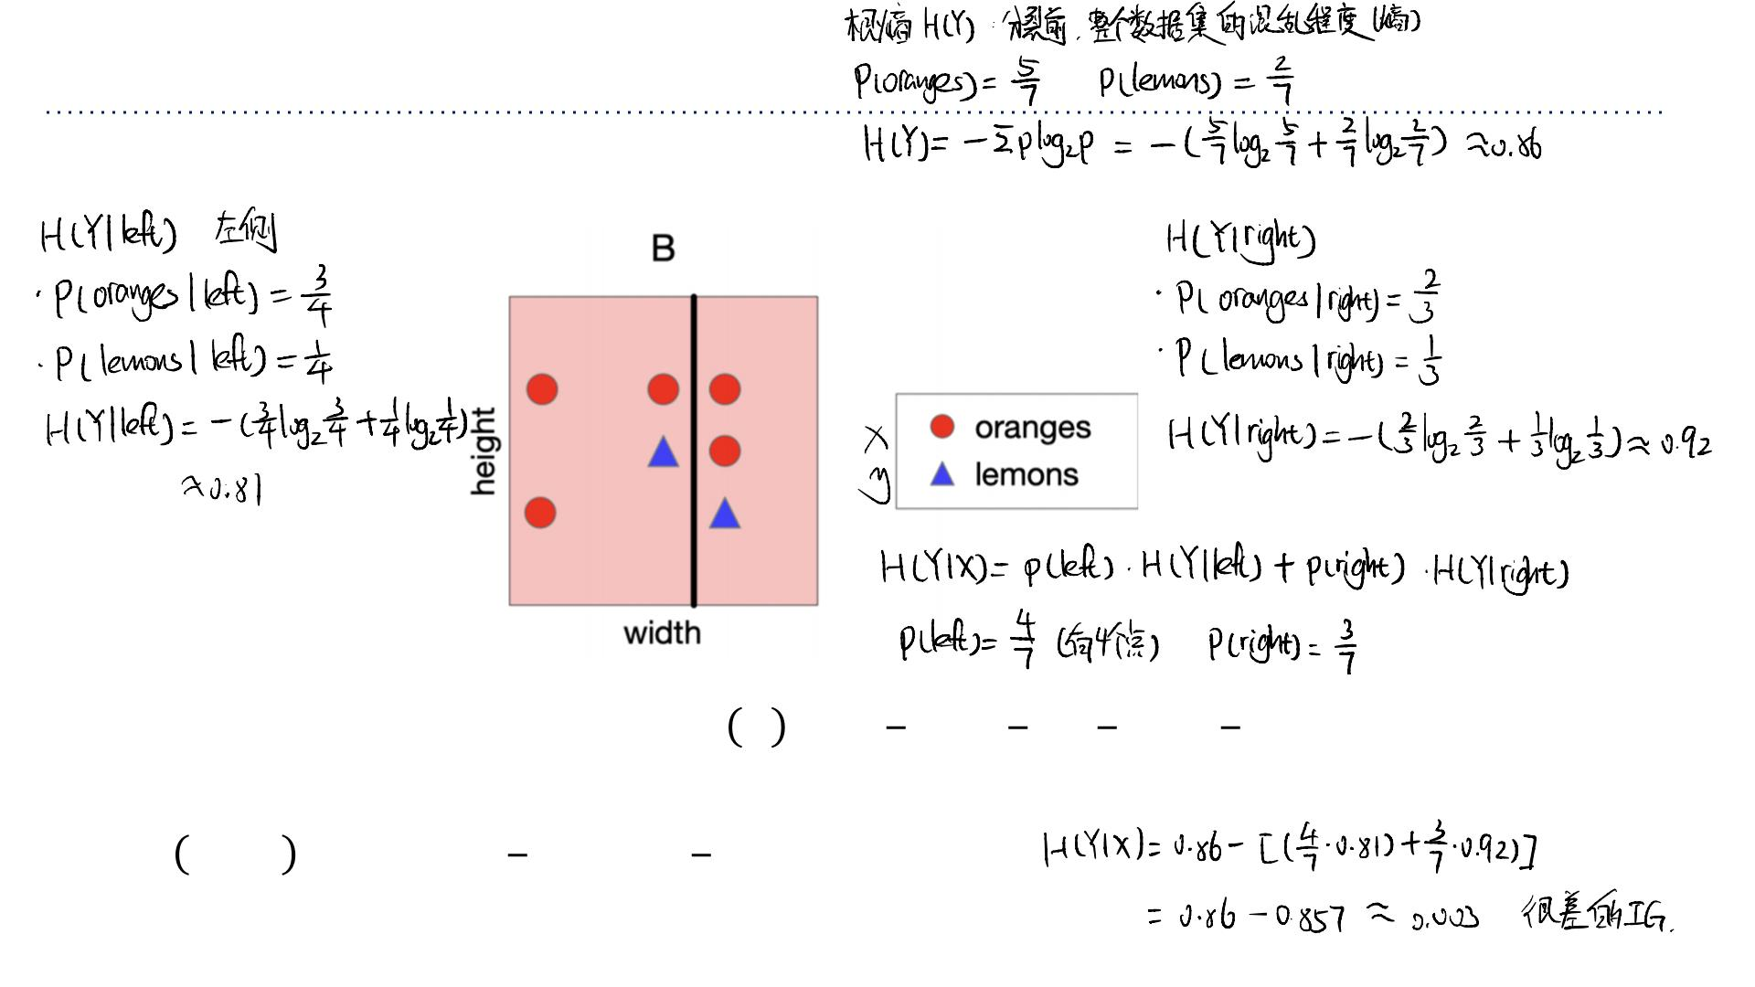
Revisiting Our Original Example
• What is the information gain of split B? Not terribly informative…
2 2 5 5
• Root entropy of class outcome: ꢈ ꢇ =− log ( )− log ( ) ≈ 0.86
2
2
7 7 7 7
• Leaf conditional entropy of class outcome: ꢈ(ꢇ|ꢑꢒꢓꢃ) ≈ 0.81, ꢈ(ꢇ|ꢔꢕꢖℎꢃ) ≈ 0.92
4
3
• ꢏꢐ ꢗꢆꢑꢕꢃ ≈ 0.86−( ∙ 0.81+ ∙ 0.92) ≈ 0.006
7
7

Slide 32
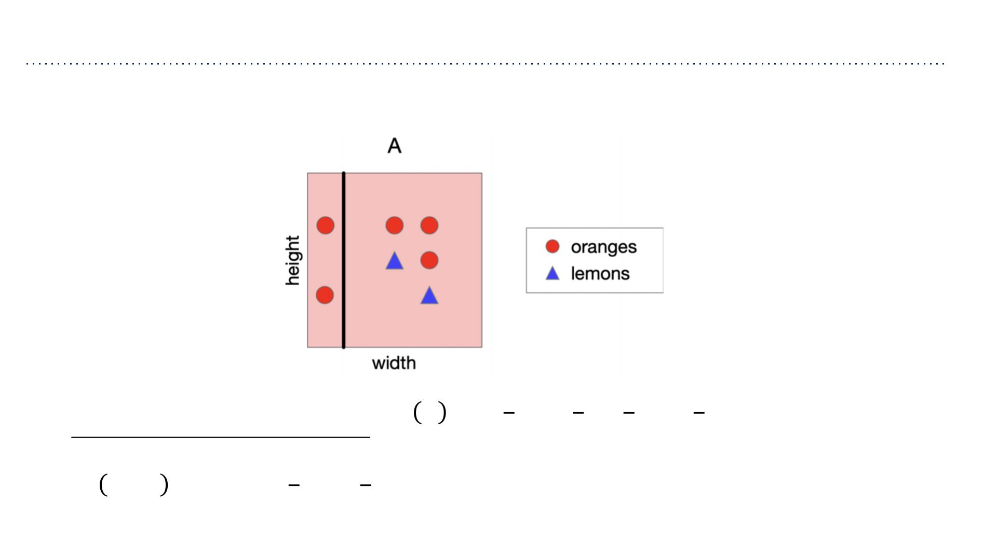
Revisiting Our Original Example
• What is the information gain of split A? Very informative!
2 2 5 5
• Root entropy of class outcome: ꢈ ꢇ =− log ( )− log ( ) ≈ 0.86
2
2
7 7 7 7
• Leaf conditional entropy of class outcome: ꢈ(ꢇ|ꢑꢒꢓꢃ) ≈ 0, ꢈ(ꢇ|ꢔꢕꢖℎꢃ) ≈ 0.97
2 5
• ꢏꢐ ꢗꢆꢑꢕꢃ ≈ 0.86−( ∙0+ ∙ 0.97) ≈ 0.17!
7 7

Slide 33
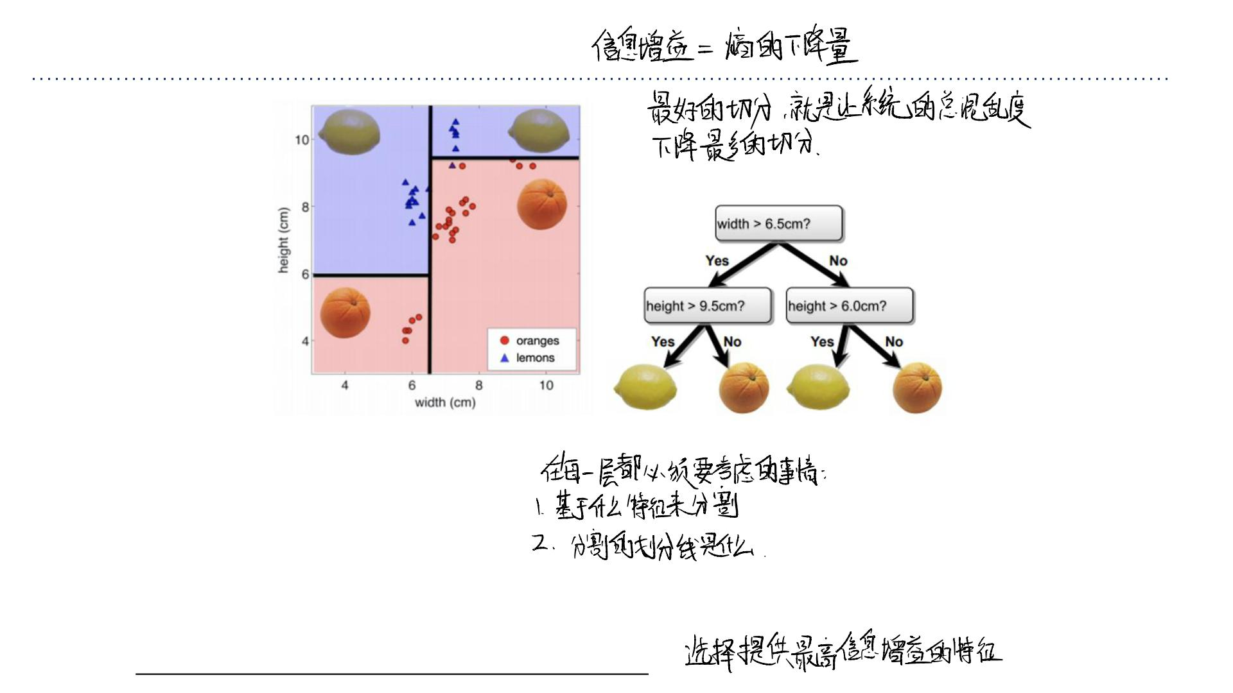
Constructing Decision Trees
• At each level, one must choose:
1. Which feature to split.
2. Possibly where to split it.
• Choose them based on how much information we would gain fr om the decision!
(choose feature that gives the highest gain)

Slide 34
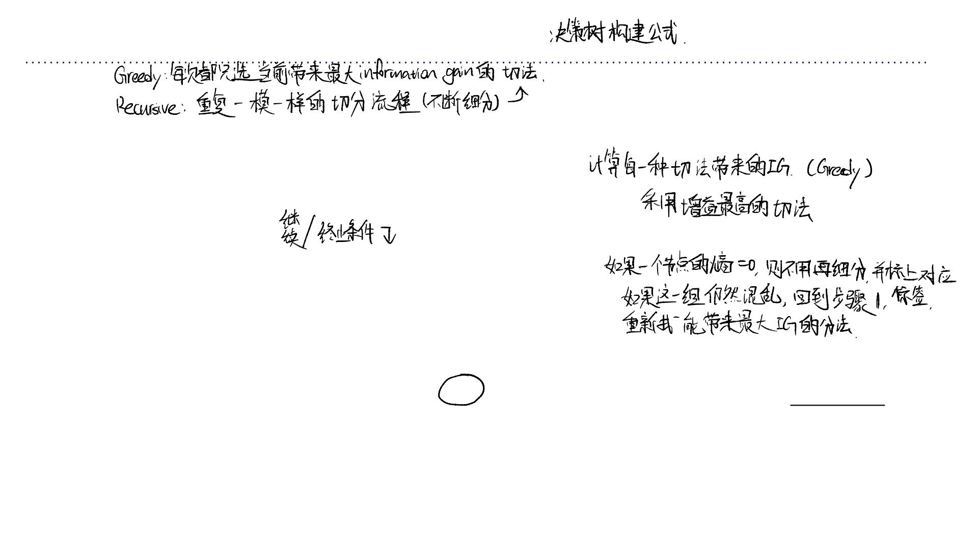
Decision Tree Construction Algorithm
• Simple, greedy, recursive approach, builds up tree node-by-node
1. Pick a feature to split at a non-terminal node
2. Split examples into groups based on feature value
3. For each group:
➢If no examples – return majority from parent
➢Else if all examples in same class – return class
➢Else loop to step 1
• Terminates when all leaves contain only examples in the same class or are empty.

Slide 35
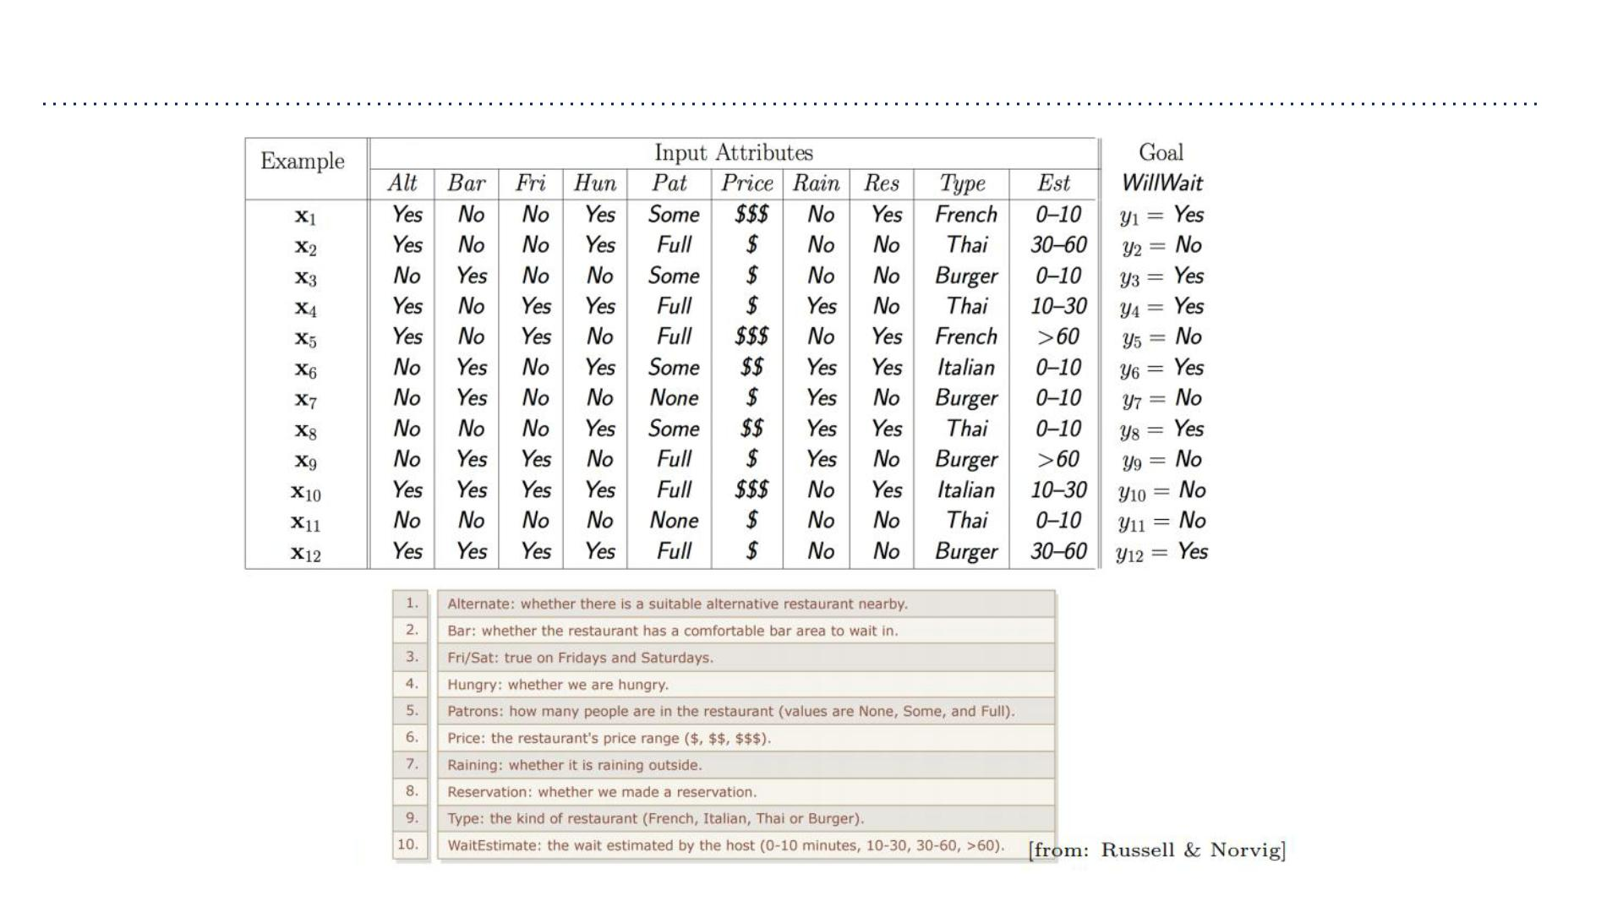
Back to Our Example
Features:

Slide 36
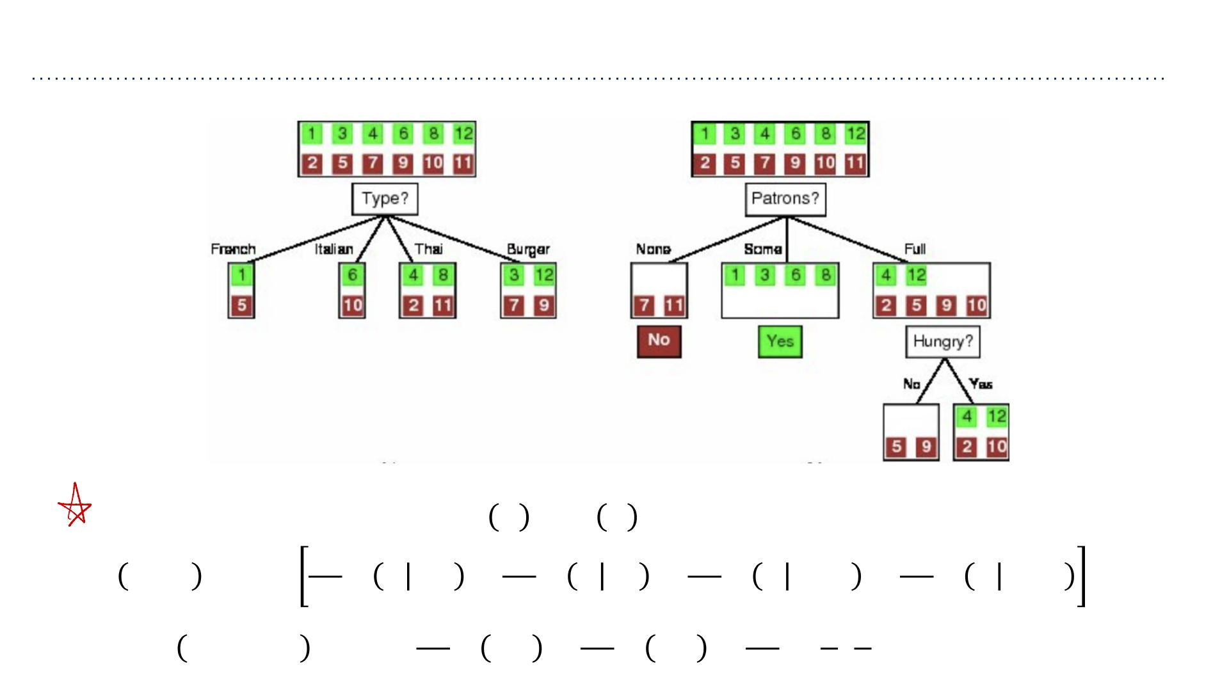
Feature Selection
ꢏꢐ ꢇ =ꢈ ꢇ − ꢈ(ꢇ|ꢋ)
2
2
4
4
ꢏꢐ ꢃꢅꢆꢒ =1− ꢈ ꢇ Fr. + ꢈ ꢇ It. + ꢈ ꢇ Thai + ꢈ ꢇ Bur. =0
12 12 12 12
2 4 6 2 4
ꢏꢐ ꢘꢙꢃꢔꢚꢛꢗ =1−[ ꢈ 0,1 + ꢈ 1,0 + ꢈ( , )] ≈ 0.541
12 12 12 6 6

Slide 37
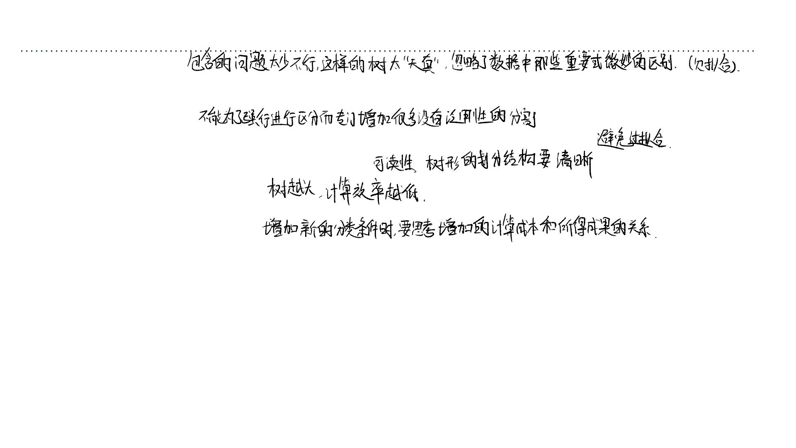
What Makes a Good Tree?
• Not too small: need to handle important but possibly subtle distinctions in data
• Not too big:
➢Computational efficiency (avoid redundant, spurious attributes)
➢Avoid over-fitting training examples
➢Human interpretability
• “Occam’s Razor”: find the simplest hypothesis that fits the observations
➢Useful principle, but hard to formalize (how to define simplicity?)
➢See Domingos, 1999, “The role of Occam’s razor in knowledge discovery”
如果有两棵树，⼀棵 5 层的树能达到
95% 的准确率，⼀棵 50 层的树能达
到 96% 的准确率。我们应该毫不犹豫
地选择那棵 5 层的！
• We desire small trees with informative nodes near the root

Slide 38
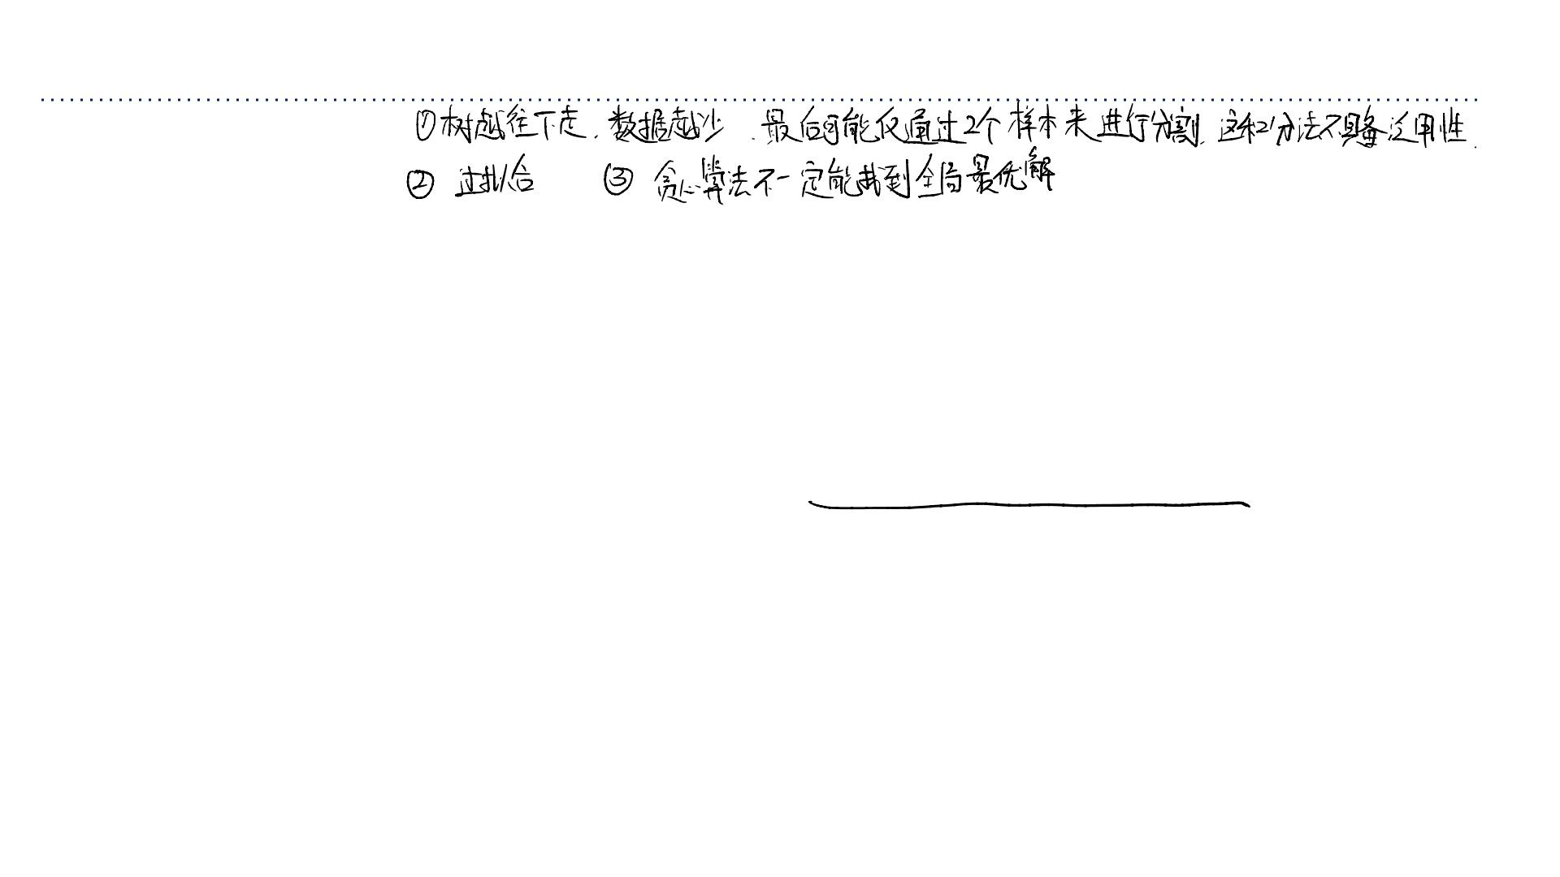
Decision Tree Miscellany
• Problems:
➢You have exponentially less data at lower levels
➢Too big of a tree can overfit the data
➢Greedy algorithms don’t necessarily yield the global optimum
• Handling continuous attributes
➢Split based on a threshold, chosen to maximize information gain

Slide 39
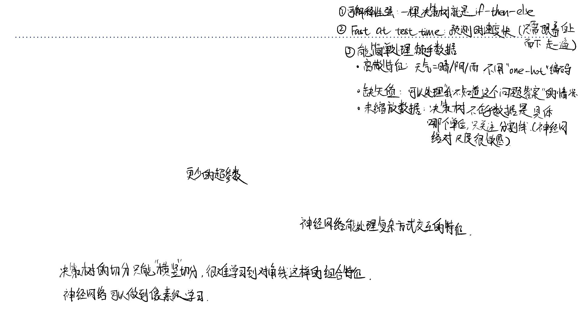
Comparison to some other classifiers
Advantages of decision trees over KNNs and neural nets
• Simple to deal with discrete features, missing values, and poorly scaled data
• Fast at test time
• More interpretable
Advantages of KNNs over decision trees
• Few hyperparameters
• Can incorporate interesting distance measures (e.g. shape contexts)
Advantages of neural nets over decision trees
• Able to handle attributes/features that interact in very complex ways (e.g. pixels)

Slide 40
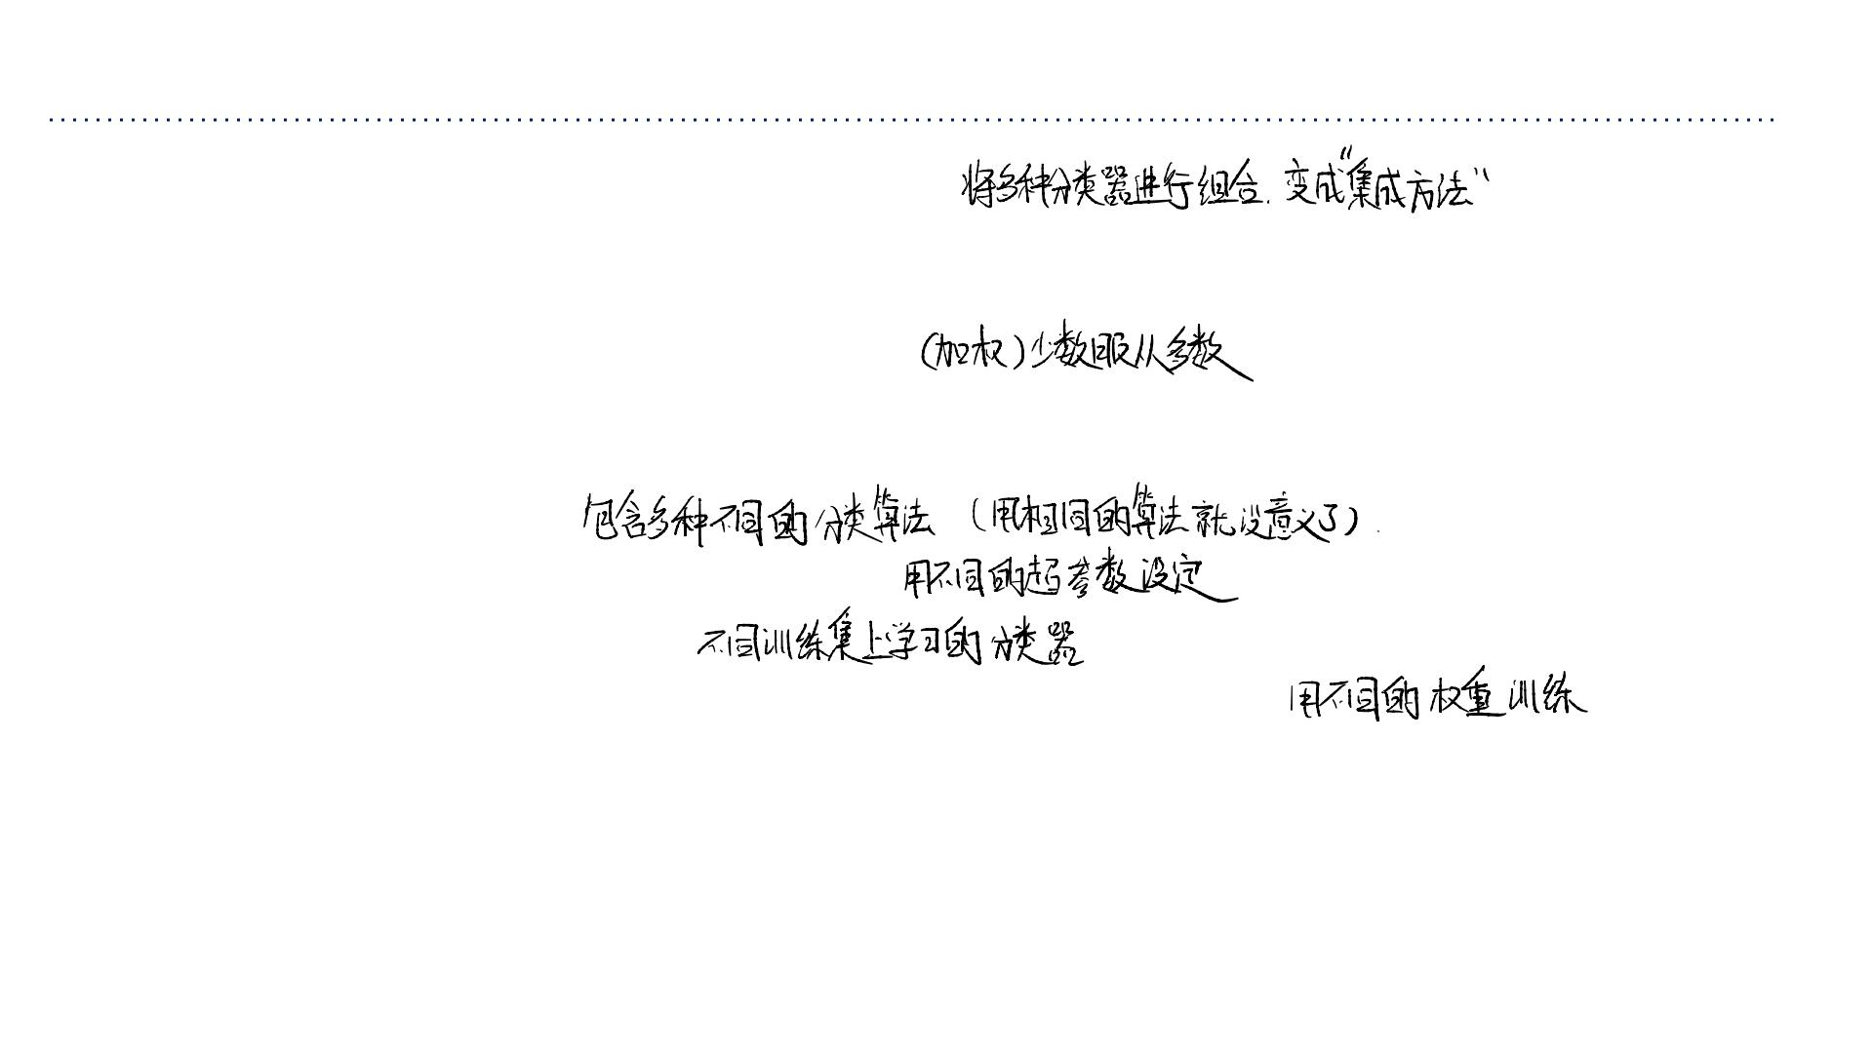
Comparison to some other classifiers
• We’ve seen many classification algorithms.
• We can combine multiple classifiers into an ensemble, which is a set of predictors
whose individual decisions are combined in some way to classify new examples
➢E.g., (possibly weighted) majority vote
• For this to be nontrivial, the classifiers must differ somehow, e.g.
➢Different algorithm
➢Different choice of hyperparameters
➢Trained on different data
➢Trained with different weighting of the training examples
• Next lecture, we will study some specific ensembling techniques.

Slide 41
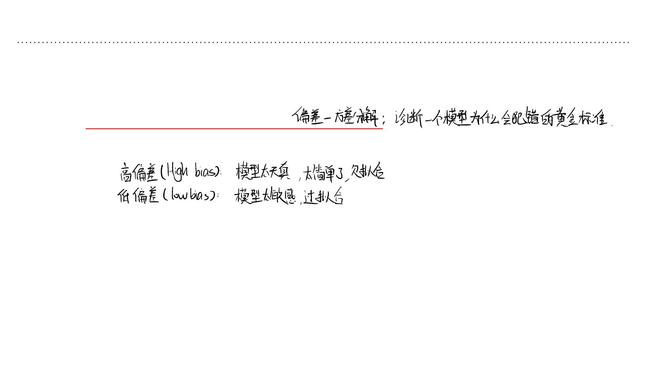
• Today, we deepen our understanding of generalization through a
bias-variance decomposition.
➢This will help us understand ensembling methods.

Slide 42
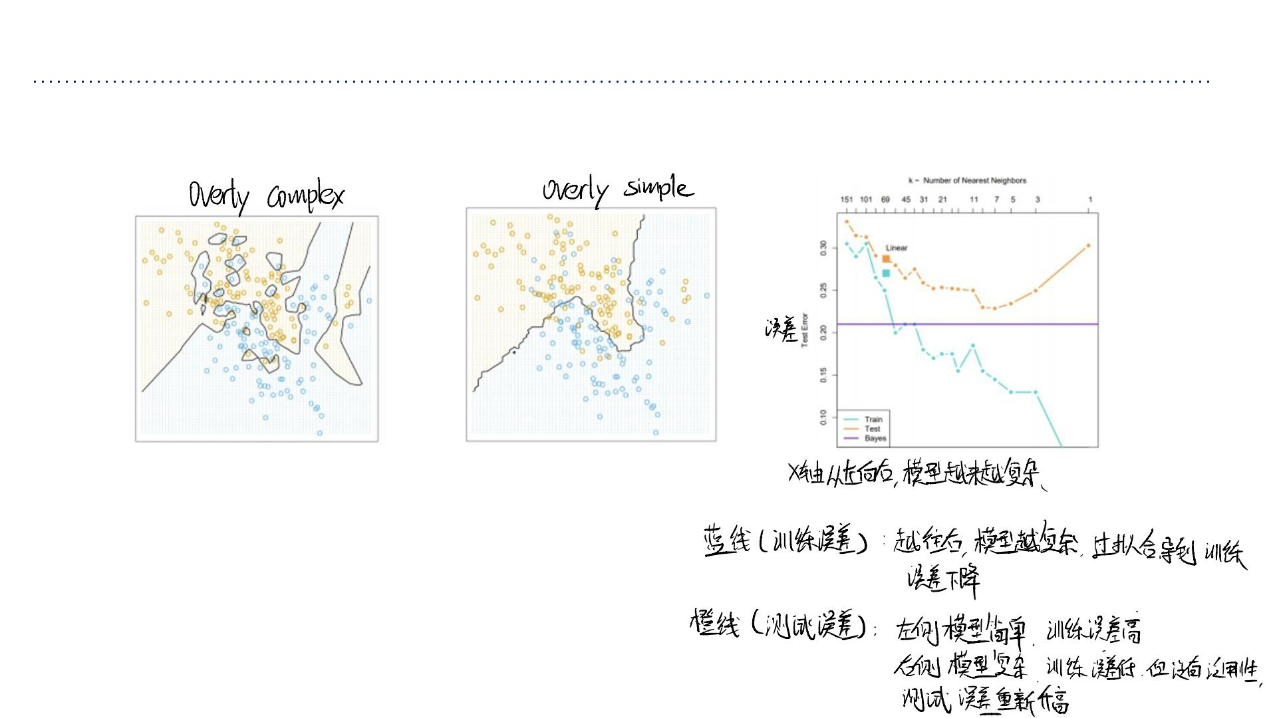
Bias-Variance Decomposition
• Recall that overly simple models underfit the data, and overly complex models overfit.
• We can quantify this effect in terms of the bias/variance decomposition.
➢Bias and variance of what?

Slide 43
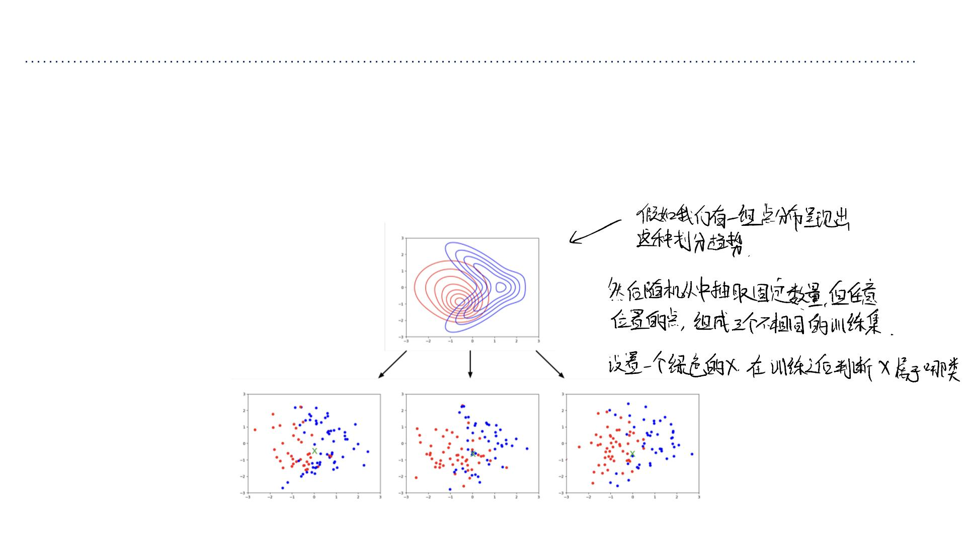
Bias-Variance Decomposition: Basic Setup
• Suppose the training set ꢜconsists of pairs (ꢝ_{ꢞ},ꢃ_{ꢞ})sampled independent and
identically distributed (i.i.d) from a single data generating distribution ꢆ_{sample}
• Pick a fixed query point ꢟ(denoted with a green x).
.
• Consider an experiment where we sample lots of training sets independently from
ꢆ_{sample}
.

Slide 44
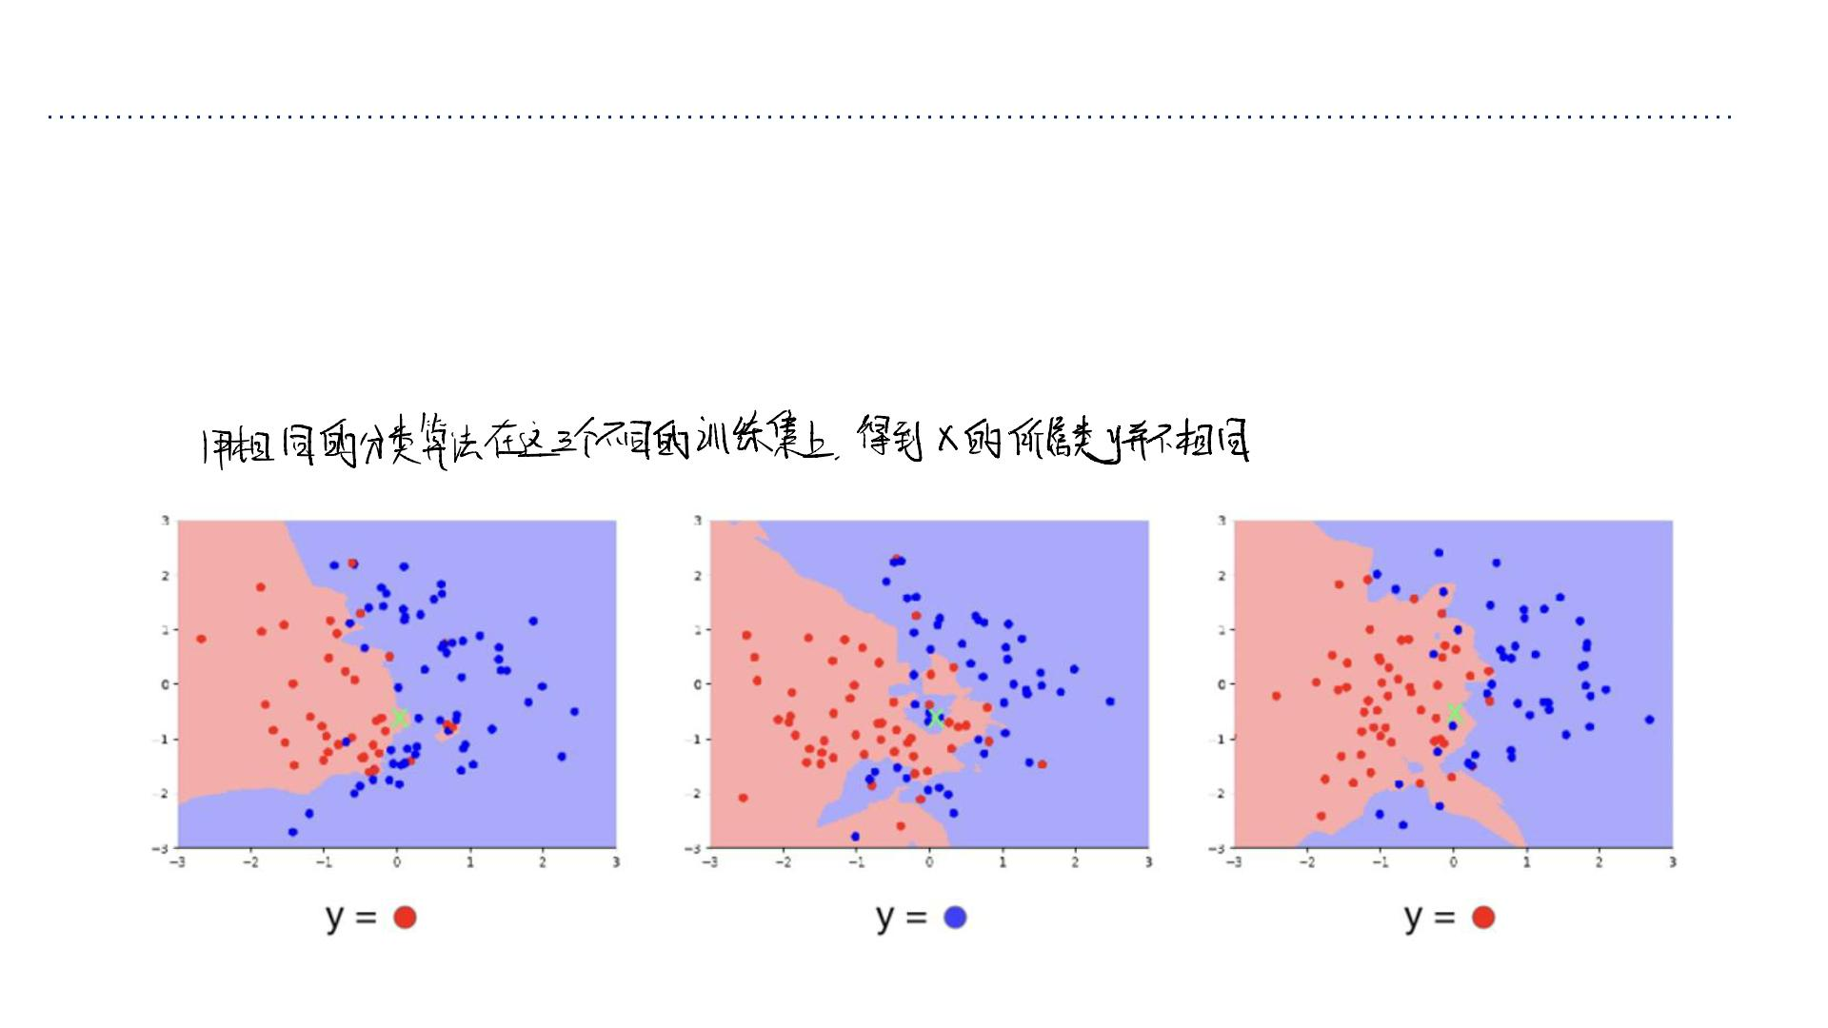
Bias-Variance Decomposition: Basic Setup
• Let’s run our learning algorithm on each training set, and compute its prediction ꢅat
the query point ꢟ.
• we can view ꢅas a random variable, where the randomness comes from the choice of
training set.
• The classification accuracy is determined by the distribution of ꢅ.

Slide 45
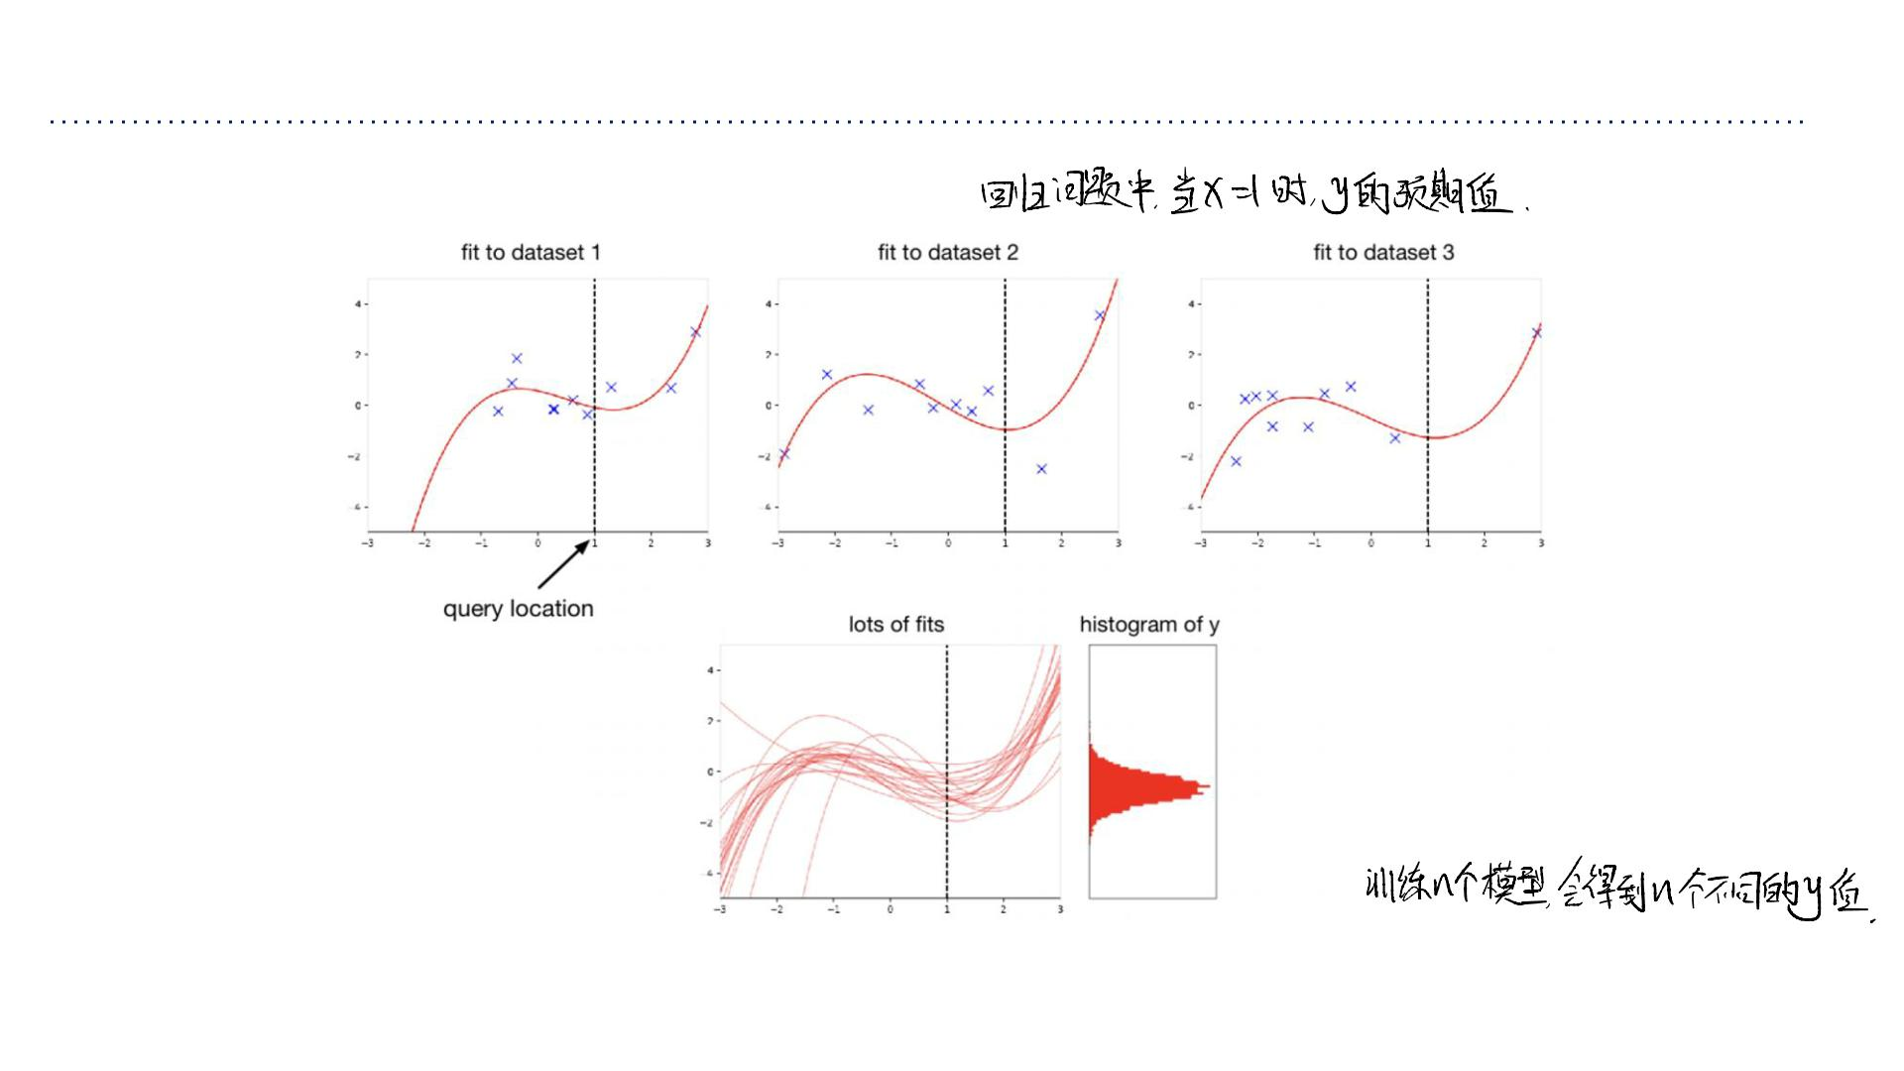
Bias-Variance Decomposition: Basic Setup
Here is the analogous setup for regression:
Since ꢅis a random variable, we can talk about its expectation, variance, etc.

Slide 46
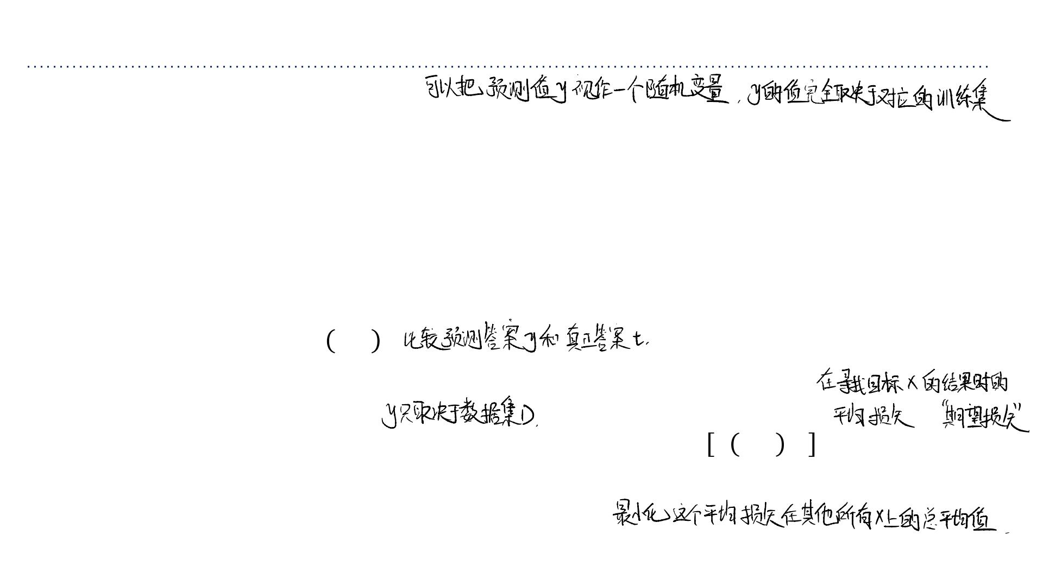
Bias-Variance Decomposition: Basic Setup
• Recap of basic setup:
➢Fix a query point ꢟ.
➢Repeat:
➢Sample a random training dataset ꢢi.i.d. from the data generating distribution
ꢆ_{sample}
.
➢Run the learning algorithm on ꢢto get a prediction ꢅat ꢟ.
➢Sample the (true) target from the conditional distribution ꢆ(ꢃ|ꢟ).
➢Compute the loss ꢡ ꢅ,ꢃ .
• Notice: ꢅis independent of ꢃ.
• This gives a distribution over the loss at ꢟ, with expectation ꢠꢡ ꢅ,ꢃ |ꢟ.
• For each query point ꢟ, the expected loss is different. We are interested in minimizing
the expectation of this with respect to ꢟ~ꢆ_{sample}
.

Slide 47
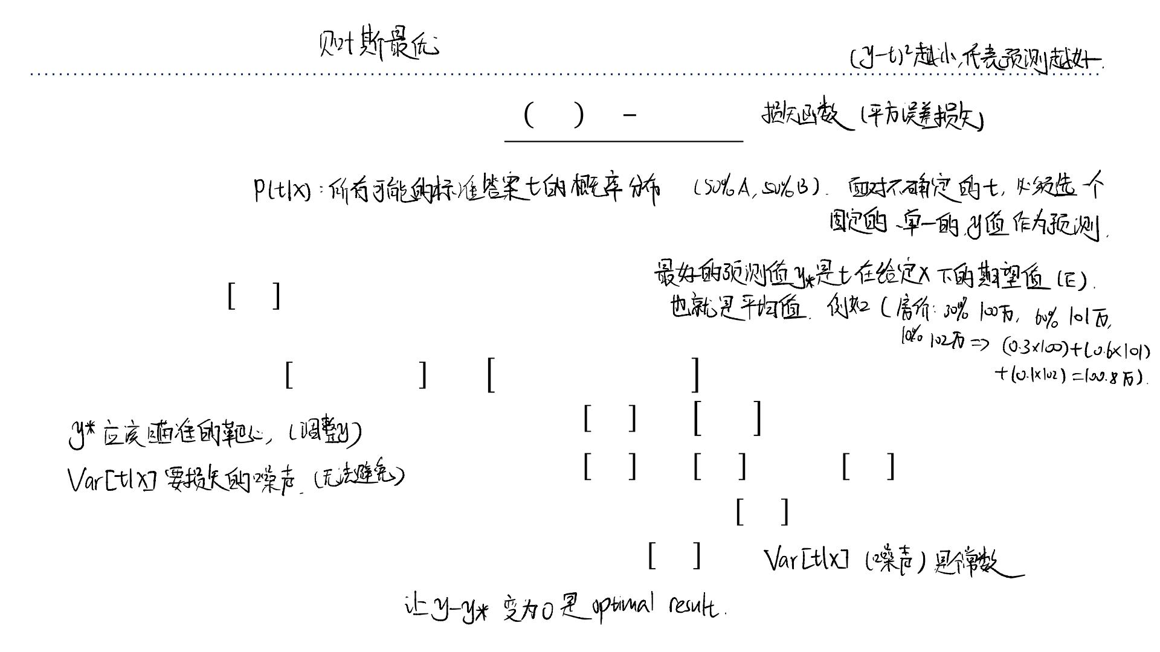
Bayes Optimality
1
• For now, focus on squared error loss, ꢡ ꢅ,ꢃ = (ꢅ − ꢃ)².
2
• A first step: suppose we knew the conditional distribution ꢆ(ꢃ|ꢟ). What value ꢅshould
we predict?
➢Here, we are treating ꢃas a random variable and choosing ꢅ.
• Claim: ꢅ∗ =ꢠ ꢃ|ꢟ is the best possible prediction.
• Proof:
2
2
ꢣ
ꢠ (ꢅ−ꢃ) |ꢟ =ꢠꢅ −2ꢅꢃ+ꢃ |ꢟ
2
ꢣ
=ꢅ −2yꢠ ꢃ|ꢟ +ꢠꢃ |ꢟ
2
2
=ꢅ −2yꢠ ꢃ|ꢟ +ꢠ ꢃ|ꢟ +Var ꢃ|ꢟ
2
2
=ꢅ −2ꢅꢅ +ꢅ +Var ꢃ|ꢟ
∗ ∗
2
=(ꢅ−ꢅ) +Var ꢃ|ꢟ
∗

Slide 48
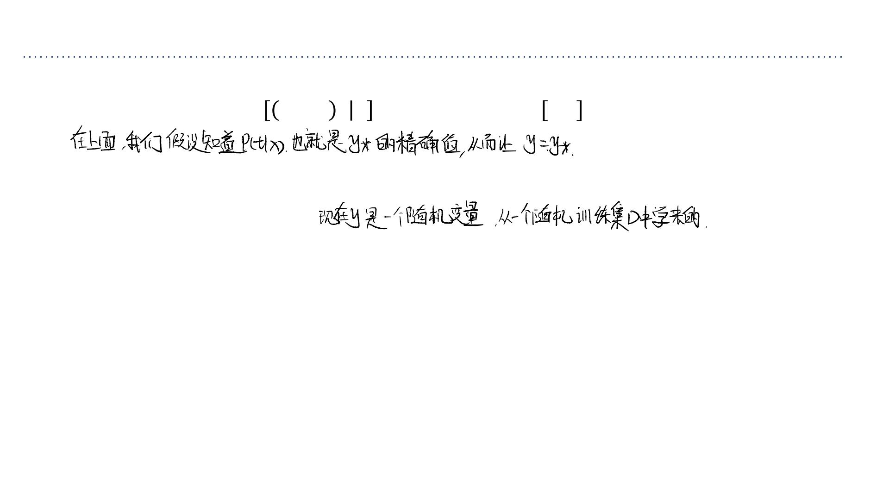
Bayes Optimality
2
2
ꢠ ꢅ−ꢃ ꢟ =(ꢅ−ꢅ) +Var ꢃ|ꢟ
∗
• The first term is nonnegative, and can be made 0 by setting ꢅ=ꢅ∗.
• The second term corresponds to the inherent unpredictability, or noise, of the targets,
and is called the Bayes error.
➢This is the best we can ever hope to do with any learning algorithm. An algorithm
that achieves it is Bayes optimal.
➢Notice that this term doesn’t depend on ꢅ.
• This process of choosing a single value ꢅ∗ based on ꢆ(ꢃ|ꢟ)is an example of decision
theory.

Slide 49
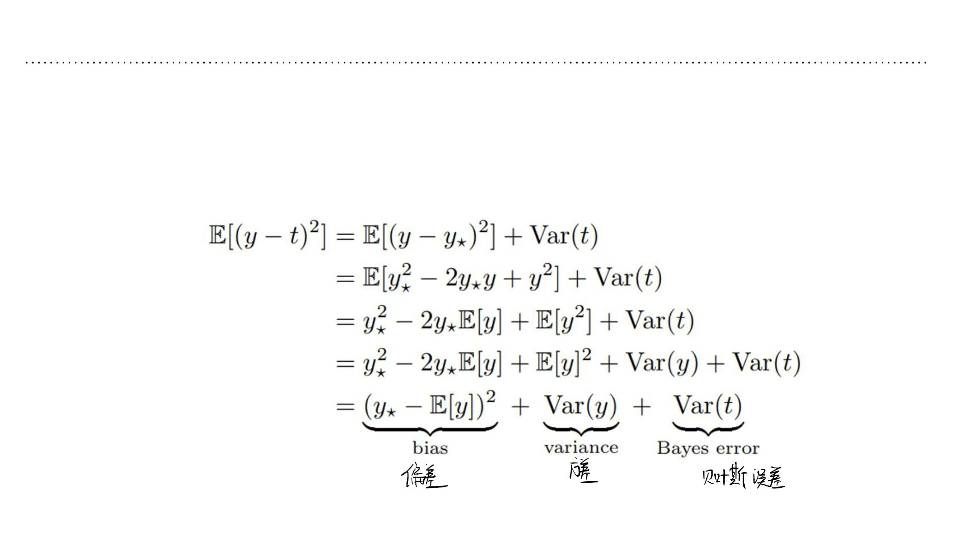
Bayes Optimality
• Now return to treating ꢅas a random variable (where the randomness comes fr om the
choice of dataset).
• We can decompose out the expected loss (suppressing the conditioning on ꢟfor clarity):

Slide 50
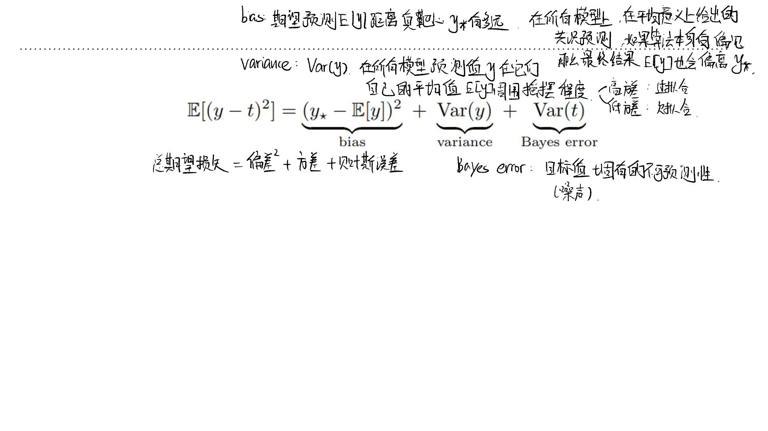
Bayes Optimality
• We just split the expected loss into three terms:
➢bias: how wrong the expected prediction is (corresponds to underfitting)
➢variance: the amount of variability in the predictions (corresponds to overfitting)
➢Bayes error: the inherent unpredictability of the targets
• Even though this analysis only applies to squared error, we often loosely use “bias”
and “variance” as synonyms for “underfitting” and “overfitting”.

Slide 51
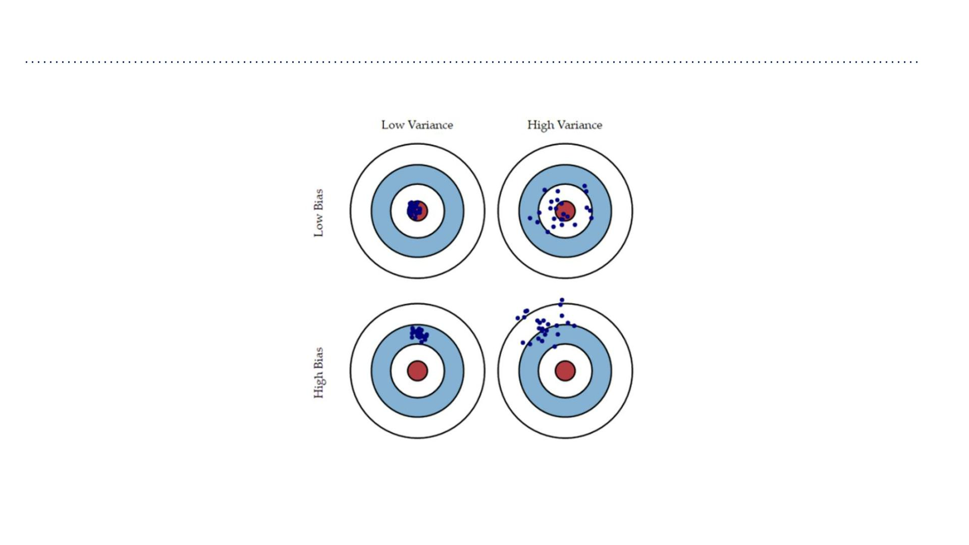
Bias and Variance
• Throwing darts = predictions for each draw of a dataset
• Be careful, what doesn’t this capture?
➢We average over points x from the data distribution.

