Slide 1

INT305 Machine Learning
Lecture 8
Bagging & Boosting
Siyue Yu
Department Intelligence Science
siyue.yu02@xjtlu.edu.cn

Slide 2
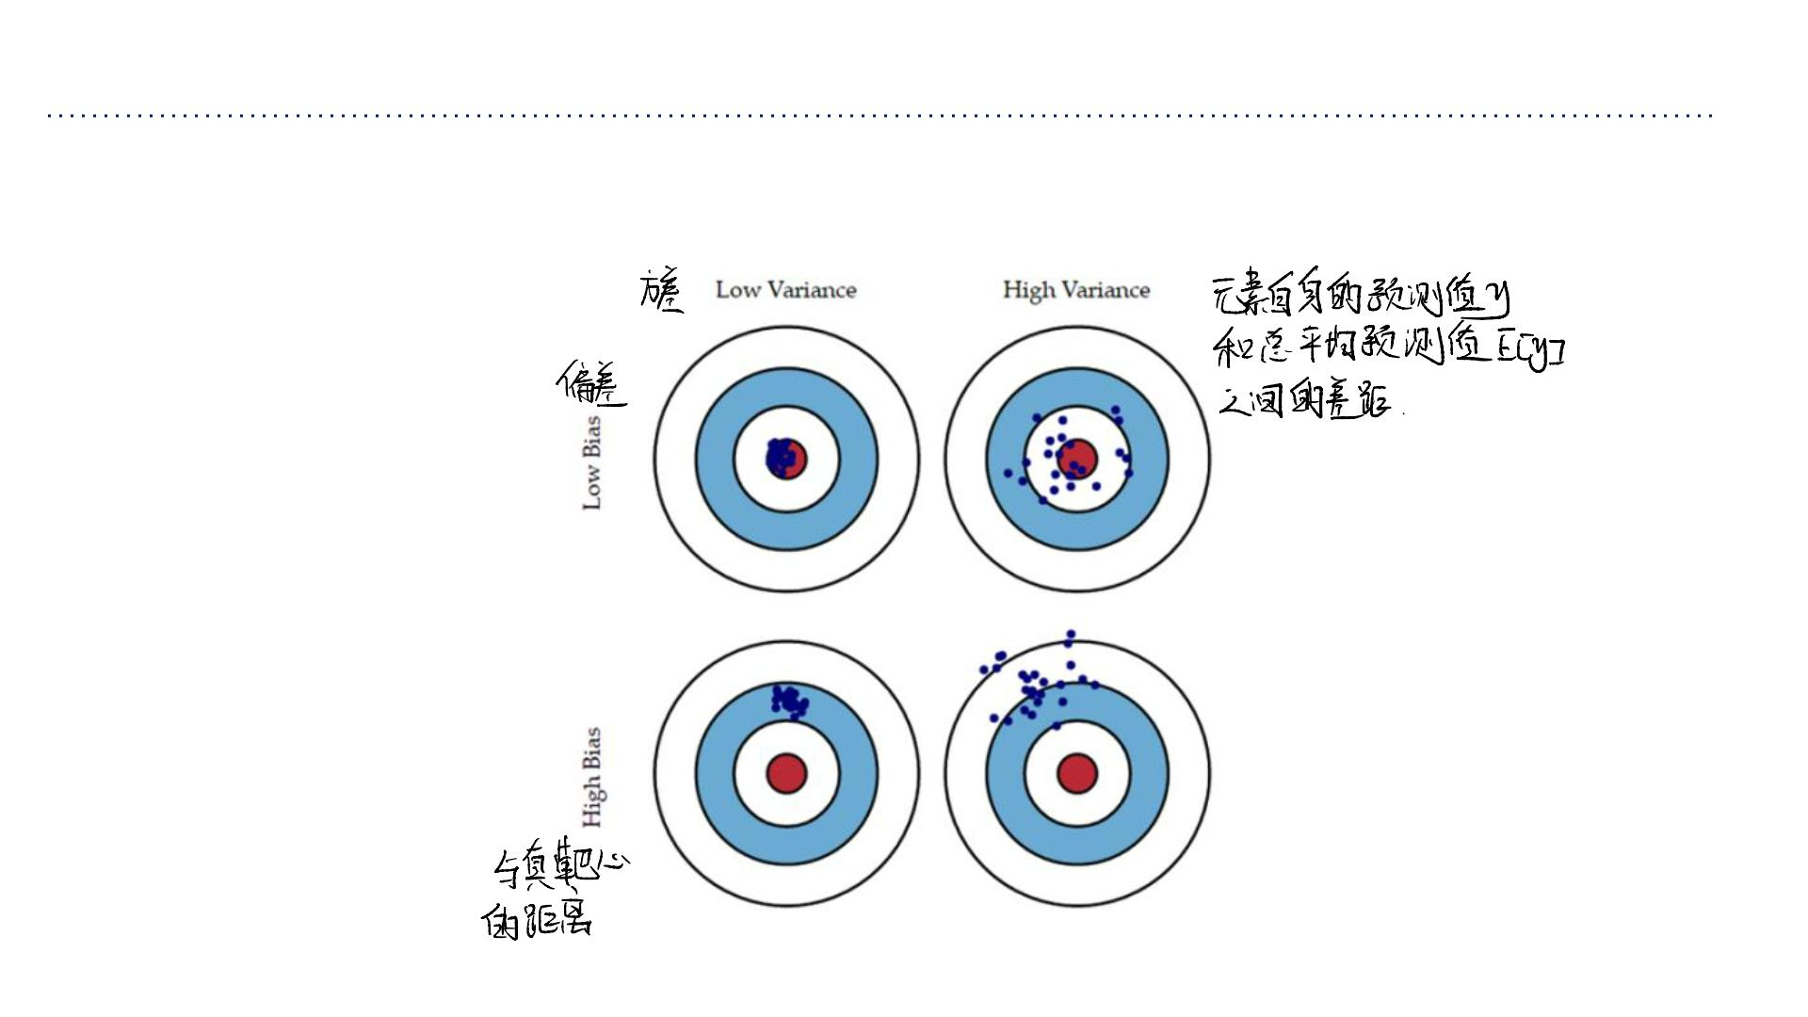
Bias/Variance Decomposition: Another Visualization

Slide 3
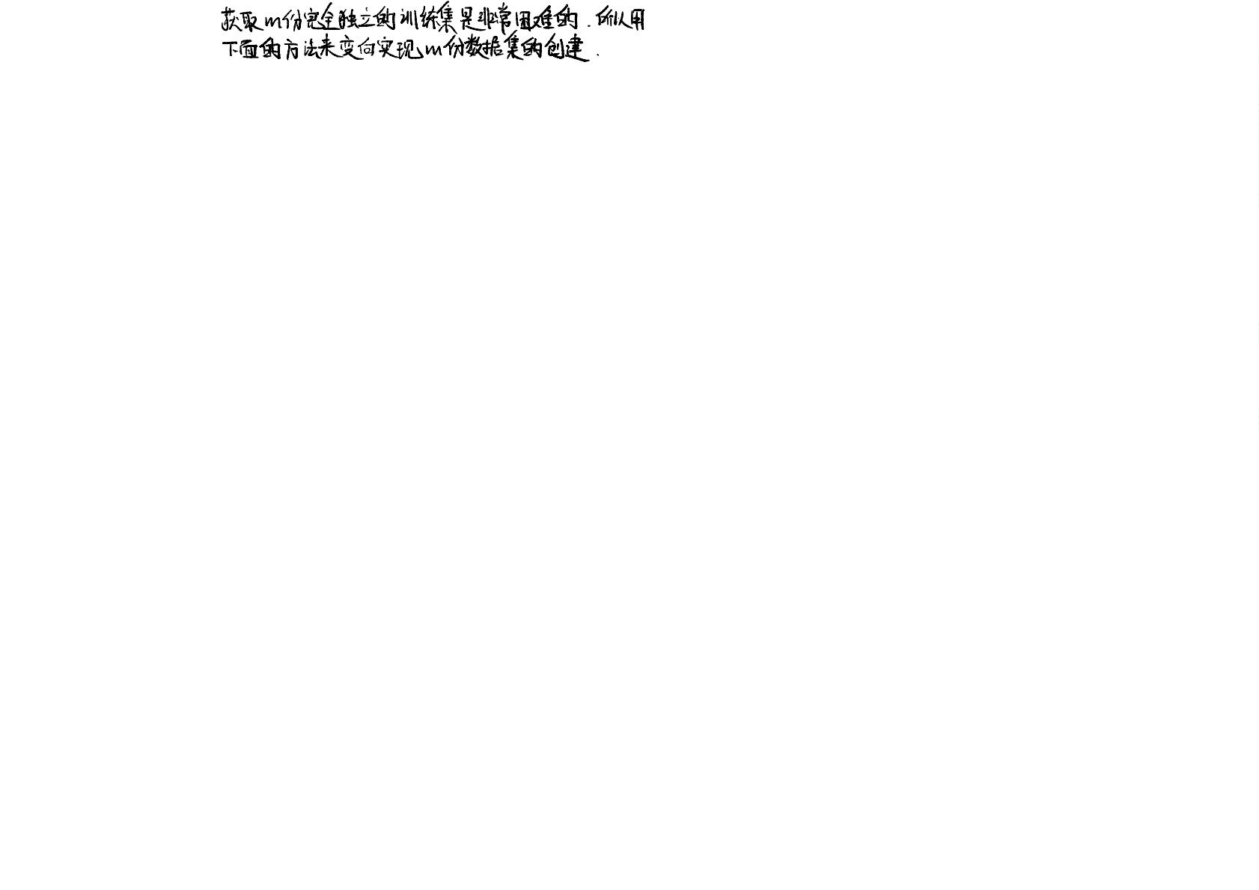
Bagging 的⼯作原理（两步⾛）
第⼀步：Bootstrap 采样 - 制造“多样性”
Bagging之所以强⼤，主要是因为它能有效降低模型的⽅差。
⽅差：衡量模型对于训练数据微⼩变化的敏感度。⽅差⾼的模型（如深度决
策树）容易对训练数据“过度学习”，即过拟合。它可能在新数据上表现很
差。
假设我们有⼀个原始训练数据集。为了训练出多个不同的“臭⽪匠”模型，我们不能⽤完全相同的数据，否则训练出来的模型会⼀模⼀样，没有多样性。
Bagging采⽤了⼀种⾮常聪明的⽅法来创造数据多样性：
有放回地随机抽取：从原始数据集中，随机抽取⼀个样本，记录下来后，再把这个样本放回去。然后进⾏下⼀次抽取。
形成⼀个新的训练集：重复上述抽取过程N次（N通常等于原始数据集的⼤⼩），这样就形成了⼀个和原始数据集⼀样⼤的新训练集。这个新训练集被称为 Bootstrap 数据集。
Bagging通过“平均”来降低⽅差：
单个复杂的模型可能很不稳定，换⼀套训练数据，预测结果可能天差地别。
Bootstrap数据集的特点：
但是，通过Bagging组合多个模型后，某个模型的“错误”会被其他模型的“正
确”所抵消。⼤家“吵吵闹闹”⼀平均，最终的结果反⽽会变得⾮常稳定和可
靠。
样本重复：由于是有放回抽样，⼀些样本可能会被抽到多次，⽽另⼀些样本可能⼀次都没被抽到。
数据差异：每个Bootstrap数据集都和原始数据集略有不同，这就为训练不同的模型提供了基础。
我们重复这个过程，创建出⼏⼗个、⼏百个这样的Bootstrap数据集。
第⼆步：Aggregating 聚合 - 综合⼤家的意⻅
现在，我们为第⼀步中创建的每⼀个Bootstrap数据集，都独⽴地训练⼀个基学习器（Base Learner，⽐如决策树）。
训练完成后，我们就得到了⼀个“模型委员会”。当有⼀个新的数据需要预测时，我们让委员会⾥的每个模型都进⾏预测，然后：
对于回归问题（预测数值）：我们将所有模型的预测结果取平均值，作为最终的预测结果。
最终预测值 = (模型1预测值 + 模型2预测值 + ... + 模型M预测值) / M
对于分类问题（预测类别）：我们采⽤投票法，即选择所有模型预测中出现次数最多的类别，作为最终的预测结果。
最终预测类别 = 票数最多的那个类别

Slide 4
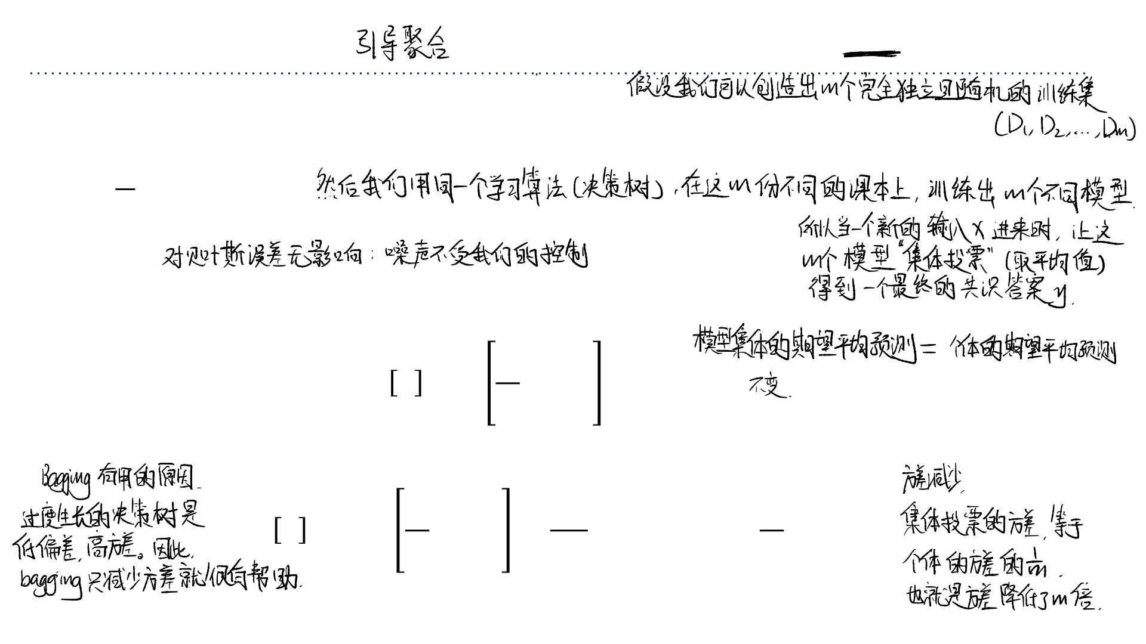
Bagging: Motivation
⽤于解决我们在决策树中诊断出的“⾼⽅差”（过度拟合）问题
• Suppose we could somehow sample ꢀindependent training sets from ꢁ_{sample}
• We could then compute the prediction ꢂ based on each one, and take the average
.
ꢃ
1
ꢄ
ꢂ= σ ꢂ .
ꢄ
ꢃ=1 ꢃ
• How does this affect the three terms of the expected loss?
➢Bayes error: unchanged, since we have no control over it
➢Bias: unchanged, since the averaged prediction has the same expectation
ꢄ
1
ꢅꢂ =ꢅ ෍ꢂ =ꢅ[ꢂ ]
ꢀ
ꢃ
ꢃ
ꢃ=1
➢Variance: reduced, since we’re averaging over independent samples
ꢄ
ꢄ
1 1
Varꢂ =Var ෍ꢂ = ෍Var[ꢂ ]= Var[ꢂ ]
1
ꢃ
2
ꢃ
ꢃ
ꢀ ꢀ
ꢃ=1
ꢀ
ꢃ=1

Slide 5
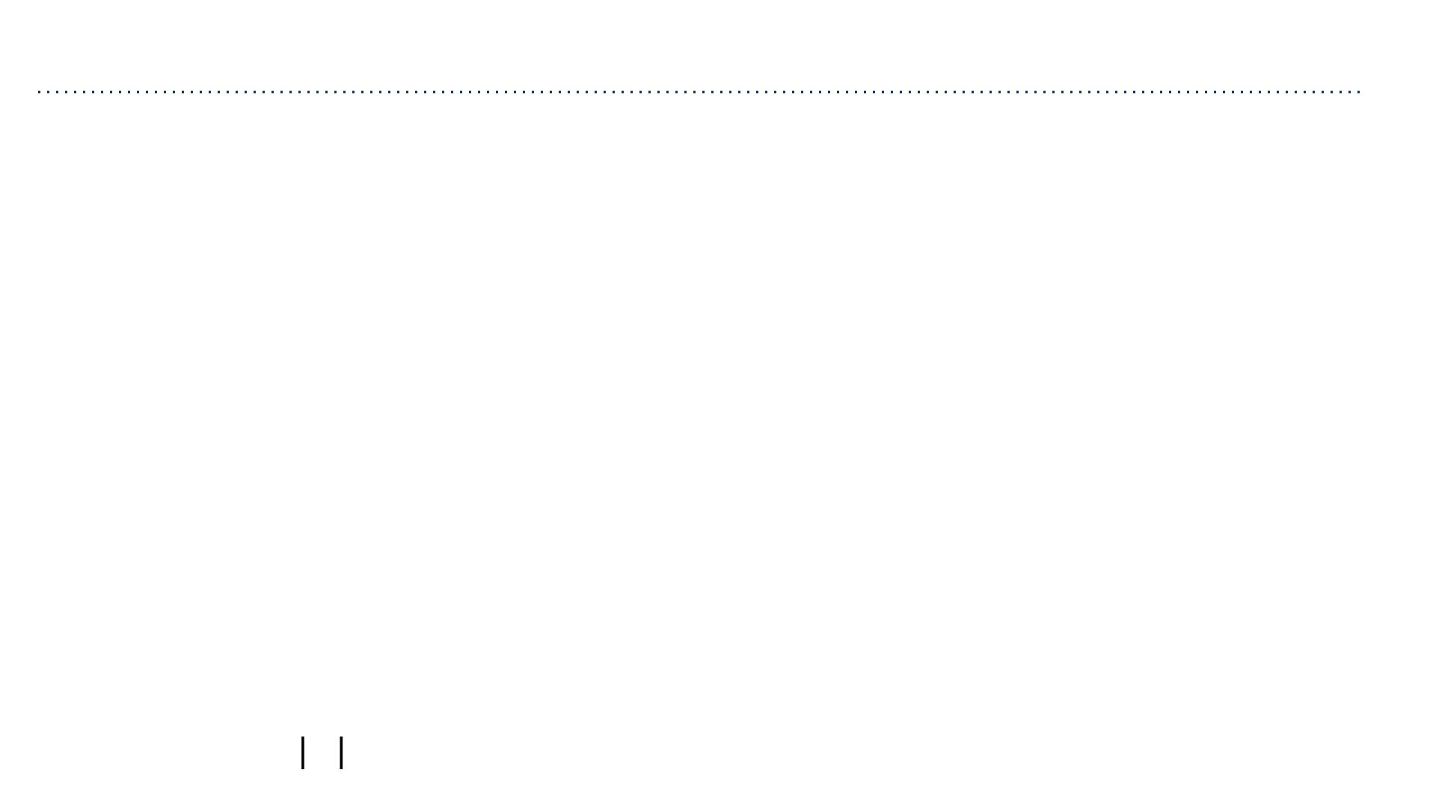
Bagging: The Idea
• In practice, the sampling distribution ꢁ_{sample} is often finite or expensive to sample
from.
• So training separate models on independently sampled datasets is very wasteful of
data!
➢Why not train a single model on the uni on of all sampled datasets?
• Solution: given training set ꢆ, use the empirical distribution ꢁ_{ꢆ} as a pr oxy for ꢁ_{sample}
.
This is called bootstrap aggregation, or bagging.
➢Take a single dataset ꢆwith ꢇexamples.
➢Generate ꢀnew datasets (“resamples” or “bootstrap samples”), each by sampling ꢇ
training examples from ꢆ, with replacement.
➢Average the predictions of models trained on each of these datasets.
• The bootstrap is one of the most important ideas in all of statistics!
➢Intuition: As ꢆ →∞, we have ꢁ →ꢁ
_{ꢆ sample}.

Slide 6
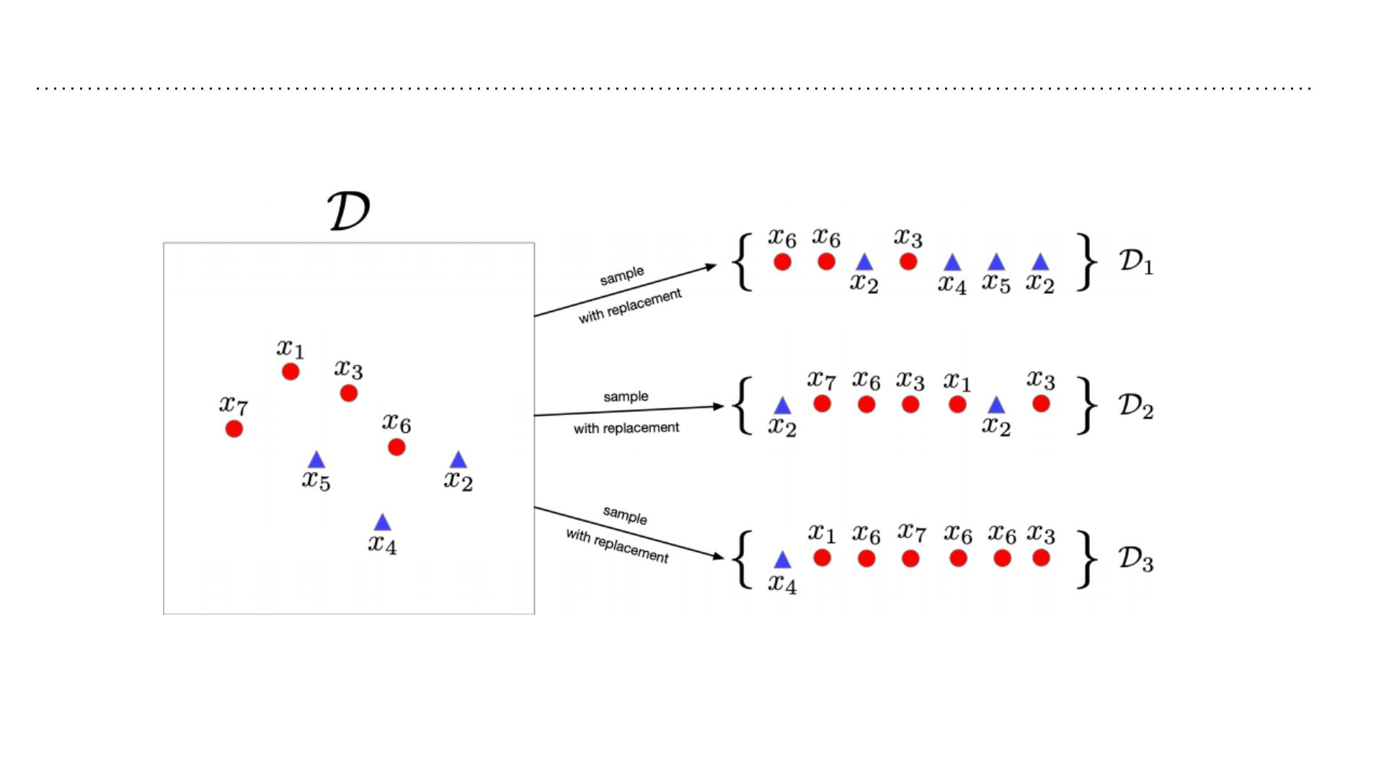
Bagging
In this example ꢇ=7, ꢀ=3

Slide 7
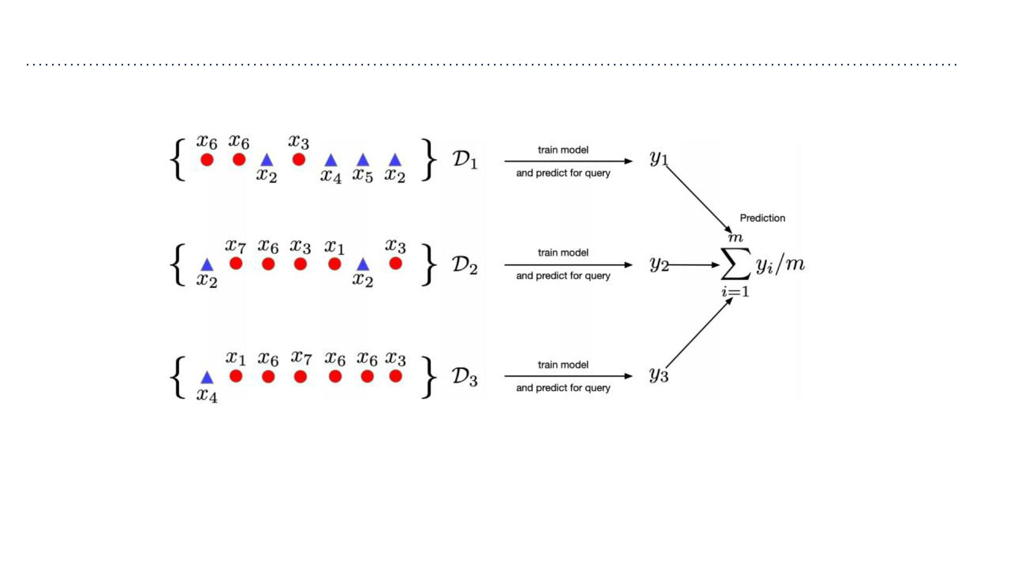
Bagging
Predicting on a query point ꢈ

Slide 8
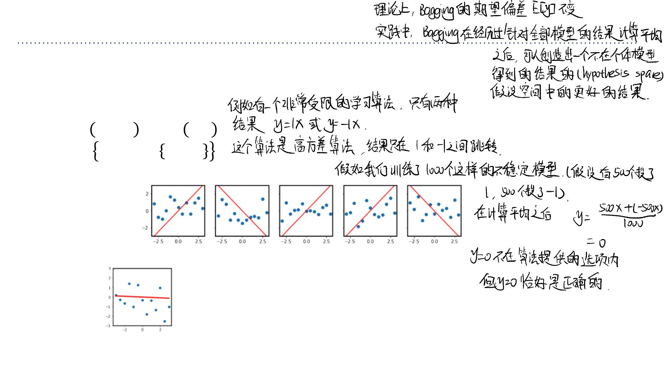
Bagging: Effect on Hypothesis Space
• We saw that in case of squared error, bagging does not affect bias.
• But it can change the hypothesis space / inductive bias.
• Illustrative example:
➢ꢈ~ꢉ −3, 3 , ꢊ~ꢋ 0,1
➢ℋ= ꢌꢈ|ꢌ ∈ −1,1
➢Sampled datasets & fitted hypotheses:
➢Ensembled hypotheses (mean over 1000 samples):
➢The ensembled hypothesis is not in the
original hypothesis space!
• This effect is most pronounced when combining classifiers…

Slide 9
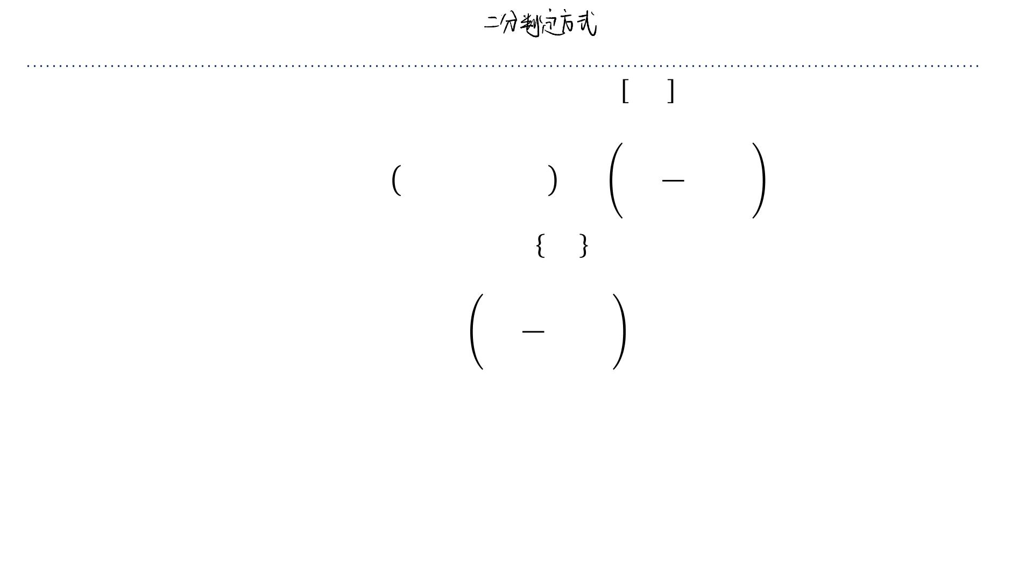
Bagging for Binary Classification
• If our classifiers output real-valued probabilities, ꢍ_{ꢃ} ∈ 0,1, then we can average the
predictions before thresholding:
ꢄ
ꢍ
ꢃ
ꢂ =ꢎ ꢍ > 0.5 =ꢎ ෍ > 0.5
bagged
bagged
ꢀ
ꢃ=1
• If our classifiers output binary decisions, ꢂ_{ꢃ} ∈ 0,1 , we can still average the predictions
before thresholding:
ꢄ
ꢂ
ꢃ
ꢂ =ꢎ ෍ > 0.5
bagged
ꢀ
ꢃ=1
• A bagged classifier can be stronger than the average underlying model.
➢E.g., individual accuracy on “Who Wants to be a Millionaire” is only so-so, but “Ask
the Audience” is quite effective.

Slide 10
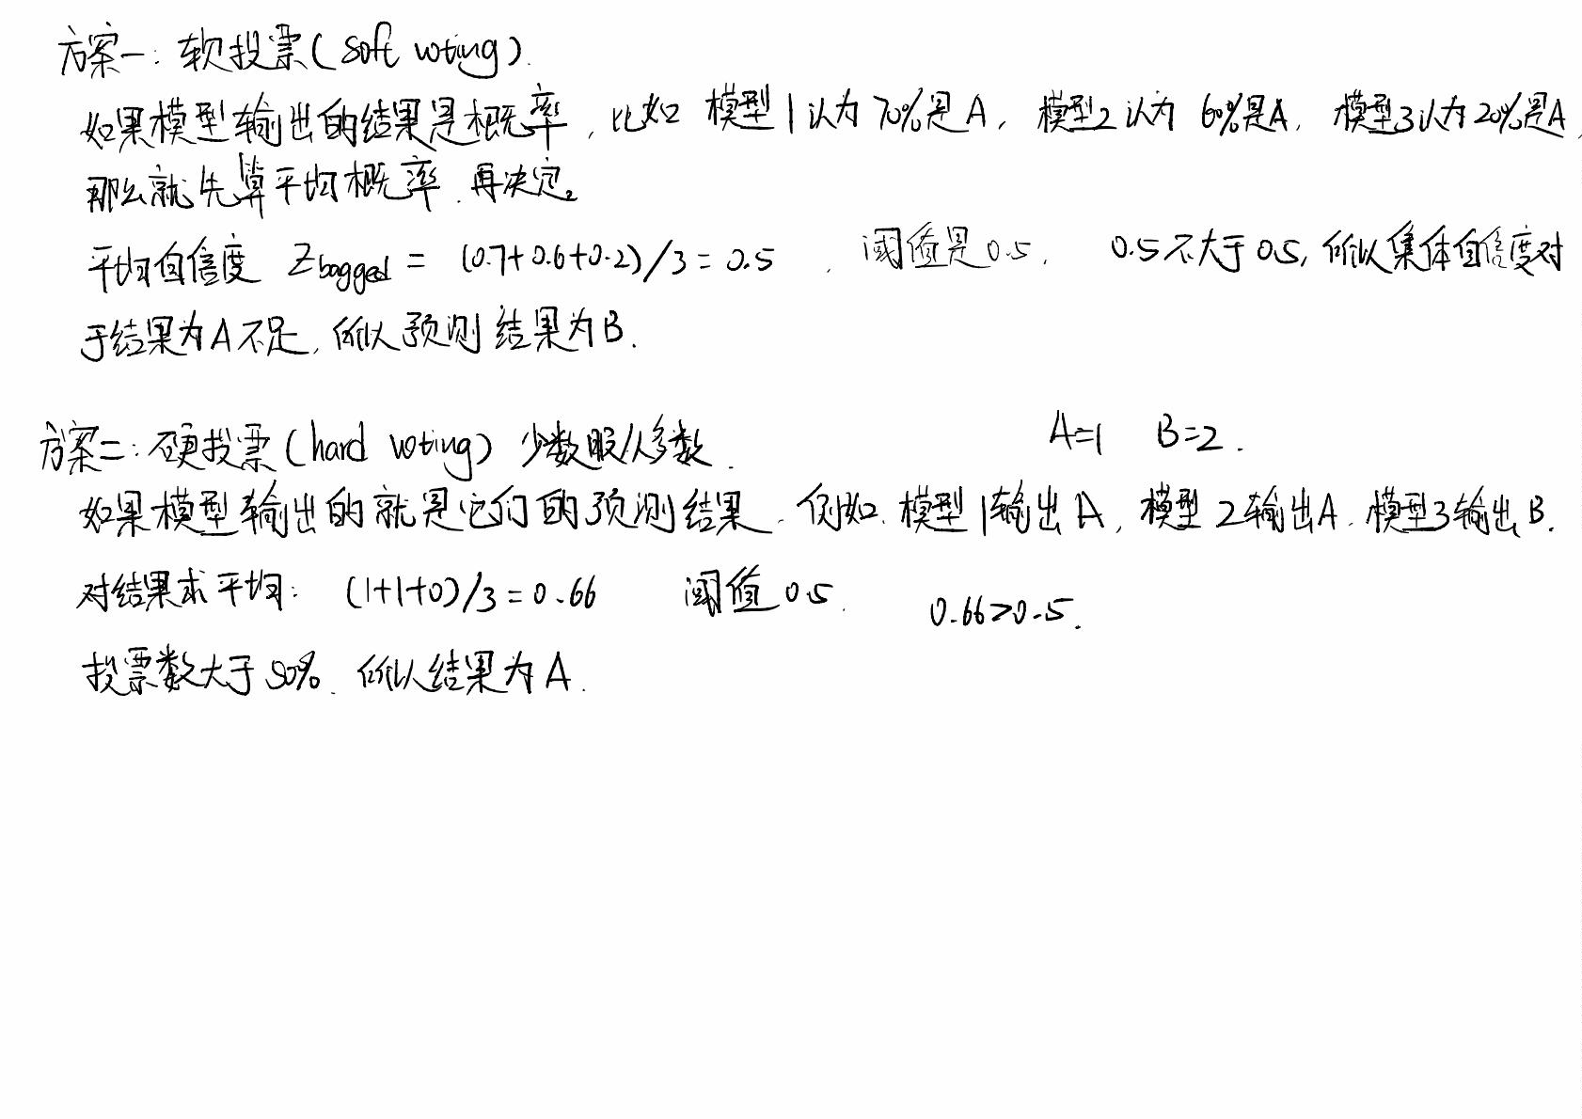

Slide 11
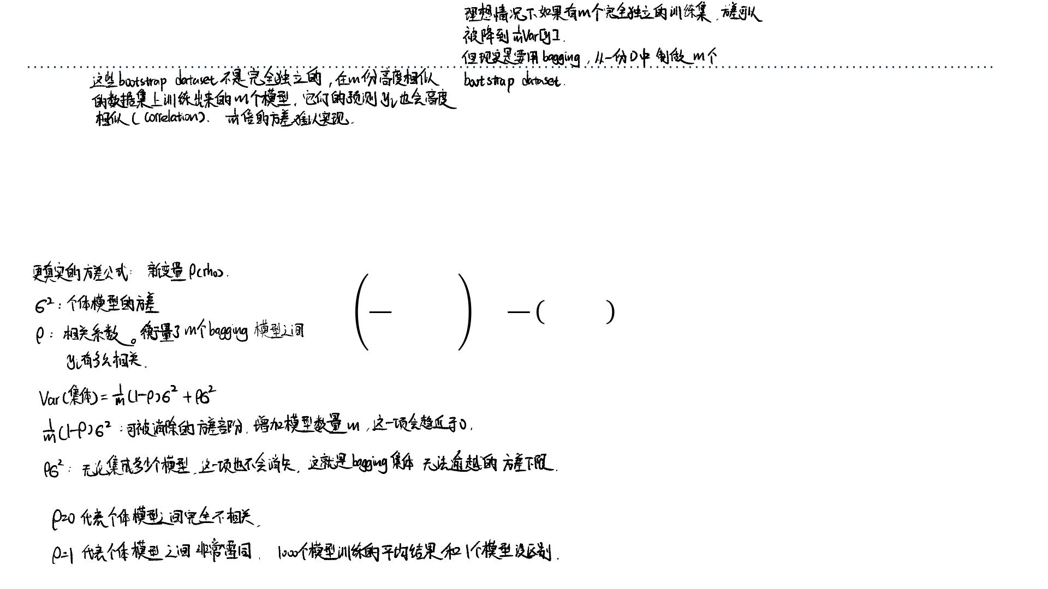
Bagging: Effect of Correlation
• Problem: the datasets are not independent, so we don’t get the 1Τꢀvariance
reduction.
➢Possible to show that if the sampled predictions have variance ꢁ² and
correlation ꢂ, then
ꢄ
1 1
2 2
Var ෍ꢅ = 1−ꢂ ꢁ +ꢂꢁ
ꢃ
ꢀ ꢀ
ꢃ=1

Slide 12
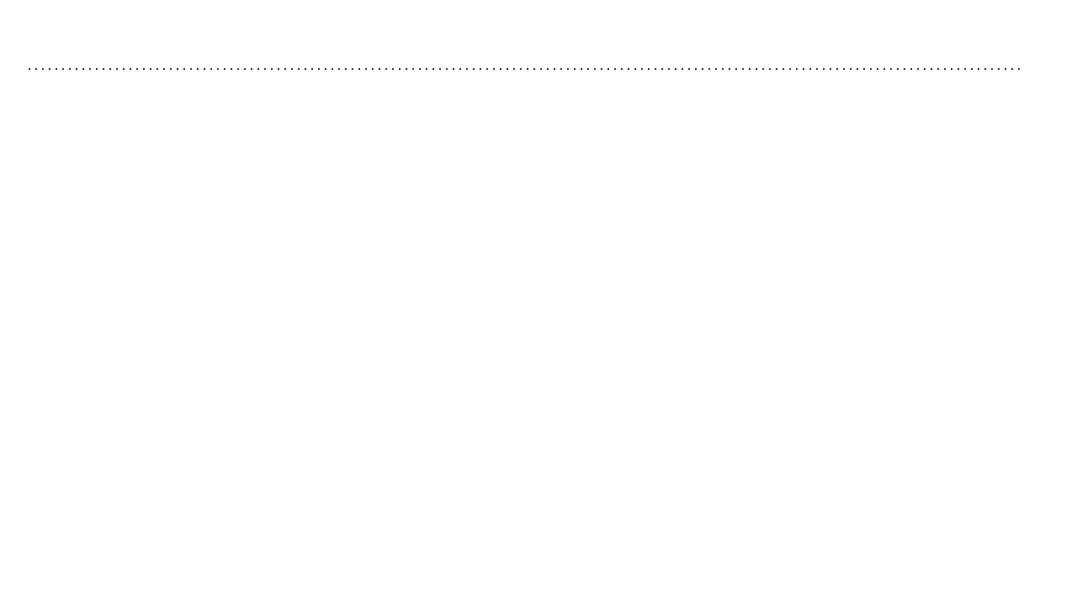
Random Forests
在构建每⼀棵决策树的每⼀个节点时，我们不再允许它看所有的特征（⽐如 width 和 height）。我们强迫它只能从随机抽取的⼀⼩部分特征中
做选择！这就像把决策树的“眼睛”蒙住⼀部分。有些树只能看 width，有些树只能看 height。这样训练出来的树，肯定⻓得各不相同！
• Random forests = bagged decision trees, with one extra trick to decorrelate the
predictions
➢When choosing each node of the decision tree, choose a random set of ꢆinput
features, and only consider splits on those features
• Random forests are probably the best black-box machine learning algorithm – they
often work well with no tuning whatsoever.
➢one of the most widely used algorithms in Kaggle competitions

Slide 13
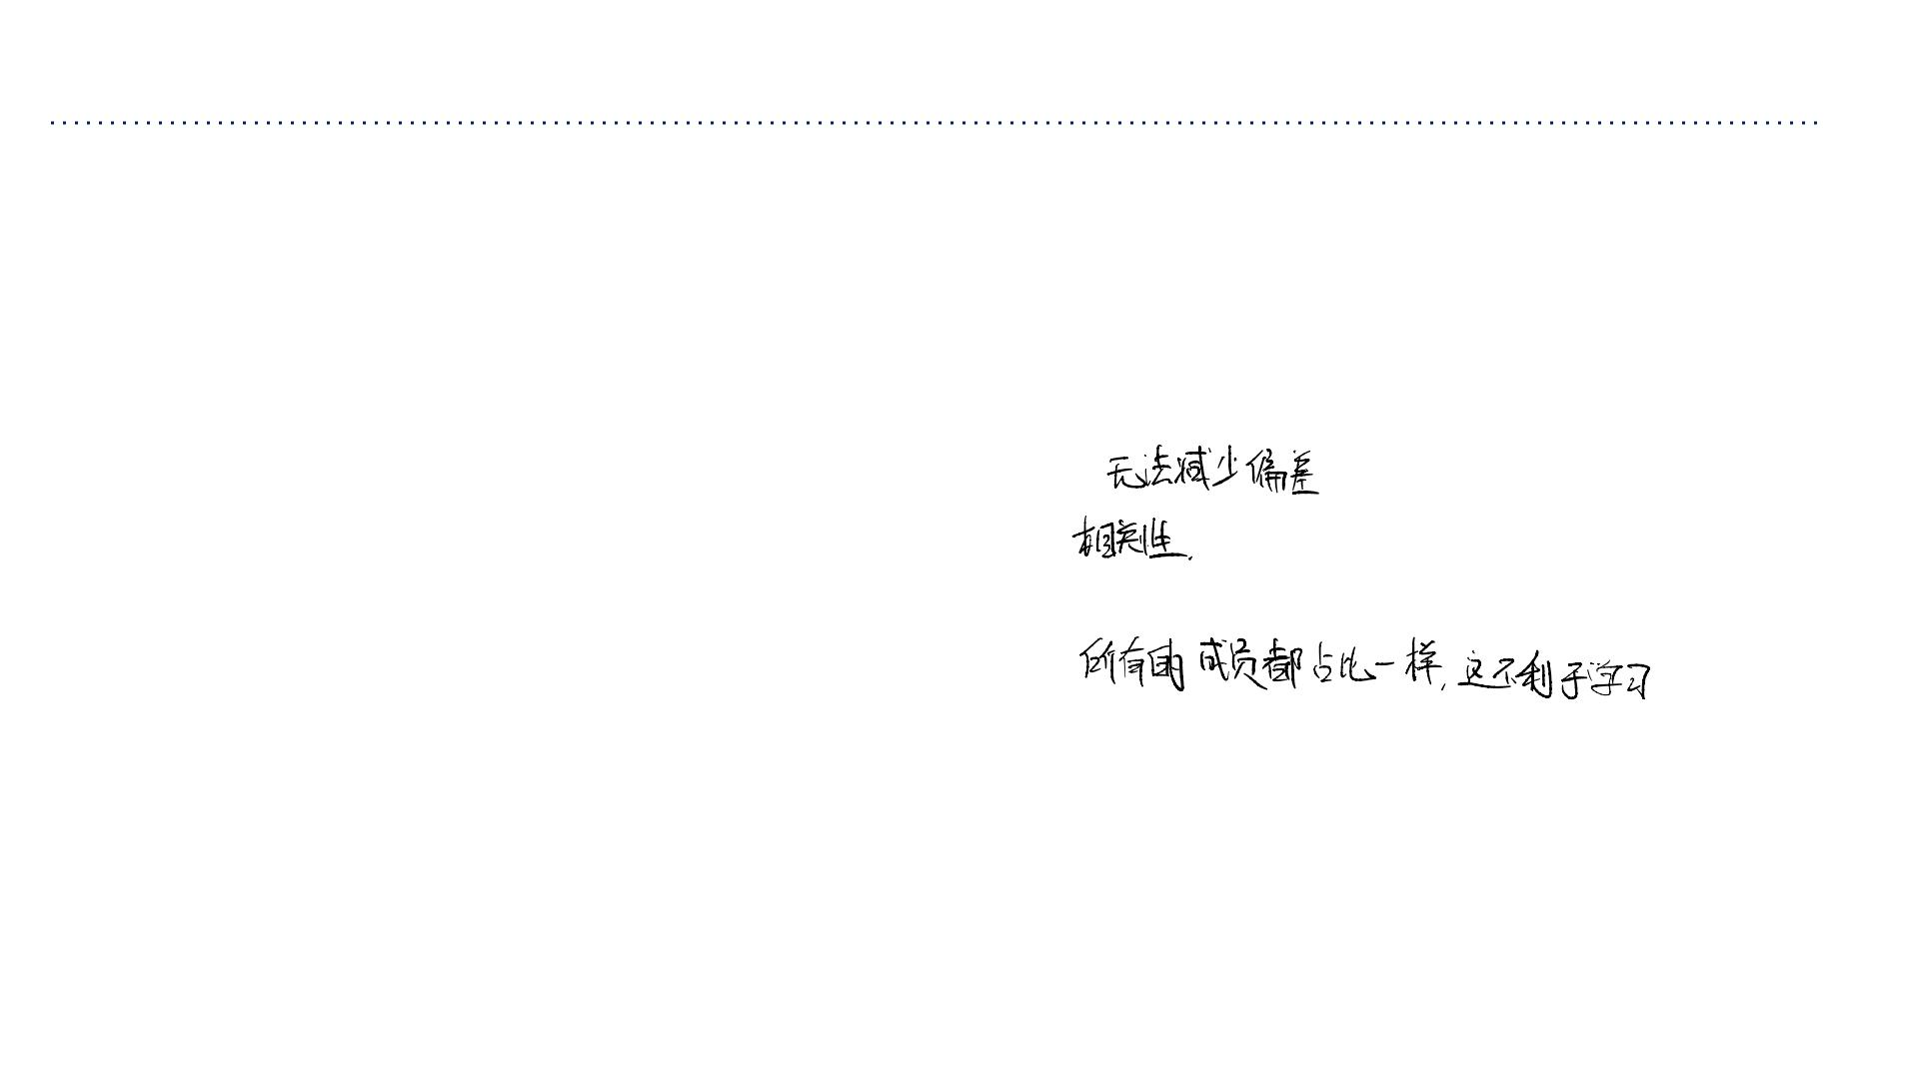
Bagging Summary
• Bagging reduces overfitting by averaging predictions.
• Used in most competition winners
(减少过度拟合)：通过降低⽅差。
即使你已经有了⼀个很强的模型，再搞
⼏个模型来 Bagging ⼀下（集成），通
常都能把分数再刷⾼⼀点。
➢Even if a single model is great, a small ensemble usually helps.
• Limitations:
➢Does not reduce bias in case of squared error.
➢There is still correlation between classifiers.
➢Random forest solution: Add more randomness.
➢Naive mixture (all members weighted equally).
➢If members are very different (e.g., different algorithms, different data sources,
etc.), we can often obtain better results by using a principled approach to
weighted ensembling.
• Boosting, up next, can be viewed as an approach to weighted ensembling that strongly
decorrelates ensemble members.

Slide 14
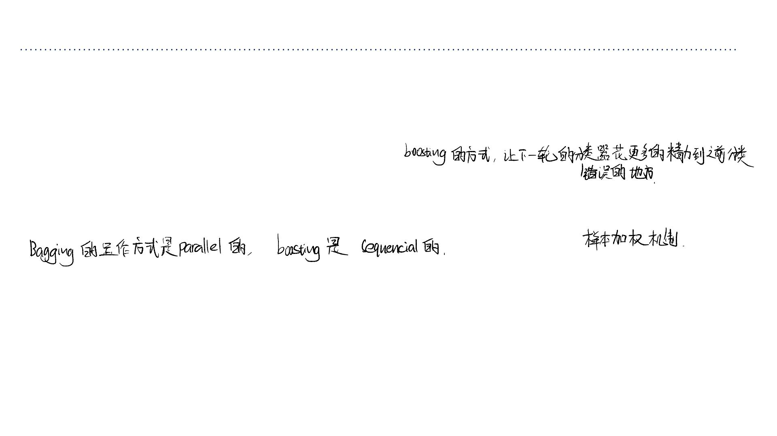
Boosting
• Boosting
➢Train classifiers sequentially, each time focusing on training examples
that the previous ones got wrong.
➢The shifting focus strongly decorrelates their predictions.
• To focus on specific examples, boosting uses a weighted training set.
Bagging：请 10 个⽔平差不多的⽼师，每⼈随机改⼀部分卷⼦，最后平均分。
Boosting：先请第 1 个⽼师改卷⼦。他改错的那些难题，被加粗标记出来，交给第 2 个更厉害的⽼师专⻔攻克。第 2 个⽼师还搞不定的，交给第 3
个……

Slide 15
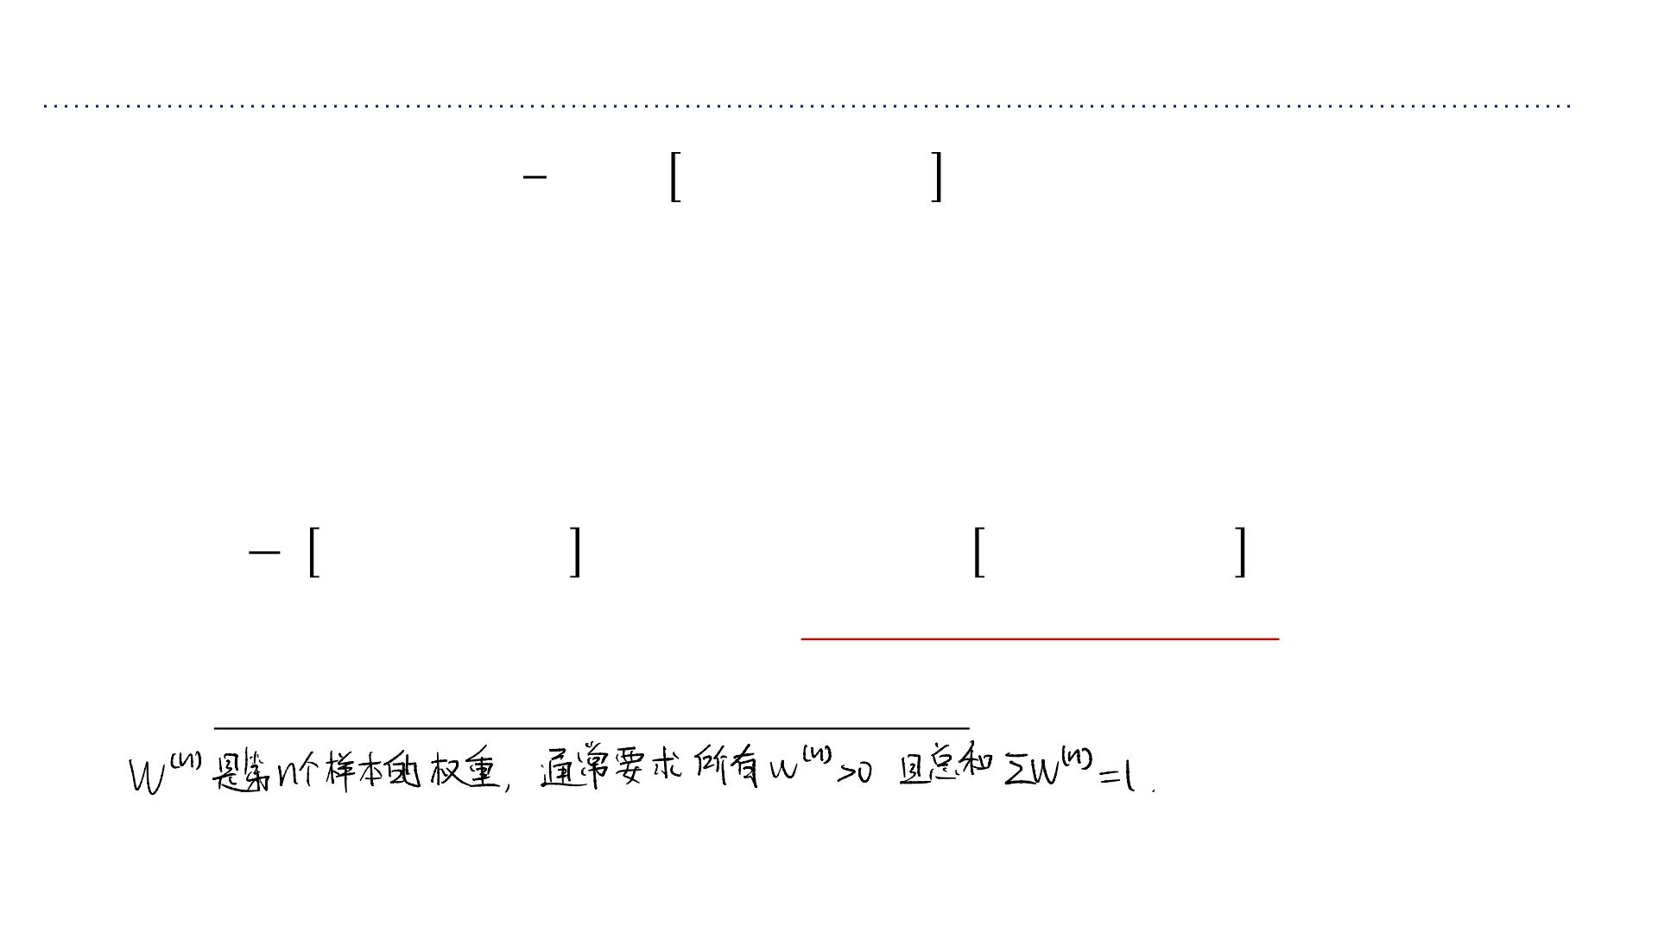
Weighted Training set
通过改变样本权重来影响模型的训练⽬标
1
• The misclassification rate ꢇ ꢉ ℎ(ꢊ^{(ꢈ)})≠ꢋ^{(ꢈ)} weights each training example
σ
ꢇ
ꢈ=1
equally.
这个公式意味着每⼀个训练样本对最终误差的贡献都是⼀样的（权重均为 1/N）。模型会平等地对待所有样本。
• Key idea: we can learn a classifier using different costs (aka weights) for examples.
➢Classifier “tries harder” on examples with higher cost
• Change cost function:
我们可以给不同的训练样本分配不同的代价 (costs) 或 权重
(weights)。
如果赋予某些样本更⾼的权重，分类器在训练时为了最⼩化总代价，
就必须优先保证这些⾼权重样本被分类正确。
ꢇ
ꢇ
1
(ꢈ) (ꢈ)
(ꢈ) (ꢈ) (ꢈ)
becomes ෍ꢌ ꢉ ℎ(ꢊ )≠ꢋ
෍ ꢉ ℎ(ꢊ )≠ꢋ
ꢍ
ꢈ=1
ꢈ=1
• Usually require each ꢌ^{(ꢈ)} >0and ꢇ ꢌ^{(ꢈ)} =1.
σ
ꢈ=1

Slide 16
AdaBoost (Adaptive Boosting)
• We can now describe the AdaBoost algorithm.
• Given a base classifier, the key steps of AdaBoost are:
1. At each iteration, re-weight the training samples by assigning larger weights to samples (i.e., data
points) that were classified incorrectly.
2. Train a new base classifier based on the re-weighted samples.
3. Add it to the ensemble of classifiers with an appropriate weight.
4. Repeat the process many times.
• Requirements for base classifier:
➢ Needs to minimize weighted error.
➢ Ensemble may get very large, so base classifier must be fast. It turns out that any so -called weak learner /
classifier suffices.
• Individually, weak learners may have high bias (underfit). By making each classifier
focus on previous mistakes, AdaBoost reduces bias.

Slide 17

1. 算法步骤： AdaBoost 通过⼀个循环过程来构建分类器集合：
步骤 1（重加权）：在每⼀轮迭代开始时，调整训练样本的权重。对于上⼀轮被分类错误的样本，增加它们的权重；
对于分类正确的样本，降低权重。
步骤 2（训练）：基于这些重新加权的样本，训练⼀个新的基分类器 (Base Classiﬁer)。这个分类器会把重点放在处
理那些之前做错的样本上。
步骤 3（集成）：将这个新训练的基分类器加⼊到分类器集合中。注意，每个基分类器本身也会被分配⼀个权重（表
现越好的分类器，在最终决策中话语权越⼤）。
步骤 4（重复）：重复上述过程多次，构建出⼀系列分类器。
2. 对基分类器的要求：
基分类器必须⽀持最⼩化加权误差（即能处理上⼀张幻灯⽚提到的加权代价函数）。
由于集成模型通常包含很多个基分类器，所以基分类器必须计算速度快。
弱分类器 (Weak Learner) 即可满⾜要求：即那些准确率只需略⾼于随机猜测（>50%）的简单模型（例如只有⼀层
深度的决策树，称为“决策树桩”）。
3. 降低偏差 (Reducing Bias)：
单个弱分类器通常太简单，存在⾼偏差 (High Bias) 和 ⽋拟合 (Underﬁtting) 的问题。
Boosting 的作⽤：通过迫使每⼀个新的分类器去修正前⼀个分类器的错误，AdaBoost 能够逐步逼近复杂的决策边
界。因此，AdaBoost 的主要作⽤是降低偏差 (Bias)，将多个弱分类器组合成⼀个强分类器。

Slide 18
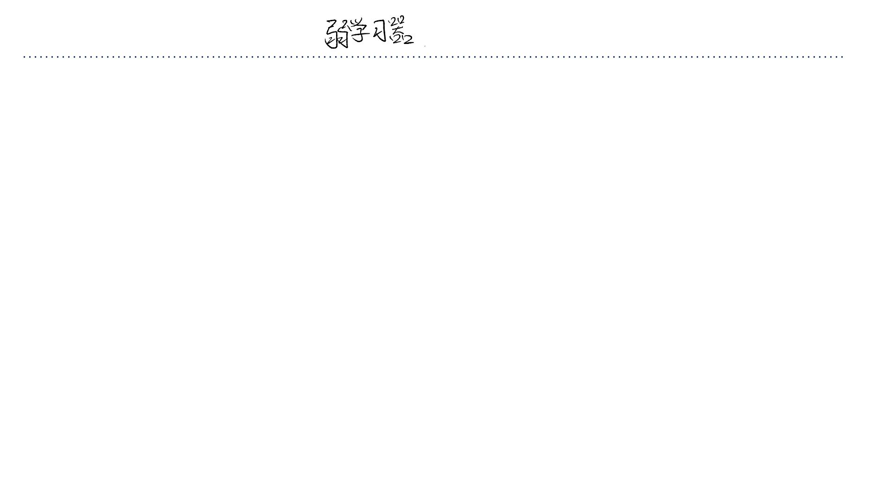
Weak Learner/Classifier
• (Informal) Weak learner is a learning algorithm that outputs a hypothesis (e.g., a
classifier) that performs slightly better than chance, e.g., it predicts the correct label
with probability 0.51 in binary label case.
• We are interested in weak learners that are computationallyefficient.
➢Decision trees
➢Even simpler: Decision Stump: A decision tree with a single split
[Formal definition of weak learnability has quantifies such as “for any distribution over data” and the
requirement that its guarantee holds only probabilistically.]
计算效率 (Computationally Eﬃcient)：
⾮正式定义 (Informal Deﬁnition)：
弱学习器是⼀种学习算法，它输出的假设（模型）只需要⽐随机猜测
(Chance) 稍微好⼀点点即可。
我们不仅要求它能分类，还要求它计算速度⾮常快。因为 Boosting 需要串⾏训练成百上千
个这样的分类器，如果单个分类器太慢，整体训练时间将不可接受。
在⼆分类问题（⽐如抛硬币猜正反）中，随机猜测的准确率是 50% (0.5)。
⾸选模型：
因此，⼀个弱分类器只要能在新数据上达到 51% (0.51) 的准确率，就被认
为是合格的。
1. 决策树 (Decision Trees)：特别是⾮常浅的树。
2. 决策树桩 (Decision Stump)：这是最简单的决策树，它只包含⼀个分裂节点 (single
split)。也就是只问⼀个问题（⽐如“x > 5 吗？”）就⽴即做决定。

Slide 19
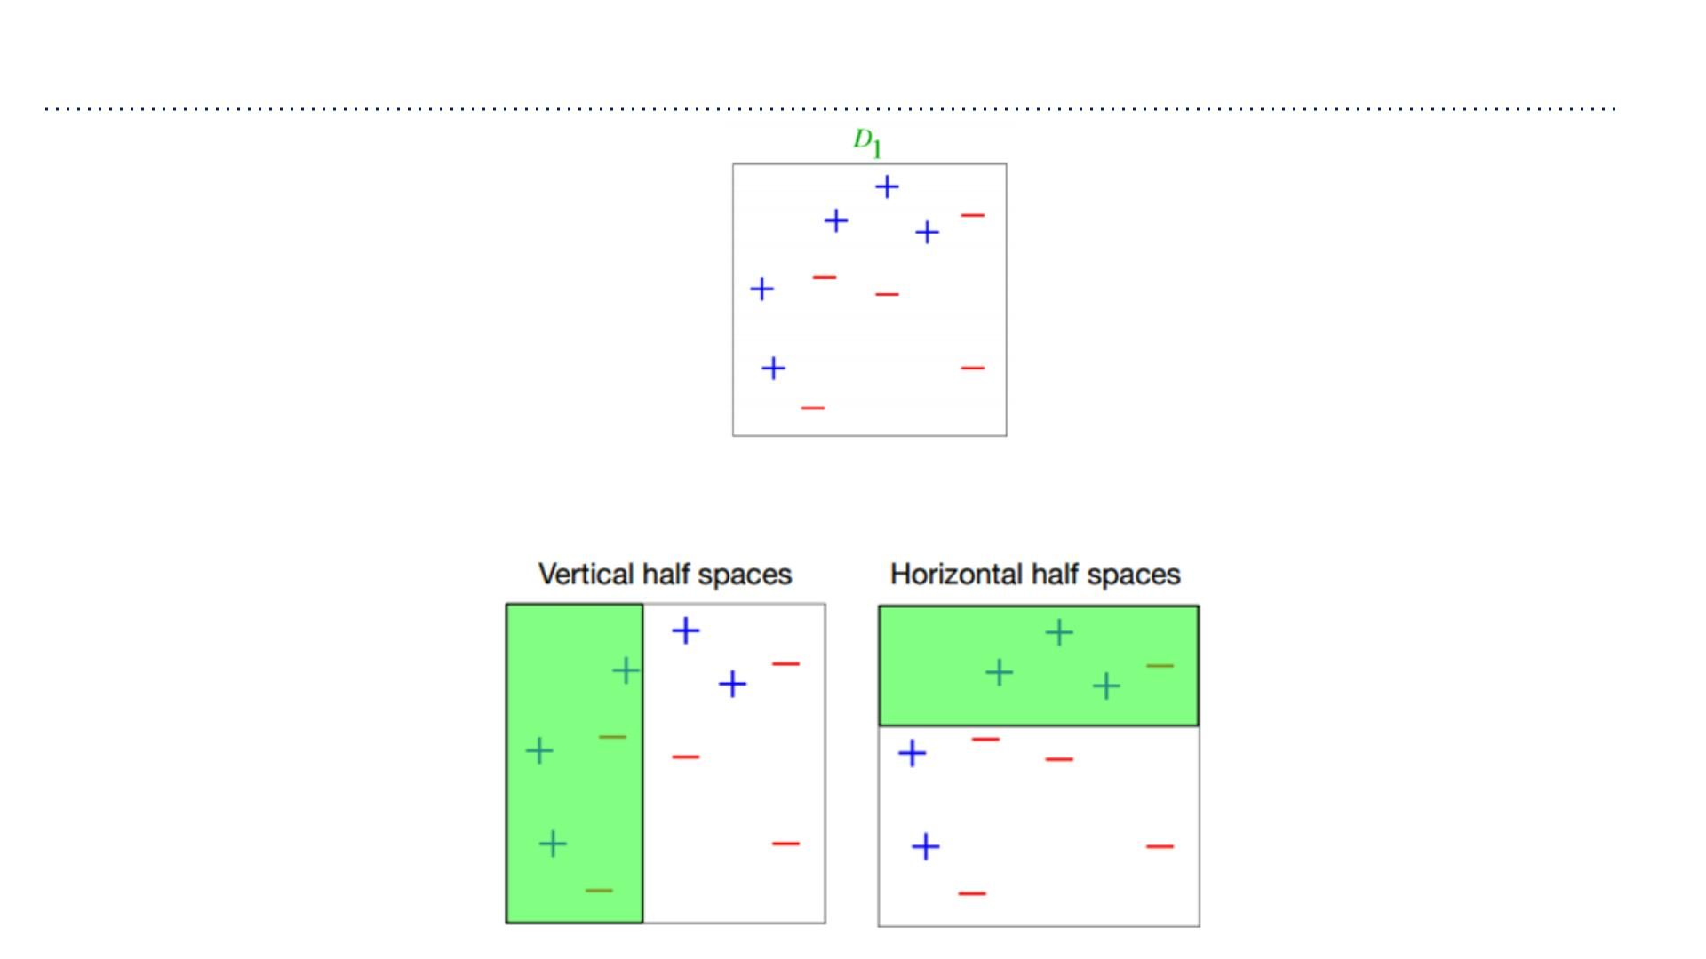
Weak Classifiers
左图 (Vertical)：这是通过垂直切分（例如
x1 < threshold）得到的分类边界。
右图 (Horizontal)：这是通过⽔平切分（例
如 x2 < threshold）得到的分类边界。
⽆论是垂直切还是⽔平切，单⼀的决策树桩都⽆法完美
地将所有 + 和 - 分开。它们只能做到“⼤概分对了⼀部
分”，这正符合“弱分类器”的定义。
These weak classifiers, which are decision stumps, consist of the set of horizonal and
vertical half spaces.

Slide 20
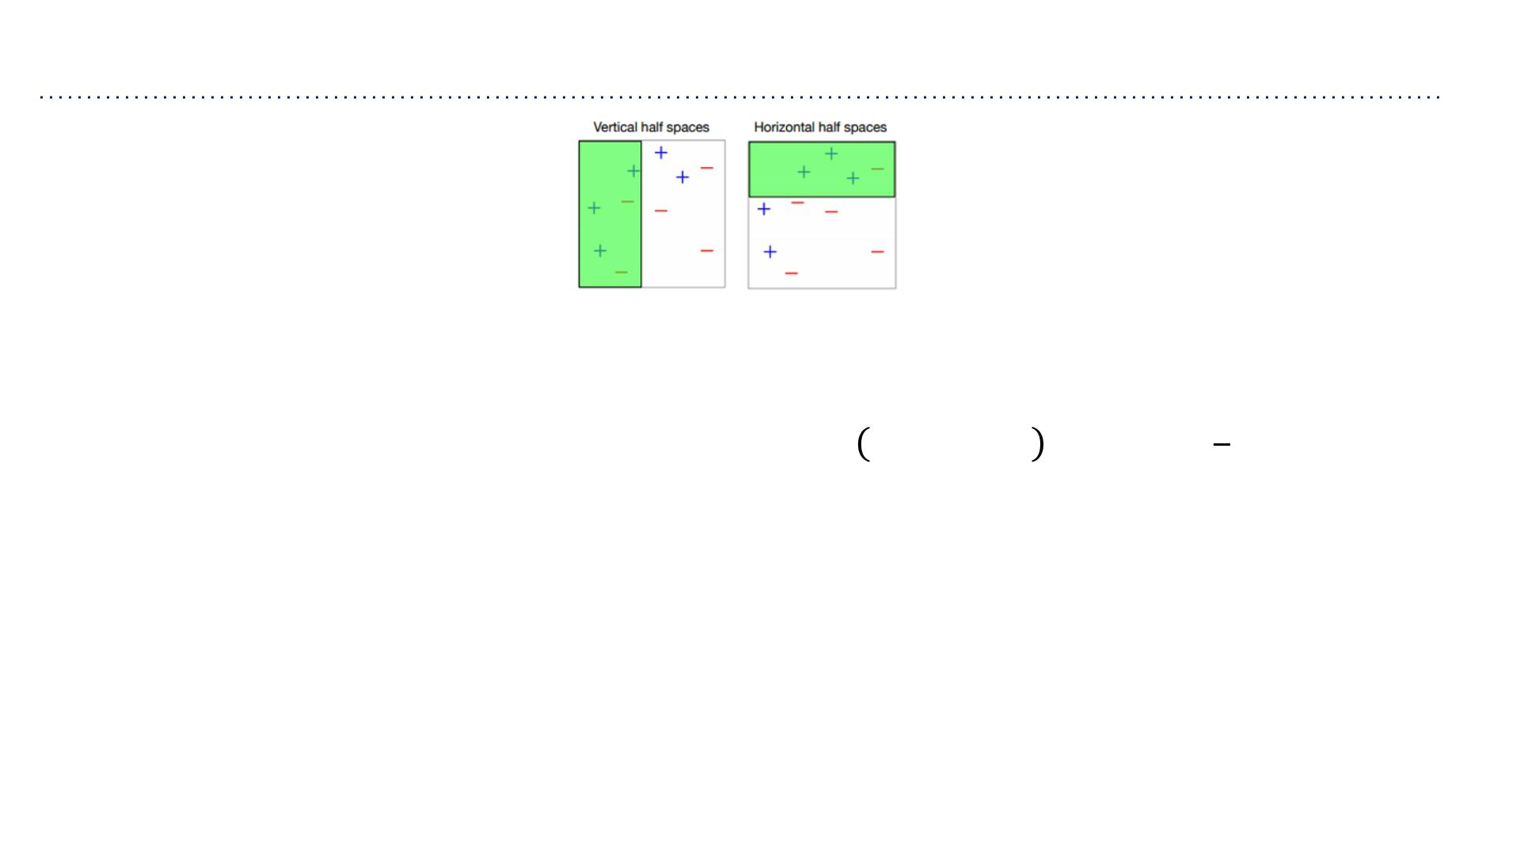
Weak Classifiers
⼀个单独的弱分类器（如决策树桩）太简单了，
它⽆法使训练误差变得很⼩（即⾼偏差 High
Bias）。它⽆法拟合复杂的数据分布。
虽然单个分类器很弱，但只要它保证⽐随机猜测好⼀点点，那么
AdaBoost 就可以通过组合它们，最终逼近任意复杂的函数
（Universal Function Approximator）。AdaBoost 能把⾼偏差的弱
分类器组合成⼀个低偏差的强模型。
• A singleweak classifier is not capable of making the training error small
• But if can guarantee that it performs slightly better than chance, i.e., the weighted error
1
of classifier ℎaccording to the given weights ꢀ= ꢁ ,⋯,ꢁ is at most −ꢃfor some
1 ꢂ
2
ꢃ>0, using it with AdaBoost gives us a universal function approximator!
• Last lecture we used information gain as the splitting criterion. When using decision
stumps with AdaBoost we often use a “GINI Impurity”, which (roughly speaking) picks
the split that directly minimizes error.
• Now let’s see how AdaBoost combines a set of weak classifiers in order to make a better
ensemble of classifiers…
在之前的决策树课程中，我们使⽤“信息增益 (Information Gain)”来选择分裂点。
在 AdaBoost 中使⽤决策树桩时，通常使⽤ “基尼不纯度 (GINI Impurity)” 作为标准。
简单来说，基尼不纯度是⼀种更直接衡量分类误差的⽅法，它能帮我们快速找到那个能让加权误
差最⼩的切分点。

Slide 21
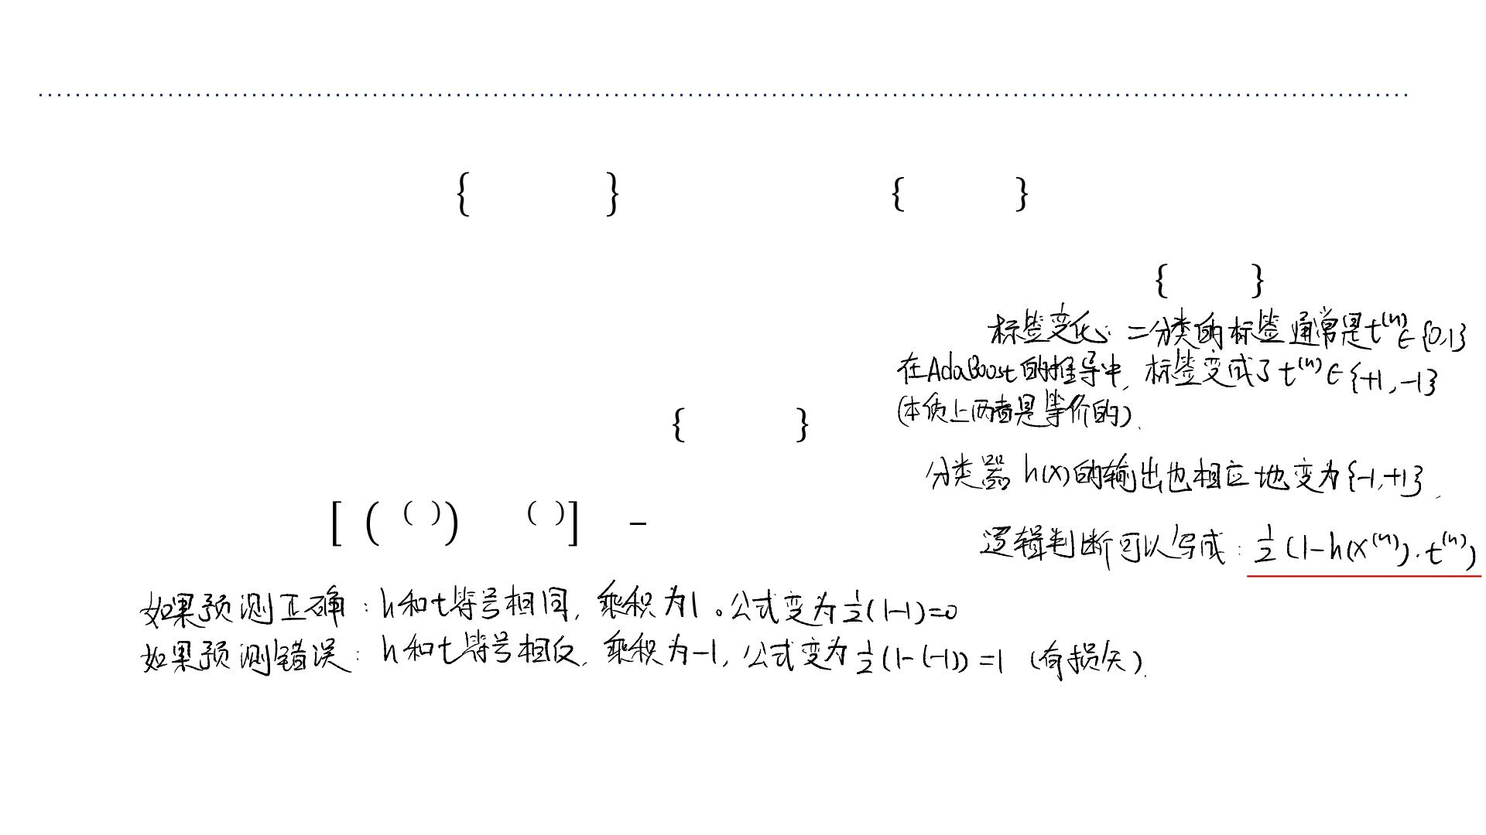
Notation in this lecture
• Input: Data ꢄ_{ꢂ} = ꢅ^{(ꢆ)},ꢇ^{(ꢆ)}
ꢂ
where ꢇ^{(ꢆ)} ∈ −1,+1
ꢆ=1
➢This is different from previous lectures where we had ꢇ^{(ꢆ)} ∈ 0, +1
➢It is for notational convenience, otw equivalent.
• A classifier or hypothesis ℎ:ꢅ → −1,+1
1
• 0-1 loss: ꢈℎ ꢉ^{ꢆ} ≠ꢇ ^{ꢆ} = (1− ℎ(ꢉ^{(ꢆ)})∙ꢇ^{(ꢆ)})
2

Slide 22
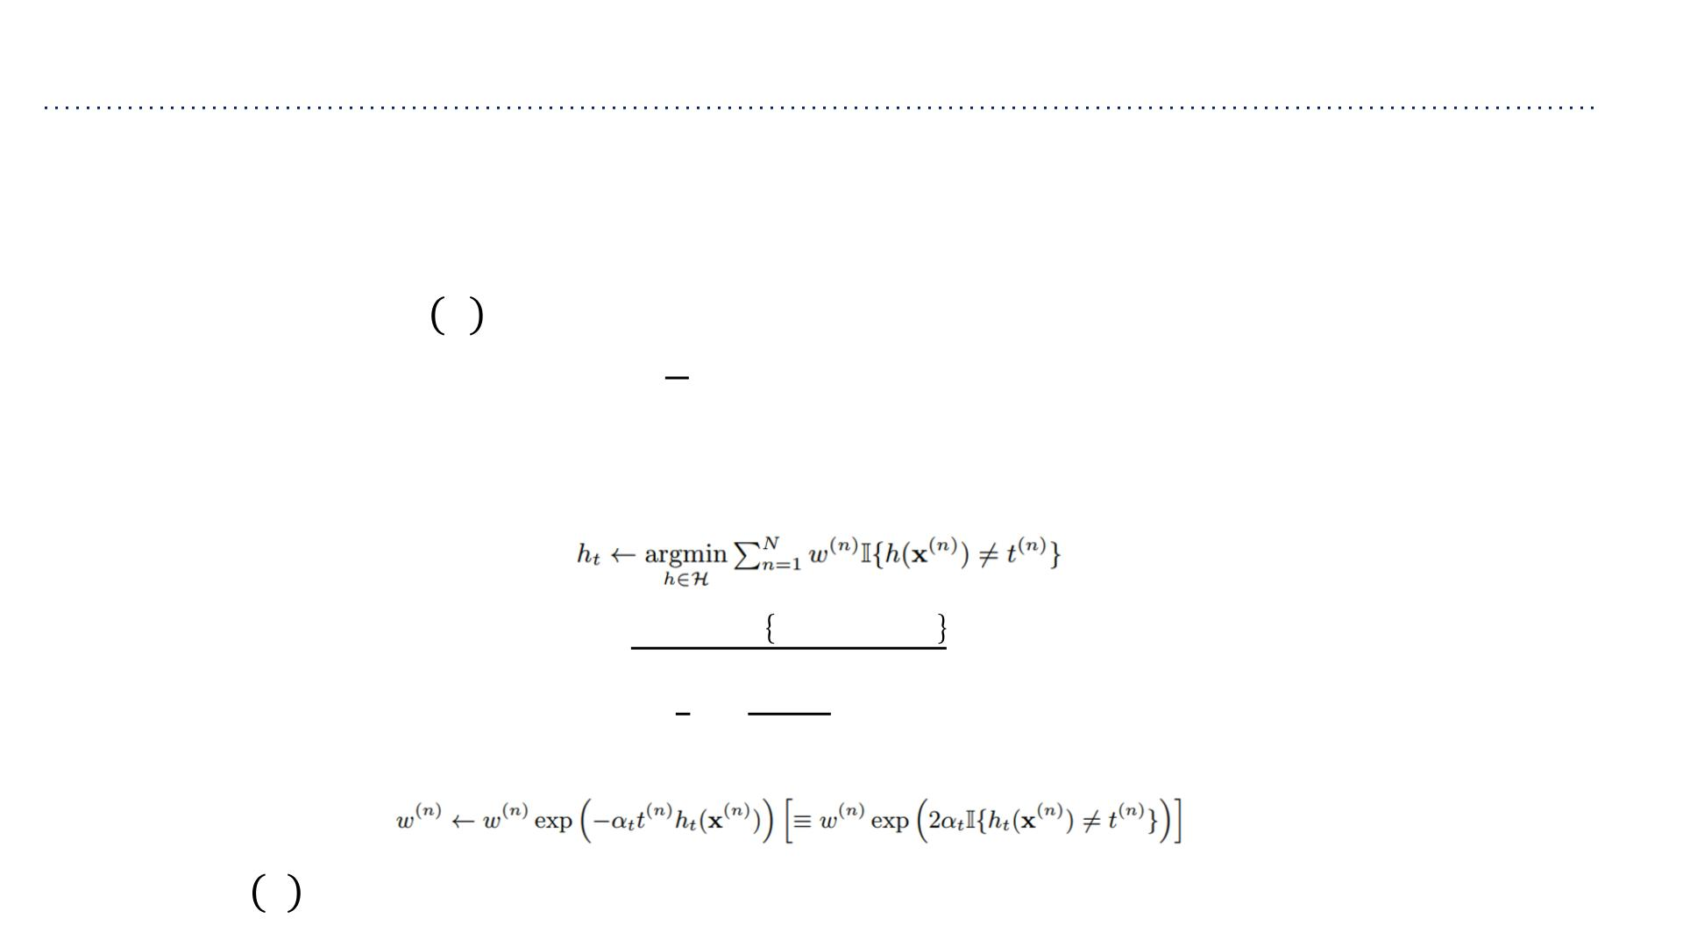
Ada Boost Algorithm
• Input: Data ꢄ_{ꢂ}, weak classifier WeakLearn (a classification procedure that returns a
classifier ℎ, e.g. best decision stump, from a set of classifiers ℋ, e.g., all possible
decision stumps), number of iterations ꢊ
• Output: Classifier ꢋ ꢉ
1
• Initialize sample weights: ꢁ^{(ꢆ)} = for ꢌ=1,⋯,ꢍ
ꢂ
• For ꢇ=1,⋯,ꢊ
➢ Fit a classifier to weighted data (ℎ ← WeakLearn(ꢄ , ꢀ)), e.g.,
ꢎ
ꢂ
ꢒ
(ꢑ)
(ꢑ) (ꢑ)
σ ꢓ ꢈ ℎ (ꢕ )≠ꢎ
➢ Compute weighted error err_{ꢎ} = ^{ꢑ=1}
ꢔ
ꢒ
(ꢑ)
σ ꢓ
ꢑ=1
1 1−err
➢ Compute classifier coefficient ꢐ_{ꢎ} = log
ꢔ
(∈ (0,∞))
2 err_{ꢔ}
➢ Update data weights
• Return ꢋ x = sign( ^{ꢏ} ꢐ ℎ (ꢅ))
σ
ꢎ=1 ꢎ ꢎ

Slide 23
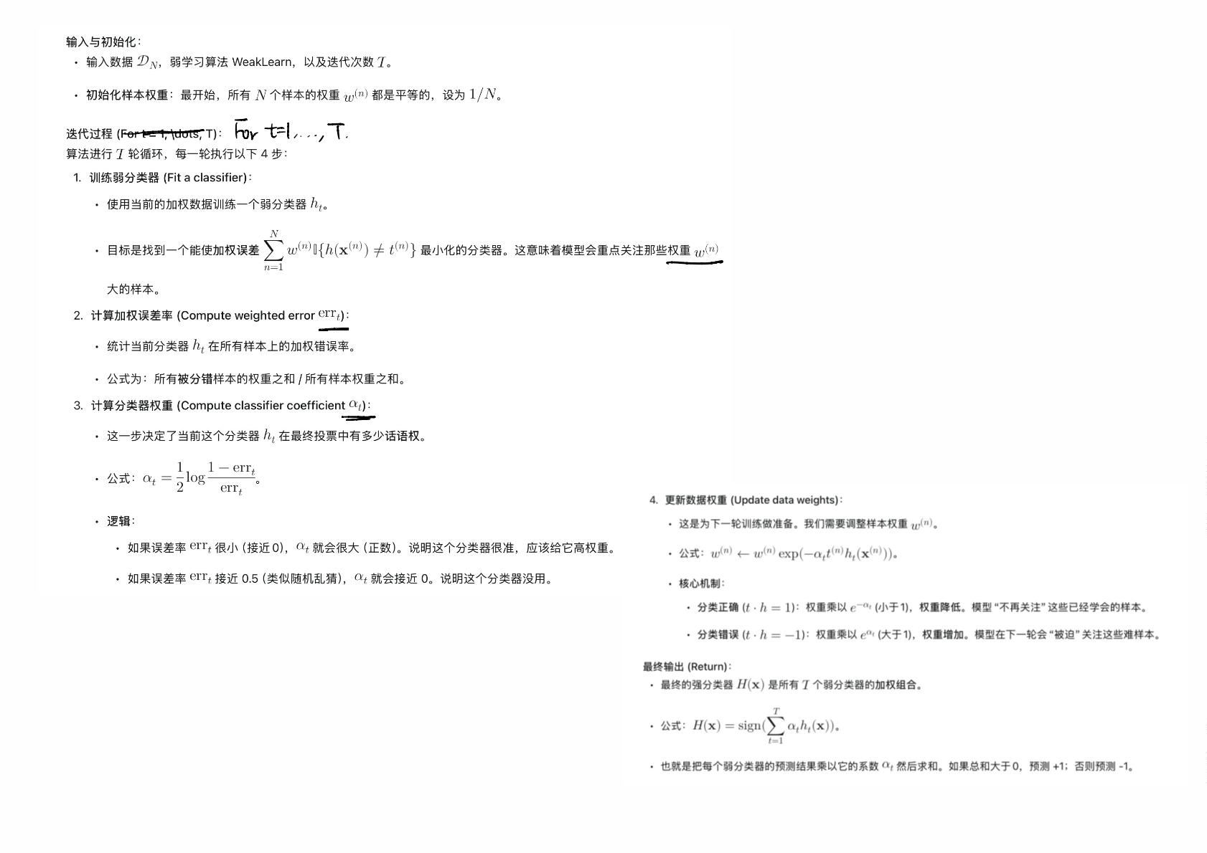

Slide 24
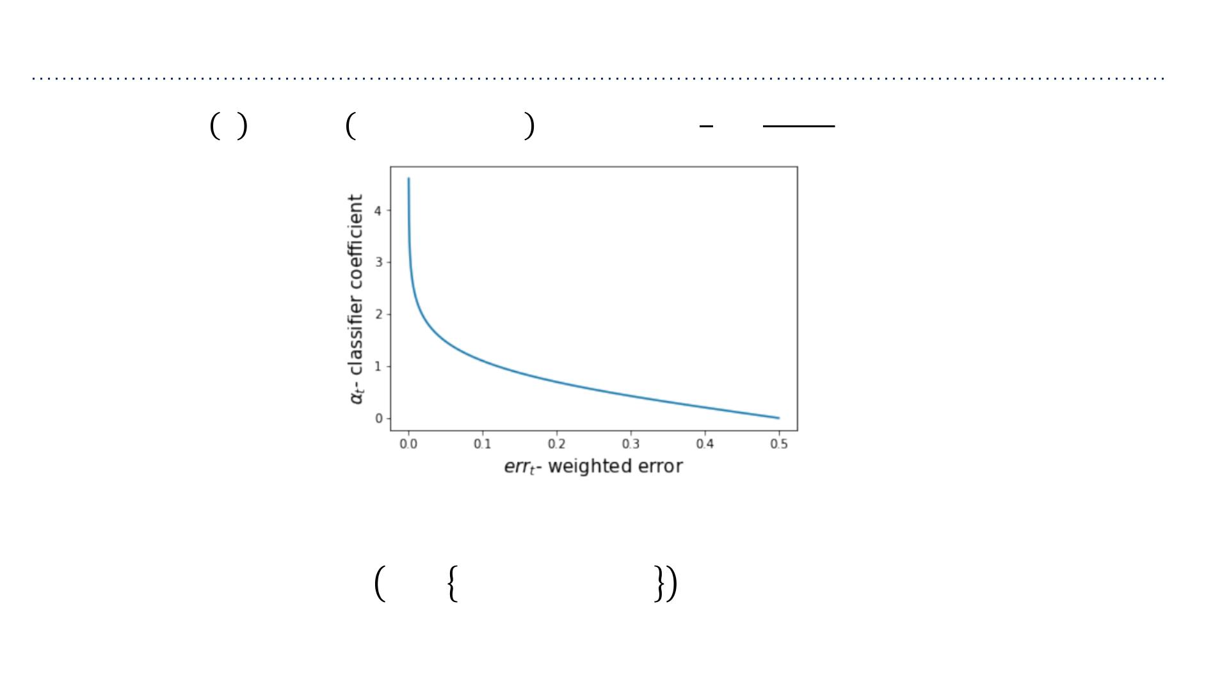
Weighting Intuition
1 1−err
• Recall: ꢀ ꢁ = sign ꢃ ꢄ ℎ (ꢁ) where ꢄ = log ꢅ
σ
ꢂ=1 ꢂ ꢂ
ꢂ
2 err
ꢅ
• Weak classifiers which get lower weighted error get more weight in the final
classifier
• Also: ꢆ^{(ꢇ)} ←ꢆ^{(ꢇ)}exp 2ꢄ_{ꢂ}ꢈ ℎ_{ꢂ}(ꢁ^{(ꢇ)})≠ꢉ^{(ꢇ)}
➢If err ≈ 0,ꢄ high so misclassified examples get more attention
ꢂ
ꢂ
➢If err ≈ 0.5,ꢄ low so misclassified examples are not emphasized
ꢂ
ꢂ

Slide 25
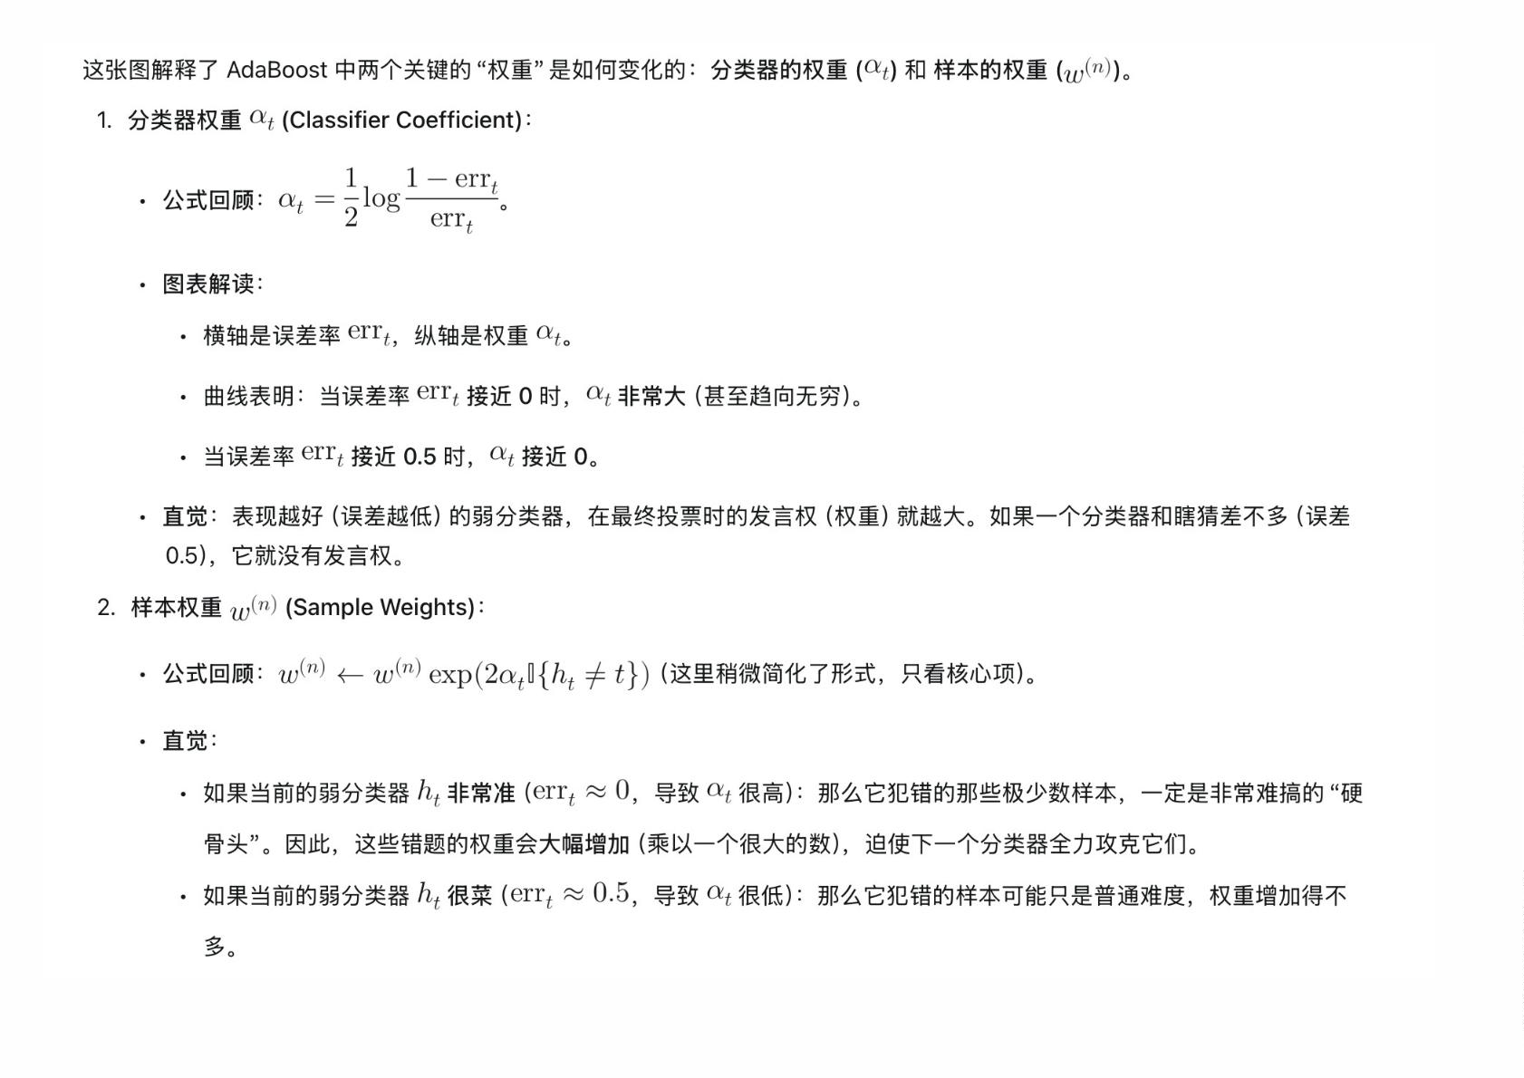

Slide 26
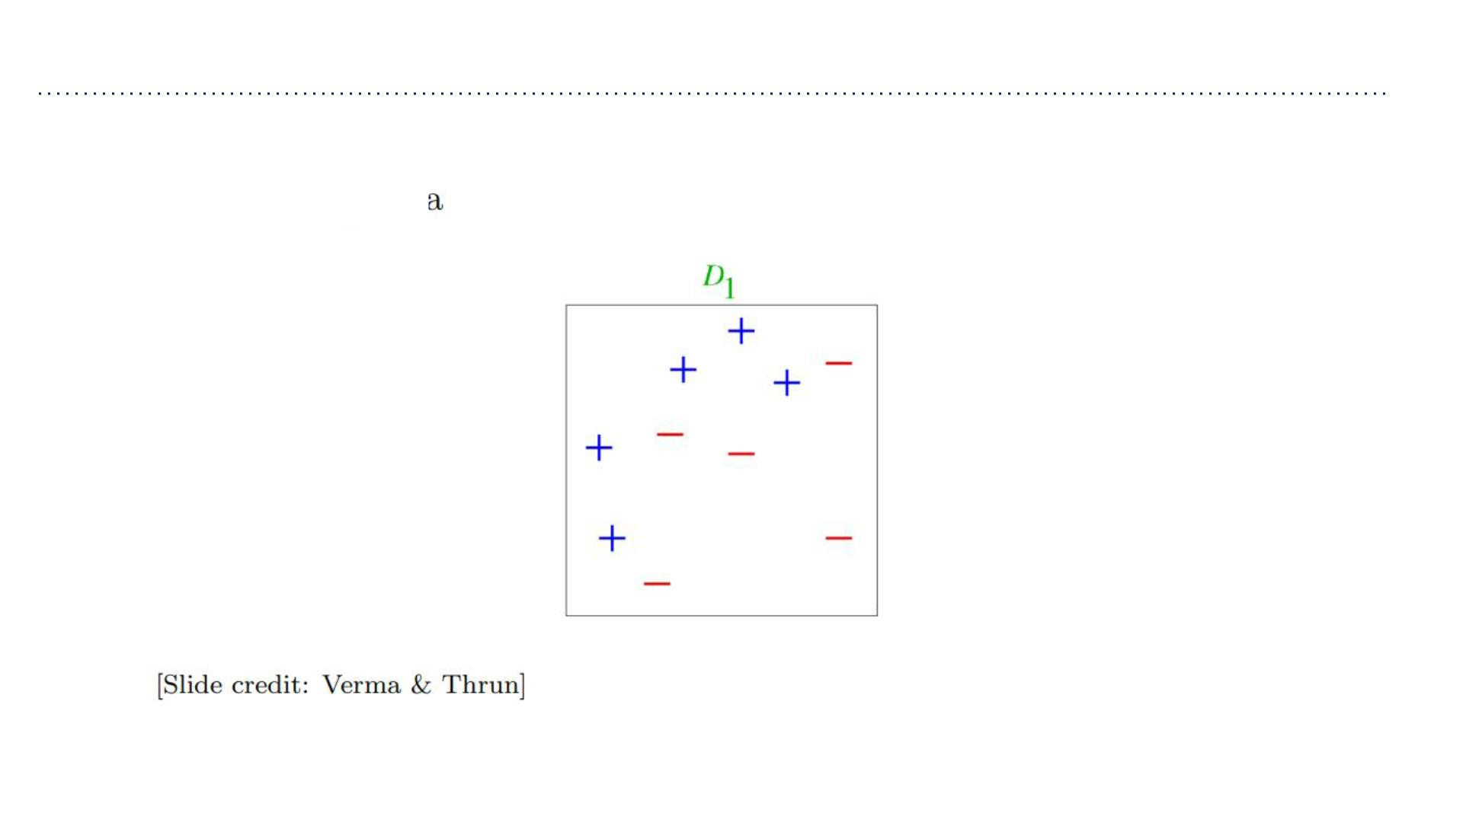
AdaBoost Example
• Training data

Slide 27
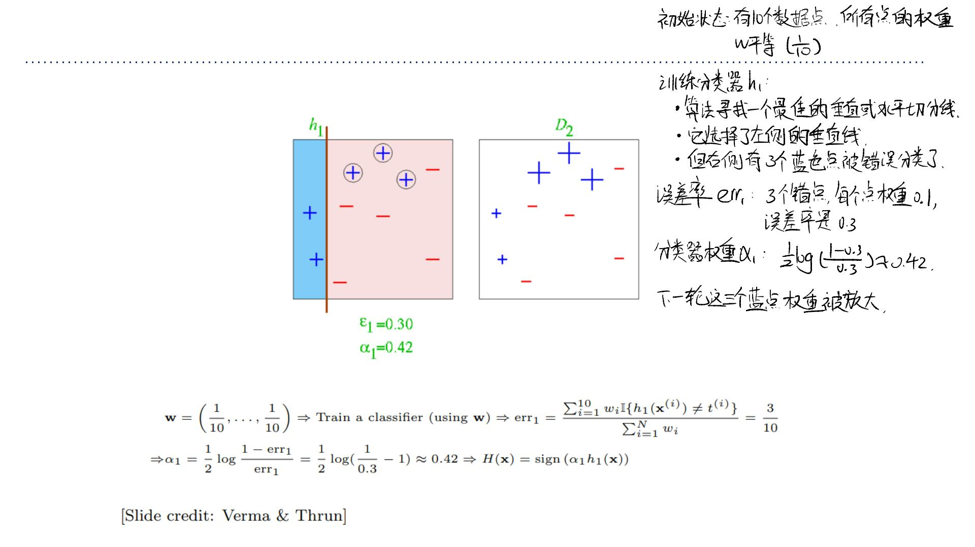
AdaBoost Example
• Round 1

Slide 28
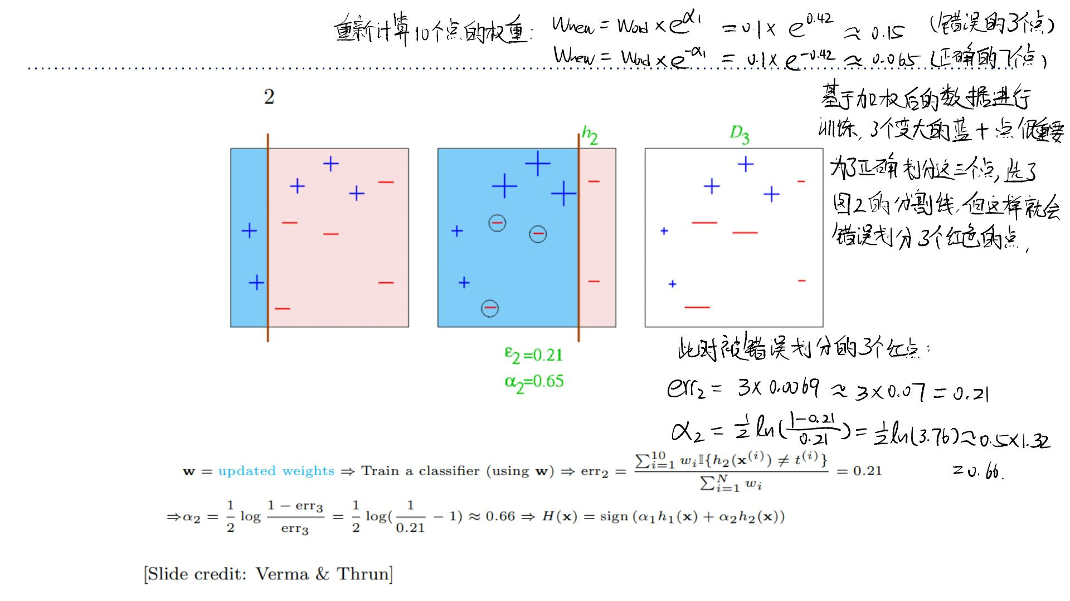
AdaBoost Example
• Round 2

Slide 29
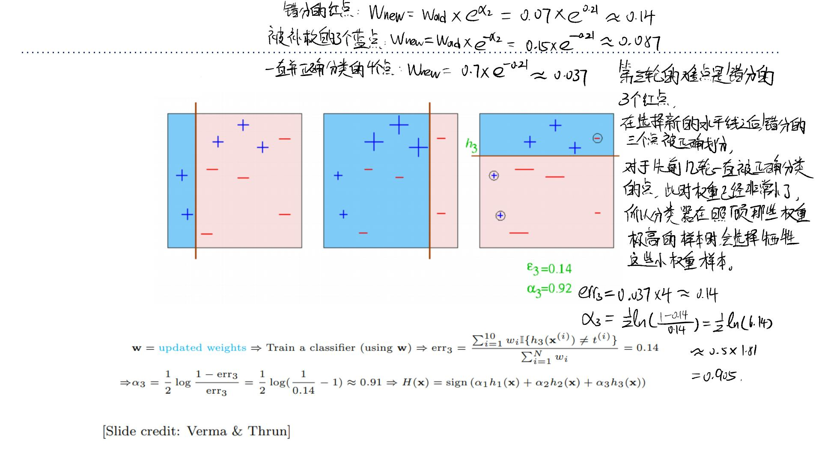
AdaBoost Example
• Round 3

Slide 30
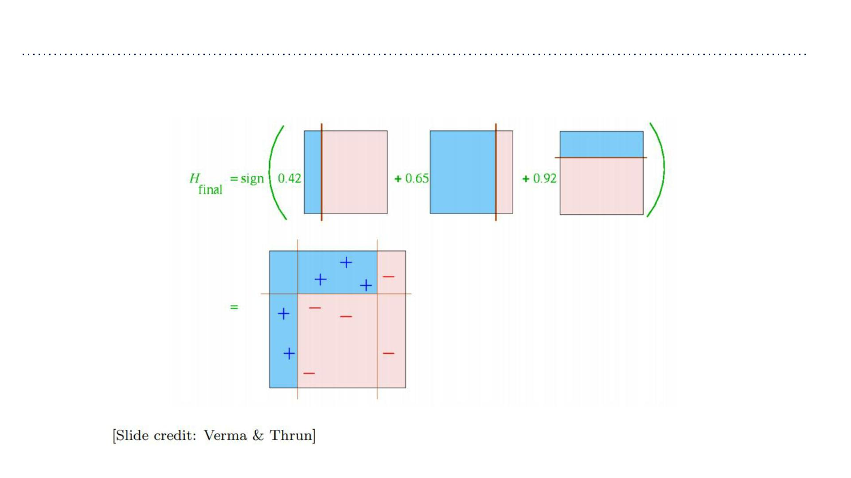
AdaBoost Example
• Final classifier

Slide 31
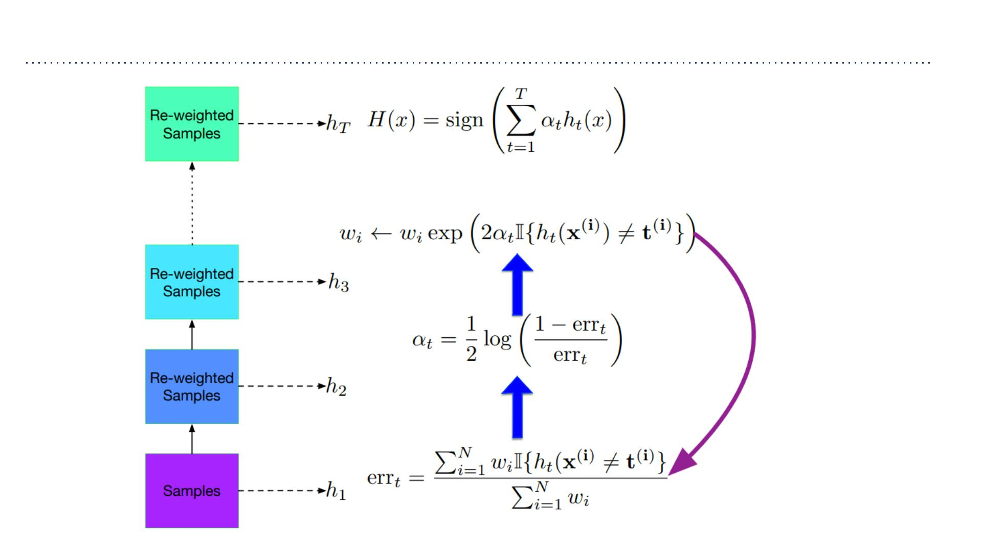
AdaBoost Algorithm

Slide 32
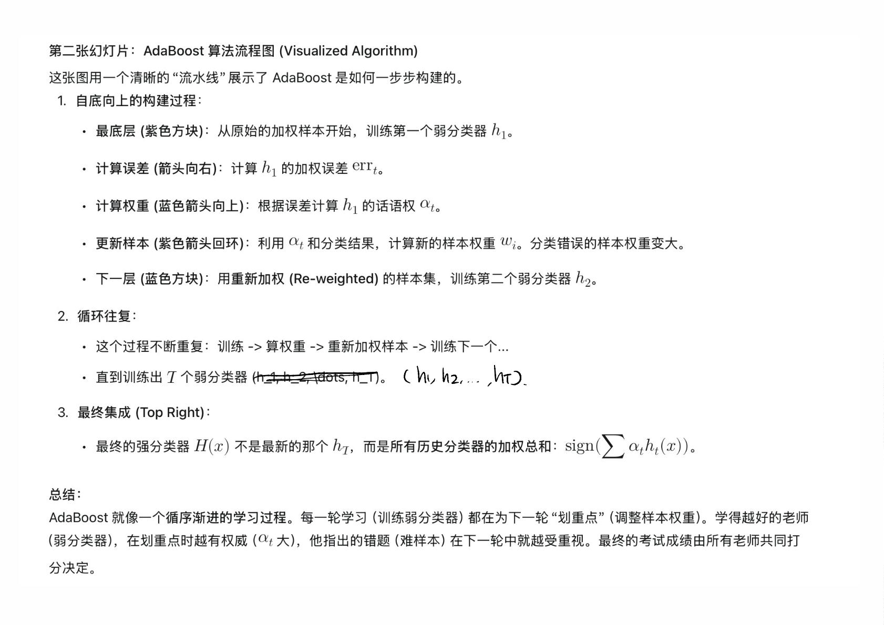

Slide 33
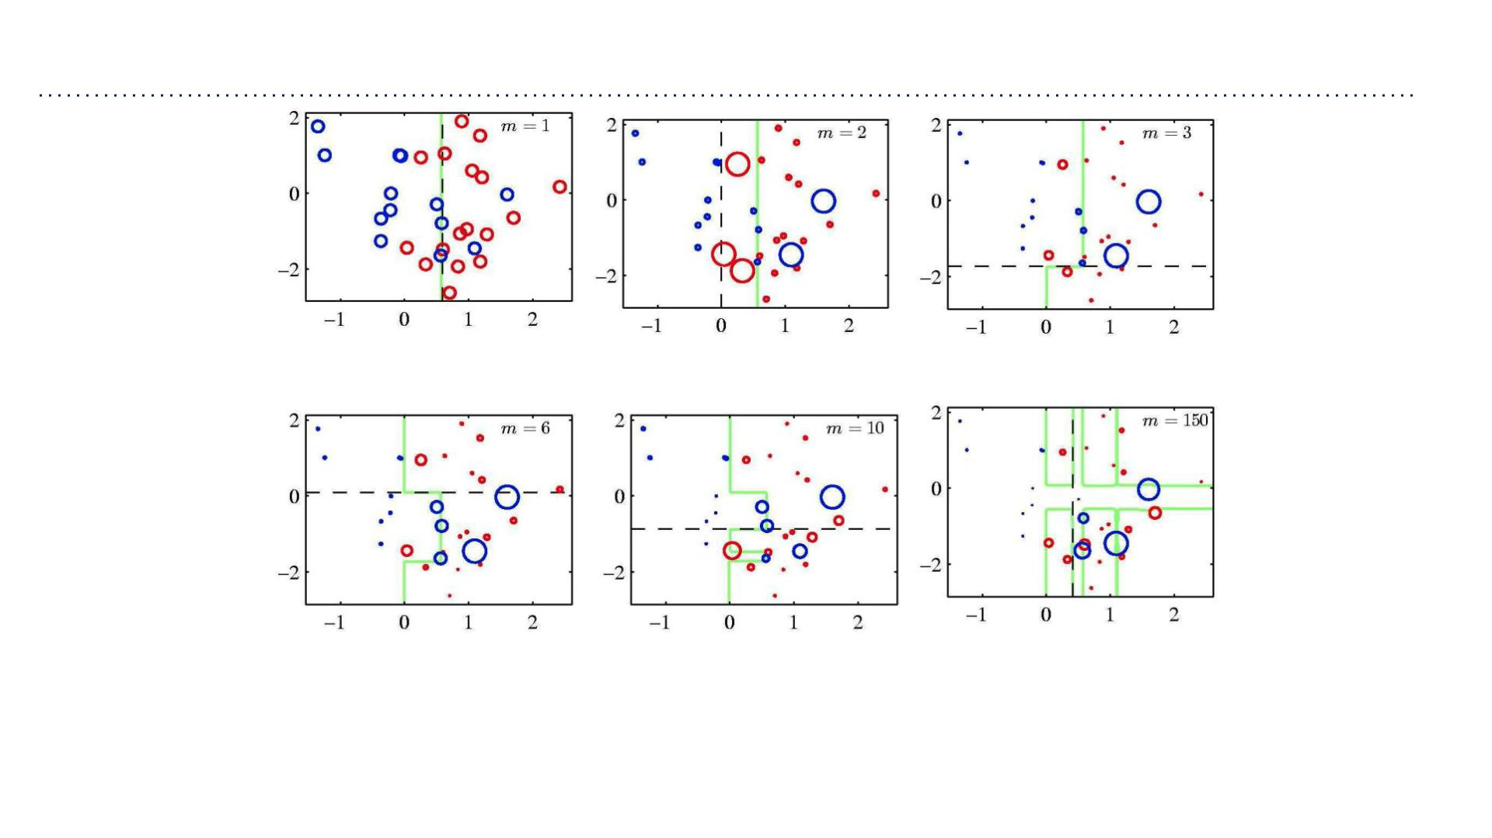
AdaBoost Example
• Each figure shows the number ꢀof base learners trained so far, the decision of the
most recent learner (dashed black), and the boundary of the ensemble (green)

Slide 34
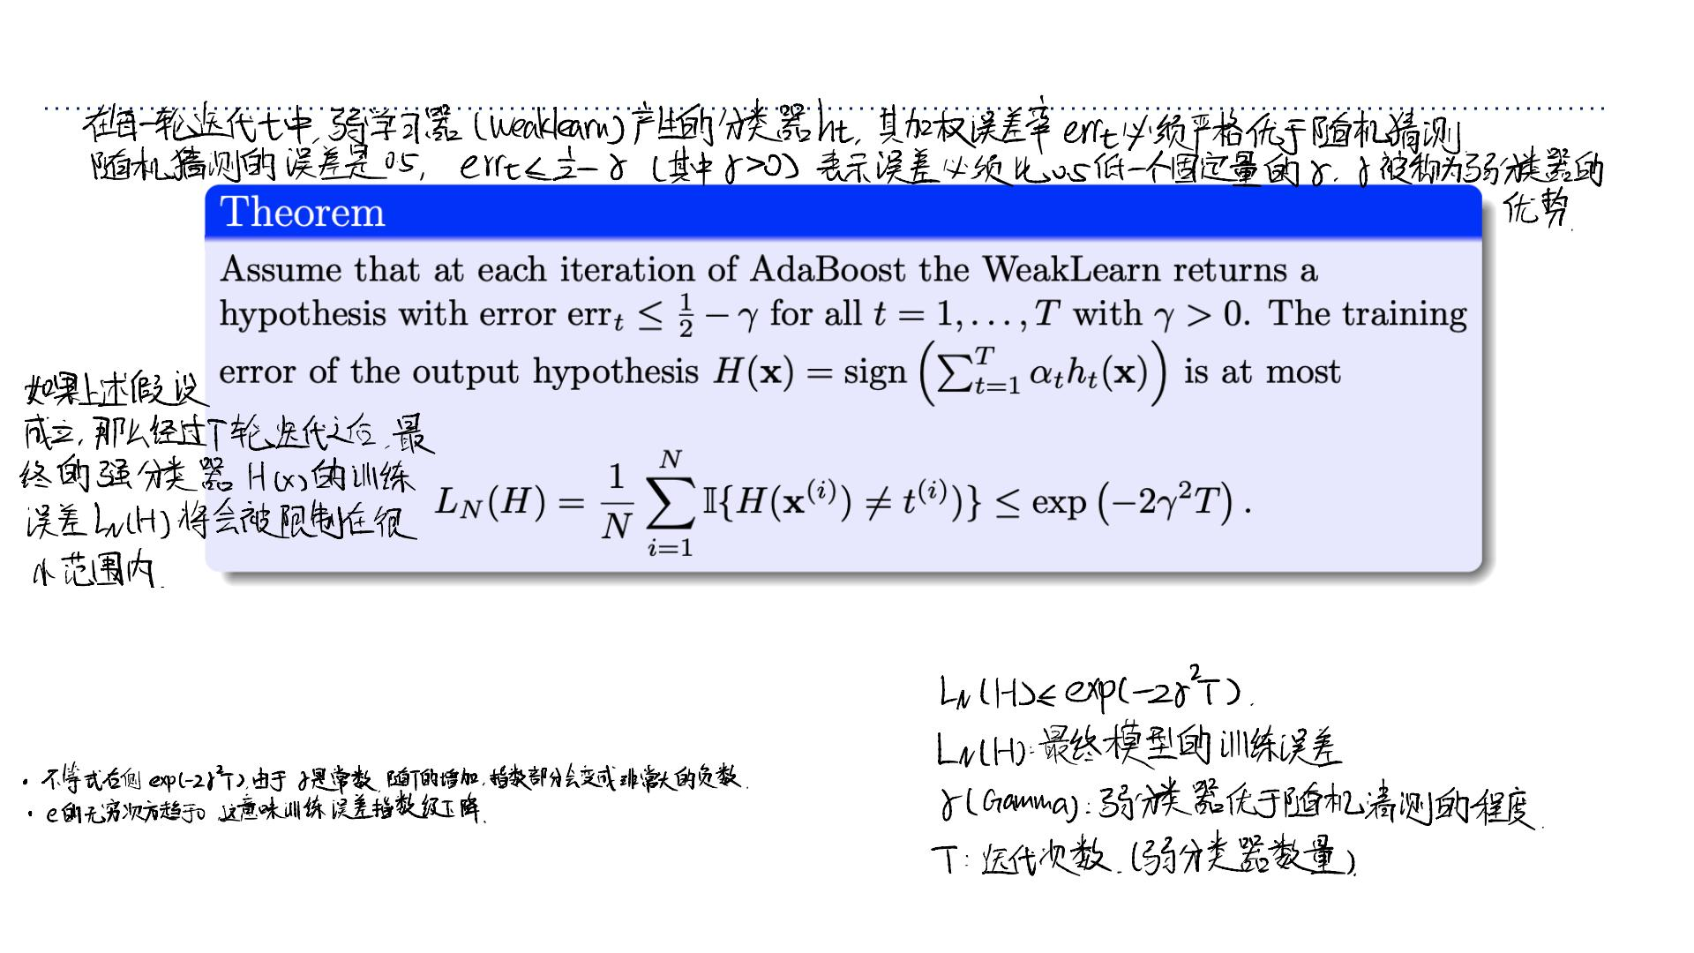
AdaBoost Minimizes the Training Error
AdaBoost 算法的⼀个核⼼理论保证：它能以极快的速度最⼩化训练误差。
• This is under the simplifying assumption that each weak learner is ꢁ-better than a
random predictor.
• This is called geometric convergence. It is fast!

Slide 35
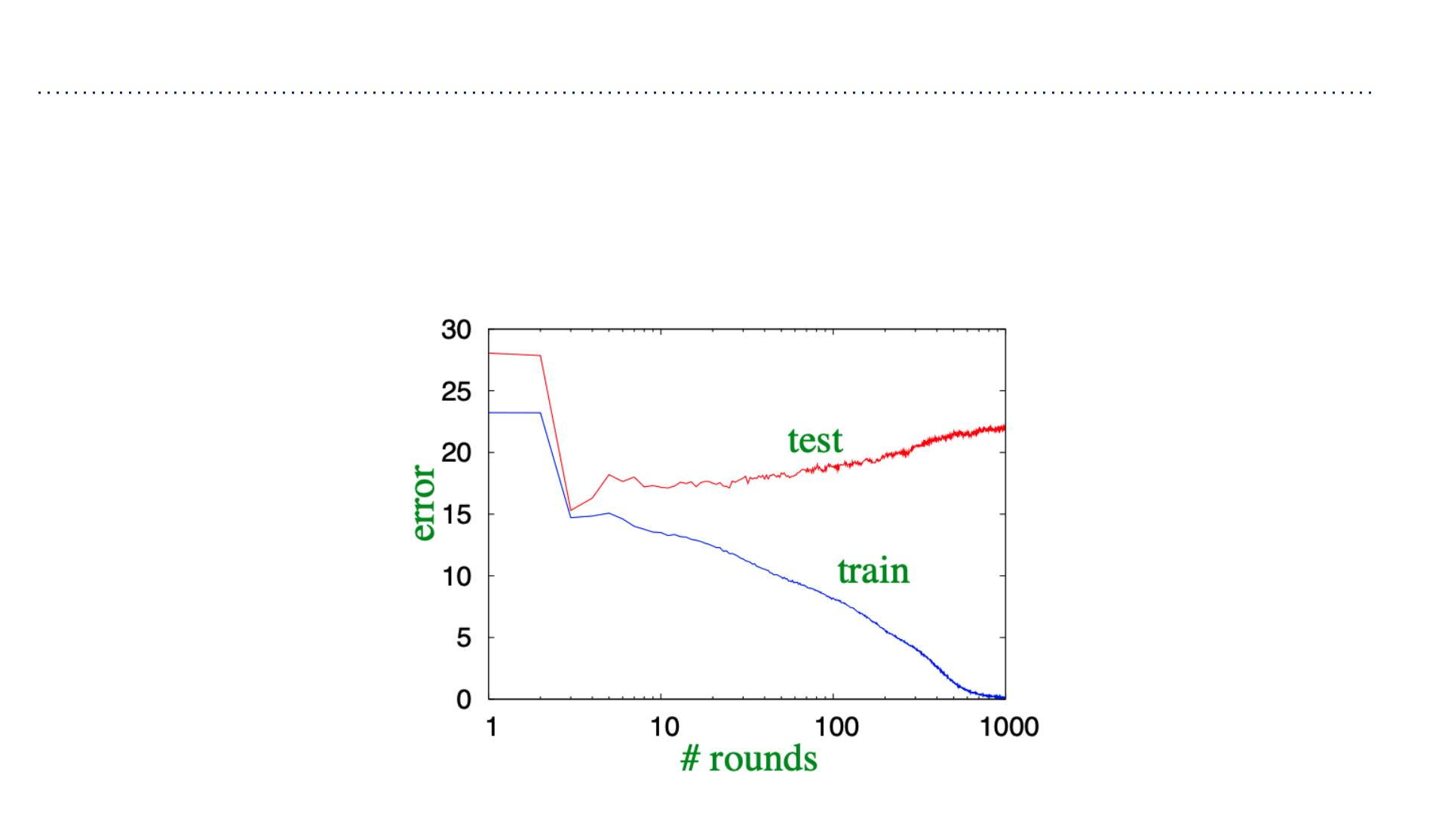
Generalization Error of AdaBoost
• AdaBoost’s training error (loss) converges to zero. What about the test error of ꢂ?
• As we add more weak classifiers, the overall classifier ꢂbecomes more “complex”.
• We expect more complex classifiers overfit.
• If one runs AdaBoost long enough, it can in fact overfit.
模型变复杂：
随着我们添加越来越多的弱分类器（迭代次数 T 增加），强分类器 H(x) 会变得
越来越复杂。
训练误差 (Training Error)：
如图中蓝线所示，随着模型变复杂，训练误差会⼀路下降，最终接近 0。这符合
我们之前的理论。
测试误差 (Test Error)：
如图中红线所示，这是关键！
起初，测试误差随着模型变强⽽下降（从 28 降到 15 左右）。
但是，在迭代约 10 次后，测试误差开始反弹上升。
这就是典型的“过度拟合”！ 模型太复杂了，开始死记硬背训练数据中的噪声，
导致泛化能⼒变差。

Slide 36
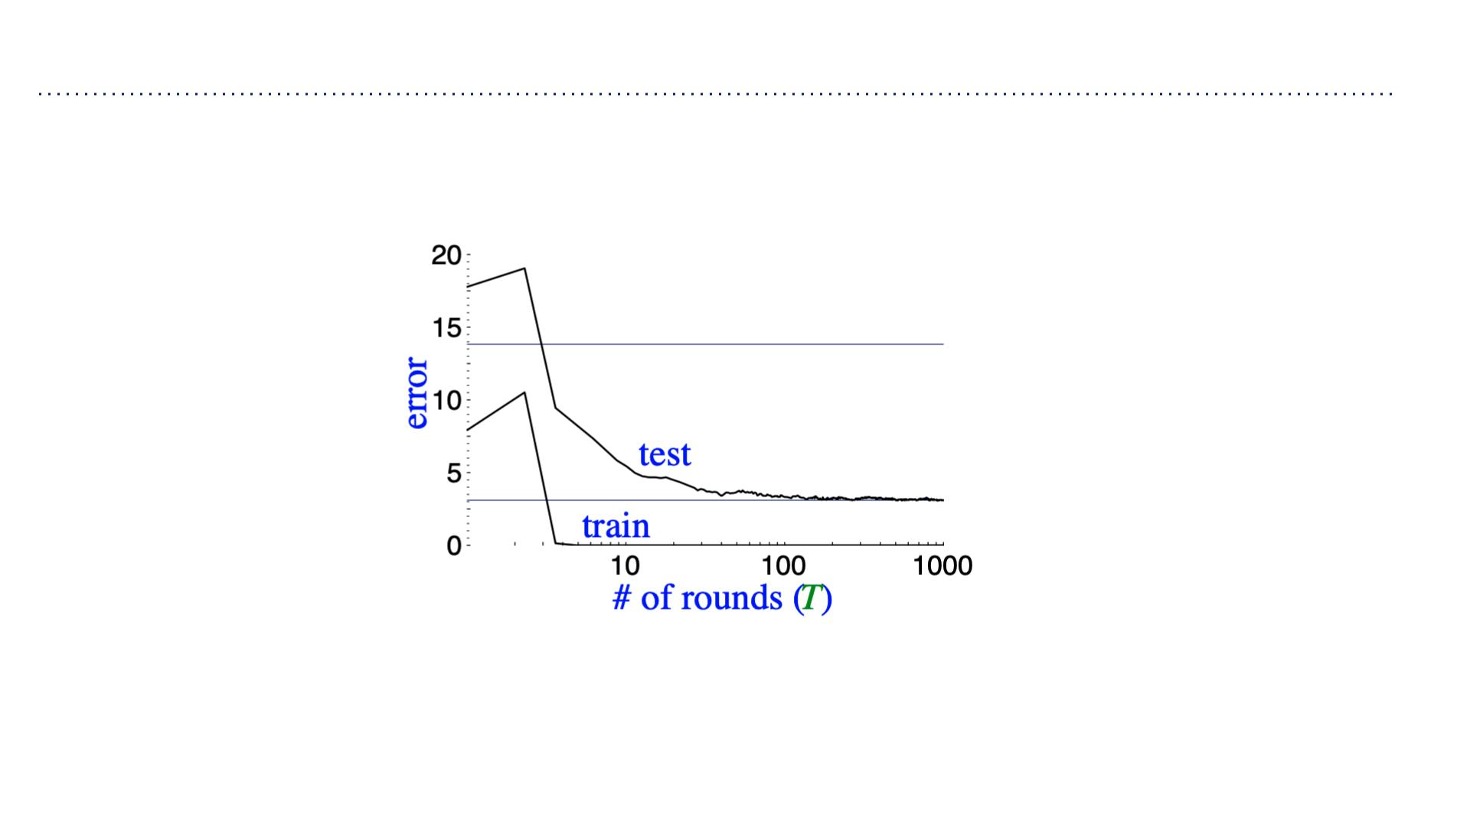
Generalization Error of AdaBoost
• But often it does not!
• Sometimes the test error decreases even after the training error is zero!
现象描述：
这⾥的测试误差（Test Error）并没有像上⼀张图那样反弹上升。
相反，它在训练误差降到 0 之后，竟然还在继续下降（或者⾄少保持平稳，没有恶化）！
即使迭代到了 1000 次，模型已经极其复杂了，它依然表现良好。
为什么会这样？(How does that happen?)
按照传统理论，训练误差为 0 后，再训练就是纯粹的“死记硬背”，应该导致过拟合才对。
但 AdaBoost 似乎有⼀种“免疫⼒”，即使在那之后，它似乎还在学习某种“有⽤的东⻄”，⽽
不是噪声。
解释的伏笔：
幻灯⽚最后说：“Next, we provide an alternative viewpoint on AdaBoost.”
这暗示了 AdaBoost 背后还有⼀个更深层的机制（通常被称为“间隔理论 (Margin
Theory)”），它解释了为什么 AdaBoost 往往能抵抗过拟合，即使在模型⾮常复杂的情况
下。简单来说，即使所有点都分对了，AdaBoost 还在努⼒让分类的“信⼼”（间隔）变得更
⼤、更稳固。
• How does that happen?
• Next, we provide an alternative viewpoint on AdaBoost.

Slide 37
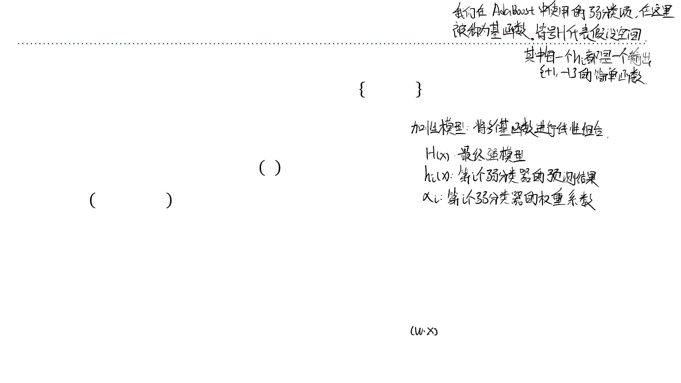
Additive Models
将 AdaBoost 解释为⼀种加性模型 (Additive Model) 的拟合过程
Next, we’ll now interpret AdaBoost as a way of fitting an additive model.
• Consider a hypothesis class ℋwith each ℎ → −1, +1 within ℋ, i.e., ℎ ∈ℋ. These
ꢃ
ꢃ
are the “weak learners”, and in this context they’re also called bases.
• An additive model with ꢀterms is given by
ꢅ
ꢂ ꢄ =σ ꢆ ℎ (ꢇ),
ꢅ
ꢃ=1 ꢃ ꢃ
ꢅ
Where ꢆ ,⋯,ꢆ ∈ℝ .
1 ꢅ
• Observe that we’re taking a linear combination of base classifiers ℎ_{ꢃ}(ꢄ), just like in
boosting.
• Note also the connection to feature maps (or basis expansions) that we saw in linear
regression and neural networks!
幻灯⽚最后指出，这与我们在线性回归或神经⽹络中看到的特征映射 (Feature Maps) 或 基函数展开 (Basis Expansions) ⾮常相似。
核⼼逻辑的变化：
传统线性模型：直接对原始特征 x 进⾏加权求和
。
加性模型 (AdaBoost)：先通过函数 hi 将原始数据 x 转换（映射）成⼀个新的“特征”（即分类结果 -1 或 +1），然后再对这些“新特征”
进⾏加权求和。

Slide 38
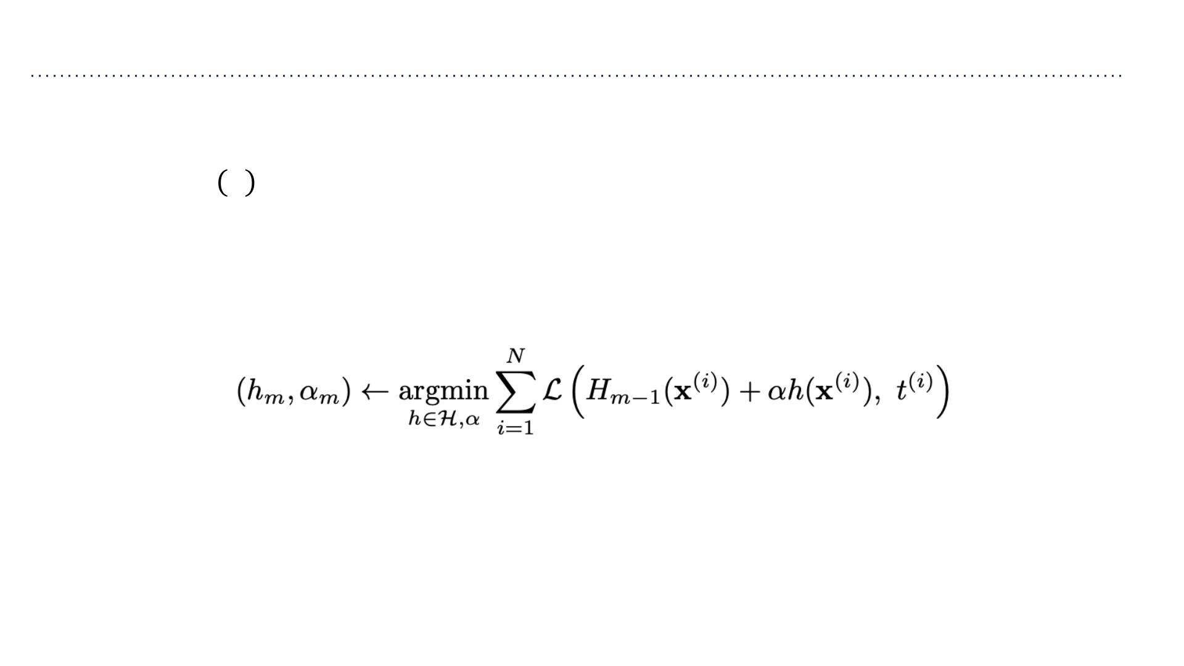
Stagewise Training of Additive Models
A greedy appr oach to fitting additive models, known as stagewise training:
1. Initialize ꢂ₀ ꢄ = 0
2. For ꢀ=1to ꢈ:
➢Compute the ꢀ-th hypothesis ꢂ =ꢂ +ꢆ ℎ , i.e. ℎ and ꢆ , assuming
ꢅ ꢅ−1 ꢅ ꢅ ꢅ ꢅ
previous additive model ꢂ_{ꢅ−1}is fixed:
➢Add it to the additive model
ꢂ =ꢂ +ꢆ ℎ
ꢅ ꢅ−1 ꢅ ꢅ

Slide 39
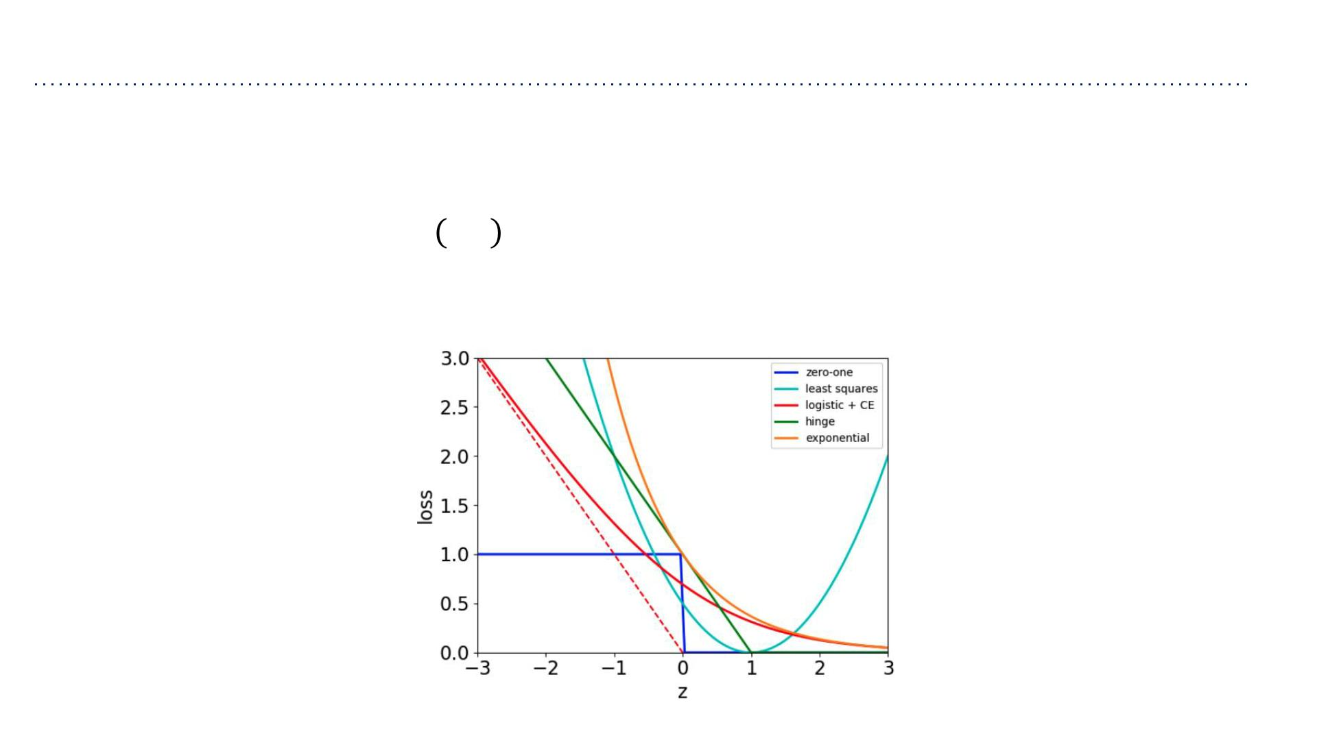
Additive Models with Exponential Loss
Consider the exponential loss
ℒ_{E} ꢉ,ꢊ = exp(−ꢊꢉ)
We want to see how the stagewise training of additive models can be done.

Slide 40
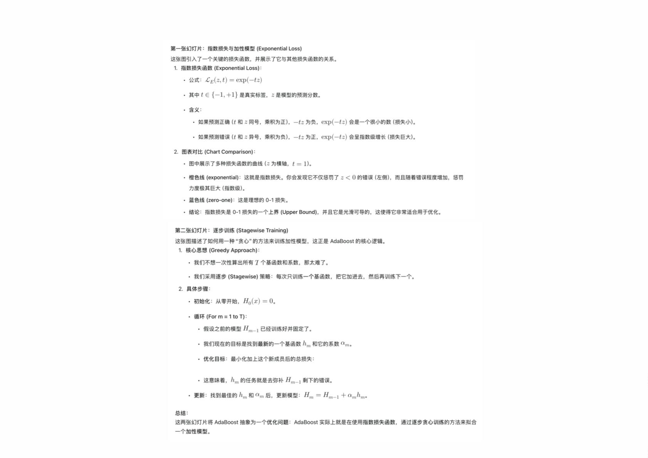

Slide 41
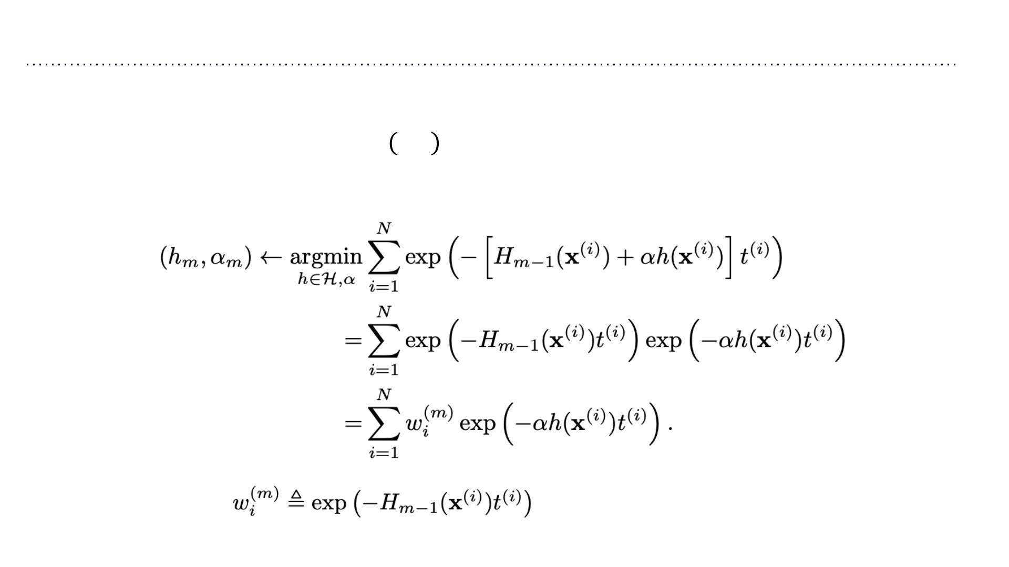
Additive Models with Exponential Loss
Consider the exponential loss
ℒ_{E} ꢀ,ꢁ = exp(−ꢁꢀ)
We want to see how the stagewise training of additive models can be done.
Here we defined
(doesn’t depend on ℎ, ꢂ).

Slide 42
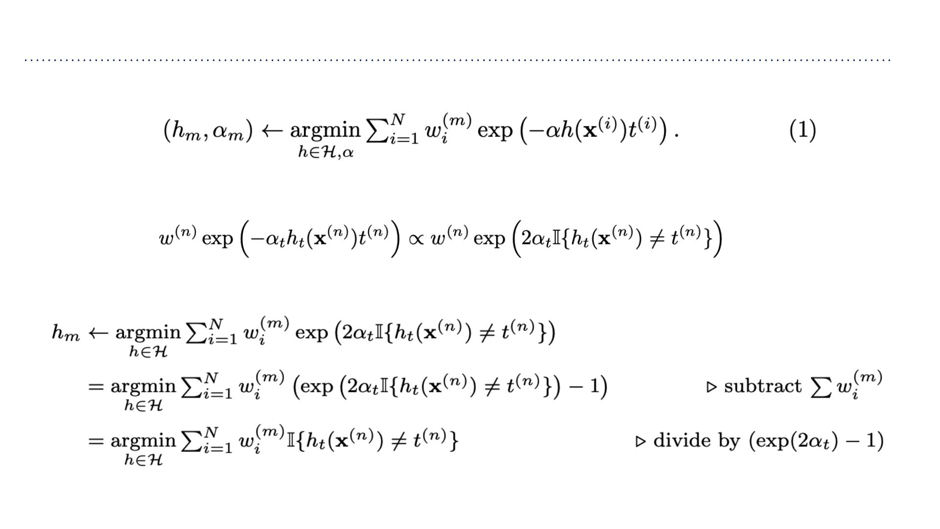
Additive Models with Exponential Loss
We want to solve the following minimization problem:
• Recall from Slide 23 that
• Thus, for ℎ_{ꢃ}, the above minimization is equivalent to:
• This means that ℎ_{ꢃ} is the minimizer of the weighted 0/1-loss.

Slide 43
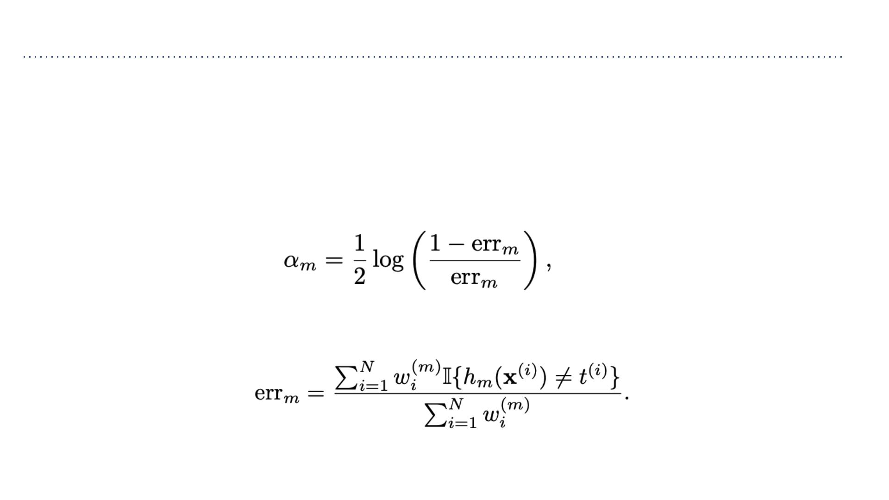
Additive Models with Exponential Loss
• Now that we obtained ℎ_{ꢃ}, we can plug it into our exponential loss objective (1) and
solve for ꢂ_{ꢃ}.
• The derivation is a bit laborious and doesn’t provide additional insight, so we skip it.
• We arrive at:
where err_{ꢃ} is the weighted classification error:

Slide 44
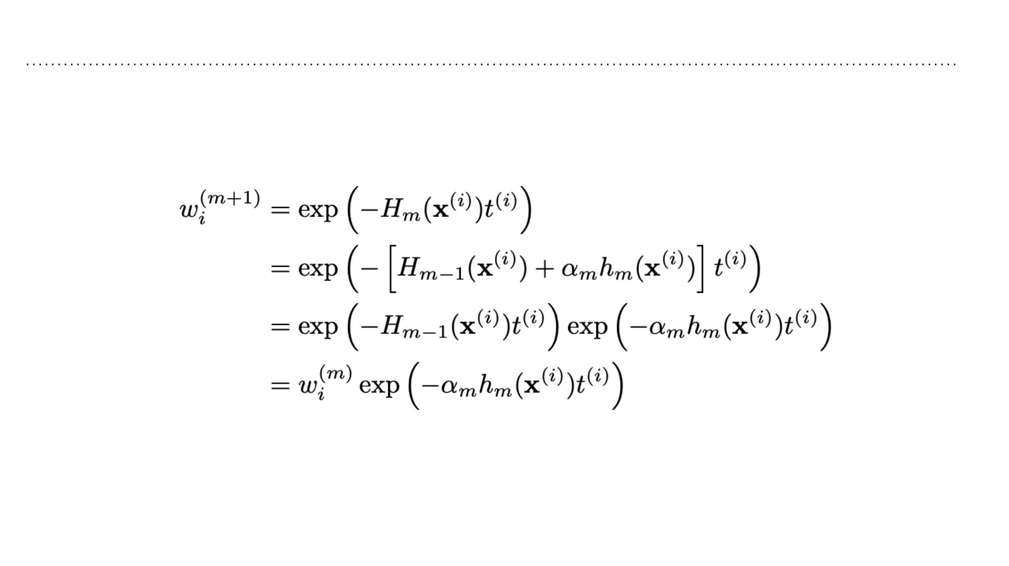
Additive Models with Exponential Loss
We can now find the updated weights for the next iteration:

Slide 45
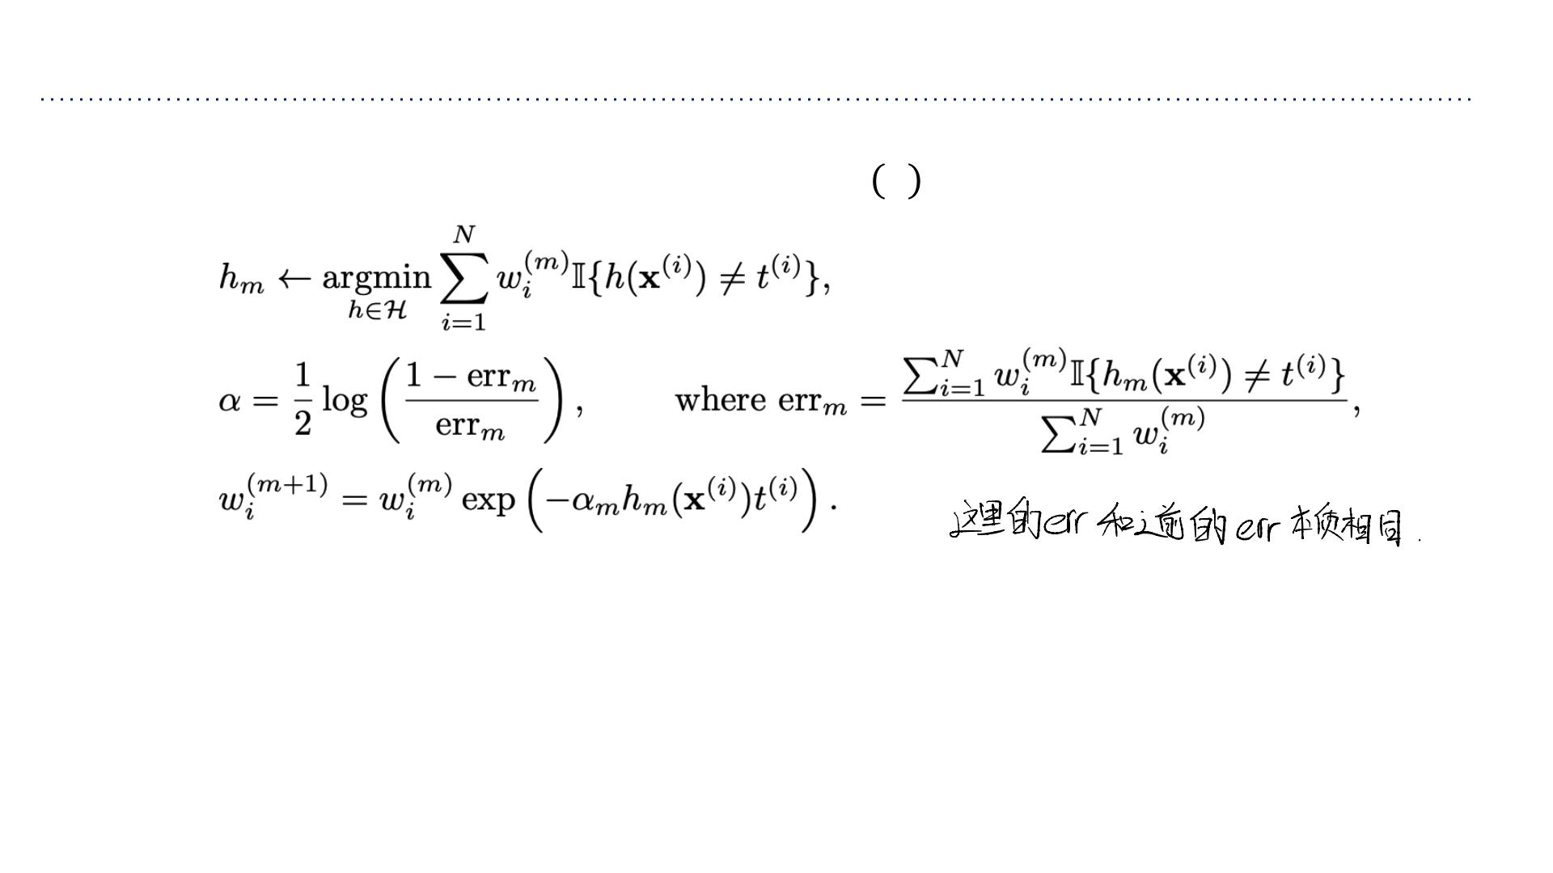
Additive Models with Exponential Loss
ꢃ
To summarize, we obtain the additive model ꢄ_{ꢃ} ꢅ =
σ ꢂℎ (ꢇ)
with
ꢆ=1 ꢆ ꢆ
We derived the AdaBoost algorithm!

Slide 46
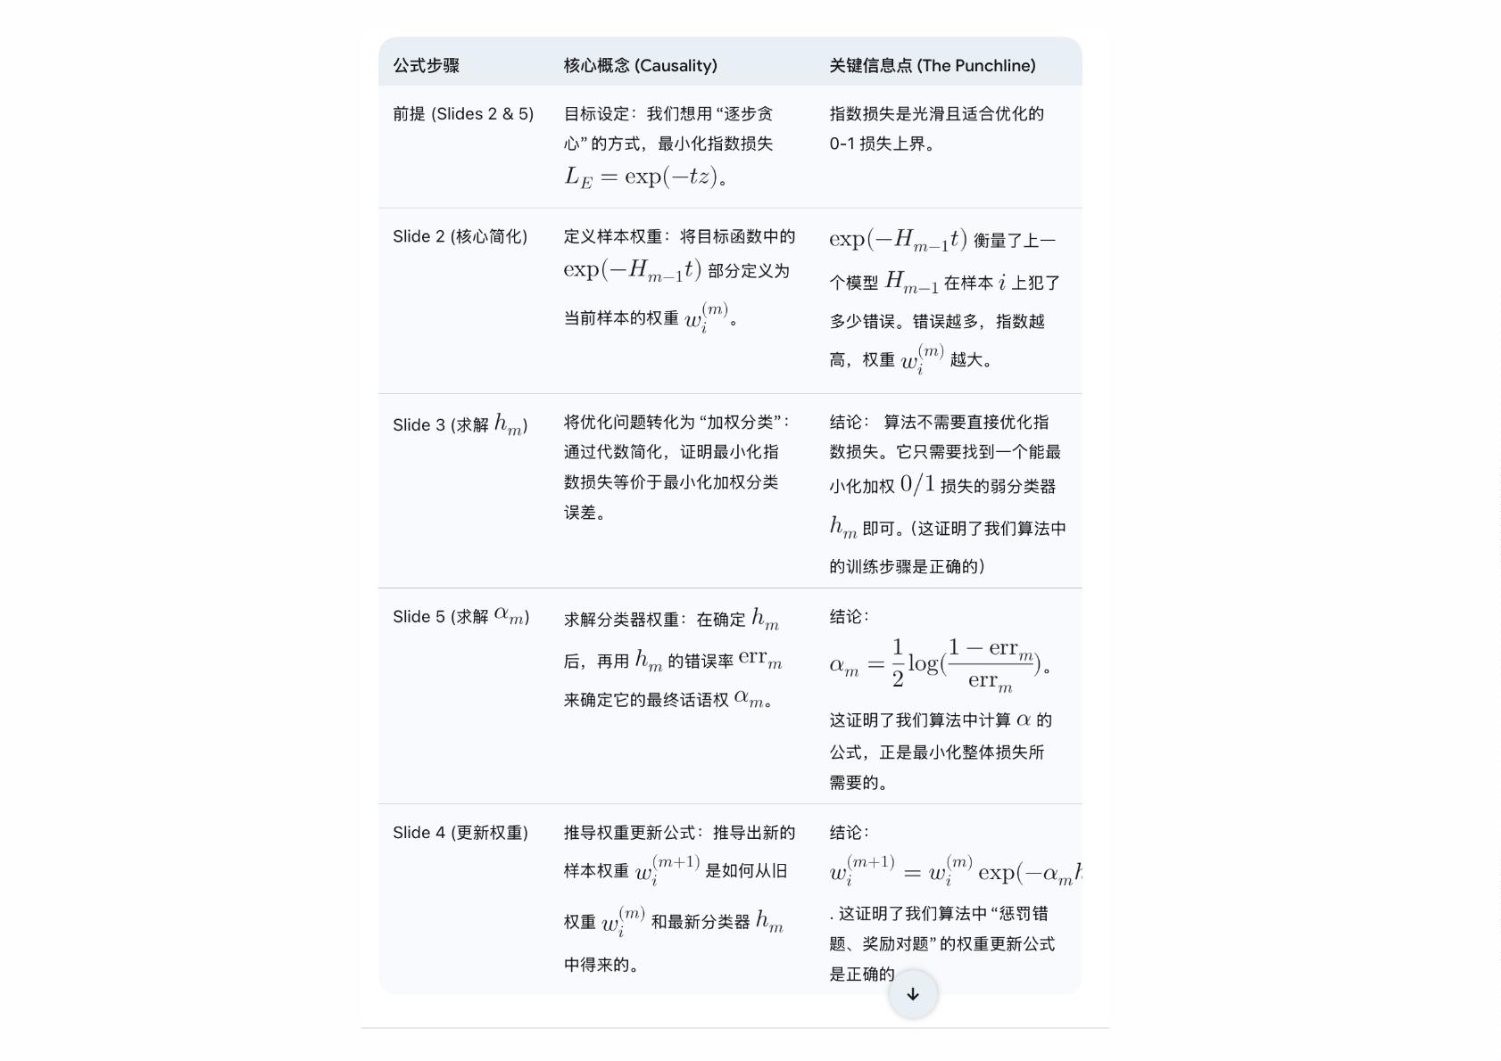

Slide 47
Boosting Summary
• Boosting reduces bias by generating an ensemble of weak classifiers.
• Each classifier is trained to reduce errors of previous ensemble.
• It is quite resilient to overfitting, though it can overfit.

Slide 48
Ensembles Recap
• Ensembles combine classifiers to improve performance
• Boosting
➢Reduces bias
➢Increases variance (large ensemble can cause overfitting)
➢Sequential
➢High dependency between ensemble elements
• Bagging
➢Reduces variance (large ensemble can’t cause overfitting)
➢Bias is not changed (much)
➢Parallel
➢Want to minimize correlation between ensemble elements.

