Slide 1

INT305 Machine Learning
Lecture 9
Probabilistic Models
Siyue Yu
Department Intelligence Science
siyue.yu02@xjtlu.edu.cn

Slide 2
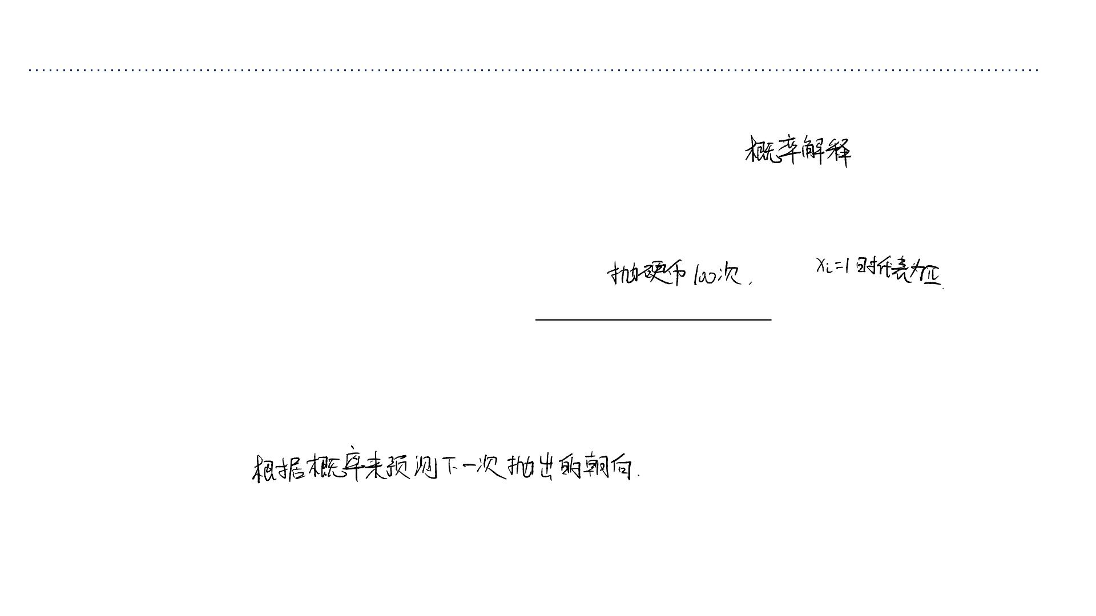
Today
• So far in the course we have adopted a modular perspective, in which the model, loss
function, optimizer, and regularizer are specified separately.
• Today we will begin putting together a probabilistic interpretation of the choice of
model and loss, and introduce the concept of maximum likelihood estimation.
• Let’s start with a simple biased coin example.
➢You flip a coin ꢀ = 100times and get outcomes {ꢁ ,...,ꢁ }where ꢁ ∈
1 ꢂ
ꢃ
{0,1}and ꢁ_{ꢃ} = 1is interpreted as heads ꢄ.
➢Suppose you had ꢀ = 55heads andꢀ = 45tails.
ꢅ
ꢆ
➢What is the probability it will come up heads if we flip again? Let’s design a model
for this scenario, fit the model. We can use the fit model to predict the next
outcome.

Slide 3
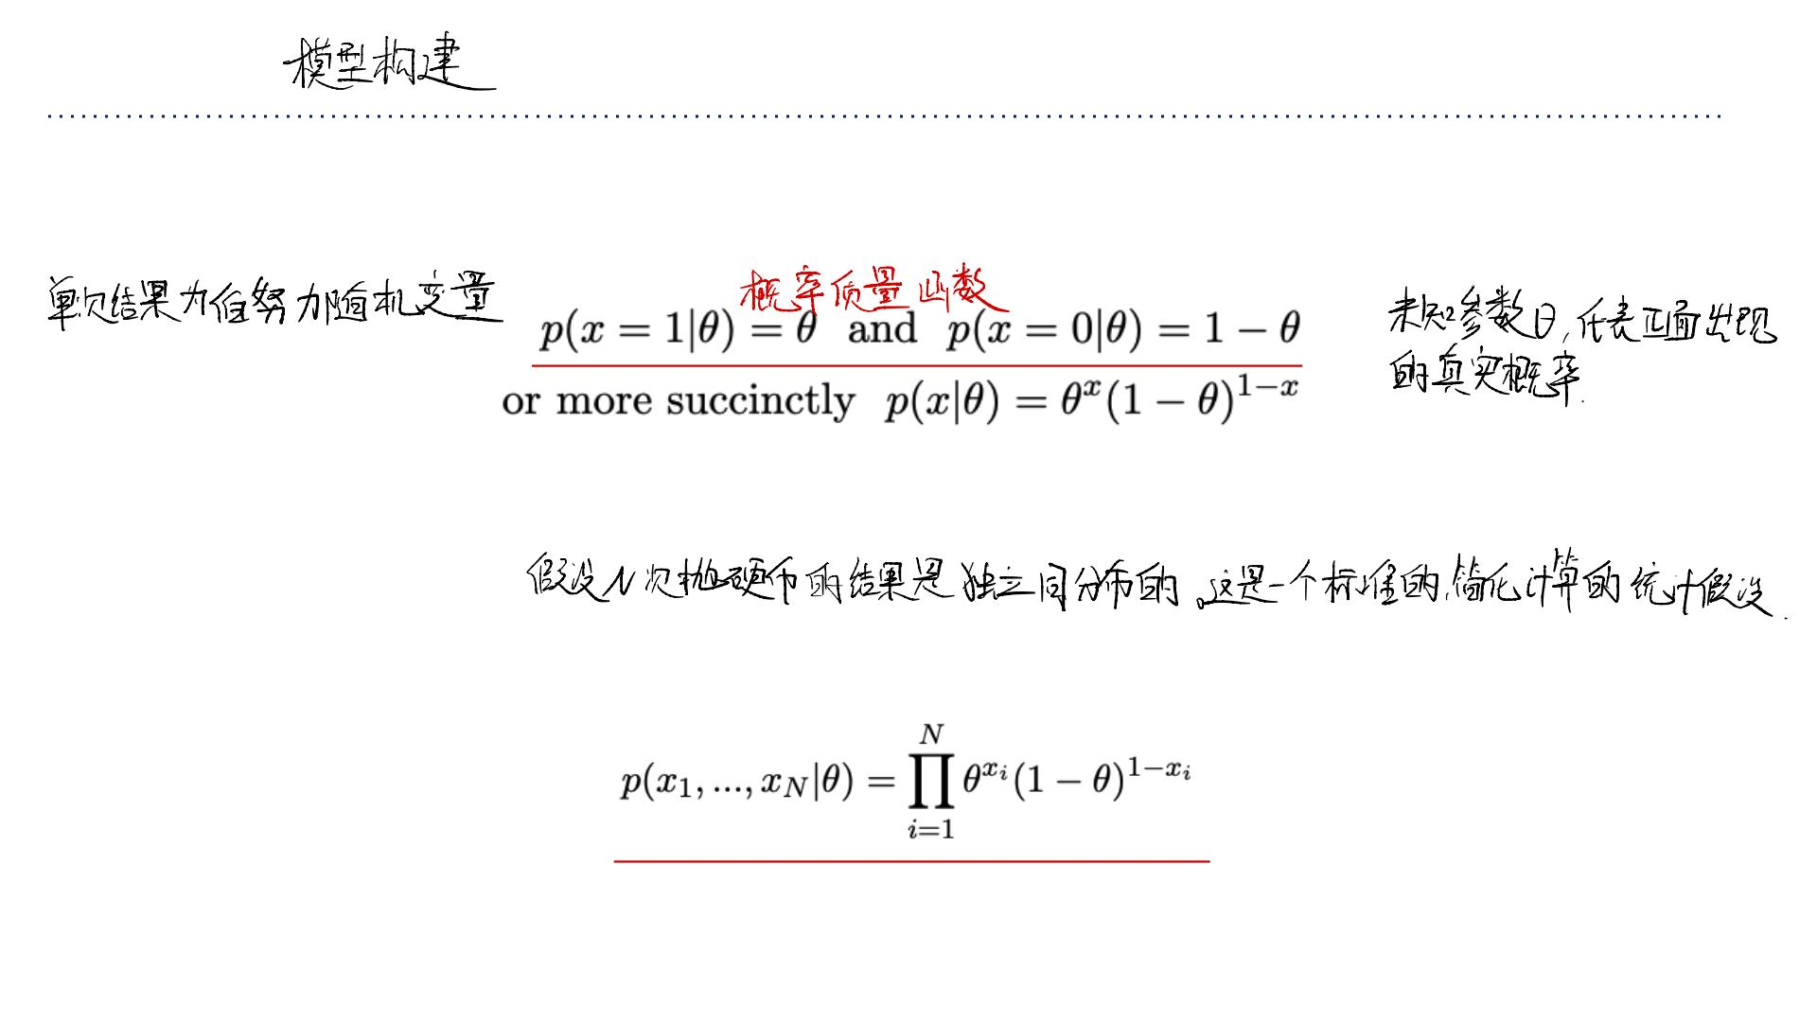
Model?
• The coin is possibly loaded. So, we can assume that one coin flip outcome ꢁis a
Bernoulli random variable for some currently unknown parameter ꢇ ∈ [0, 1].
• It’s sensible to assume that{ꢁ₁,...,ꢁ_{ꢂ} }are independent and identically distributed
(i.i.d.) Bernoullis.
• Thus the joint probability of the outcome {ꢁ₁,...,ꢁ_{ꢂ} }is
基于 i.i.d. 假设，观察到整个序列x的联
合概率是每次伯努利试验概率的乘积。

Slide 4
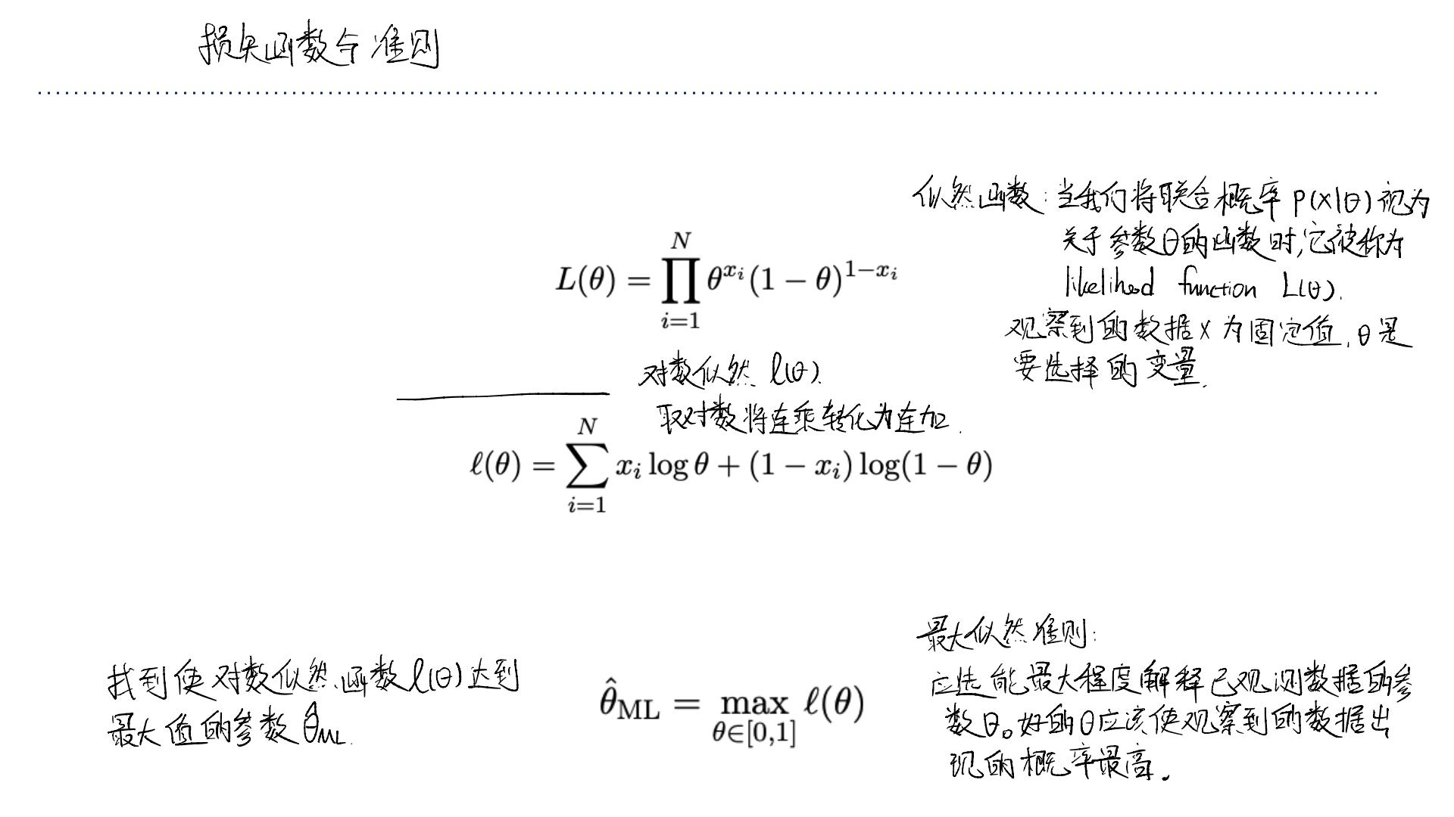
Loss?
• We call the probability mass (or density for continuous) of the observed data the
likelihood function (as a function of the parameters ꢇ):
• We usually work with log-likelihoods:
• How can we choose ꢇ? Good values of ꢇshould assign high probability to the observed
data. This motivates the maximum likelihood criterion, that we should pick the
parameters that maximize the likelihood:

Slide 5
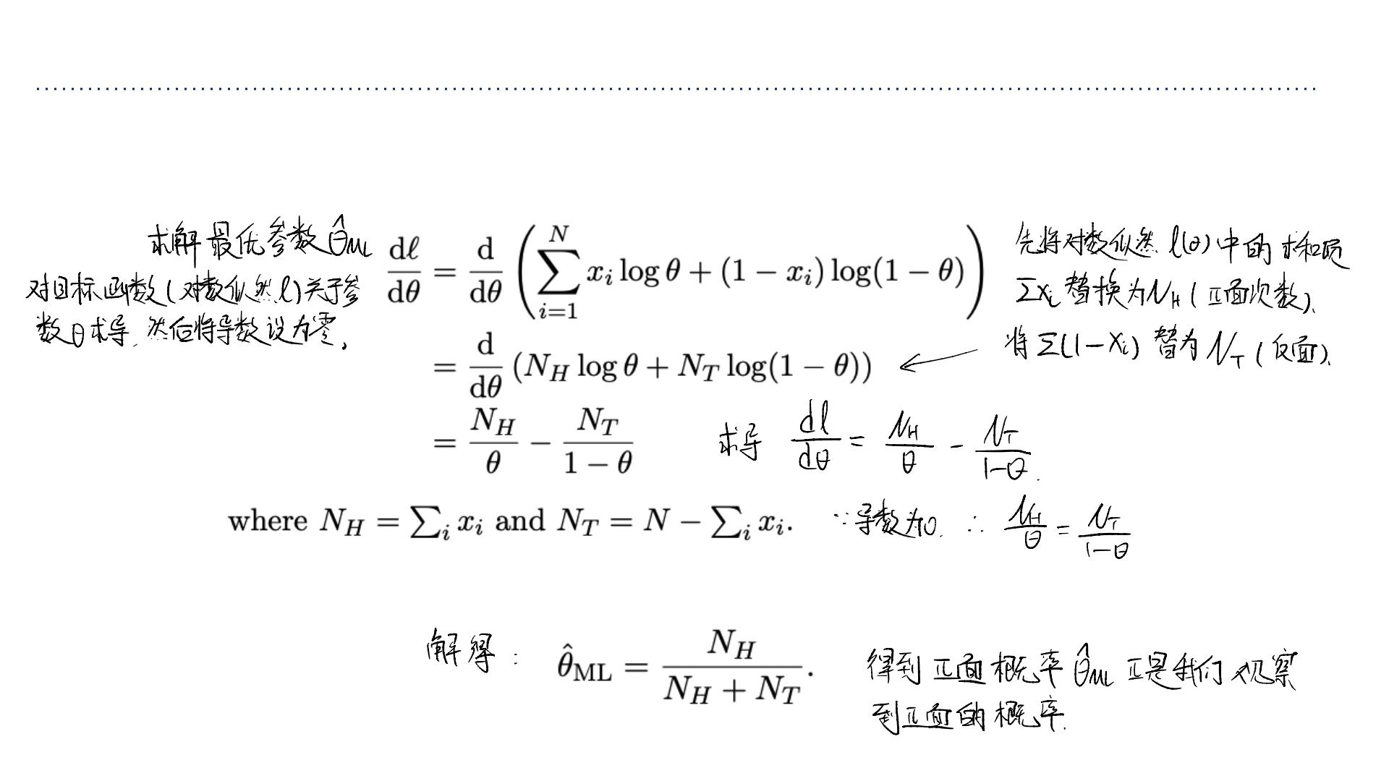
Maximum Likelihood Estimation for the Coin Example
• Remember how we found the optimal solution to linear regression by setting
derivatives to zero? We can do that again for the coin example.
• Setting this to zero gives the maximum likelihood estimate:

Slide 6
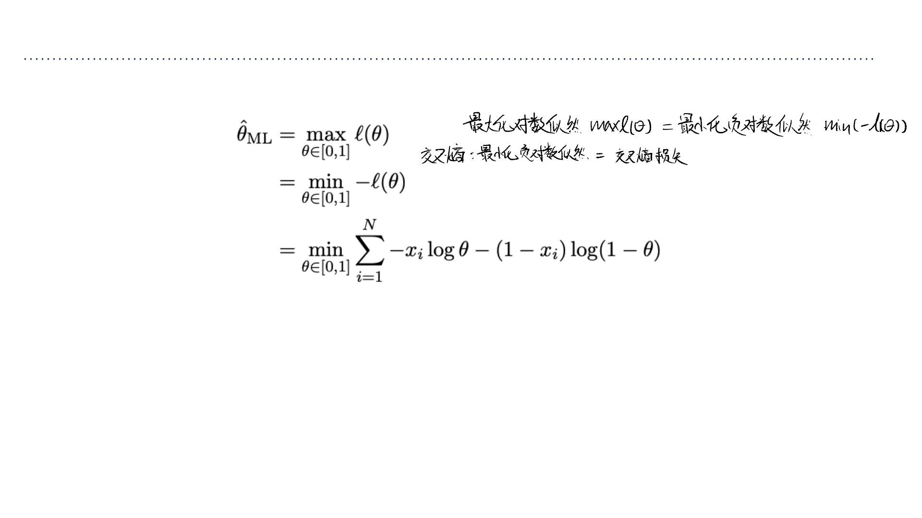
Maximum Likelihood Estimation
• Notice, in the coin example we are actually minimizing cross-entropies!
最⼤似然估计的通⽤框架：
步骤⼀：定义⼀个能够为数据集分配概率
（或概率密度）的概率模型。
结论：这表明我们过去在神经⽹络中最⼩化的交叉熵损
失，从概率⻆度来看，就是在进⾏最⼤似然估计。
步骤⼆：通过最⼤化似然（或最⼩化负对
数似然）来确定模型的参数。
MLE 提供了⼀个统⼀的、坚实的概率基础，来解
释许多机器学习算法的⽬标函数。
• This is an example of maximum likelihood estimation.
➢define a model that assigns a probability (or has a probability density at) to a
dataset
➢maximize the likelihood (or minimize the neg. log-likelihood).
• Many examples we’ve considered fall in this framework! Let’s consider classification
again.

Slide 7

Discriminative VS Generative?
判别式和⽣成式
Two approaches to classification:
• Discriminative approach: estimate parameters of decision boundary/class separator
directly fr om labeled examples.
➢Model ꢈ(ꢉ|ꢊ)directly (logistic regression models)
➢Learn mappings from inputs to classes (linear/logistic regression, decision trees etc)
➢Tries to solve: How do I separate the classes?
• Generative approach: model the distribution of inputs characteristic of the class (Bayes
classifier).
➢Model ꢈ(ꢊ|ꢉ)
➢Apply Bayes Rule to derive ꢈ(ꢉ|ꢊ)
➢Tries to solve: What does each class ”look” like?
• Key difference: is there a distributional assumption over inputs?

Slide 8
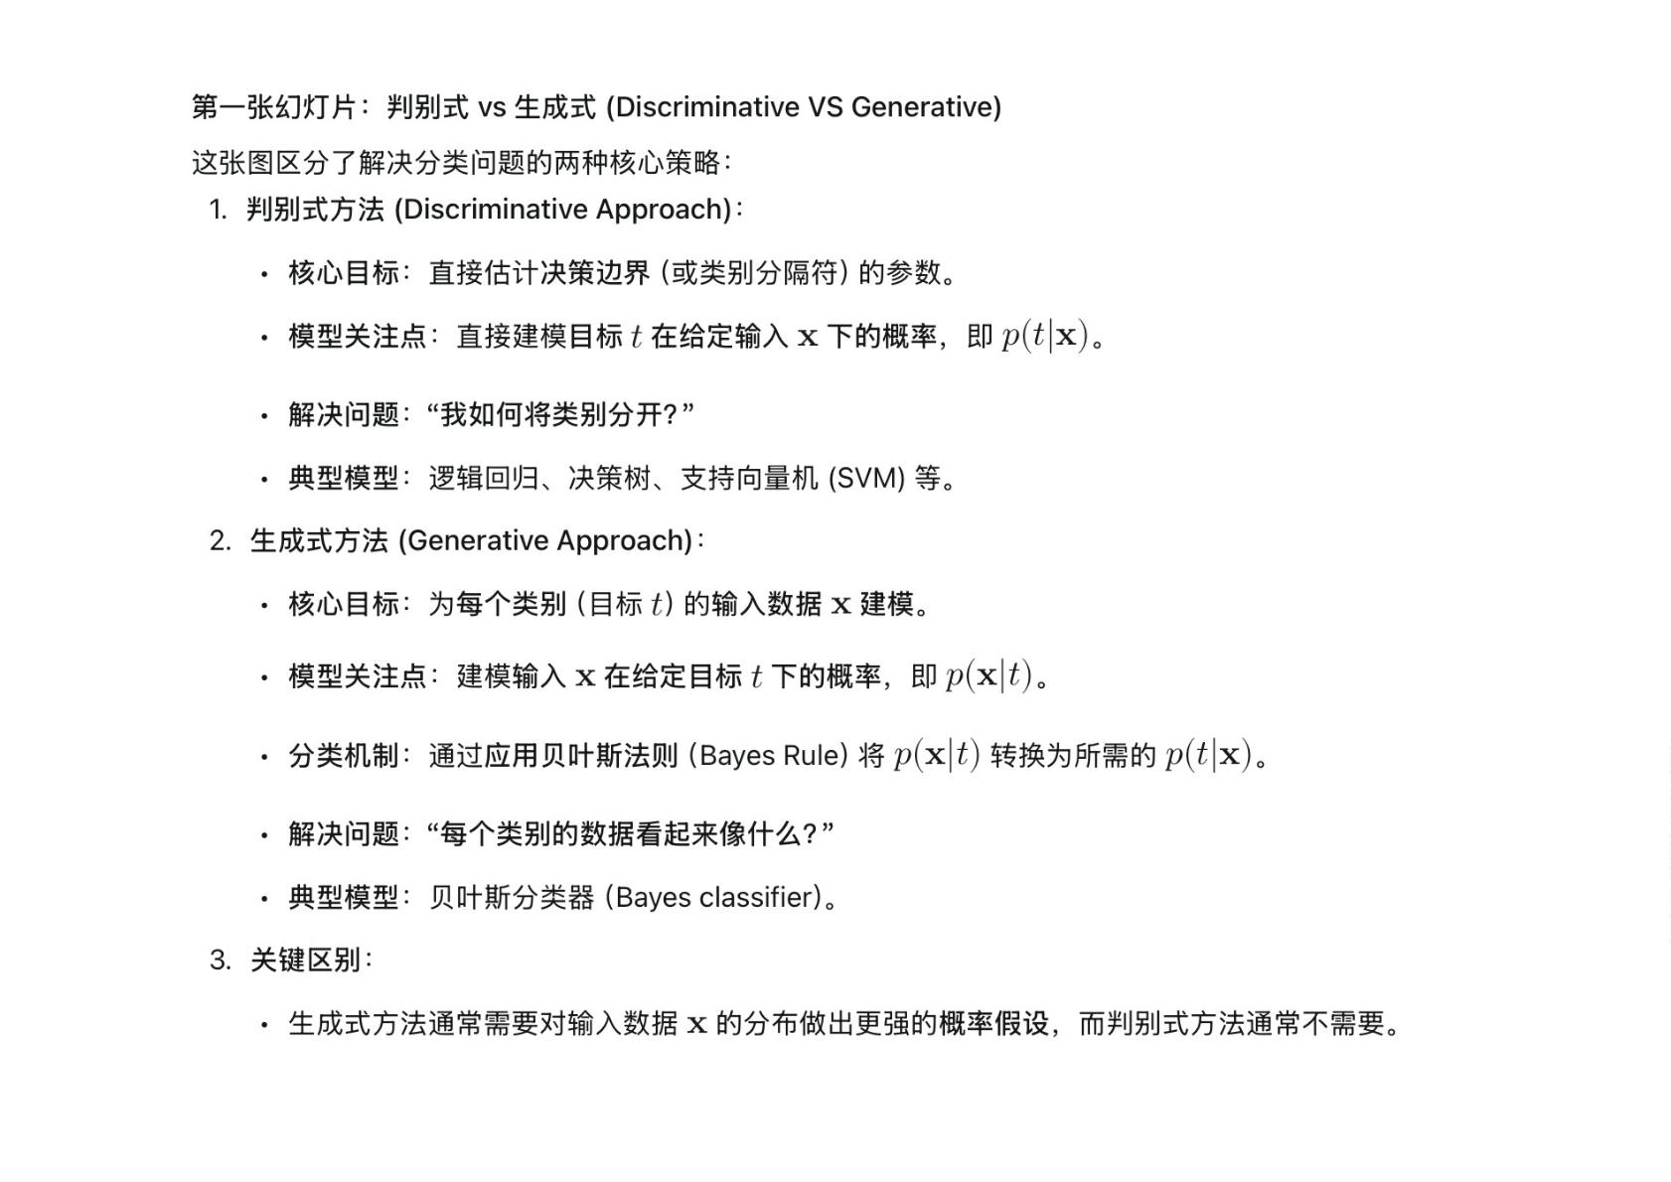

Slide 9
A Generative Model: Bayes Classifier ⽣成式模型示例 (A Generative Model: Bayes Classiﬁer)
• Aim to classify text into spam/not-spam (yes c=1; no c=0)
• Example: “You are one of the very few who have been selected as a winners for the
free $1000 Gift Card.”
• Use bag-of-words features, get binary vector ꢀfor each email
• Vocabulary:
➢“a”: 1
➢...
➢“car”: 0
➢“card”: 1
➢...
➢“win”: 0
➢“winner”: 1
➢“winter”: 0
➢...
➢“you”: 1

Slide 10
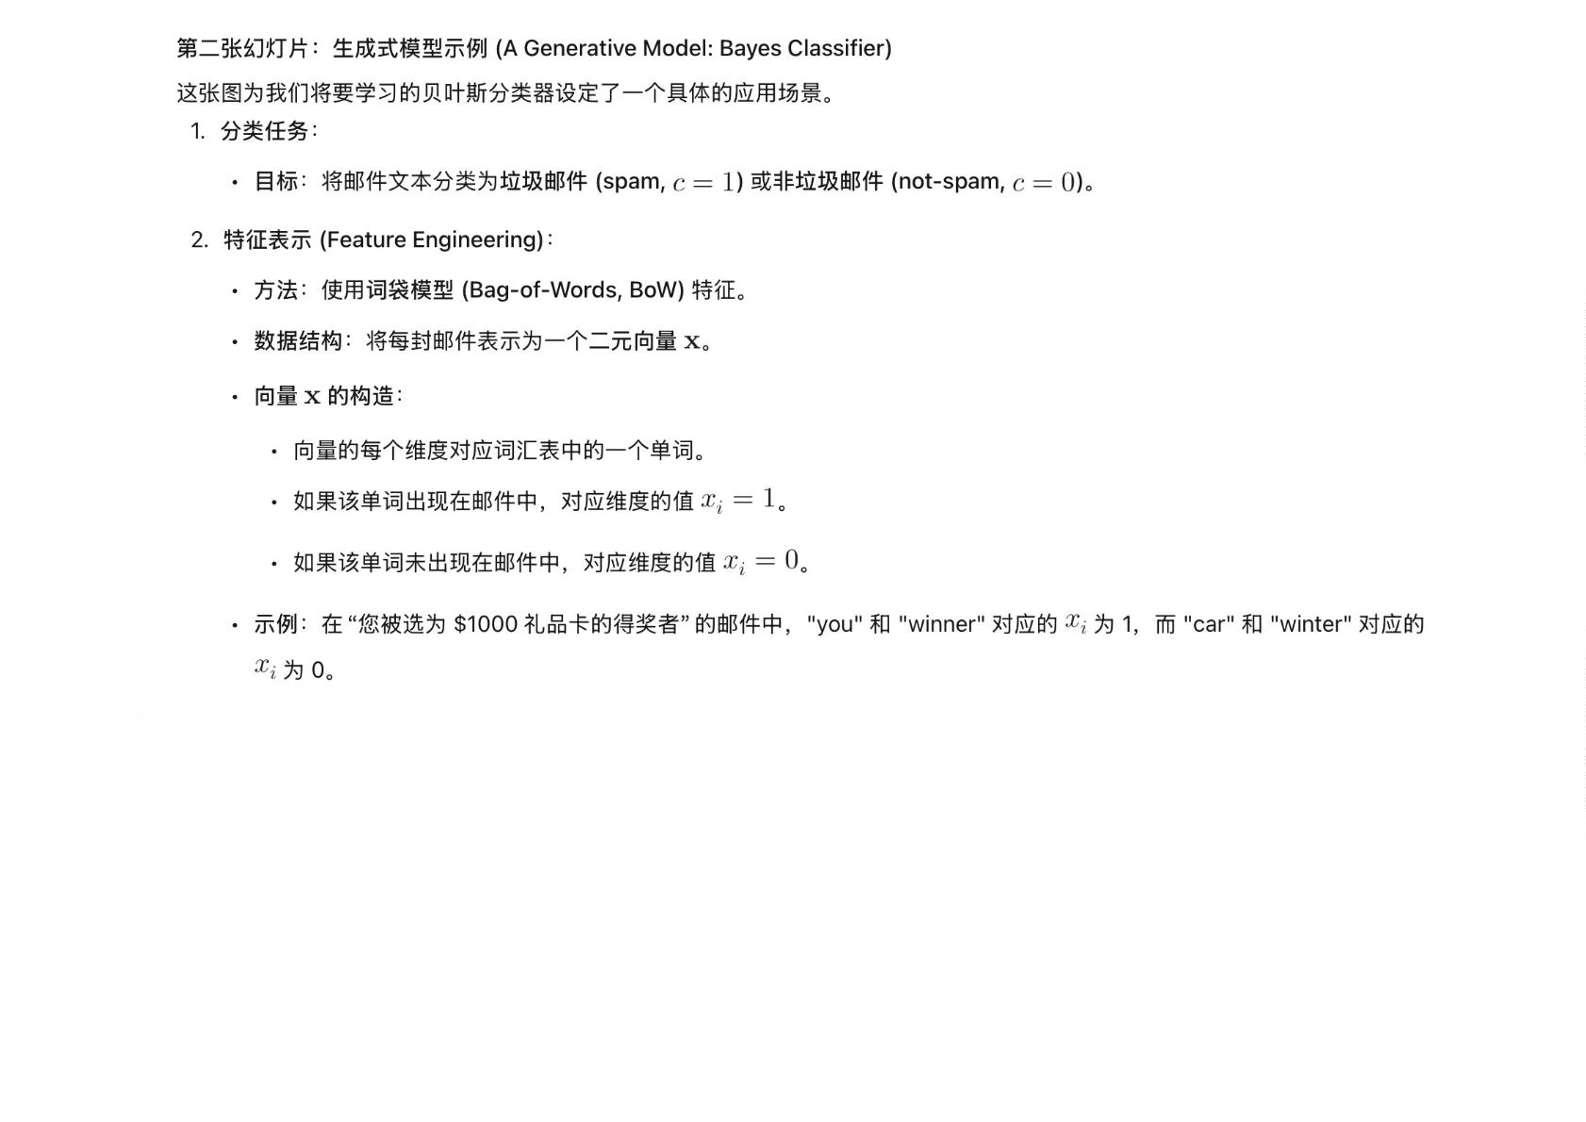

Slide 11
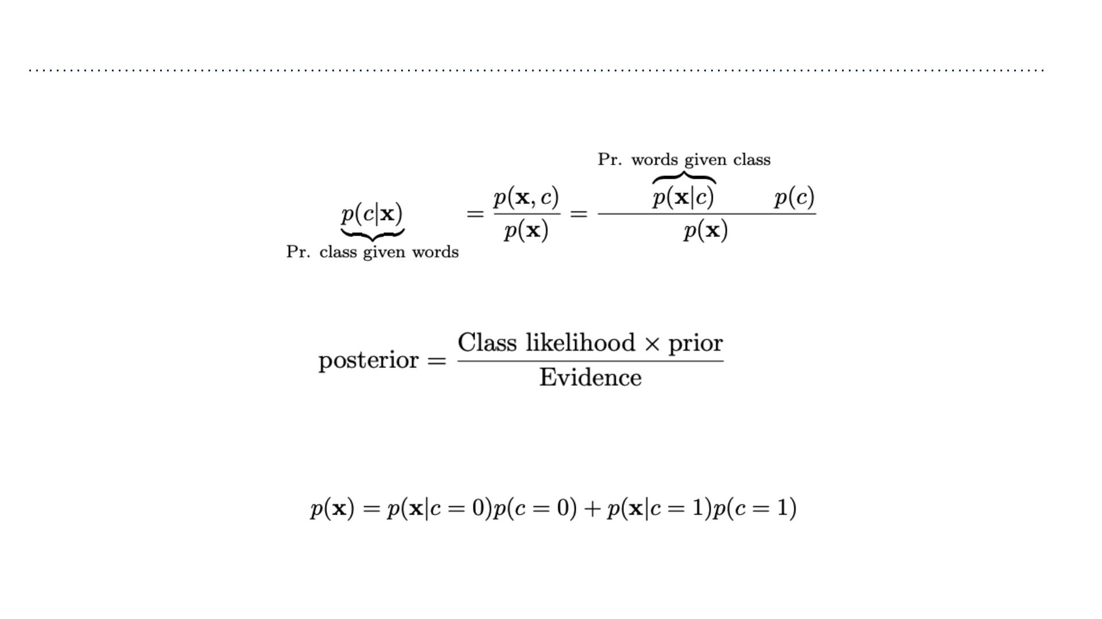
Bayes Classifier
• Given features ꢀ = [ꢁ₁,ꢁ₂,···,ꢁ_{ꢂ}]^{ꢃ}we want to compute class probabilities using
Bayes Rule:
• More formally
• How can we compute ꢄ(ꢀ)for the two-class case? (Do we need to?)
• To compute ꢄ(ꢅ|ꢀ)we need: ꢄ(ꢀ|ꢅ)and ꢄ(ꢅ)

Slide 12
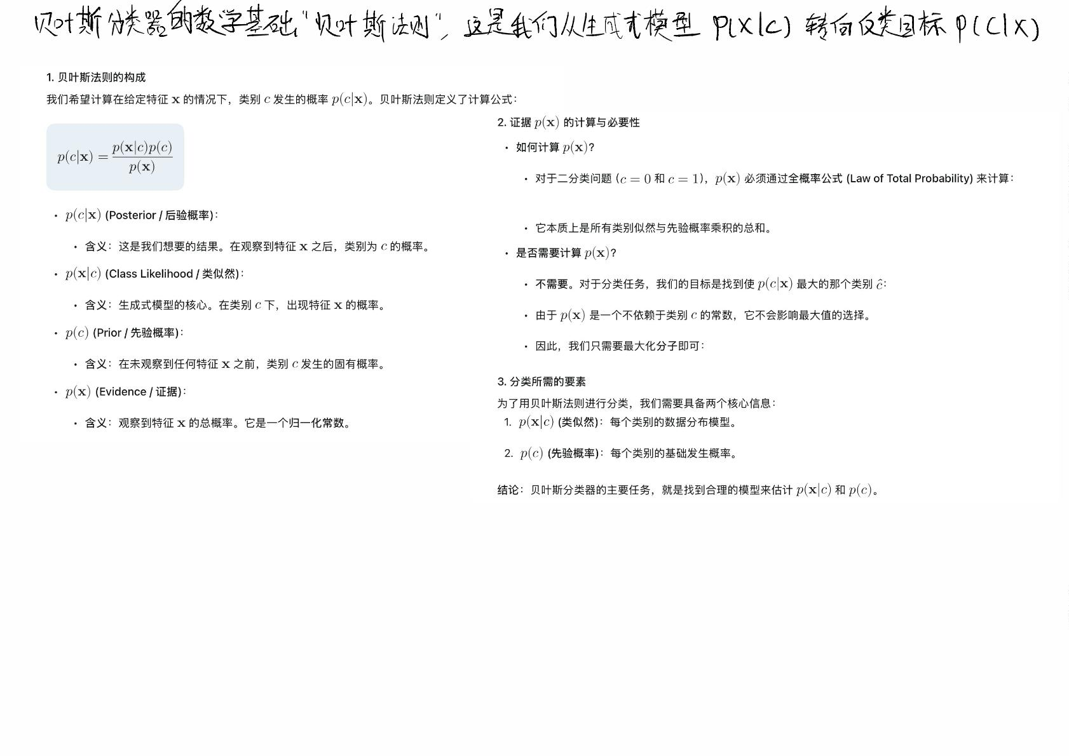

Slide 13
Naive Bayes
• Assume we have two classes: spam and non-spam. We have a dictionary of ꢀwords,
and binary features ꢁ =[ꢂ₁,ꢂ₂,···,ꢂ_{ꢃ}]saying whether each word appears in the e-
mail.
• If we define a joint distribution ꢄ(ꢅ, ꢂ₁,···,ꢂ_{ꢃ}),this gives enough information to
determine ꢄ(ꢅ)and ꢄ(ꢁ|ꢅ).
• Problem: specifying a joint distribution over ꢀ + 1binary variables requires 2^{ꢃ+1} −
1entries. This is computationally prohibitive and would require an absurd amount of
data to fit.
• We’d like to impose structure on the distribution such that:
➢it can be compactly represented
➢learning and inference are both tractable

Slide 14
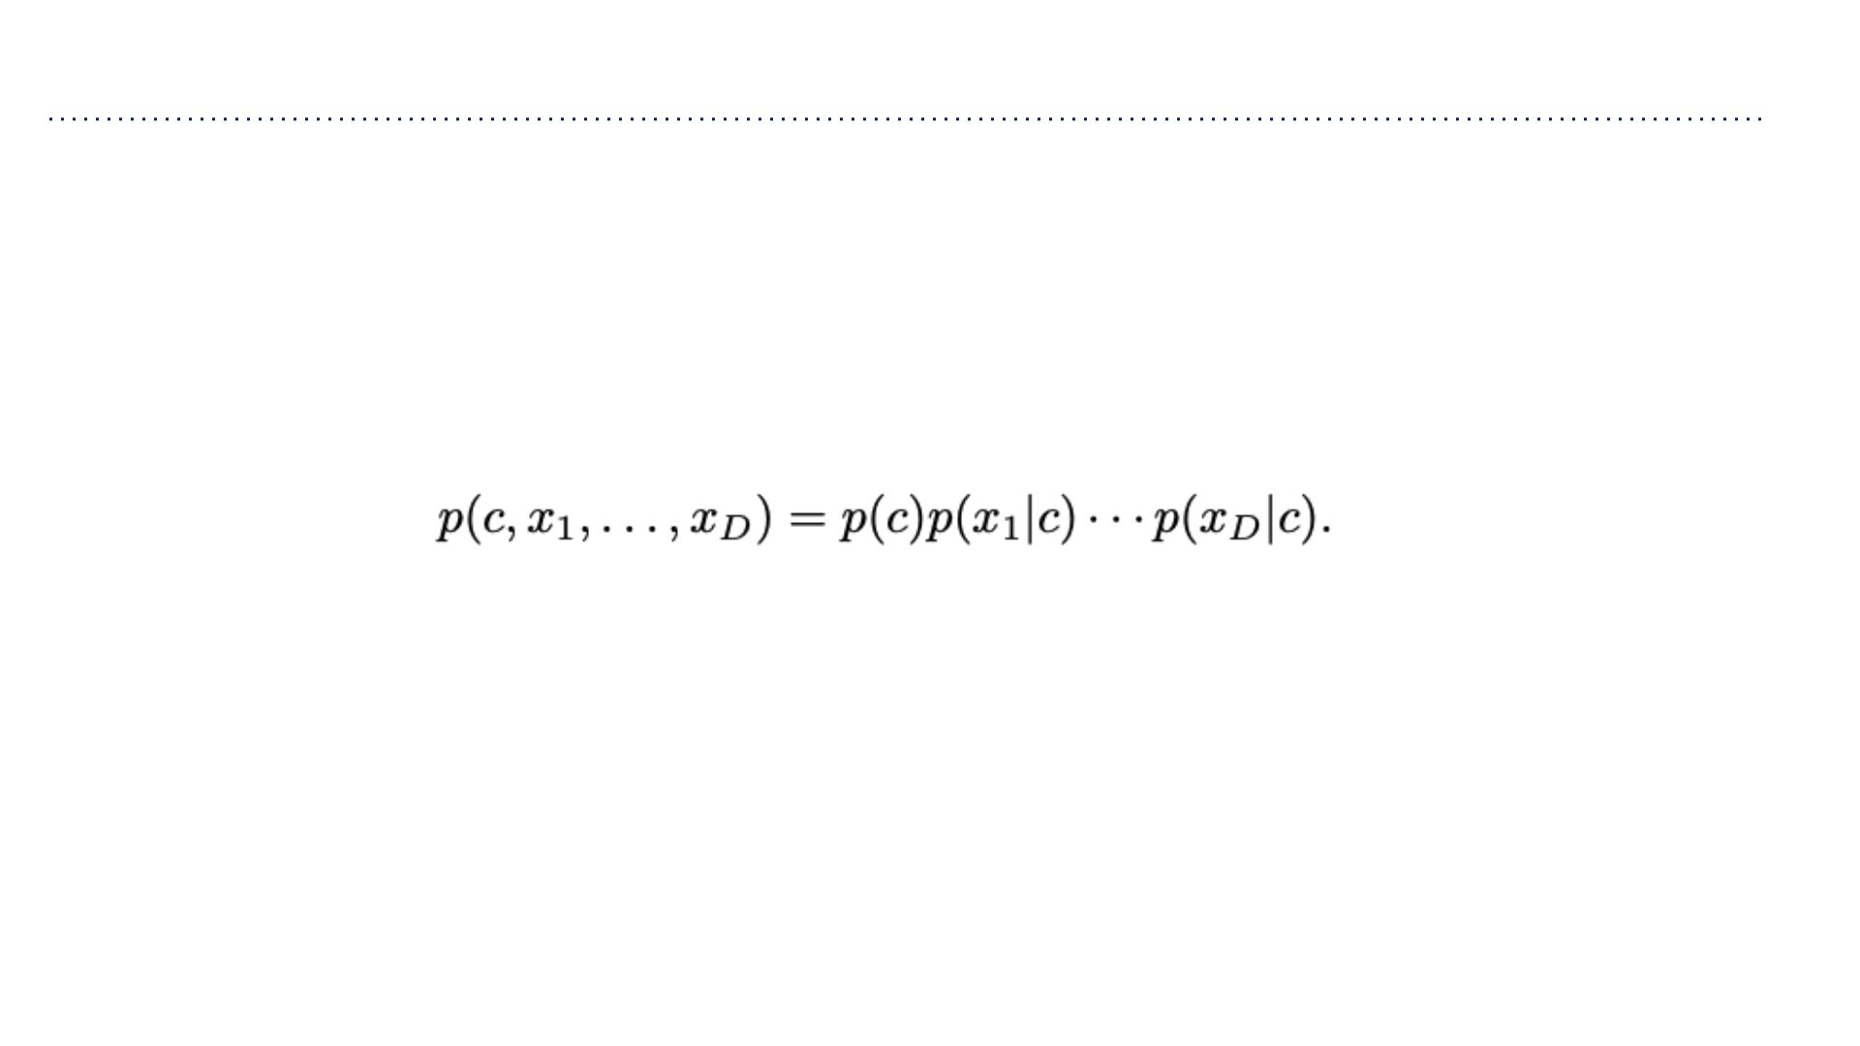
Naive Bayes
• Naive assumption: Naive Bayes assumes that the wor d features ꢂ_{ꢆ} are conditionally
independent given the class ꢅ.
➢This means ꢂ_{ꢆ} and ꢂ_{ꢇ} are independent under the conditional distribution ꢄ(ꢁ|ꢅ).
➢Note: this doesn’t mean they’re independent.
➢Mathematically,
• Compact representation of the joint distribution
➢Prior probability of class: ꢄ(ꢅ = 1) = ꢈ(e.g. spam email)
➢Conditional probability of word feature given class: ꢄ(ꢂ = 1|ꢅ) = ꢉ (e.g.
ꢇ
ꢇꢊ
word ”price” appearing in spam)
➢2ꢀ + 1parameters total (before 2^{ꢃ+1} − 1 )

Slide 15
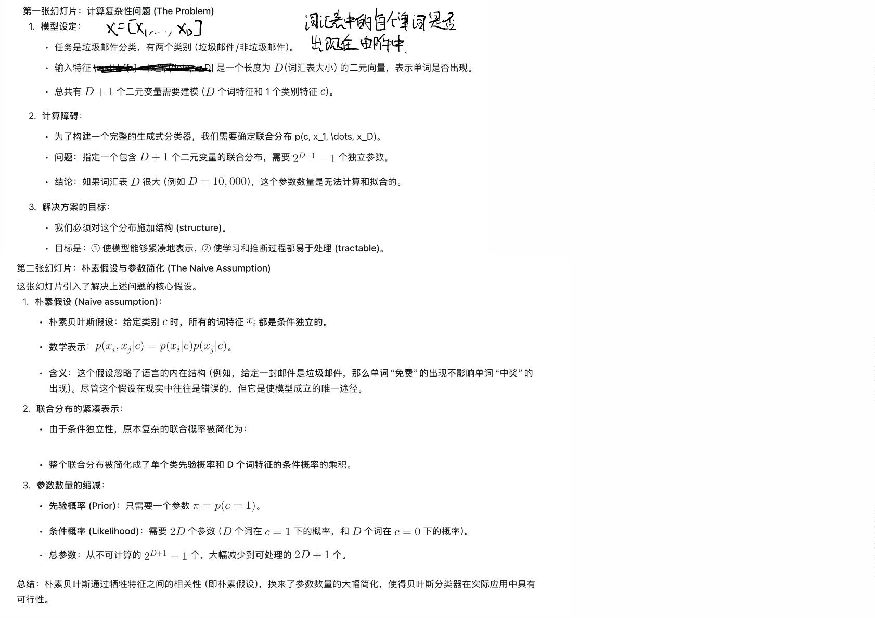

Slide 16
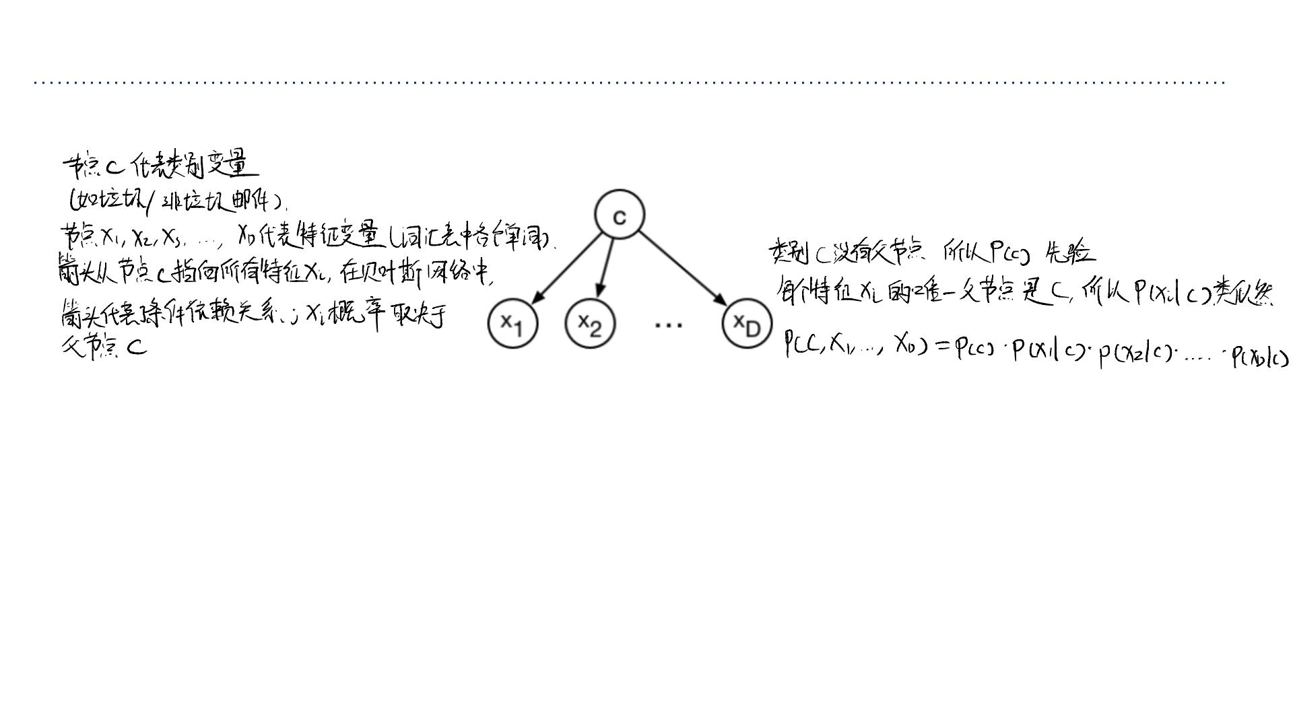
Bayes Nets
• We can represent this model using an directed graphical model, or Bayesian network:
我们可以使⽤有向图模型 (directed graphical model) 或⻉叶斯⽹络来直观地表示模型中的变量关系。
⼀般规则：任何⻉叶斯⽹络图结构都意味着其联合分布可以分解为所
有变量的条件概率的乘积，条件是该变量的⽗节点。
• This graph structure means the joint distribution factorizes as a product of conditional
distributions for each variable given its parent(s).
• Intuitively, you can think of the edges as reflecting a causal structure. But
mathematically, this doesn’t hold without additional assumptions.
直觉 (Intuition)：从直觉上，你可以将这些箭头理解为⼀种因果结构。例如，类别 c（“这是垃圾邮件”）是导致特
征 f{x}（“出现 free 这个词”）出现的原因。
数学严谨性：然⽽，从数学上讲，⻉叶斯⽹络仅依赖于条件独⽴性假设来简化联合分布。模型并不需要严格的因果
关系来成⽴。

Slide 17
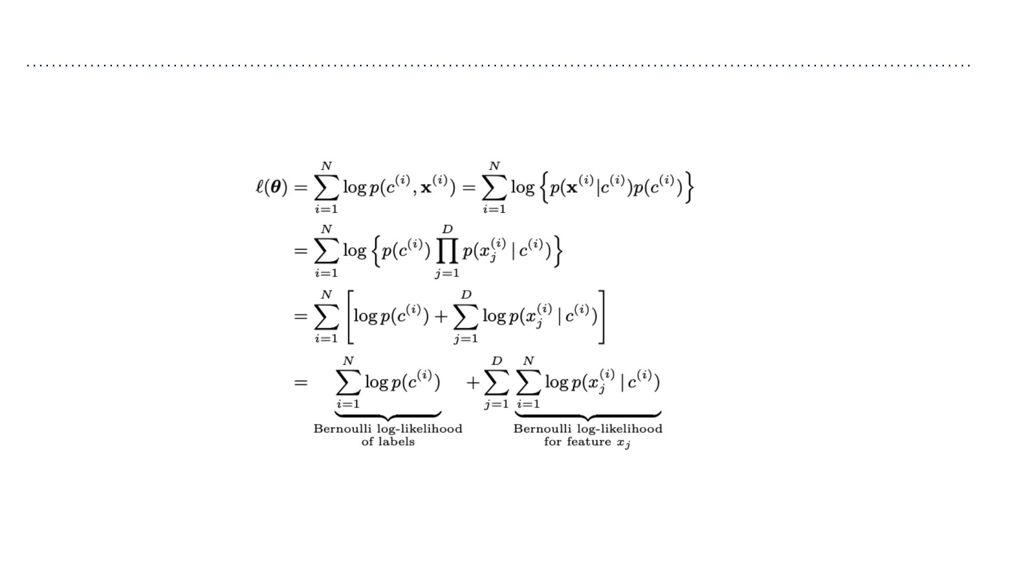
Naive Bayes: Learning
• The parameters can be learned efficiently because the log-likelihood decomposes into
independent terms for each feature.
• Each of these log-likelihood terms depends on different sets of parameters, so they can
be optimized independently.

Slide 18
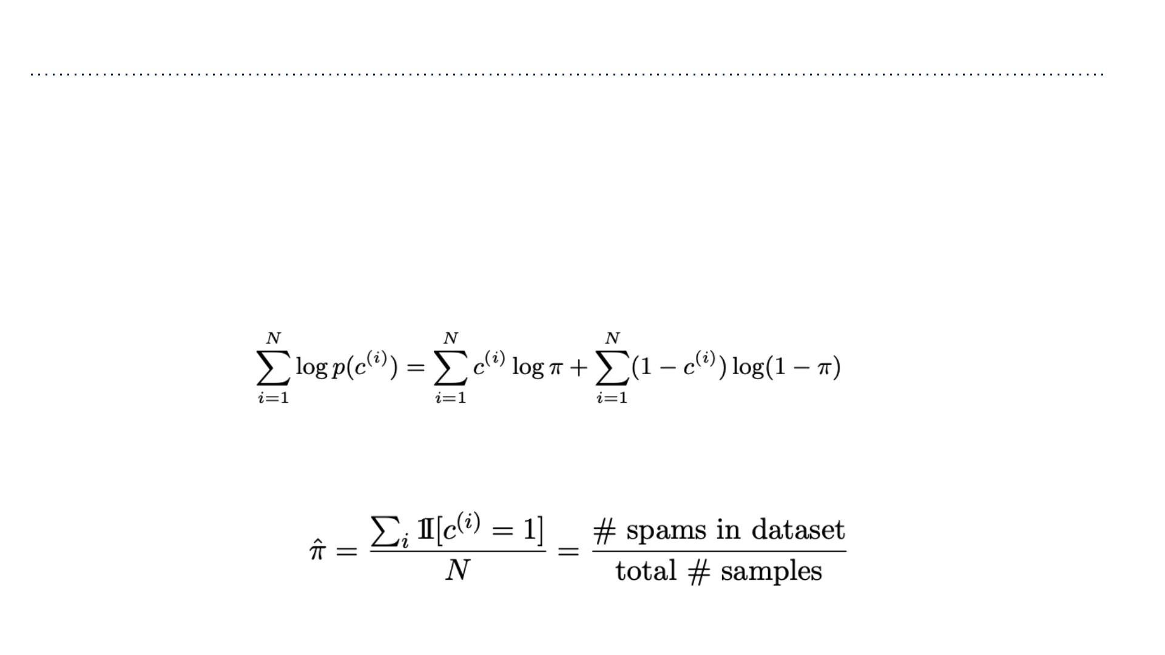
Naive Bayes: Learning
• We can handle these terms separately. For the prior we maximize: ꢁ log ꢂ(ꢃ^{(ꢀ)})
σ
ꢀ=1
• This is a minor variant of our coin flip example. Let ꢂ(ꢃ^{(ꢀ)} = 1)=ꢄ. Note ꢂ(ꢃ^{(ꢀ)}) =
(ꢆ)
_{1−ꢅ}(ꢆ)
ꢅ
ꢄ (1−ꢄ)
• Log-likelihood:
• Obtain MLEs by setting derivatives to zero:

Slide 19
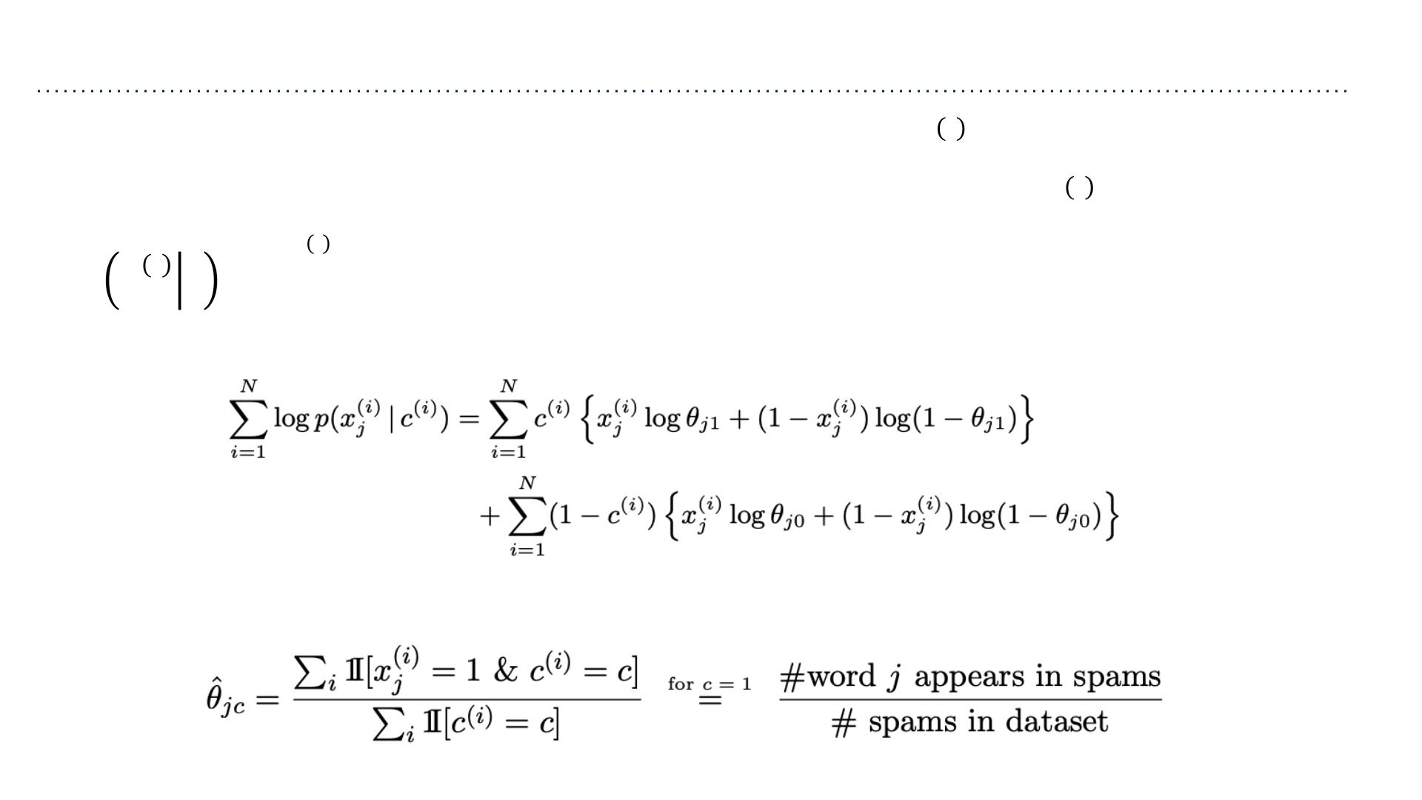
Naive Bayes: Learning
ꢀ
• Each ꢇ ’s can be treated separately: maximize ꢁ logꢂ(ꢉ |ꢃ^{(ꢀ)})
σ
ꢈꢅ
ꢀ=1
ꢈ
ꢀ
• This is (again) a minor variant of our coin flip example. Let ꢇ =ꢂ(ꢉ =1|ꢃ). Note
ꢈꢅ
ꢈ
ꢆ
ꢋ
(ꢆ)
ꢋ
ꢀ
ꢊ
1−ꢊ
ꢂ ꢉ ꢃ =ꢇ (1−ꢇ )
.
ꢈ
ꢈꢅ
ꢈꢅ
• Log-likelihood:
• Obtain MLEs by setting derivatives to zero:

Slide 20
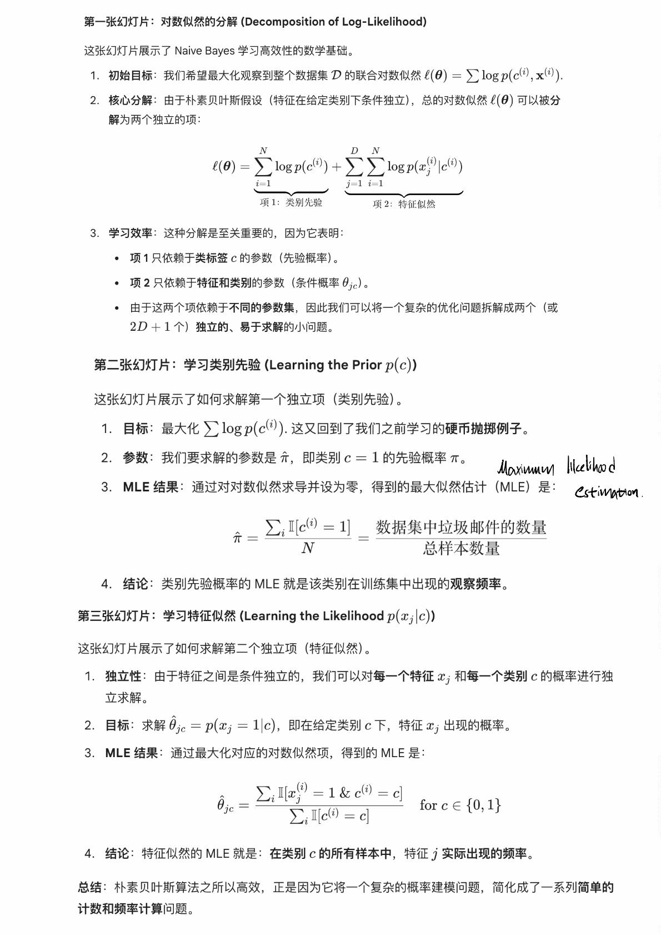

Slide 21
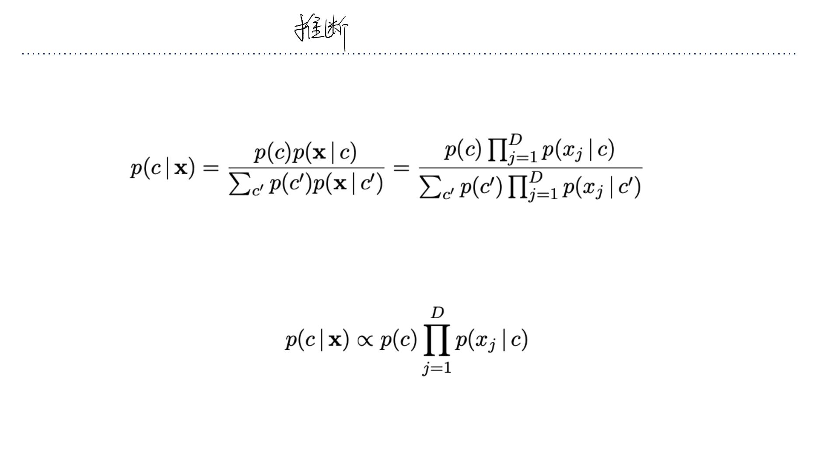
Naive Bayes: Inference
• We predict the category by performing inference in the model.
• Apply Bayes’ Rule:
• We need not compute the denominator if we’re simply trying to determine the most
likely ꢀ.
• Shorthand notation:
• For input ꢁ, predict by comparing the values of ꢂ(ꢀ) ꢄ ꢂ(ꢅ |ꢀ)for different ꢀ(e.g.
ς
ꢃ=1 ꢃ
choose the largest).

Slide 22
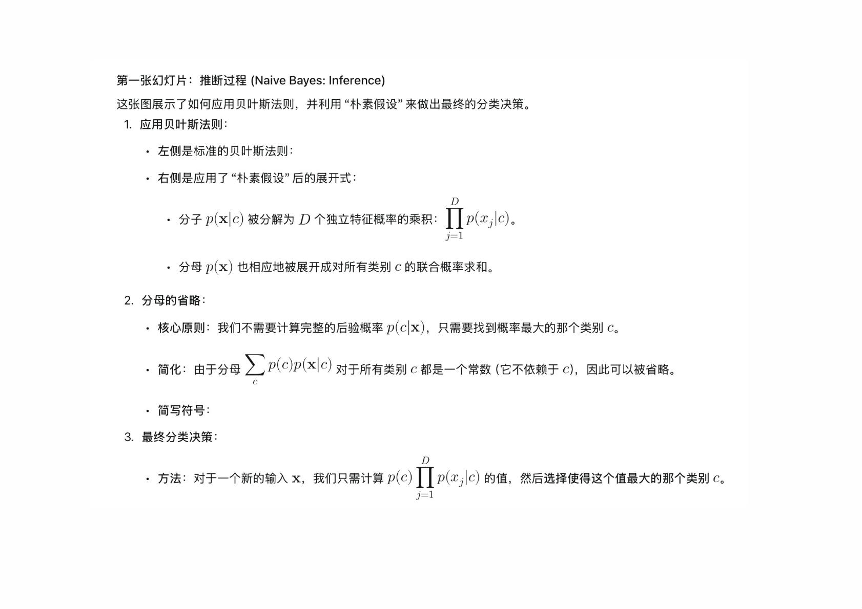

Slide 23
Naive Bayes
• Naive Bayes is an amazingly cheap learning algorithm!
• Training time: estimate parameters using maximum likelihood
➢Compute co-occurrence counts of each feature wi th the labels.
➢Requires only one pass through the data!
• Test time: apply Bayes’ Rule
➢Cheap because of the model structure. (For more general models, Bayesian
inference can be very expensive and/or complicated.)
• We covered the Bernoulli case for simplicity. But our analysis easily extends to other
probability distributions.
• Unfortunately, it’s usually less accurate in practice compared to discriminative models
due to its “naive” independence assumption.

Slide 24

朴素⻉叶斯算法在计算效率和实际准确性⽅⾯的特点。
⾼效性 (An amazingly cheap learning algorithm!)：
训练时间：
算法只需通过计算每个特征与标签的共现次数（即计算频率）。
学习过程只需遍历数据⼀次 (one pass)，没有复杂的迭代优化过程（如梯度下降），因此训练速度极快。
测试时间：
由于模型结构简单（只有简单的乘法和求和），应⽤⻉叶斯法则进⾏推断也⾮常快。
局限性 (Limitations)：
准确性：朴素⻉叶斯在实践中的准确性通常不如判别式模型（如逻辑回归、SVM 或神经⽹络）。
原因：这是由于它的“朴素”假设（特征在给定类别下是条件独⽴的）导致的。这个假设在真实世界的复杂数据（如语
⾔）中经常被违反，这限制了模型的表达能⼒。
泛化性：
尽管我们⽤⼆元伯努利分布进⾏了分析，但朴素⻉叶斯的分析框架可以轻松扩展到其他概率分布（例如⾼斯分布、多项式
分布），⽤于处理连续特征或计数特征。
总结：朴素⻉叶斯是⼀种计算极其⾼效的算法，它通过将复杂问题简化为简单的频率计数来实现快速训练。然⽽，它的准
确性受限于“朴素”假设。

Slide 25
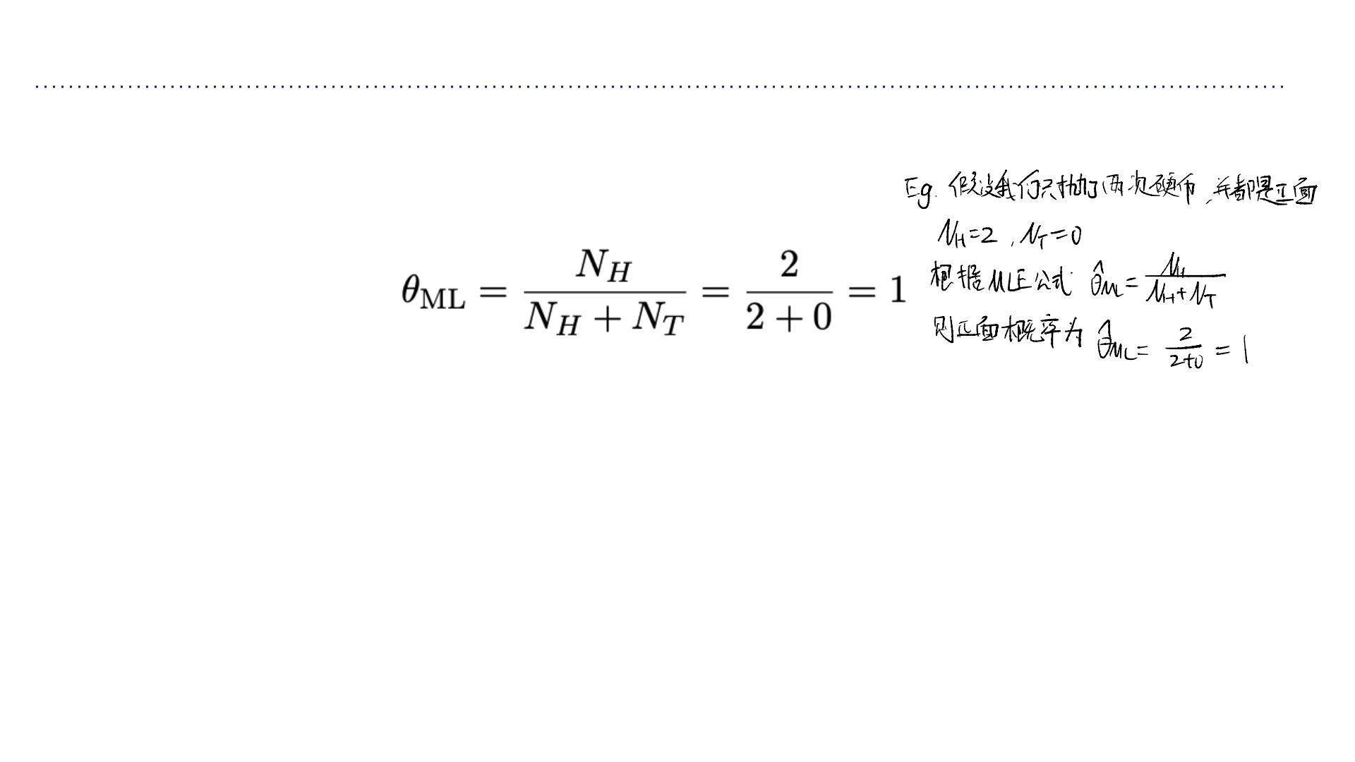
MLE issue: Data Sparsity
核⼼问题：最⼤似然估计有⼀个缺陷——当训练数据量不⾜（数据稀疏）时，它会导致模型过度拟合。
• Maximum likelihood has a pitfall: if you have too little data, it can overfit.
• E.g., what if you flip the coin twice and get H both times?
• Because it never observed T, it assigns this outcome probability 0. This problem is
known as data sparsity.
数据稀疏性的后果 (The Consequence)：
问题：因为模型从未观察到反⾯ (Tails, T)，它根据 MLE 规则，将出现反⾯的概率估计为 0。
含义：模型从数据中得出了⼀个过于极端的结论：反⾯是绝对不可能发⽣的。
影响：
过度拟合：这是⼀种极端的过度拟合，模型完全信任了它观察到的有限数据。
实际危害：如果我们在下⼀次测试中真的抛到了反⾯，模型给这个真实事件分配了 0 的概率，这会在后续的概率计算中（尤其是朴
素⻉叶斯中的概率乘法）导致严重错误（任何数乘以 0 都得 0），使得整个模型不可⽤。

Slide 26
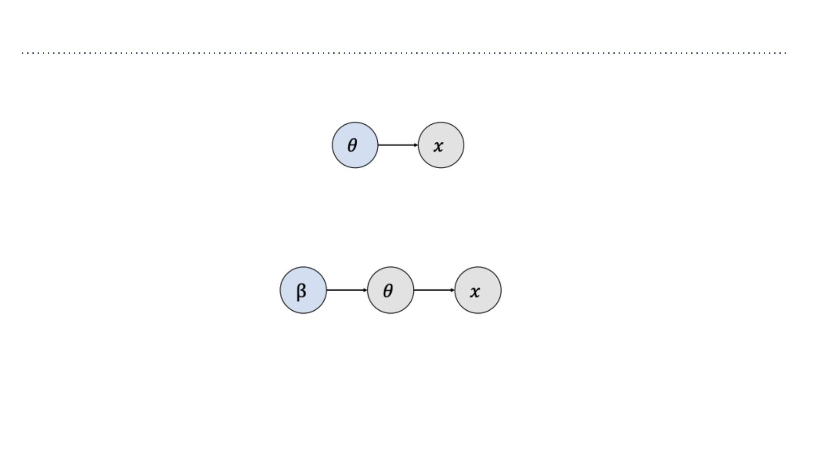
Bayesian Parameter Estimation
• In maximum likelihood, the observations are treated as random variables, but the
parameters are not.
• The Bayesian approach treats the parameters as random variables as well.ꢀis the set
of parameters in the prior distribution of ꢁ.
• To define a Bayesian model, we need to specify two distributions:
➢The prior distribution ꢂ(ꢃ),which encodes our beliefs about the parameters before
we observe the data
➢The likelihood ꢂ(ꢄ|ꢃ),same as in maximum likelihood

Slide 27
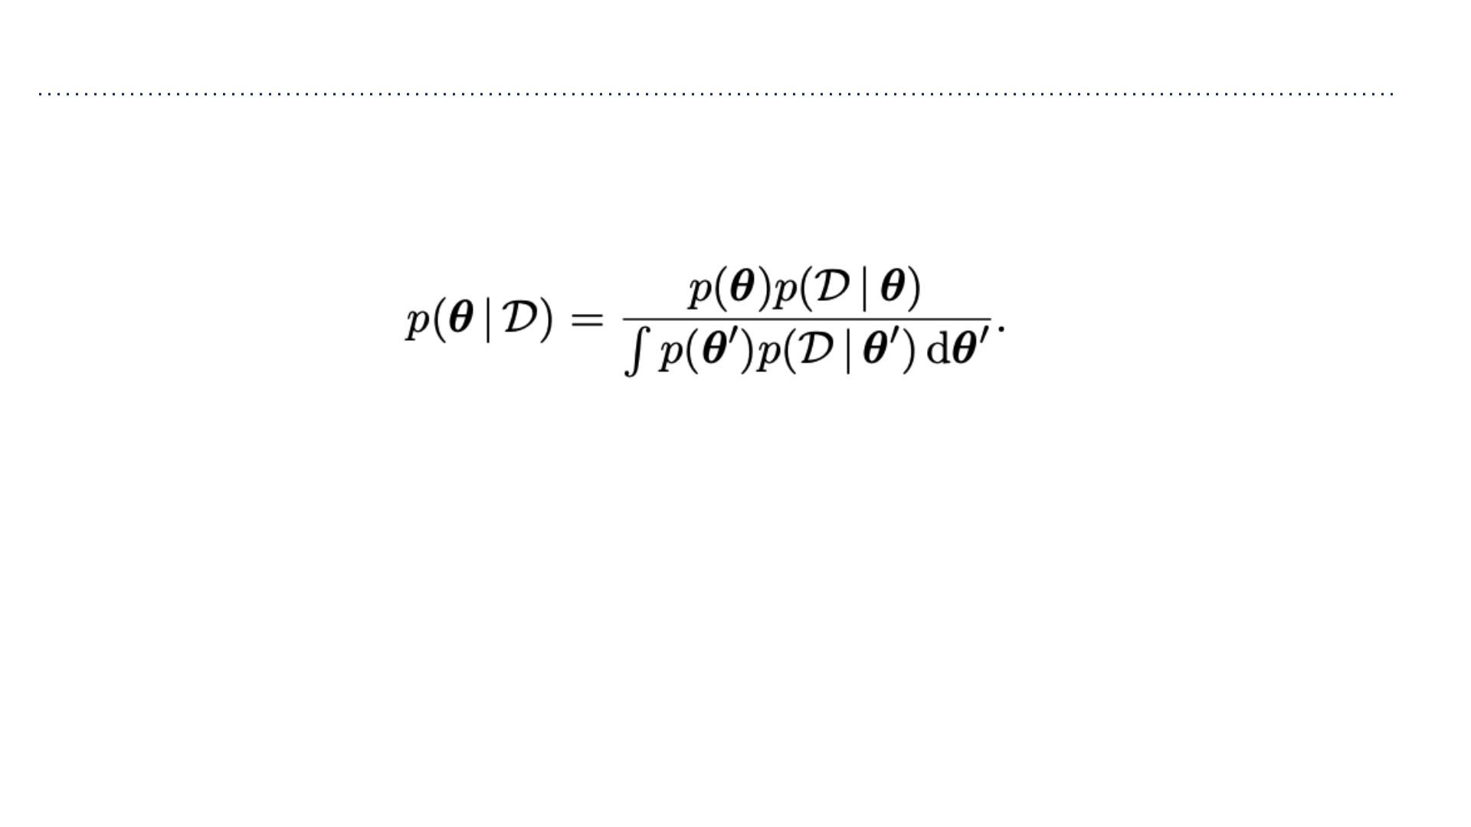
Bayesian Parameter Estimation
• When we update our beliefs based on the observations, we compute the posterior
distribution using Bayes’ Rule:
• We rarely ever compute the denominator explicitly. In general, it is computationally
intractable.

Slide 28
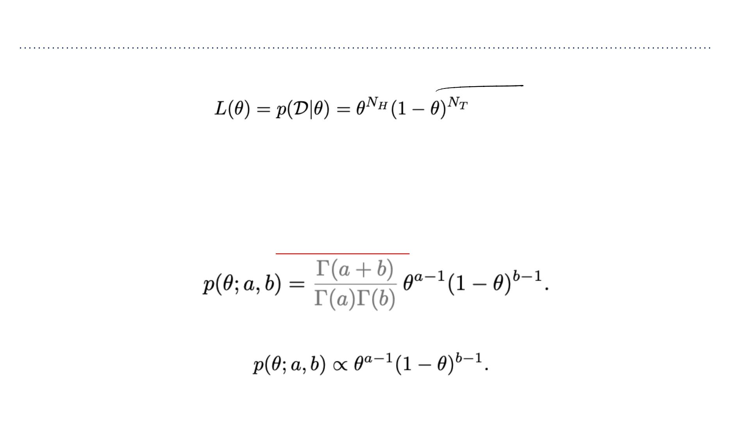
Bayesian Parameter Estimation
• Let’s revisit the coin example. We already know the likelihood:
• It remains to specify the prior ꢂ(ꢁ).
➢We can choose an uninformative prior, which assumes as little as possible. A
reasonable choice is the uniform prior.
➢But our experience tells us 0.5 is more likely than 0.99. One particularly useful prior
that lets us specify this is the beta distribution:
➢This notation for proportionality lets us ignore the normalization constant:

Slide 29
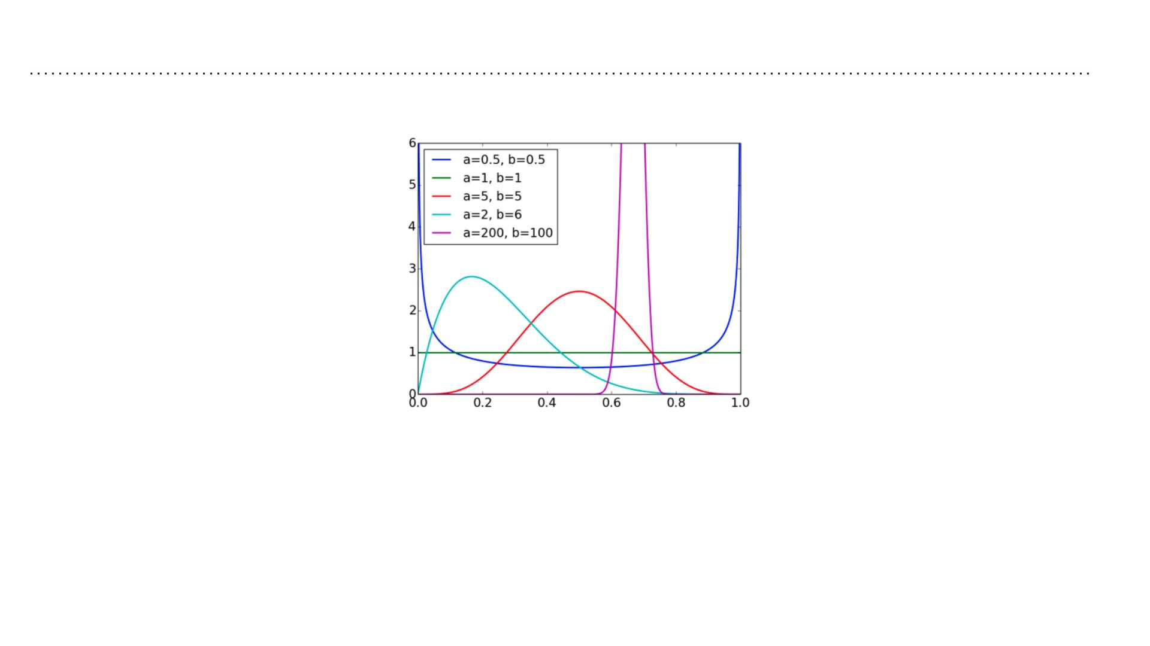
Bayesian Parameter Estimation
• Beta distribution for various values of ꢅ, ꢆ:
• Some observations:
➢The expectation ꢇ[ꢁ] = ꢅ/(ꢅ + ꢆ)(easy to derive).
➢The distribution gets more peaked when ꢅand ꢆare large.
➢The uniform distribution is the special case where ꢅ = ꢆ = 1.
• The beta distribution is used for is as a prior for the Bernoulli distribution.

Slide 30
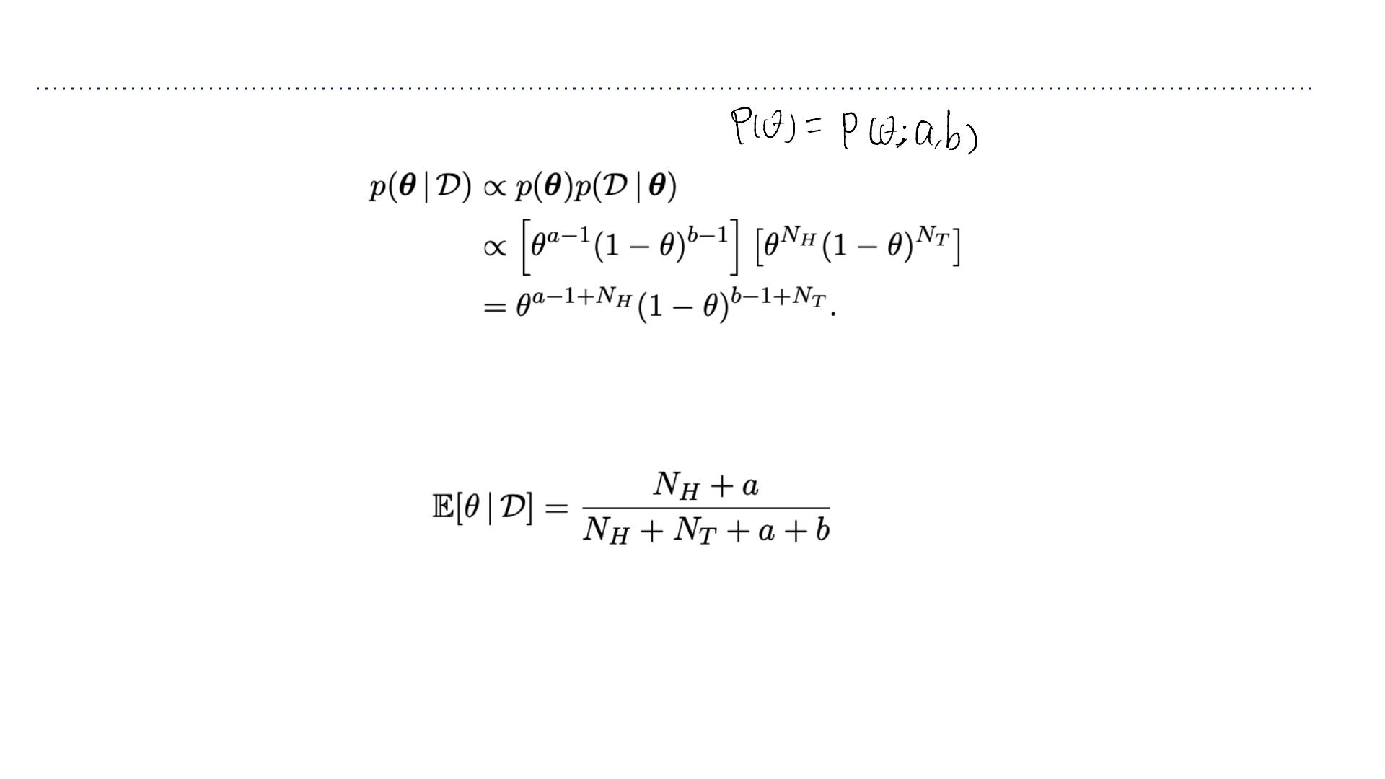
Bayesian Parameter Estimation
• Computing the posterior distribution:
• This is just a beta distribution with parameters ꢈ +ꢅand ꢈ +ꢆ.
ꢉ
ꢊ
• The posterior expectation of ꢁis:
• The parameters ꢅand ꢆof the prior can be thought of as pseudo-counts.
➢The reason this works is that the prior and likelihood have the same functional
form. This phenomenon is known as conjugacy (conjugate priors), and it’s very
useful.

Slide 31
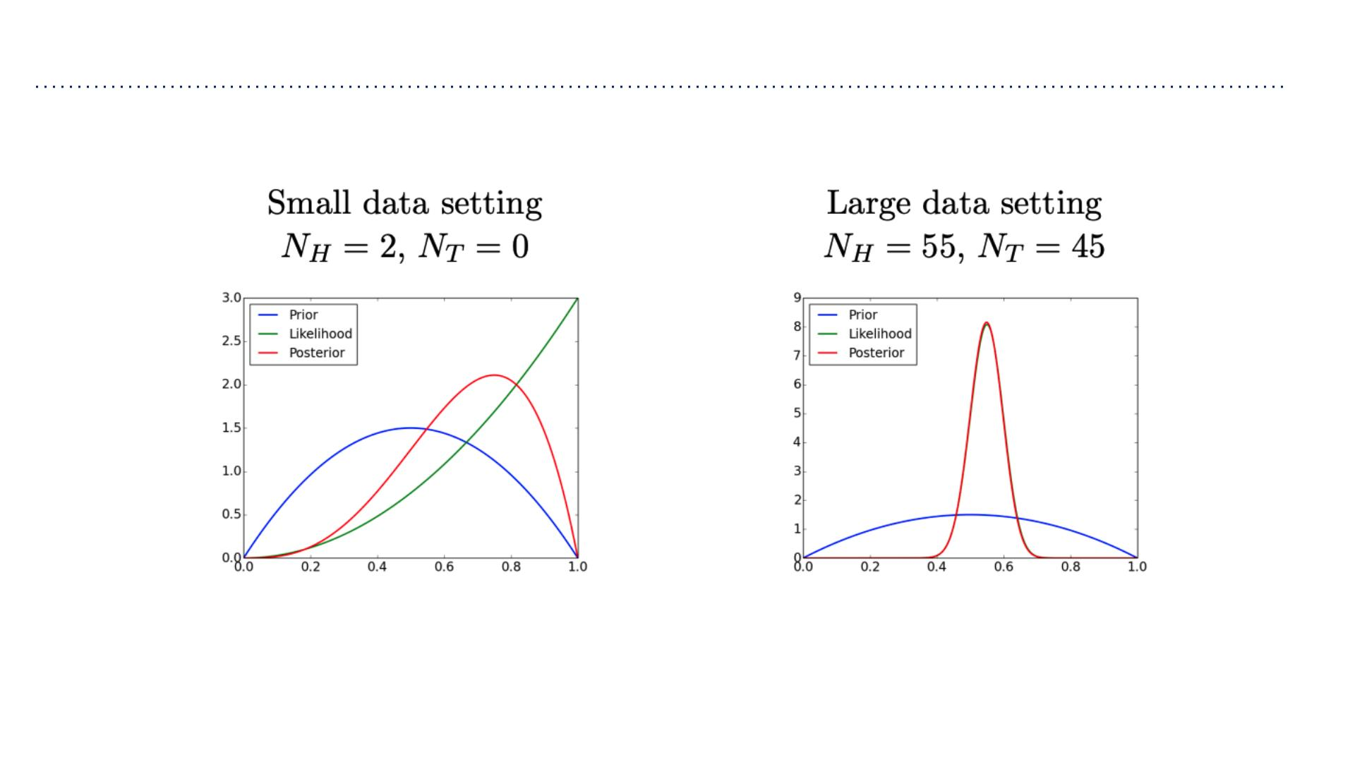
Bayesian Parameter Estimation
Bayesian inference for the coin flip example:
When you have enough observations, the data overwhelm the prior.

Slide 32
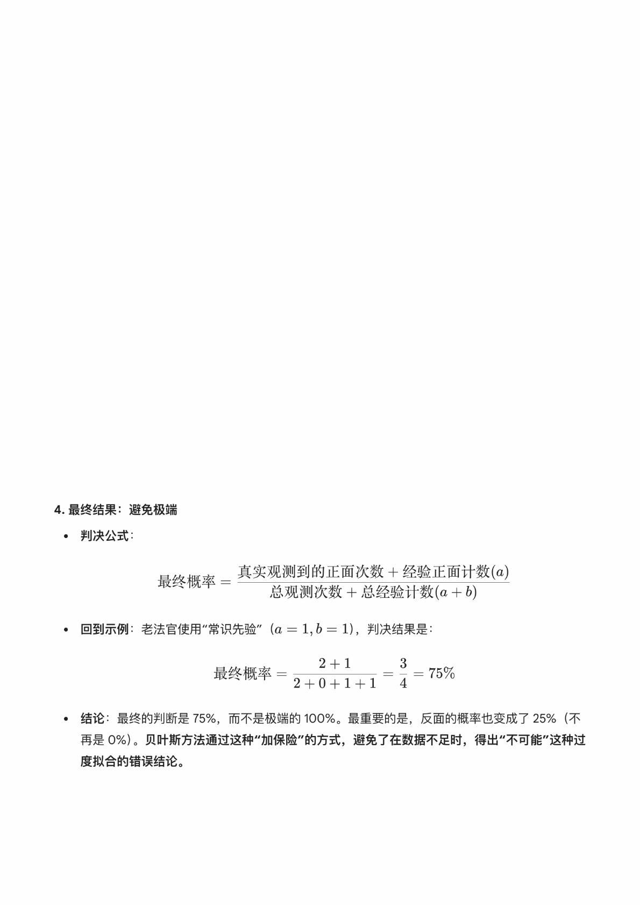
如何避免在数据太少时，做出极端的错误判断。
1. 问题的根源：“菜⻦法官” (MLE)
传统做法 (MLE)：我们之前学到的最⼤似然估计，可以看作是⼀个“菜⻦法官”。他只相信眼前看到的证据。
示例：你只抛了两次硬币，两次都是正⾯（2个正⾯，0个反⾯）。
判决：菜⻦法官会宣布：“根据我看到的证据，反⾯出现的概率是 0%！反⾯是不可能存在的！”
后果 (数据稀疏性)：这种极端的 0% 判决就是过度拟合，它把⼀个⼩概率事件当作了不可能事件，如果下次真
的出现反⾯，整个模型的判断就会崩溃。
2. ⻉叶斯⽅法的解决之道：“经验法官”
⻉叶斯⽅法：可以看作是⼀个“经验丰富的⽼法官”。他相信证据，但他更相信他多年积累的“经验”（或称作“常
识”）。
⽼法官的逻辑：他知道世界上⼏乎不存在完美的硬币，所以即使你只给他 2 个正⾯，他也不会⽴即宣布反⾯概
率为 0。
3. 核⼼机制：添加“经验保险”
经验 (Prior)：在⻉叶斯⽅法中，这种“经验”被称为先验分布。通过使⽤Beta 分布作为先验，我们可以轻松地将
“经验”转化为数据。
伪计数 (Pseudo-Counts)：这种经验被量化为“伪计数”（⽐如 a 和 b）。你可以把它视为⼀个保险策略。
策略：在看你的真实数据之前，我先在账本上偷偷记上“我预计会有 a 次正⾯，和 b 次反⾯”。
⽼法官的最终判决：他会将你的真实观测数据 (N_H, N_T) 和他的经验伪计数 (a, b) 加在⼀起，然后做出最终判
决。

Slide 33
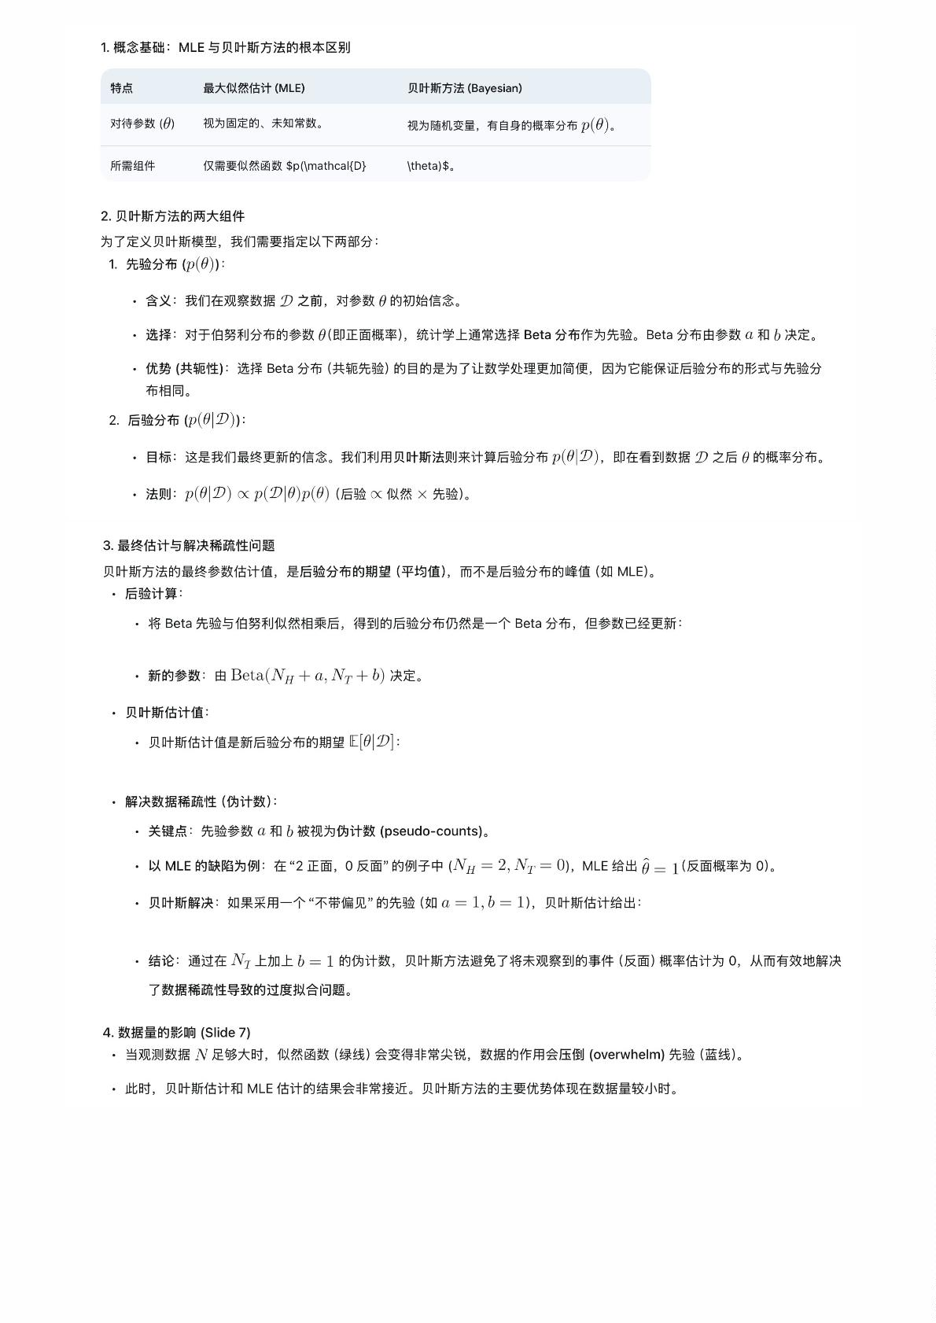

Slide 34
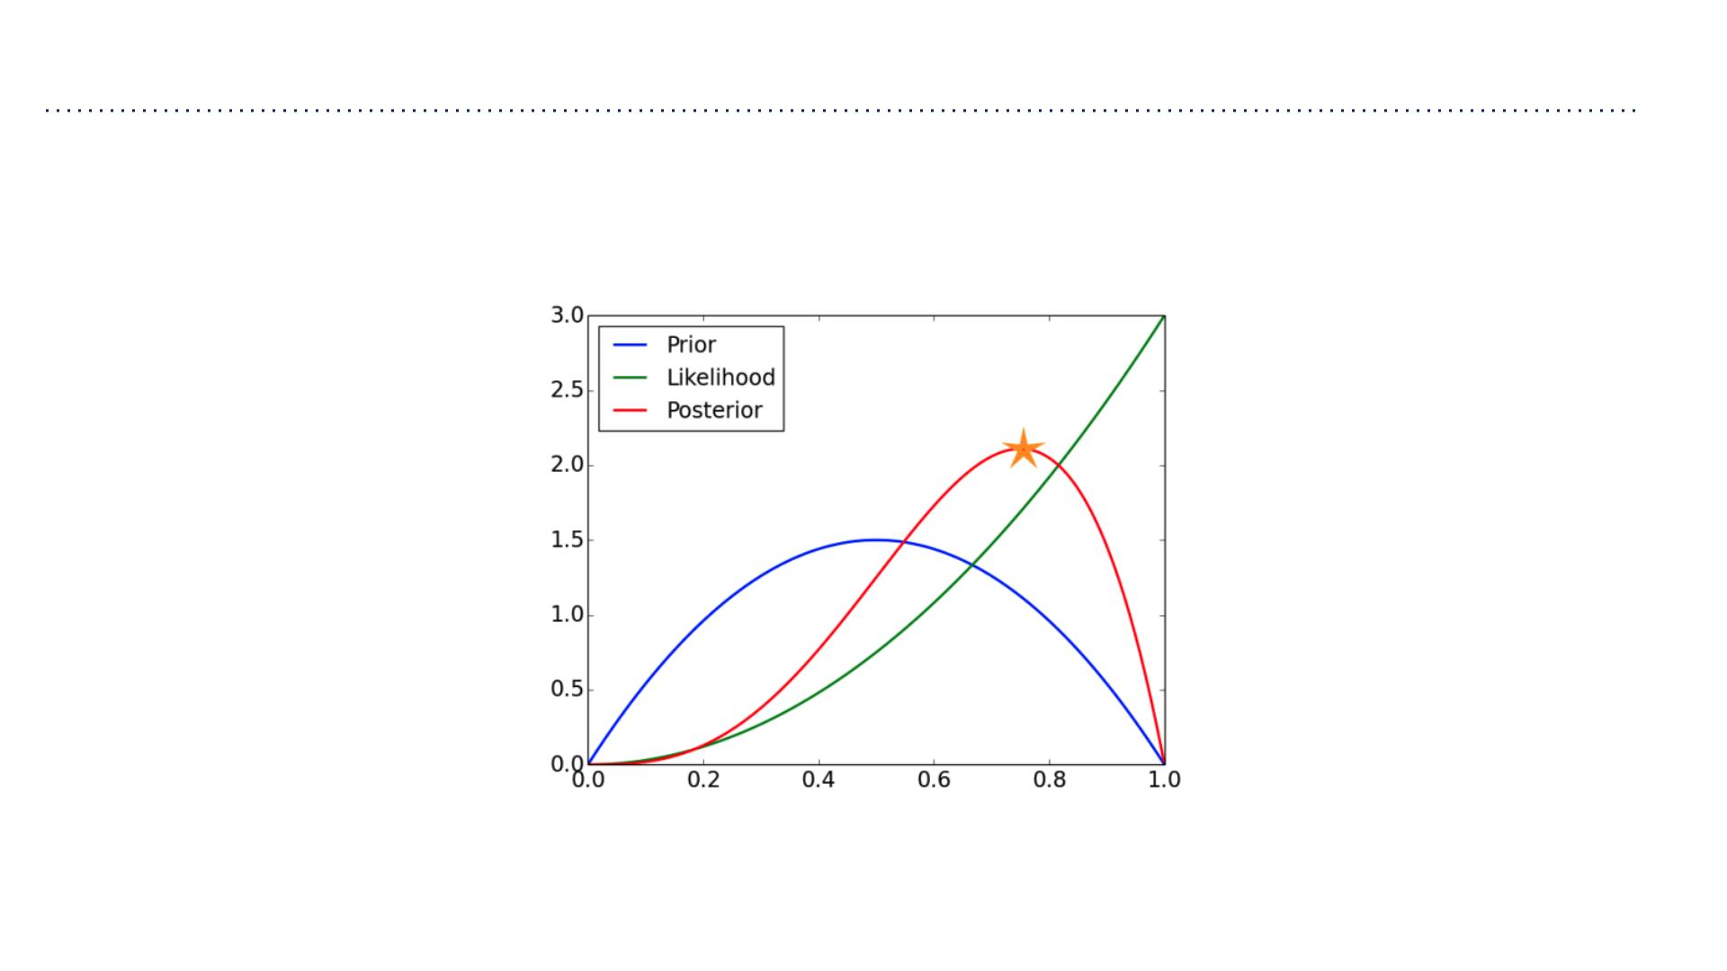
Maximum A-Posteriori Estimation
Maximum a-posteriori (MAP) estimation: find the most likely parameter settings under
the posterior

Slide 35
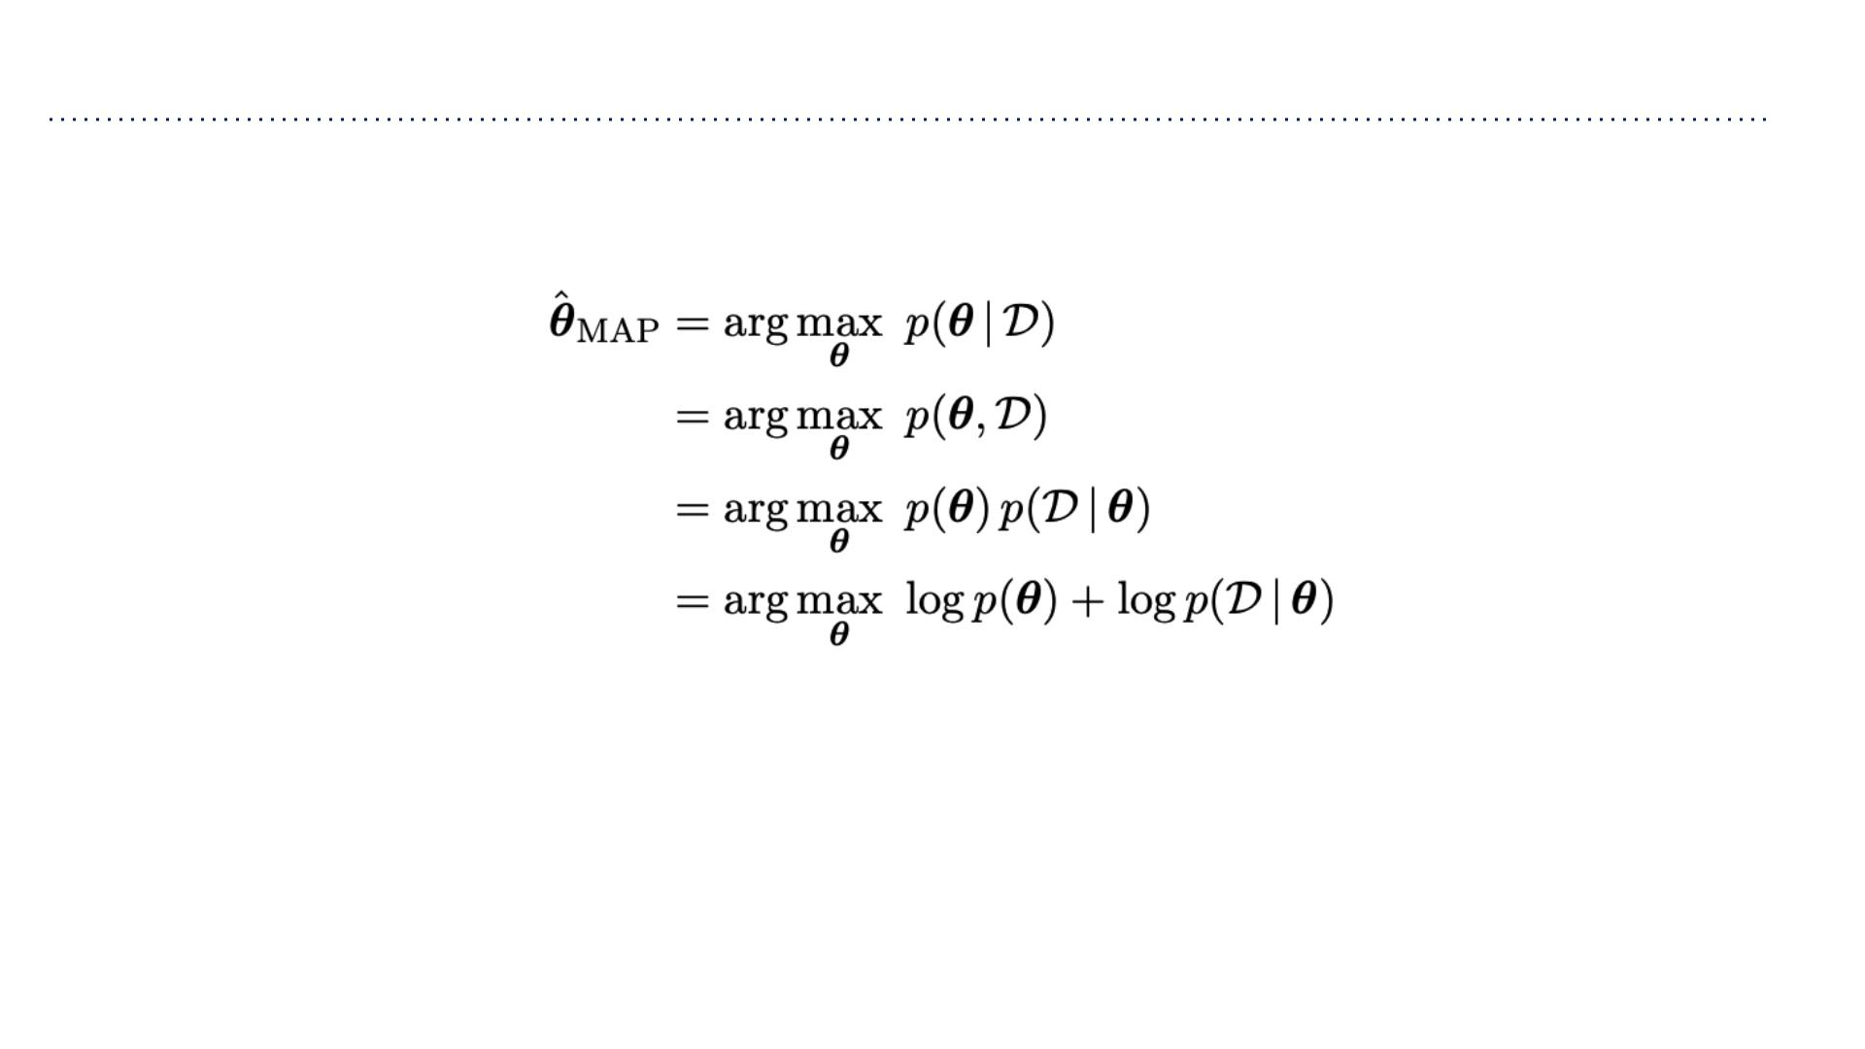
Maximum A-Posteriori Estimation
• This converts the Bayesian parameter estimation problem into a maximization problem

Slide 36
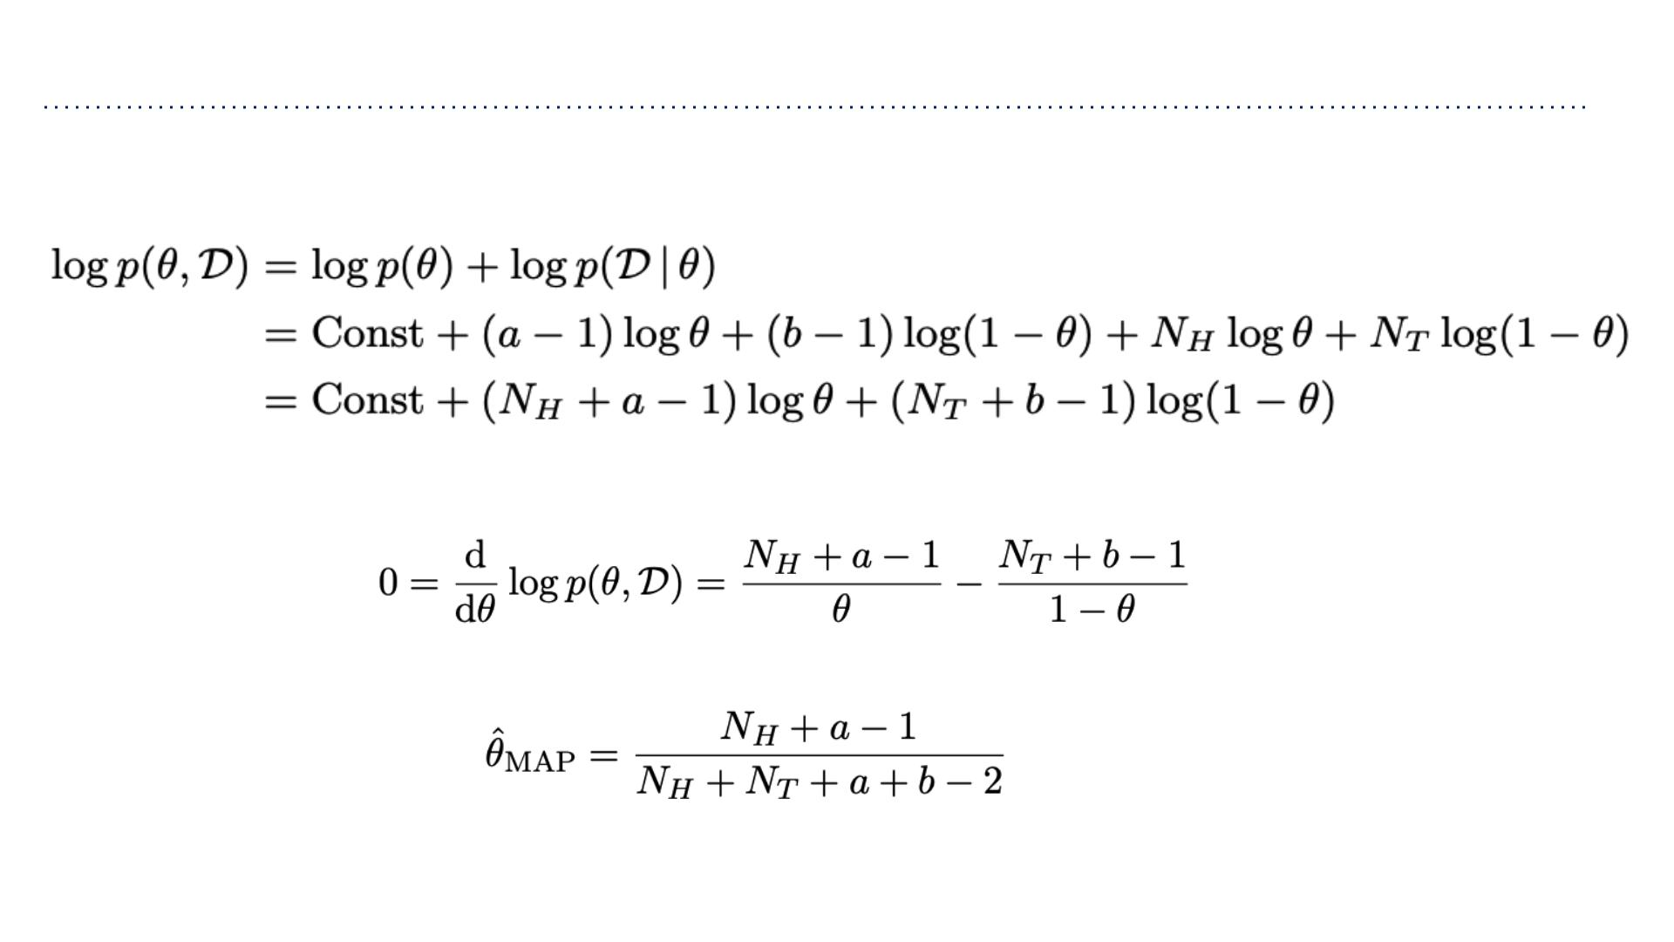
Maximum A-Posteriori Estimation
• Joint probability in the coin flip example:
• Maximize by finding a critical point
• Solving for ꢀ,

Slide 37
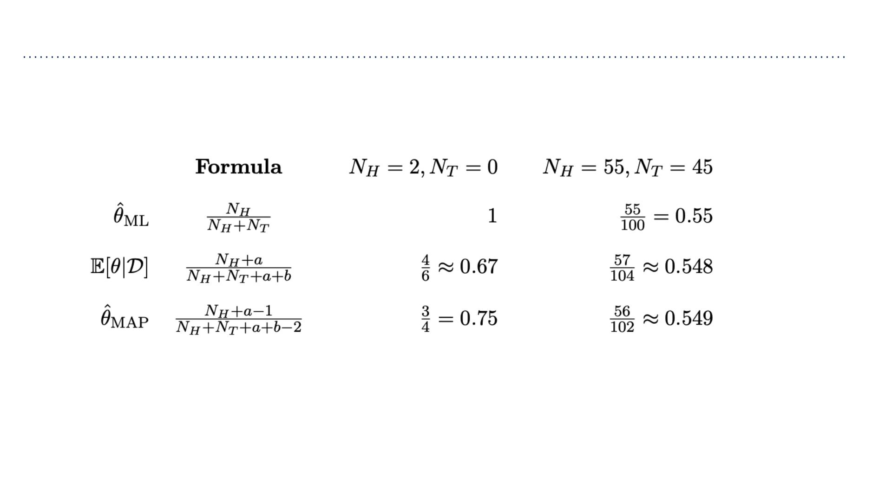
Maximum A-Posteriori Estimation
Comparison of estimates in the coin flip example:
෠
ꢀ assigns nonzero probabilities as long as ꢁ,ꢂ > 1.
MAP

Slide 38
