Slide 1




INT201 Decision, Computation and Language
Lecture 2 – Deterministic Finite Automata Dr Yushi Li

Slide 2
Controlling a toll gate
When a car arrives at the toll gate, the gate is closed. The gate opens as soon as the driver has payed 25 cents. We assume that we have only three coin denominations: 5, 10, and 25 cents. Notably, no excess change is returned.
After having arrived at the toll gate, the driver inserts a sequence of coins into the machine. At any moment, the computer has to decide whether or not to open the gate, i.e., whether or not the driver has paid 25 cents (or more).

Slide 3
Controlling a toll gate
The machine is in state q₀, if it has not collected any money yet.
The machine is in state q₁, if it has collected exactly 5 cents.
The machine is in state q₂, if it has collected exactly 10 cents.
The machine is in state q₃, if it has collected exactly 15 cents.
The machine is in state q₄, if it has collected exactly 20 cents.
The machine is in state q₅, if it has collected 25 cents or more.

Slide 4



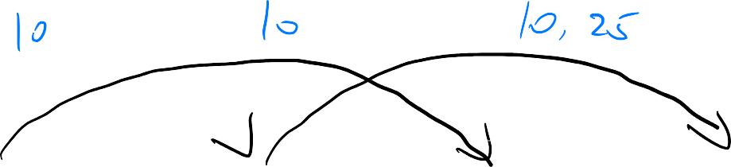
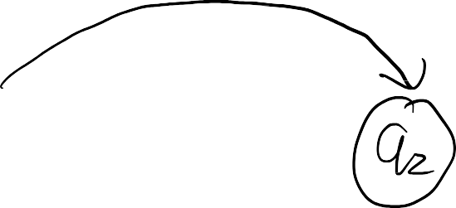







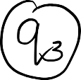



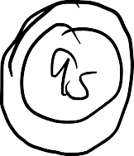





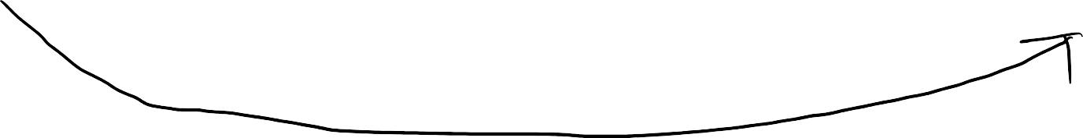


Controlling a toll gate
Question.
Can we draw a figure to represent the behavior of the computer for all possible sequences of coins?

Slide 5
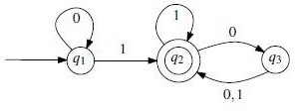



Deterministic Finite Automata (DFA)
Example
We have a machine state diagram as below:
q₁ is the start state and q₂ is an accept state.
Question.
Can the input string 0101010 be accepted by this machine? Which kind of strings can be accepted by this machine?

Slide 6













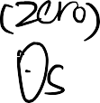









Deterministic Finite Automata (DFA)
Example

Slide 7
Deterministic Finite Automata (DFA)
DFA is a finite-state machine that accepts or rejects a given string of symbols, by running through a state sequence uniquely determined by the string.
It is invented to recognize a special class of formal language and have many practical applications:
Lexical analysis – scans the input program from beginning to end and divides it into tokens like identifiers, constants, and keywords and to remove comments and white space (specify tokens of programming languages).
Model checking, reasoning about systems with objective of proving they satisfy useful properties.
Statistical models for analyzing biological and textual sequences.

Slide 8

Deterministic Finite Automata (DFA)
We shall see that DFA can be used to describe
Any finite set of strings
Various infinite sets of strings, e.g.
strings having exactly 2 occurrences of the letter a
strings having more than 6 letters
strings in which letter b never comes before letter a

Slide 9
Deterministic Finite Automata (DFA)
DFA cannot be used to describe certain languages such as:
the set of strings containing more a’s than b’s
all words that remain the same if you read them back to front
well-formed arithmetic expressions, if there is no limit on nesting of parentheses.

Slide 10



Deterministic Finite Automata (DFA)
A DFA is defined as a 5-tuple:
M = (Q, Σ, δ, q, F)
Where
Q is a finite set of states,
Σ is a finite set of symbols, called the alphabet of the automaton,
δ : Q × Σ → Q is a function, called the transition function,
q ∈ Q is called the initial state,
F ⊆ Q is a set of accepting/terminal states.

Slide 11
Deterministic Finite Automata (DFA)
State of a machine tells you something about the prefix that has been read so far. If the string is a member of the language of interest, the state reached when the whole string has been scanned will be an accepting state (a member of F).
Transition function δ tells you how state should change when an additional
letter is read by the DFA.

Slide 12
Deterministic Finite Automata (DFA)
Example of transition function
Initially the state is i and if the input word is w = a₁ a_{2….} a_{n} then, as each letter
is read, the state changes and we get q_{1,} q_{2…} q_{n} defined by:
𝑞₁ = 𝛿 𝑖, 𝑎₁
𝑞₂ = 𝛿 𝑞₁, 𝑎₂
𝑞₃ = 𝛿 𝑞₂, 𝑎₃
⋮
𝑞_{𝑛} = 𝛿 𝑞_{𝑛−1}, 𝑎_{𝑛}

Slide 13


Deterministic Finite Automata (DFA)
We can extend the definition of the transition function δ so that it tells us which state we reach after a word (not just a single letter) has been scanned:
In the above notation, extend the map δ : Q × Σ → Q to δ* : Q × Σ* → Q by
defining:
δ*(q, ϵ) = q for all q ∈ Q
δ* (q, w𝑎) = δ (δ* (q, w) , 𝑎) for all q ∈ Q; w ∈ Σ* ; a ∈ Σ

Slide 14

Deterministic Finite Automata (DFA)
Example
δ (q₀, 𝑎) = q₁ and δ (q₁, b) = q₂
Then
δ* (q₀, 𝑎b) = q₂
Proof Steps:
δ* (q₀, 𝑎b) = δ (δ* (q₀, 𝑎) , 𝑏)
δ* (q₀, 𝑎b) = δ (q₁, b) = q₂
δ* (q₀, 𝑎) = δ (q₀, 𝑎) = q₁

Slide 15

Deterministic Finite Automata (DFA)
A DFA M = (Q, Σ, δ, q, F) is often depicted as a directed graph G_{M} (called
transition graph) has exactly |Q| vertices, each one labeled with a different q_{i}
∈ Q. For each transition function δ(q_{i} ,a) = q_{j}, the graph has edges (q_{i ,} q_{j}) labeled (a), (b), and (a, b), . The vertex associated with q₁ is called the initial vertex, while those labeled with q_{f} are the final vertices.

Slide 16
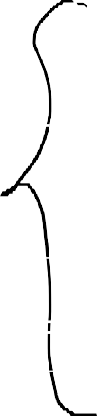




















Deterministic Finite Automata (DFA)
Let M = (Q, Σ, δ, q, F) be a finite automaton and let w = w₀ w₁ . . . w_{n} be a string over .
Define the sequence q₀ , q₁ , . . . , q_{n} of states, in the following way:
q₀ = q,
q_{i+1} = δ(q_{i}, w_{i+1}), for i = 0, 1, . . . , n − 1.
If q_{n} ∈ F, then we say that M accepts w.
If q_{n} ∉ F, then we say that M rejects w.

Slide 17





Deterministic Finite Automata (DFA)
Symbolic description of the example DFA
r
0, 1
0
i
1
t
0, 1

Slide 18
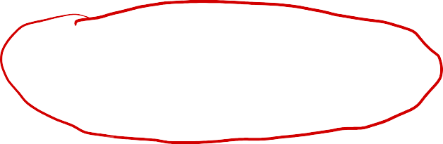
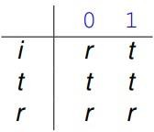
Deterministic Finite Automata (DFA)
Symbolic description of the example DFA
Automaton M = (Q, Σ, δ, q, F)
Set of states Q = {i, t, r}, Σ = {0, 1}, F = {t} and the transition function δ is given
by
δ(i, 0) = r
δ(t, 0) = t
δ(r, 0) = r
δ(i, 1) = t
δ(i, 1) = t
δ(r, 1) = r
It is simpler to describe a transition function by a table of values. In this example we have:

Slide 19
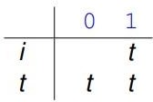
Deterministic Finite Automata (DFA)
Symbolic description of the example DFA
If δ is a partial function (not defined for some state/letter pairs), then the DFA
rejects an input if it ever encounters such a pair.
This convention often simplifies the definition of a DFA. In the previous example we could use transition table

Slide 20

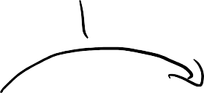


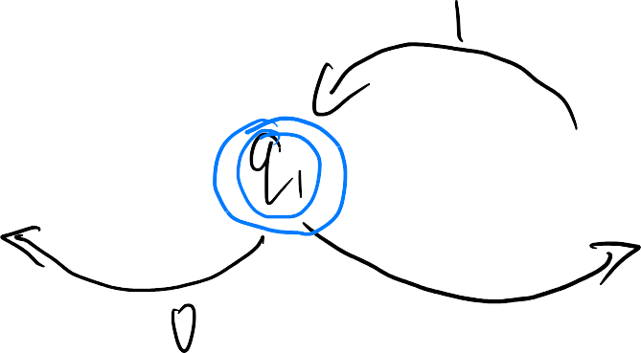




Deterministic Finite Automata (DFA)
Exercise
DFA M =({q_{0,} q_{1,} q₂ }, {0, 1}, δ, q₀, {q₁}), where δ is given as:
δ(q₀ , 0) = q₀
δ(q₁ , 0) = q₀
δ(q₂ , 0) = q₂
δ(q₀ , 1) = q₁
δ(q₁ , 1) = q₂
δ(q₂ , 1) = q₁
Can the input word 110100 be accepted/recognized by this M ?

Slide 21






Deterministic Finite Automata (DFA)
Exercise
How about the following infinite language. Can you give a DFA that accepts the words:
bad, baad, baaad, baaaad, ...?

Slide 22




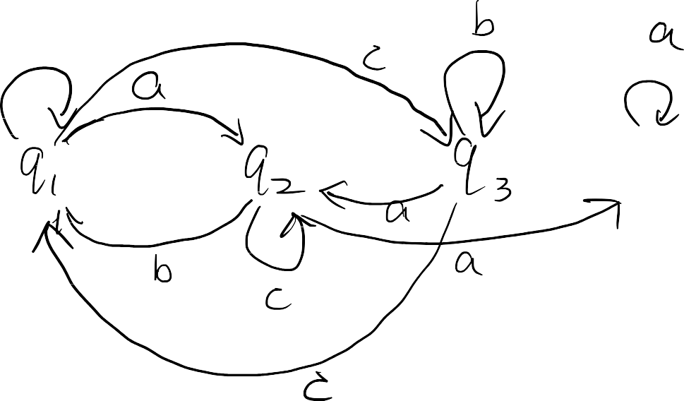

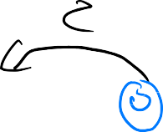



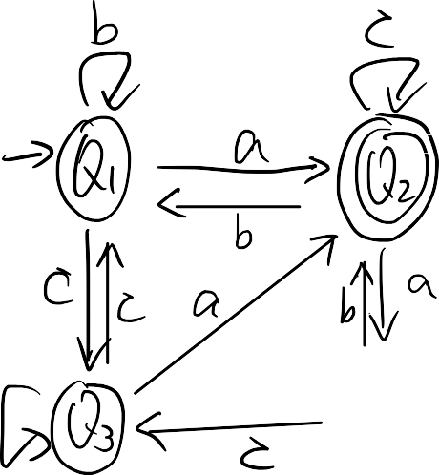

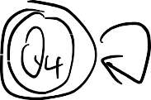

Deterministic Finite Automata (DFA)
Exercise
Given the symbolic description of a DFA, can you draw its corresponding diagram?
δ | a | b | c
𝑄₁ | 𝑄₂ | 𝑄₁ | 𝑄₃
𝑄₂ | 𝑄₄ | 𝑄₁ | 𝑄₂
𝑄₃ | 𝑄₂ | 𝑄₃ | 𝑄₁
𝑄₄ | 𝑄₄ | 𝑄₂ | 𝑄₃

Slide 23














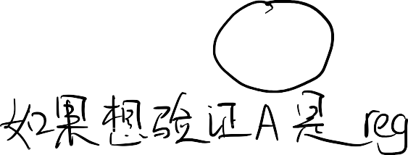






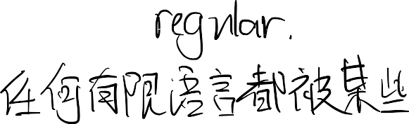




Deterministic Finite Automata (DFA)
Language defined by DFA
Suppose we have a DFA M. A word w ∈ Σ* is said to be accepted or recognized by M if δ*(q₀, w) ∈ F, otherwise it is said to be rejected. The set of all words accepted by M is called the language accepted by M and will be denoted by L(M). Thus
L(M) = {w ∈ Σ* : δ*(q₀, w) ∈ F}
Any finite language is accepted by some DFA
A language A is called regular, if there exists a finite automaton M such that A = L(M)

Slide 24








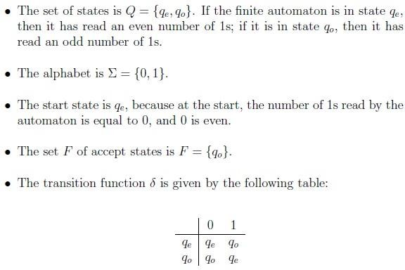


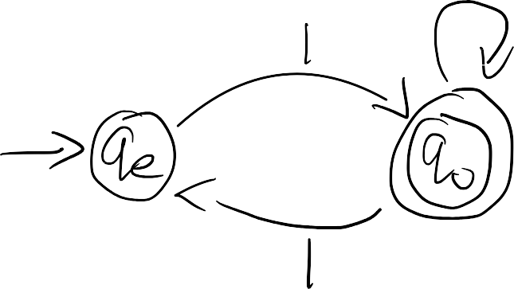
Deterministic Finite Automata (DFA)
Example

Slide 25













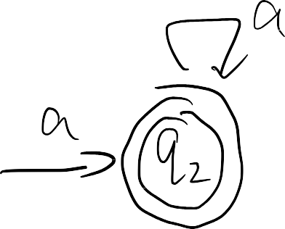




Deterministic Finite Automata (DFA)
Exercise
Show that the language L is regular:
L = {awa: w ∈ {a,b}* }
Can you design a DFA that accepts this language?

Slide 26
Deterministic Finite Automata (DFA)
Regular operations on languages
Let A and B be two languages over the same alphabet. The union of A and B is defined as:
A ∪ B = {w : w ∈ A or w ∈ B} The concatenation of A and B is defined as:
AB = {ww′ : w ∈ A and w′ ∈ B}
The star of A is defined as:
A* = {u₁ u₂ . . . u_{k} : k ≥ 0 and u_{i} ∈ A for all i = 1, 2, . . . , k}

Slide 27
Deterministic Finite Automata (DFA)
Example of A*
Given two languages A = {0, 01} and B = {1, 10}. Then
A ∪ B = {0, 01, 1, 10}
AB = {01, 010, 011, 0110}
A* = {ϵ, 0, 01, 00, 001, 010, 0101, 000, 0001, 00101, . . .}

Slide 28
Deterministic Finite Automata (DFA)
Theorem
The set of regular languages is closed under the union operation, i.e., if A and B are regular languages over the same alphabet Σ, then A ∪ B is also a regular language.

