Slide 1




INT201 Decision, Computation and Language
Lecture 3 – Nondeterministic Finite Automata Dr Yushi Li

Slide 2
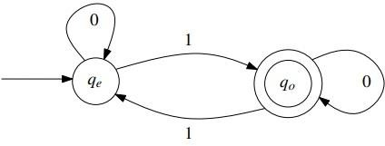



Nondeterministic Finite Automata (NFA)
A finite automata is deterministic, if the next state the machine goes to on any
given symbol is uniquely determined.
DFA has exactly one transition leaving each state for each symbol.

Slide 3


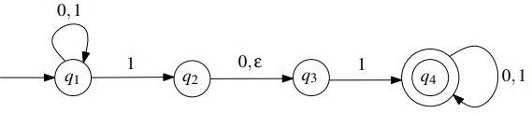


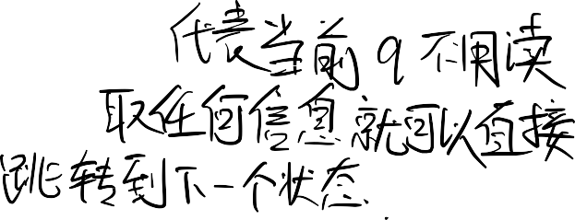


Nondeterministic Finite Automata (NFA)
A finite automata is nondeterministic, if the machine allows for several or no choices to exist for the next state on a given symbol.
For a state q and symbol s ∈ Σ, NFA can have:
Multiple edges leaving q labelled with the same symbol s;
No edge leaving q labelled with symbol s;
Edge leaving q labelled with ϵ (without reading any symbol).

Slide 4






Nondeterministic Finite Automata (NFA)
This NFA is in a state with multiple ways to proceed, e.g. state q₁ has two transition paths with 1.
The machine splits into multiple copies of itself (threads):
每个副本都独⽴于其他副本进⾏计算。
Each copy proceeds with computation independently of others.
NFA may be in a set of states, instead of a single state.
NFA follows all possible computation paths in parallel.
If a copy is in a state and next input symbol doesn’t appear on any outgoing
edge from the state, then the copy dies or crashes.

Slide 5









Nondeterministic Finite Automata (NFA)
The NFA accepts the input string, if any copy ends in an accept state after reading the entire string.
The NFA rejects the input string, if no copy ends in an accept state after reading
the entire string.

Slide 6
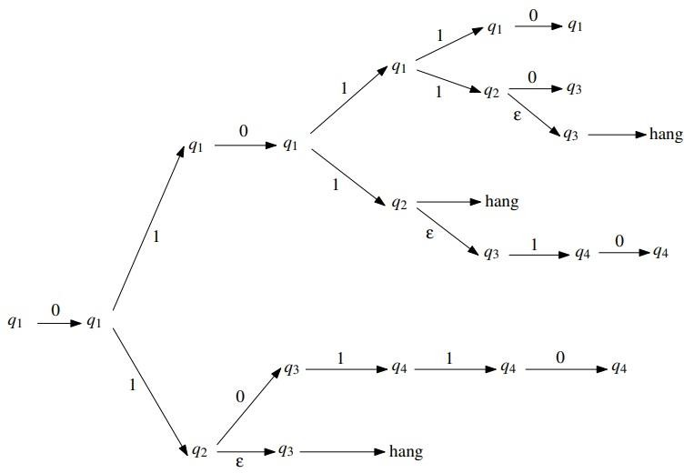

Nondeterministic Finite Automata (NFA)
What can this automaton do when it gets the string 010110 as input?

Slide 7
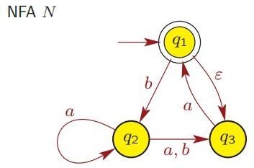































Nondeterministic Finite Automata (NFA)
Example

Slide 8
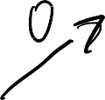






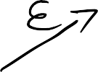






Nondeterministic Finite Automata (NFA)
Question
How about 010?

Slide 9


Formal Definition of NFA
For any alphabet Σ, we define Σ_{ϵ} to be the set:
Σ_{ϵ} = Σ ∪ {ϵ}
Recall the notion of a power set: For any set Q, the power set of Q, denoted by
P(Q), is the set of all subsets of Q:
P(Q) = {R : R ⊆ Q}
A nondeterministic finite automaton (NFA) is a 5-tuple M = (Q, Σ, δ, q, F), where
Q is a finite set of states,
Σ is a finite set of symbols, called the alphabet of the automaton,
δ : Q × Σ_{ϵ} → P(Q) is a function, called the transition function,
q ∈ Q is called the initial/start state,
F ⊆ Q is a set of accepting/terminal states.

Slide 10
Formal Definition of NFA
Example
Formal description of above NFA M = (Q, Σ, δ, q, F)
1. Q = {q_{1,} q_{2,} q_{3,} q₄}
2. Σ = {0, 1}
3. δ : Q × Σ_{ϵ} → P(Q)
q₁ is the start state
F = {q₄} is a set of accepting states.

Slide 11
Formal Definition of NFA
Let M = (Q, Σ, δ, q, F) be an NFA, and let w ∈ Σ∗ . We say that M accepts w, if w can be written as w = y₁ y₂… y_{m} where y_{i} ∈ Σ_{ϵ} for all i with 1 ≤ i ≤ m, and there exists a sequence of states r₁ , r₂ ,… , r_{m} in Q, such that:
r₀ = q
r_{i+1} ∈ δ(r_{i} , y_{i+1}), for i = 0, 1, . . . , m − 1
r_{m} ∈ F
Otherwise, we say that M rejects the string w.

Slide 12





Difference between DFA and NFA
DFA has transition function δ : Q × Σ → Q
NFA has transition function δ : Q × Σ_{ϵ} → P(Q)
Returns a set of states rather than a single state.
Allows for ϵ-transition because Σ_{ϵ} = Σ ∪ {ϵ}.
Note that every DFA is also an NFA.

Slide 13
Formal Definition of NFA
Extend the map δ to a map Q × Σ* → P(Q) by defining:
δ(q, ϵ) = {q} for all q ∈ Q
δ(q, 𝑤𝑎) = ∪_{p∈δ(q, w)} δ(p, 𝑎) for all q ∈ Q; w ∈ Σ*; a ∈ Σ
Thus δ(q, w) is the set of all possible states that can arise when the input w is received in the state q. w is accepted provided that δ(q, w) contains an accepting state.

Slide 14







Suppose, in a DFA, we can get from state p to state q via transitions labelled by letters of a word w. Then we say that the states p and q are connected by a path with label w.
Notation: accepting/rejecting paths
If w = abc and the 2 intermediate states are r₁ and r₂ we could write this as:
𝑎 𝑏 𝑐
𝑝 ՜ r₁ ՜ r₂ ՜ q
In a NFA, if δ(p, 𝑎) = {q, r } we could write:
𝑎
𝑝 ՜ {𝑞, 𝑟}
and this would be an accepting path if any state on the RHS is an accepting state, otherwise it would be rejecting path.

Slide 15











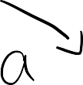













Nondeterministic Finite Automata (NFA)
Exercise
b
b
a
a
s
p
i
q
t
a
Can input string abaa be accepted by this NFA?
Possible paths of this string?
The accepting path of this string?

Slide 16
Language accepted by NFA
Let M = (Q, Σ, δ, q, F) be an NFA. The language L(M) accepted by M is defined as
L(M) = {w ∈ Σ∗ : M accepts w }.
Example
Let A be the language A = {w ∈ {0, 1}∗ : w has a 1 in the third position from the right} , design M : L(M).

Slide 17







































Equivalence of DFAs and NFAs)
Two machines (of any type) are equivalent if they recognize the same language.
DFA is a restricted form of NFA:
Every NFA has an equivalent DFA.
We can convert an arbitrary NFA to a DFA that accepts the same language.
DFA has the same power as NFA

Slide 18




DFA to NFA
The formal conversion of a DFA to an NFA is done as follows: Let M = (Q, Σ, δ, q, F) be a DFA. Recall that δ is a function δ : Q × Σ → Q. We define the function δ′ : Q × Σ_{ϵ}
→ P(Q) as follows. For any r ∈ Q and for any a ∈ Σ_{ϵ} ,
_{δ}′
δ 𝑟, 𝑎
= ቊ
𝑖𝑓 𝑎 ≠ ϵ
∅ 𝑖𝑓 𝑎 = ϵ
𝑟, 𝑎
Then N = (Q, Σ, δ′, q, F) is an NFA, whose behavior is exactly the same as that of the DFA M; the easiest way to see this is by observing that the state diagrams of M and N are equal. Therefore, we have L(M) = L(N).

Slide 19
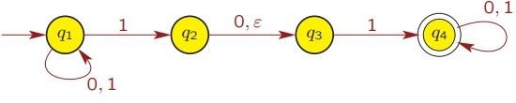
NFA to DFA
Example
Convert NFA into equivalent DFA

Slide 20
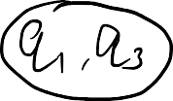

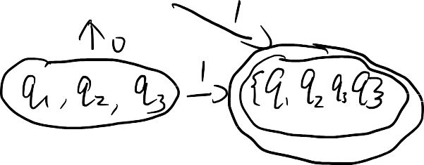



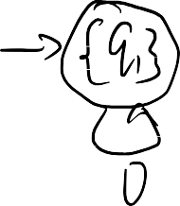


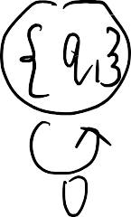
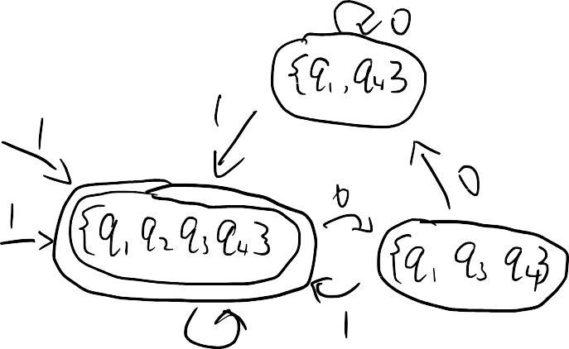

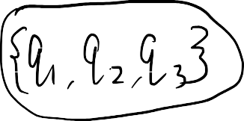

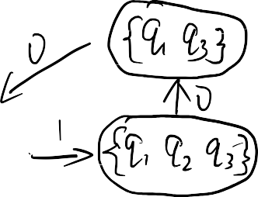
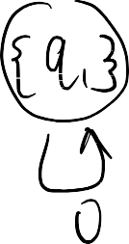

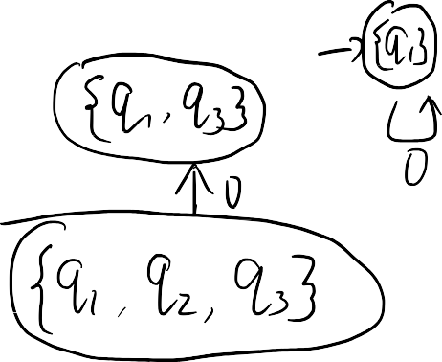
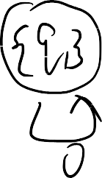



NFA to DFA
Conversion step

Slide 21
















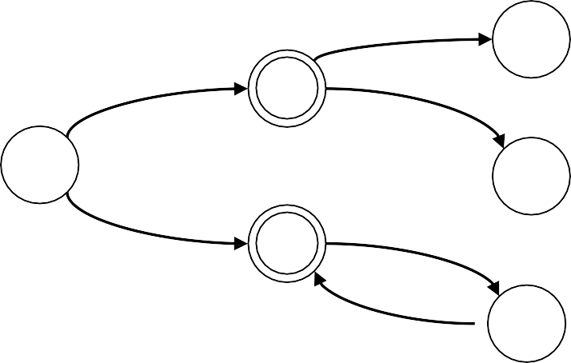




NFA to DFA
The ε-closure of a set of states R ⊆ Q :
E(R) = { q | q can be reached from R by travelling over zero or more ε transitions }.
Example
E({q_{1,} q₂}) = {q_{1,} q_{2,} q₃}.
Question
ε
ε
q₄
q₂
a
q
1
q₅
q₃
a
ε
q₆
a
E(q₂) = ?
E(q₁) = ?

Slide 22
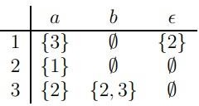
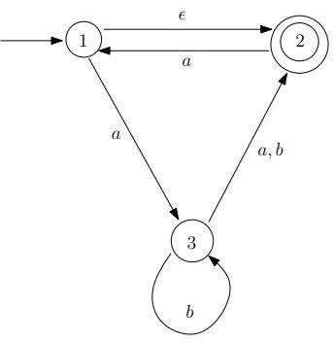
NFA to DFA
Example
Consider the NFA M = (Q, Σ, δ, q, F), where Q = {1, 2, 3}, Σ = {a, b}, q = 1, F =
{2}, and δ is given by the following table:

Slide 23












































NFA to DFA
Example
How can we convert the above NFA to a DFA?

Slide 24
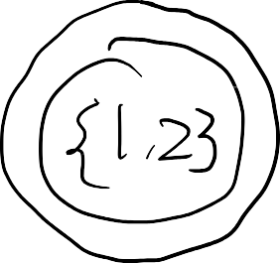

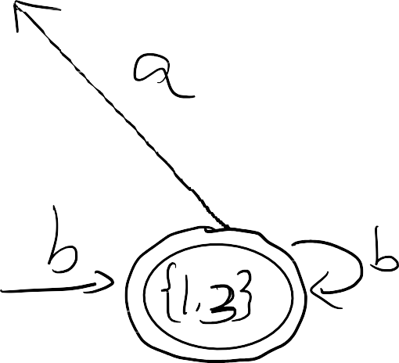
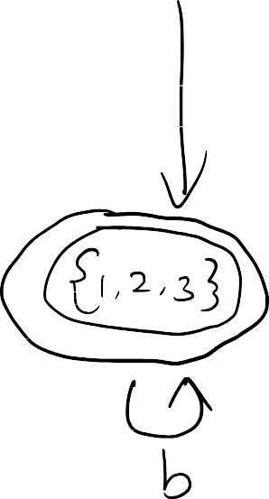

NFA to DFA
Example
How can we convert the above NFA to a DFA?

