Slide 1


INT201 Decision, Computation and Language
Lecture 4 – Regular Language Dr Yushi Li

Slide 2
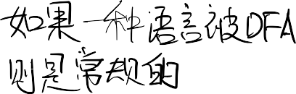

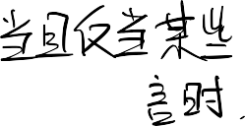
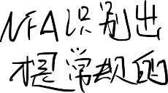















Definition
Previous: A language is regular if it is recognized by some DFA
Now: A language is regular if and only if some NFA recognizes it. Some operations on languages: Union, Concatenation and Kleene star
Closed under operation
A collection S of objects is closed under operation f if applying f to members of S
always returns an object still in S.
Regular languages are indeed closed under the regular operations (e.g. union,
concatenation, star …)

Slide 3












Regular Languages Closed Under Union
The set of regular languages is closed under the union operation.
i.e. A and B are regular languages over the same alphabet Σ, then A∪B is also a regular language.
Proof:
Since A and B are regular languages, there are finite automata M₁ = (Q₁, Σ, δ₁, q₁, F₁) and M₂ = (Q₂, Σ, δ₂, q₂, F₂) that accept A and B, respectively.
In order to prove that A ∪ B is regular, we have to construct a finite automaton M that accepts A ∪ B. In other words, M must have the property that for every string w ∈ Σ*:

Slide 4













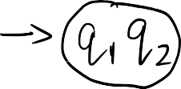

Regular Languages Closed Under Union
Proof
Given M₁ and M₂ that A = L(M₁) and B = L(M₂), we can define M = (Q, Σ, δ, q, F):
Q = Q₁ × Q₂ = {(q_{1,} q₂): q₁ ∈ Q₁ and q₂ ∈ Q₂}
Σ is same as the alphabet of A and B
q = (q_{1,} q₂)
F = {(q_{1,} q₂): q₁ ∈ Q₁ or q₂ ∈ Q₂}
δ : Q × Σ → Q
δ((q_{1,} q₂), a) = (δ(q₁, a) , δ(q₂, a)), a ∈ Σ

Slide 5







Regular Languages Closed Under Union
Proof
δ*((q_{1,} q₂), w) = (δ*(q₁, w) , δ*(q₂, w))
δ*((q_{1,} q₂), w) ∈ F ⇔ δ* (q₁, w) ∈ F₁ or δ*(q₂, w) ∈ F₂
M accepts w ⇔ δ* (q₁, w) ∈ F₁ or δ*(q₂, w) ∈ F₂
M accepts w ⇔ M₁ accepts w or M₂ accepts w
Proved

Slide 6





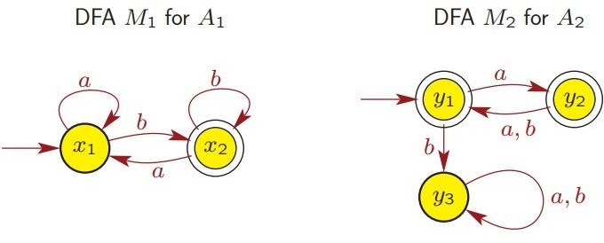
Example
Consider the following DFAs and languages over Σ = {a, b}:
DFA M₁ recognizes A₁ = L(M₁)
DFA M₂ recognizes A₂ = L(M₂)
DFA M for A₁ ∪ A₂?

Slide 7


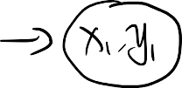



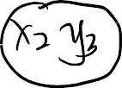


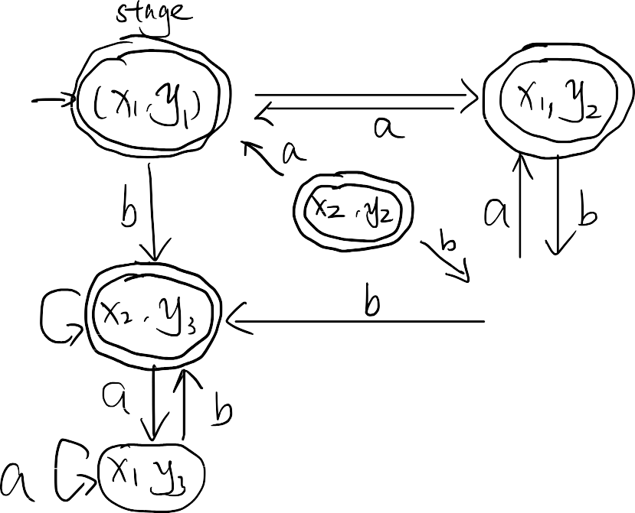
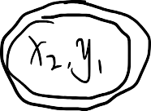
Example

Slide 8
Example

Slide 9


Regular Languages Closed Under Union
How to prove this from the perspective of NFA?
Proof
Consider the following NFAs:
NFA M₁ = (Q₁, Σ, δ₁, q₁, F₁) recognizes A₁ = L(M₁)
NFA M₂ = (Q₂, Σ, δ₂, q₂, F₂) recognizes A₂ = L(M₂)
We will construct an NFA M = (Q, Σ, δ, q, F)

Slide 10


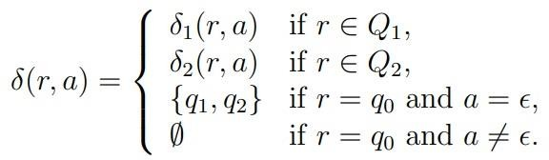

Regular Languages Closed Under Union
Proof
Q = {q₀}∪ Q₁ ∪ Q₂
q₀ is the start state of M
F = F₁ ∪ F₂
δ : Q × Σ_{ϵ} → P(Q) is defined as: For any r ∈ Q and for any a ∈ Σ_{ϵ}

Slide 11




















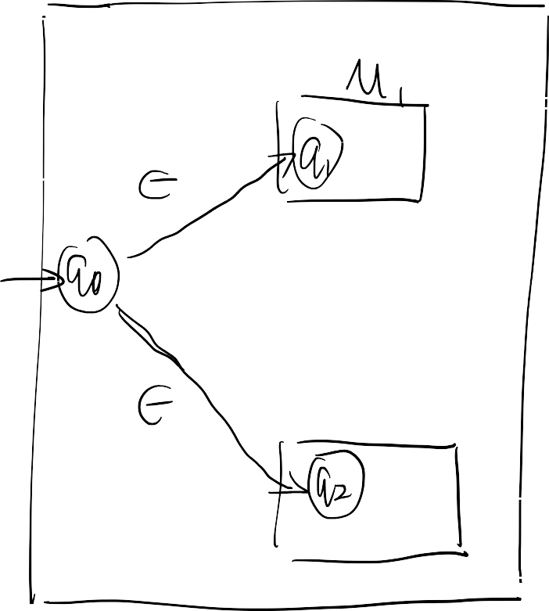


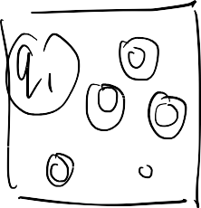


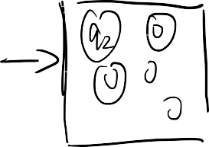

Regular Languages Closed Under Union
Proof

Slide 12


Regular Languages Closed Under Concatenation
The concatenation of A₁ and A₂ is defined as:
A₁ A₂ = {ww′ : w ∈ A₁ and w′ ∈ A₂}
Proof
Consider the following NFAs:
NFA M₁ = (Q₁, Σ, δ₁, q₁, F₁) recognizes A₁ = L(M₁) NFA M₂ = (Q₂, Σ, δ₂, q₂, F₂) recognizes A₂ = L(M₂) We will construct an NFA M = (Q, Σ, δ, q, F) for A₁ A₂

Slide 13


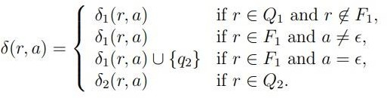
Regular Languages Closed Under Union
Proof
Q = Q₁ ∪ Q₂
M has the same start state as M₁ : q₁
Set of accept states of M is same as M₂ : F₂
δ : Q × Σ_{ϵ} → P(Q) is defined as: For any r ∈ Q and for any a ∈ Σ_{ϵ}

Slide 14

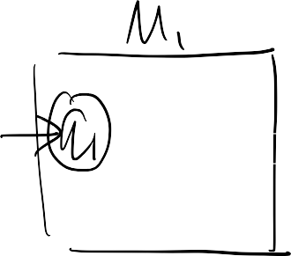
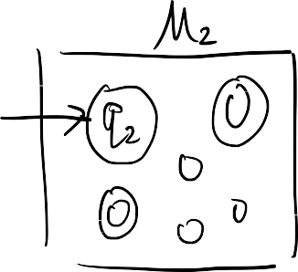


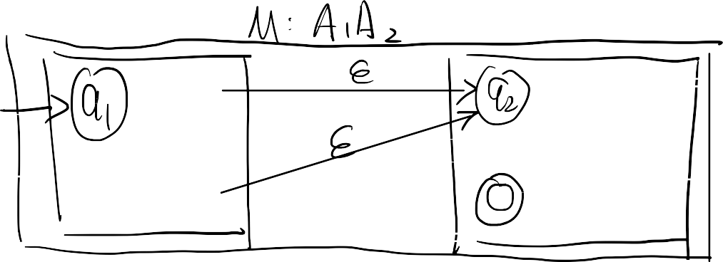















Regular Languages Closed Under Union
Proof

Slide 15

Regular Languages Closed Under Kleene star
The star of A is defined as:
A* = {u₁ u₂ . . . u_{k} : k ≥ 0 and u_{i} ∈ A for all i = 1, 2, . . . , k}
Proof
Consider the following NFA:
NFA M₁ = (Q₁, Σ, δ₁, q₁, F₁) recognizes A = L(M₁)
We will construct an NFA M = (Q, Σ, δ, q, F) for A*

Slide 16



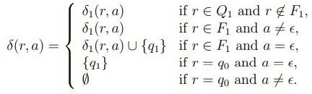
Regular Languages Closed Under Union
Proof
Q = {q₀}∪ Q₁
q₀ is the start state of M
F = {q₀}∪ F₁
δ : Q × Σ_{ϵ} → P(Q) is defined as: For any r ∈ Q and for any a ∈ Σ_{ϵ}

Slide 17




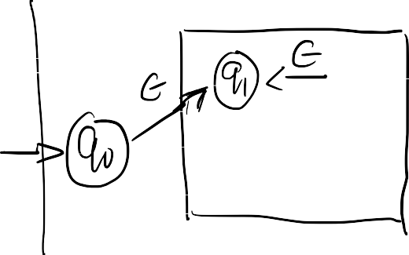
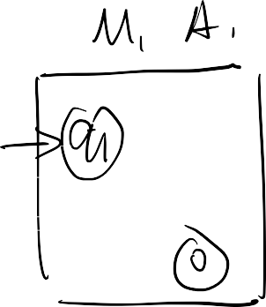









Regular Languages Closed Under Union
Proof

Slide 18


















Regular Languages Closed Under Complement and Interaction
The set of regular languages is closed under the complement and interaction operations:
If A is a regular language over the alphabet Σ, then the complement:
A^{ഥ} = {w ∈ Σ∗: w ∉A}
is also a regular language.
If A₁ and A₂
interaction:
are regular languages over the same alphabet Σ, then the
A₁ ∩ A₂ = {w ∈ Σ∗: w ∈ A₁ and w ∈ A₂}
is also a regular language.

Slide 19




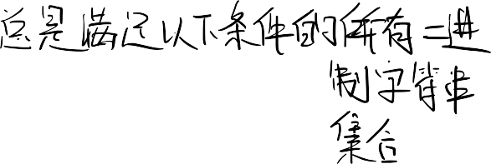






Regular Expressions
Regular expressions are means to describe certain languages.
Example
Consider the expression:
(0∪1)01 *
The language described by this expression is the set of all binary strings satisfy:
that start with either 0 or 1 (this is indicated by (0 ∪ 1) ),
for which the second symbol is 0 (this is indicated by 0),
that end with zero or more 1s (this is indicated by 1∗ ).

Slide 20
















Example
The language {w : w contains exactly two 0s} is described by the expression:
The language {w : w contains at least two 0s} is described by the expression:
The language {w : 1011 is a substring of w} is described by the expression:

Slide 21








Formal Definition of regular expressions
Let Σ be a non-empty alphabet.
ϵ is a regular expression.
∅ is a regular expression.
For each a ∈ Σ, a is a regular expression.
If R₁ and R₂ are regular expressions, then R₁ ∪ R₂ is a regular expression.
If R₁ and R₂ are regular expressions, then R₁ R₂ is a regular expression.
If R is a regular expression, then R∗ is a regular expression.

Slide 22




























Example
Given (0∪1)*101(0∪1)* , prove it is a regular expression (note: Σ={0, 1}).

Slide 23







Formal Definition of regular expressions
If R is a regular expression, then L(R) is the language generated (or described or defined) by R.
Let Σ be a non-empty alphabet.
The regular expression ϵ describes the language {ϵ}.
The regular expression ∅ describes the language ∅.
For each a ∈ Σ, the regular expression a describes the language {a}.
Let R₁ and R₂ be regular expressions and let L₁ and L₂ be the languages
described by them, respectively. The regular expression R₁ ∪ R₂ describes the language L₁ ∪ L₂ .
Let R₁ and R₂ be regular expressions and let L₁ and L₂ be the languages described by them, respectively. The regular expression R₁R₂ describes the language L₁L₂ .
Let R be a regular expression and let L be the language described by it. The regular expression R∗ describes the language L∗ .

Slide 24
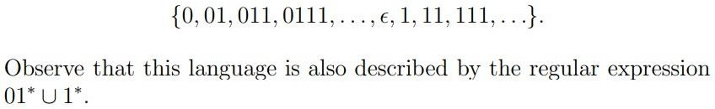
Example
Given a regular expression (0∪ ϵ) 1 *, it describes the language:

Slide 25




THANK YOU

