Slide 1


INT201 Decision, Computation and Language
Lecture 5 – Regular Languages (2) Dr Yushi Li

Slide 2






Kleene’s Theorem
Let L be a language. Then L is regular if and only if there exists a regular expression that describes L.
If a language is described by a regular expression, then it is regular.
如果⼀种语⾔是⽤正则表达式描述的，那么它就是正则语⾔。
If a language is regular, then it has a regular expression.
如果⼀种语⾔是正则表达式，那么它就有正则表达式。

Slide 3




The language described by a regular expression is a regular language
如果⼀种语⾔是⽤正则表达式描述的，那么它就是正则语⾔。
Proof Convert a regular expression R into a NFA M
1st case. If R = ϵ, then L(R) = {ϵ}. The NFA is M = ({q}, Σ, δ, q, {q}) where:
δ(q, a) = ∅ for all a ∈ Σ_{ϵ}
2nd case. If R =∅, then L(R) = ∅. The NFA is M = ({q}, Σ, δ, q, ∅) where:
δ(q, a) = ∅ for all a ∈ Σ_{ϵ}

Slide 4

The language described by a regular expression is a regular language
Proof
3rd case. If R = a for a ∈ Σ, then L(R) = {a}. The NFA is M = ({q₁, q₂}, Σ, δ, q₁, {q₂})
where:
δ(q₁, a) = {q₂}
δ(q₁, b) = ∅ for all b ∈ Σ_{ϵ}\{a}
δ(q₂, b) = ∅ for all b ∈ Σ_{ϵ}

Slide 5
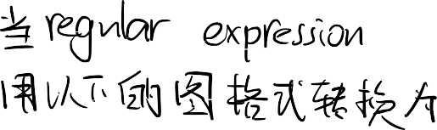





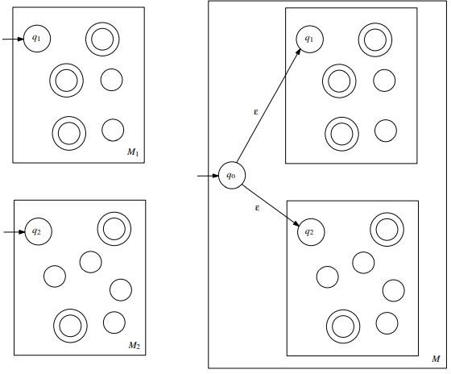
The language described by a regular expression is a regular
language
Proof
4th case (union). If R = (R₁ ∪ R₂) and
L(R₁) has NFA M₁
L(R₂) has NFA M₂
Then L(R₁) = L(R₁) ∪ L(R₂) has NFA as:

Slide 6





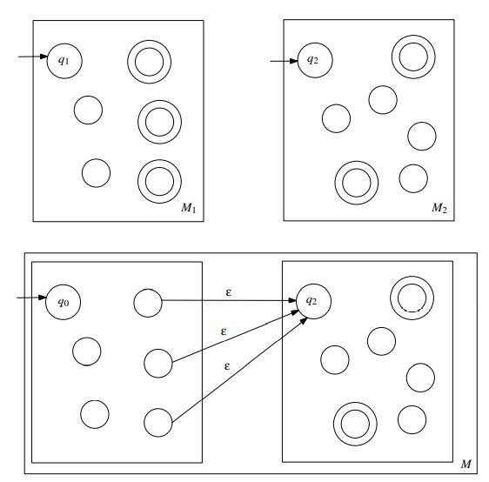
The language described by a regular expression is a regular
language
Proof
5th case (concatenation). If R = R₁ R₂ and
L(R₁) has NFA M₁
L(R₂) has NFA M₂
Then L(R₁) = L(R₁) L(R₂) has NFA as:

Slide 7
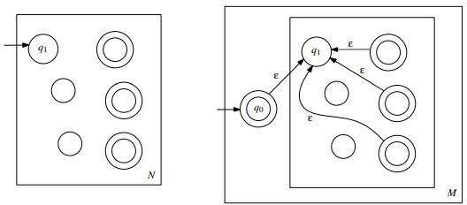
The language described by a regular expression is a regular language
Proof
6th case (Kleene star). If R = (R₁)*
has NFA M as:
and L(R₁) has NFA N, then L(R) = ( L(R₁) )*

Slide 8




































The language described by a regular expression is a regular language
Example
Given a regular expression R = (ab ∪ a)∗, where the alphabet is {a, b}. Prove that this regular expression describes a regular language, by constructing a NFA that accepts L(R).

Slide 9
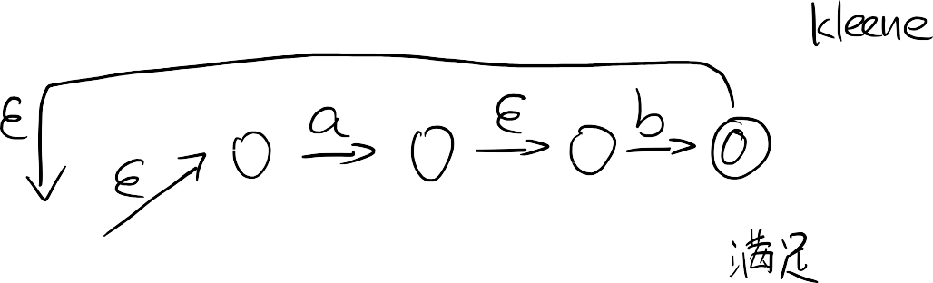






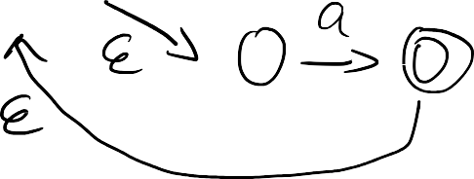
The language described by a regular expression is a regular language
Example

Slide 10




















A regular language has a regular expression
Convert DFA into regular expression
Every DFA M can be converted to a regular expression that describes the language L(M).
Generalized NFA (GNFA)
A GNFA can be defined as a 5-tuple, (Q, Σ, δ, {s}, {t}), consisting of
a finite set of states Q;
a finite set called the alphabet Σ;
a transition function (δ : (Q ∖ {t}) × (Q ∖ {s}) → R);
a start state (s ∈ Q);
an accept state (t ∈ Q);
where R is the collection of all regular expressions over the alphabet Σ.

Slide 11












A regular language has a regular expression
Iterative procedure for converting a DFA M = (Q, Σ, δ, q, F) into a regular expression:
Convert DFA M = (Q, Σ, δ, q, F) into equivalent GFNA G:
Introduce new start state s
Introduce new start state t
Change edge labels into regular expressions
e.g., “a, b” becomes “a ∪ b”
Iteratively eliminate a state from GNFA G until only 2 states remaining: start and accept.
Need to take into account all possible previous paths.
Never eliminate new start state s or new accept state t.

Slide 12
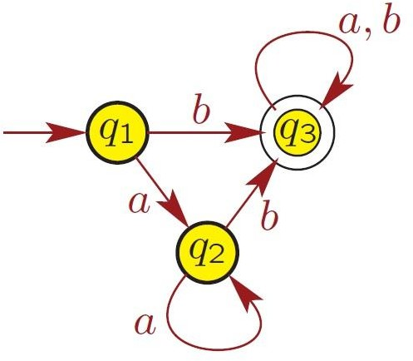

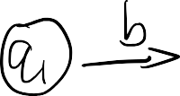
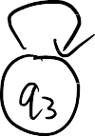






A regular language has a regular expression
Example
Convert the given DFA into regular expression
1st step: DFA -> GNFA

Slide 13

























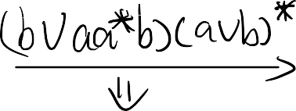





A regular language has a regular expression
Example
Convert the given DFA into regular expression
2nd step: eliminate states

Slide 14
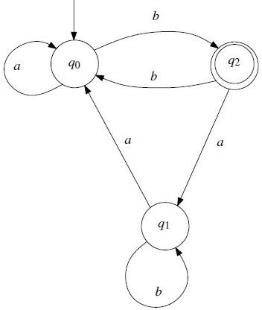
A regular language has a regular expression
Exercise
M = (Q, Σ, δ, q₀, F), where Q = {q₀, q₁, q₂}, Σ = {a, b}, F = {q₂}, and δ is given as:
Convert it to a regular expression.

Slide 15


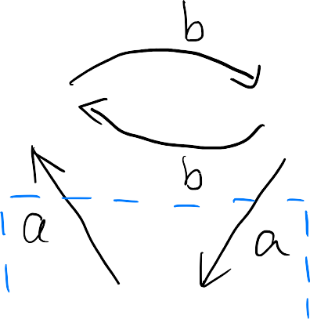








Exercise
Convert it GNFA.

Slide 16


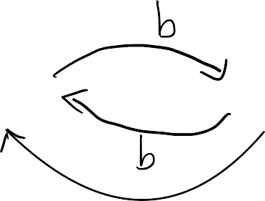








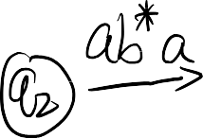

















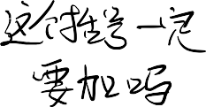









Exercise

Slide 17




Exercise

Slide 18





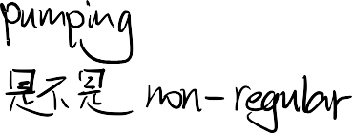
Pumping Lemma for Regular Languages
可⽤于证明某些语⾔不规则的⼯具｡ 该定理说明, 所有正则表达式语⾔都有⼀个特殊属性｡
A tool that can be used to prove that certain languages are not regular. This theorem states that all regular languages have a special property.
This property states that all strings in the language can be “pumped” if they are at least as long as a certain special value, called the pumping length.
If a language L is regular, it always satisfies pumping lemma. If there exists at least one string made from pumping which is not in L, then L is surely not regular.
The opposite may not be true. If pumping lemma holds, it does not mean that the language is regular.

Slide 19
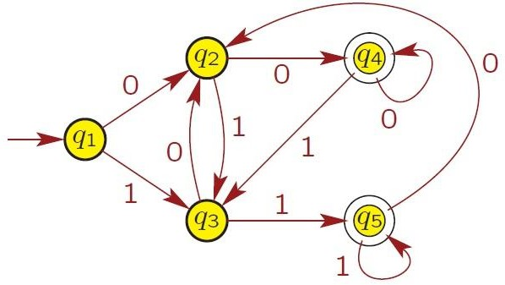
Pumping Lemma for Regular Languages
Example
DFA with Σ = {0, 1} for language A.
Q = {q₁ , q₂ , q₃ , q₄ , q₅}

Slide 20


Pumping Lemma for Regular Languages
For any string s with | s | ≥ 5, guaranteed to visit some state twice by the
pigeonhole principle.
String s = 0011011 is accepted by DFA, i.e., s ∈ A
q₂ is first state visited twice.
Using q₂, divide string s into 3 parts x, y, z such that s = xyz.
x = 0, the symbols read until first visit to q₂.
y = 0110, the symbols read from first to second visit to q₂.
z = 11, the symbols read after second visit to q₂.

Slide 21





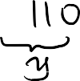









Pumping Lemma for Regular Languages
DFA accepts string
DFA also accepts string
String xy^{i}z ∈ A for each i ≥ 0.

Slide 22
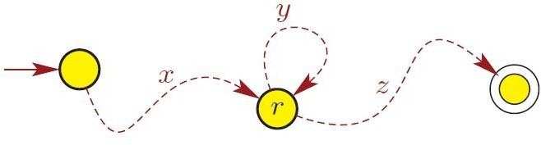
Pumping Lemma for Regular Languages
More generally, consider
language A with DFA M having p states (where p is number of states in DFA).
string s ∈ A with |s| ≥ p.
When processing s on M, guaranteed to visit some state twice.
Let r be first state visited twice.
Using state r, can divide s as s = xyz.
x are symbols read until first visit to r.
y are symbols read from first to second visit to r.
z are symbols read from second visit to r to end of s.

Slide 23
Pumping Lemma for Regular Languages
Because y corresponds to starting in r and returning to r,
xy^{i}z ∈ A for each i ≥ 1.
Also, note xy⁰z = xz ∈ A, so
xy^{i}z ∈ A for each i ≥ 0.
|y| > 0 because
y corresponds to starting in r and coming back;
this consumes at least one symbol (because DFA), so y can’t be empty

Slide 24
Pumping Lemma for Regular Languages
|xy| ≤ p, where p is number of states in DFA, because
xy are symbols read up to second visit to r.
Because r is the first state visited twice, all states visited before second visit to r
are unique.
So just before visiting r for second time, DFA visited at most p states, which
corresponds to reading at most p − 1 symbols.
The second visit to r, which is after reading 1 more symbol,corresponds to reading at most p symbols.

Slide 25
Pumping Lemma for Regular Languages
Let A be a regular language. Then there exists an integer p ≥ 1, called the pumping length, such that the following holds: Every string s in A, with | s | ≥ p, can be
written as s = xyz, such that
y ≠ ϵ (i.e., | y | ≥ 1),
|xy| ≤ p, and
for all i ≥ 0, xy^{i}z ∈ A.

Slide 26







































Example
Language A = { 0^{n}1^{n} | n ≥ 0 } is Nonregular
Proof

Slide 27


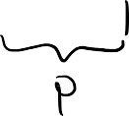
















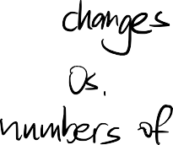




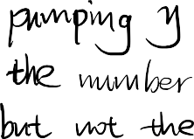

























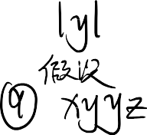











Example
Language A = { 0^{n}1^{n} | n ≥ 0 } is Nonregular
Proof

Slide 28





Slide 29




THANK YOU

