Slide 1


INT201 Decision, Computation and Language
Lecture 6 – Context-Free Languages (1) Dr Yushi Li

Slide 2
Context-Free Languages
Context-Free Grammar (CFG)
Chomsky Normal Form (CNF)

Slide 3



















Context-Free Languages
Finite automata accept precisely the strings in the language.
Perform a computation to determine whether a specific string is in the language.
Regular expressions describe precisely the strings in the language
Describe the general shape of all strings in the language.
Context-free grammar (CFG) is an entirely different formalism for defining a class
of languages.
Give a procedure for listing off all strings in the language.

Slide 4














Context-Free Languages
Applications of CFG
Programming languages: CFGs are used to define the syntax of programming languages, allowing parsers to analyze code structure.
NLP: CFGs help in parsing sentences, enabling applications like machine translation and speech recognition
Compilers: CFGs facilitate syntax analysis, ensuring that the source code adheres to
the language’s grammatical rules.

Slide 5




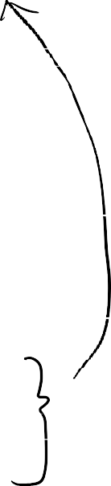




















Context-Free Grammar
Example
Start variable S with rules:
S → AB
A → a A → aA B → b B → bB
variables: S, A, B terminals: a, b
Following these rules, we can yield ?

Slide 6


















Context-Free Grammar
Definition
A context-free grammar is a 4-tuple G = (V, Σ, R, S), where
V is a finite set, whose elements are called variables,
Σ is a finite set, whose elements are called terminals,
3. V ∩ Σ = ∅,
S is an element of V ; it is called the start variable,
R is a finite set, whose elements are called rules. Each rule has the form A → w, where A ∈ V and w ∈ (V ∪ Σ)∗.

Slide 7


























Context-Free Grammar
Example
Language L = {0^{k}0^{k} : k ≥ 0} has CFG G = (V, Σ, R, S),

Slide 8

Deriving strings and languages using CFG
⇒ : yeild
Let G = (V, Σ, R, S) be a context free grammar with
A ∈ V
u, v, w ∈ (V ∪ Σ)∗,
A → w is a rule of the grammar
The string uwv can be derived in one step from the string uAv, written as
uAv ⇒ uwv
Example: aaAbb ⇒ aaaAbb

Slide 9









Deriving strings and languages using CFG
∗
⇒ : derive
Let G = (V, Σ, R, S) be a context free grammar with
u, v ∈ (V ∪ Σ)∗
∗
The string v can be derived from the string u, written as u ⇒ v, if one of the following
conditions holds:
u = v
there exist an integer k ≥ 2 and a sequence u₁, u₂, . . . , u_{k} of strings in (V ∪ Σ)∗, such that
u = u₁,
v = u_{k}, and u₁ ⇒ u₂ ⇒ . . . ⇒ u_{k} .
Example: With the rules A → B1 | D0C
∗
0AA ⇒ 0D0CB1

Slide 10











Language of CFG
Definition
The language of CFG G = (V, Σ, R, S) is
∗
L(G) = { w ∈ Σ∗ | S ⇒ w }.
Such a language is called context-free, and satisfies L(G) ⊆ Σ∗.
Example
CFG G = (V, Σ, R, S) with
1. V = {S}
2. Σ = {0, 1}
3. Rules R: S → 0S | ε
L(G) = ?

Slide 11














































Example (Palindrome)
CFG G = (V, Σ, R, S) with
1. V = {S}
2. Σ = {a, b}
3. Rules R: S → aSa | bSb | a | b | ε
Language of this CFG ?

Slide 12












Example (Simple Arithmetic Expressions)
CFG G = (V, Σ, R, S) with
1. V = {S}
2. Σ = {+, −, ×, /, (, ), 0, 1, 2, . . . , 9}
3. Rules R:
S → S + S | S − S | S × S | S/S | (S) | −S | 0 | 1 | ・ ・ ・ | 9
L(G): valid arithmetic expressions over single-digit integers
S derives string 3 × (5 + 6)?

Slide 13






























Regular Languages are context-free
Theorem
Let Σ be an alphabet and let L ⊆ Σ∗ be a regular language. Then L is a context-free
language (Every regular language is context-free).
Proof
Since L is a regular language, there exists a deterministic finite automaton M = (Q, Σ, δ, q, F) that accepts L. To prove that L is context-free, we have to define a context- free grammar G = (V, Σ, R, S), such that L = L(M) = L(G). Thus, G must have the following property:
For every string w ∈ Σ∗,
w ∈ L(M) if and only if w ∈ L(G),
which can be reformulated as
∗
M accepts w if and only if S ⇒ w.
Set V = {R_{i} |q_{i} ∈ Q} (that is, G has a variable for every state of M). Now, for every transition δ(q_{i} , a) = q_{j} add a rule R_{i} → aR_{j} . For every accepting state q_{i} ∈ F add a rule R_{i} → ε . Finally, make the start variable S = R₀.

Slide 14





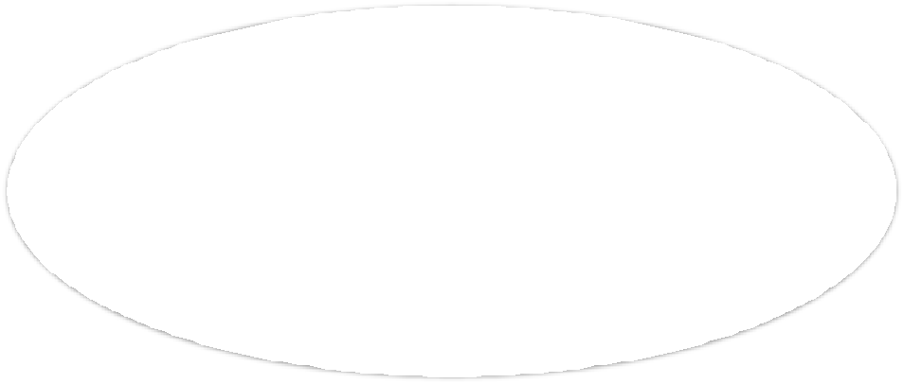


Regular Languages are context-free
Regular Languages
Context-free
Languages
All Languages
Closure properties of CFLs: CFLs are closed under operations like union and
concatenation but not under intersection or complementation.

Slide 15

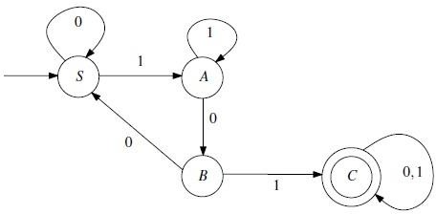


Regular Languages are context-free
Example
Let L be the language defined as
L = {w ∈ {0, 1}∗: 101 is a substring of w}.
The DFA M that accepts L
How can we convert M to a context-free grammar G whose language is L?

Slide 16































Regular Languages are context-free
Example

Slide 17





Chomsky Normal Form (CNF)
Definition
A context-free grammar G = (V, Σ, R, S) is said to be in Chomsky normal form, if
every rule in R has one of the following three forms:
A → BC, where A, B, and C are elements of V , B ≠ S, and C ≠ S.
A → a, where A is an element of V and a is an element of Σ.
S → ε, where S is the start variable.
Why CNF?
Grammars in Chomsky normal form are far easier to analyze.
Example
Rules of CFG in Chomsky normal form with V = {S, A, B}, Σ = {a, b}: G₁ : S → AB, S → c, A → a, B → b (CNF)
G₁ : S → aA, A → a, B → c (not CNF)

Slide 18
Chomsky Normal Form (CNF)
Theorem
Let Σ be an alphabet and let L ⊆ Σ∗ be a context-free language. There exists a context-free grammar in Chomsky normal form, whose language is L (Every CFL can be described by a CFG in CNF).
CFL → CNF
Given CFG G = (V, Σ, R, S). Replace, one-by-one, every rule that is not “Chomsky”.
Start variable (not allowed on RHS of rules)
ε-rules (A → ε not allowed when A isn’t start variable)
all other violating rules (A → B, A → aBc, A → BCDE)

Slide 19









Converting CFG into CNF
Transformation steps
Step 1. Eliminate the start variable from the right-hand side of the rules.
New start variable S₀
New rule S₀ → S
Step 2. Remove ε-rules A → ε, where A ∈ V − {S}.
Before: B → xAy and A → ε | ・ ・・
After: B → xAy | xy and A → ・・ ・
When removing A → ε rules, insert all new replacements:
Before: B → AbA and A → ε | ・・・
After: B → AbA | bA | Ab | b and A→・ ・ ・

Slide 20










Converting CFG into CNF
Transformation steps
Step 3. Remove unit rules A → B, where A ∈ V.
Before: A → B and B → xCy
After: A → xCy and B → xCy
Step 4. Eliminate all rules having more than two symbols on the right-hand side.
Before: A → B₁B₂B₃
After: A → B₁A₁, A₁ → B₂B₃
Step 5. Eliminate all rules of the form A → ab, where a and b are not both variables.
Before: A → ab
After: A → B₁B₂, B₁ → a, B₂ → b.

Slide 21












Converting CFG into CNF
Example
Given a CFG G = (V, Σ, R, S), where V = {A, B}, Σ = {0, 1}, A is the start variable, and R consists of the rules:
A → BAB | B | ε B → 00 | ε
Convert this G to CNF:
Step 1. Eliminate the start variable from the right-hand side of the rules.

Slide 22































Converting CFG into CNF
Example
Step 2. Remove ε-rules.
(1) Remove A → ε: S → A, A → BAB
(2) Remove B → ε: A → BAB, A → B, A → BB

Slide 23









































Converting CFG into CNF
Example
Step 3. Remove unit-rules.
(1) Remove A → A:
(2) Remove S → A:

Slide 24















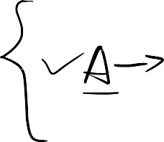




















Converting CFG into CNF
Example
Step 3. Remove unit-rules.
(3) Remove S → B:
(4) Remove A → B:

Slide 25























































Converting CFG into CNF
Example
Step 4. Eliminate all rules having more than two symbols on the right-hand side.
(1) Remove S → BAB:
(2) Remove A → BAB:

Slide 26
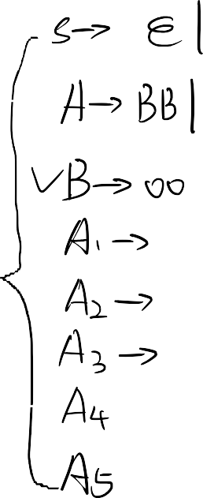




















Converting CFG into CNF
Example
Step 5. Eliminate all rules, whose right-hand side contains exactly two symbols, which are not both variables.
(1) Remove S → 00:
(1) Remove A → 00:

Slide 27
Converting CFG into CNF
Example
Step 5. Eliminate all rules, whose right-hand side contains exactly two symbols, which are not both variables.
(3) Remove S → 00:

Slide 28

THANK YOU

