Slide 1
INT201 Decision, Computation and Language
Lecture 7 – Context-Free Languages (2) Dr Yushi Li and Dr Chunchuan Lyu

Slide 2
Assistant Professor-Dr Chunchuan Lyu
Graduated from The University of Edinburgh and XJTLU
Studied computational semantics but moved to unsupervised reinforcement learning (what an agent should do if no moral gold standard is given?)
Office hour: 14:00-16:00 Thursday at SD543 (or by appointment)
Contact: chunchuan.lyu@xjtlu.edu.cn

Slide 3
Overall Study Tips
Theory of Computation in 12 Hours by Easy Theory Youtuber Really clear explaination
Theory of Computation 2020 by Michael Sipser MIT OCW We are following closely
The Nature of Computation Good complementary book
Please come to office hour, if you are having difficulty or question about anything.

Slide 4
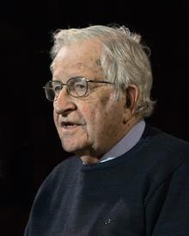
Noam Chomsky 1928-now
An American professor, father of modern linguistics
Transformational Analysis (1955)
Syntactic Structures (1957)
Minimalist program (1995)
What is language?
Why does it have the properties it has?
Formal Basis of a Language Universal (2021 Miloš Stanojević, Mark Steedman)

Slide 5
Noam Chomsky 1928-now
A public intellectual
Manufacturing Consent (1988 with Edward S. Herman)
On Palestine (2015 with Ilan Pappé)
Consequences of Capitalism (2021 with Marv Waterstone)
"one of the most notable contemporary champions of the people“
"pathological hatred of his own country"

Slide 6
Recap
Regular languages are context-free
Every context-free grammar has a Chomsky Normal Form
Today
Closure property of context-free grammar
Syntactic parsing (*optional)
Pushdown Automata

Slide 7


Closure Properties of Context Free Language
Theorem: If 𝐿₁and 𝐿₂ are context-free languages, their union 𝐿₁ ∪ 𝐿₂ is also context
free.
Example:
𝐿₁ = {𝑎^{𝑛}𝑏^{𝑛}𝑐^{𝑚}|𝑚 ≥ 0, 𝑛 ≥ 0}
𝐿₂ = {𝑎^{𝑛}𝑏^{𝑚}𝑐^{𝑚}|𝑚 ≥ 0, 𝑛 ≥ 0}
𝐿₃ = 𝐿₁ ∪ 𝐿₂ = {𝑎^{𝑖}𝑏^{𝑗}𝑐^{𝑘}|𝑖 ≥ 0, 𝑗 ≥ 0, 𝑘 ≥ 0, 𝑖 = 𝑗 𝑜𝑟 𝑗 = 𝑘}
Proof idea:
For 𝐿₁and 𝐿₂ , there exists corresponding context free grammars 𝐺₁ = (𝑉₁, Σ₁, 𝑅₁,
𝑆₁) and 𝐺₂ = (𝑉₂, Σ₂, 𝑅₂, 𝑆₂). Let 𝐺₃ = (𝑉₁ ∪ 𝑉₂, Σ₁ ∪ Σ₂, , 𝑅₁ ∪ 𝑅₂ ∪ {𝑆 →
𝑆₁|𝑆₂}, 𝑆) , clearly L(𝐺₃) = 𝐿₁ ∪ 𝐿₂ .

Slide 8

Closure Properties of Context Free Language
Theorem: If 𝐿₁and 𝐿₂ are context-free languages, their union 𝐿₁ ∘ 𝐿₂ is also context
free.
Example:
𝐿₁ = {𝑎^{𝑛}|𝑛 ≥ 0}
𝐿₂ = {𝑏^{𝑛}|𝑛 ≥ 0}
𝐿₃ = 𝐿₁ ∘ 𝐿₂ = {𝑎^{𝑖}𝑏^{𝑗}|𝑖 ≥ 0, 𝑗 ≥ 0}
Proof idea:
For 𝐿₁and 𝐿₂ , there exists corresponding context free grammars 𝐺₁ = (𝑉₁, Σ₁, 𝑅₁,
𝑆₁) and 𝐺₂ = (𝑉₂, Σ₂, 𝑅₂, 𝑆₂). Let 𝐺₃ = (𝑉₁ ∪ 𝑉₂, Σ₁ ∪ Σ₂, , 𝑅₁ ∪ 𝑅₂ ∪ {𝑆 → 𝑆₁𝑆₂},
𝑆) , clearly L(𝐺₃) = 𝐿₁ ∘ 𝐿₂ .

Slide 9






Closure Properties of Context Free Language
Theorem: If 𝐿₁is context-free languages, their Kleene closure 𝐿∗ is also context free.
1
Example:
𝐿₁ = {𝑎^{𝑛}𝑏^{𝑛}|𝑛 ≥ 0}
𝐿₂ = 𝐿∗ = {(𝑎^{𝑛}𝑏^{𝑛})^{𝑘} |𝑛 ≥ 0, 𝑘 ≥ 0}
1
Proof idea:
For 𝐿₁ , there exists corresponding context free grammars 𝐺₁ = (𝑉₁, Σ₁, 𝑅₁, 𝑆₁). Let
𝐺₂ = (𝑉₁, Σ₁, , 𝑅₁ ∪ {𝑆 → 𝑆₁𝑆|𝜖}, 𝑆) , clearly L(𝐺₂) =𝐿∗ .
1

Slide 10











Parsing Natural Language with Context-Free Grammar
Given CFG G = (V, Σ, R, S)
Variables V = {S, NP,VP,Det,Nominal,Noun,PP,Preposition,Verb}
Terminals Σ={The, spy, saw, cop, with, a , telescope}
Rules:
Grammar
S → NP VP
NP → Det Nominal
Nominal → Noun | Nominal PP VP → VP PP | Verb NP
PP → Preposition NP
Lexicon
Det → The|a
Noun → spy|cop|telescope
Verb → saw Preposition → with
Is this CNF？
How to generate
The spy saw a cop with a telescope

Slide 11
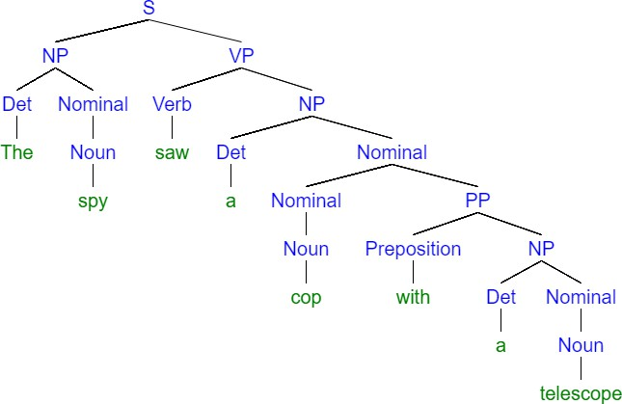

Parsing Natural Language with Context-Free Grammar
CNF properties help, because we only need to consider to merge two consecutive phrases
Rules:
S → NP VP
NP → Det Nominal
Nominal → Noun | Nominal PP VP → VP PP | Verb NP
PP → Preposition NP

Slide 12
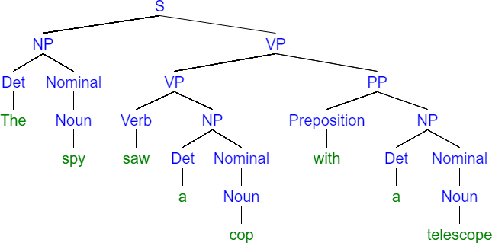
Parsing Natural Language with Context-Free Grammar
A different tree with different meaning
Rules:
S → NP VP
NP → Det Nominal
Nominal → Noun | Nominal PP VP → VP PP | Verb NP
PP → Preposition NP

Slide 13
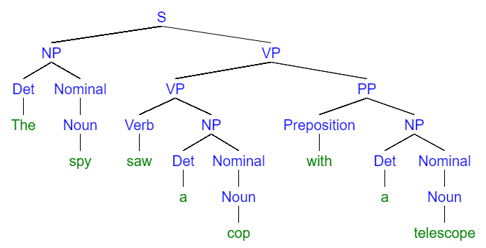
Parsing Natural Language with Context-Free Grammar
Different derivation corresponds to different meaning.
Liu, Alisa et al. “We're Afraid Language Models Aren't Modeling Ambiguity.” ArXiv abs/2304.14399
(2023): n. pag.

Slide 14



















Pushdown Automata (PDAs)
The class of languages that can be accepted by pushdown automata is exactly the
class of context-free languages (finite automata are for regular languages).
The input for a pushdown automaton is a string w in Σ∗.
PDA accepts or doesn’t accept w.
Different from finite automata, PDAs have a stack.
Stack have 2 different operations:
push – adds item to top of stack
pop – removes item from top of stack

Slide 15
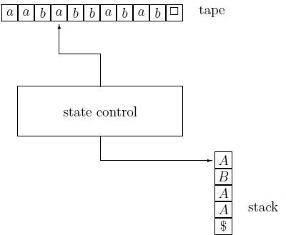








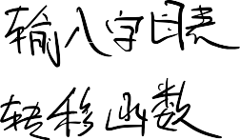

Pushdown Automata (PDAs)
A PDA consists of: a tape, a stack and a state control
Tape: divided into cells that store symbols belonging to Σ_{ε} = Σ ∪ {ε}.
Tape head: move along the tape, one cell to the right per move.
Stack: containing symbols from a finite set
Γ, called the stack alphabet. This set contains a special symbol $ (often mark bottom of stack).
Stack head: reads the top symbol of the stack. This head can also pop the top
symbol, and it can push symbols of Γ onto the stack.
State control: can be in any one of a finite
number of states. The set of states is
denoted by Q. The set Q contains one special state q, called the start state.

Slide 16
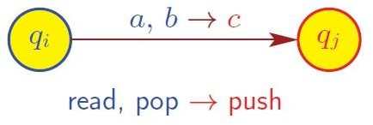
PDA Transition
If PDA
in state q_{i}
reads a ∈ Σ_{ε}
pops b ∈ Γ_{ε} off the stack
If a = ε, then no input symbol is read.
If b = ε, then nothing is popped off stack.
then PDA
moves to state q_{j}
push c ∈ Γ_{ε} onto top of stack
If c = ε, then b is popped from stack.
If c = u₁u₂. . . u_{k} with k ≥ 1 and u₁, u₂, . . . , u_{k} ∈ Γ, then b is replaced by c, and u_{k}
becomes the new top symbol of the stack .

Slide 17





















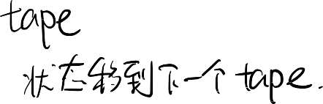


PDA Definition
Definition
A pushdown automaton is a 6-tuple M = (Q, Σ, Γ, δ, q, F):
Q is finite set of states
Σ is (finite) input (tape) alphabet
Γ is (finite) stack alphabet
δ is the transition function: Q × Σ_{ε} × Γ_{ε} → Q × Γ_{ε} ∗
q is start state, q ∈ Q
F is set of accept states, F ⊆ Q, PDA accepts as long as it is in F regardless of
the stack.
Let r, r′ ∈ Q, a∈ Σ∗ and b, c ∈ Γ∗
δ(r, a, b) = (r′, c).
In state r, PDA reads a on the tape and pop b from the stack, move to state r′ and
push c to the stack. The tape head moves to the right.

Slide 18
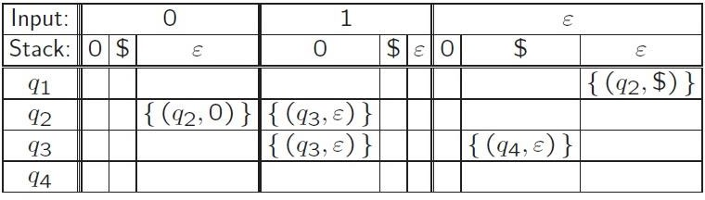
Example
Given a PDA M = (Q, Σ, Γ, δ, q₁, F)
Q = {q₁, q₂, q₃, q₄}
Σ = {0, 1}
Γ = {0, $}
q₁ is start state
F = {q₁ , q₄}
δ: Q × Σ_{ε} × Γ_{ε} → Q × Γ_{ε} ∗

Slide 19
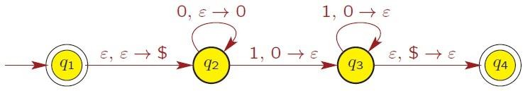
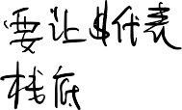
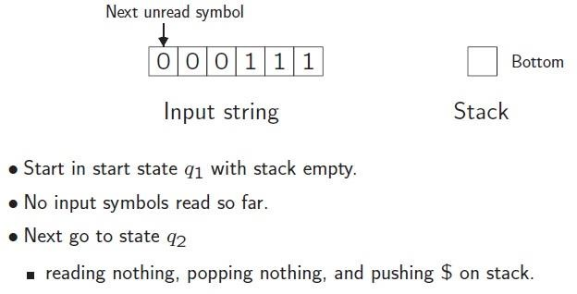
Example
Process string 000111

Slide 20
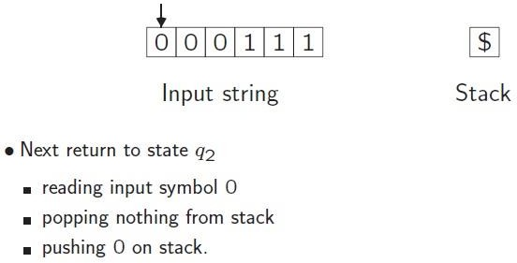
Example

Slide 21
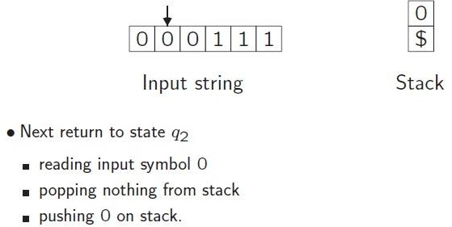
Example

Slide 22
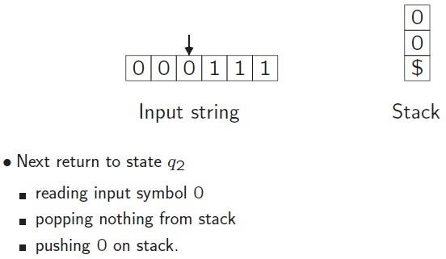
Example

Slide 23
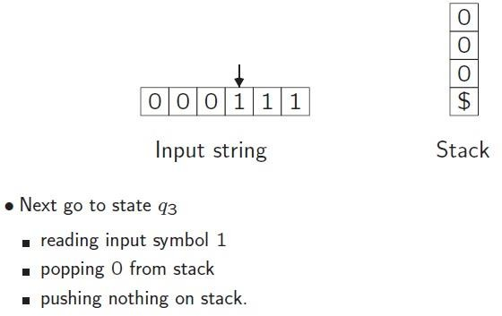
Example

Slide 24
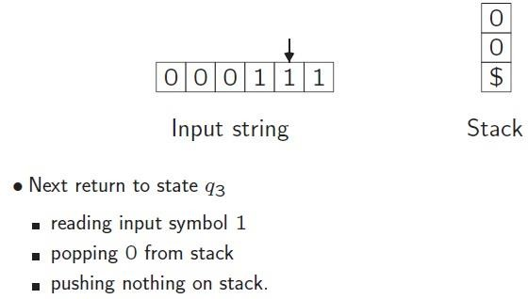
Example

Slide 25
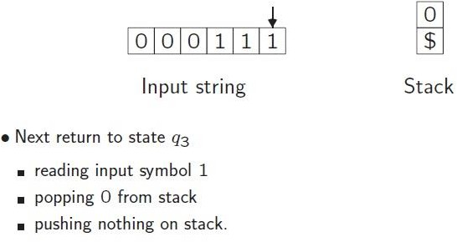
Example

Slide 26
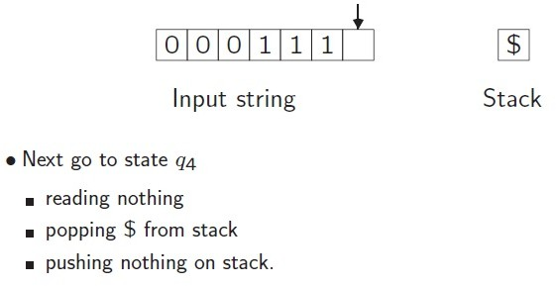
Example

Slide 27
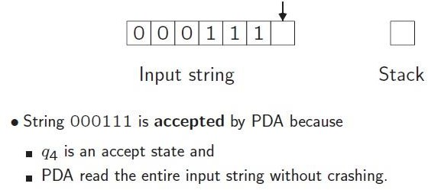
Example

Slide 28
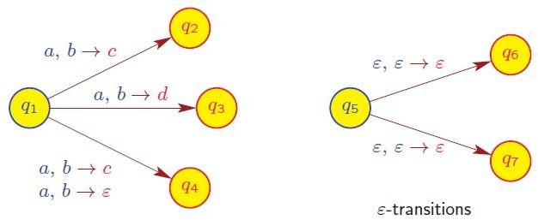
Nondeterministic PDA
PDA transition function allows for nondeterminism
δ: Q × Σ_{ε} × Γ_{ε} → P (Q × Γ_{ε} )

Slide 29
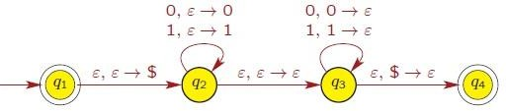
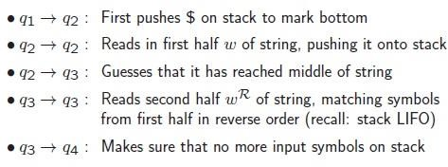
Language accepted by PDA
Definition
The set of all input strings that are accepted by PDA M is the language recognized by M and is denoted by L(M).
Example
PDA for language {ww^{R} | w ∈ {0, 1}∗}

Slide 30
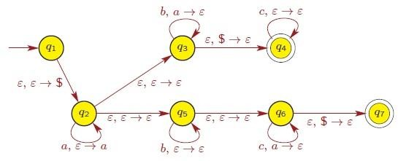
Language accepted by PDA
Example
PDA for language { a^{i}b^{j}c^{k} | i, j, k ≥ 0 and i = j or i = k }

Slide 31
Quick review
CFLs are closed under concatenation, union and Kleene closure
CFLs/Natural language exhibits ambiguities (* optional)
Pushdown automata has an additional stack to store information

Slide 32
Q&A
Does the stack elements have any influence on the accepting condition of PDA?
No, the acceptance is solely decidec by the state.
Why we put the $ at the beginning for some PDA?
Combined with poping $ before accepting, we make sure that all things being added later will be processed. Back to the first question, if a stack conditioned PDA is defined by accepting when its‘ state is accepting and stack elements match some criteria. We can add popping transitions to make an equivalent standard PDA.

Slide 33

THANK YOU

