Slide 1

INT201 Decision, Computation and Language
Lecture 7 – Context-Free Languages (3) Dr Yushi Li and Dr Chunchuan Lyu

Slide 2
Recap
CFLs are closed under concatenation, union and Kleene closure
CFLs/Natural language exhibits ambiguities (* optional)
Pushdown automata are NFA with a stack
A PDA recognizes a language iff for all strings in the language, there exists one branch
of computation that accepts it, and no other strings can be accepted by the PDA.
Today
Equivalence between PDA and CFL
Pumping Lemma for CFL

Slide 3
Equivalence of PDA and CFGs
Let Σ be an alphabet and let A ⊆ Σ∗ be a language. Then A is context-free if and only if there exists a nondeterministic pushdown automaton that recognizes A.
If A = L(G) for some CFG G, then A = L(M) for some PDA M.
If A = L(M) for some PDA M, then A = L(G) for some CFG G.
Proof If A = L(G) for some CFG G, then A = L(M) for some PDA M.
Basic idea: Given CFG G, convert it into PDA M with L(M) = L(G) by building PDA that simulates a derivation.

Slide 4
Equivalence of PDA and CFGs
Convert CFG into PDA
CFG G= (V, Σ, R, S)
PDA
𝜖, 𝜖 → 𝑆𝑆
Start symbol 𝑆
𝑞₁
𝑞₂
Production rules A ∈ 𝑉 → 𝑈 ∈
V ∪ Σ ∗
𝑞
2
𝜖, 𝐴 → 𝑈
𝑎, 𝑎 → 𝜖
Terminal Symbols a ∈ Σ
𝜖, 𝑆 → 𝜖
End generation when no variables left.
𝑞₂
𝑞₃
Problem: 𝑈 could consist of multiple symbols, PDA only push one at a time. Solution: Enter intermediate states when a production rule is applied, and use epsilon transitions to add symbols one by one.

Slide 5
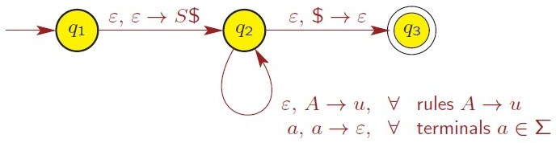
Equivalence of PDA and CFGs
Convert CFG into PDA
PDA works as follows:
Pushes $ and then S on the stack, where S is start variable.
Repeats following until stack empty
If top of stack is variable A ∈ V , then replace A by some u ∈ (Σ ∪ V )∗, where
A → u is a rule in R.
If top of stack is terminal a ∈ Σ and next input symbol is a, then read and pop a.
If top of stack is $, then pop it and accept.

Slide 6
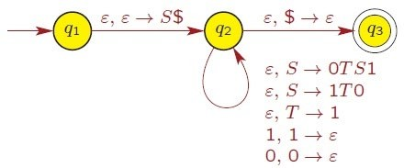
Equivalence of PDA and CFGs
Example
Given CFG G = (V, Σ, R, S)
Variables V = {S, T}
Terminals Σ={0, 1}
Rules: S → 0TS1 | 1T0, T → 1
Convert the above CFG into a PDA.
PDA cannot push strings (e.g, S$, 0TS1, 1T0) onto stack. We need to create the intermediate states.

Slide 7
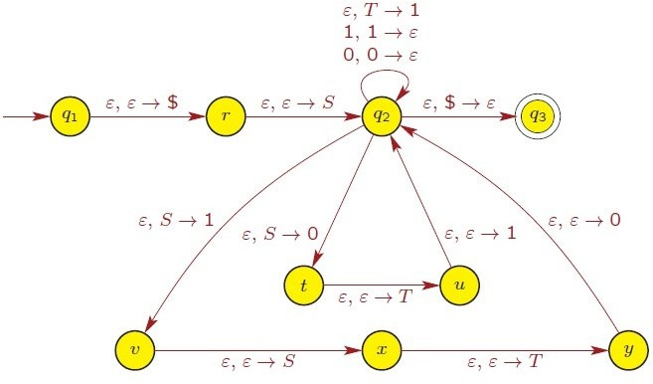

Equivalence of PDA and CFGs
Example

Slide 8
Equivalence of PDA and CFGs
Convert PDA into CFG
We observe that the PDA we built from CFG looks quite special. It has a single accepting state with empty stack. This suggests that we need to somehow convert all PDA to some simplified PDA.
We propose the following simplification of PDA
PDA P has a single accepting state 𝑞_{𝑎𝑐𝑐𝑒𝑝𝑡},
PDA P accepts on empty stack,
Each transition either pushes a symbol onto the stack (a push move) or pops one off the stack (a pop move), but it does not do both at the same time.
Lemma:
PDA with the above simplifications are equivalent to standard PDA.

Slide 9
Equivalence of PDA and CFGs
Convert PDA into CFG
PDA P has a single accepting state 𝑞_{𝑎𝑐𝑐𝑒𝑝𝑡},
PDA P accepts on empty stack,
Each transition either pushes a symbol onto the stack (a push move) or pops one off the stack (a pop move), but it does not do both at the same time.
Consequence of those simplifications:
The computation history of PDA will grow and shrink the stack.
We would like to construct CFG with variables 𝐴_{𝑝𝑞} generating all strings that take
PDA from 𝑝 with empty stack to 𝑞 with empty stack (i.e., 𝑝 to 𝑞 without touching the stack below).
Intuitively, the empty stack condition allows CFG modeling.
Stack height
𝑞₀
Input string
^{𝑞}𝑎𝑐𝑐𝑒𝑝𝑡

Slide 10
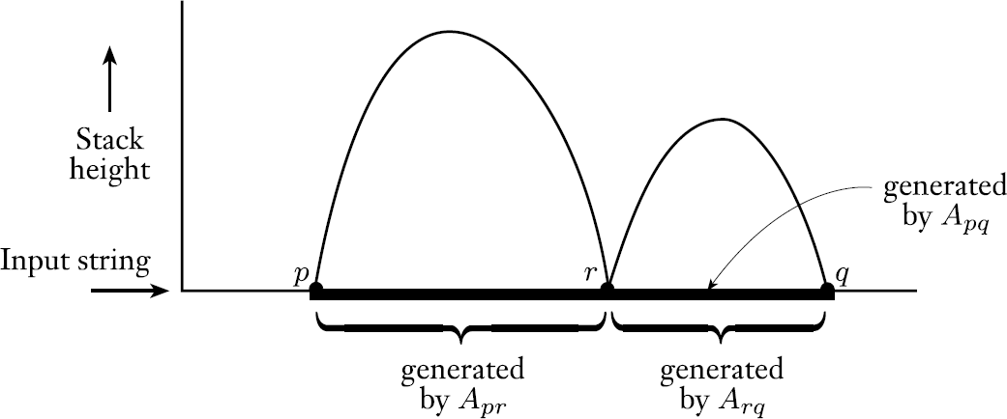
Equivalence of PDA and CFGs
Convert PDA into CFG
𝐴_{𝑝𝑞} generating all strings that take PDA from 𝑝
with empty stack to 𝑞 with empty stack (i.e., 𝑝 to
𝑞 without touching the stack below).
Formally,for PDA 𝑃 = 𝑄𝑄, Z, 𝛤, 𝛿𝛿, 𝑞₀, 𝑞_{accept}
We construct G= 𝑉, Z, 𝑅, 𝐴_{𝑞0𝑞accept} with 𝑉 = 𝐴_{𝑝𝑞} 𝑝, 𝑞 ∈ 𝑄𝑄 , Z=Z
and most importantly production rules in three parts:
1. For each 𝑝 ∈ 𝑄𝑄, put 𝐴_{𝑝𝑝} → 𝜖 (the base case)
2. For each 𝑝, 𝑞, 𝑟 ∈ 𝑄𝑄, put 𝐴_{𝑝𝑞} → 𝐴_{𝑝𝑟}𝐴_{𝑟𝑞}
Conditioning on the stack will pop out the element, but we are pushing at p and r. Remember that we cannot push and pop.

Slide 11
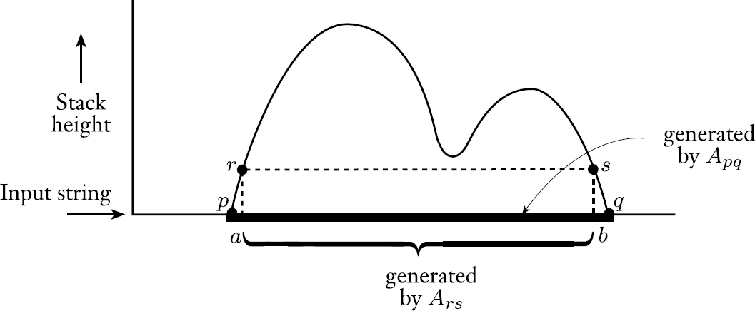
Equivalence of PDA and CFGs
Convert PDA into CFG
𝐴_{𝑝𝑞} generating all strings that take PDA from 𝑝
with empty stack to 𝑞 with empty stack (i.e., 𝑝 to
𝑞 without touching the stack below).
Production rules in three parts:
For each 𝑝 ∈ 𝑄𝑄, put 𝐴_{𝑝𝑝} → 𝜖 (the base case)
For each 𝑝, 𝑞, 𝑟 ∈ 𝑄𝑄, put 𝐴_{𝑝𝑞} → 𝐴_{𝑝𝑟}𝐴_{𝑟𝑞}
For each 𝑝, 𝑞, 𝑟, 𝑠 ∈ 𝑄𝑄 , 𝑢 ∈ 𝛤 (stack symbol), and 𝑎, 𝑏 ∈ Z_{𝜖}, if
𝛿𝛿 𝑝, 𝑎, 𝜖 contains (𝑟, 𝑢) and 𝛿𝛿 𝑠, 𝑏, 𝑢 contains (𝑞, 𝜖) , put
𝐴_{𝑝𝑞} → 𝑎 𝐴_{𝑟𝑠}𝑏
Conditioning on the stack will pop out the element, but we are pushing at p and r. Remember that we cannot push and pop.

Slide 12
Equivalence of PDA and CFGs
Convert PDA into CFG
𝐴_{𝑝𝑞} generating all strings that take PDA from 𝑝
with empty stack to 𝑞 with empty stack (i.e., 𝑝 to
𝑞 without touching the stack below).
Production rules in three parts:
For each 𝑝 ∈ 𝑄𝑄, put 𝐴_{𝑝𝑝} → 𝜖 (the base case)
For each 𝑝, 𝑞, 𝑟 ∈ 𝑄𝑄, put 𝐴_{𝑝𝑞} → 𝐴_{𝑝𝑟}𝐴_{𝑟𝑞}
For each 𝑝, 𝑞, 𝑟, 𝑠 ∈ 𝑄𝑄 , 𝑢 ∈ 𝛤 (stack symbol), and 𝑎, 𝑏 ∈ Z_{𝜖}, if
𝛿𝛿 𝑝, 𝑎, 𝜖 contains (𝑟, 𝑢) and 𝛿𝛿 𝑠, 𝑏, 𝑢 contains (𝑞, 𝜖) , put
𝐴_{𝑝𝑞} → 𝑎 𝐴_{𝑟𝑠}𝑏
Formally, we still need to show this construction works in the sense that 𝐴_{𝑝𝑞} generates 𝑥 if and only if 𝑥 can bring PDA from 𝑝 with empty stack to 𝑞 with empty stack.
See section 2.2 in Sipser 3rd for proof based on mathematical induction on the length of 𝑥.

Slide 13
CFLs and regular languages
If A is a regular language, then A is also a CFL.
Proof
Suppose A is regular, so it has a corresponding NFA.
NFA is a PDA without stack.
So A has a PDA
A is context-free
Converse is not ture. (e.g, L = { 0^{n}1^{n} | n ≥ 0 } is CFL but not regular. )

Slide 14
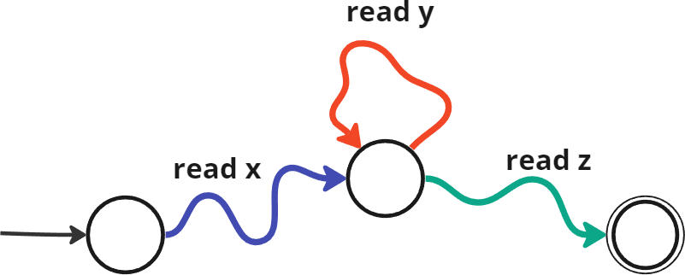
Recap: pumping Lemma for RE
Let L be a regular language. Then there exists an integer p ≥ 1, called the pumping length, such that the following holds: Every string s in L, with |s| ≥ p, can be written as s = xyz, such that
|y| ≥ 1 (i.e., v and y are not both empty),
|xy| ≤ p, and
xy^{i}z ∈ L, for all i ≥ 0.

Slide 15
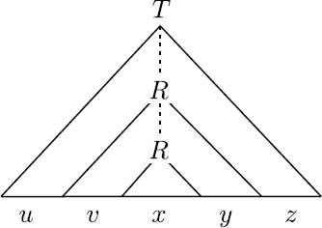
Pumping Lemma for CFLs
Let L be a context-free language. Then there exists an integer p ≥ 1, called the pumping length, such that the following holds: Every string s in L, with |s| ≥ p, can be written as s = uvxyz, such that
|vy| ≥ 1 (i.e., v and y are not both empty),
|vxy| ≤ p, and
uv^{i}xy^{i}z ∈ L, for all i ≥ 0.
Since the grammar is finite, if every variable only appear once in the parse tree, only strings of finite length can be generated. For long enough strings, there must exists variables being used at least twice.

Slide 16
Pumping Lemma for CFLs
Proof
Let 𝑏 = the length of the longest right hand side of a rule
= the max branching of the parse tree
Let ℎ = the height of the parse tree for 𝑠.
(E → E+T)
A tree of height ℎ and max branching 𝑏 has at most 𝑏^{ℎ} leaves. So 𝑠 ≤ 𝑏^{ℎ}.
Let 𝑝 = 𝑏 ^{𝑉} + 1 where 𝑉 = # variables in the grammar.
_{> 𝑏}|𝑉|
So if 𝑠 ≥ 𝑝 > 𝑏 ^{𝑉} then 𝑠 and so ℎ > 𝑉 .
As only variables can be nonterminal,
at least 𝑉 + 1 variables occur in the longest path. So some variable 𝑅 must repeat on a path.

Slide 17
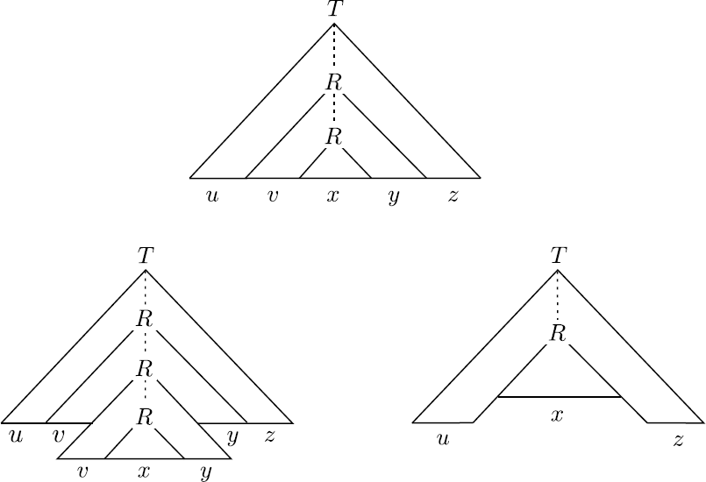
Pumping Lemma for CFLs
Proof
Every string s in L, with |s| ≥ p, can be written as s = uvxyz, such that
|vy| ≥ 1 (CNF forbids ε of non-starting variable ),
|vxy| ≤ p, (repeat the construction if |vxy|>p)
uv^{i}xy^{i}z ∈ L, for all i ≥ 0. (pump for more or le^{E}ss)
What if no long string?
The statement is vacuously true.

Slide 18
Pumping Lemma for CFLs
Example
Let’s look at the palindrome CFL, S → ε | 0S0 | 1S1
Branching factor Varible numbers Pumping length
b=3 V=1
𝑝 = 𝑏 ^{𝑉} + 1=4
For strings of length 4, let‘s consider
s=0110
Pumping lemma claims s = uvxyz, such that
|vy| ≥ 1 (i.e., v and y are not both empty),
|vxy| ≤ p, and
uv^{i}xy^{i}z ∈ L, for all i ≥ 0.
u=0,v=1,x= ε ,y=1, z = 0
u=0,v= ε,x= 1 ,y=1, z = 0
u=01,v= ε,x= ε ,y=1, z = 0
u=0,v= 1,x= ε ,y= ε, z = 10
?

Slide 19
How to prove non-CFLs using pumping lemma
Example
Every string 𝑠 in 𝐿, with |𝑠| ≥ 𝑝, can be written as 𝑠 =
𝑢𝑣𝑥𝑦𝑧, such that
|𝑣𝑦| ≥ 1 (i.e., v and y are not both empty),
|𝑣𝑥𝑦| ≤ 𝑝, and
𝑢𝑣^{𝑖}𝑥𝑦^{𝑖}𝑧 ∈ 𝐿, for all 𝑖 ≥ 0.
L = {𝑎^{𝑛}𝑏^{𝑛}𝑐^{𝑛}| n} is non-CFL.
Proof by contradiction:
We assume that B is a CFL. Let p be the pumping length
𝑠 = 𝑎^{𝑝}𝑏^{𝑝}𝑐^{𝑝}. Clearly s is a member of B and of length at least p.
We show that no matter how we divide 𝑠 into 𝑢𝑣𝑥𝑦𝑧, one of the three conditions of the lemma is violated.

Slide 20
How to prove non-CFLs using pumping lemma
Example
Every string 𝑠 in 𝐿, with |𝑠| ≥ 𝑝, can be written as 𝑠 =
𝑢𝑣𝑥𝑦𝑧, such that
|𝑣𝑦| ≥ 1 (i.e., v and y are not both empty),
|𝑣𝑥𝑦| ≤ 𝑝, and
𝑢𝑣^{𝑖}𝑥𝑦^{𝑖}𝑧 ∈ 𝐿, for all 𝑖 ≥ 0.
𝑠 = 𝑎^{𝑝}𝑏^{𝑝}𝑐^{𝑝}
L = {𝑎^{𝑛}𝑏^{𝑛}𝑐^{𝑛}| n} is non-CFL.
Proof by contradiction:
Condition 2 requires we find the 𝑣𝑥𝑦 substring to be of length 𝑝
at most.
Case 1: if 𝑎^{𝑝−𝑘}= 𝑣𝑥𝑦 where 𝑘 ≥ 0, and due to |𝑣𝑦| ≥ 1 , pumping will change the number of 𝑎 , and we get strings not in the language. Similarly, 𝑏^{𝑝−𝑘}= 𝑣𝑥𝑦 or 𝑐^{𝑝−𝑘}= 𝑣𝑥𝑦 won‘t work.
Now, 𝑣𝑥𝑦 has to be a combination of two alphbets.

Slide 21
How to prove non-CFLs using pumping lemma
Example
Every string 𝑠 in 𝐿, with |𝑠| ≥ 𝑝, can be written as 𝑠 =
𝑢𝑣𝑥𝑦𝑧, such that
|𝑣𝑦| ≥ 1 (i.e., v and y are not both empty),
|𝑣𝑥𝑦| ≤ 𝑝, and
𝑢𝑣^{𝑖}𝑥𝑦^{𝑖}𝑧 ∈ 𝐿, for all 𝑖 ≥ 0.
𝑠 = 𝑎^{𝑝}𝑏^{𝑝}𝑐^{𝑝}
L = {𝑎^{𝑛}𝑏^{𝑛}𝑐^{𝑛}| n} is non-CFL.
Proof by contradiction:
Condition 2 requires we find the 𝑣𝑥𝑦 substring to be of length 𝑝 at most.
Case 2: 𝑎^{𝑚}𝑏^{𝑝−𝑚−𝑘}= 𝑣𝑥𝑦 where 𝑘 ≥ 0. Still, after pumping either the number of 𝑎 or 𝑏 will be different from number of 𝑐. Similarly,
𝑏^{𝑚}𝑐^{𝑝−𝑚−𝑘}= 𝑣𝑥𝑦 won‘t work.
In all, we get a contradiction by assuming L is CFL, so it must not be.

Slide 22
Quick review
CFG and PDA are equivalent
There exists non context-free language provable by using the pumping lemma for CFLs.

Slide 23

THANK YOU

