Slide 1


INT201 Decision, Computation and Language
Lecture 9 – Turing Machine and Variants Dr Yushi Li & Dr Chunchuan Lyu

Slide 2
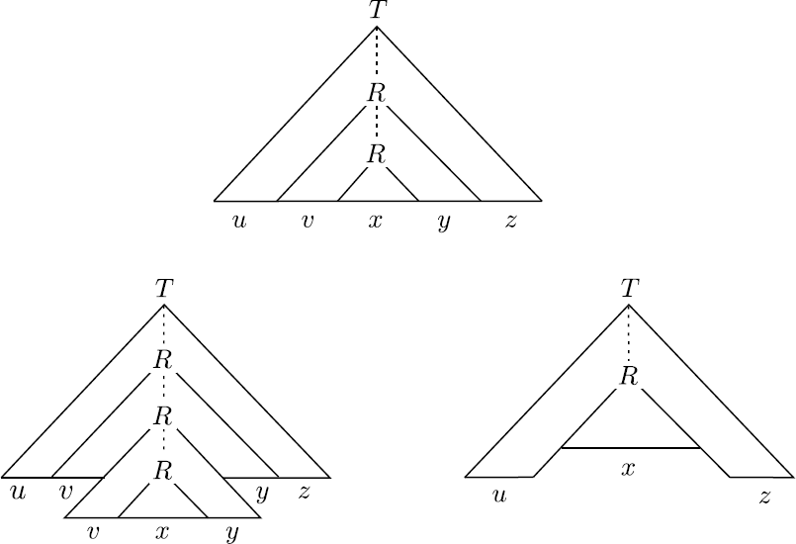

Recap
Equivalence between PDA and CFL
Pumping Lemma for CFL
Today
Turing Machine
Turing-recognizable and Turing-decidable languages
Multi-tape TM and Nondeterministic TM

Slide 3
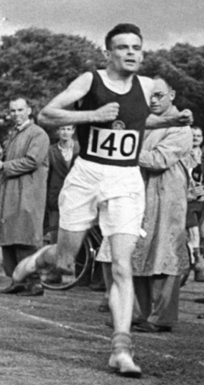
Alan Turing 1912-1954
English mathematician, computer scientist, logician, cryptanalyst, philosopher and theoretical biologist
Run marathon in 2:46:03
while the 1948 Olympic Marathon winner was 2:34:52
Computability and 𝜆-Definability (1936)
On computable numbers, with an application to the Entscheidungsproblem (1937)
Computing Machinery and Intelligence (1950)
What is the limit of computation? Can machines think?

Slide 4
DFA, NFA and PDA
DFA
NFA
M = (Q, Σ, δ, q, F)
δ : Q × Σ → Q
M = (Q, Σ, δ, q, F)
δ : Q × Σ_{ϵ} → P(Q)
Finite control (δ) based on
State
Input symbol
PDA
M = (Q, Σ, Γ, δ, q, F):
δ : Q × Σ_{ε} × Γ_{ε} → Q × Γ_{ε} ∗
Finite control (δ) based on
State
Input symbol
Variable popped from stack

Slide 5
Turing Machine
Finite Automata | Pushdown Automata | Turing Machine
Regular | Context-free | Regular, context-free, context-sensitive, recursively enumerable.
Previous machines can be used to accept or generate regular and context- free languages. However, they are not powerful enough to accept simple language such as
A = {a^{m}b^{n}c^{mn}: m ≥ 0, n ≥ 0}.
Turing machine is a simple model of real computer.

Slide 6
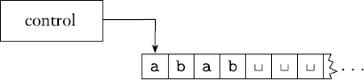

Turing Machine
infinitely long tape, divided into cells. Each cell stores a symbol belonging to Γ (tape alphabet).
Tape head (↓) can move both right and left, one cell per move. It read from or write to a tape
State control can be in any one of a finite number of states Q. It is based on: state and symbol read from tape
Machine has one start state, one accept state and one reject state.
Machine can run forever: infinite loop.

Slide 7
Properties of Turing Machine
Turing machine can both read from tape and write on it.
Tape head can move both right and left.
Tape is infinite and can be used for storage.
Accept and reject states take immediate effect.

Slide 8
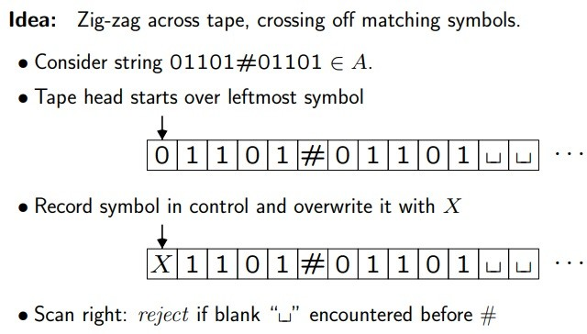
Turing Machine
Example
Machine for language A = { s#s | s ∈ {0, 1}∗ }, input string is 01101#01101 ∈ A.

Slide 9
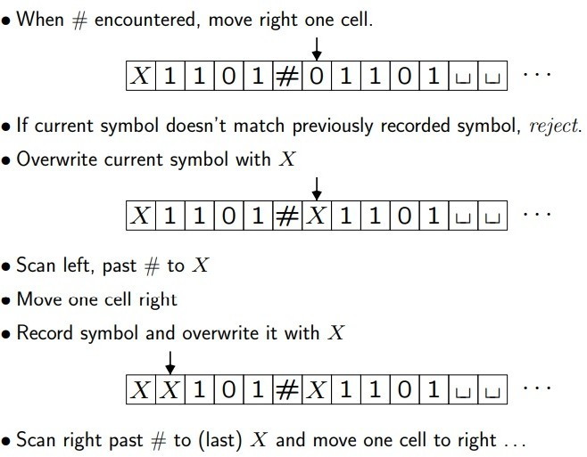
Turing Machine
Example
Machine for language A = { s#s | s ∈ {0, 1}∗ }, input string is 01101#01101 ∈ A.

Slide 10
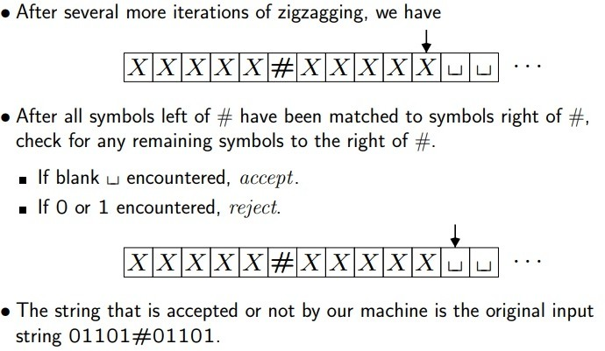
Turing Machine
Example
Machine for language A = { s#s | s ∈ {0, 1}∗ }, input string is 01101#01101 ∈ A.

Slide 11
Turing Machine
Definition
A Turing machine (TM) is a 7-tuple M = (Σ, Γ, Q, δ, q, q_{accept}, q_{reject}), where
Σ is a finite set, called the input alphabet; the blank symbol ˽ is not contained in
Σ,
Γ is a finite set, called the tape alphabet; this alphabet contains the blank symbol
˽ , and Σ ⊆ Γ,
Q is a finite set, whose elements are called states,
q is an element of Q; it is called the start state,
q_{accept} is an element of Q; it is called the accept state,
q_{reject} is an element of Q; it is called the reject state, q_{reject} ≠ q_{accept}
δ is called the transition function, which is a function δ : Q × Γ → Q × Γ × {L, R, N}.
L: move to left, R: move to right, N: no move.

Slide 12
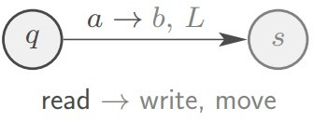
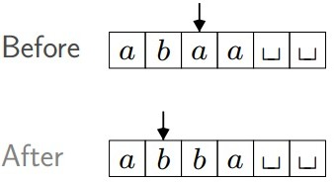
Turing Machine
Transition function
δ(q, a) = (s, b, L)
If TM
in state q ∈ Q,
tape head reads tape symbol a ∈ Γ
Then TM
moves to state s ∈ Q
overwrites a with b ∈ Γ
moves head left (i.e., L ∈ {L, R,N})
Is no move necessary ?

Slide 13
Turing Machine
Computation steps
Before the computation step, the Turing machine is in a state r ∈ Q, and the tape head is on a certain cell.
TM M proceeds according to transition function:
δ : Q × Γ → Q × Γ × {L, R, N}
Depending on r and k symbols read from tape:
switches to a state r′ ∈ Q;
tape head writes a symbol of Γ in the cell it is currently scanning;
tape head moves one cell to the left or right or stay at the current cell.
Computation continues until q_{reject} or q_{accept} is entered. (stopped once entered)
Otherwise, M will run forever (input string is neither accepted nor rejected)

Slide 14
Turing Machine
Example
TM M for language
A = {0^{2𝑛} | n ≥ 0 },
which consists of strings of 0s whose length is a power of 2.
On input string w:
Sweep left to right across the tape, crossing off every other 0.
If in stage 1 the tape contained a single 0, accept.
If in stage 1 the tape contained more than a single 0 and the number of 0s
was odd, reject.
Return the head to the left end of the tape.
Go to stage 1.

Slide 15
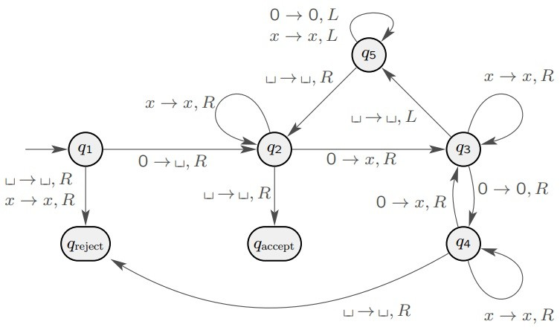
Turing Machine
Example

Slide 16

Example
Run M when input w = 0000
Step 0, state q₁
Step 4, state q₃
Step 8, state q₅
0 | 0 | 0 | 0 | ˽
˽ | X | 0 | X | ˽
˽ | X | 0 | X | ˽
Step 1, state q₂
Step 5, state q₅
Step 8, state q₂
˽ | 0 | 0 | 0 | ˽
˽ | X | 0 | X | ˽
˽ | X | 0 | X | ˽
Step 2, state q₃
Step 6, state q₅
Step 9, state q₂
˽ | X | 0 | 0 | ˽
˽ | X | 0 | X | ˽
˽ | X | 0 | X | ˽
Step 3, state q₄
Step 7, state q₅
˽ | X | 0 | 0 | ˽
˽ | X | 0 | X | ˽

Slide 17
Example
Run M when input w = 0000
Step 10, state q₃
Step 14, state q₅
Step 18, state q₂
˽ | X | X | X | ˽
˽ | X | X | X | ˽
˽ | X | X | X | ˽
Step 11, state q₃
Step 15, state q₅
Step 19, state q₂
˽ | X | X | X | ˽
˽ | X | X | X | ˽
˽ | X | X | X | ˽
Step 12, state q₅
Step 16, state q₂
Accept
˽ | X | X | X | ˽
˽ | X | X | X | ˽
Step 13, state q₅
Step 17, state q₂
˽ | X | X | X | ˽
˽ | X | X | X | ˽

Slide 18
Turing Machine
Start configuration. The input is a string over the input alphabet Σ. Initially, this input string is stored on the first tape, and the head of this tape is on the leftmost symbol of the input string.
Computation and termination. Starting in the start configuration, the Turing machine performs a sequence of computation steps. The computation terminates at the moment when the Turing machine enters the accept state q_{accept} or the reject state q_{reject}. (If the machine never enters q_{accept} and q_{reject} the computation does not terminate. )
Acceptance. The Turing machine M accepts the input string w ∈ Σ∗ , if the computation on this input terminates in the state q_{accept}.

Slide 19

TM Configuration
Provides a “snapshot” of TM at any point during computation:
state
tape contents
head location
Example
Configuration 1011q01:
current state is q
LHS of tape is 1011
RHS of tape is 01
head is on RHS 0

Slide 20
TM Configuration
Definition
Configuration of a TM M = (Q, Σ, Γ, δ, q, q_{accept}, q_{reject}) is a string uqv with u, v ∈
Γ ∗ and q ∈ Q, and specifies that currently
M is in state q
tape contains uv
tape head is pointing to the cell containing the first symbol in v.

Slide 21
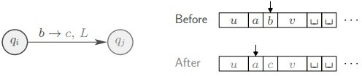
TM Transitions
Definition
Configuration C1 yields configuration C2 if the Turing machine can legally go from C1 to C2 in a single step. For TM M = (Q, Σ, Γ, δ, q, q_{accept}, q_{reject}), suppose
𝑢, 𝑣 ∈ Γ ∗
𝑎, 𝑏, 𝑐 ∈ Γ
𝑞_{𝑖𝑖}, 𝑞_{𝑗𝑗} ∈ 𝑄𝑄
transition function 𝛿𝛿 ∶ 𝑄𝑄 × Γ → 𝑄𝑄 × Γ × {𝐿, 𝑅, 𝑁}.
Example
configuration 𝑢𝑎𝑞𝑖𝑖𝑏𝑣 yields configuration 𝑢𝑞_{𝑗𝑗}𝑎𝑐𝑣
if 𝛿𝛿(𝑞_{𝑖𝑖}, 𝑏) = (𝑞_{𝑗𝑗}, 𝑐, 𝐿).

Slide 22
TM Computation
Definition
Given a TM M = (Q, Σ, Γ, δ, q, q_{accept}, q_{reject}) and input string w ∈ Σ∗. M accepts input w if there is a finite sequence of configurations C₁, C₂,...,C_{k} for some k ≥ 1 with
C₁ is the starting configuration q0w
C_{i} yields C_{i+1} for all i = 1, ..., k − 1 (sequence of configurations obeys transition function δ)
C_{k} is an accepting configuration uq_{accept}v for some u, v ∈ Γ∗.

Slide 23
Language accepted by TM
Definition
The language L (M) accepted by the Turing machine M is the set of all strings in Σ∗ that are accepted by M.
Language A is Turing-recognizable if there is a TM M such that A = L(M)
On an input w ∉ L(M), the machine M can either halt in a rejecting state, or it can loop indefinitely.
Turing-recognizable not practical because never know if TM will halt.

Slide 24
Decider
Definition
A decider is TM that halts on all inputs, i.e., never loops.
Language A = L(M) is decided by TM M if on each possible input w ∈ Σ∗, the TM finishes in a halting configuration, i.e.,
M ends in q_{accept} for each w ∈ A
M ends in q_{reject} for each w ∉ A.
Is decidable language nicer?
A is Turing-decidable if ∃ TM M that decides A
Differences to Turing-recognizable language:
Turing-decidable language has TM that halts on every string w ∈ Σ∗
TM for Turing-recognizable language may loop on strings w ∉ this language

Slide 25
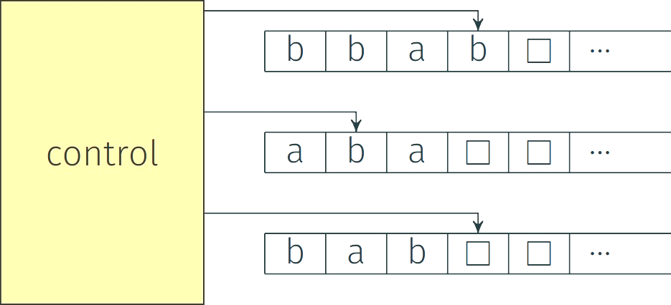
Multi-tape TM
Multi-tape TM has multiple tapes
Each tape has its own head
Transition determined by
state
the content read by all heads
Reading and writing of each head are independent of others

Slide 26
Multi-tape TM
Definition
A k-tape Turing machine (TM) is a 7-tuple M = (Σ, Γ, Q, δ, q, q_{accept}, q_{reject}) has k different tapes and k different read/write heads, where
Σ is a finite set, called the input alphabet; the blank symbol ˽ is not contained
in Σ,
Γ is a finite set, called the tape alphabet; this alphabet contains the blank
symbol ˽ , and Σ ⊆ Γ,
Q is a finite set, whose elements are called states,
q is an element of Q; it is called the start state,
q_{accept} is an element of Q; it is called the accept state,
q_{reject} is an element of Q; it is called the reject state
δ is called the transition function, which is a function δ : Q × Γ ^{k} → Q × Γ ^{k}
× {L, R, N} ^{k}.
Γ ^{k} = Γ × Γ ×… × Γ

Slide 27
Multi-tape TM
Transition
Transition function:
δ : Q × Γ ^{k} → Q × Γ ^{k} × {L, R, N} ^{k}
Given δ(q_{i}, a₁, a₂,..., a_{k})=(q_{j}, b₁, b₂,..., b_{k}, L, R, . . . , L)
TM is in state q_{i}
heads 1-k read a₁, a₂,..., a_{k}
Then
TM moves to q_{j}
heads 1-k write b₁, b₂,..., b_{k}
Heads move (left or right) or don’t move as specified (L, R, N).

Slide 28
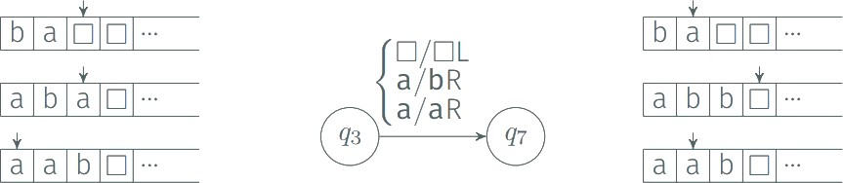
Multi-tape TM
Example
Multiple tapes are convenient
Some tapes can serve as temporary storage

Slide 29
Multi-tape TM equivalent to 1-tape TM
Let k ≥ 1 be an integer. Any k-tape Turing machine can be converted to an equivalent 1-tape Turing machine.
For every multi-tape TM M, there is a single-tape TM M ‘ such that L(M) = L(M’).
Proof
Basic idea: simulate k-tape TM using 1-tape TM.

Slide 30
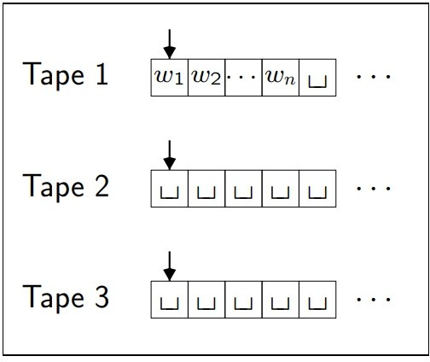

Multi-tape TM equivalent to 1-tape TM
Proof
Let TM M = (Σ, Γ, Q, δ, q, q_{accept}, q_{reject}) be a k-tape TM.
M has:
input w = w₁, w₂,..., w_{k} on tape 1
other tapes contain only blanks ˽
each head points to first cell.
Construct 1-tape TM M’ by extending tape alphabet
Γ’ = Γ 𝖴 Γ̇ 𝖴 {#}
Note: head positions of different tapes are marked by dotted symbol

Slide 31
Multi-tape TM equivalent to 1-tape TM
Proof
For each step of k-tape TM M, 1-tape M’ operates its tape as:
At the start of the simulation, the tape head of M’ is on the leftmost #
Scans the tape from first # to (k+1)st # to read symbols under heads.
Rescans to write new symbols and move heads.

Slide 32
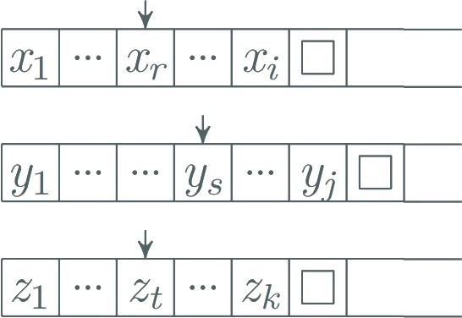
Multi-tape TM equivalent to 1-tape TM
Example
Simulate a 3-tape TM

Slide 33
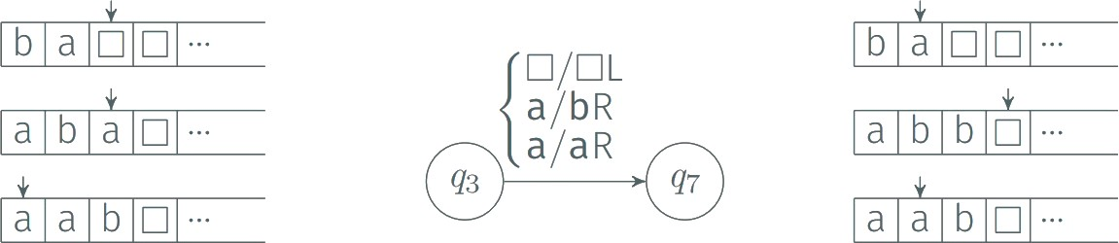
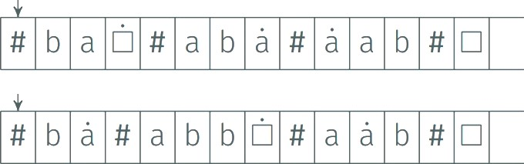
Multi-tape TM equivalent to 1-tape TM
Example
Suppose the given TM M moves like this:

Slide 34

Multi-tape TM equivalent to 1-tape TM
Key points of simulation
To simulate a model M by another model N:
Say how the state and storage of N is used to represent the state and storage of M
Say what should be initially done to convert the input of N
Say how each transition of M can be implemented by a sequence of transitions of N
Turing-recognizable Multiple-tape Turing-recognizable
Language L is TM-recognizable if and only if some multi-tape TM recognizes L.

Slide 35
Nondeterministic TM
A nondeterministic Turing machine (NTM) M can have several options at every step. It is defined by the 7-tuple M = (Σ, Γ, Q, δ, q, q_{accept}, q_{reject}), where
Σ is input alphabet (without blank ˽ )
Γ is tape alphabet with { ˽ } 𝖴 Σ ⊆ Γ
Q is a finite set, whose elements are called states δ is transition function δ : Q × Γ → P(Q × Γ × {L, R})
q is start state ∈ Q
q_{accept} is accept state ∈ Q
q_{reject} is reject state ∈ Q

Slide 36
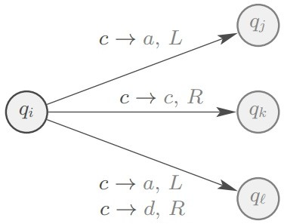
Nondeterministic TM
Transition
Transition function
δ : Q × Γ → P(Q × Γ × {L, R})
δ(q_{i}, c) = { (q_{j}, a, L), (q_{k}, c, R), (q_{l}, a, L), (q_{l}, d, R) }

Slide 37
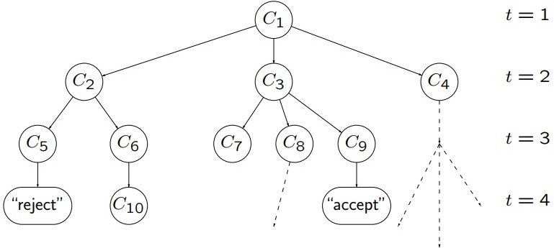
Nondeterministic TM (NTM)
Computation
With any input w, computation of NTM is represented by a configuration tree.
If ∃ (at least) one accepting leaf, then NTM accepts.

Slide 38
NTM equivalent to TM
Every nondeterministic TM has an equivalent deterministic TM.
Proof
Build TM D to simulate NTM N on each input w. D tries all possible branches of N’s tree of configurations.
If D finds any accepting configuration, then it accepts input w.
If all branches reject, then D rejects input w.
If no branch accepts and at least one loops, then D loops on w.

Slide 39
Address
Every node in the tree has at most b children.
b is size of largest set of possible choices for N’s transition function.
Every node in tree has an address that is a string over the alphabet Γ_{b} = {1, 2,...,b}
To get to node with address 231:
start at root
take second branch
then take third branch
then take first branch
Ignore meaningless addresses.
Visit nodes in breadth-first search order by listing addresses in Γ∗ in string order:
𝑏
ε, 1, 2, . . . , b, 11, 12, ..., 1b, 21, 22, ...

Slide 40
Address
Example
“accept” configuration has address 231
Configuration C₆ has address 12.
Configuration C₁ has address ε.
Address 132 is meaningless.

Slide 41
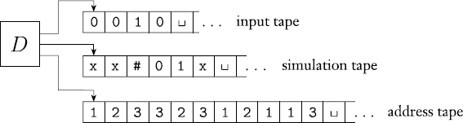
Simulating NTM by DTM
Initially, input tape contains input string w. Simulation and address tapes are initially empty.
Copy input tape to simulation tape.
Use simulation tape to simulate NTM N on input w on path in tree from root to the address on address tape.
At each node, consult next symbol on address tape to determine which branch to take.
Accept if accepting configuration reached.
Skip to next step if
symbols on address tape exhausted
nondeterministic choice invalid
rejecting configuration reached
4. Replace string on address tape with next string in Γ∗ in string order, and go to
𝑏
Stage 2

Slide 42
Encoding
Input to a Turing machine is a string of symbols over an alphabet.
When we want TMs to work on different objects such as:
Polynomials
Graphs
Grammars
etc
We need to encode this object as a string of symbols over an alphabet.

Slide 43
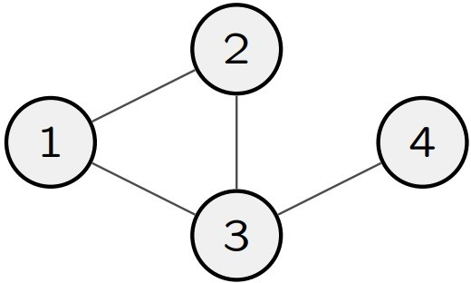
Encoding of Graph
Given an undirected graph G
One possible encoding
G = (1, 2, 3, 4) ( (1, 2), (1, 3), (2, 3), (3, 4) )
G of graph G is string of symbols over some alphabet Σ, where the string starts with list of nodes and followed by list of edges.

Slide 44
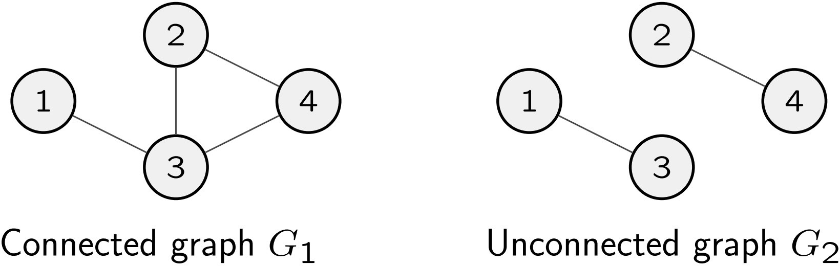
Encoding of Graph
An undirected graph is connected if every node can be reached from any other node by travelling along edge
Let A be the language consisting of strings representing connected undirected graph
A = { G | G is a connected undirected graph } So G₁ ∈ A and G₂ ∉ A.

Slide 45
TM to decide the connectedness of a Graph
A = { G | G is a connected undirected graph }
On input G ∈ Ω, where G is an undirected graph:
Check if G is a valid graph encoding. If not, reject.
Select first node of G and mark it.
Repeat until no new nodes marked.
For each node in G, mark it if it’s attached by an edge to a node already marked
Scan all nodes of G to see whether they all are marked. If they are, accept; otherwise, reject.”
Ω denotes the universe of a decision problem, comprising all instances.

Slide 46
TM to decide the connectedness of a Graph
For TM M that decides A = { G | G is a connected undirected graph }
Ω = { G | G is an undirected graph }
Step 1 checks that input G ∈ Ω is valid encoding:
Two list
first is a list of numbers
second is a list of pairs of numbers
First list contains no duplicate
Every node in second list appears in first list Step 2-5 check if G is connected.

Slide 47
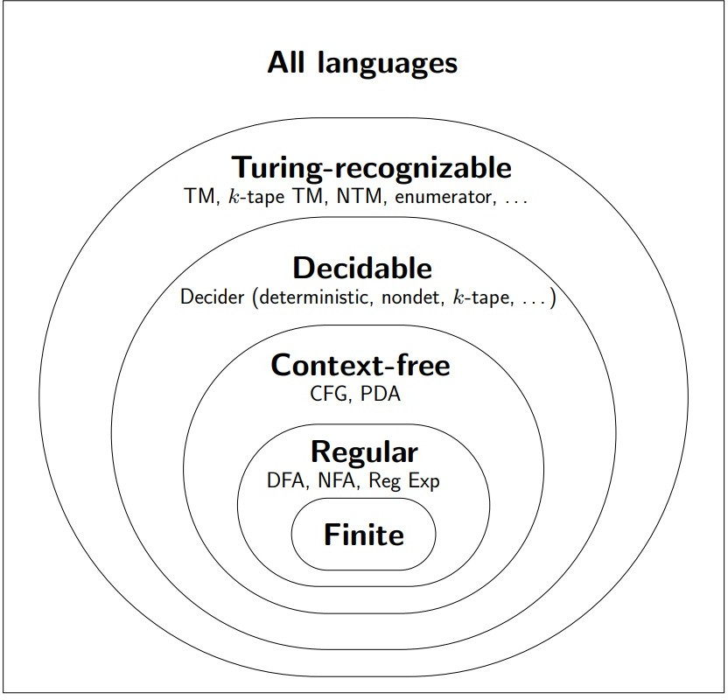
Language Hierarchy

Slide 48
Quick review
Turing machine is DFA with a Tape
A is Turing-recognizable if A=L(M) for some TM M
A is Turing-decidable if A=L(M) for some TM M (decider )that halts on all inputs
Multi-tape TM and Nondeterministic TM are equivalent to TM

Slide 49




THANK YOU

