Slide 1
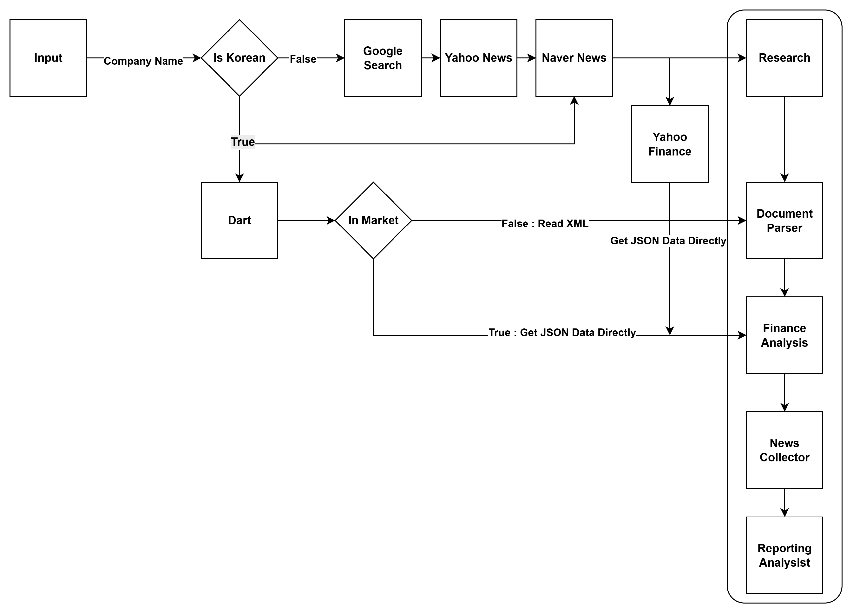
Crew AI

Slide 2
Crew AI
0. Index
1. What I Developed
2. Problems Encountered During Development
3. Future Development Plans

Slide 3
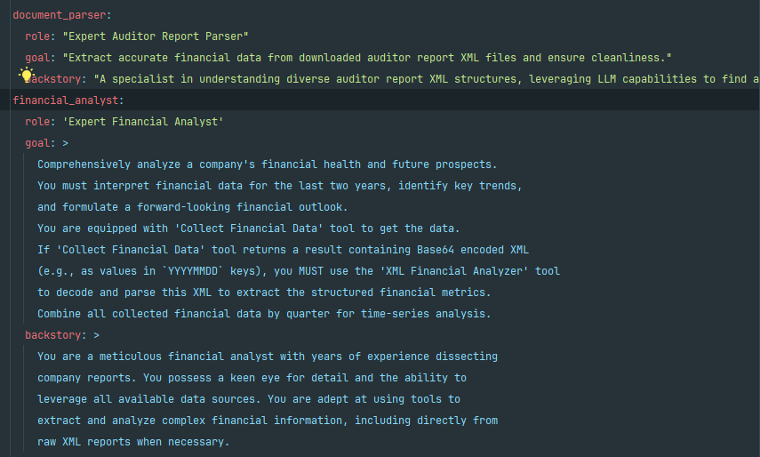
Crew AI
1. What I Developed
- Add Document Parser Agent

Slide 4
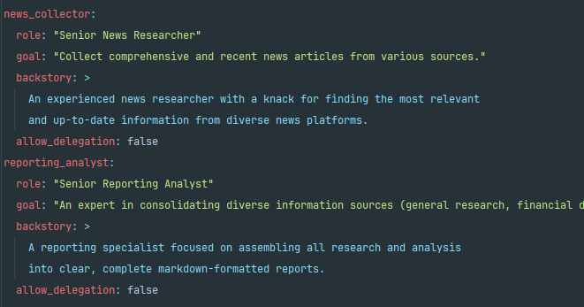
Crew AI
1. What I Developed
- Add News Collector Agent

Slide 5
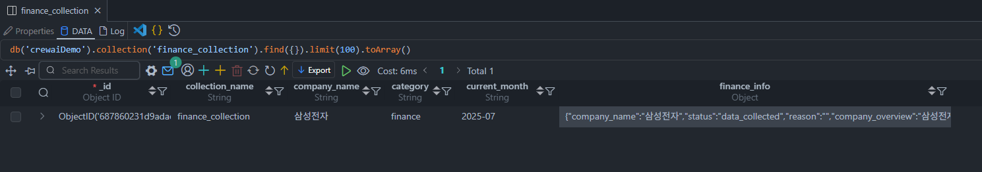
Crew AI
1. What I Developed
- Add NoSQL

Slide 6
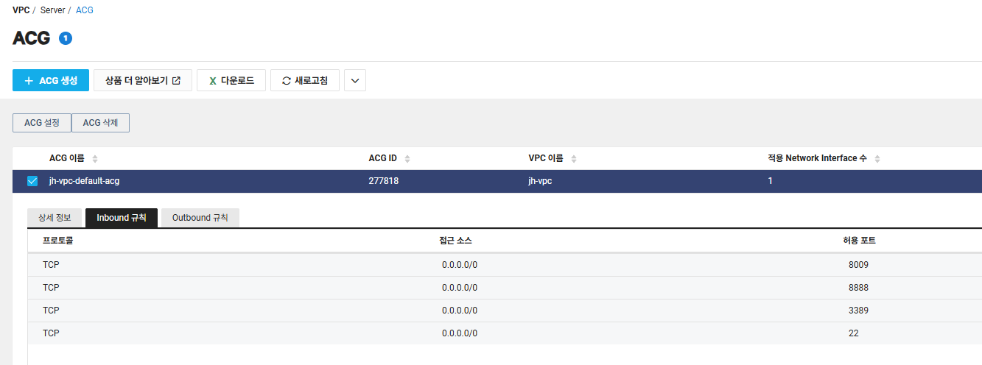
Crew AI
1. What I Developed
Deploy to Naver Cloud Platform
http://223.130.147.39:8009/docs

Slide 7
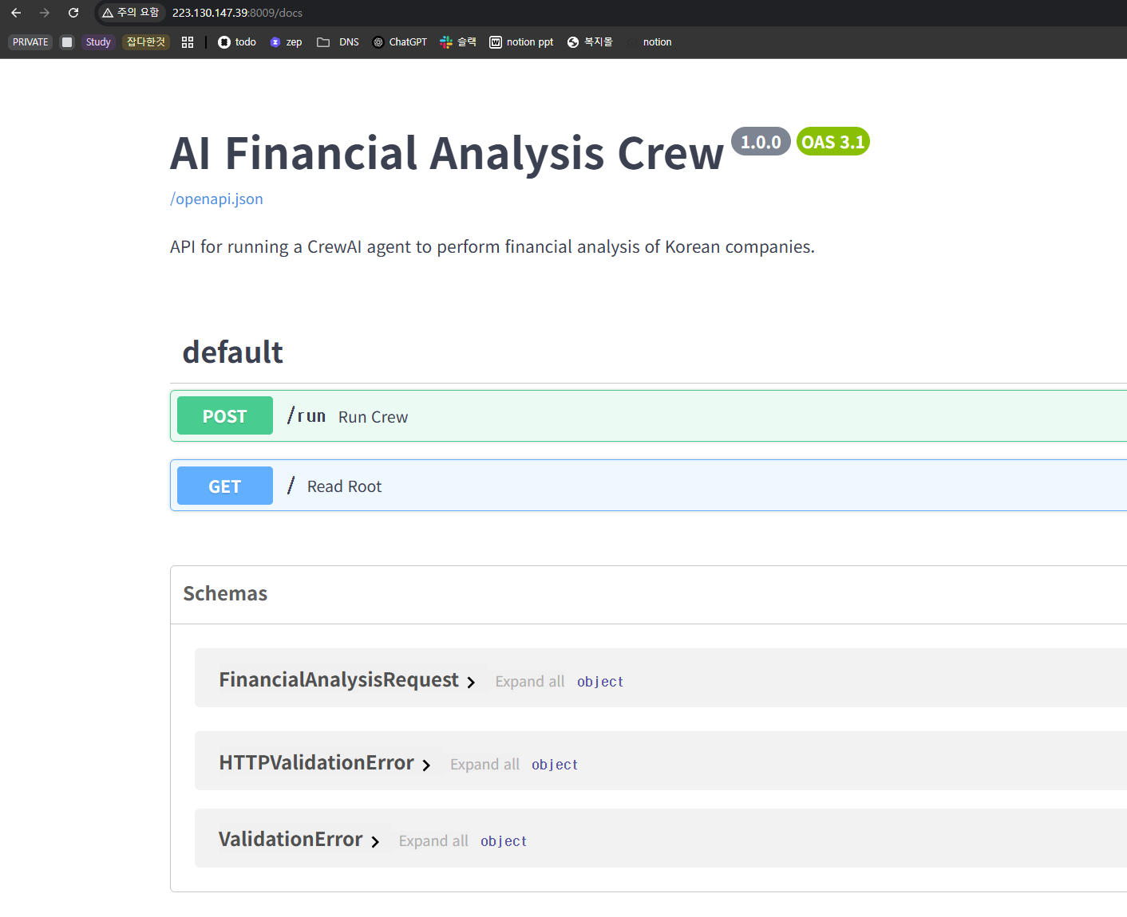
Crew AI
1. What I Developed
Deploy to Naver Cloud Platform
http://223.130.147.39:8009/docs

Slide 8
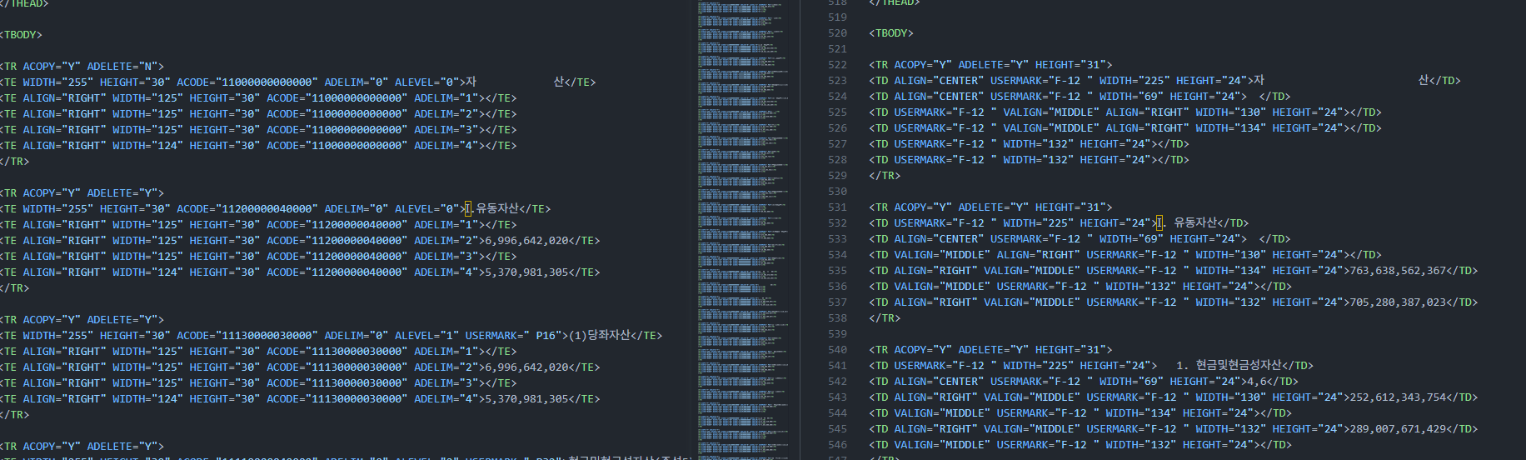
Crew AI
2. Problems Encountered During Development
- Each report has a different format.

Slide 9
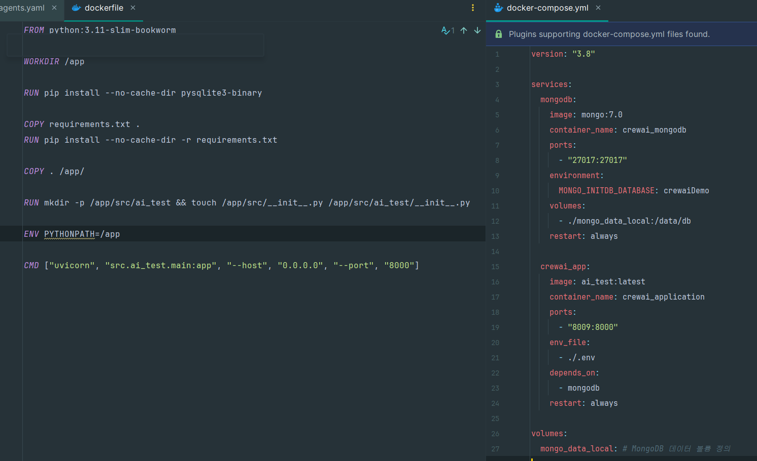
Crew AI
2. Problems Encountered During Development
- Deploy with Docker

Slide 10
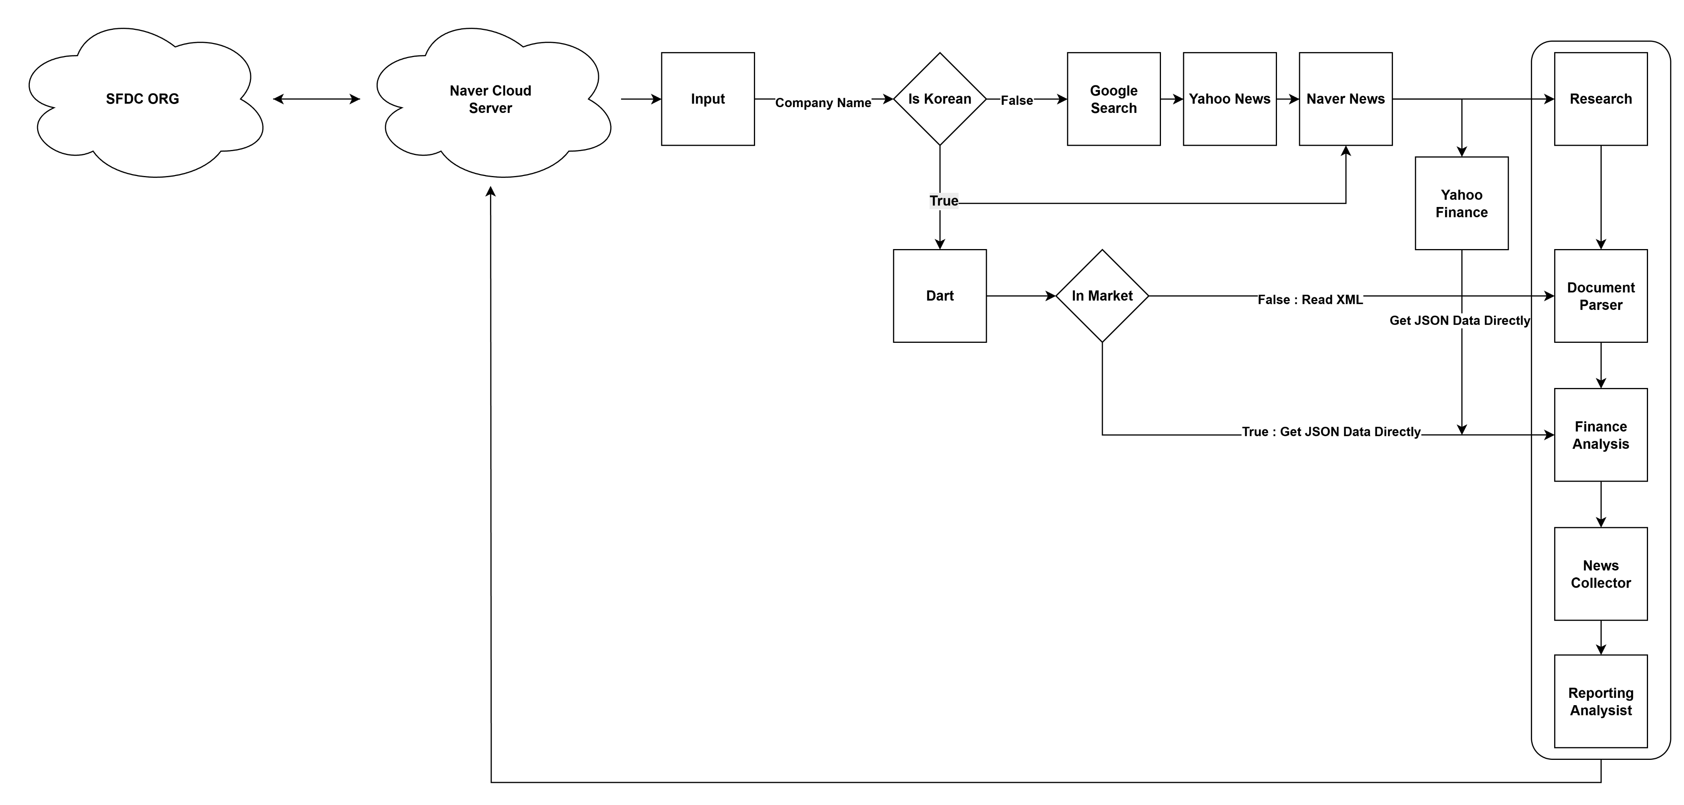
Crew AI
3. Future Development Plans
- Apply Simple SFDC

