Slide 1
Crew AI
Architecture

Slide 2
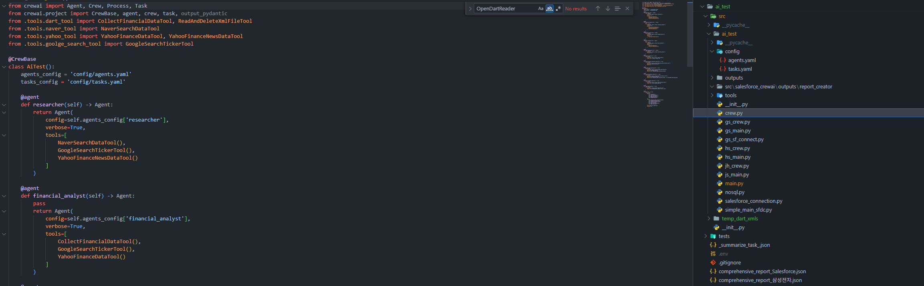
Crew AI
Architecture

Slide 3

Crew AI
Architecture

Slide 4
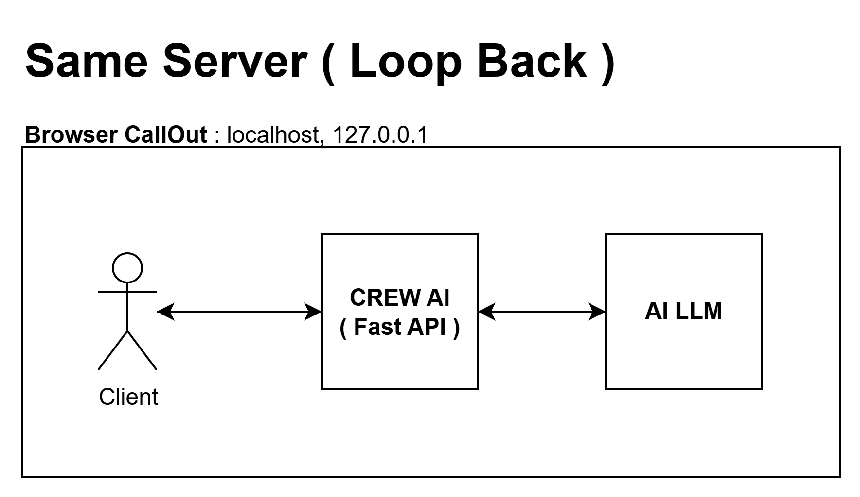
Crew AI
Architecture

Slide 5
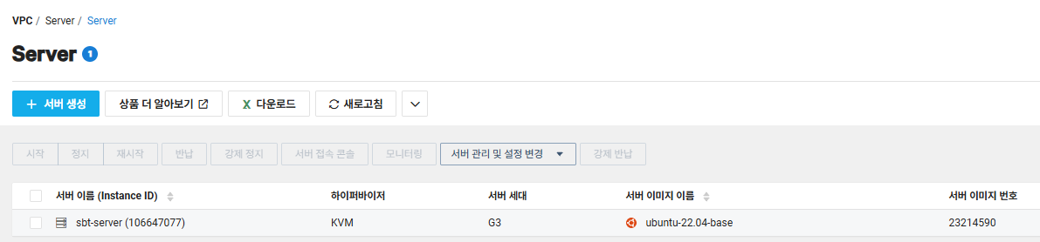
Crew AI
Architecture

Slide 6
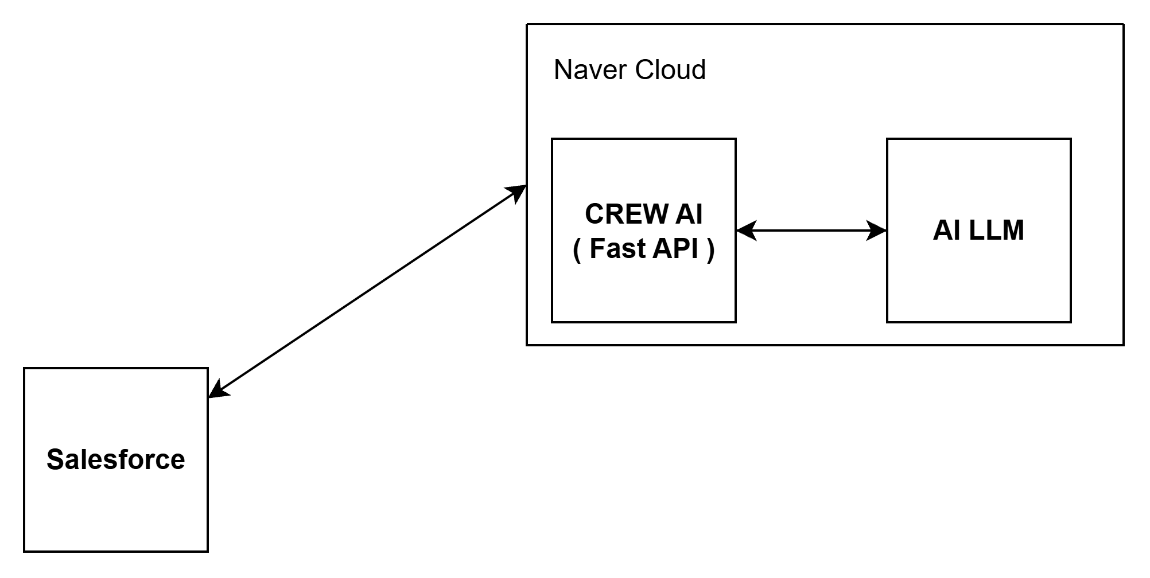
Crew AI
Architecture

Slide 7
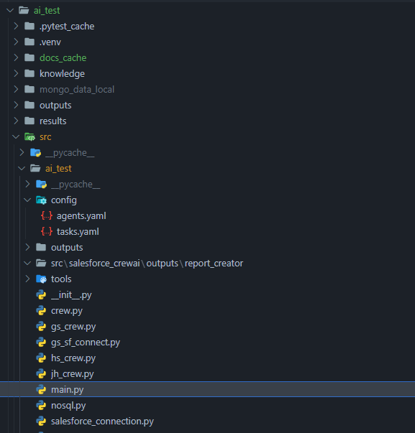
Crew AI
Deploy

Slide 8
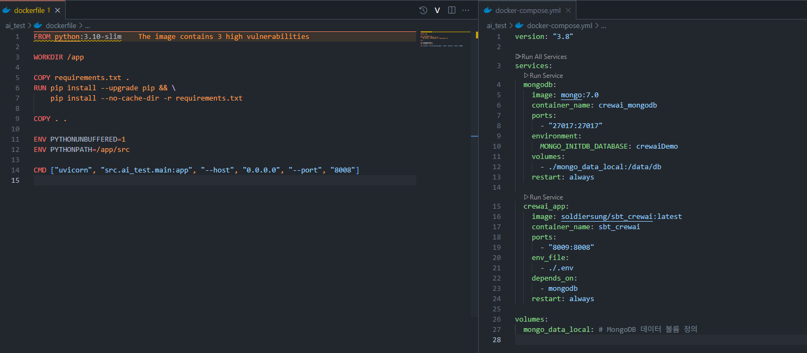
Crew AI
Deploy

Slide 9

Crew AI
Deploy

Slide 10
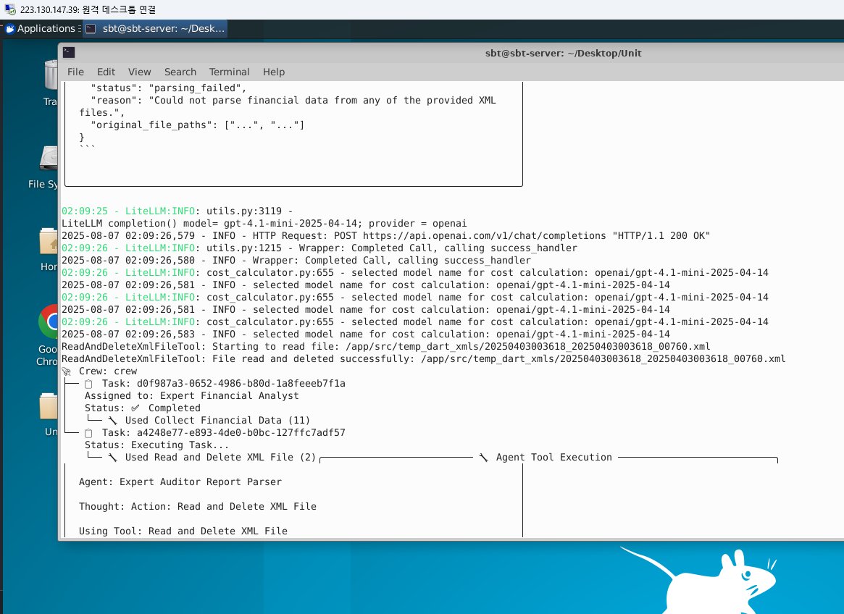
Crew AI
Deploy

Slide 11

Crew AI

