Slide 2
HTK Case – group9
02441 Applied statistics and statistical software
Spyridon Safikos -s223409
Gustavo Martins Ferreira de Aquino - s231491
Yanfen Chen - s222420

Slide 3
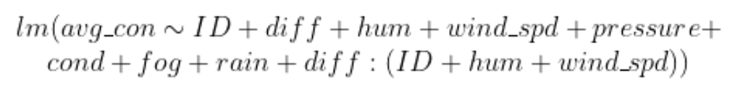
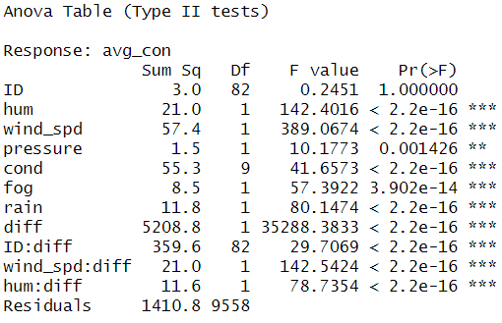
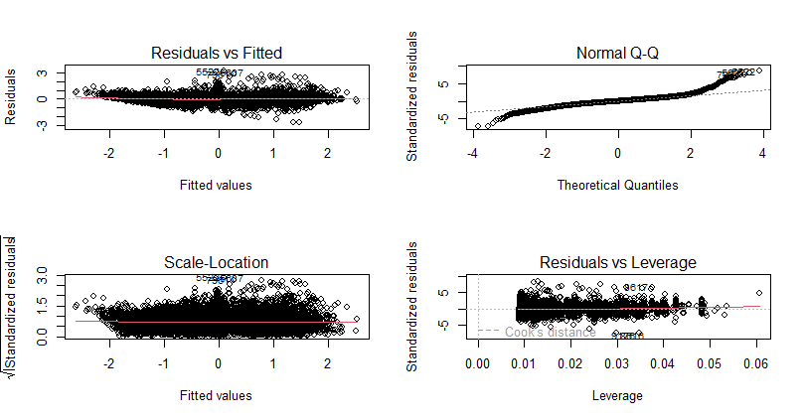
Final model
Backwards selection from Maximal Model
Residuals still not normally distributed

Slide 4
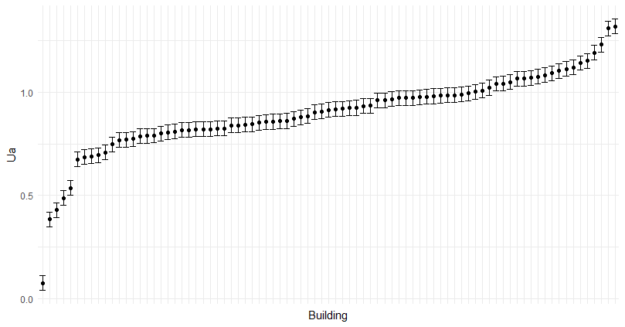
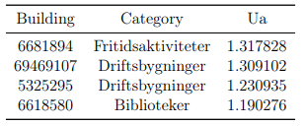

Results
Calculate for each building considering the average humitidy and wind speed of the provided data.
The recommendation goes for the 4 worst performance buildings.
For all the worst four buildings we have the same sd.error = 0.035

Slide 5
Thank you for the time and attention
Possible improvements:
-Subsetting the data
-Implementation of new parameters (temporal/size)

