Slide 1

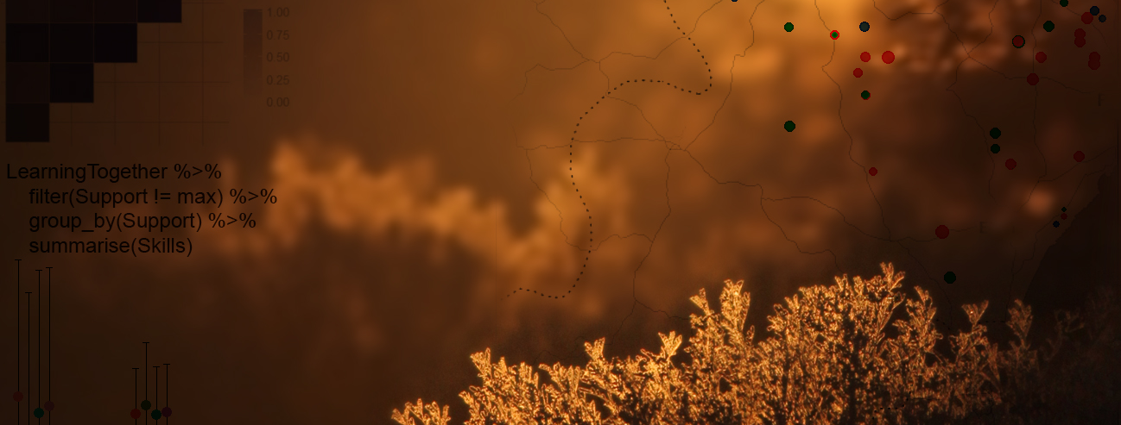
Quantifying population change and visualising species occurrence
Gergana Daskalova, Francesca Mancini
John Godlee, Sandra Angers-Blondin
Isla Myers-Smith

Slide 2
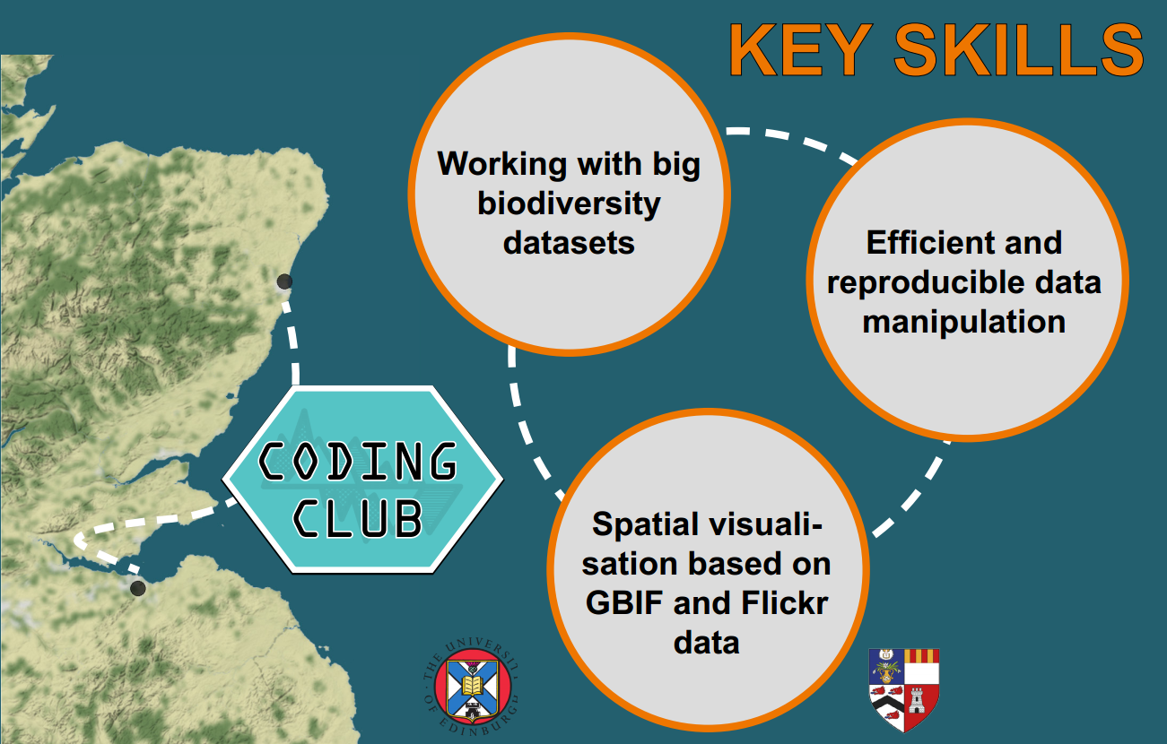
Workshop aims

Slide 3

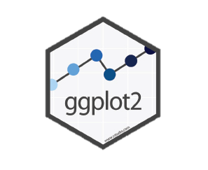




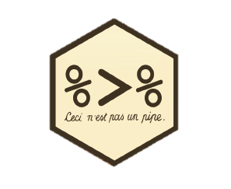

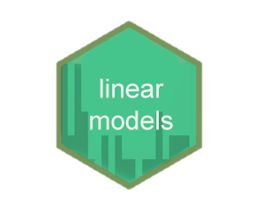
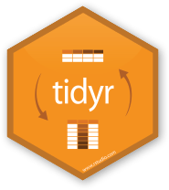
Import
Visualise
Communicate
Transform
tidyverse
Tidy
Model

Slide 4
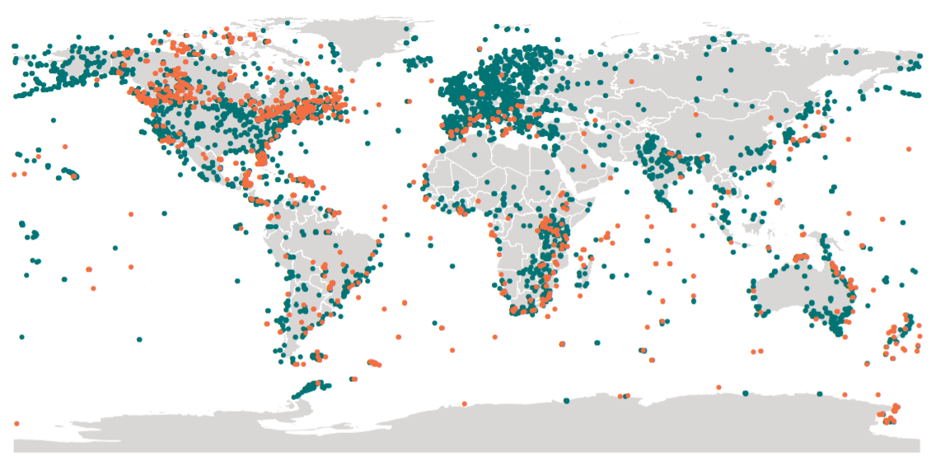
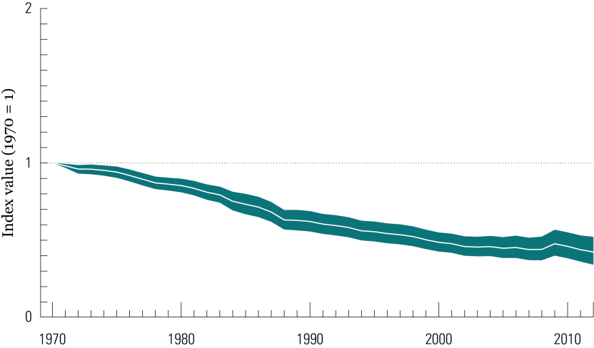
Living Planet Index
Quantifying global biodiversity change
http://www.livingplanetindex.org

Slide 5
Visualising species occurrence // Density maps

Slide 6

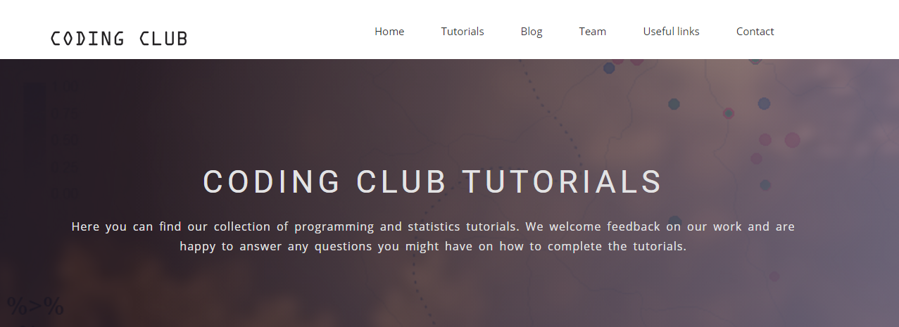
https://ourcodingclub.github.io/2017/03/20/seecc.html

Slide 7
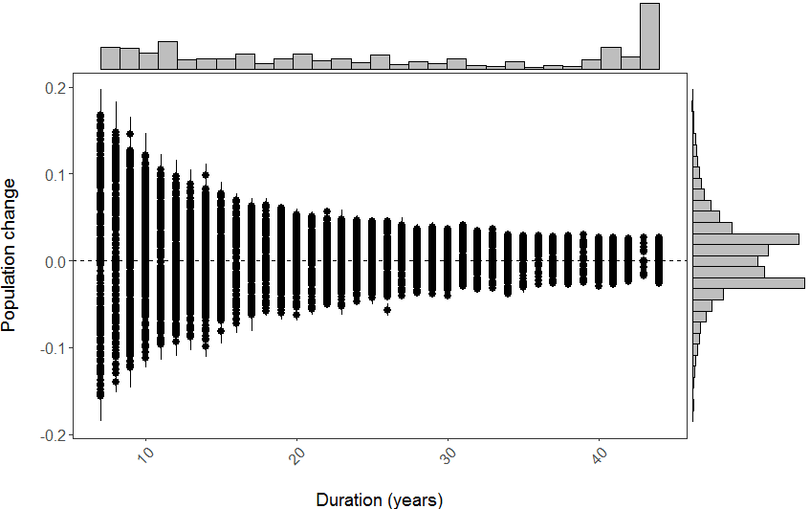
Results – what does it all mean?

Slide 8
Results – what does it all mean?
Results of density maps based on GBIF vs Flickr?

