Slide 1
Automatic classification of music genres
Student: Gustavo Moreira
Number: 1130604
Supervisor: Fátima Rodrigues

Slide 2
1 – Context
Artificial Intelligence has become a hot topic among the tech community
Streaming services are now mainstream.
Competitivess requires quality.
Neural network are a powerful tool to explore music.
Catalog of music genres.
Recomendations.
Playlist generation for clients.

Slide 3
2 – Problem
A human being is slow to classify one single song when compared to a computer.
120 songs per day is the maximum capacity a single human being is capable of doing.
Big companies in the music streaming business require a much bigger number than humans are capable of providing to guarentee a good scalability of their services.

Slide 4
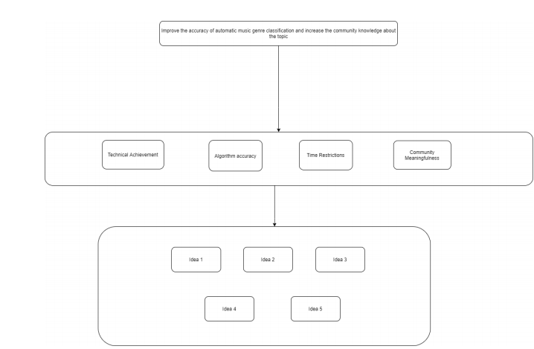
3 – Value Analysis
Continue the work of an individual researcher that has publicly made his work available to the community.
Build a technical solution from scratch, using a dataset that was previously define.
Build a technical solution and a dataset from scratch.
Use previous research to identify common points of implementation and propose a guideline of implementation that is accepted by the community.
Build a music genre classification framework.

Slide 5
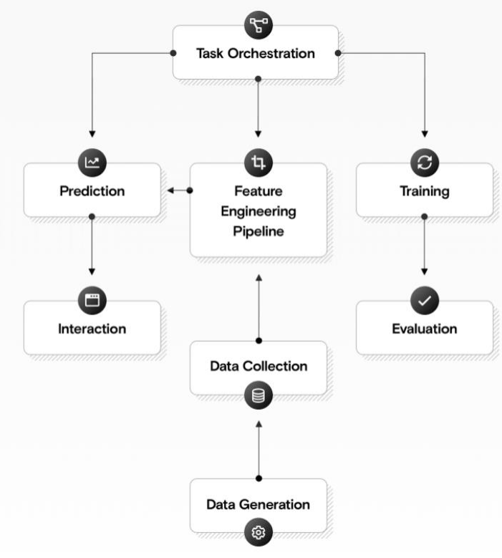
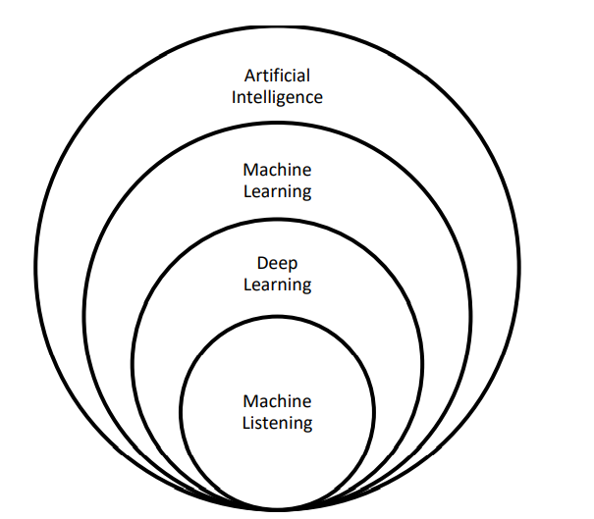
4 – Background e process

Slide 6
5 – State of the art
Deep Learning frameworks: Pytorch, MxNet, TensorFlow, MATLAB, NvidiaCaffe, Chainer
Audio spectrum analysis is key to a good music genre classification.
GTZAN, Million Song and FMA(Free Music Archive) are the most known and used datasets in the industry.
Simpler datasets reveal better accuracy results, but the classification is targeting a smaller amount of music genres. On the other hand, more complext datasets are capable of classifying a bigger number of music genres, but they drop the accuracy of the neural network.
Neural networks accuracy varies between 20% to 80%.

Slide 7
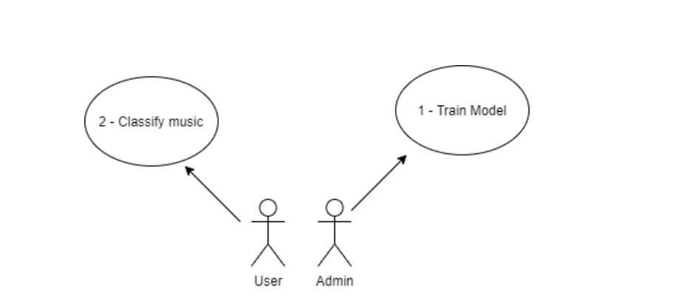
6 – Design – Casos de uso

Slide 8
7 – Design – Listagem de componentes
Android Application
Web-API
Storage
Neural Network
Code Library
Audio Loader
Audio Converter
Data Preprocessor
Evaluator

Slide 9
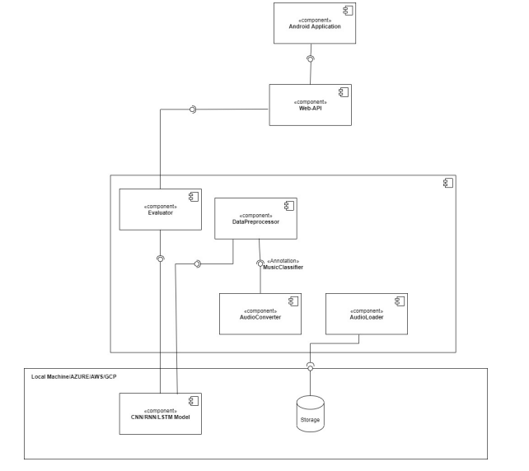
7 – Design – Component Diagram

