Slide 1
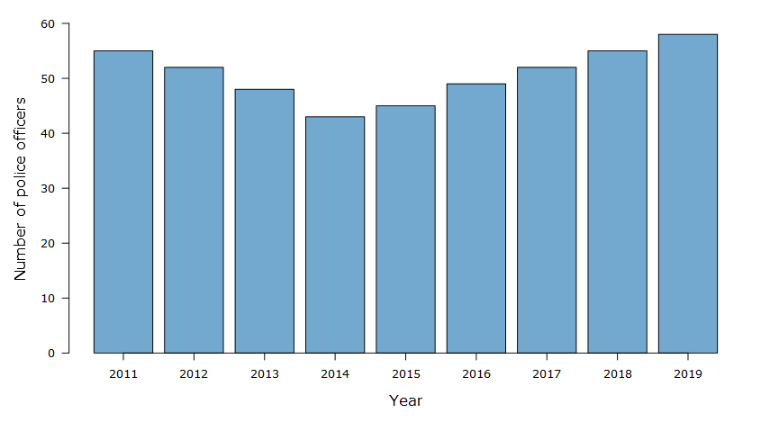
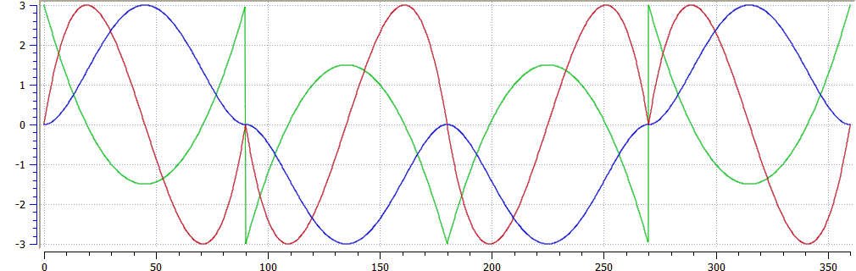



Data Visualization Hub
Last Readings
By block
Block 1
Block 2
Block 3
Block 4
Mean of blocks
XX
Block 1
XX
Block 2
XX
Block 3
XX
Block 4
Temperature curves
By blocks
Block 1
Block 2
Block 3
Block 4
Day
Week
Year
Mean of blocks
Day
Week
Year
Download the data
Download
This tool was developed by the Ciampitti Lab Group

