Slide 1
Wildcat Squad
Luiz Felipe Almeida - Agronomy
Gustavo Santiago - Agronomy
Gabriel Hintz - Agronomy
Carlos Hernandez - Agronomy

Slide 2
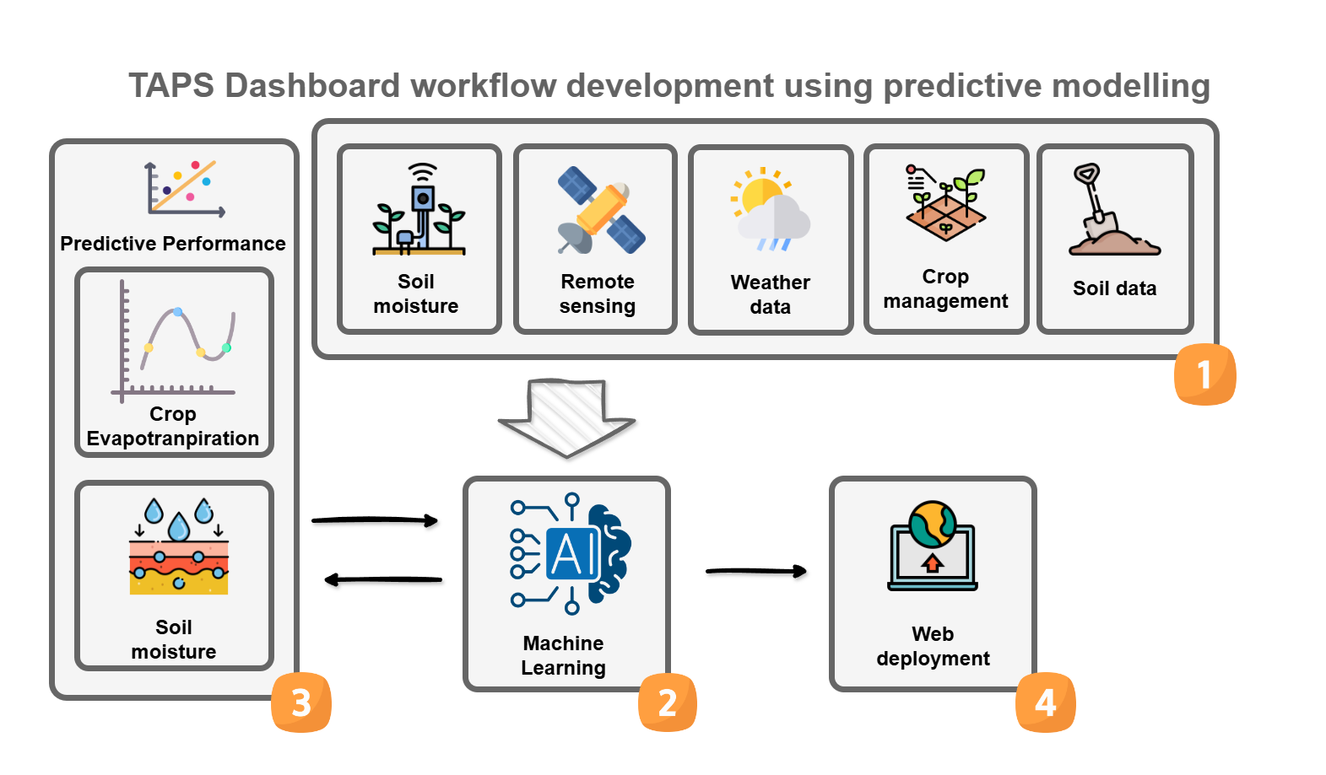
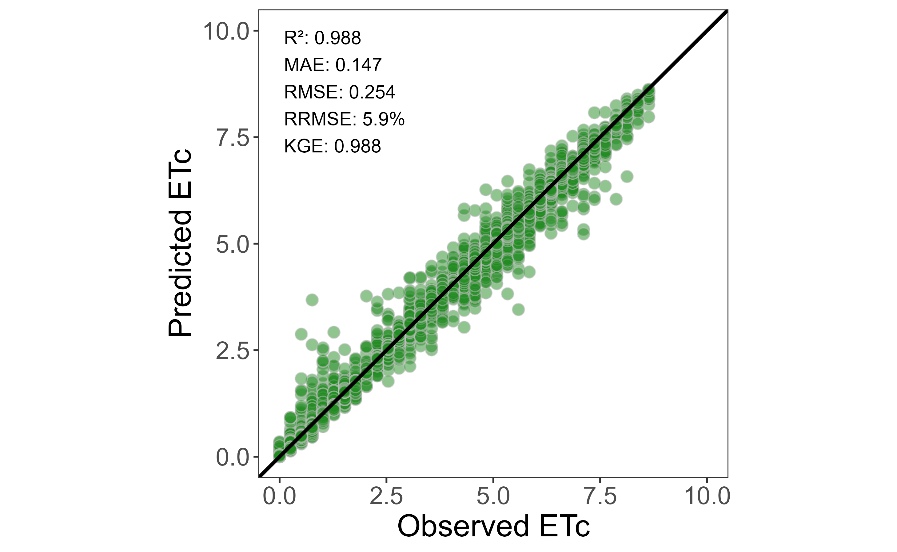

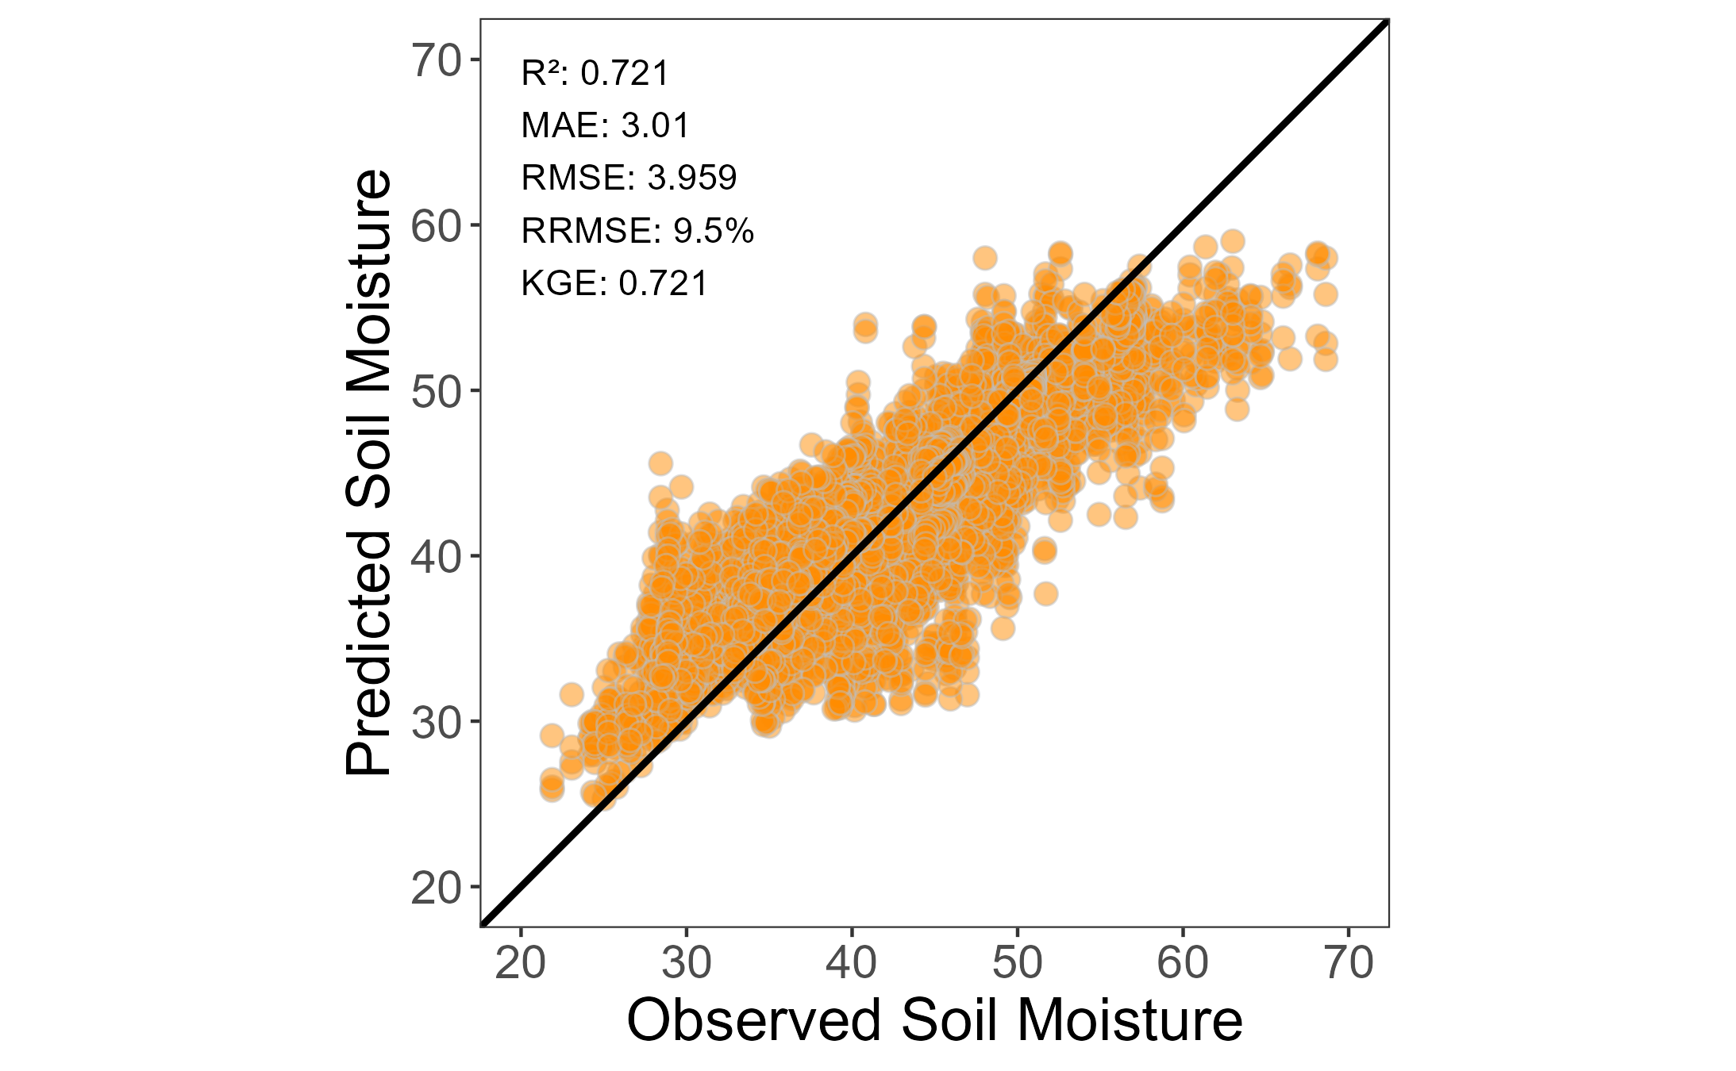

Notes:
Create a sketch showing dashboard input datasets, outputs, programming language, dashboard framework, and the overall data processing pipeline. Ensure the sketch is clearly visible. Focus on the main aspects of the dashboard.

