Slide 1

A Data Fusion Approach for Digital Dependency
Gustavo Lazarotto Schroeder

Slide 2
Context
Technological connection brings a dark side, like internet overuse and screen addiction.
(KHALILI-MAHANI; SMYRNOVA & KAKINAMI, 2019).
Fear of missing out, anxiety and depression.
(ELHAI et al., 2020)
Mobile game addiction relation to depression, social anxiety, and loneliness.
(WANG & SHENG, 2019)
Many individuals have become addicted to using technologies and, as a consequence have experience negative mental effects.
(ZARA & MONTEIRO, 2021)
The home confinement due to the COVID-19 pandemic may have worsened this situation.
(ZARA & MONTEIRO, 2021)

Slide 3
Related Work
Analysis of behavioral characteristics of smartphone addiction using data mining
(LEE, MyungSuk; HAN, MuMoungCho; PAK, JuGeon., 2018)
A Smartphone Addiction and Disease Prevention System Through the Collection and Analysis of Smartphone Usage Patterns
(RYU, Myeong-Un et al., 2015)
Correlation Analysis of Internet Addiction with Daily Be-havior: A Data-Driven Method
(ZHANG, Xingxu et al., 2020)
Internet Addiction and Mental Health Prediction Using Ensemble Learning Based on Web Browsing History
(PURWANDARI, Betty et al., 2020)
Smartphone dependence classification using tensor factorization
(CHOI, Jingyun et al., 2017)
A systemic smartphone usage pattern analysis: focusing no smartphone addiction issue
(AHN, Heejune; WIJAYA, Muhammad Eka, 2014)

Slide 4
Proposed Solution
The related works focus on analyzing specific contexts such as internet addiction using browsing history or smartphone addiction using sensor data.
Using data fusion this study aim to combine context information into a context record to later identify the level of digital dependency.

Slide 5
Data Fusion
Data Fusion was developed in 1985 by the U.S. Joint Directors of Laboratories (JDL) Data Fusion Group.
“A multi-level process dealing with the association, correlation, and combination of data and information from single and multiple sources to achieve refined position, identify estimates and complete timely assessments of situations, threats and their significance.”

Slide 6
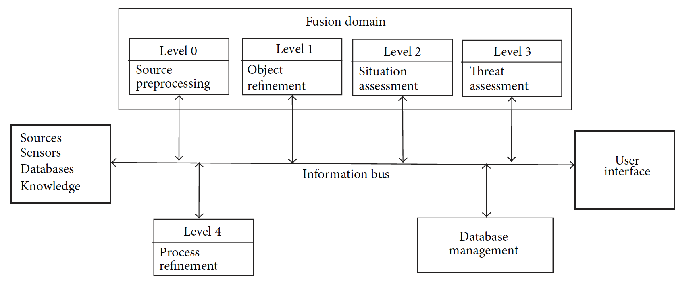
Data Fusion
The JDL (Joint Directors of Laboratories) data fusion framework
Notes:
Level 0 -> Smartphone Log Data + Web Browser History

Slide 7
Data fusion involves combining data to estimate or predict the state of some aspect of the universe.
STEINBERG, Alan N.; BOWMAN, Christopher L. Revisions to the JDL data fusion model. In: Handbook of multisensor data fusion. CRC press, 2017. p. 65-88.

Slide 8
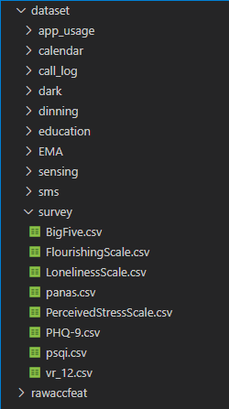
StudentLife Dataset
The StudentLife continuous sensing app assessed the day-to-day impact of workload on stress, sleep, activity, mood, sociability, mental well-being and academic performance of a single class of 48 students across a 10 week using Android phones
The whole StudentLife dataset is presented in one big file, which contains:
Sensor data
EMA data
Survey responses
Educational data

Slide 9
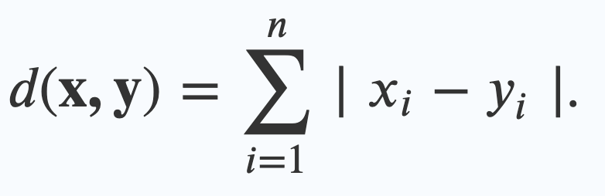
Manhattan Distance
One of the simplest classification algorithms, k-NN measures the distance between the unlabelled observations and the training samples to infer which class they belong.
The Manhattan distance between two points x = (x₁, x₂, …, x_{n}) and y = (y₁, y₂, …, y_{n}) in n-dimensional space is the sum of the distances in each dimension.
Manhattan distance (L1 norm) may be preferable to Euclidean distance (L2 norm) for the case of high dimensional data.

Slide 10
Data Fusion Development

Slide 11
Level 0 - Source Preprocessing
Reduce the amount of data and to maintain useful information for the high-level processes.
In this first step, the sensors, EMA, and surveys that could be used to detect the level of digital intoxication were selected and loaded into PostgreSQL.

Slide 12
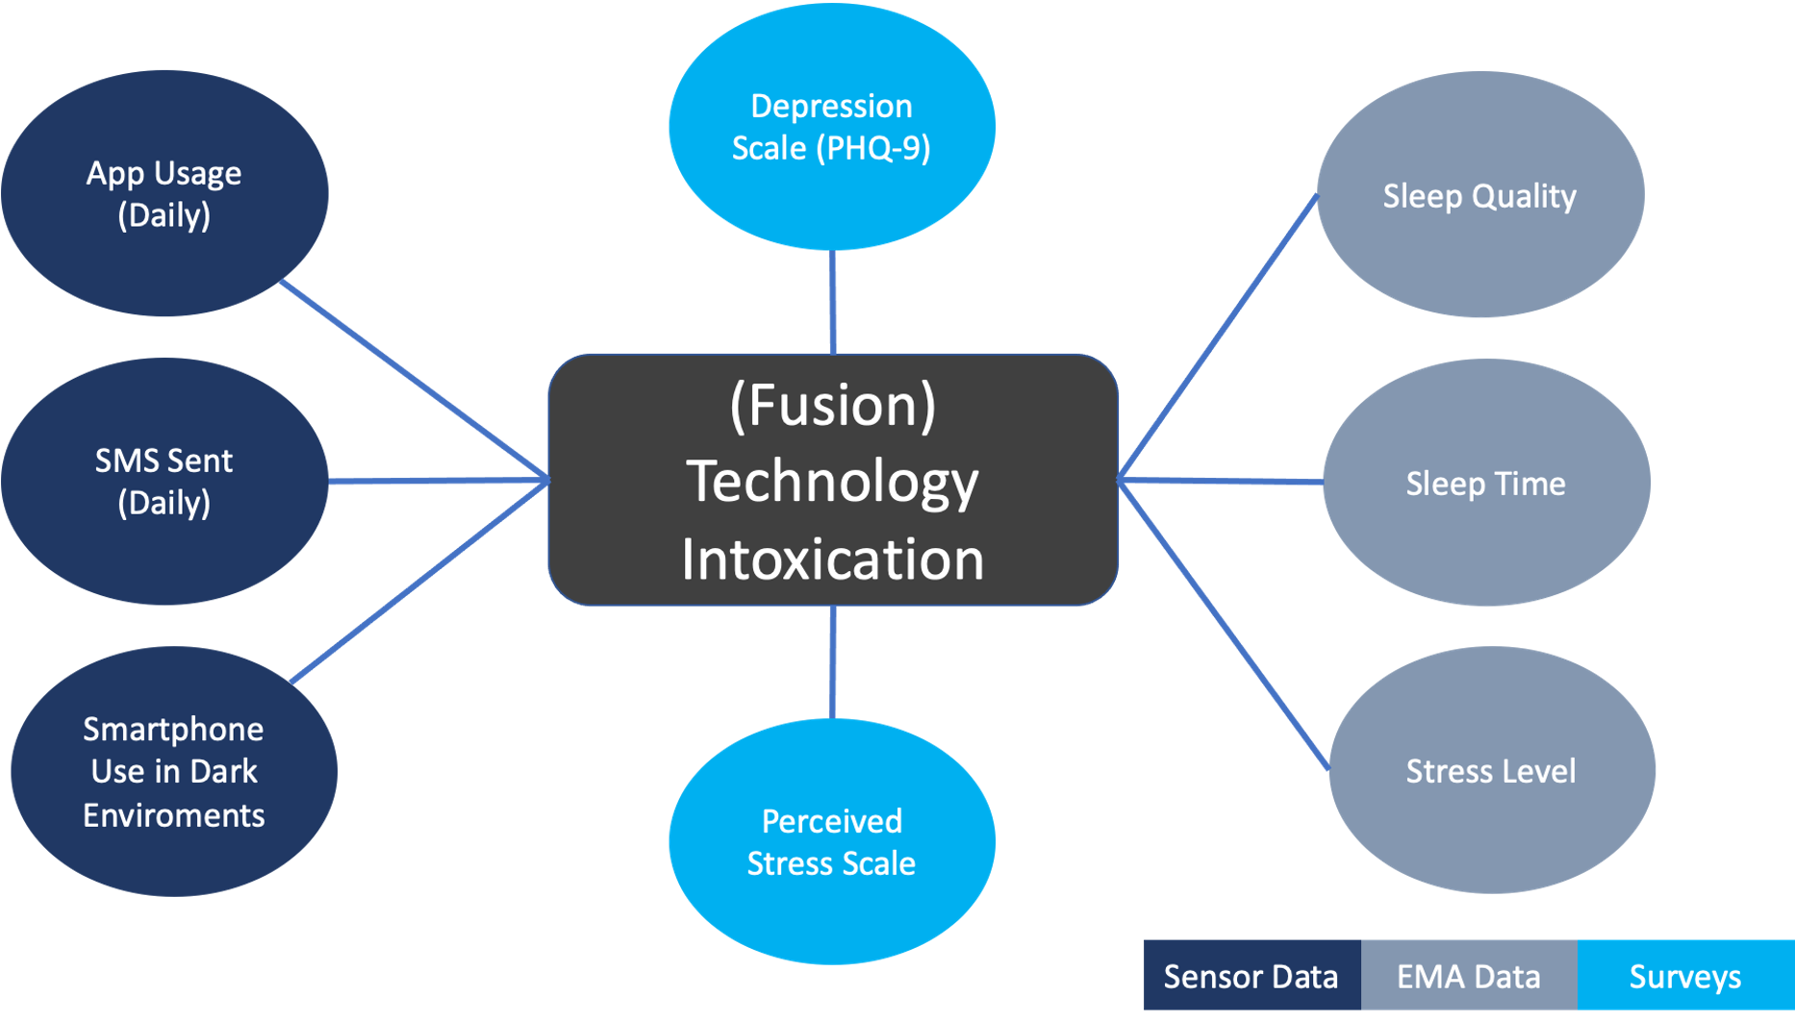
Level 0 - Source Preprocessing

Slide 13
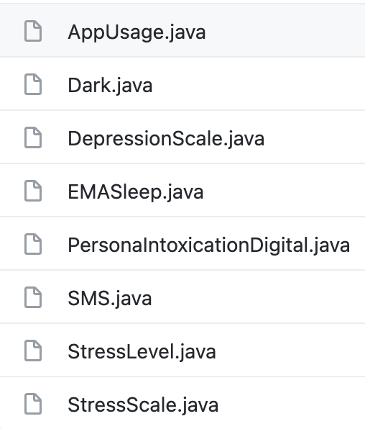
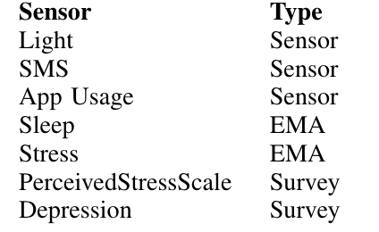
Level 0 - Source Preprocessing

Slide 14
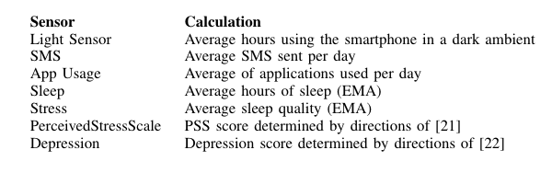
Level 1 - Object Refinement
This step aims to perform the estimation and prediction of entity states based on inferences from observations.
After loading the sensor data into PostgreSQL, calculations were performed for each of the sensors.

Slide 15
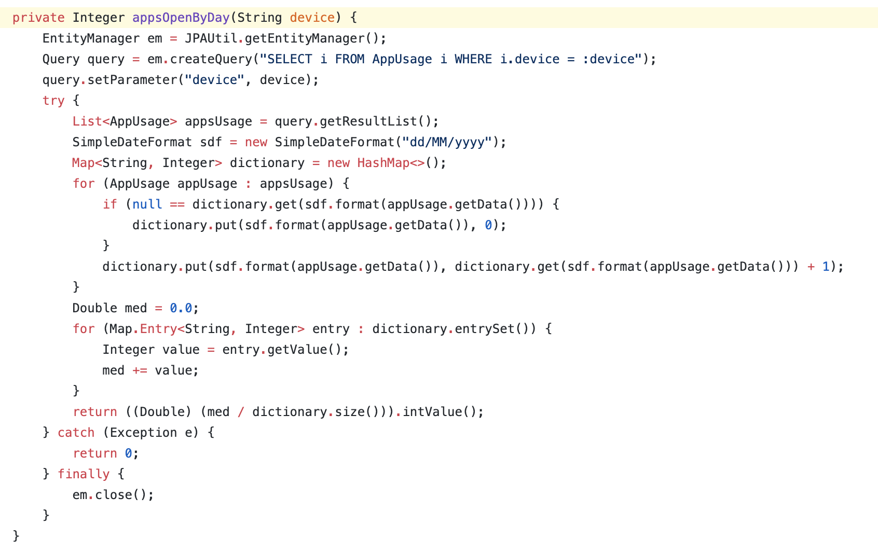

Slide 16
Level 2 - Situation Assessment
This step aimed to estimate and predict entity states based on inferred relationships between entities.
Using the architecture constructed in Level 1, a report was built to list data by device ID, generating a CSV file.
From this file, a data analysis process took place using Microsoft Excel.
This analysis aimed to understand the distribution of values by sensors and to create target personas of digital intoxication.

Slide 17
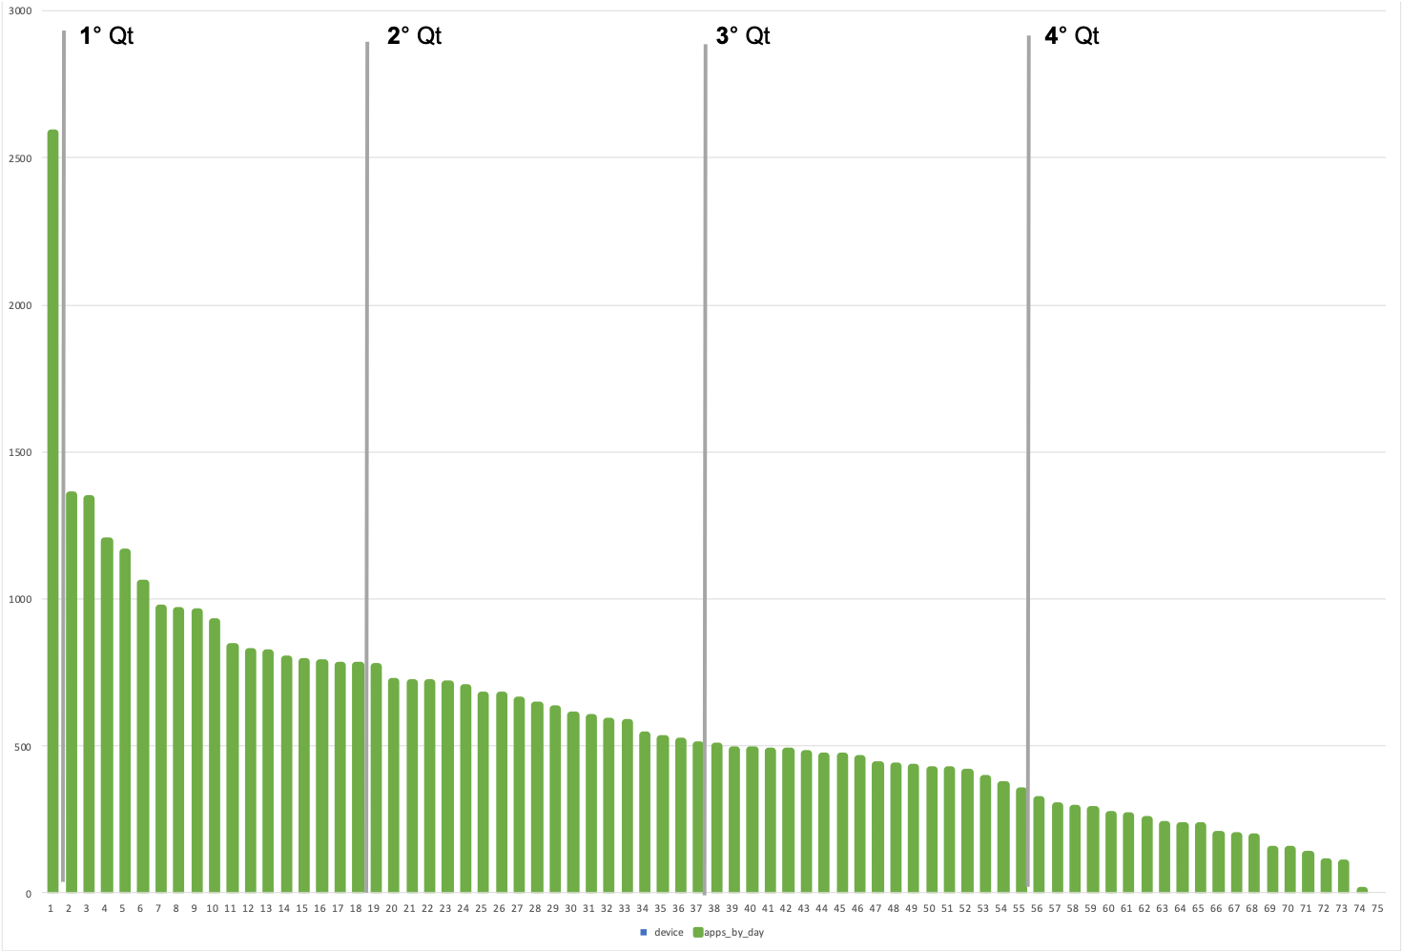
Level 2 - Situation Assessment
AVG Open Apps

Slide 18
Personas

Slide 19
Level 3 - Impact assessment
This step aimed to estimate and forecast effects in situations of planned and estimated actions, foreseen by the participants.
In this step, the algorithm was build using the feature level non-parametric Manhattan Distance.
For each device, the distance between the distribution pattern of sensors, EMA, and questionnaires was compared to the personas defined values, using Manhattan Distance.

Slide 20
Level 3 - Impact assessment
The distance is the sum of all dimensions, multiplied by the importance weight, divided by the individual rounded average.
The weights were assigned through the interpretation of the data distribution.
To prevent a numerical attribute from gaining a greater weight than another, in addition, the normalization of all dimensions was performed through the rounded average of the distances.

Slide 21
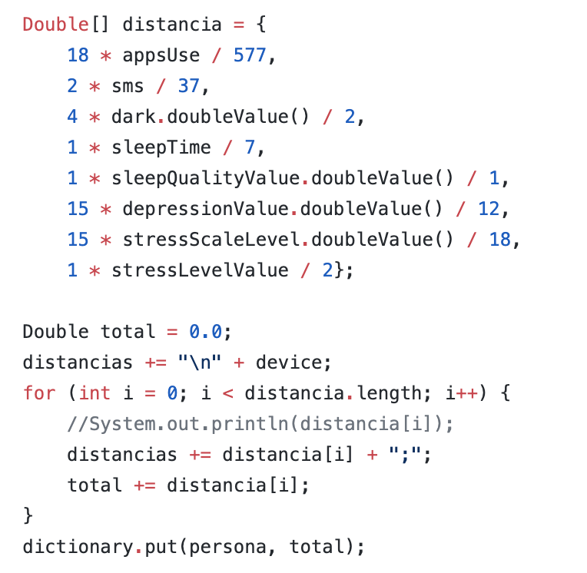
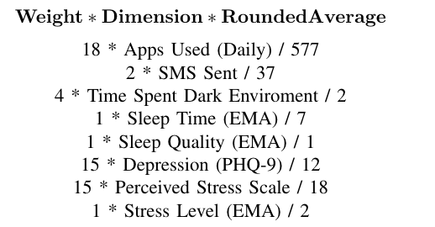
Level 3 - Impact assessment

Slide 22
Level 4 - Process Refinement
At this stage, in order to carry out the acquisition and processing of adaptable data to support the objectives;
The calculation for sensitivity analysis was performed to select only the most relevant persona for each device, providing as output a probability of the user belonging to each persona.

Slide 23
Running Code

Slide 24
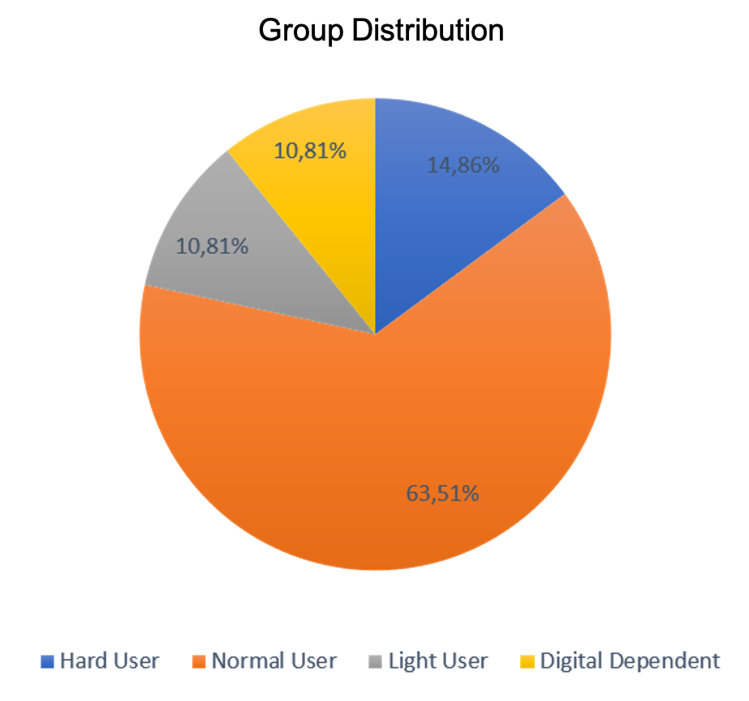
Results

Slide 25

Digital Dependent
1edff768-5466-42b7-86d3-539556887683
Apps Open By Day (AVG): 955
SMS Sent By Day (AVG): 40
Dark Enviroment (AVG): 2 Hours
Sleep Time (EMA): 7 Hours
Sleep Quality (EMA): 1 (Very Good)
Stress Level (EMA): 2 (Definitely Stressed)
Depression Scale PHQ: 18 (Moderately Severe)
Perceived Stress Scale: 12 (Low Stress)

Slide 26
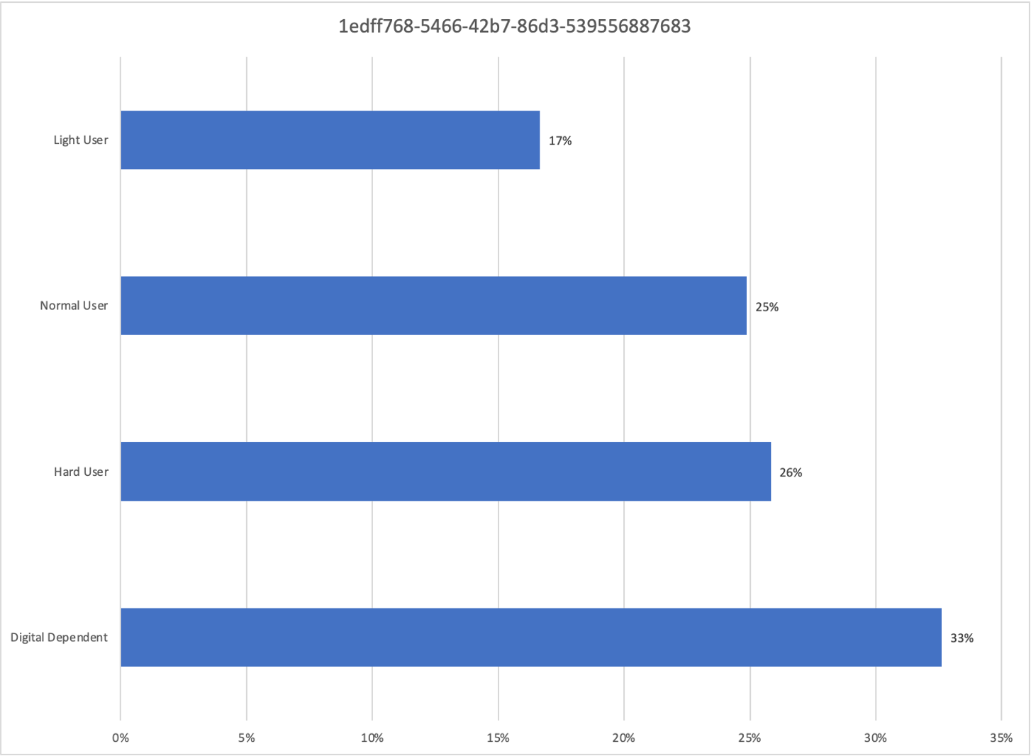

Slide 27
Conclusion
Data Fusion is a powerfull tool when analysing behaviora characteristics of smartphone addiction.
The combination of context information with Data Fusion helps to quickly identify the level of digital dependency.
An approach using Manhattan Distance allows for quick identification of the nearest neighbor, allowing future use in an application that can intervene by identifying sudden changes in levels of digital intoxication.

Slide 28
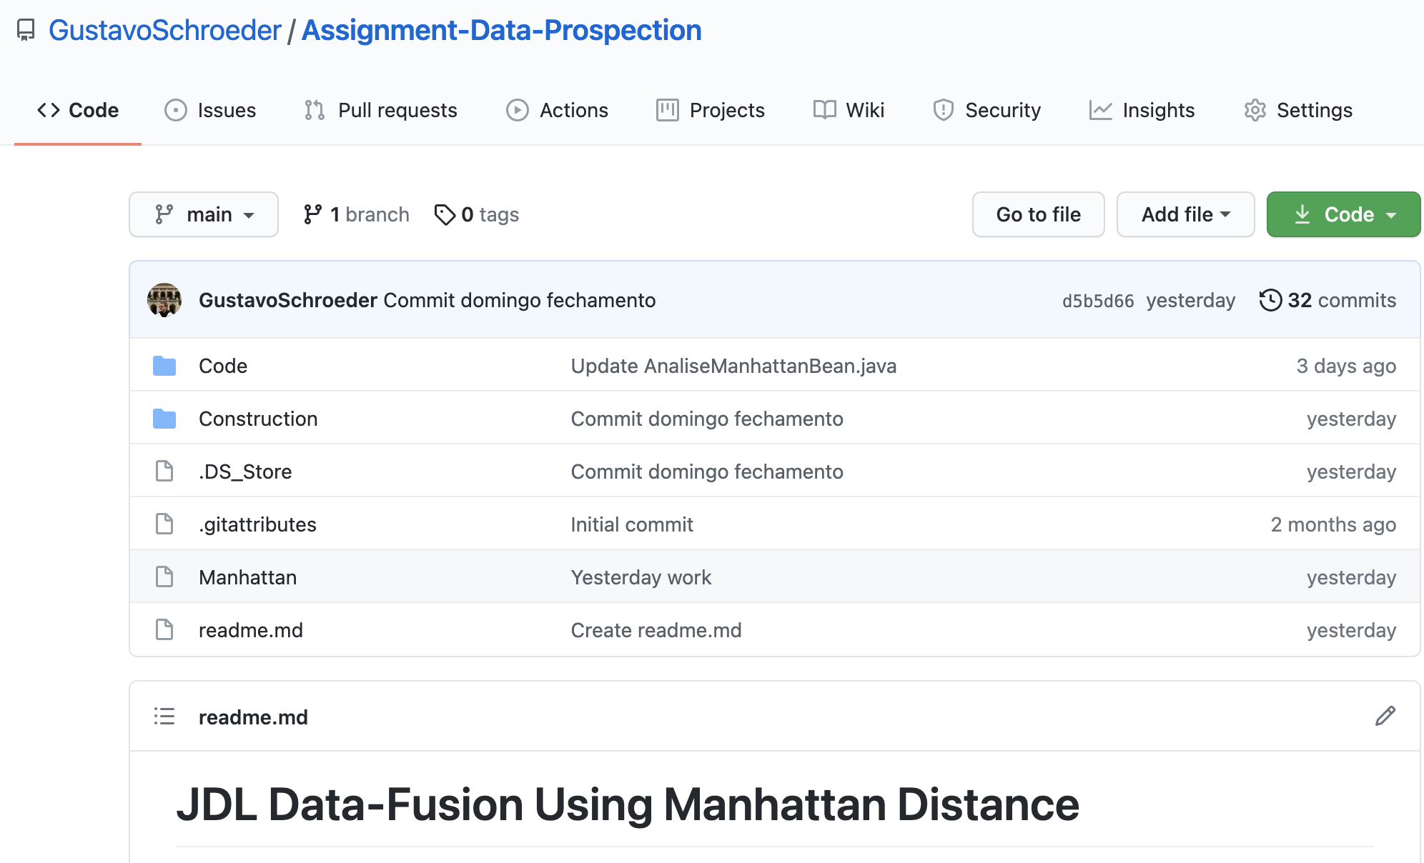
https://github.com/GustavoSchroeder/Assignment-Data-Prospection

