Slide 1
Machine learning in bioinformatics
An introduction to supervised/unsupervised machine learning in transcriptomics

Slide 2
Short about me:
Gustaw Eriksson (gustaw.eriksson@ki.se)
B.Sc. in Molecular Biology & M.Sc. in Bioinformatics from Lund University.
PhD student in the Reproductive Endocrinology and Metabolism group led by Elisabet Stener-Victorin
Researching the etiology of PCOS
Single-nuclei RNA-sequencing and bioinformatics
Endometrium organoids
Wet and dry lab

Slide 3
Todays schedule:
Before lunch:
Supervised Machine Learning (SML)
Linear regression, K-nearest neighbours (KNN), Random Forest
Unsupervised Machine Learning (UML)
K-means clustering, Hierarchical clustering, Principal component analysis (PCA)
After lunch:
Machine Learning (ML) in practice
DESeq2 tutorial in R analysing bulk RNA-sequencing data
Questions and discussion

Slide 4
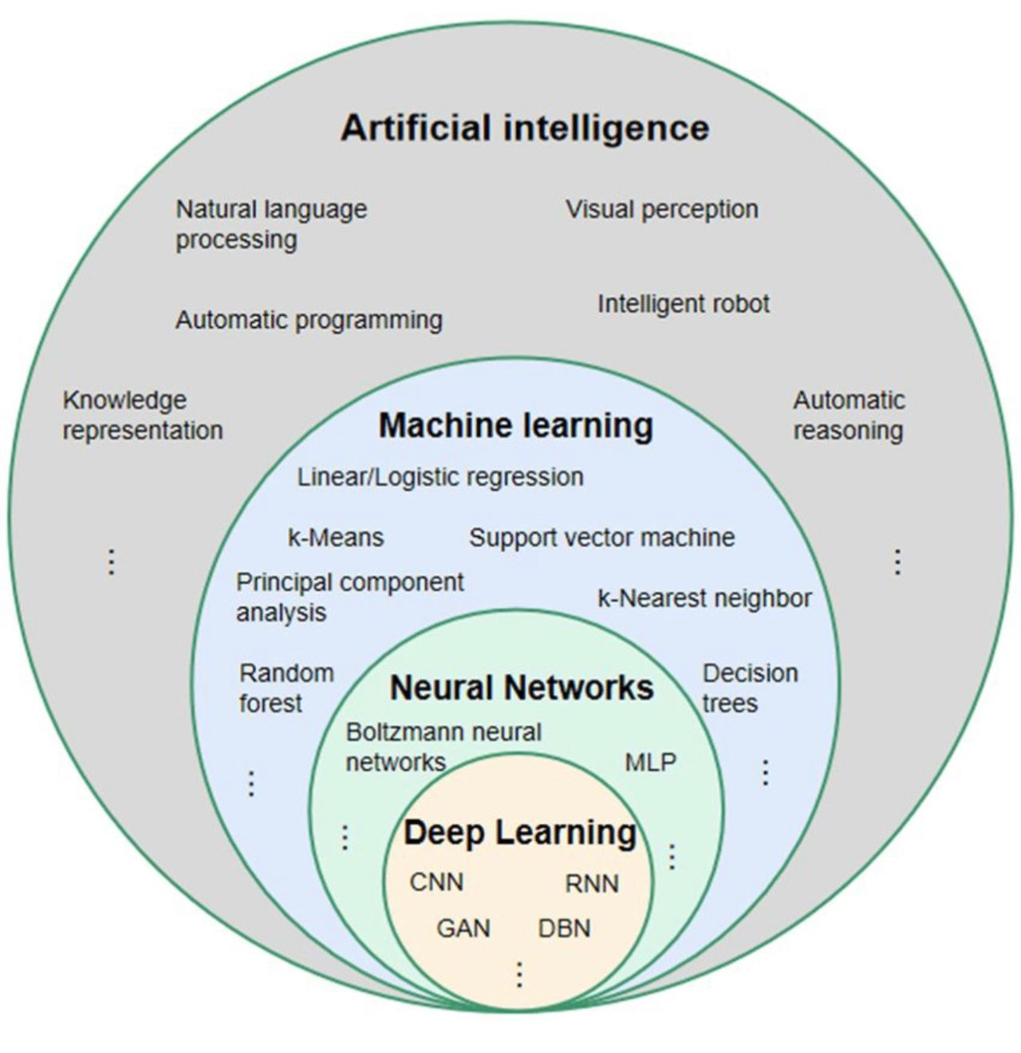
AI, Machine Learning, Neural Network and Deep Learning. What’s the difference?
Machine learning (ML) is a subfield of AI, or a path to AI
Algorithms to learn insights and recognise patterns from data
Deep Learning and Neural Networks are methods of ML
Deep Learning structures algorithms in Neural Networks, with the aim of teaching them to take decisions
AlphaSignal.ai

Slide 5
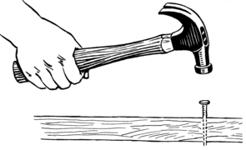
ML algorithms are tools used by us and machines
Today we will go through several algorithms. Remember that:
Most important, know when to apply the tools and when not to
Understanding the math will help you to master the tools, but it is not crucial
Validation and quality control is vital
Terminology is key when communicating

Slide 6
Supervised Machine Learning (SML)
In SML, algorithms learn from labelled data
Regression is used to understand the relationship between dependent and independent variables
Classification assign test data into categories based on specific variables

Slide 7
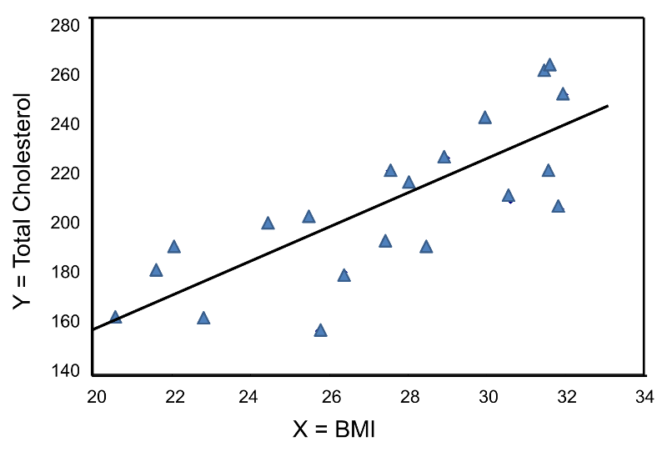
Simple Linear (and logistic) regression
Used to predict (forecast) the value of the dependent variable based on the independent variable
Linear regression is applied on continuous variables, whilst logistic regression on discrete

Slide 8
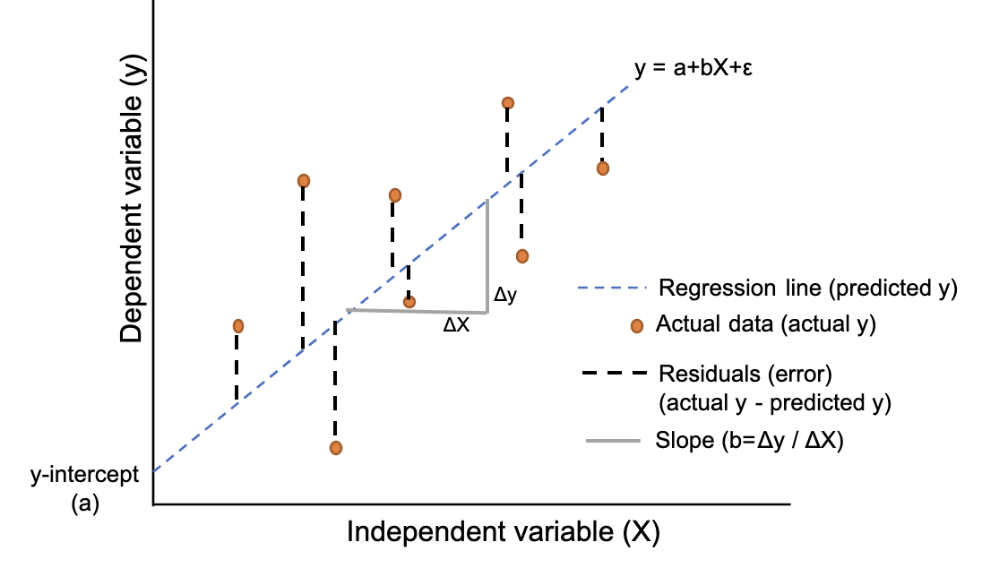

Simple linear regression
Constant/
Intercept
Independent Variable
$$y=a+bx+ ∈$$
Dependent
Variable
Slope/
Coefficient
Residual/
Error
Reneshbedre.com
Residuals can be used to validate the model by making sure that they are independent and normally distributed
As independent variables increases, multiple linear regression is applied

Slide 9
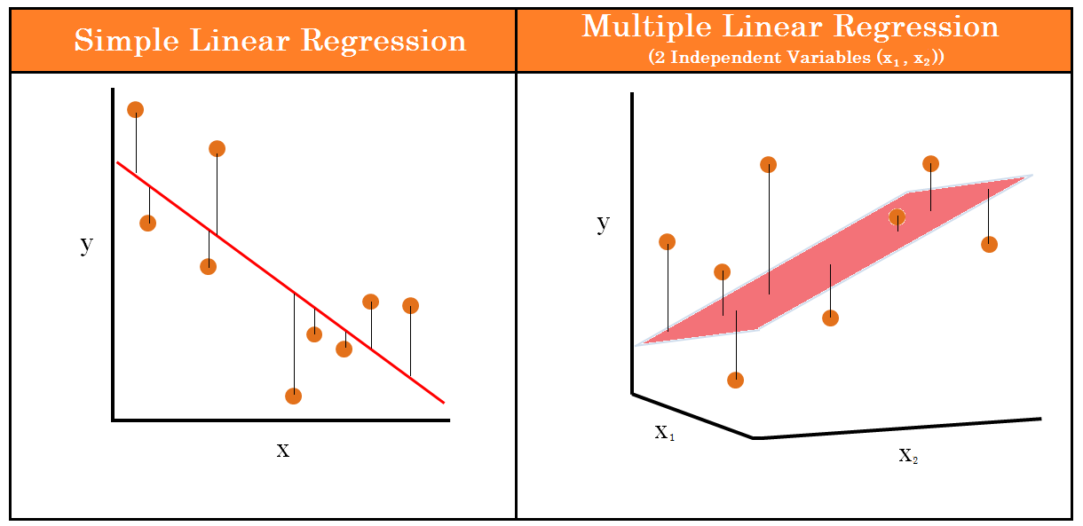

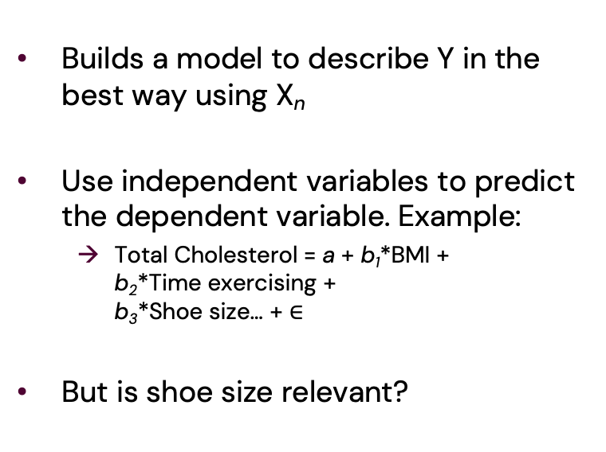
Multiple linear regression
Builds a model to describe Y in the best way using X_{n}
Use independent variables to predict the dependent variable. Example:
Total Cholesterol = a + b₁*BMI + b₂*Time exercising + b₃*Shoe size… + $∈$
But is shoe size relevant?
$$y=a+b_{1}x_{1}+b_{2}x_{2}+b_{3}x_{3}+ …+ ∈$$
Reneshbedre.com

Slide 10
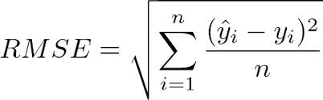
Multiple linear regression assumptions and Root Mean Square Error
Parametric test based on assumptions:
Linear relationship between Y and X
X_{i} are not highly correlated with each other
The variance of the residuals is constant
Independence of observations
Residuals are normally distributed
Model can be tested with Root Mean Square Error (RMSE), the standard deviation of the residuals:
n = Sample size
ŷ = Predicted value
y = True value
i = Variable i

Slide 11
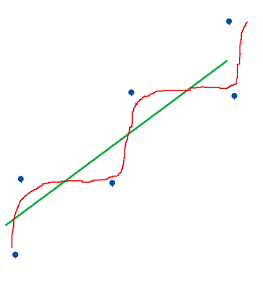
Multiple linear regression for prediction
Create a random 80/20 split of the data, generating training data (80%) and test data (20%)
Train a regression model on the training data
Apply the model on the test data
Calculate RMSE of the training data (in-sample RMSE) and test data (out-of-sample RMSE)
Compare the RMSE. Indicates how well the model performs on new data.
More complex model → Decreasing RMSE → Overfitting

Slide 12
Linear regression models pros and cons
Pros:
Can be used on continuous (linear) and discrete (logistic) data
Determine influence of independent variables on the dependent
Identifying outliers
Cons:
No mixed data (continuous & discrete
Many assumptions
Requires complete data and no missing data

Slide 13
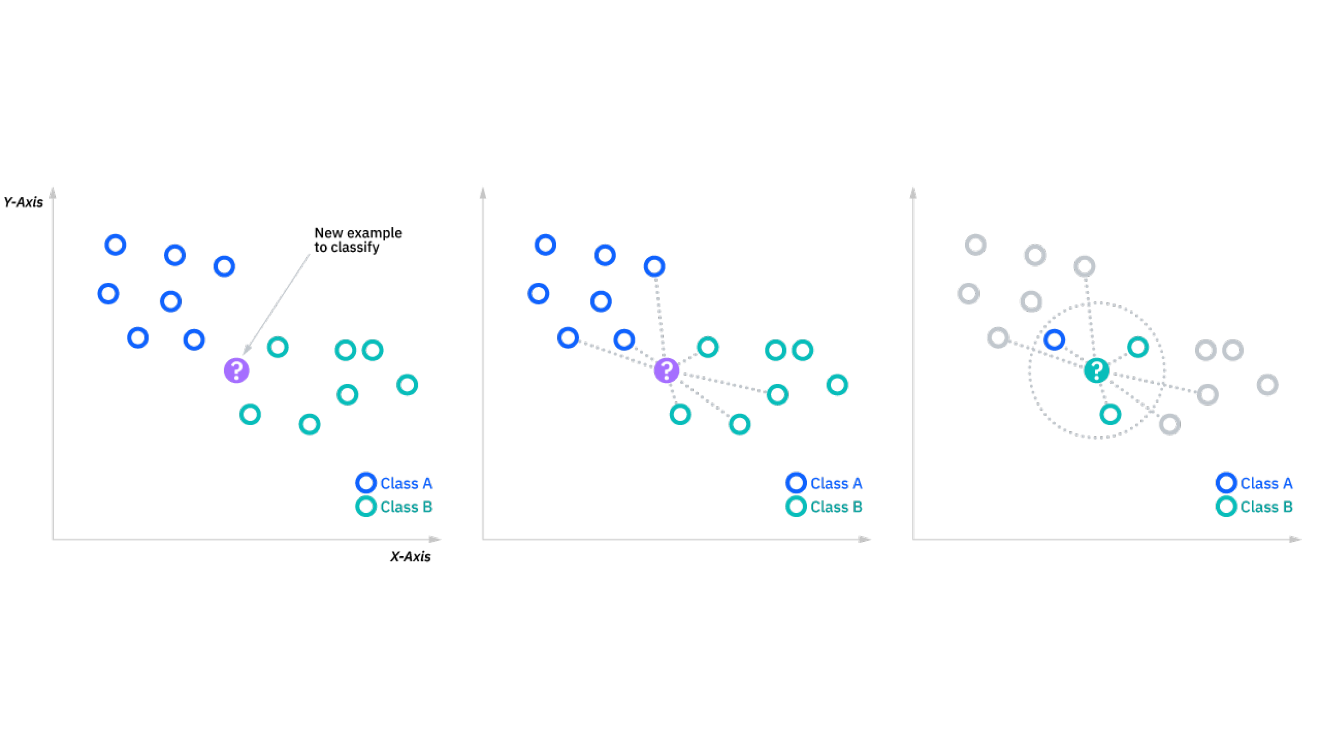
K-nearest neighbors (KNN)
Non-parametric algorithm i.e. no strong assumptions
Often used for classification, predicting the group of a data point
Applies majority voting based on:
Distance metrics
Number of K’s
IBM.com

Slide 14
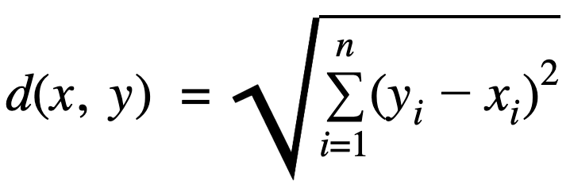
Computing KNN by distance and K’s
K = 3
Calculate the distances, usually with Euclidean distance
Find the nearest neighbours by ranking the distances
Majority vote on the predicted class label based on the K nearest neighbours
IBM.com

Slide 15
KNN pros and cons
Pros:
It is easy to implement
No need to train a model
Versatile, distance algorithms can handle different types of data
Cons:
Data should be of the same scale which can be difficult with large datasets
Setting the K can be challenging
Tips:
Test different K’s
K should be odd numbers to avoid any draws

Slide 16
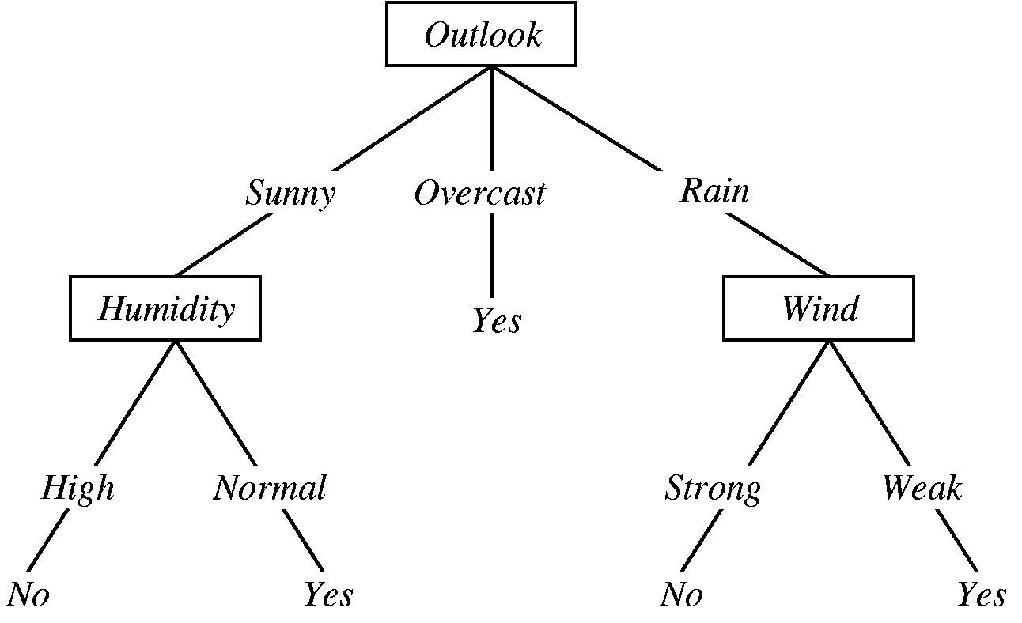
Decision tree and random forest
Random forest is based on decision tree’s
Generates many decision tree’s creates the random forest to classify unlabeled data
A single tree is not accurate
Can use both categorical and continuous variables
Will it rain? Yes or no?
Towardsdatascience.com

Slide 17
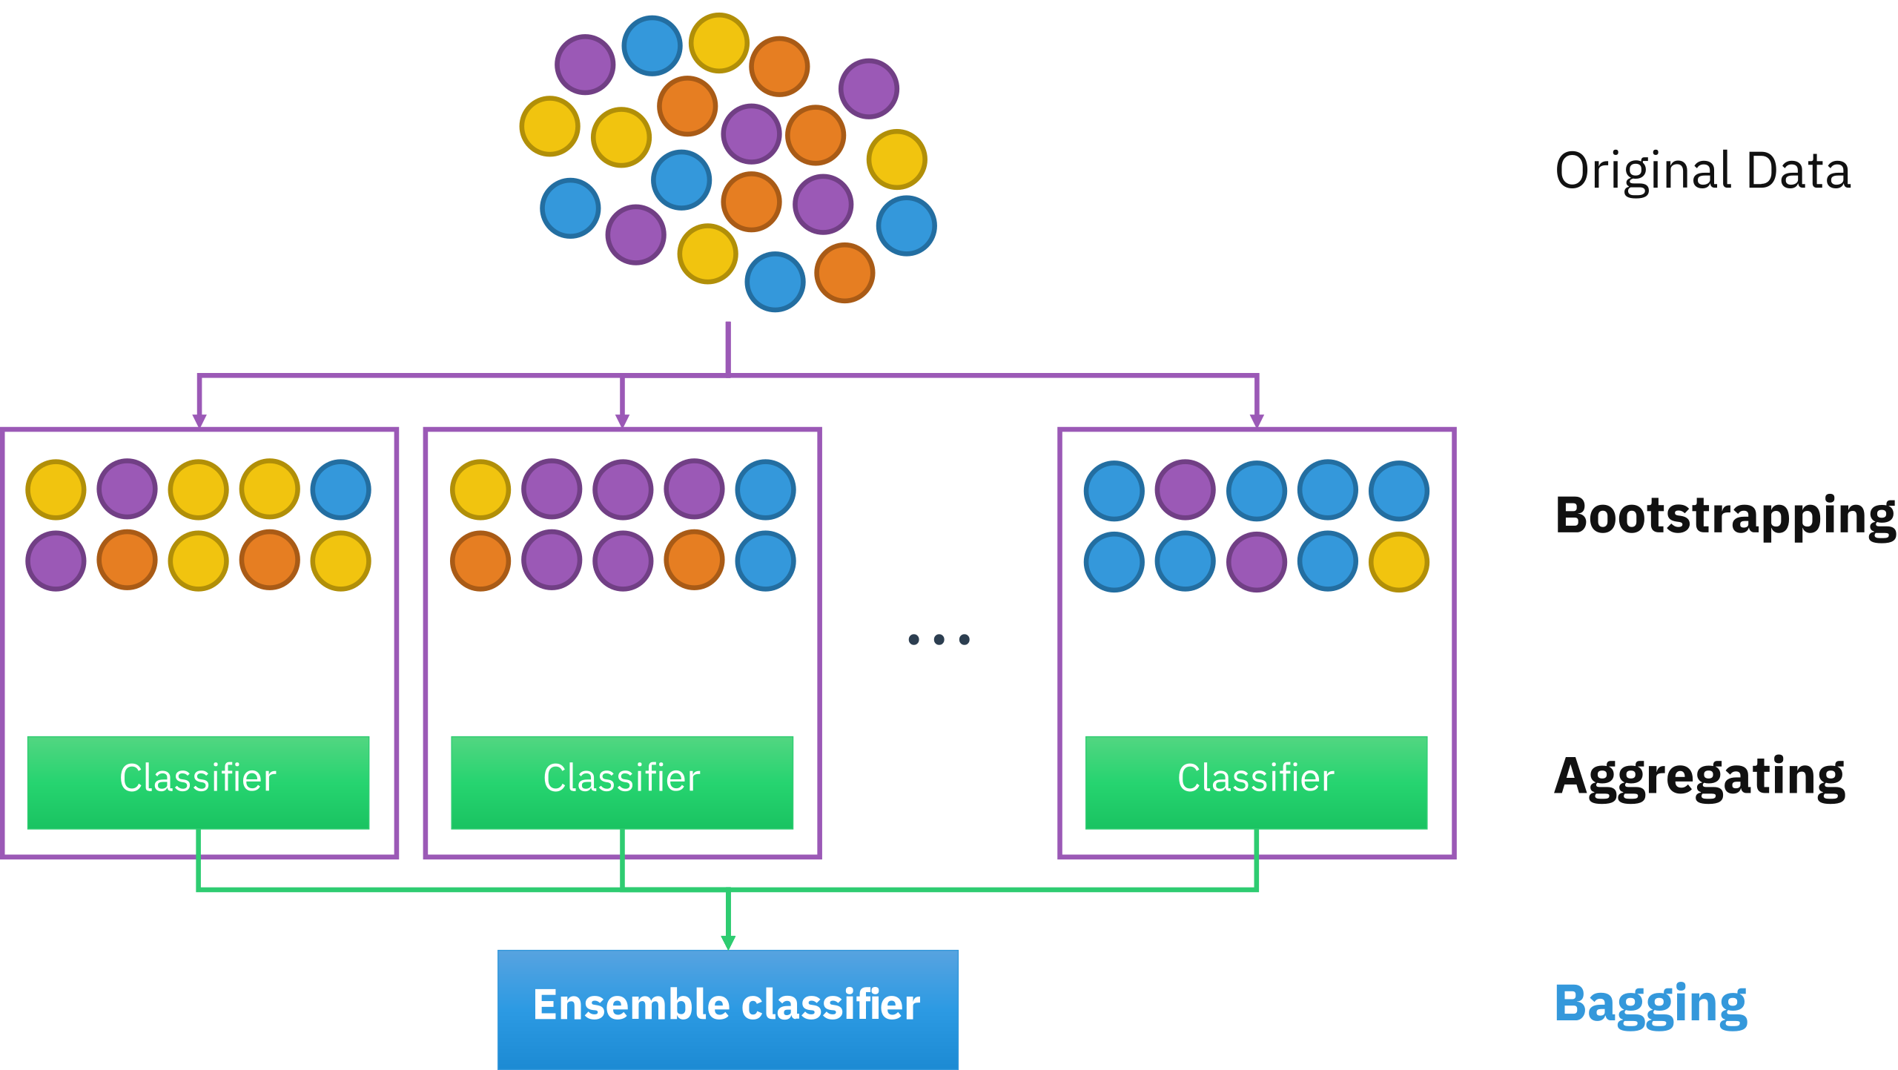
Random forest
Create a bootstrapped dataset that is the same size of the original
Randomly selected data, where duplicates are allowed
Create a decision tree using the bootstrapped data using a random subset of variables
Repeat 1 and 2 multiple times
Impute your unlabeled data and let the random forests’ many classifiers label
Majority vote classifies the unlabeled data
Majority voting
Will it rain?
Yes | No
80 | 20
Wikipedia.org

Slide 18
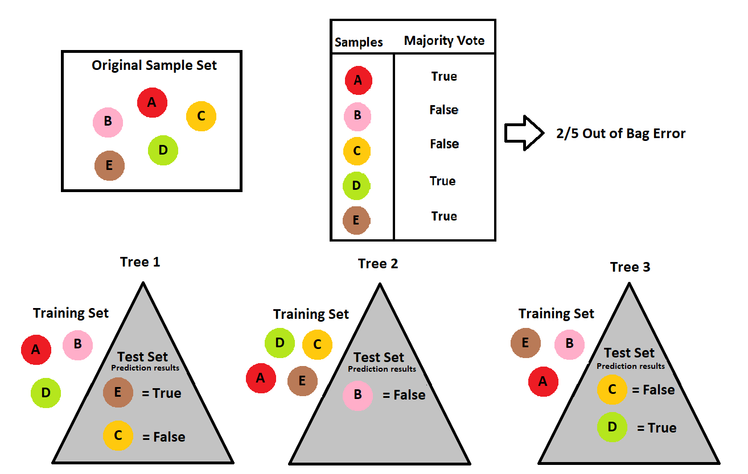
Random forest validation with Out-of-Bag
The Random forest model can be validated using the Out-of-bag error
The Random forest is used to predict labels of data not selected for the bootstrapped data (test set)
By Sauxeris - Own work, CC BY-SA 4.0, https://commons.wikimedia.org/w/index.php?curid=97324306

Slide 19
Random forest pros and cons
Pros:
Can be used on many types and mixes of data
Can be applied on both classification and regression problems
Can be applied on data with missing values
No overfitting and curse of dimensionality
Cons:
Very complex and you can’t follow the decision of the tree
Training the model takes time and computing power

Slide 20
Unsupervised machine learning (UML)
In UML, algorithms are used to analyze and cluster unlabelled data
Data grouping based on patterns
Similarities and differences of the data
Clustering is applied on raw data and groups it based on similarities and differences between the structure and/or patterns of the data
Dimensionality reduction can be applied to reduce complexity of data whilst preserving the structure to reduce ”noise” and overfitting ML algorithms.

Slide 21
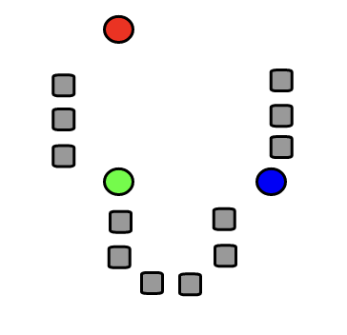
K-means clustering
Not to be confused with KNN
Groups similar datapoints in clusters
K is the number of cluster and means generated
K means shown in colour
By I, Weston.pace, CC BY-SA 3.0, https://commons.wikimedia.org/w/index.php?curid=2463053

Slide 22
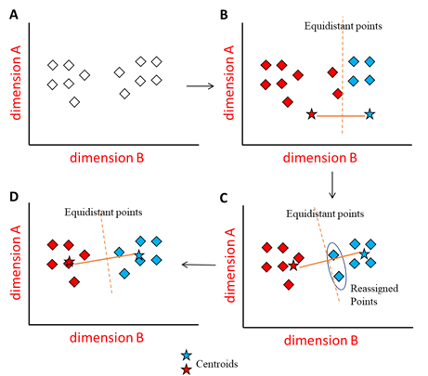
K-means clustering steps
Set the number of K’s
With Elbow plot
Generates K random centroids
Creates K clusters by assigning each data point to closest centroid
Calculates new centroids for each cluster
Reassigns points with new centroids
If new assignments, repeat 4
If no new assignments, terminate algorithm
Oxford Protein Informatics group, https://www.blopig.com/blog/2020/07/k-means-clustering-made-simple/

Slide 23
K-means clustering steps
Set the number of K’s
With Elbow plot
Generates K random centroids
Creates K clusters by assigning each data point to closest centroid
Calculates new centroids for each cluster
Reassigns points with new centroids
If new assignments, repeat 4
If no new assignments, terminate algorithm
By Chire - Own work, CC BY-SA 4.0, https://commons.wikimedia.org/w/index.php?curid=59409335

Slide 24
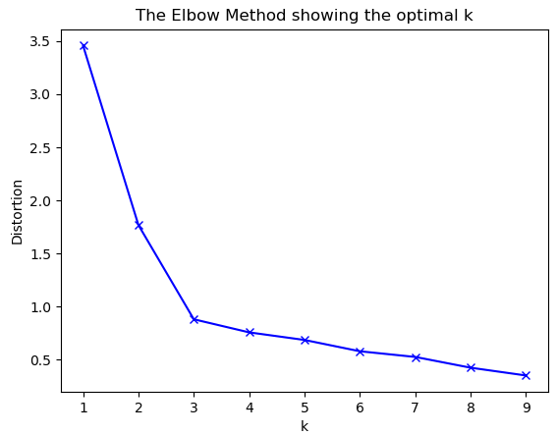
Elbow plot determines number of K’s
First step of K-means clustering is to set the K
The Elbow method is common
Distortions is the sum of squared distances of data points from cluster centers
Decreases as K increases.
0 when K = number of points
Geekforgeeks.org

Slide 25
K-means clustering pros and cons
Pros:
Easy to use
Can be used on large datasets
Adapts to new data
Clusters can be of different shapes and sizes
Cons:
Sensitive to outliers
Choosing K is manual labour and sometimes tough

Slide 26
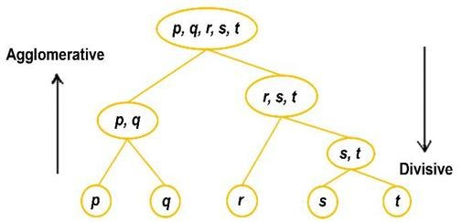
Hierarchical clustering
Groups similar data points to clusters
Defines clusters that are distinct from each other and datapoints within are similar
Creates cluster by ordering clusters:
Bottom-up (Agglomerative)
Top-down (Divisive)
Giacoumidis E et al., “Blind Nonlinearity Equalization by Machine-Learning-Based Clustering for Single- and Multichannel Coherent Optical OFDM”, Journal of Lightwave technology, 2017

Slide 27
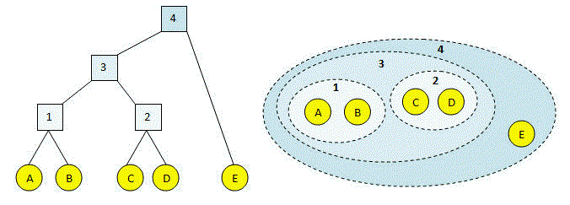
Hierarchical clustering
The length of the branch in the dendogram show how similar the data points are.
Long branch = dissimilar, short branch = similar
https://drive5.com/usearch/manual/agg.html

Slide 28
Hierarchical clustering pros and cons
Pros:
Easy to use
The dendrogram gives information about the data structure
Can be used to set number of clusters
Cons:
Sensitive to outliers
Does not work well with missing data or mixed data
In complex data, difficult to determine number of relevant clusters

Slide 29
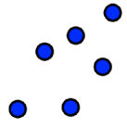

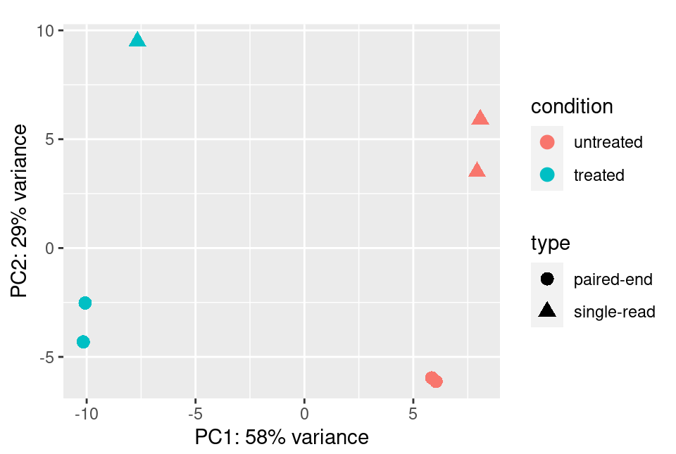
Principal component analysis (PCA)
Common and versatile method used for:
Analysing the structure of data features
Pre-processing for other ML algorithms
Visualisation
Summarises large multi-dimensional datasets to smaller number of dimensions (ideally 2) that can be visualised
Sequenced samples. Many genes, many dimensions
Love M et al., “Analyzing RNA-seq data with DESeq2”, DESeq2 Vignette, 2023

Slide 30
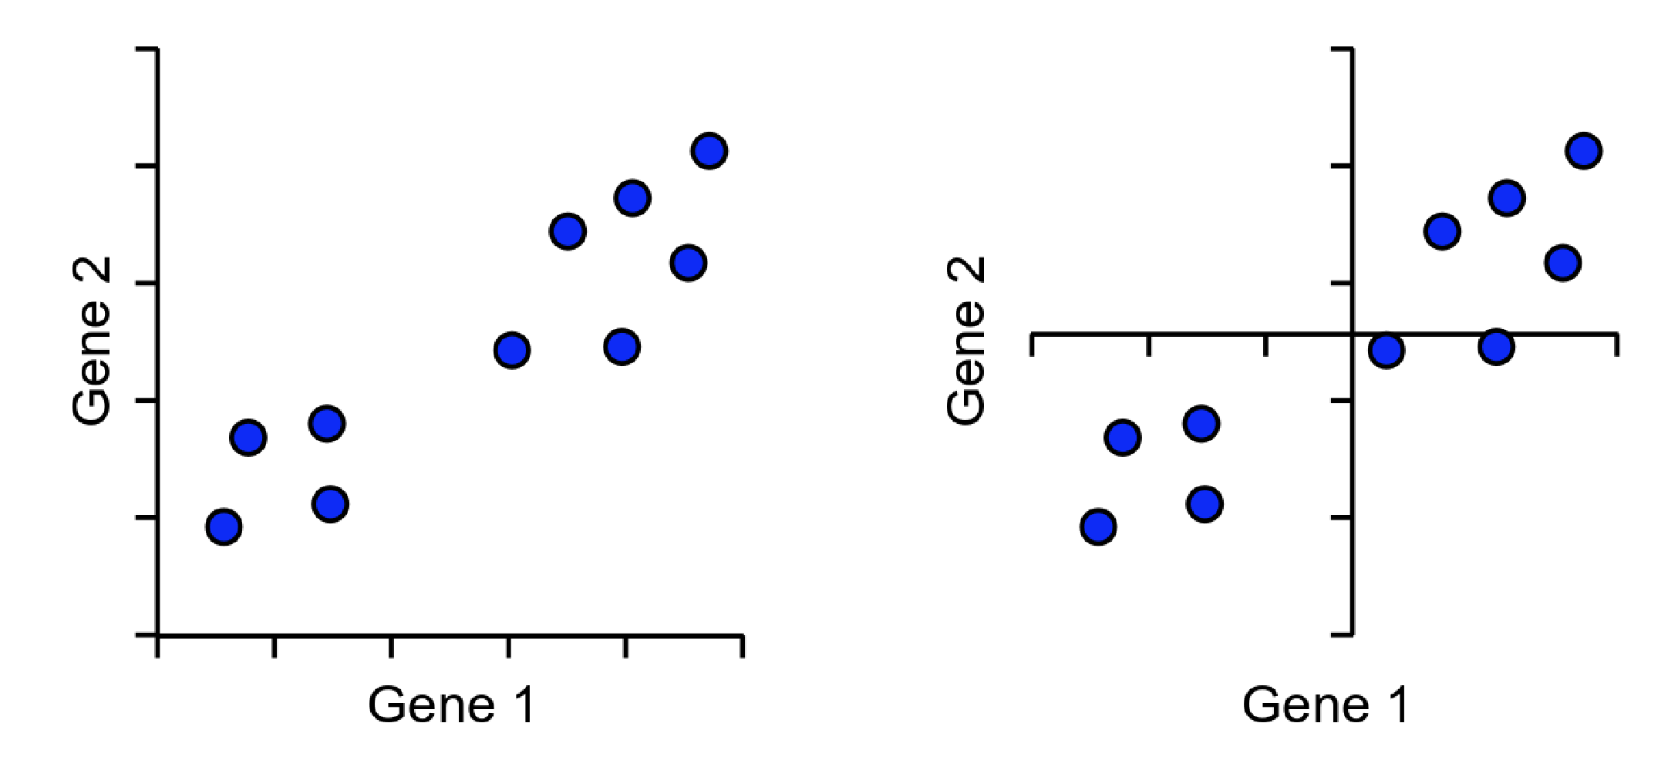
Initializing the PCA
1
 | Sample 1 | Sample 2 | Sample 3 | Sample 4
Gene 1 | 10 | 11 | 3 | 2
Gene 2 | 15 | 14 | 2 | 5
Gene 3 | 10 | 7 | 8 | 9
2
4
3
1. Plot the data. Gene 1 & 2 is higher in sample 1 & 2…
2. Calculate the average of gene 1 and 2 (and n) to find the center of the data.
3. Center the data at the origin (0,0)
https://www.bioinformatics.babraham.ac.uk/training/10XRNASeq/Dimension%20Reduction.pdf

Slide 31
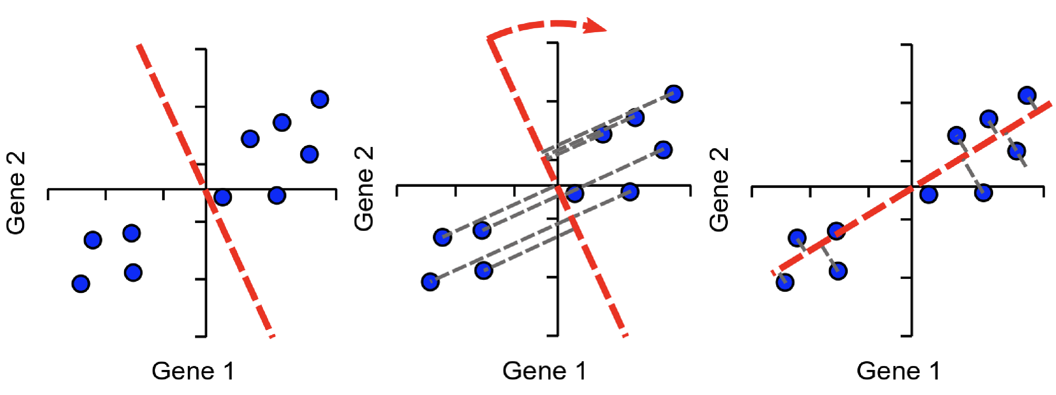
Initializing the PCA and PC1
Find the line, through the origin, with the best fit. The best fit is defined by PCA projecting the distance of the point to the line and minimizing it.
The line is called Principal Component 1 (PC1)
https://www.bioinformatics.babraham.ac.uk/training/10XRNASeq/Dimension%20Reduction.pdf

Slide 32
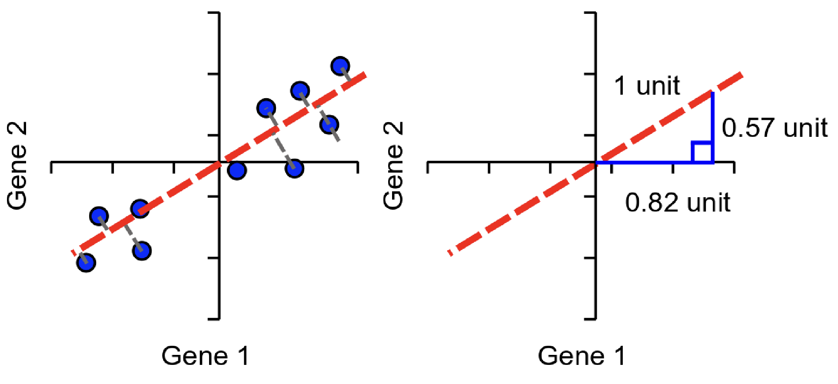
Calculating the eigenvector
The eigenvectors are calculated.
Higher loading indicated more influence on the PC i.e. Gene 1 (0.82) influence more than Gene 2 (0.57).
https://www.bioinformatics.babraham.ac.uk/training/10XRNASeq/Dimension%20Reduction.pdf

Slide 33
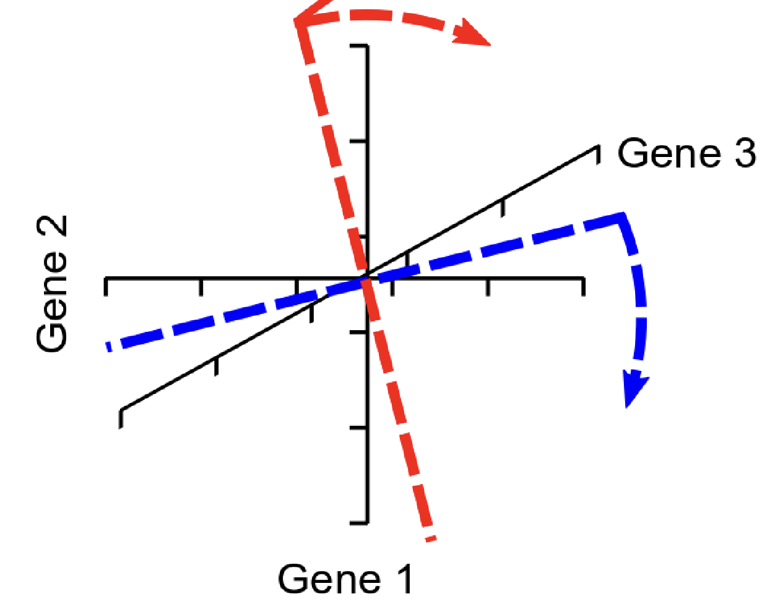
Multi-dimensions and PC n
PC2 is perpendicular to PC1. PC3 is perpendicular to PC1 and PC2 etc.
PCs are the same number as genes
PC1 explains most of the variance in the data. P2 the second most etc.
Projection in 2D, so two PC’s are projected
https://www.bioinformatics.babraham.ac.uk/training/10XRNASeq/Dimension%20Reduction.pdf

Slide 34
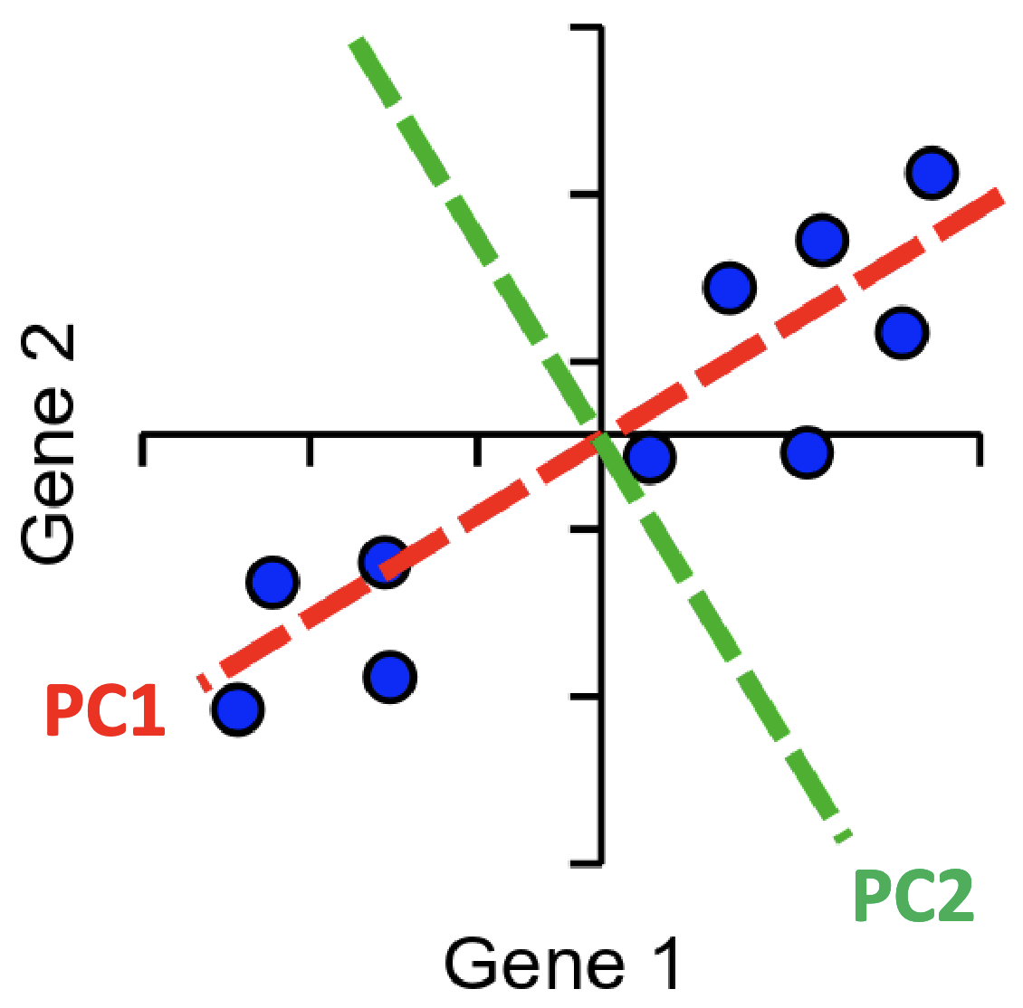
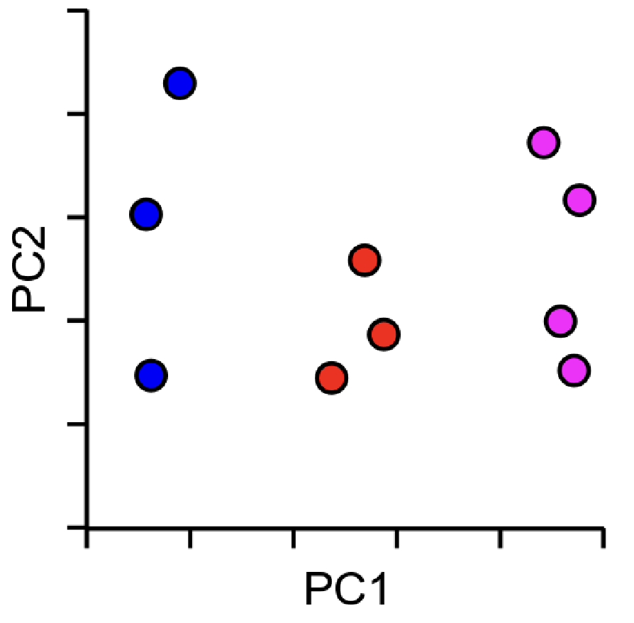
Generating the PCA plot
The datapoints are projected onto PC.
Hopefully, we see some clustering…
https://www.bioinformatics.babraham.ac.uk/training/10XRNASeq/Dimension%20Reduction.pdf

Slide 35
PCA pros and cons
Pros:
Can remove noise (correlated features)
Improve ML algorithms by removing noise
Reduces overfitting
Visualisation
Cons:
PCA turns independent variables to PC’s which can be hard to interpretate
Requires standardised data and therefore does not work well on mixed data
tSNE and UMAP are advancements of PCA, projecting the data better making clustering easier

Slide 37
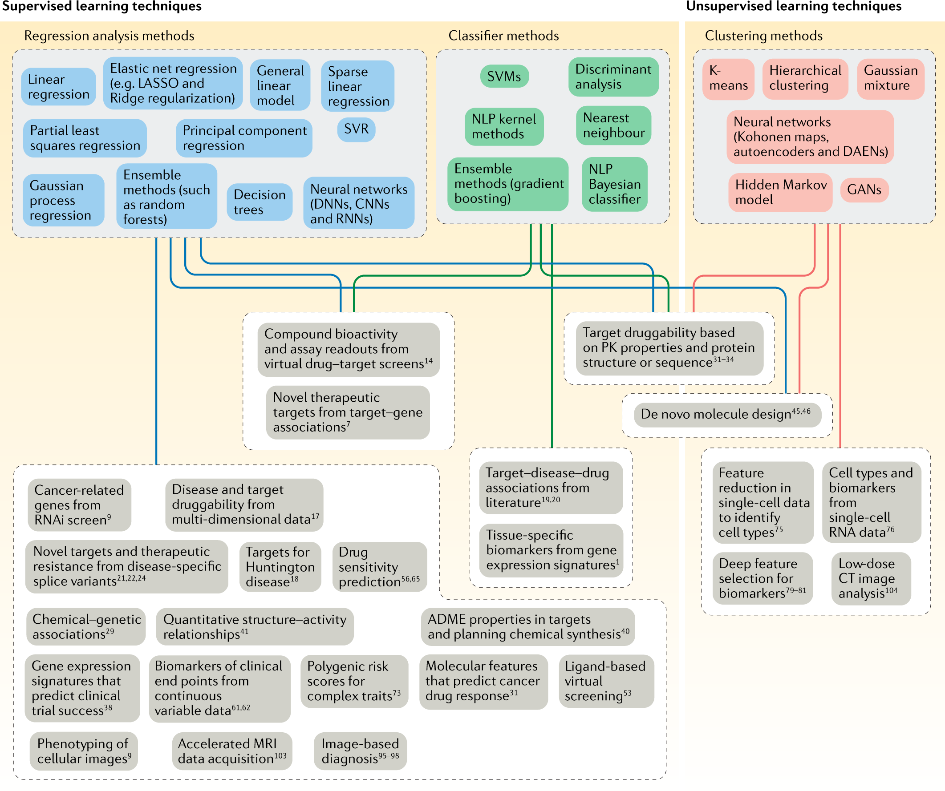
ML in medicine and pharmacology
ML algorithms are used together
Nested in networks or parts of pipelines
Used as tools, from a ML toolbox
Important to know when and why to use it
Vamathevan, J., Clark, D., Czodrowski, P. et al. Applications of machine learning in drug discovery and development. Nat Rev Drug Discov 18, 463–477 (2019). https://doi.org/10.1038/s41573-019-0024-5

Slide 38
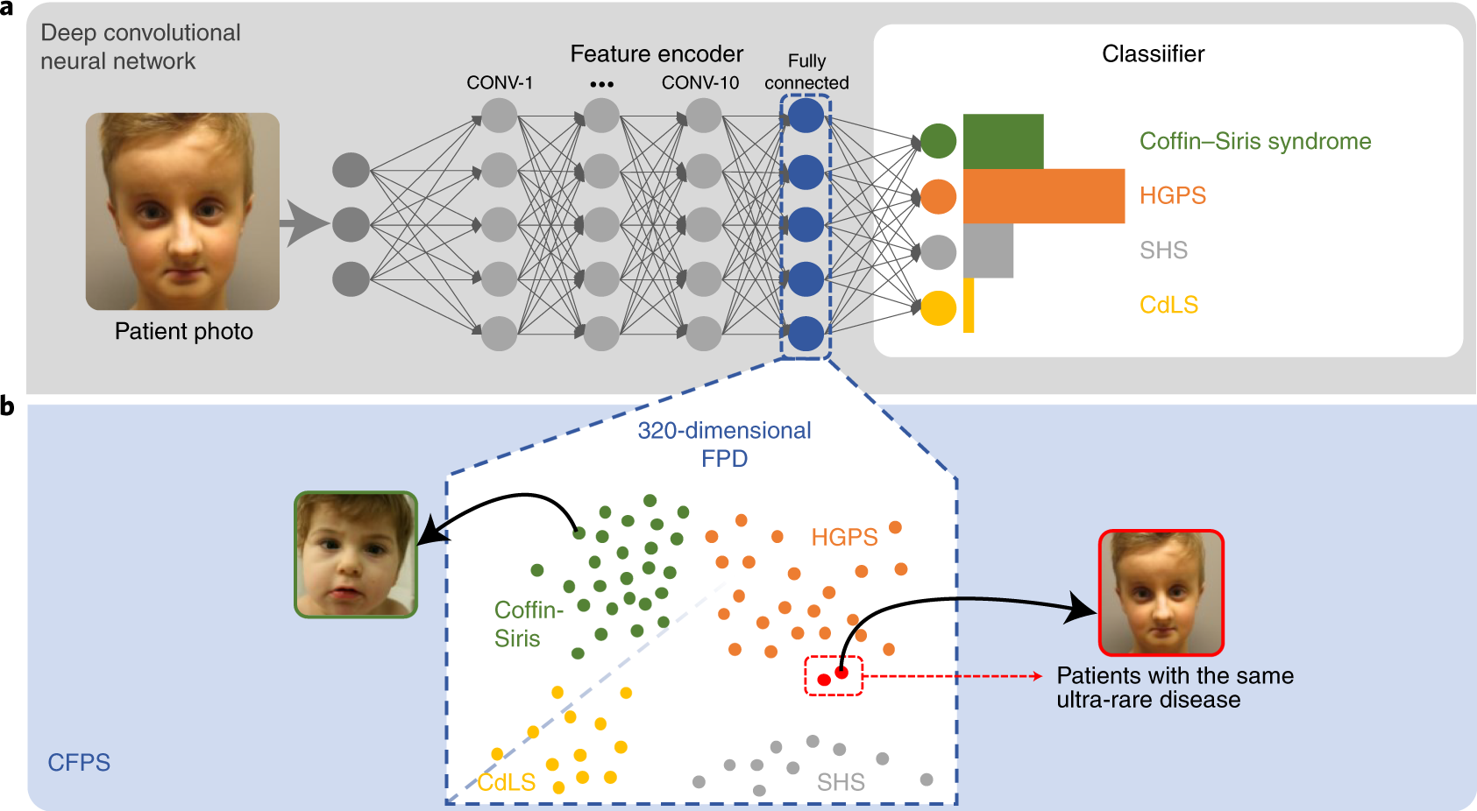
GestaltMatcher and Face2Gene
Supervised classifiers are often used in image analysis, for example when diagnosing rare diseases.
Here, KNN is nested into a Deep Neural Network.
Datapoints in the KNN is other phenotype patients
Hsieh, TC., Bar-Haim, A., Moosa, S. et al. GestaltMatcher facilitates rare disease matching using facial phenotype descriptors. Nat Genet 54, 349–357 (2022). https://doi.org/10.1038/s41588-021-01010-x

Slide 39
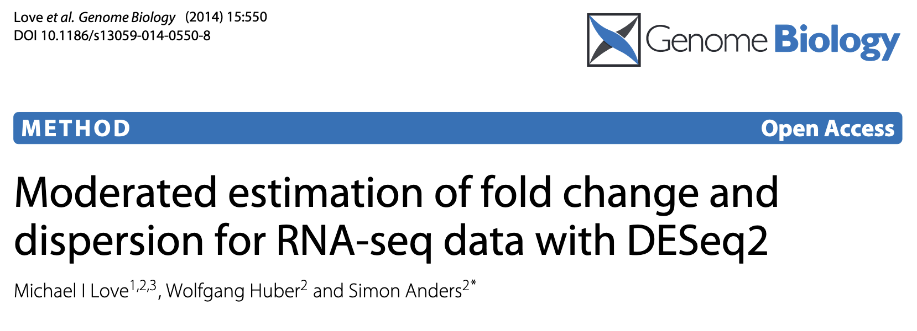
DESeq2, a brief introduction
Most used method in analysing bulk RNA-sequencing data
Other methods are limma and edgeR. Commom aim is to find differentially expressed genes (proteins, lipids etc.)
Great vignette and good start when going into bioinformatics: http://bioconductor.org/packages/devel/bioc/vignettes/DESeq2/inst/doc/DESeq2.html

