Slide 1

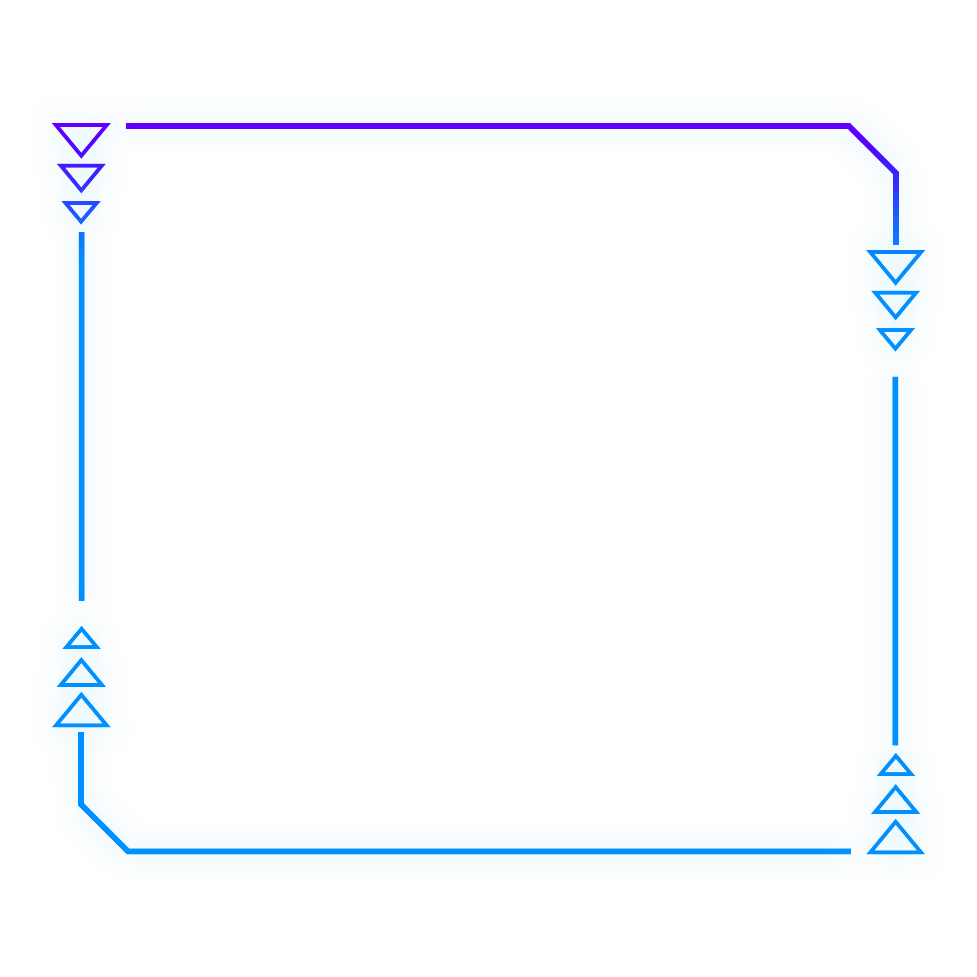


Image recognition

Slide 2
What is image recognition
01

Slide 3
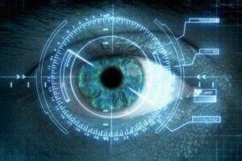
What is image recognition
Image recognition, refers to the use of computer image processing, analysis and understanding, in order to identify a variety of different patterns of the target and image technology.

Slide 4
Three parts
Image segmentation
Image feature extraction
classifier recognition classification

Slide 5
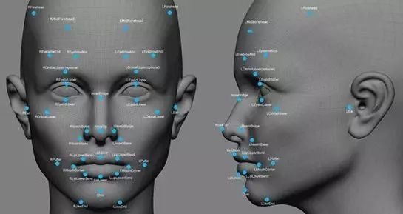
Process
Image preprocessing
image segmentation
feature extraction
judgment matching
output results

Slide 6
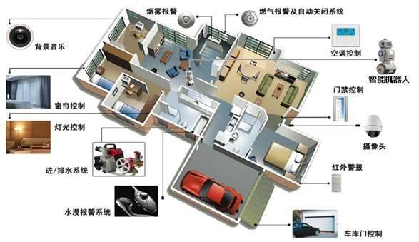
smart home
In the field of smart home, the image is obtained by the camera, and then the content of the image is recognized by the image recognition technology, so as to make different responses.

Slide 7

Online shopping
The "similar style (photo recognition/scan recognition)" search function used by consumers in online shopping is based on image recognition technology. When consumers hover the mouse over the commodities they are interested in, they can choose to view similar styles. At the same time, by adjusting the algorithm, it can also better guess consumers' intentions. Even if the search results cannot provide a perfect match, it will also recommend the most relevant products to consumers to meet their shopping needs as far as possible.

Slide 8
Field of security
Image recognition is widely applied in the field of security. In the future, in the construction and transformation of laying software and hardware to back-end software management platform, image recognition system will become the core link of building smart city. For example, face recognition is an indispensable part of video surveillance in the era of intelligent security, which can directly help users extract human information from the video screen, which greatly improves the value of the monitoring system.

Slide 9
Field of security
Identifying bird species can help bird rescue centers prepare for them.

