Slide 1

Newspaper Segmentation
Ph.D. Project

Slide 2
Phases
Phase-1
Phase-2
Phase-3
Dataset Preparation
Image Preprocessing
Feature Analysis
Classifier/Models Selection
Feature Extraction and Processing
ML/DL Models developments
Model Training & Testing
Improving model segmentation accuracy
Detecting and reducing anomalies
1 month
1 1/2 month
1 month
Time Line

Slide 3
Working:
Phase-1:
Dataset collection –
Collected sample images of newspapers from Times of India
Preprocessing-
Methods identified for initial segmentation
FAST Algorithm for Corner Detection
RAST algorithm

Slide 4
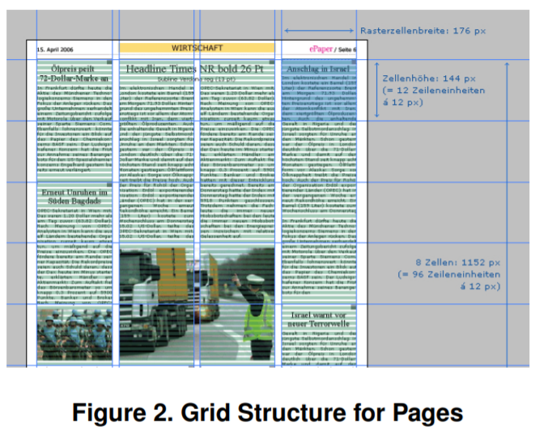
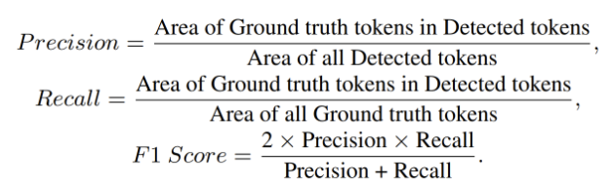
Working:

Slide 5
References:
https://github.com/microsoft/unilm/tree/master/layoutlm
https://github.com/doc-analysis/DocBank
https://github.com/LivingSkyTechnologies/Dense_Article_Dataset_DAD
https://github.com/leonlulu/DeepLayout
https://github.com/rbaguila/document-layout-analysis
https://github.com/search?q=Layout+Analysis
https://archive.org/details/TOIDELJAN18
http://www.dlib.org/dlib/november14/tkaczyk/11tkaczyk.html
https://dl.acm.org/doi/10.1145/3340531.3412767
https://www.primaresearch.org/datasets/Layout_Analysis

