Slide 1

Newspaper Article Segmentation
Ph.D. Project

Slide 2
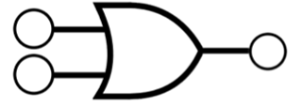
Preprocessing Flow:
Step 1: Bitwise OR of RLSA vertical and RLSA horizontal output
Step 2: Bitwise Not of step 1 output
Input Image
RLSA*
Vertical
Article Layout
Mapping
Grayscale
conversion
Binary
Thresholding
RLSA*
Final
Mappings**
Final
Dataset
Denoising
RLSA*
Horizontal
Image and Title Mapping
*RLSA – Run Length Smoothing Algorithm
**Mappings – Classifying masks/bounding area of assets in the dataset

Slide 3
References:
RLSA - http://crblpocr.blogspot.com/2007/06/run-length-smoothing-algorithm-rlsa.html
Denoising - https://docs.opencv.org/3.4/d5/d69/tutorial_py_non_local_means.html
Thresholding - https://medium.com/spinor/a-straightforward-introduction-to-image-thresholding-using-python-f1c085f02d5e

