Slide 1

Newspaper Article Segmentation
Prerequisites and Architecture

Slide 2
Prerequisites:
Technology to be focused:
Artificial Intelligence, Machine Learning and Deep Learning
Computer Vision /Image Processing
Programming Language and Libraries:
Basic Python (version 3.5+)
Keras and TensorFlow
Scikit-Learn
OpenCV
Pandas and Numpy
Matplotlib and Seaborn

Slide 3
Prerequisites:
Development Environments:
Anaconda Distribution
Jupyter Notebook
Spyder
Python IDLE

Slide 4
Phases
Phase-1
Phase-2
Phase-3
Dataset Preparation
Image Preprocessing
Feature Analysis
Classifier/Models Selection
Feature Extraction and Processing
ML/DL Models developments
Model Training & Testing
Improving model segmentation accuracy
Detecting and reducing anomalies
2 month
2 month
1 month
Time Line

Slide 5

Architecture:
Dataset Collection
Dataset Labelling
Dataset Preparation
Class 0
Class 1
Class 2
Training set - 80%
Around 1000-1200 images are needed to be collected and prepared
All dataset must be resized to a particular unique resolutions
Preparing dataset involves segmenting the newspaper/document with three different segments.
Each segments are represented with different rectangular ROIs in unique color selection.
Segments are labelled as per class labels
Labels represent the categories such title head, article clips and images that are majorly classified in any newspaper.
Labels are encoded and used during the model training
Testing set - 20%
Prepared Dataset will be divided into training and validation set for DL model development.

Slide 6
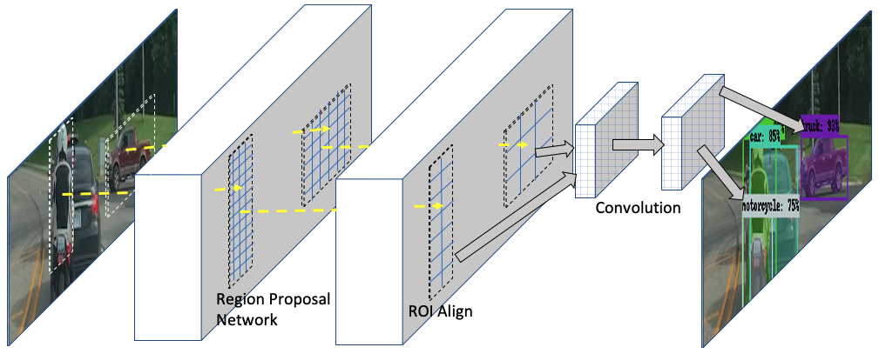
Architecture:
Model Development and Testing
Fine Tuning/Validating losses
Testing Dataset
Trained Model
Mask-RCNN
Training Dataset
Output Mask/Layout
Predicted Class/Label
Labelling and Preparation
Dataset

