Slide 1

Newspaper Segmentation
Ph.D. Project

Slide 2
Need for Preprocessing:
Resizing of collected dataset images must be done before applying segmentation.
All images should be made feature extractable with same kind of thresholding.
Detecting major whitespaces in the newspaper to understand the unique layouts.
Finding the grid structure(rows and columns) used within the article layouts.
De-noising the images for better feature extraction especially in old newspapers.
Segregating images along with respective articles within multiple grid sharing.
Extracted elements and components are chosen according to their close influences the feature extraction.

Slide 3
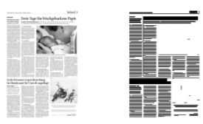
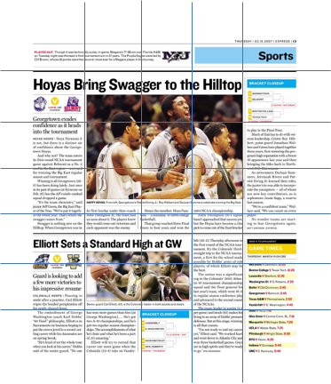
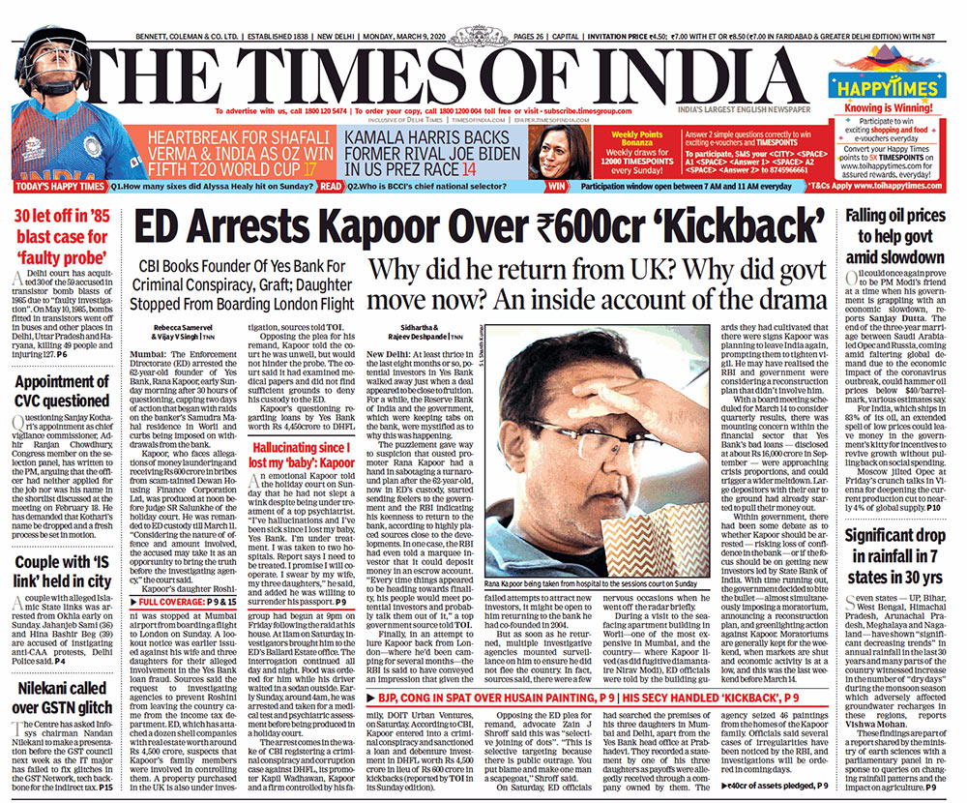
Preprocessing Methodologies
These are chosen algorithms:
Otsu’s Thresholding
Optical Character Recognition
Morphological Operations
Run Length Smoothing Algorithm
All above listed algorithms are about to be implemented for fine tuning the dataset for feature extraction and post-processing
Fig 1: OCR based Layout detection
Fig 2: Grid Analysis
Fig 3: Pre-Segmented articles boundaries
Note: Other similar methods or algorithms will be further consolidated

Slide 4
Architecture:
Dataset Collection
Dataset Labelling
Dataset Preparation
Class 0
Class 1
Class 2
Training set - 80%
Around 1000-1200 images are needed to be collected and prepared
All dataset must be resized to a particular unique resolutions
Preparing dataset involves segmenting the newspaper/document with three different segments.
Each segments are represented with different rectangular ROIs in unique color selection.
Segments are labelled as per class labels
Labels represent the categories such title head, article clips and images that are majorly classified in any newspaper.
Labels are encoded and used during the model training
Testing set - 20%
Prepared Dataset will be divided into training and validation set for DL model development.

Slide 5
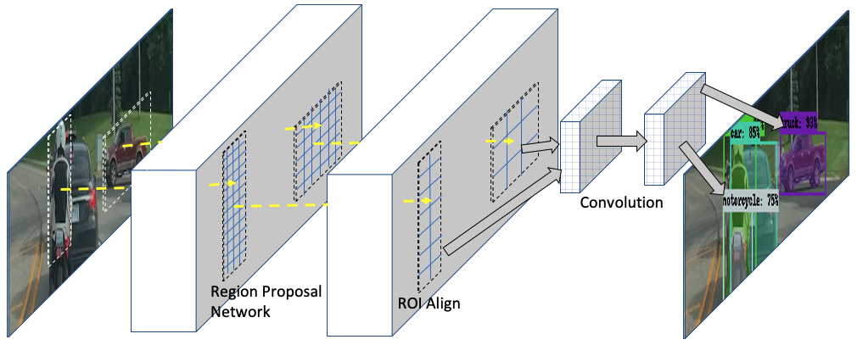
Architecture:
Model Development and Testing
Fine Tuning/Validating losses
Testing Dataset
Trained Model
Mask-RCNN
Training Dataset
Output Mask/Layout
Predicted Class/Label
Labelling and Preparation
Dataset

