Slide 1

Text Recognition in Natural Scenes

Slide 2
Pre-Requisites:
Existing approaches comparison
Dataset Preparation
Pre-processing/Feature Selection - Code Preparation
Data modelling – Code Preparation
Data modelling – Training & Validation
Evaluation Criterion Selection
Improving Results

Slide 3
Block Diagram:
Text/Non-text classification
Train-Val-Test split
Batch of input images
Dataset collection
Preprocessing image sets
Feature Extraction
Classifier/Detection Model
Bounding Box (Bbox)
prediction
(using
Resnet-50 architecture)
(using
custom RNN layers)
Model Results
mAP-Precision-Recall
IoU metric
Accuracy metrics computations

Slide 4
Existing approaches comparison:
Non Deep Learning methods:
MRF (Markov Random Field)
NESP (Nonlinear Enhancement and Selection of Plane
HOG + CRF (Histogram of Oriented Gradients + Conditional Random Field)
WFST (Weighted Finite-State Transducer)
Deep Learning methods:
CNN (Convolutional Neural Network)
RNN (Recurrent Neural Network)
RCNN (Recurrent CNN) with backbone (resnet101, resnet50)
Mask-RCNN with backbone (resnet101, resnet50)

Slide 5

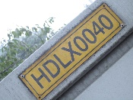

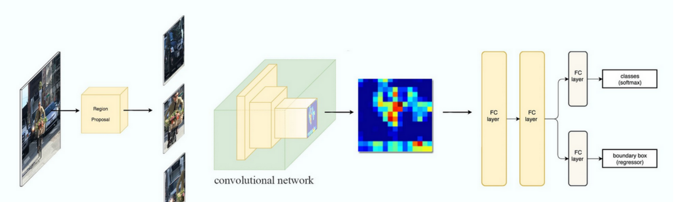
Existing approaches comparison:
Time-based/Sequential – RCNN (Recurrent Convolutional Neural Network)
Text/Non-Text Region
CNN/FCN
RNN
Classification
Bounding Box
Dataset
Feature Extraction
Feature sequence decoding
Segmentation
Example of Faster-RCNN Workflow

Slide 6
Dataset Preparation:
Listed some of few competition datasets and natural scene text datasets
Dataset Train/Val/Test
ICDAR-2013 229/0/233
IIIT-5k-1K 2000/0/3000
SVT (Street View Text) 100/0/250
MSRA-TD500 (Microsoft Research Asia) 300/0/200

Slide 7
Pre-processing/Feature Selection:
For pre-processing, planned to work with tools & environments such as
Python 3.9
Tensorflow
Keras
Scikit-Image
OpenCV
IDEs to be used:
Anaconda
Visual Studio Code
Jupyter notebook
Code preparation has been started and collecting sample codes

